Slide 1
Modernizing Ad-hoc FoxPro Apps with AI Neil Montague Syed Ali June 5, 2025

Slide 2
Idea
Modernize Legacy Systems; ETL Jobs, Reports, Data formats
From FoxPro to C# .NET
Host DBF data in MS SQL Server
Utilize GitHub Copilot

Slide 3
Modernization Plan
Phase I – Manual code conversion
Data entry user interface upgrade
Statewide access
Went live in March 2025.
Phase II – AI assisted code conversion
Internal data processes
Host data on MS SQL Server
Phase III – Classic ASP code conversion
User interfaces

Slide 4
The Challenge
FoxPro System
Thick client framework was difficult to install on users' computers without admin rights
Outdated Tech without Support
Maintenance Issues
Lack of integration with modern platforms
Hard to find developers to maintain code

Slide 5
Goal
Preserve functionality
Improve maintainability
Accelerate development
Deliver solution which is
consistent,
accessible,
testable and
scalable

Slide 6
Architecture
Two environments for project. AI is only enabled in the first one.
GitHub Copilot – Source FoxPro code to be converted, prompts and results. No database connections are stored in GitHub. Code generated by Copilot is not executed nor tested in GitHub.
Azure DevOps - Code generated by Copilot is copied to a Visual Studio project stored in DevOps, where it is executed, connects to data and is tested. Copilot does not have access to this code.

Slide 7
Groundwork
Gather requirements
Identify right tools
Isolate AI Dev environment from execution environment
Develop database structure file
Develop basic prompt

Slide 8
Solution Overview
Introduced GitHub Copilot
Developed Custom Prompt
Human-in-the-loop validation

Slide 9
What is a Prompt?
A detailed instruction of the process to achieve the desired results.
Clarity (Concise but complete details)
Context (Background info or example)
Example (of desired output or of transformation etc.)
Keywords (for specific topic or domain knowledge)
Tone (formal or creative etc.)

Slide 10
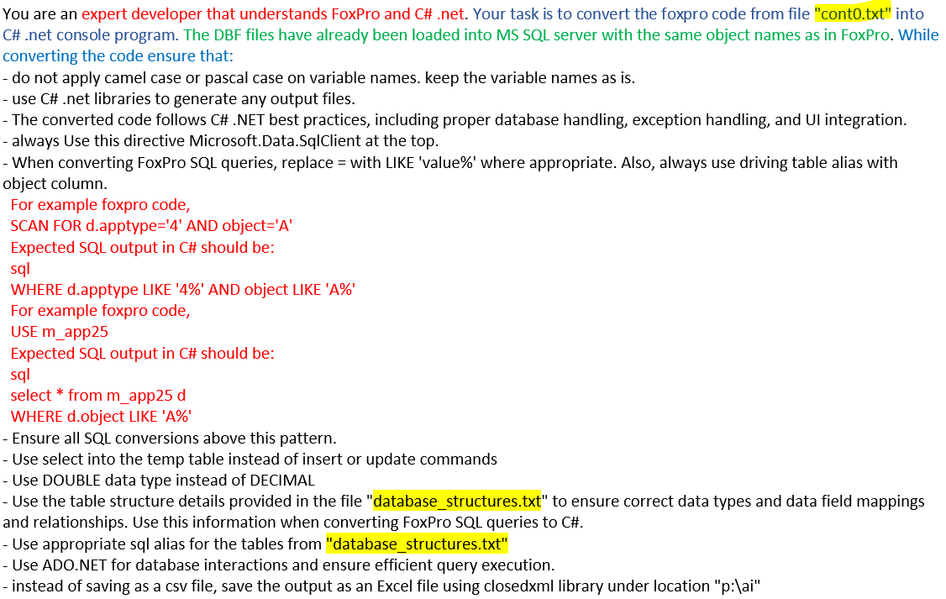
Our Prompt

Slide 11
Prompt Evolution Process

Slide 12
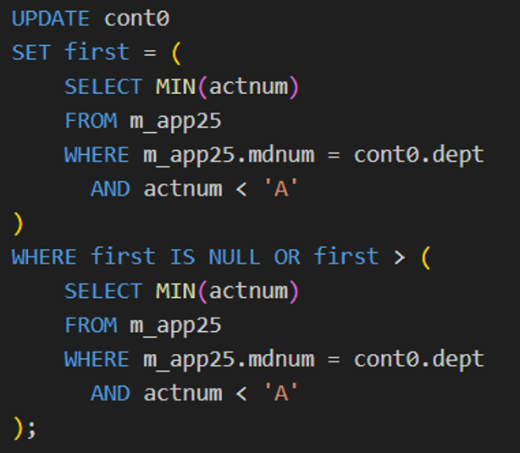
Generated Vs. Expected
Input
Generated equivalent code
Expected equivalent code

Slide 13
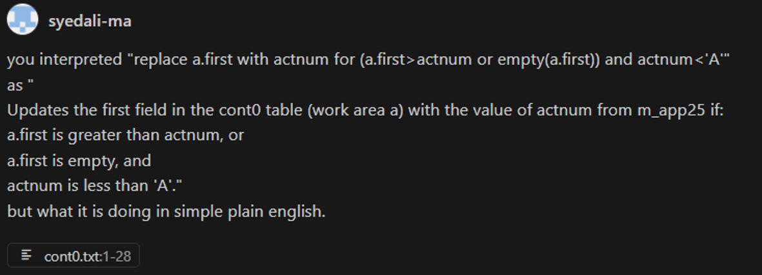
Indirect Instructions

Slide 14
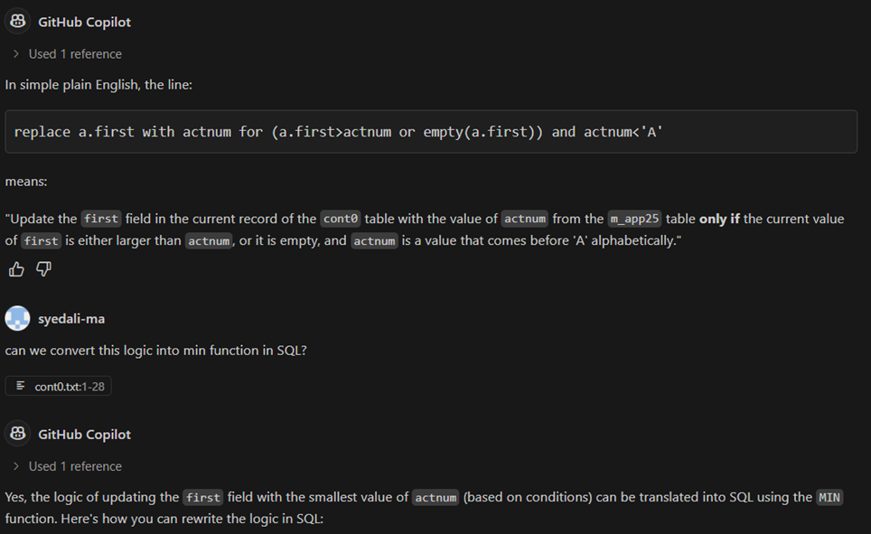
Indirect Instructions (Cont.)

Slide 15
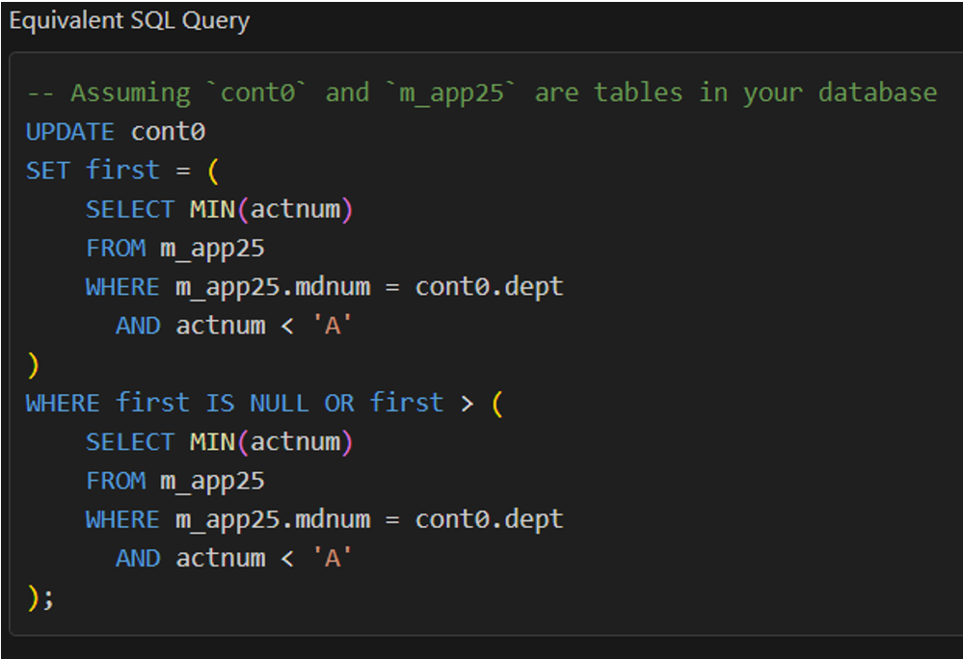
Indirect Instructions (Cont.)

Slide 16
Challenges Faced
Copilot needs structured prompting
Not all FoxPro logic was directly translatable
Manual review still essential
Prompt development for FoxPro was uncharted territory
Learned that individual developer chat should not be synched
Organizing multiple project management (over 300 original FoxPro programs in one project)

Slide 17
Lessons Learned
Initial setup requires more time
Copilot is a strong assistant, not a solo developer
Prompt development (or engineering) is a skill
Old tech can be modernized with AI
Turn around time can be reduced using AI
Testing and validation is crucial for success
Human in the loop is a must

Slide 18
Benefits & Impact
Faster Development
Easier to Debug & Maintain
Future-Ready Stack
Effortless up-to-date documentation
Bridging AI with Human Expertise
Refactoring from old, unknown programming language to new one

Slide 19
Future Roadmap
Extend to other legacy modules
Explore automated testing generation
Copilot for UI conversion
Generate test scripts from AI
Adherence to accessibility standards
Write documentation, including keeping it current with each update
Identify and remedy vulnerability and security issues
Optimize code for performance

Slide 20
Team
Neil Montague, EOANF Systems Director
Valerie Valliant, EOANF Application Lead
Jay Luo, Developer
Viji Patil, QA Supervisor
Sabrina Beach, Sr. Business Analyst
Syed Ali, Director of Digital Analytics & AI

Slide 21
Modernizing Ad-hoc FoxPro Apps with AI
Thank you!

