Slide 1

Mpox Cases and People Vaccinated by Age,
Sex and Race/Ethnicity
Massachusetts Department of Public Health – Thursday, September 7, 2023
The Mpox Cases and People Vaccinated by Age, Sex and
Race/Ethnicity Report is updated monthly and posted on the first Thursday of the month
All data included in this report are preliminary and subject to change. Data on demographics of cases is obtained through electronic reports by healthcare providers and laboratories and from cases during case interviews and entered into the Massachusetts Electronic Disease Surveillance System (MAVEN). Data on demographics of people vaccinated is obtained through provider reports into the Massachusetts Immunization Information System (MIIS).

Slide 2
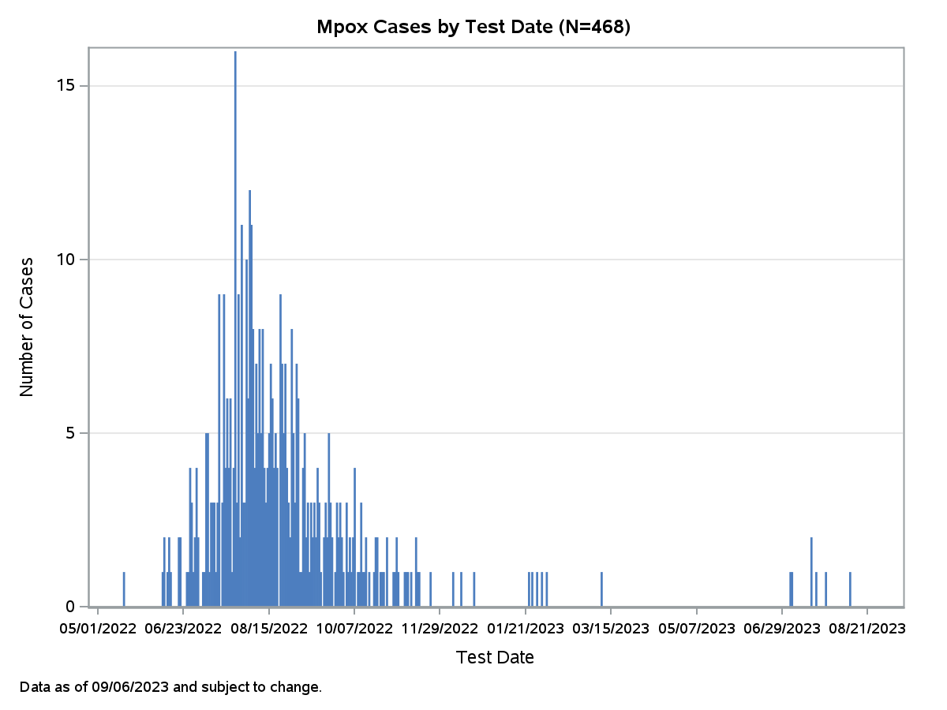
Mpox Cases – Epidemic Curve
468 confirmed and probable cases of mpox have been reported in MA as of 9/6/2023
There has been 1 new case since the last report on 8/3/2023

Slide 3
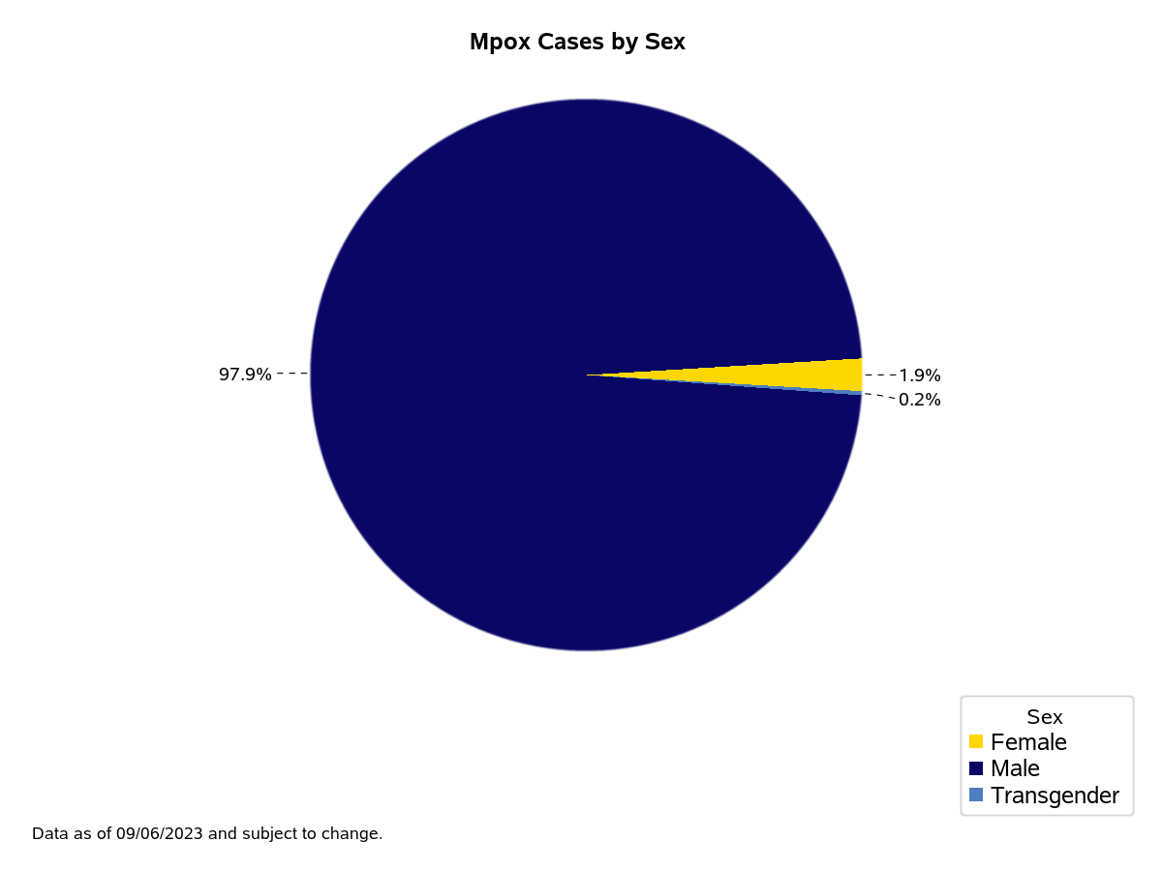
Mpox Cases by Sex

Slide 4
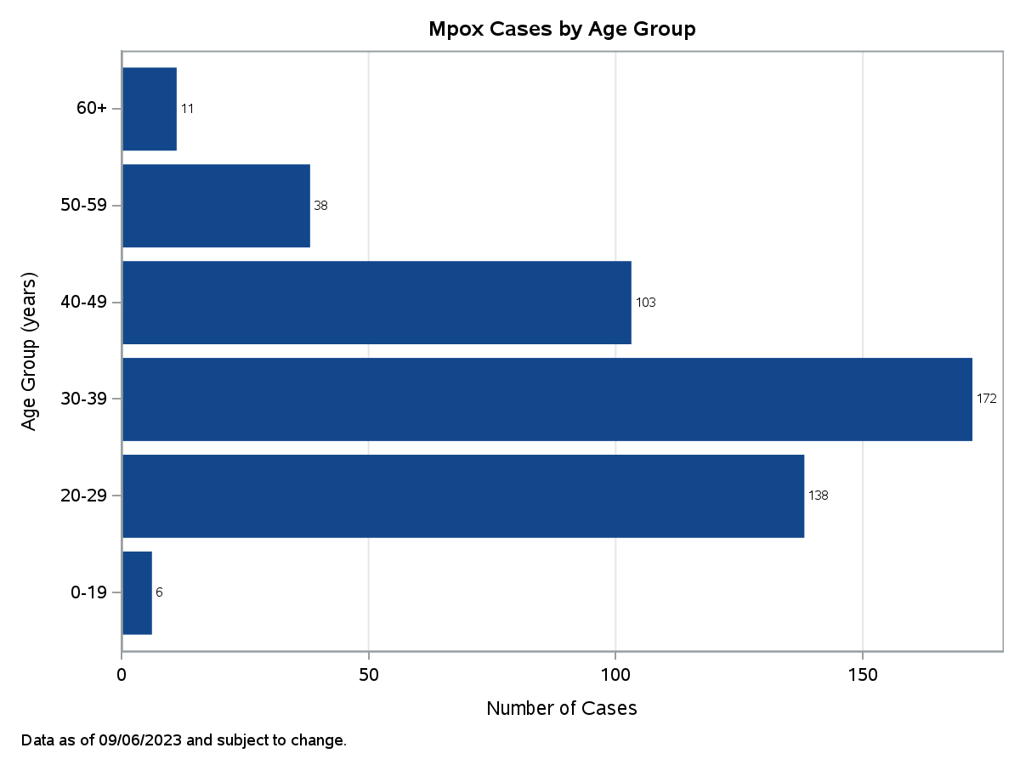
Mpox Cases by Age Group

Slide 5
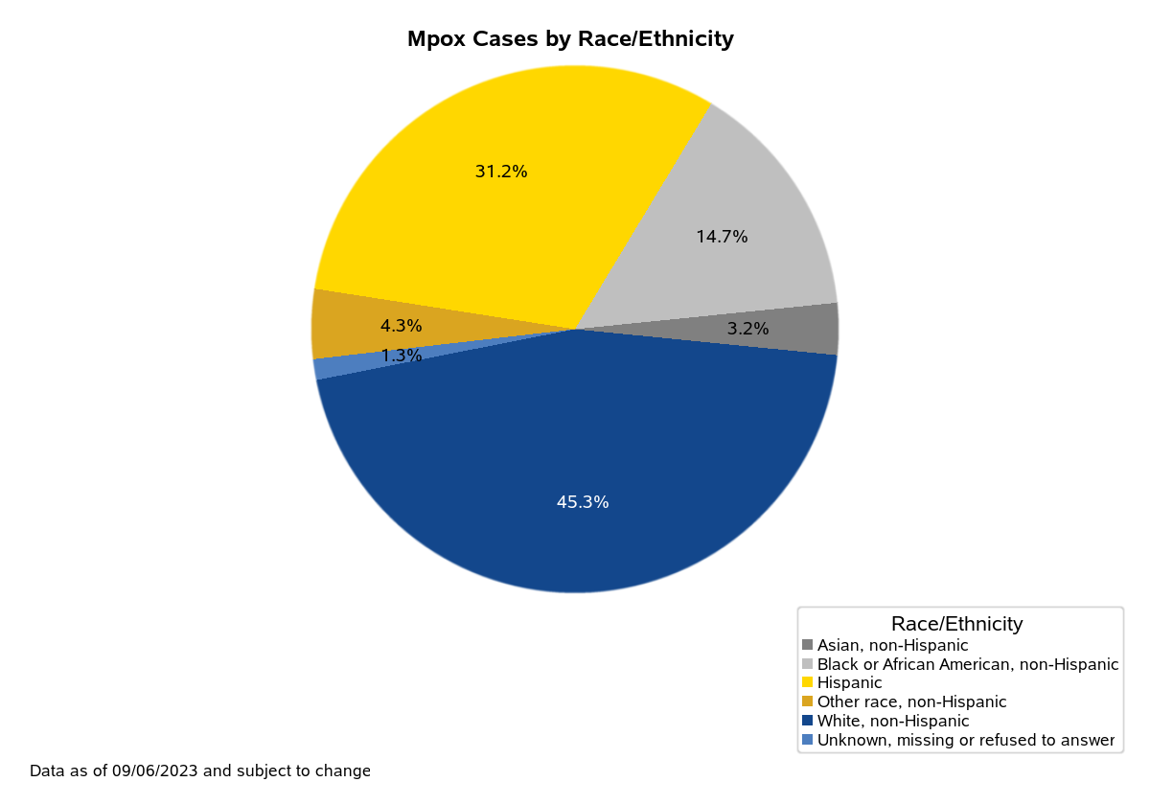
Mpox Cases by Race/Ethnicity

Slide 6
Mpox Vaccines
Since June 1, 2022, 36,949 JYNNEOS vaccine doses have been administered to 21,671 people.
6,405 people have received only one dose of vaccine and 15,266 have received two doses.
 | Number of People Vaccinated | Percentage of Total Vaccinated
SEX
Male | 19,841 | 92%
Female | 1,751 | 8%
Other | 41 | 0%
Unknown | 38 | 0%
AGE GROUP
0-19 | 234 | 1%
20-29 | 5,598 | 26%
30-39 | 6,478 | 30%
40-49 | 3,376 | 16%
50-59 | 3,379 | 16%
60+ | 2,606 | 12%
RACE/ETHNICITY
American Indian or Alaskan Native, non-Hispanic | 20 | 0%
Asian, non-Hispanic | 1,403 | 6%
Black or African American, non-Hispanic | 1,118 | 5%
Hispanic | 3,051 | 14%
Native Hawaiian or Pacific Islander, non-Hispanic | 15 | 0%
Other race, non-Hispanic* | 1,429 | 7%
White, non-Hispanic | 13,615 | 63%
Unknown, missing or refused to answer | 1,020 | 5%
Data as of 09/06/2023 and subject to change
*Includes multi-race, non-Hispanic

Slide 7
TPOXX
Since June 1, 2022, providers have reported treating 211* people with TPOXX to the Department of Public Health.
TPOXX is a prescription antiviral medication that may help treat monkeypox virus infection.
Not everyone with mpox should be treated but it may help reduce severe disease.
 | Number of People Treated with TPOXX | Percentage of Total Treated
SEX
Male | 203 | 96%
Female | 7 | 3%
Other | 1 | <1%
Unknown
AGE GROUP
0-19 | 5 | 2%
20-29 | 49 | 24%
30-39 | 83 | 40%
40-49 | 48 | 23%
50-59 | 19 | 9%
60+ | 7 | 3%
RACE/ETHNICITY
American Indian or Alaskan Native, non-Hispanic | 0 | 0%
Asian, non-Hispanic | 4 | 2%
Black or African American, non-Hispanic | 26 | 13%
Hispanic | 68 | 32%
Native Hawaiian or Pacific Islander, non-Hispanic | 0 | 0%
Other race, non-Hispanic* | 5 | 2%
White, non-Hispanic | 101 | 48%
Unknown, missing or refused to answer | 7 | 3%
*Includes out of state residents not included in Massachusetts case counts and presumptive treatment of patients prior to testing in accordance with CDC guidelines.
Data as of 09/06/2023 and subject to change
*Includes multi-race, non-Hispanic

