Slide 1
Redevelopment of Shattuck Hospital Site on Morton Street
Public Listening Sessions
February 26, 2026
April 15, 2026
May 8, 2026
May 19, 2026

Slide 2
Agenda
Welcome and Introductions
Past – Present – Future
Seeking Community Input

Slide 3
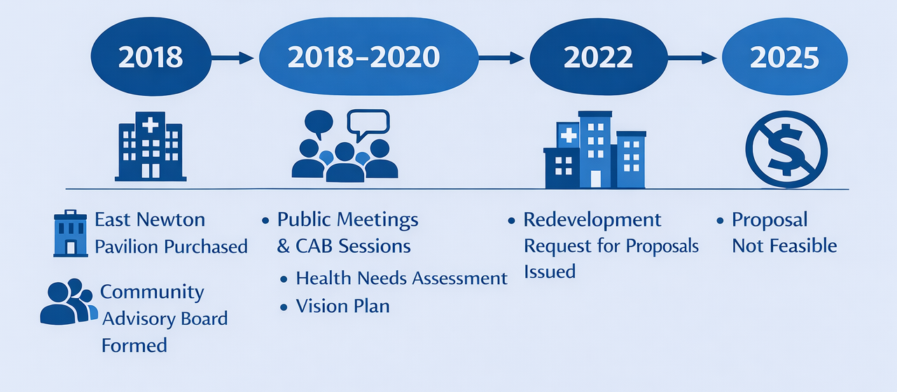
Shattuck Hospital Site on Morton Street Has a Long History
1949: City of Boston transfers the site to the Commonwealth for public health use (Chapter 770).
1954: Shattuck Hospital opens. For 70+ years, the campus has served public health needs.
Over time, the building deteriorated. Renovation was determined to be too costly.
Planning Timeline (2018–2025)
This timeline shows the major planning steps and decisions related to the future of the Morton Street campus.
Public Health Assessment is here: https://www.mass.gov/doc/shattuck-campus-public-health-needs-and-opportunities-assessment-final/download.
Vision Plan is here: https://www.mass.gov/doc/shattuck-campus-morton-street-vision-plan/download.

Slide 4
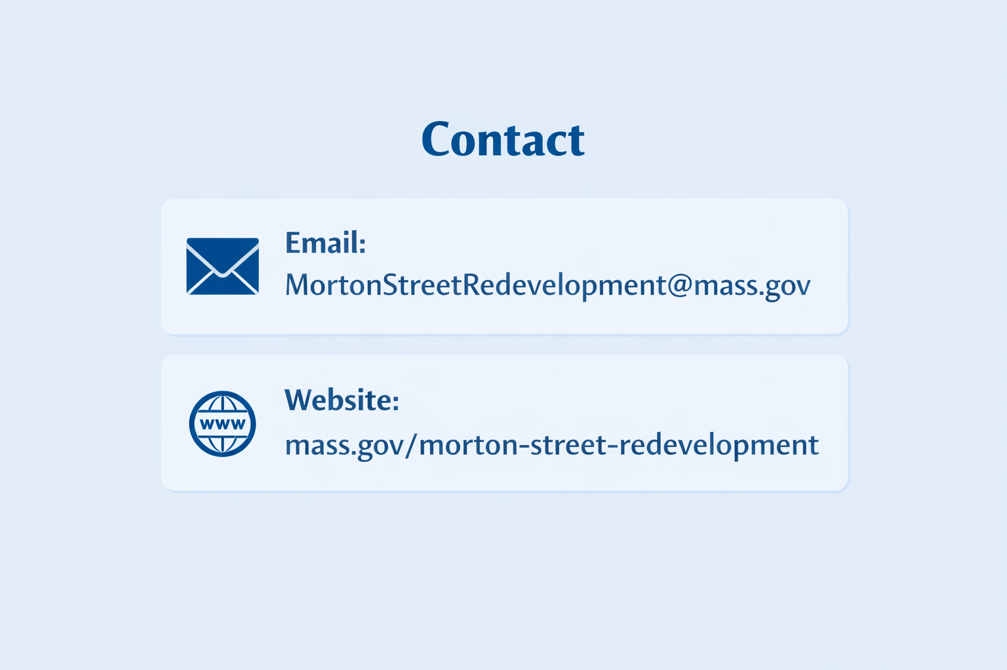
We Want to Hear from You
This is a listening process
We are seeking input on:
The process
The future use of the site
How to participate
Multiple listening sessions to accommodate various schedules and preferences:
  Thurs, Feb 26, 6:00-7:30 – Brooke High School
  Wed, April 15, 6:00-7:30 pm – Zoom
  Fri, May 8, 12:00-1:30 pm – Zoom
  Tues, May 19, 6:00-7:30 pm – Zoom
Written testimony is welcome
Want to stay involved?
Email us to be added to our distribution list to receive updates

Slide 5
What We Have Heard:
Franklin Park & Neighborhood Impact
Support for the Emerald Necklace Vision
Housing that Works for Residents
Feeling Included: Process & Equity Concerns
Fair Distribution of Services: Equity Across Communities
Protect Public Health Investment
Access to Care: Mental Health & SUD Services

Slide 6
We Want Your Input
Community input sought on process and substance alike
Prompts for speakers’ consideration:
Please start by identifying yourself
How should the state engage with your community?
  Should the state establish something similar to the previous Community Advisory Board?
  Who should be represented on it?
  How should the Board’s members be selected?
How can this site best serve the public health needs of your community?
What do you want to see coming out of this process?
“Rules of the Road”
Be respectful
One voice at a time
Stay on topic
Be concise (<4 minutes)
Stay solution oriented

