Slide 1

MOSES for Managers
How to Unlock and Reset Passwords

Slide 2
Housekeeping
Class time from 9:00 to 10:00 am
Attendance is recorded / taken
Please leave your camera on
Class is not muted, so ask questions
Limit noise where you are (or mute yourself)

Slide 3
MOSES for Managers
MOSES Users
How to Unlock and Reset Passwords

Slide 4
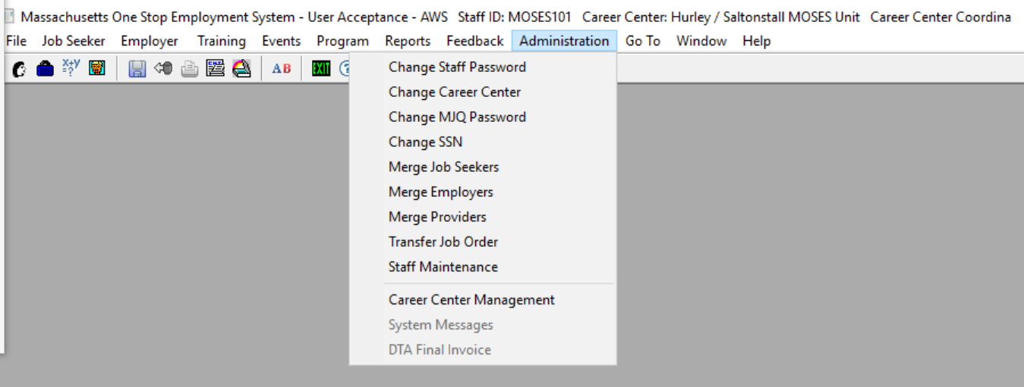
MOSES for Managers

Slide 5
MOSES for Managers
How to Unlock a MOSES Users Account

Slide 6
MOSES for Managers
Staff Maintenance

Slide 7
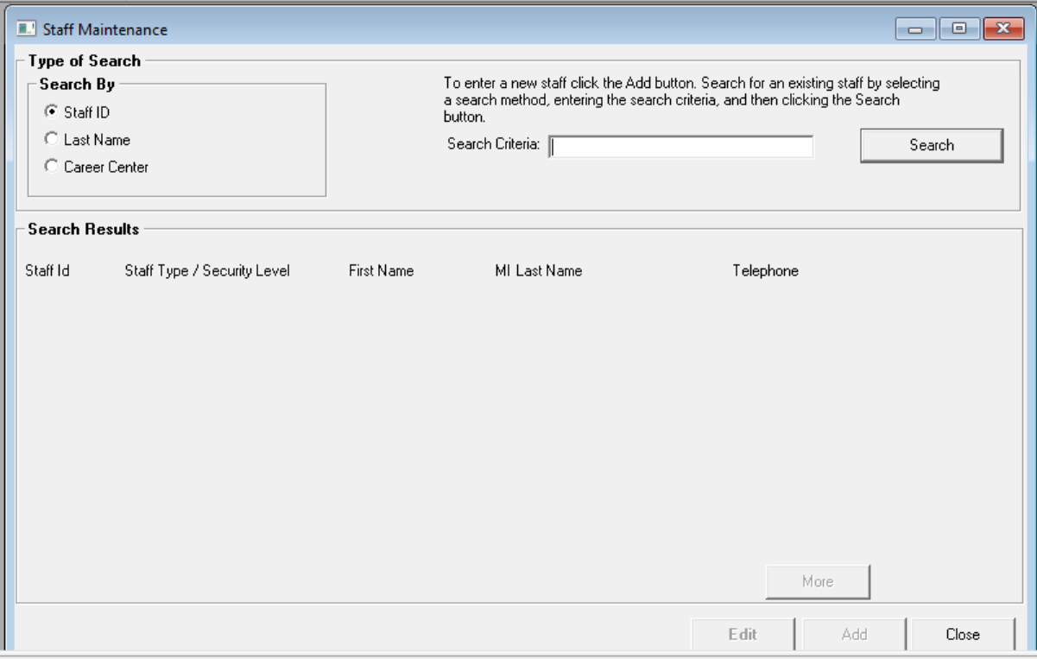
MOSES for Managers

Slide 8
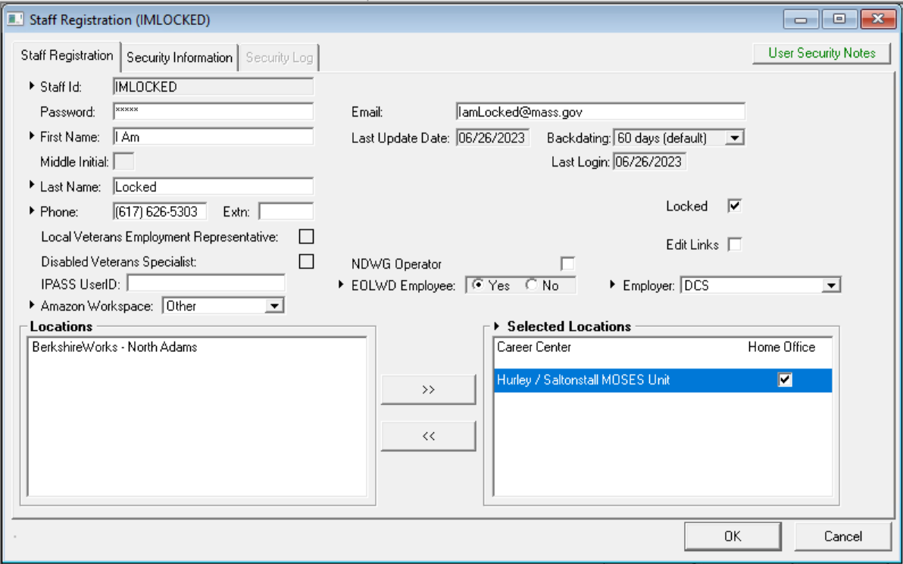
MOSES for Managers
Uncheck the Locked Box

Slide 9

MOSES for Managers
Click OK to Save

Slide 10
MOSES for Managers
How to change a password

Slide 11

MOSES for Managers
Change Staff Password

Slide 12
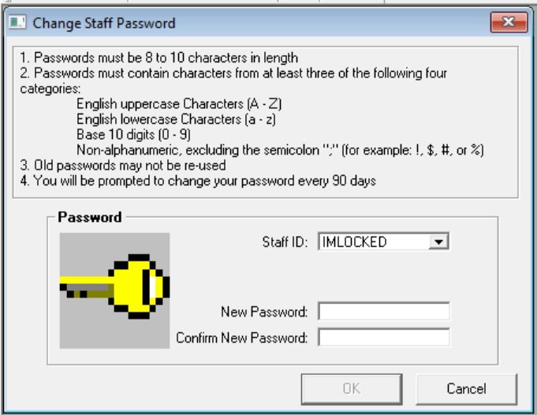
MOSES for Managers
Locate Staff on Drop Menu of Staff IDs
Enter New Password

Slide 13

Questions?
?
?
?
Questions and Answers
?
?
?
?
?
?
?
?

