Slide 1

MOSES Mini Clinic
Alerts
https://www.mass.gov/masshire-career-centers

Slide 2
MOSES Mini Clinic
Alerts
In
MOSES

Slide 3
Housekeeping
Class time from 9:00 to 10:00 am
Attendance is recorded / taken
Please leave your camera on.

Slide 4
MOSES Mini Clinic
Class is not muted, so ask questions
Limit noise where you are (or mute yourself)

Slide 5
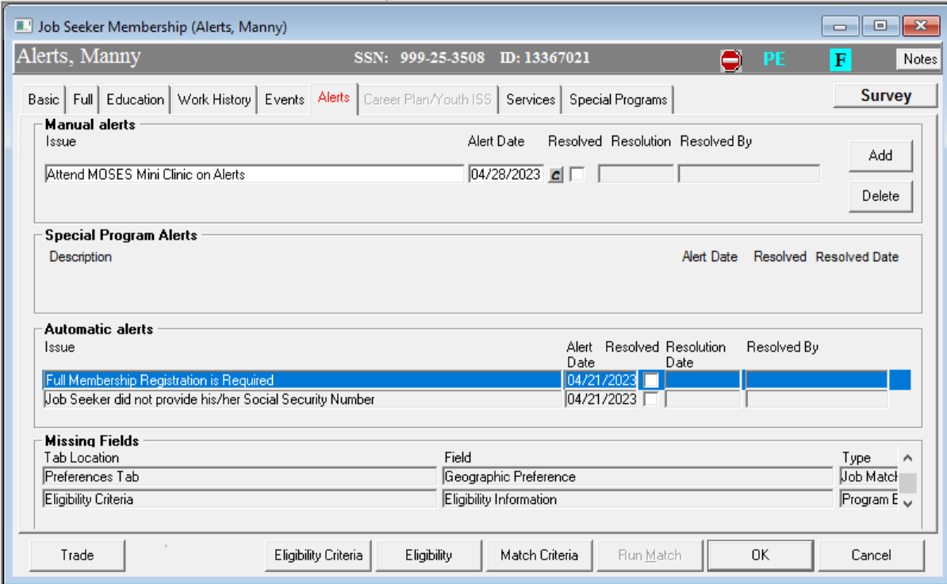

MOSES Mini Clinic

Slide 6
MOSES Mini Clinic
Alerts

Slide 7

MOSES Mini Clinic
Missing Field Alerts

Slide 8
MOSES Mini Clinic
Missing Field Alerts (Full Tab)
Employed
Disablity
Family Size
Economically Disadvantaged
In School
Highest Degree
Highest Grade
Migrant Status

Slide 9
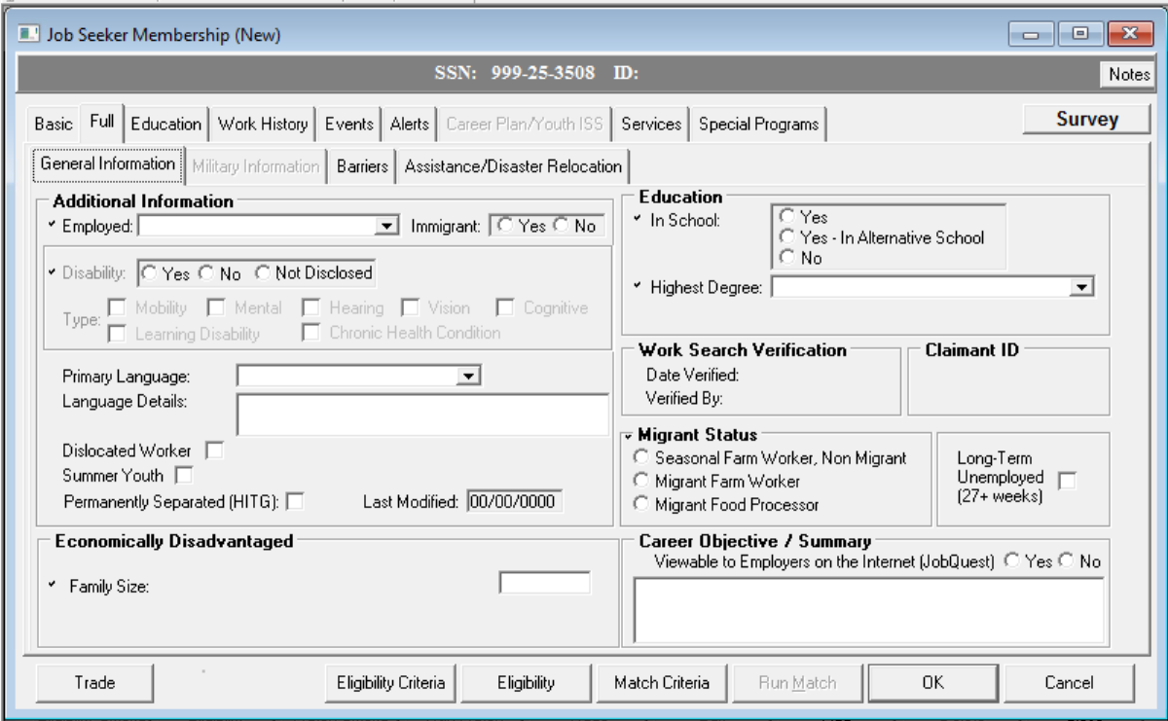
MOSES Mini Clinic

Slide 10
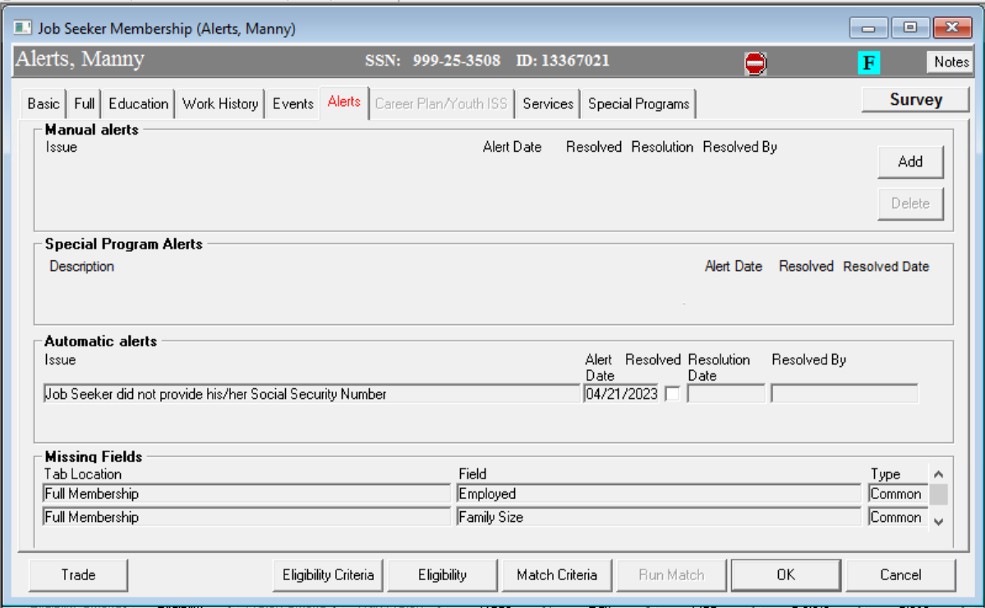
MOSES Mini Clinic

Slide 11
MOSES Mini Clinic
Missing Field Alerts (Job Match)
Geographic Preference
Pay
Pay Unit
Duration
Shift
Job Title

Slide 12
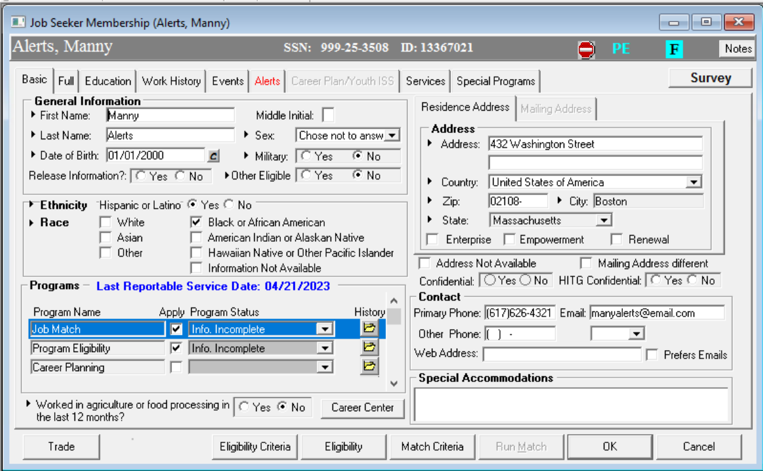
MOSES Mini Clinic

Slide 13
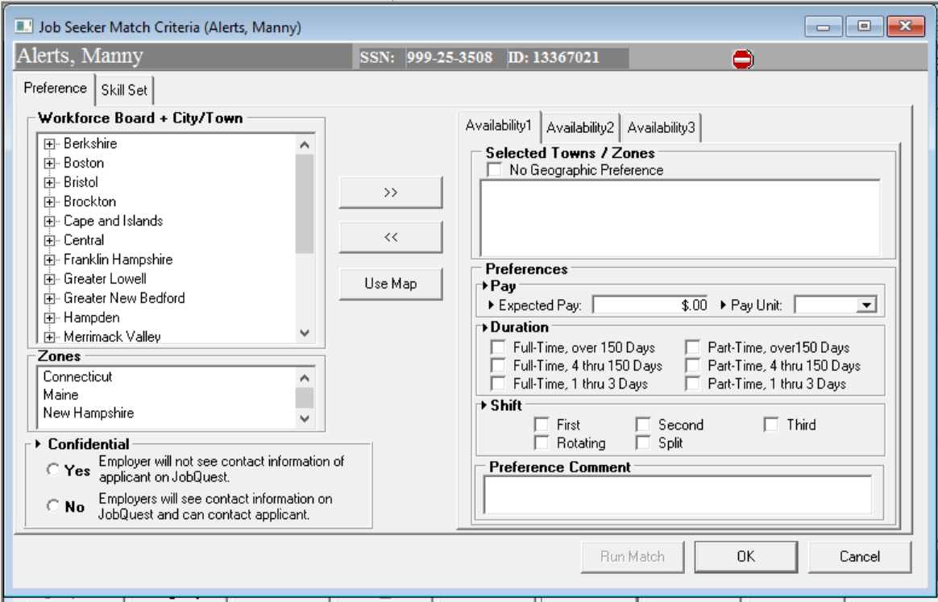
MOSES Mini Clinic

Slide 14
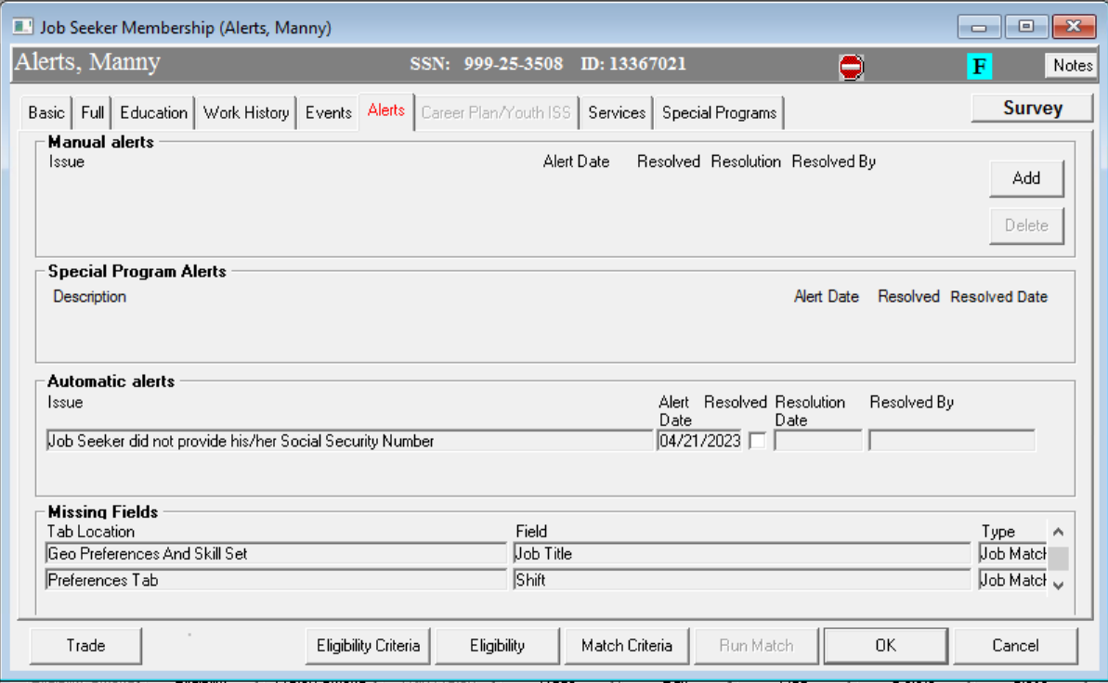
MOSES Mini Clinic

Slide 15
MOSES Mini Clinic
Missing Field Alerts (Eligibility)
Eligibility Information

Slide 16
MOSES Mini Clinic

Slide 17
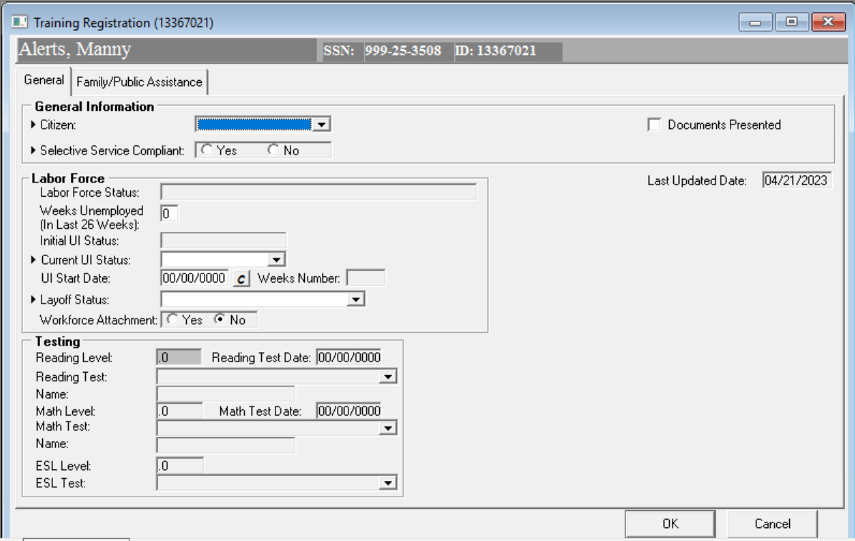
MOSES Mini Clinic

Slide 18
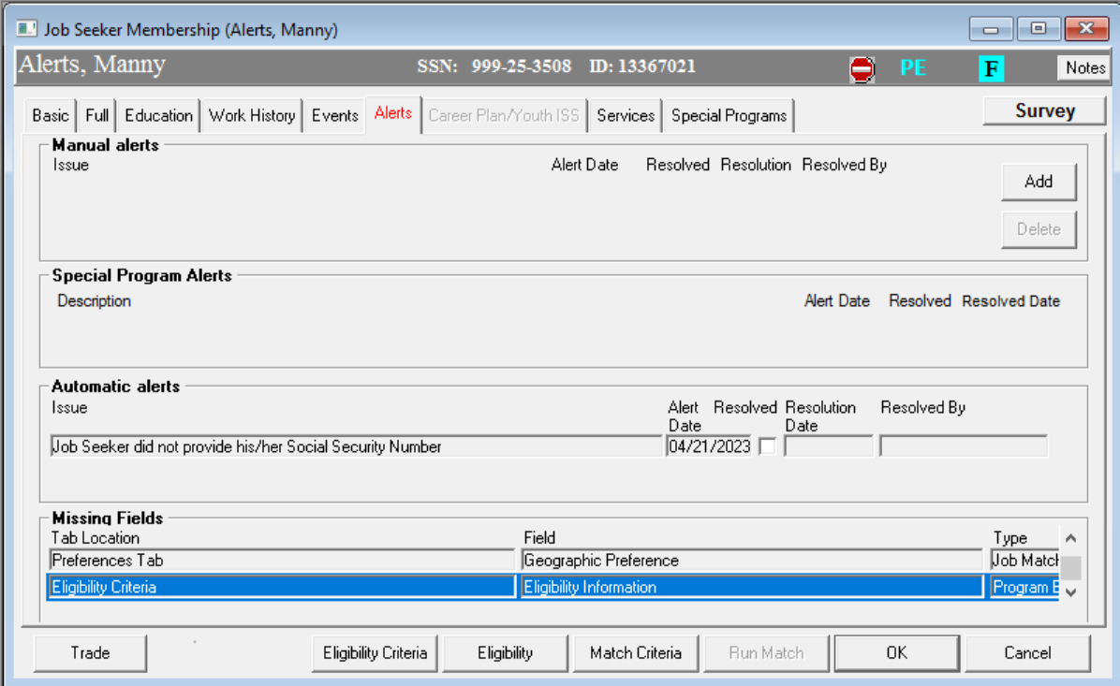
MOSES Mini Clinic

Slide 19
MOSES Mini Clinic
Missing Field Alerts (Work History tab)
Work History Information

Slide 20
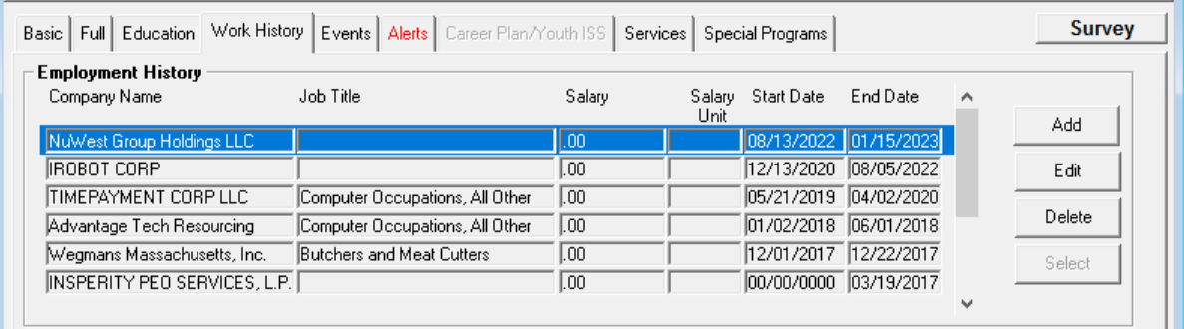
MOSES Mini Clinic

Slide 21
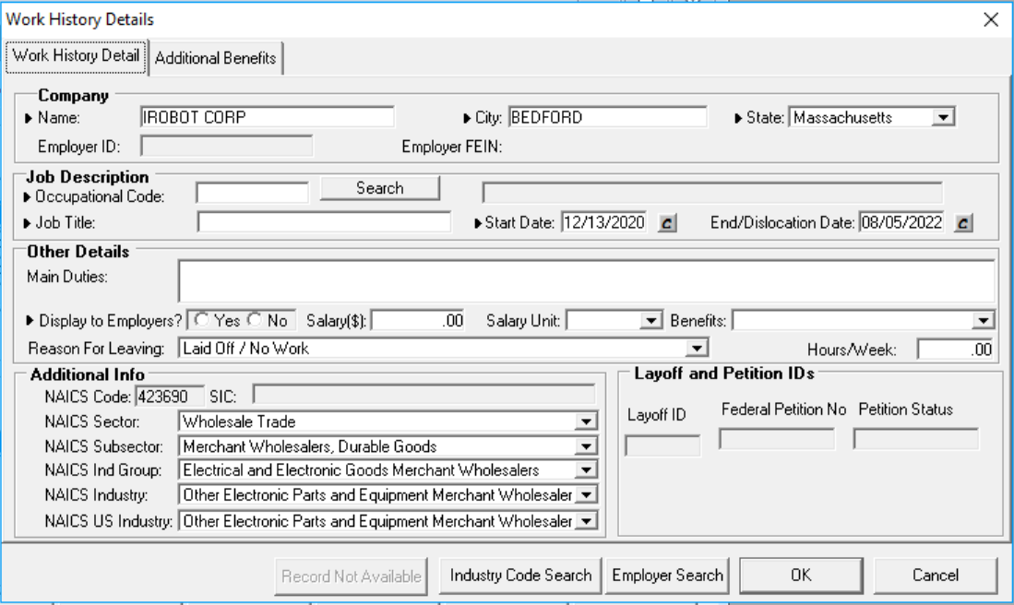
MOSES Mini Clinic

Slide 22
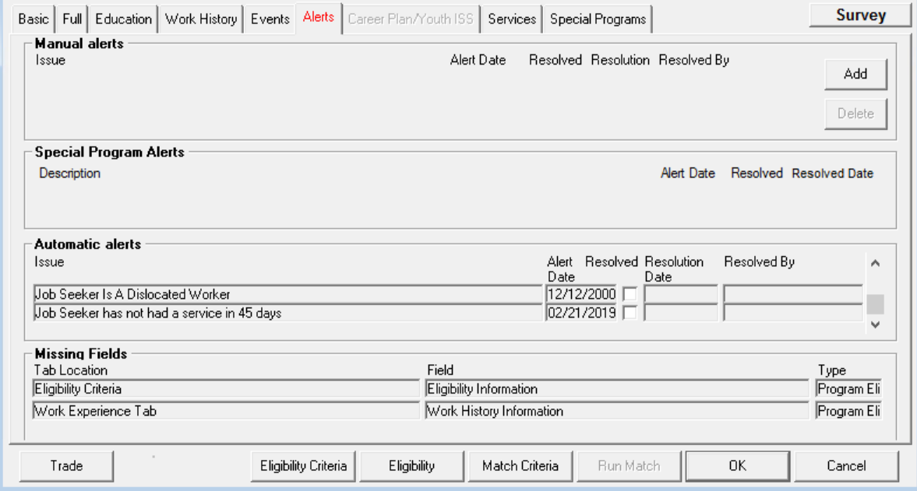
MOSES Mini Clinic

Slide 23
MOSES Mini Clinic
Missing Field Alerts (Military)
Military Information

Slide 24
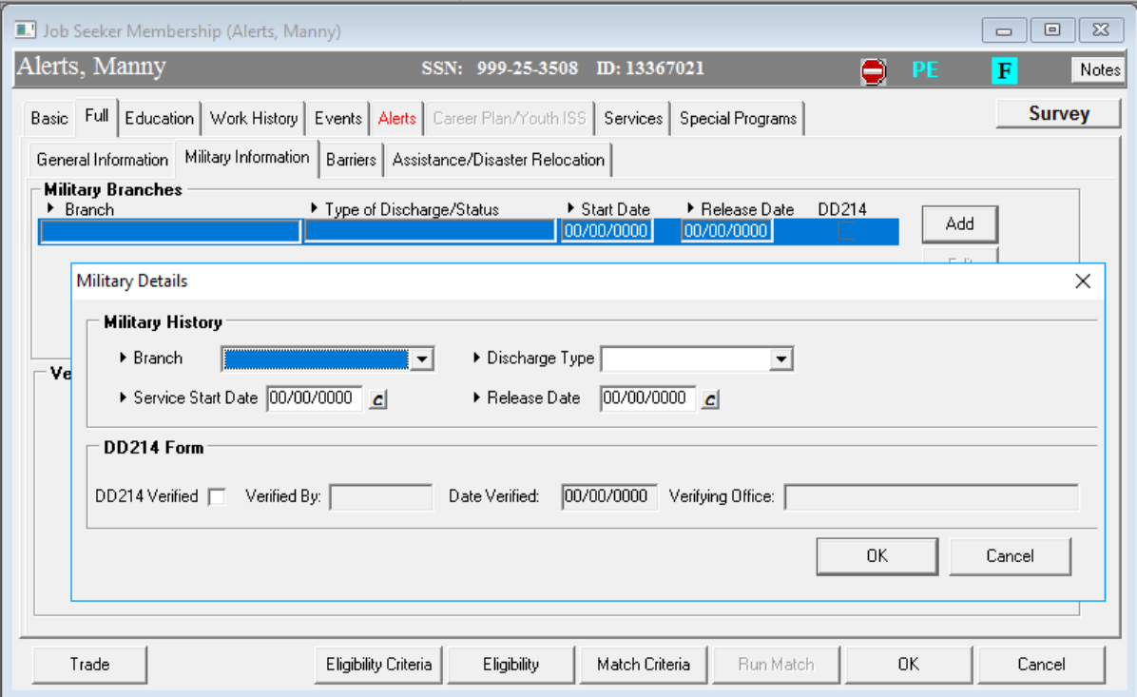

Slide 25

MOSES Mini Clinic
Automatic Alerts

Slide 26
MOSES Mini Clinic
Automatic Alerts
Claimant has approx. 1 week to enroll in Sec 30.Please notify claimant of training opportunities.
Claimant has approx. 2 weeks to enroll in Sec 30.Please notify claimant of training opportunities.
Claimant has approx. 3 weeks to enroll in Sec 30.Please notify claimant of training opportunities.
Claimant has approx. 4 weeks to enroll in Sec 30.Please notify claimant of training opportunities.
Claimant has approx. 5 weeks to enroll in Sec 30.Please notify claimant of training opportunities.
Claimant has approx. 6 weeks to enroll in Sec 30.Please notify claimant of training opportunities.
Claimant has approx. 7 weeks to enroll in Sec 30.Please notify claimant of training opportunities.
Claimant has approx. 8 weeks to enroll in Sec 30.Please notify claimant of training opportunities.

Slide 27
MOSES Mini Clinic
Automatic Alerts
Claimant has approx. 9 weeks to enroll in Sec 30.Please notify claimant of training opportunities.
Claimant has approx.10 weeks to enroll in Sec 30.Please notify claimant of training opportunities.
Claimant has approx.11 weeks to enroll in Sec 30.Please notify claimant of training opportunities.
Claimant has approx.12 weeks to enroll in Sec 30.Please notify claimant of training opportunities.
Claimant has approx.13 weeks to enroll in Sec 30.Please notify claimant of training opportunities.
Claimant has approx.14 weeks to enroll in Sec 30.Please notify claimant of training opportunities.
Claimant has approx.15 weeks to enroll in Sec 30.Please notify claimant of training opportunities.

Slide 28
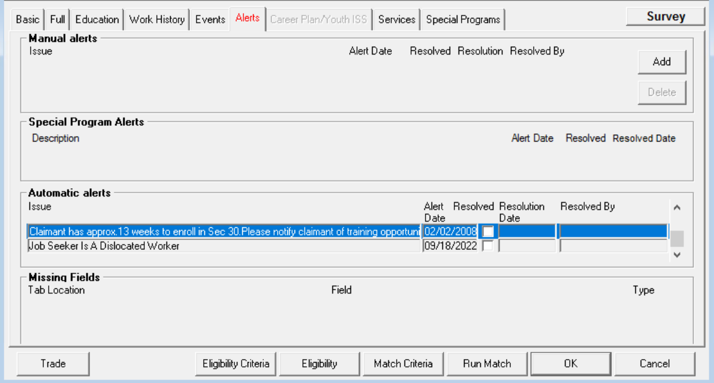
MOSES Mini Clinic

Slide 29
MOSES Mini Clinic
Automatic Alerts
Full Membership Registration is Required

Slide 30
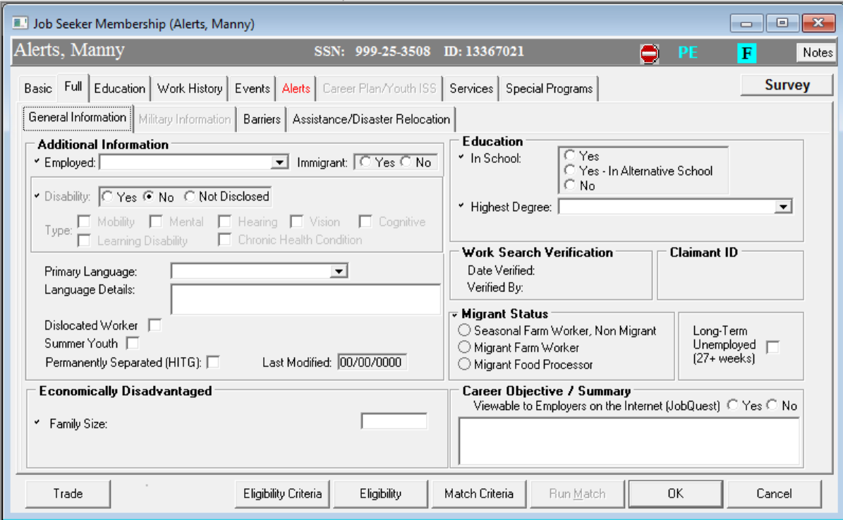
MOSES Mini Clinic

Slide 31
MOSES Mini Clinic

Slide 32
MOSES Mini Clinic

Slide 33
MOSES Mini Clinic
Automatic Alerts
Job Seeker has an Unverified Referral

Slide 34
MOSES Mini Clinic
Automatic Alerts
Unverified Referral Alerts are triggered by Pending Employment Services
  Job Referral - Staff Pending
  Job Development – Referral Pending

Slide 35
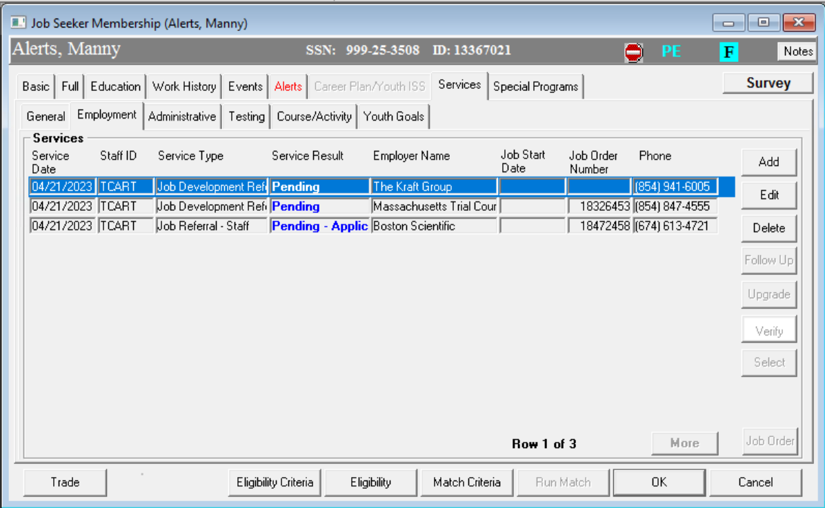
MOSES Mini Clinic

Slide 36
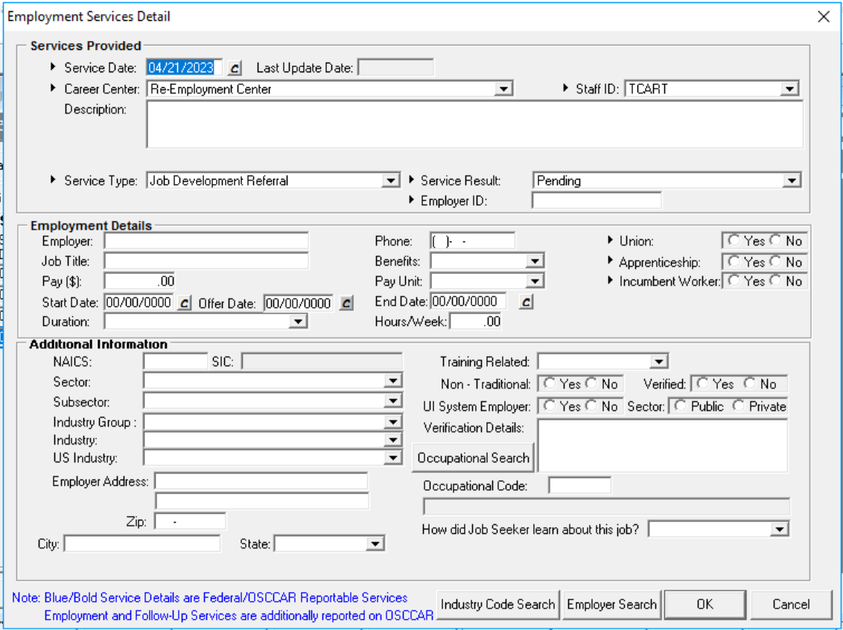
MOSES Mini Clinic
Job Seeker
Employment Services

Slide 37
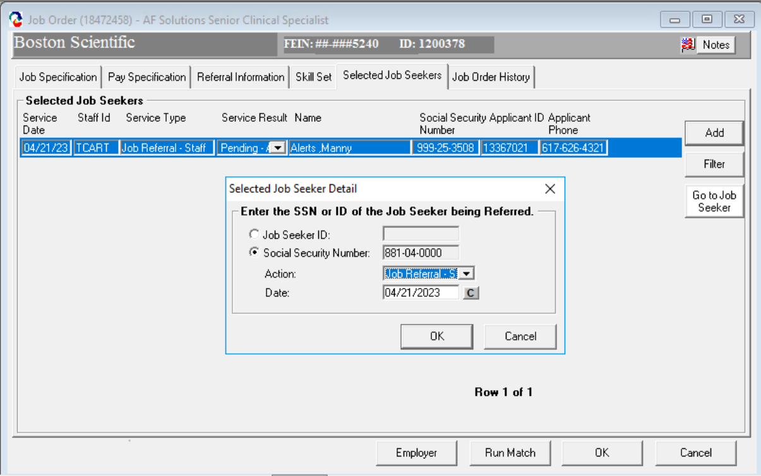
MOSES Mini Clinic
Employer Job Order
Add

Slide 38
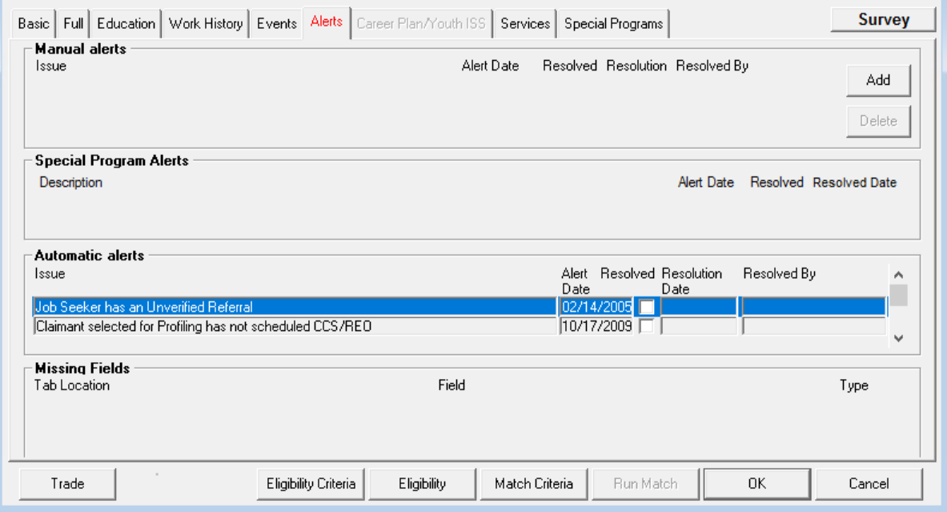
MOSES Mini Clinic

Slide 39
MOSES Mini Clinic
Automatic Alerts
Job Seeker has not had a service in 45 days

Slide 40
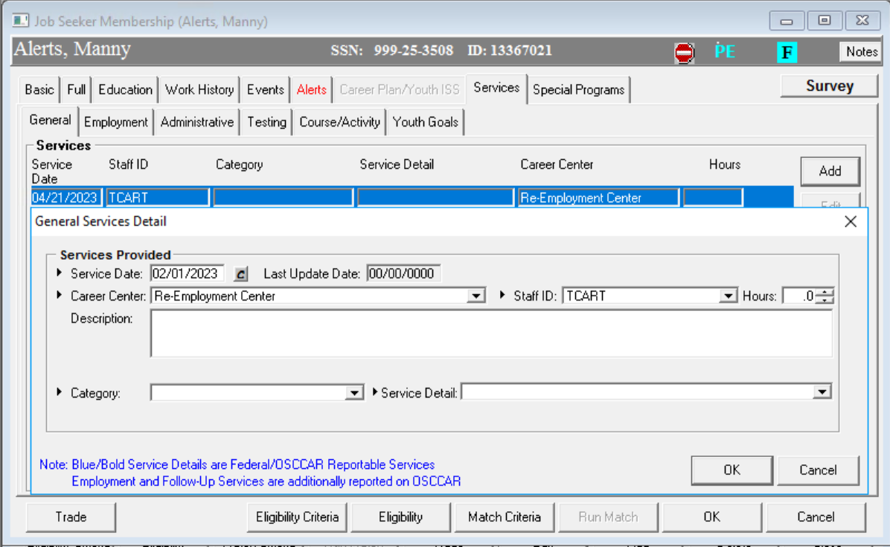
MOSES Mini Clinic

Slide 41
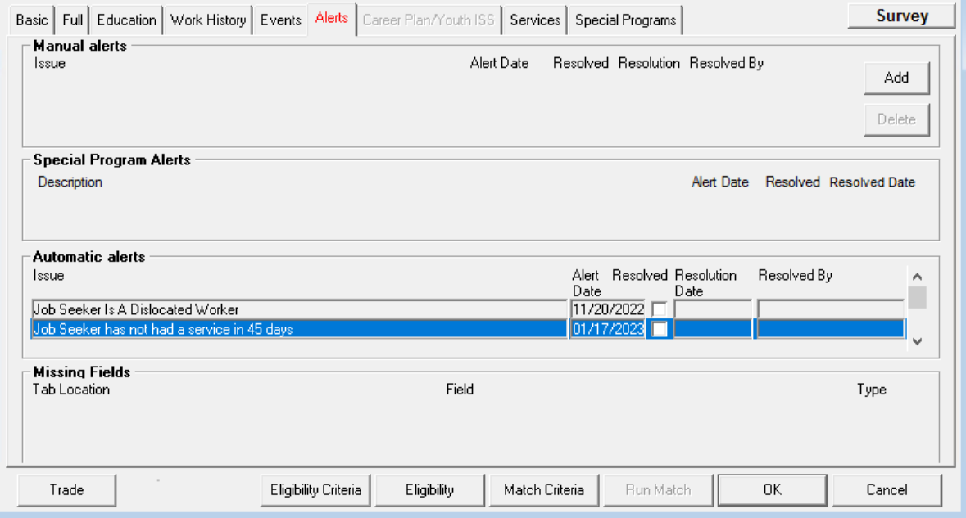
MOSES Mini Clinic

Slide 42
MOSES Mini Clinic
Automatic Alerts
Job Seeker did not provide his / her Social Security number.

Slide 43
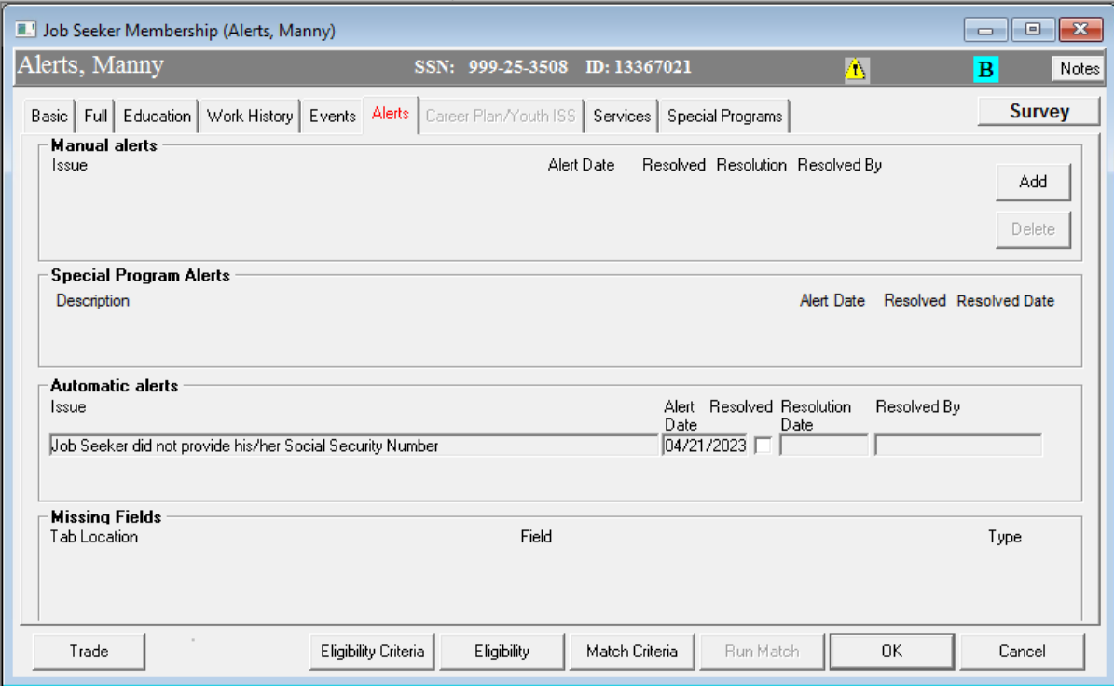
MOSES Mini Clinic

Slide 44
MOSES Mini Clinic
Automatic Alerts
Job seeker is Economically Disadvantaged. May be eligible for WOTC,Title I or Other Service.

Slide 45
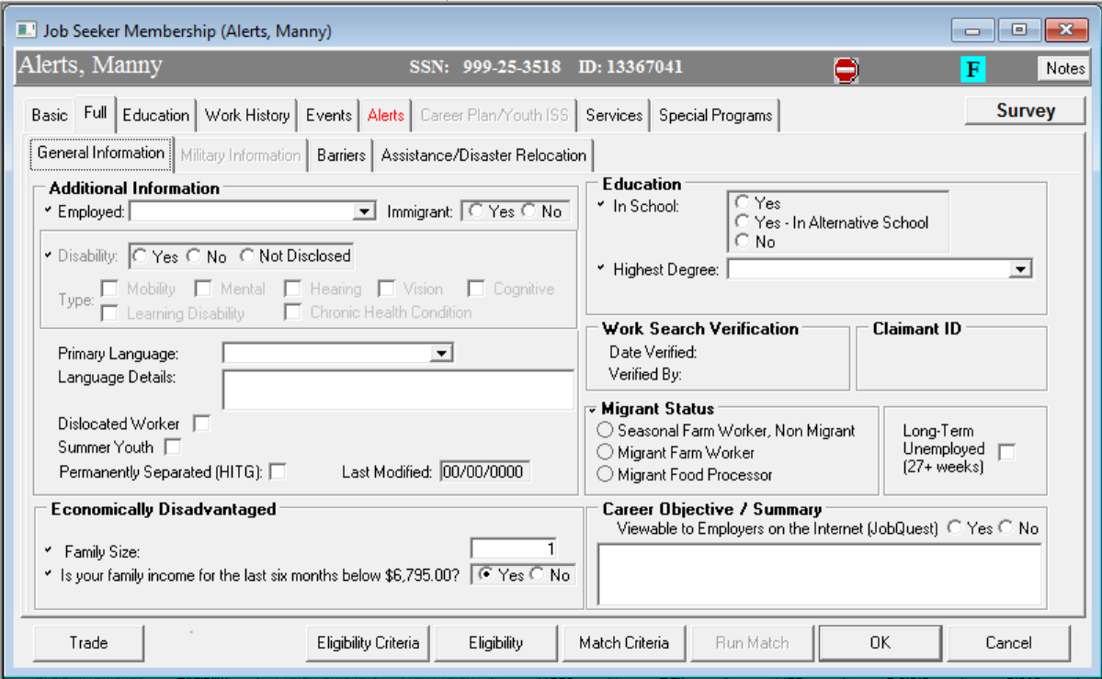
MOSES Mini Clinic

Slide 46
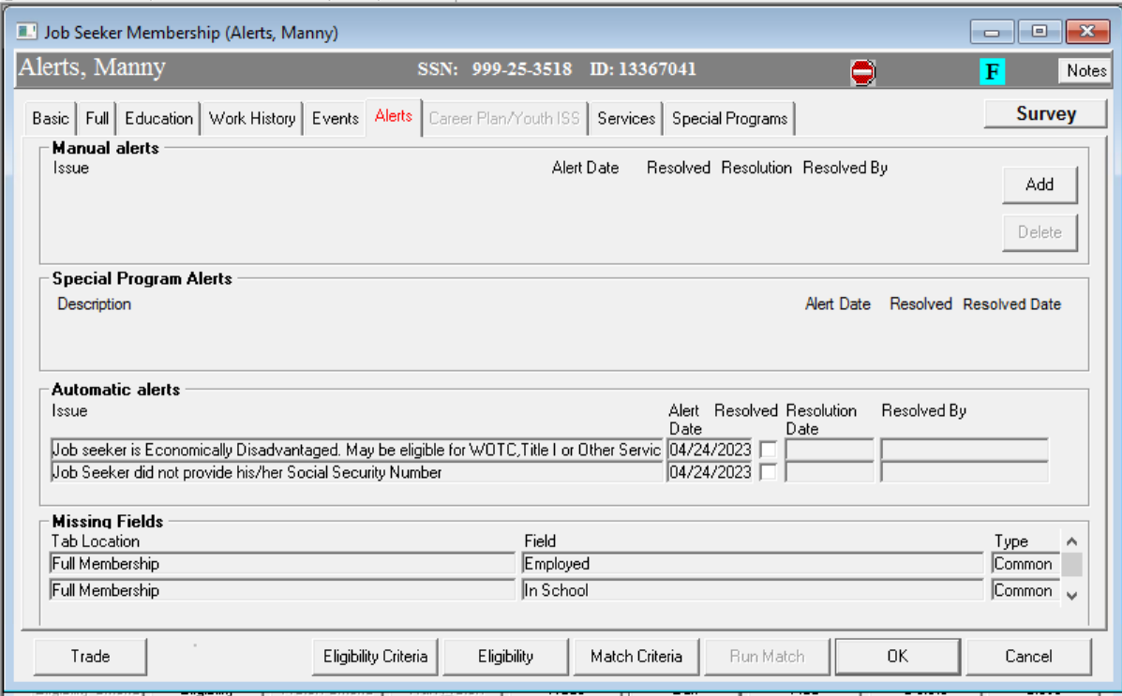
MOSES Mini Clinic

Slide 47
MOSES Mini Clinic
Automatic Alerts (Miscellaneous)
Job Seeker modified Eligibility Information. Recalculate Eligibility
Target date for youth goal has passed, and attainment is still pending.
Verify Job Seeker Work Authorization Number
Verify ethnicity, data was converted
Claimant selected for Profiling has not scheduled REO
Existing Bar Code Card has been inactivated. Please issue a new card.

Slide 48
MOSES Mini Clinic

Slide 49

MOSES Mini Clinic
Manual Alerts

Slide 50
MOSES Mini Clinic

Slide 51
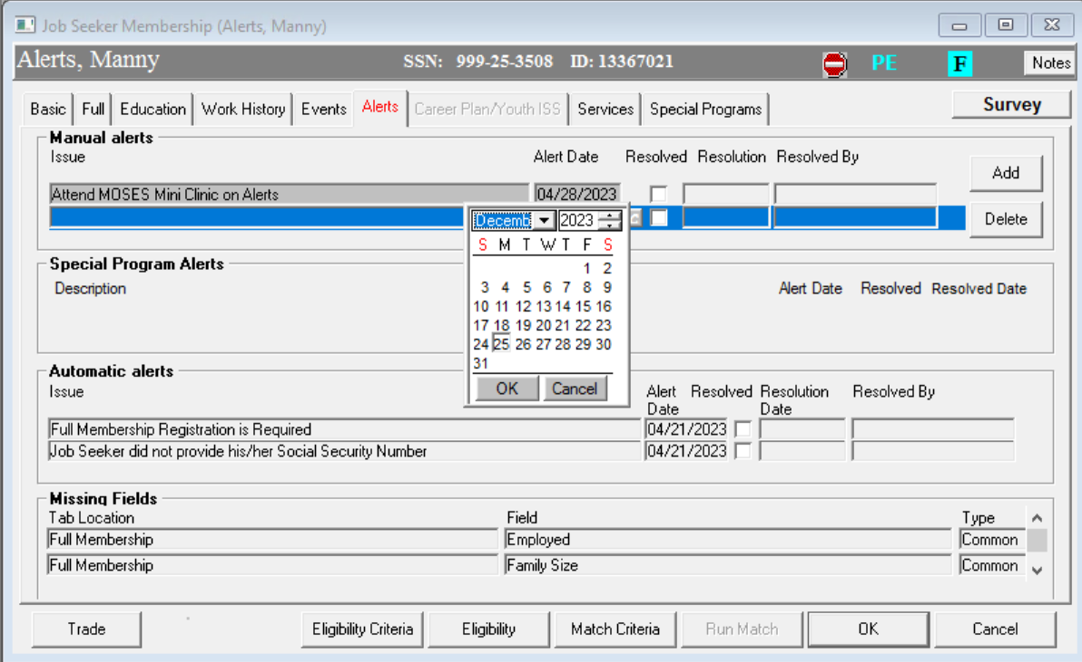
MOSES Mini Clinic

Slide 52
MOSES Mini Clinic
Housekeeping

Slide 53
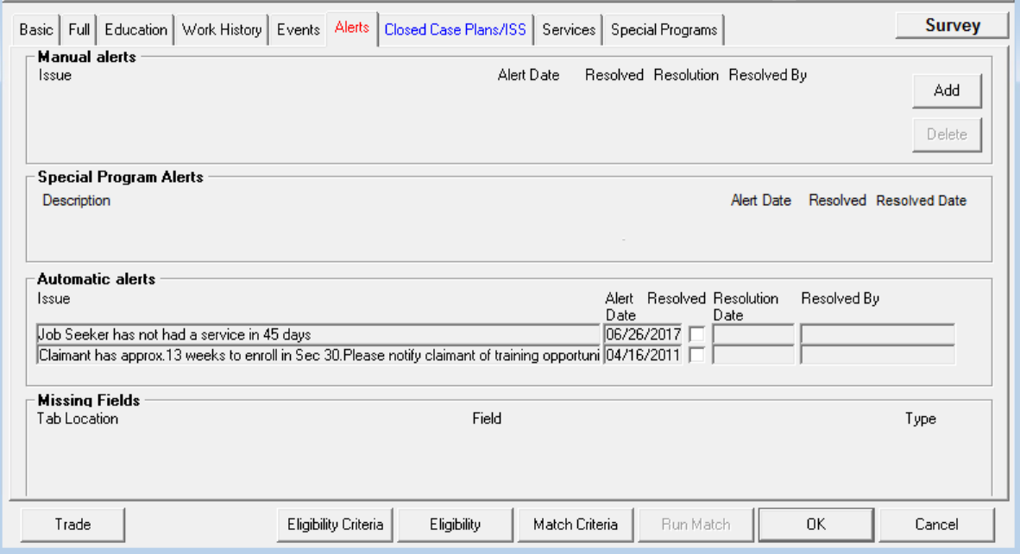
MOSES Mini Clinic

Slide 54
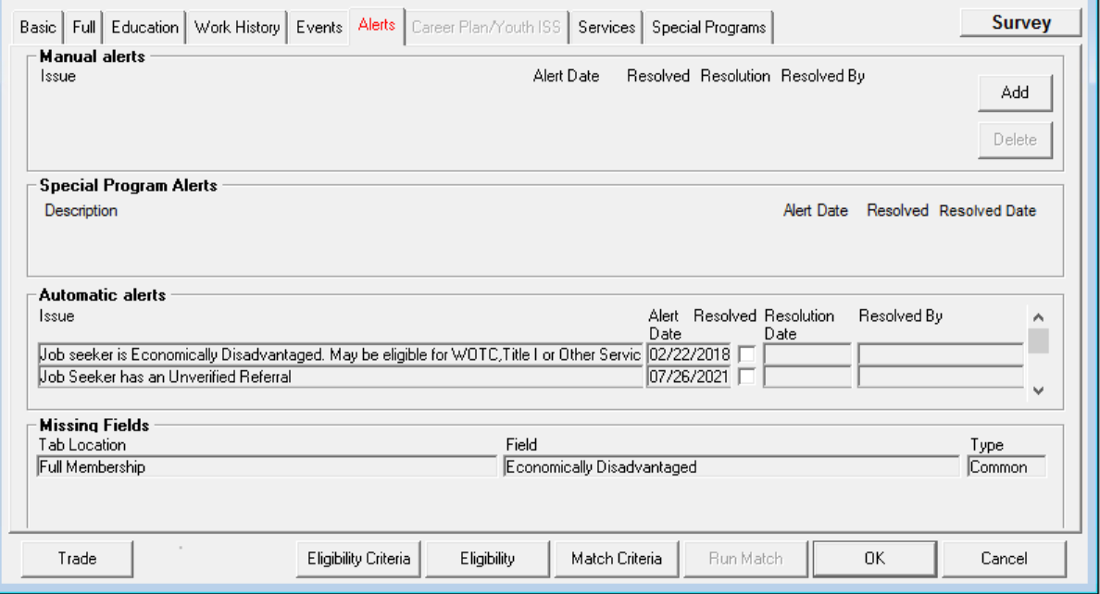
MOSES Mini Clinic

Slide 55
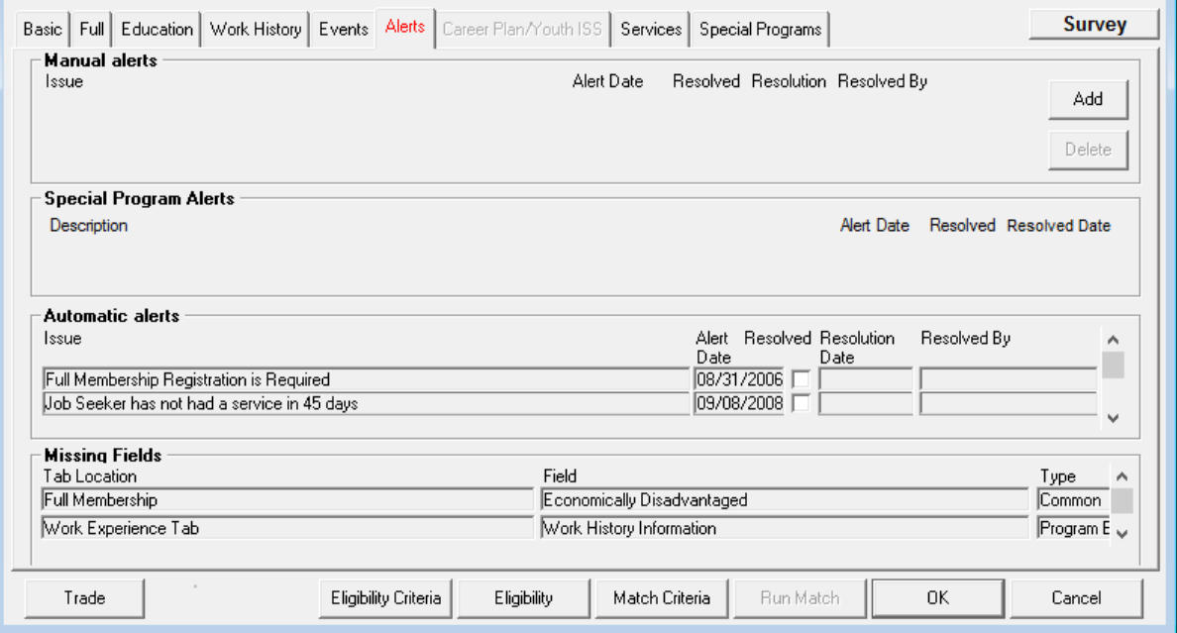
MOSES Mini Clinic

Slide 56
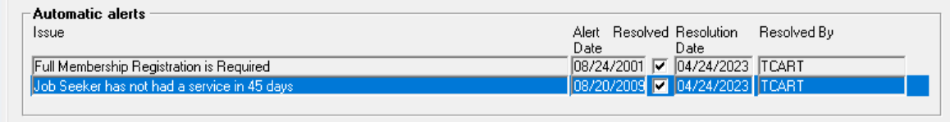
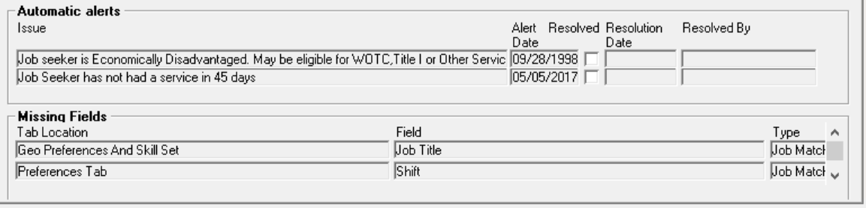
MOSES Mini Clinic

Slide 57
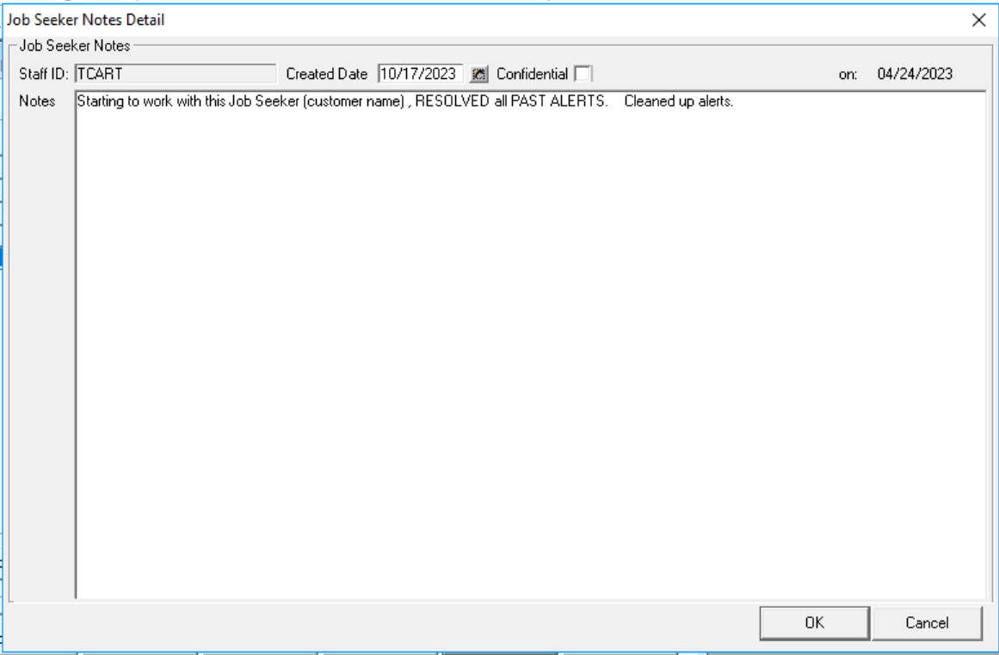
MOSES Mini Clinic

Slide 58
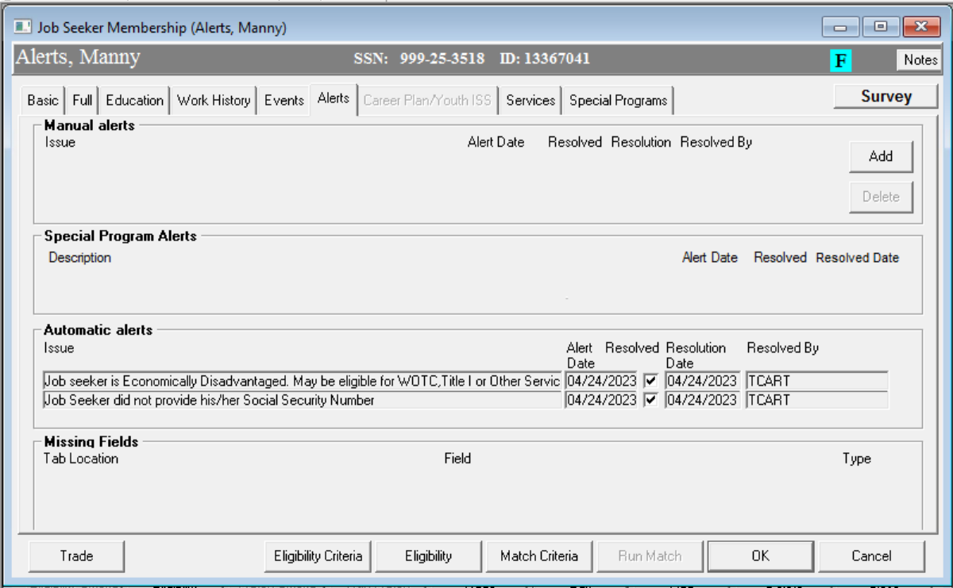
MOSES Mini Clinic

Slide 59

Questions?
?
?
?
Questions and Answers
?
?
?
?
?
?
?
?

