Slide 1

MOSES Mini Clinic
Job Seeker
Follow Up and Retention

Slide 2
Housekeeping
Class time from 9:00 to 10:00 am
Attendance is recorded / taken
Please leave your camera on.
Class is not muted, so ask questions
Limit noise where you are (or mute yourself)

Slide 3
Follow-Up Service - Types
  Required 12 Month Follow-up (General Services)
    Overarching, required by law
  Employment Follow-up Services (Employment Services)
    Possibly extremely important for federal performance
  Retention Services (General Services)
    Extremely Important for federal performance
  After Exit Follow-up Services (General Services)
    Specific services delivered after exit (e.g. Counseling)
Notes:
Employment services goals have not been negotiated as of yet, but are being tracked to establish future goals.

Slide 4
Follow- Up Services
Follow-Up Services: Provided for 12 months after the first day participants are placed in unsubsidized employment. Local area policies must define appropriate follow-up services.
  Follow-Up Services Include:
    Providing individuals counseling about the workplace
    Career planning and counseling
    Information about additional educational opportunities
    Referral to support services available in the community and peer support groups
    Case management administrative follow-up
    Follow-up services for case planning are not to be construed as follow up services required for performance reporting.
    100 DCS 08.102.1: WIOA Title I Follow Up Services Policy
    WIOA Title I Follow-Up Services for Adults, Dislocated Workers, and Youth
Notes:
Please keep in mind these are not blue bold services. Blue bold services will restart you’re your 12 month follow up clock. You also need to add notes in Moses to describe what type of follow up services you provided the customer.

Slide 5
Issuance
FOLLOW UP:
Follow-up services must be provided, as appropriate, including counseling regarding the workplace for participants in adult or dislocated worker workforce investment activities who are placed in unsubsidized employment, for up to 12 months after the first day of employment.
While follow-up services must be made available, not all of the adults and dislocated workers who are registered and placed into unsubsidized employment will need or want such services.
If a customer declines follow up services, it must be recorded in MOSES and explained why in the accompanying NOTE in MOSES.
(Issuance #08-112-3A Career Planning Elements Policy)

Slide 6
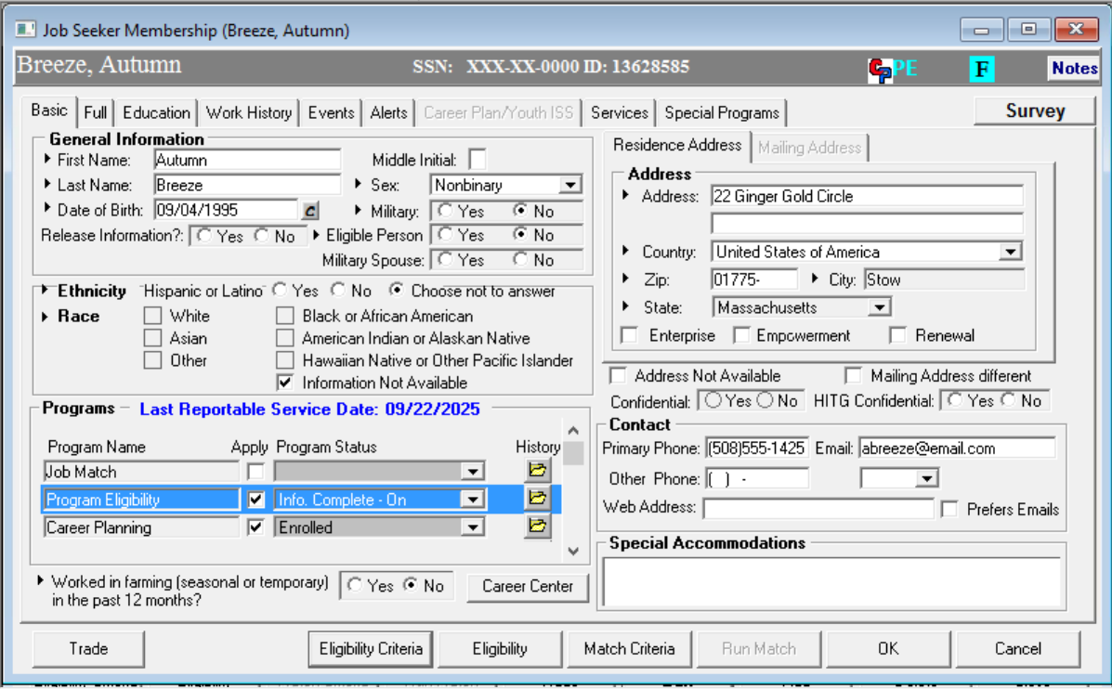
Employment Services –
Follow Up

Slide 7
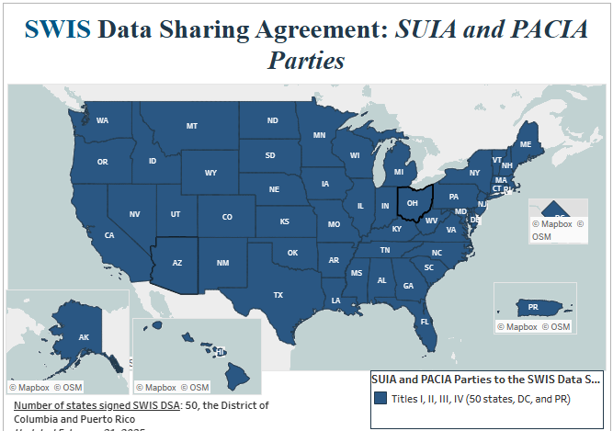
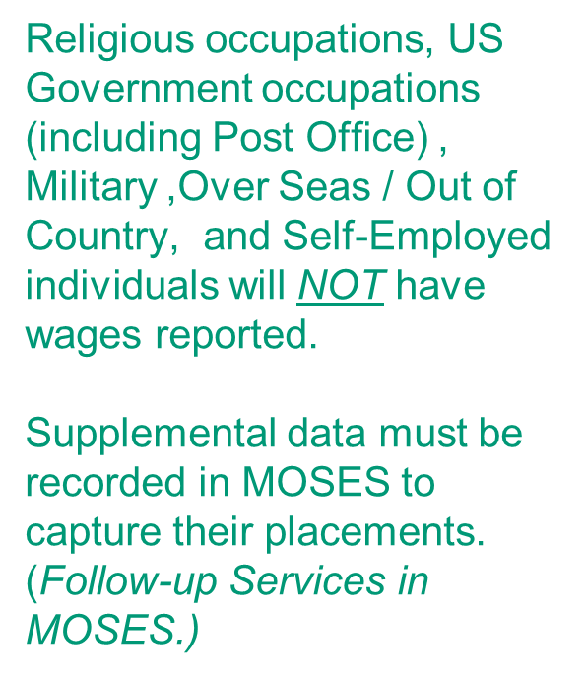
State Wage Interchange System (SWIS)
DATA VALIDATION

Slide 8
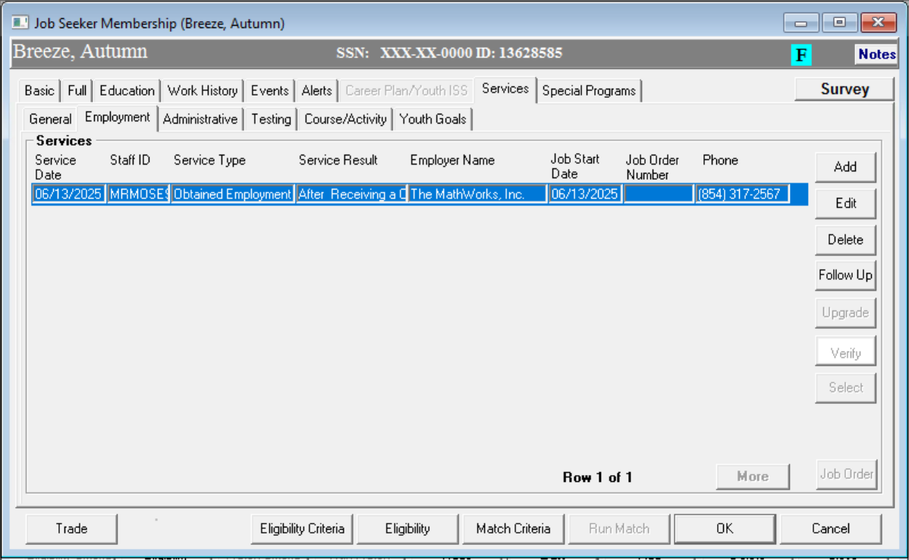
Employment Services –
Follow Up

Slide 9

Employment Services –
Follow Up
Is active when Obtain Employment or Hired service highlighted

Slide 10
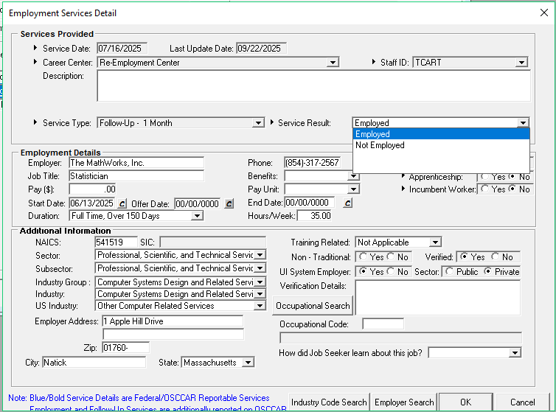
Employment Services –
Follow Up

Slide 11
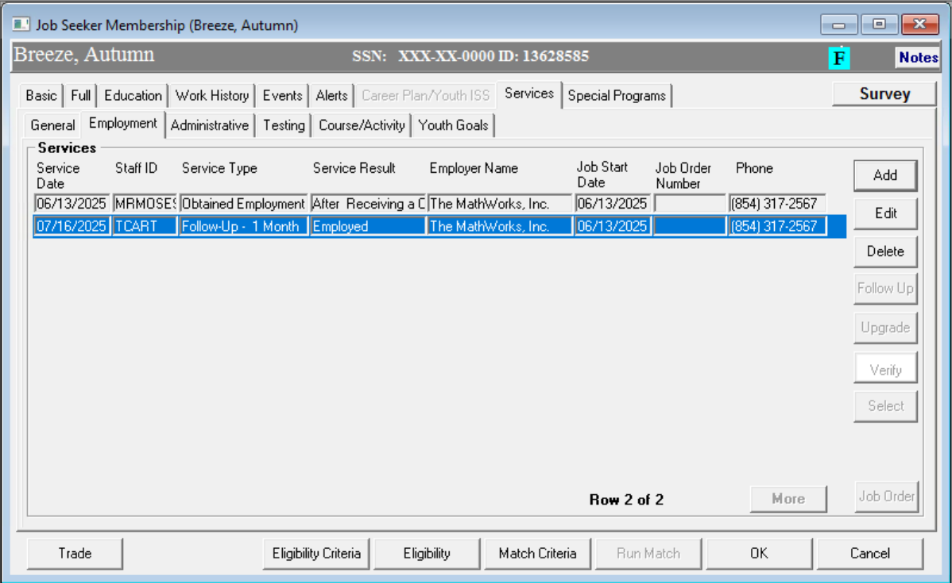
Employment Services –
Follow Up
“Supplemental Data”
is entered

Slide 12
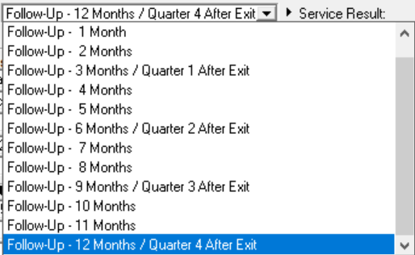
Employment Services –
Follow Up

Slide 13
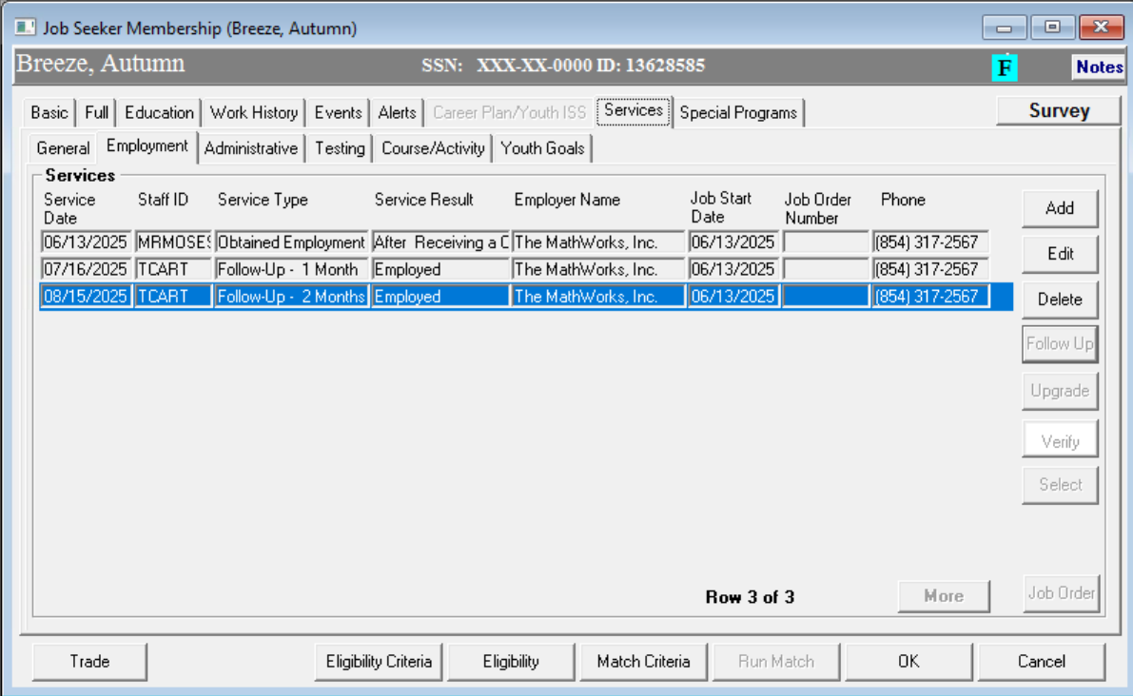
Employment Services –
Follow Up

Slide 14
Employment Services - Follow Up
New Employment

Slide 15
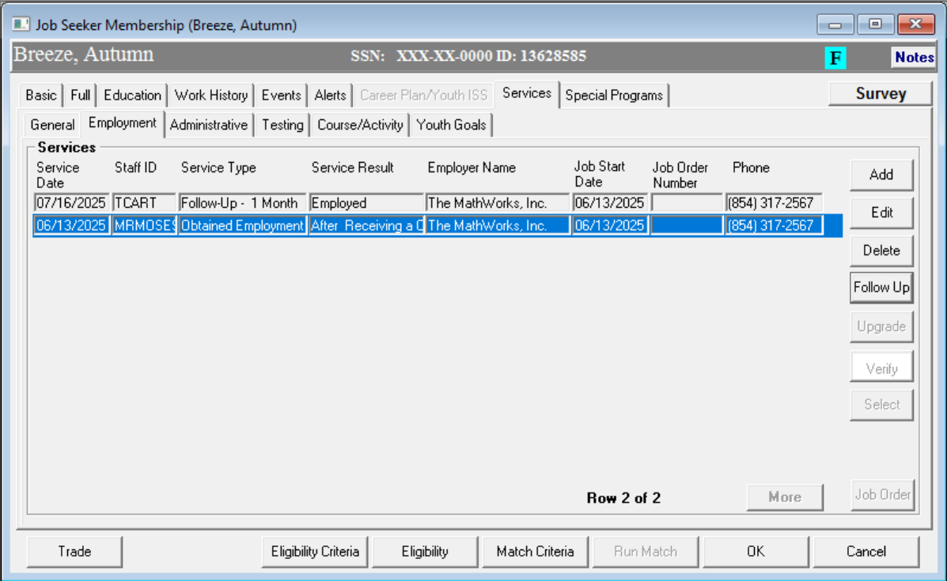
Employment Services - Follow Up
New Employment
Employment at Exit

Slide 16
Employment Services - Follow Up
New Employment

Slide 17
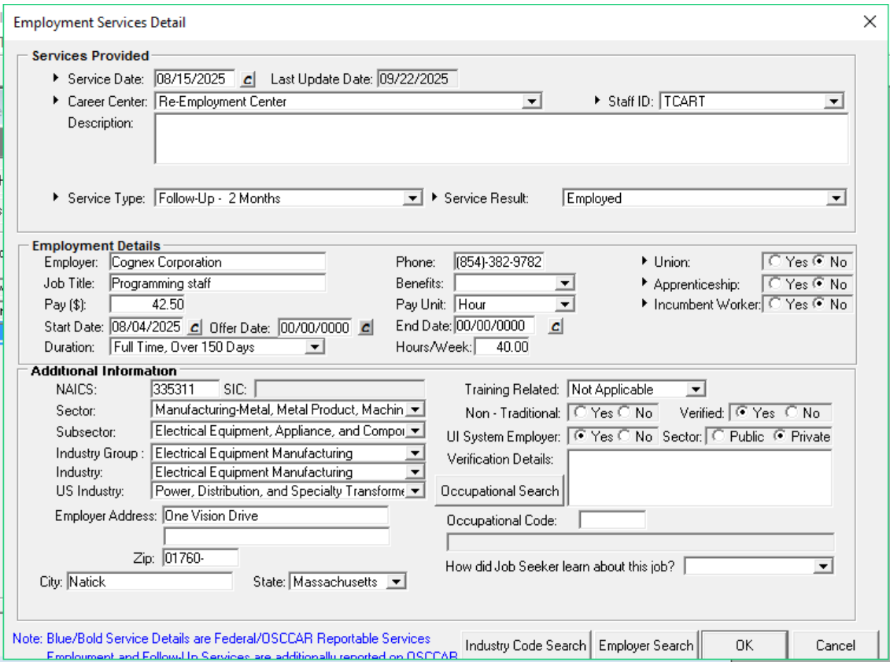
Employment Services - Follow Up
New Employment
Enter the new employment on Employment Services Follow up
This Updates the
“Employment at Exit”

Slide 18
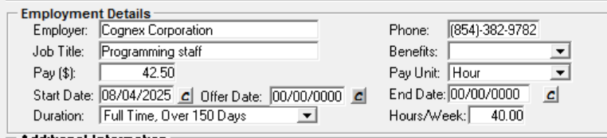
Employment Services - Follow Up
New Employment
New Employer information Entered (overwrite previous)

Slide 19
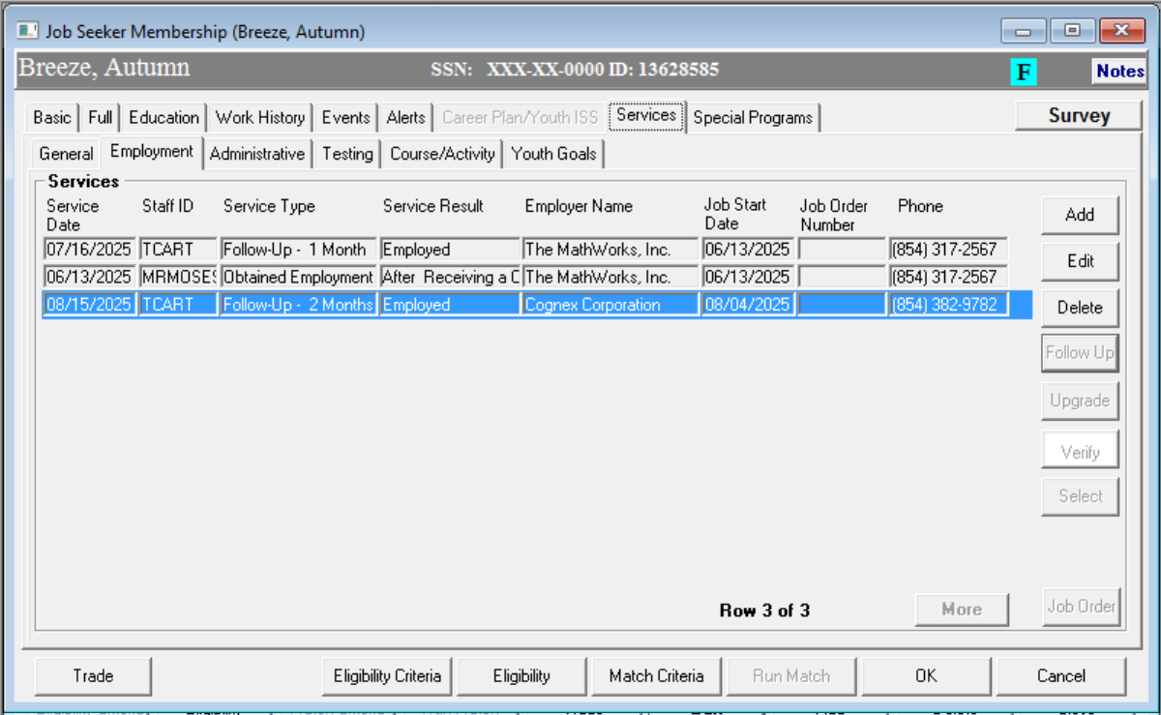
Employment Services - Follow Up
New Employment

Slide 20
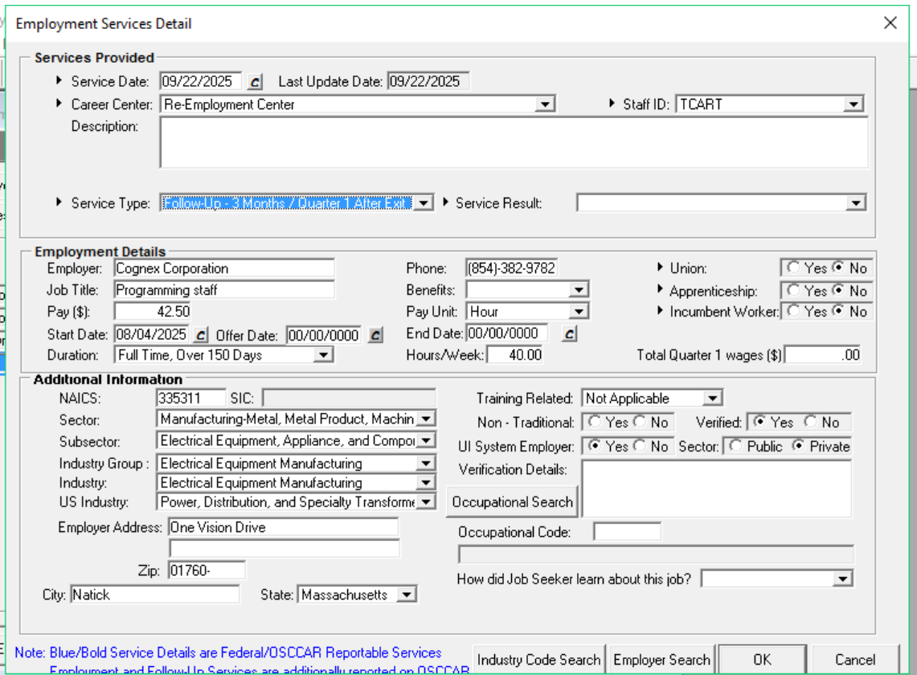
Employment Services - Follow Up
New Employment
New Employer information is retained and displayed every time you enter Employment Follow Up

Slide 21
General Services - Follow Up

Slide 22
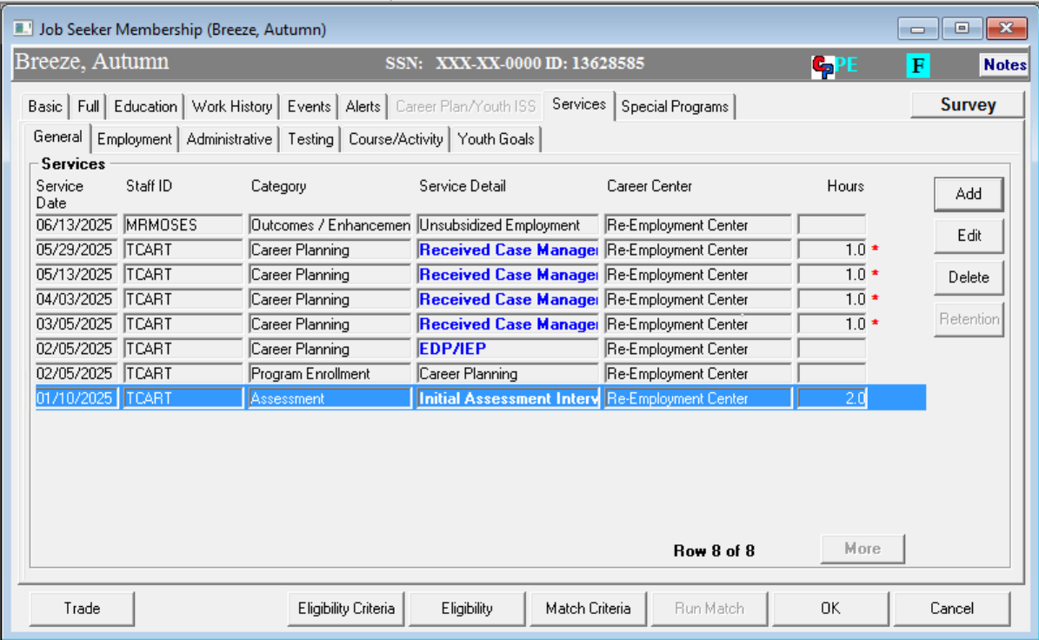
General Services - Follow Up

Slide 23
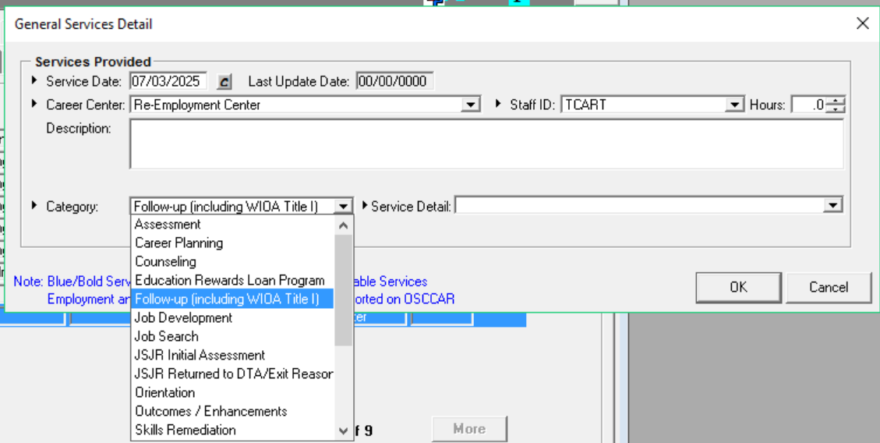
General Services - Follow Up

Slide 24
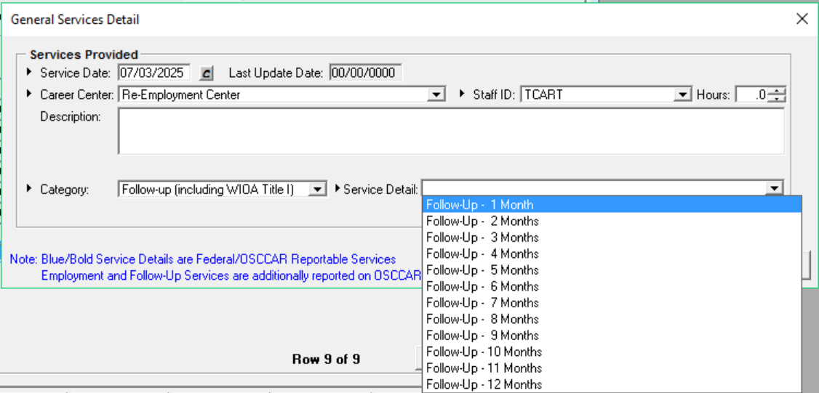
General Services - Follow Up

Slide 25
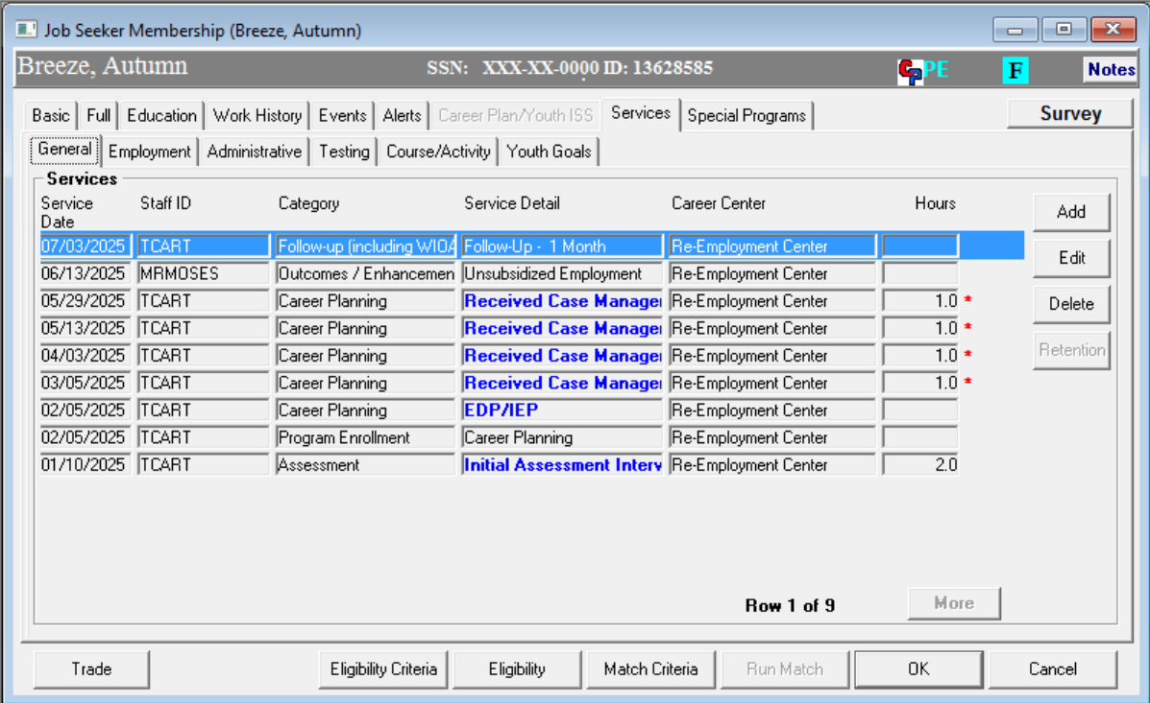
General Services - Follow Up

Slide 26
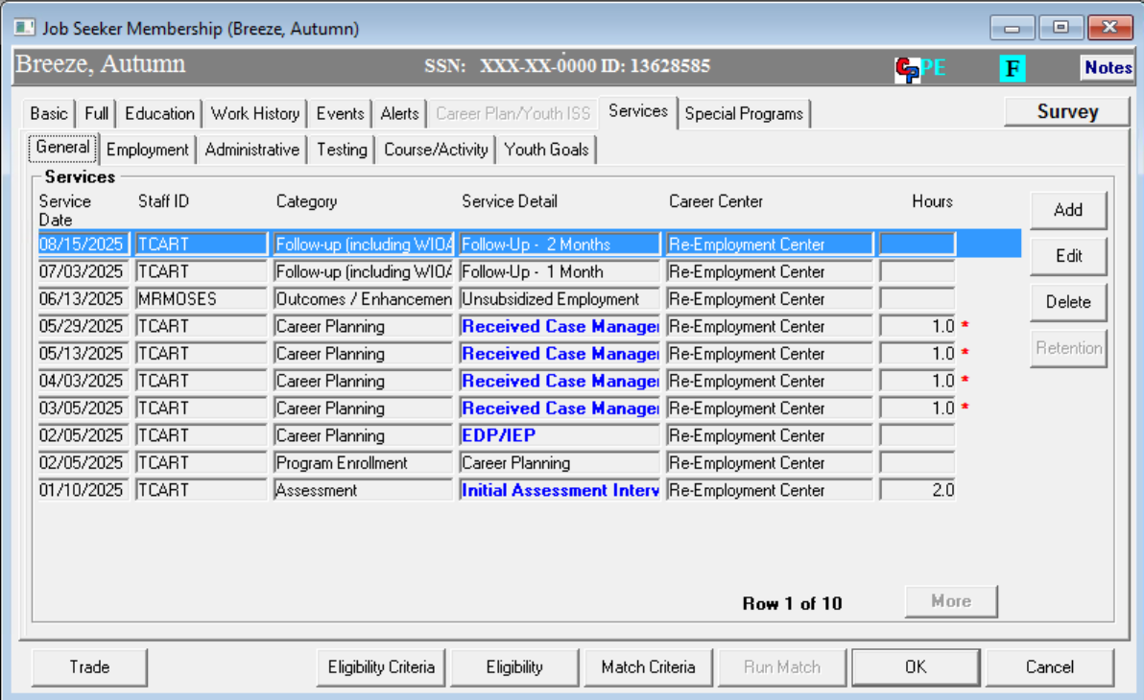
General Services - Follow Up

Slide 27
After Exit – Follow Up

Slide 28
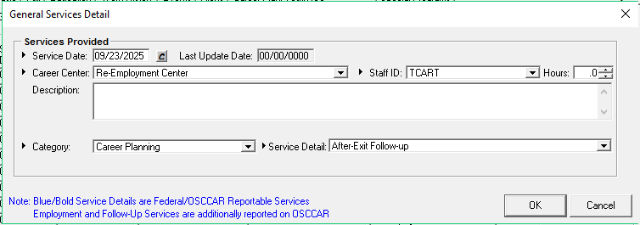
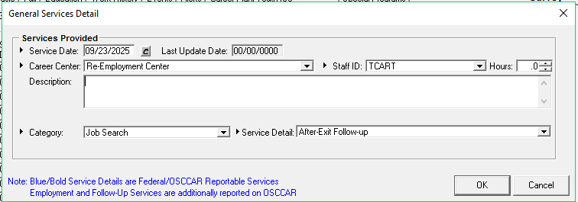

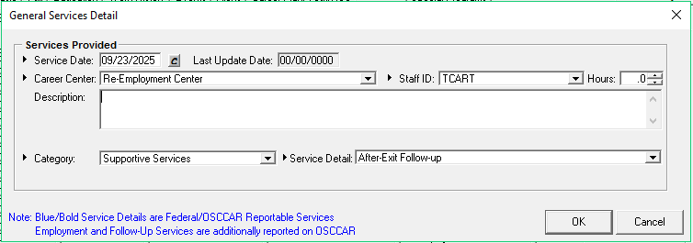
After Exit – Follow Up
Every General Service - Category has an After-Exit Follow Up service
These do not restart the Enrollment “clock” (90 days auto exit)

Slide 29
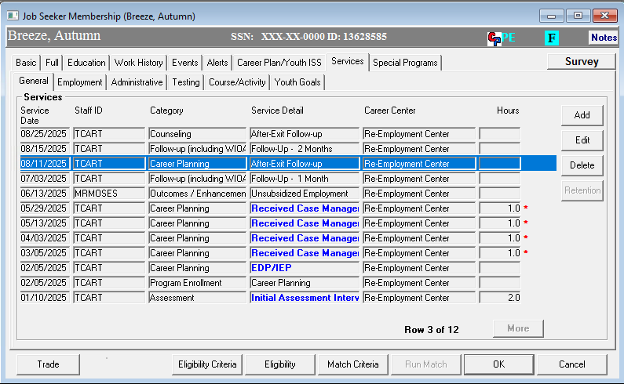
After Exit – Follow UP

Slide 30
Follow Up
Questions ??????
General Services – Follow Up
General Services - After Exit Services
Employment Services – Follow Up

Slide 31
RETENTION
RETENTION is~ FOLLOW UP

Slide 32
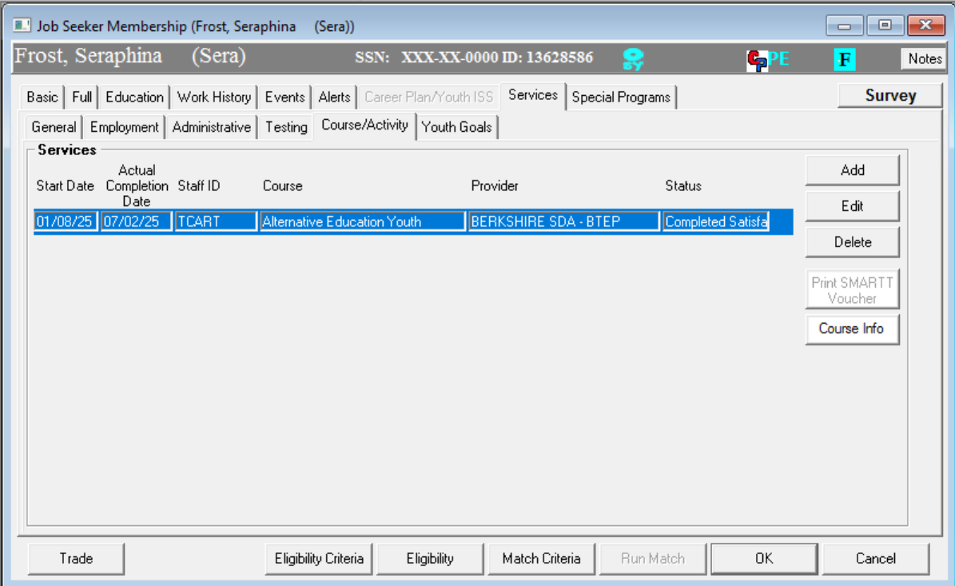
Retention
Outcome:
Completed Satisfactorily
HiSet/GED program

Slide 33
Youth Outcomes (Traditional/Standard)
HiSet/GED plus
Other possible outcomes
  Job
  (General Services – Employment Follow Up / General Services Follow Up services/ Wage Match)
  Attending Alternative School
  Attending Secondary School
  Entered Advanced Training
  Entered Military Service
  Entered Post-Secondary Education
  Entered Qualified Apprenticeship

Slide 34
Secondary School Diplomas/Equivalents
Credential Attainment
For those attaining a high school equivalency or diploma:
Only included as a positive outcome, if within one year after exit, the participant is:
  Employed
    OR
  Enrolled in education or training leading to a postsecondary credential
  (From WIOA Training class for Youth Performance)
Notes:
For employment, we will confirm employment through wage data. For the postsecondary education or training, this must be entered in Moses with notes as well. In the next couple of sides there are examples to clear this up a little more.

Slide 35
Credential Attainment
Performance Measure
Credential Attainment:
  Recognized Post Secondary Credential
  Add the Attainment Service on the General tab of MOSES.
  High School Diploma/Equivalency
  Add the Attainment Service on the General tab of MOSES
  Wage record (SWIS)
    OR
    Add Retention Service on the General tab of MOSES if in Advanced Training or Post Secondary Education
  (From WIOA Training class for Youth Performance)
  Outlier Reports | Mass.gov

Slide 36
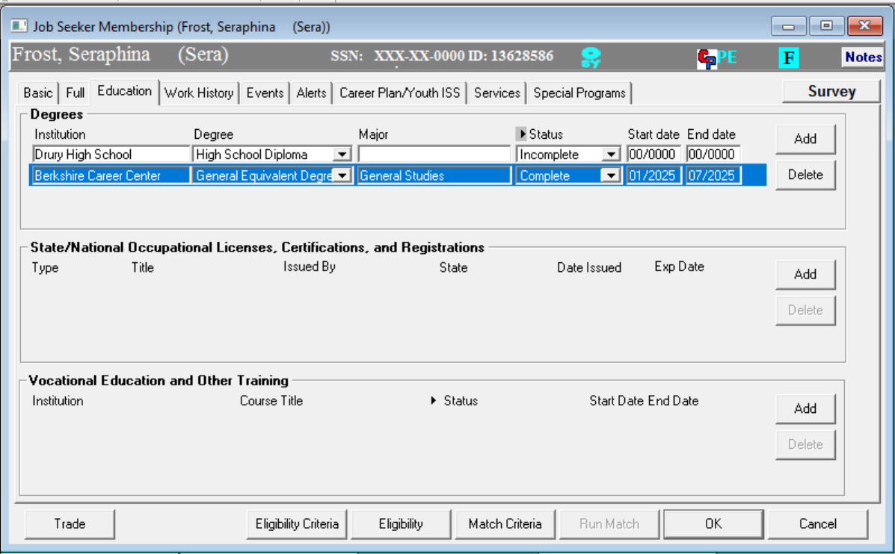
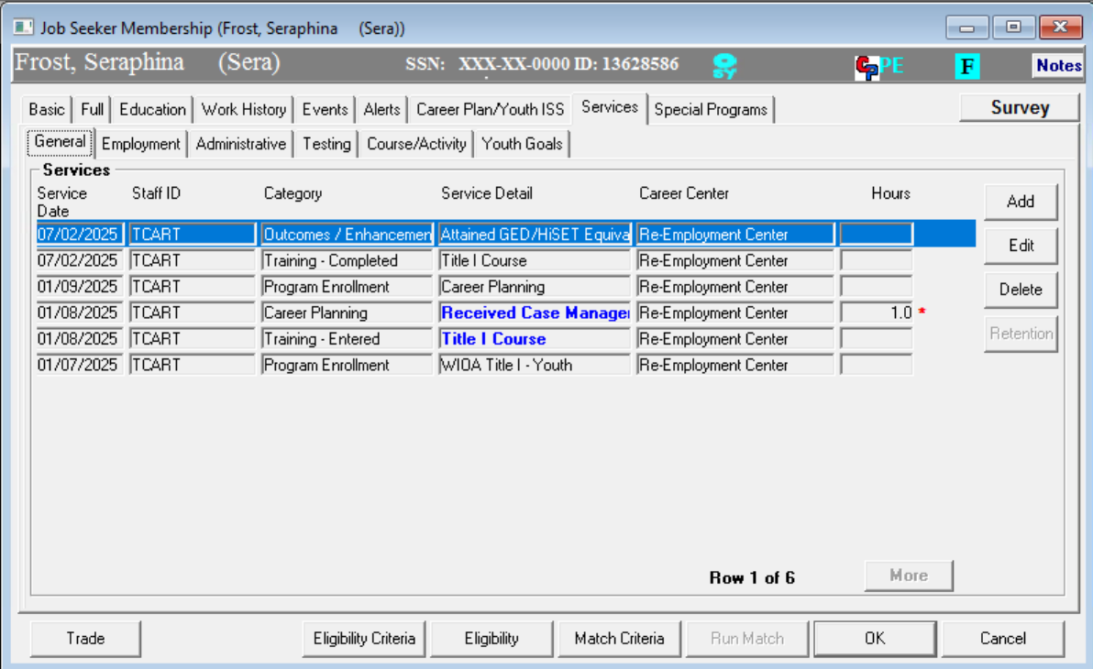
Attained HiSet/GED
Course: Completed Satisfactorily
Added to Education Tab
Added to: General Services – Outcome/Enhancement
Attained HiSet/Ged

Slide 37
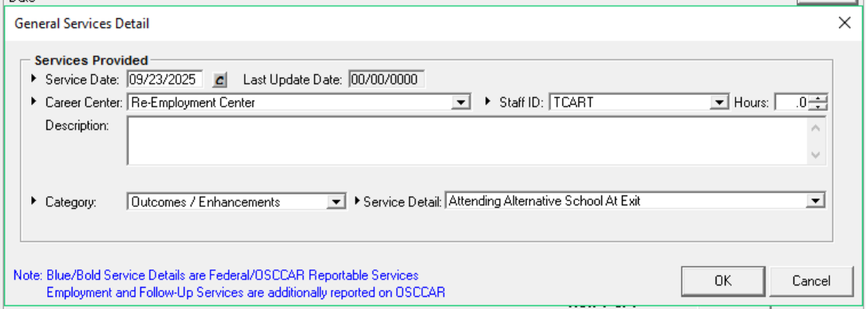
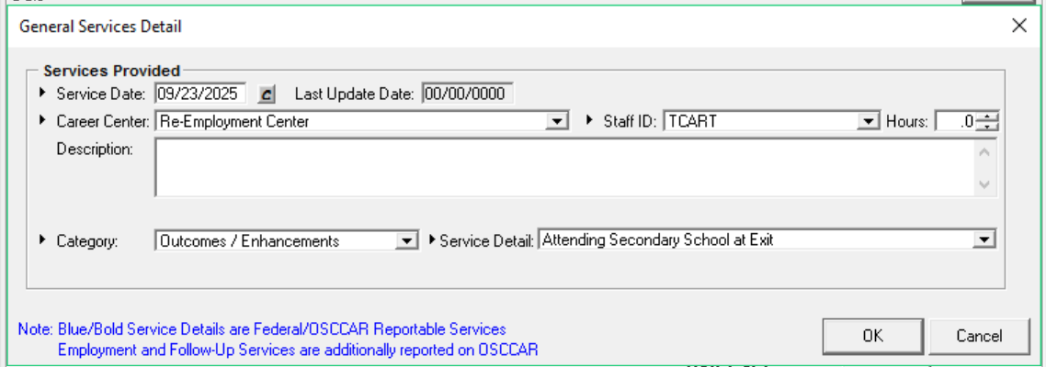
No Employment : Attending _____ at Exit

Slide 38
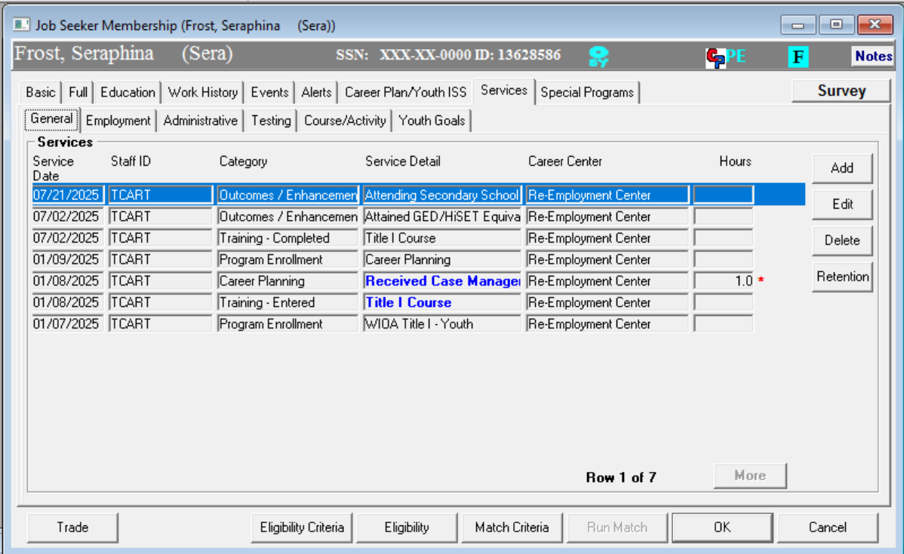
General Services - Retention

Slide 39

Retention
RETENTION is~ FOLLOW UP

Slide 40
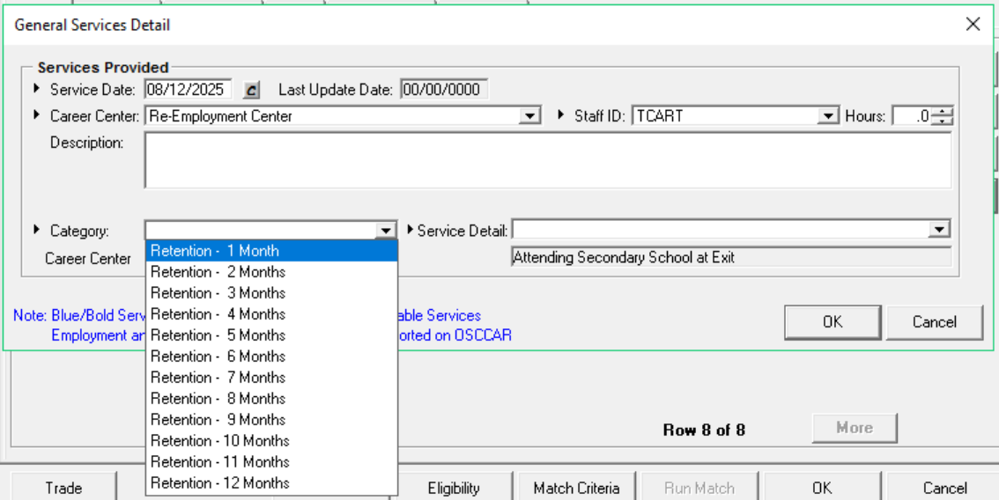
Retention Service Detail

Slide 41
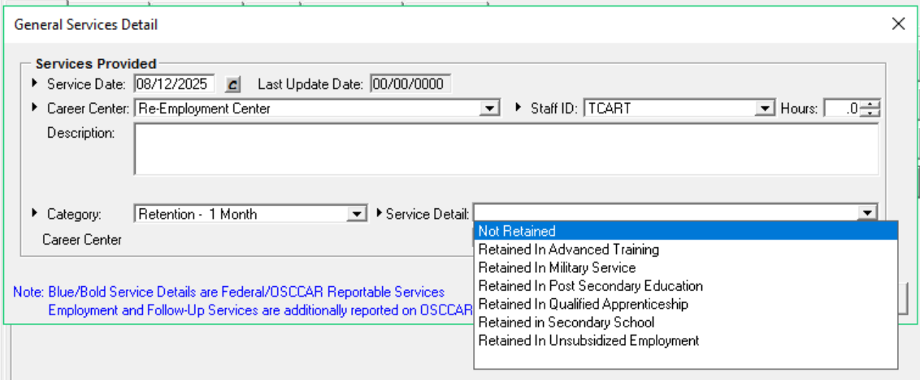
Retention Service Detail

Slide 42
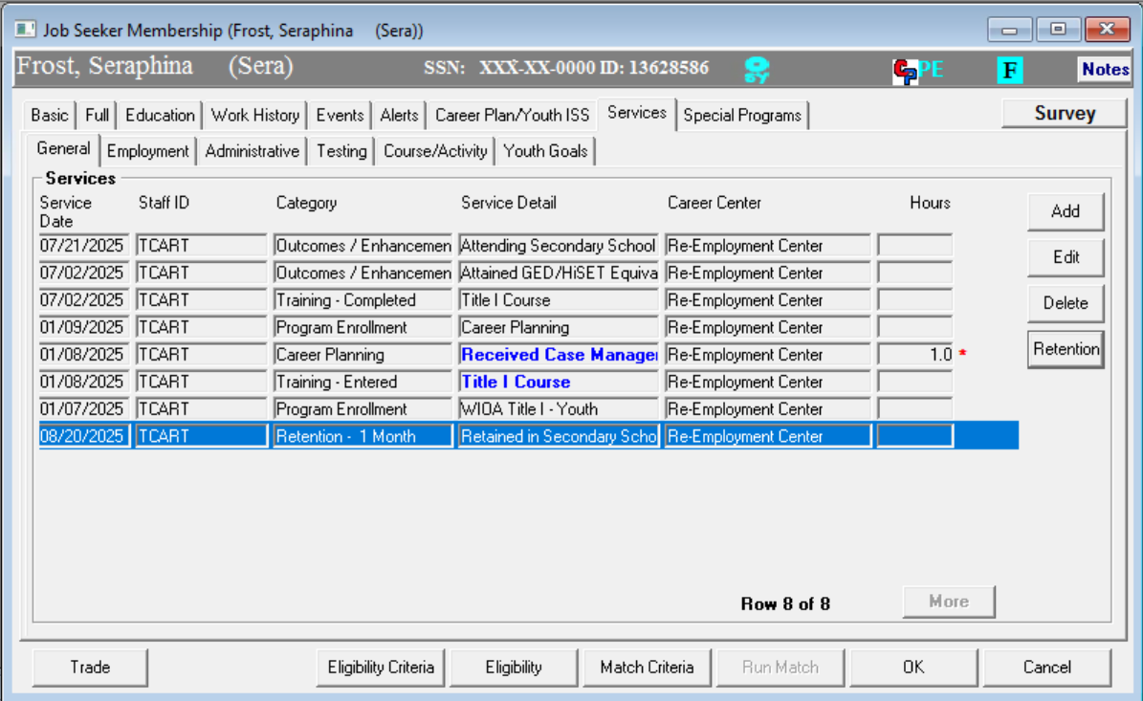
Retention Services

Slide 43
Retention Services
The General Service - Retention Category is the “supplemental data” verifying that they are still attending school and participating in the program.

Slide 44
Other “Entered” that need Retention Services
Other possible outcomes
  Job (General Services – Follow Up / Wage Match)
  Attending Alternative School
  Attending Secondary School
  Entered Advanced Training
  Entered Military Service
  Entered Post-Secondary Education
  Entered Qualified Apprenticeship

Slide 45
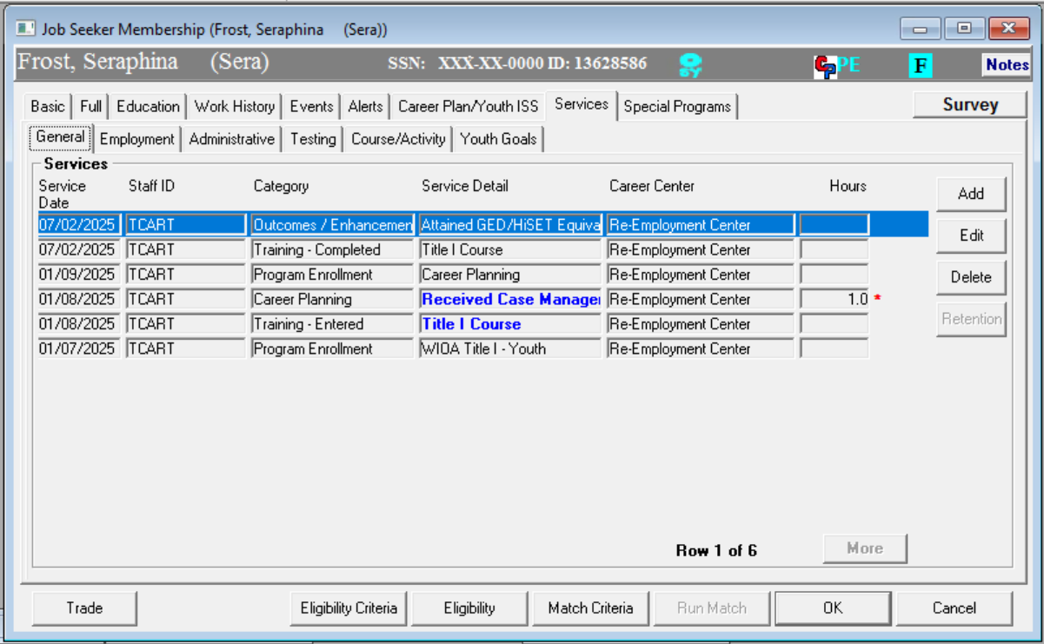
Other Retentions

Slide 46
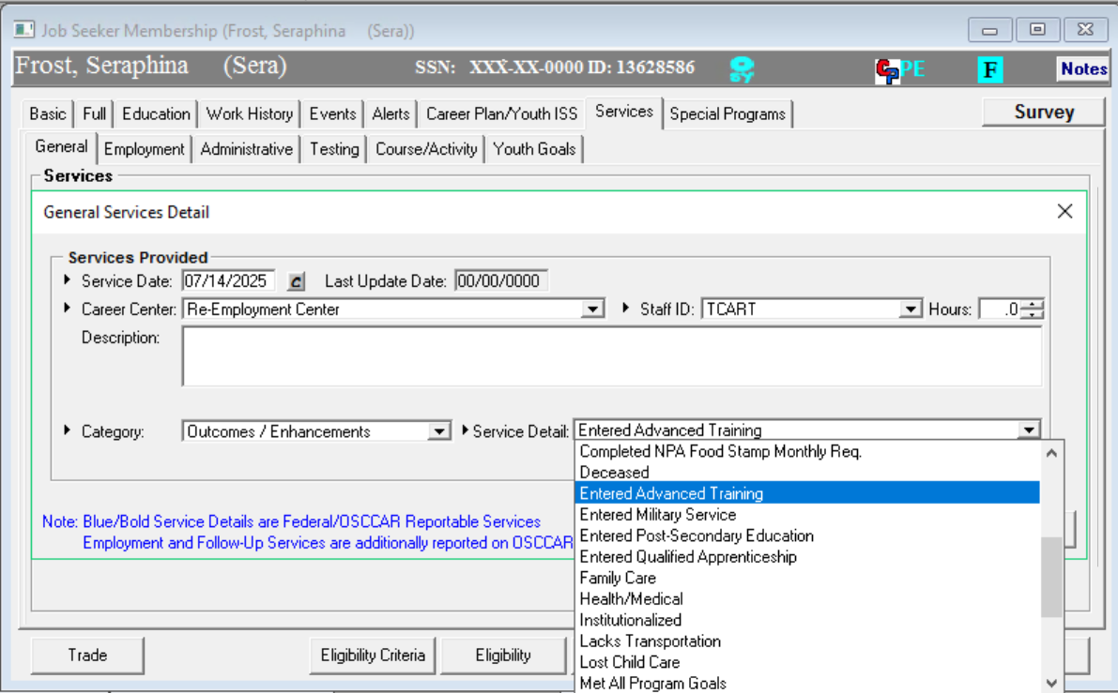
Other Retentions

Slide 47
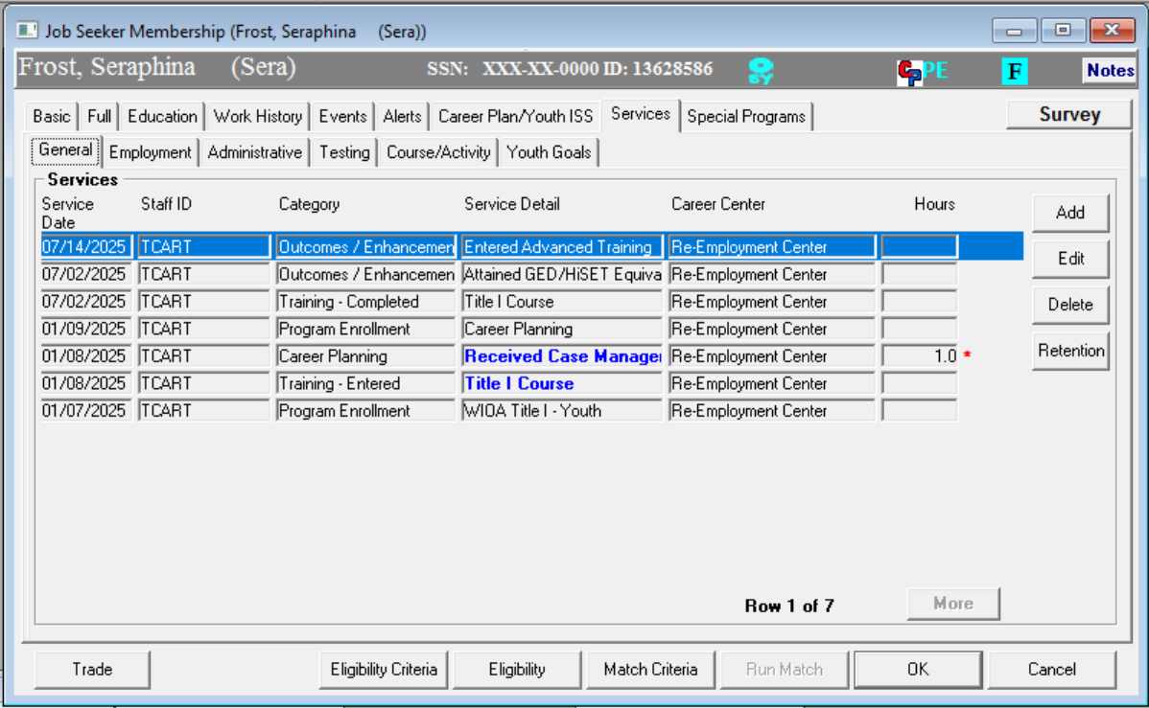
Other Retentions

Slide 48
Other Retentions
RETENTION is~ FOLLOW UP

Slide 49
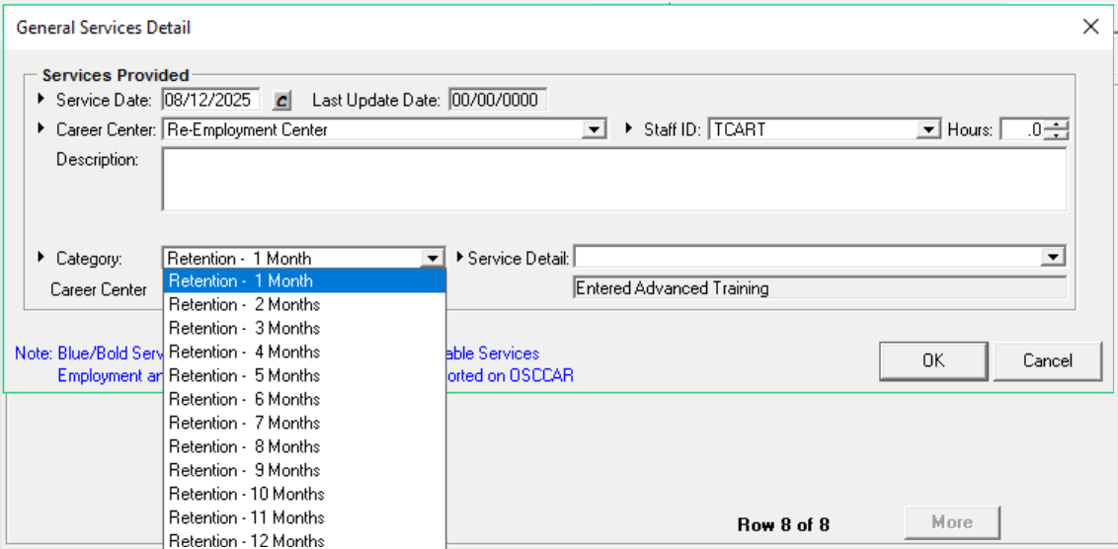
Other Retention

Slide 50
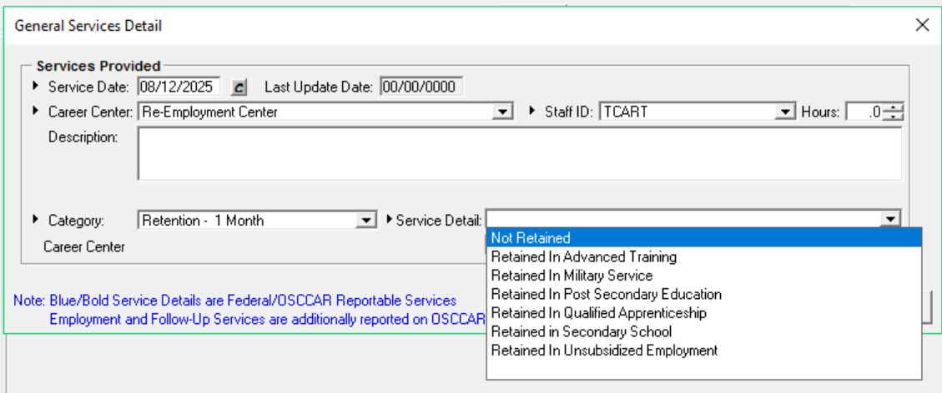
Other Retention

Slide 51
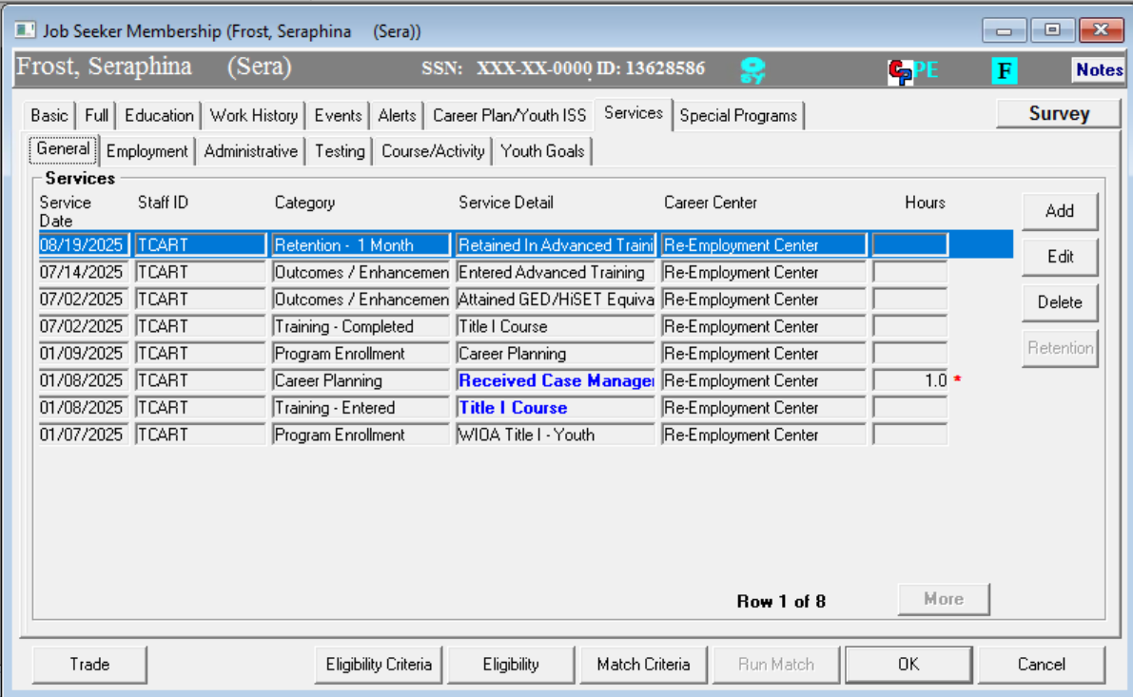
Other Retention

Slide 52
Retention
Basic RETENTION for:
  Entered Advanced Training
  Entered Post-Secondary Education

Slide 53
Retention Plus+
Outcomes with extras
  Entered Military Service
  Entered Qualified Apprenticeship

Slide 54
Retention Plus+

Slide 55
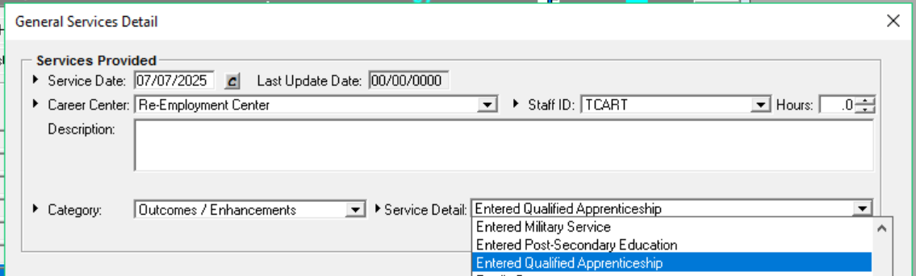
Retention Plus+

Slide 56
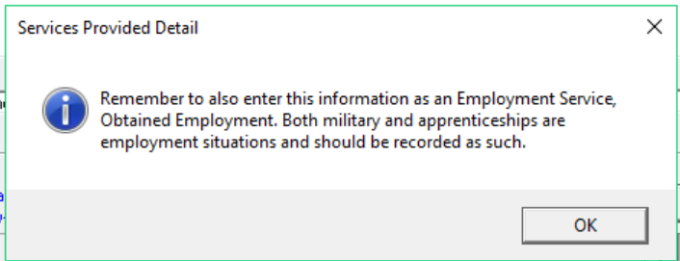
The Plus+
Plus + = Add Employment Outcome
Obtain Employment
Work History

Slide 57
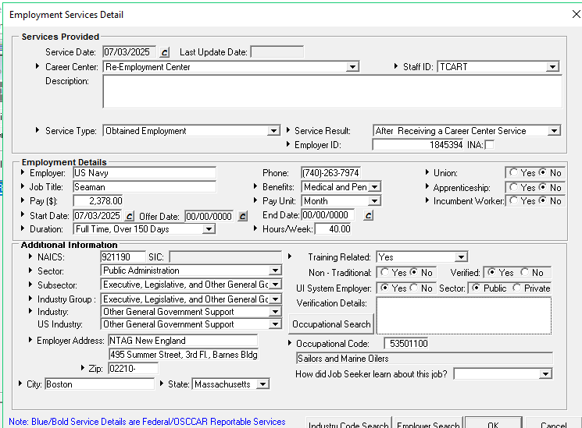
Retention Plus+

Slide 58
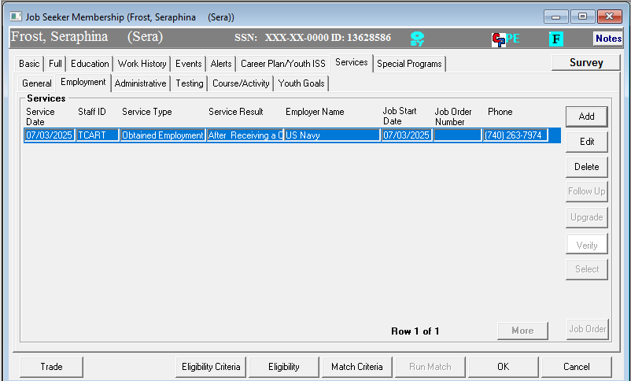
Retention Plus+
The Obtain Employment Service

Slide 59
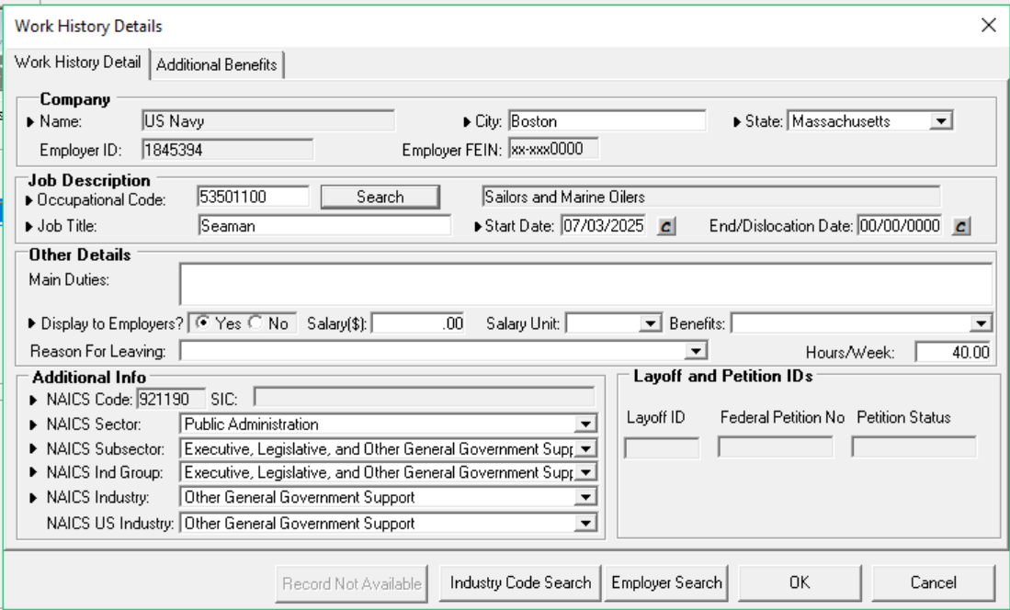
Retention Plus+

Slide 60
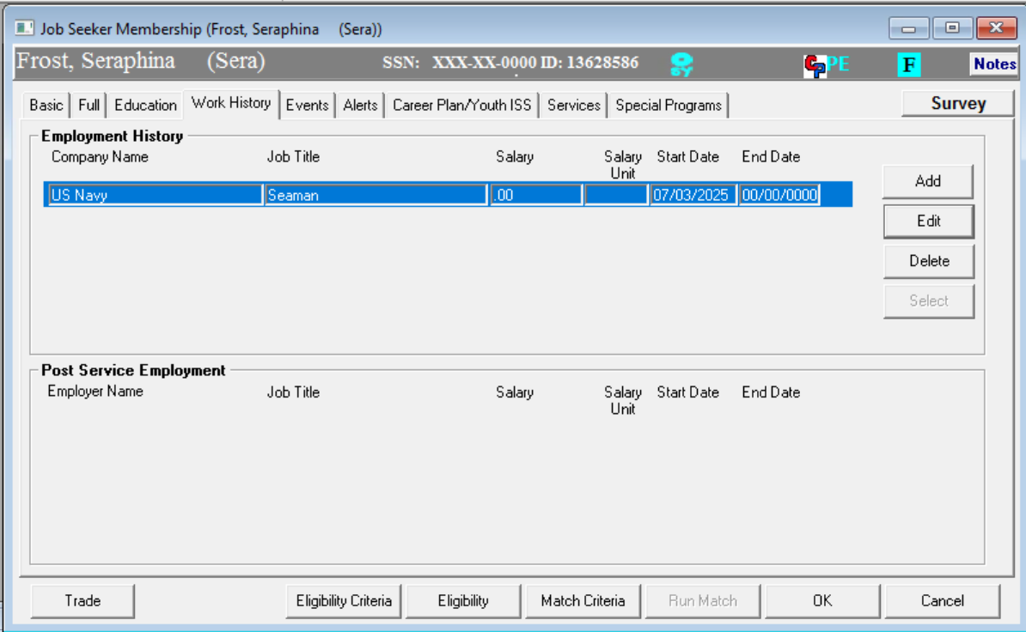
Retention Plus+
The Work History Updated

Slide 61
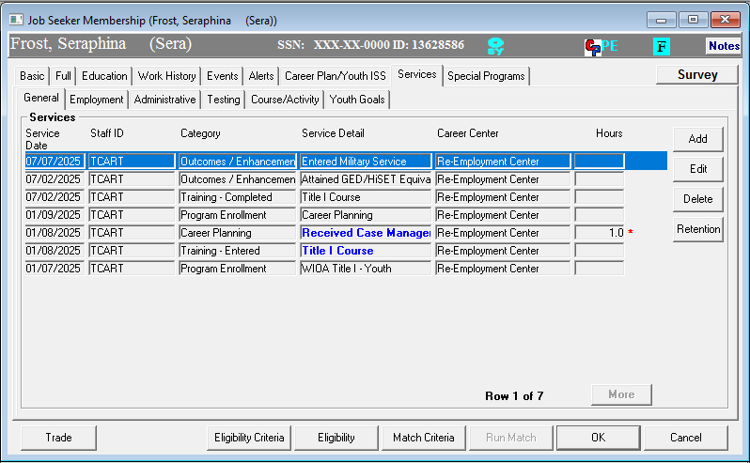
Retention Plus+

Slide 62
Retention Plus+
RETENTION is~ FOLLOW UP

Slide 63
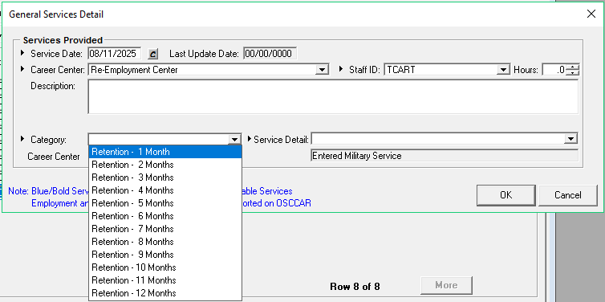
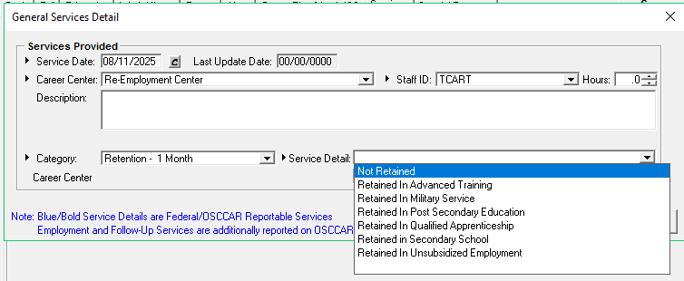
Retention Plus+

Slide 64
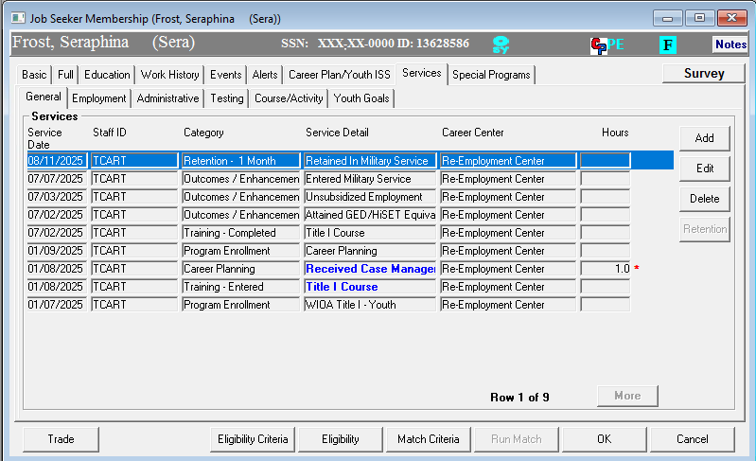
Retention Plus+
Retention Service in MOSES

Slide 65
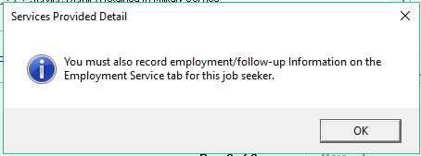
Retention Plus+

Slide 66
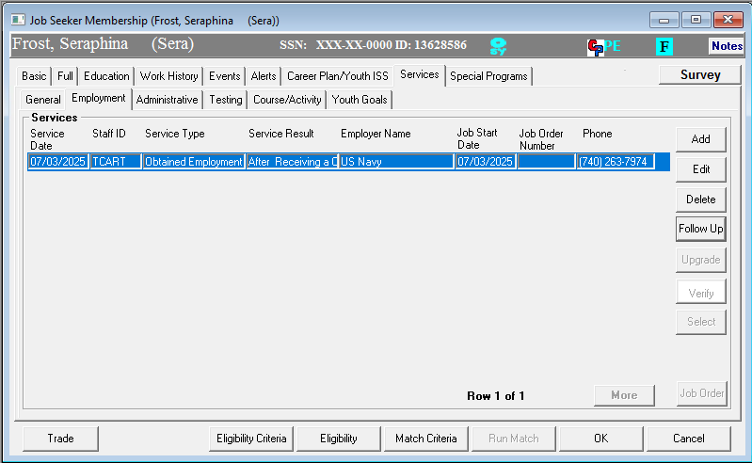
Retention Plus+

Slide 67
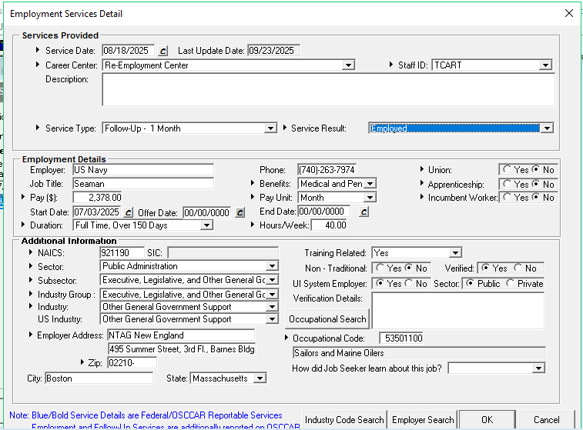
Retention Plus+

Slide 68

Retention Plus+

Slide 69
Retention Plus+
So this needs:
General Services –
Outcome Enhancements - Retention Service (by month)
Employment Services -
Follow Up Services (by month)
General Services –
Follow Up (including WIOA Title I)

Slide 70
Trivia Question
??????????
CAREER PLAN CLOSING ???????
  Open
  Suspended
  Closed
Before or After “Follow Up or Retention”????

Slide 71

Questions?
?
?
?
Questions
?
?
?
?
?
?
?
?

