Slide 1
MOSES Mini Clinic Measurable Skills Gain

Slide 2
Housekeeping
Class time from 9:00 to 10:00 am
Please leave your camera on
Class is not muted, so ask questions
Limit noise where you are (or mute yourself)

Slide 3
MOSES Mini Clinic Measurable Skills Gain Create / New

Slide 4
MOSES Mini Clinic
A Measurable skill gains goal must be recorded (created) at least once per program year, per enrollment with an education or training program.
If the training/education spans multiple program years, there must be at least one measurable skill gain goal entered in each program year.
A program year runs from July 1st to June 30th.
A measurable skills gain goal is per fiscal year.

Slide 5
WIOA Performance Indicators
Who is in the Measurable Skill Gains measure?
All WIOA participants in school are included!
Adults/Dislocated Workers who are in any occupational skills training, including OJT, or in any secondary school programs (ABE/GED) including Trade and NDWG.
Out of School Youth who are in any occupational skills training, not including OJT, or in any secondary education programs (ABE/GED), or YouthBuild or Job Corps.
Notes:
OJTs for youth are considered a Work Experience and cannot be used as an MSG.

Slide 6
WIOA Performance Indicators Measurable Skill Gains
There are five (5) types of gains;
Educational Functioning Level Gain:
Compare pre-test and post-test to see gain in educational functioning level based on standard National Reporting System (NRS) tests like TABE, CASAS, MAPT.
Diploma or Recognized Equivalent:
HS diploma or state recognized equivalent (GED/HiSET)
Transcript or Report Card:
The report card should demonstrate satisfactory achievement in all classes by the participant in secondary education for one semester.
A Post Secondary transcript showing achievement with sufficient credit hours; 12+ hours per semester for full time, or 12+ hours over two semesters during a 12-month period for part time students.
An Associate or Bachelor’s degree.

Slide 7
WIOA Performance Indicators Measurable Skill Gains
Training Milestones:
The gain is documented by a satisfactory or better progress report from an employer or trainer. Some examples are:
Completion of OJT or apprenticeship program or steps to complete either
Milestones for mastery of job skills
Increased pay from improved skills or performance
Skills Progression (based on exams):
Some examples are:
Passing a ServSafe exam on way to a culinary certification
Passing a CPR exam on way to a CNA certification
Any industry recognized credential that is achieved through exam
Notes:
Some of these can be a credential as well if the timing works out and they are attained within the same program year.

Slide 8
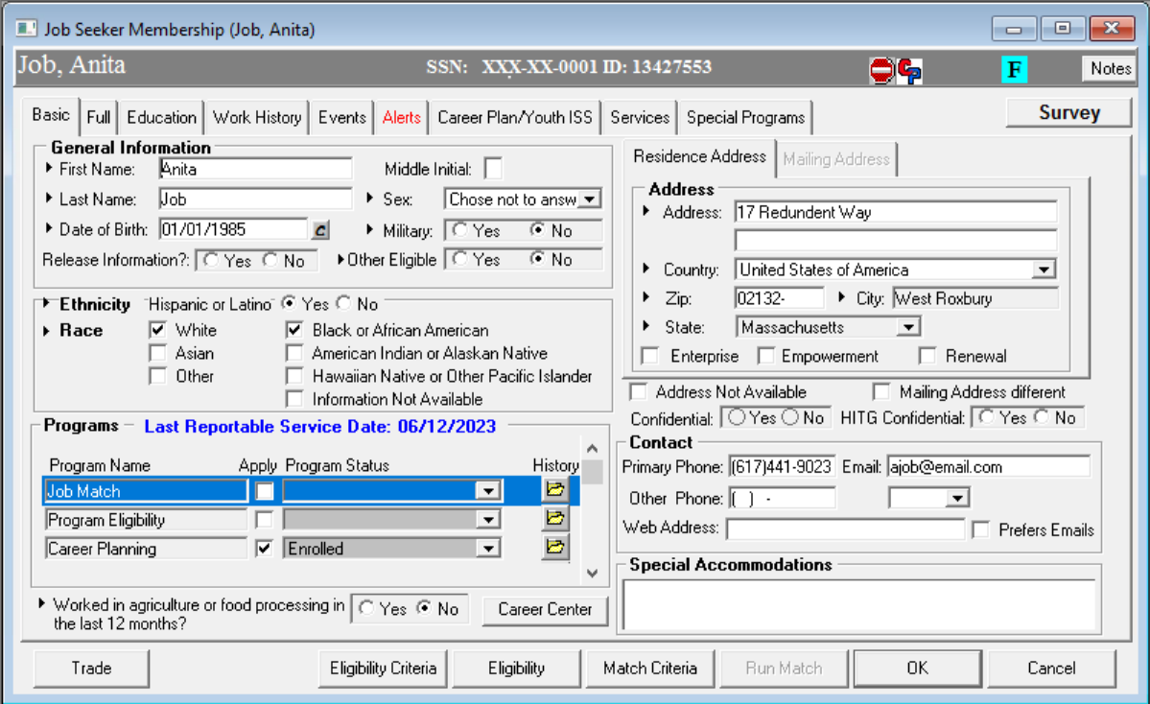
MOSES Mini Clinic

Slide 9
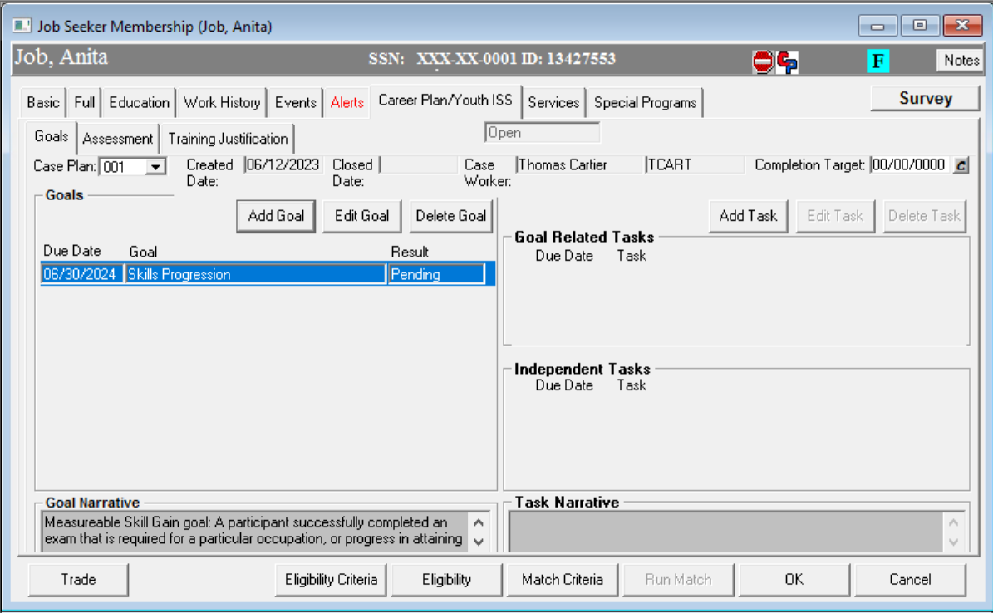
MOSES Mini Clinic

Slide 10
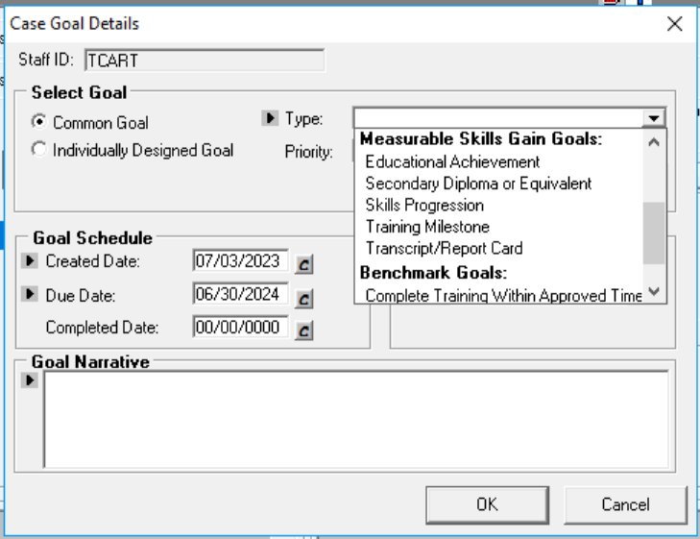
MOSES Mini Clinic

Slide 11
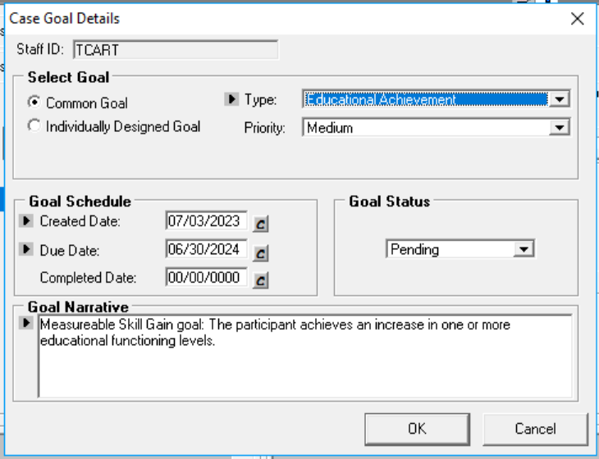
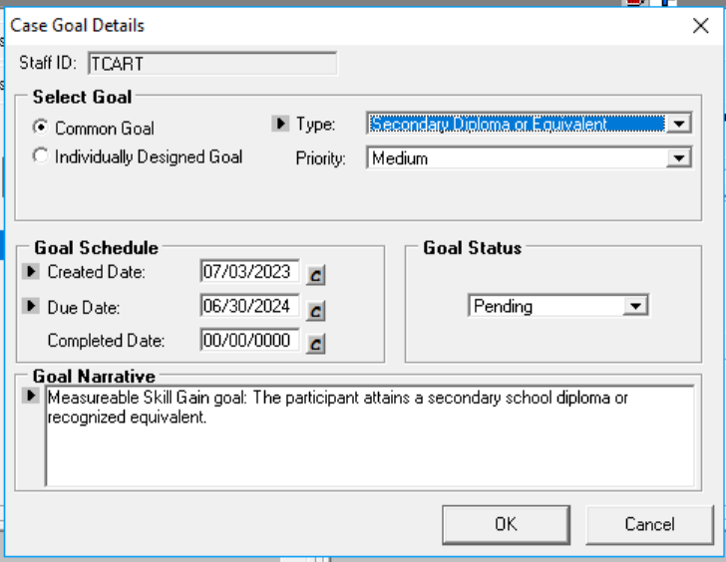
MOSES Mini Clinic
OTHER MEASURABLE SKILLS GOALS

Slide 12
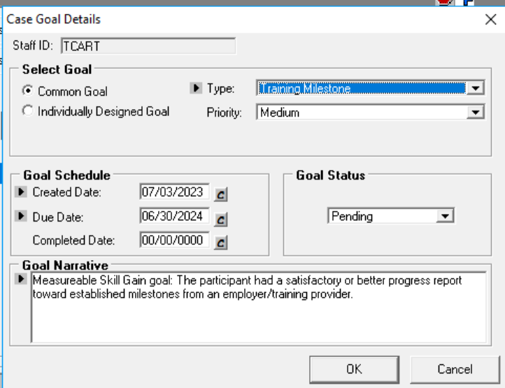
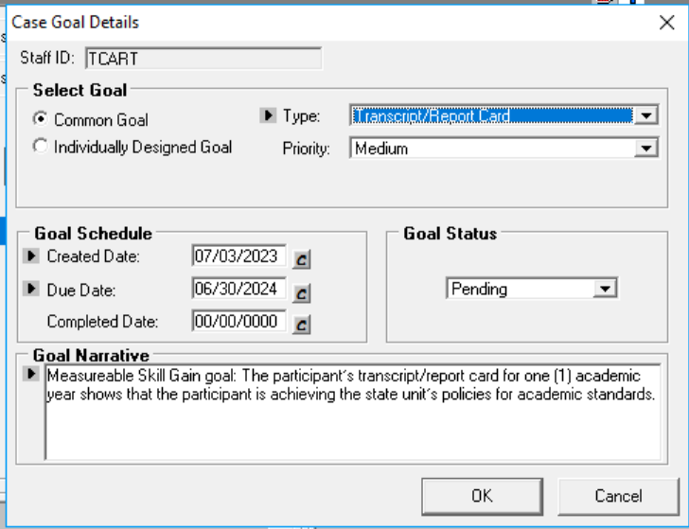
MOSES Mini Clinic
OTHER MEASURABLE SKILLS GOALS

Slide 13
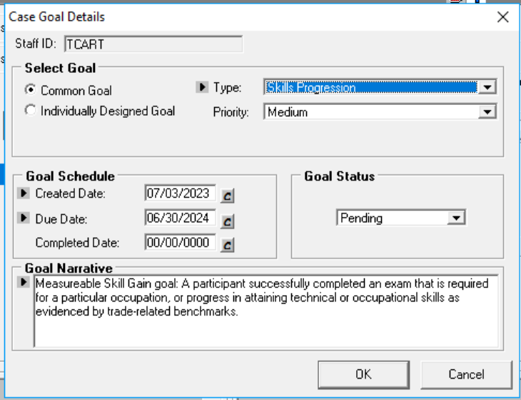
MOSES Mini Clinic
Select Appropriate TYPE
For
Customer

Slide 14
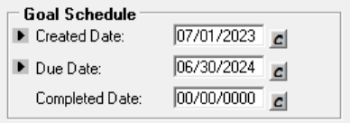
MOSES Mini Clinic
CREATED DATE SHOULD BE WITHIN THE PROGRAM YEAR

Slide 15
MOSES Mini Clinic
Beginning in the new Program year (that starts July 1) please ENTER a new and updated MEASURABLE SKILLS GOAL for the Program Year for anyone enrolled in a training.
The Job Seeker Career Plan should reflect a Measurable Skill Gain Goal for the Program year.

Slide 16
MOSES Mini Clinic Measurable Skills Gain Completions

Slide 17
MOSES Mini Clinic
There must be at least one measurable skill gain entered in each program year.
Each program year runs from July 1st to June 30th.
The measurable skills gain is per Program year.

Slide 18
MOSES Mini Clinic
Job Seeker
Career Planning Tab

Slide 19
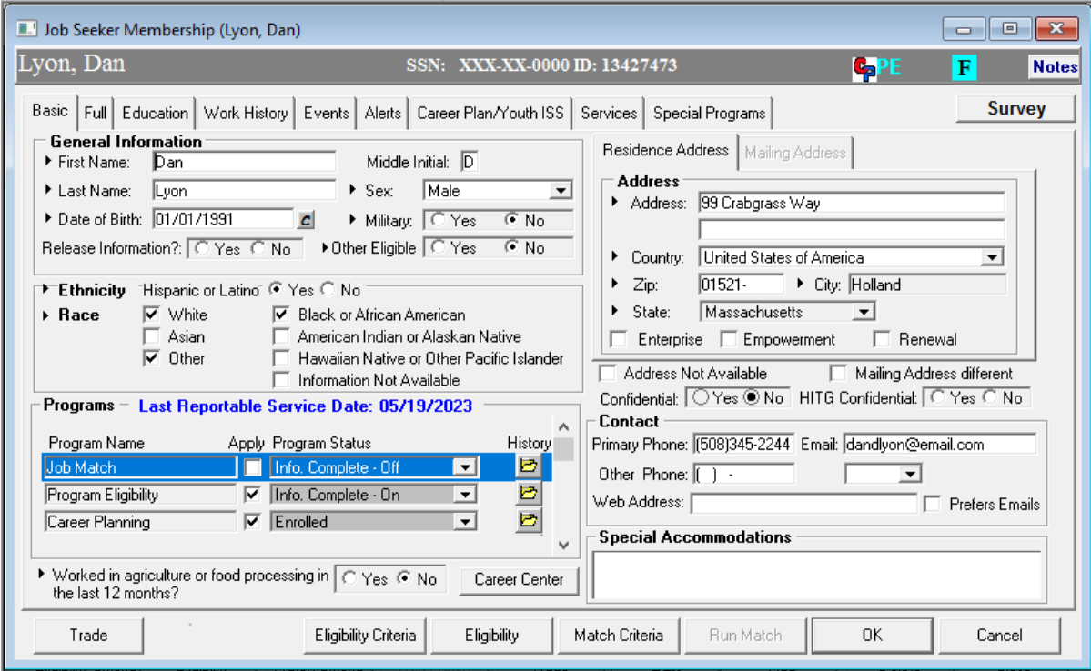
MOSES Mini Clinic

Slide 20
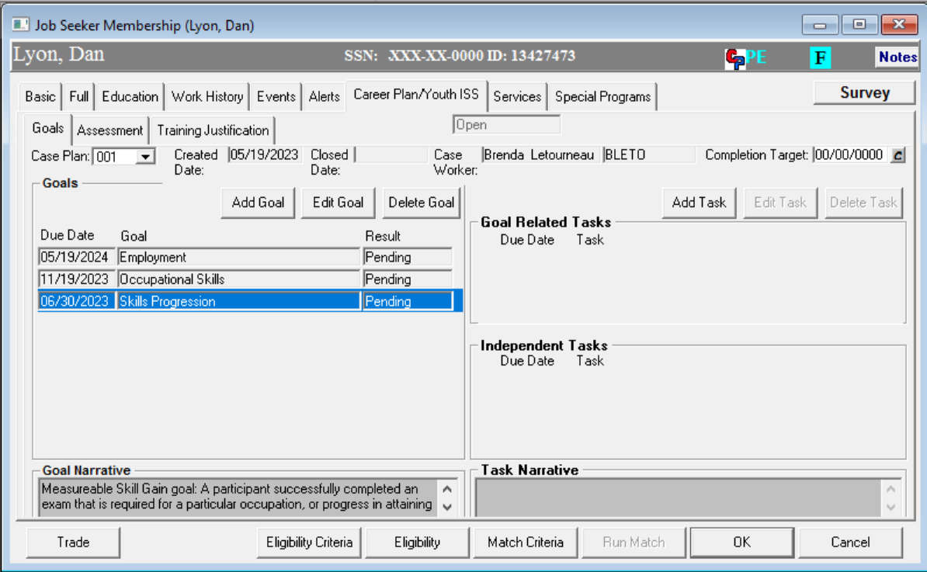
MOSES Mini Clinic

Slide 21
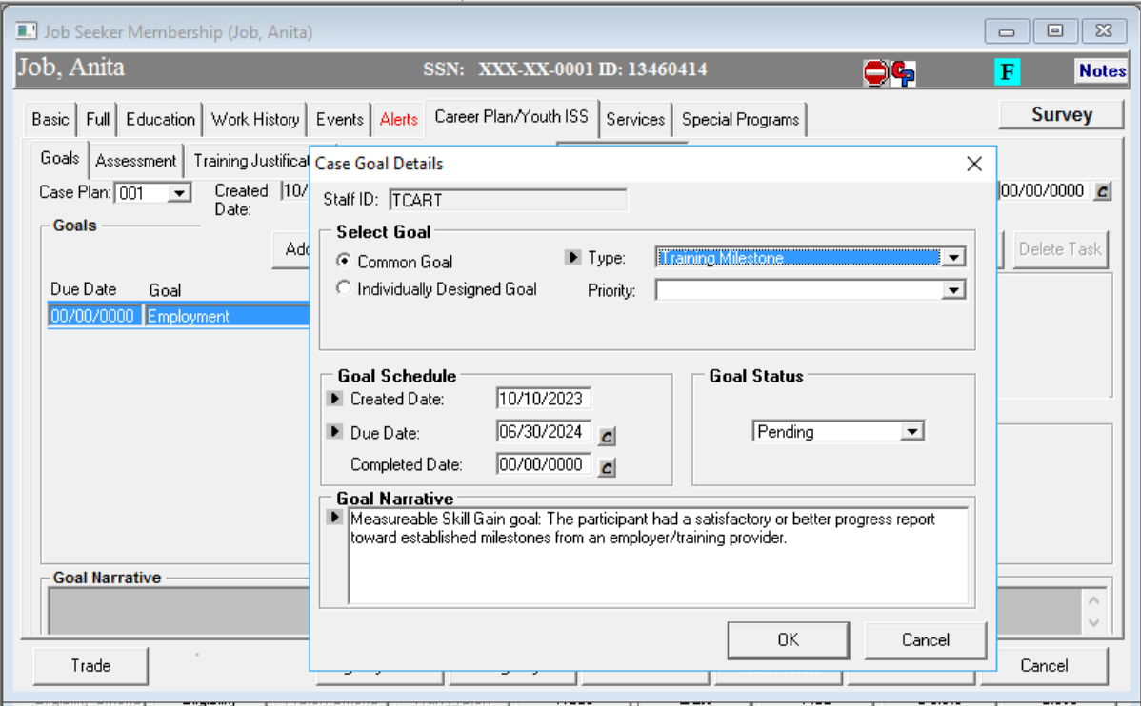
WIOA Performance Indicators Tracking Measurable Skill Gains
On the Career Planning tab:

Slide 22
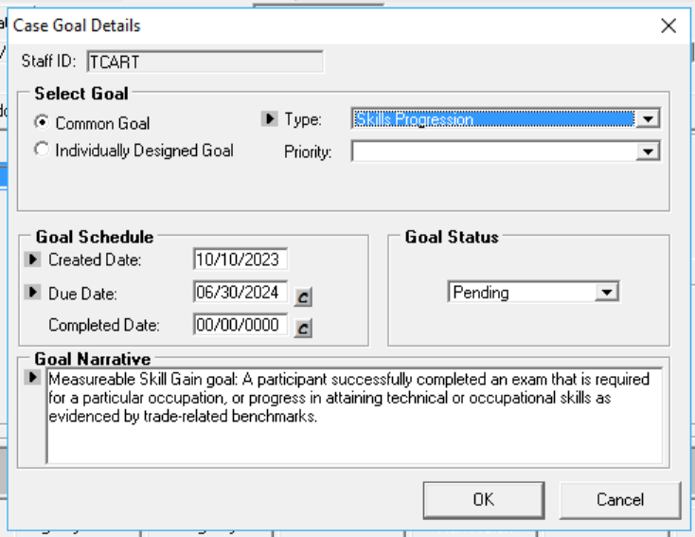
MOSES Mini Clinic

Slide 23
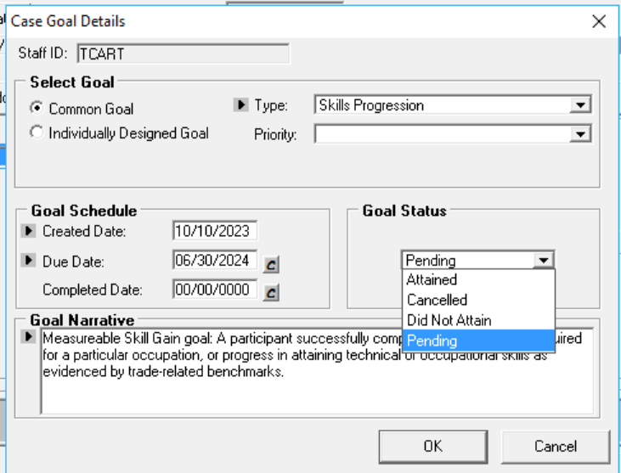
MOSES Mini Clinic
Select Appropriate Goal Status
For
Customer

Slide 24
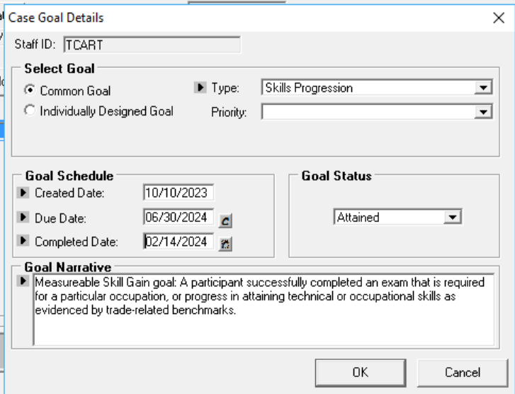
MOSES Mini Clinic

Slide 25
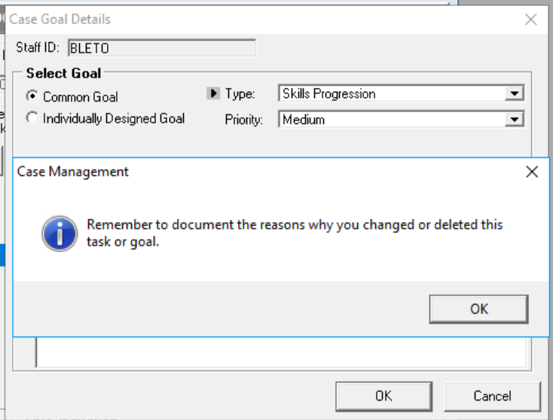
MOSES Mini Clinic
Add
A
Note
Reminder

Slide 26
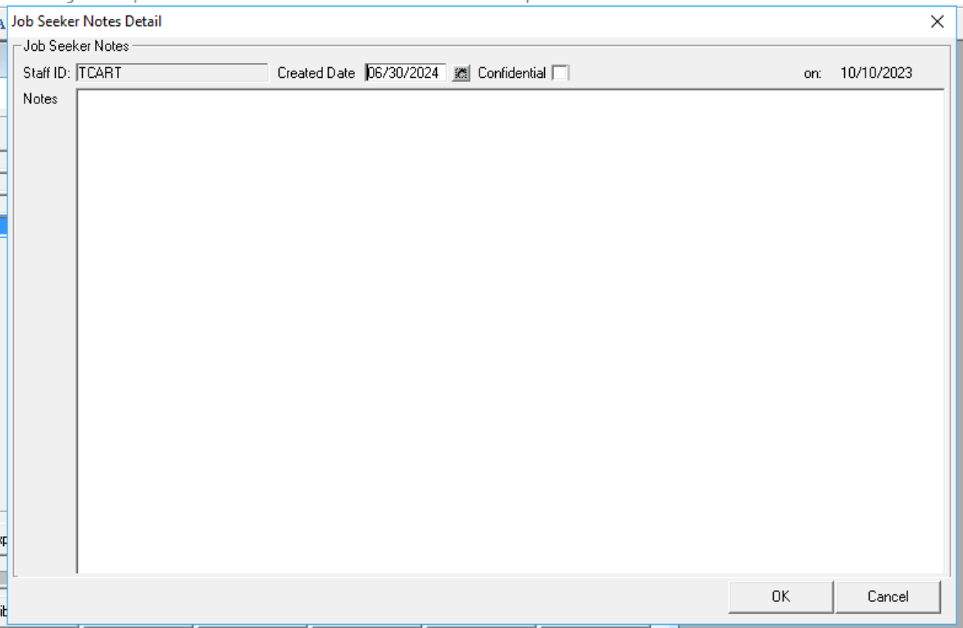
MOSES Mini Clinic

Slide 27
MOSES Mini Clinic
DATA ENTRY DATE SHOULD NOT EXCEED JUNE 30, 2024

Slide 28
WIOA Performance Indicators Measurable Skill Gains
DON’T FORGET:
When entering a Secondary Diploma/Equivalency MSG, you must add the High School diploma/equivalency attainment service on the General tab of MOSES!!!!
When entering an Educational Achievement MSG, you must add the pre and post test scores to the Testing tab of MOSES!!!
Set an MSG for each customer in training/education!!!

Slide 29
MOSES Mini Clinic
It is highly recommended all areas review Job Seekers MEASURABLE SKILLS GOALS and close out any goal that may have been entered in PY24.
Those customers enrolled in a Training program for PY24 are included in this performance measurement.
PLEASE update the customers GOAL STATUS in their Career Plan.
REMINDER PY24 ends JUNE 30, 2024.
Measurable Skill needs to reflect an accurate Status for this year.

Slide 30
MOSES Mini Clinic
Beginning in the new fiscal year (July 1, 2024) please ENTER a new and updated MESURABLE SKILLS GOAL for PY25, the Job Seeker Career Plan should reflect a new Measurable Skill Gain Goal for PY25.
Any old Measurable Skills Goals from the prior PY should be resolved / closed with the appropriate status.
A skill gain may count if attained after exit if still within the program year.

Slide 31
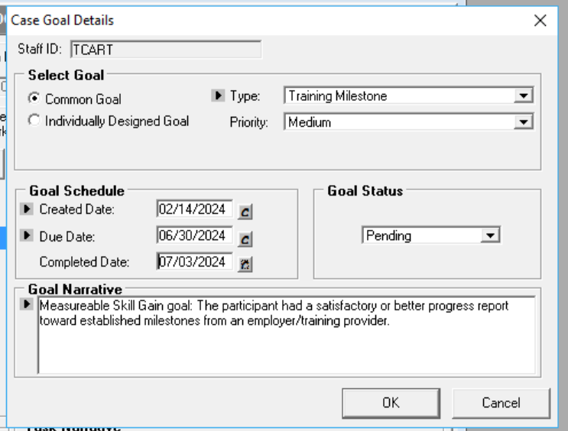
MOSES Mini Clinic
Late data entry will impact federal performance, mainly the Measurable Skill Gain metric.
Reminder this MSG will not be a positive outcome if it is entered after the prior PY dates.

Slide 32
MOSES Mini Clinic
The final federal report (PIRL) for a PY will be run over the second weekend of July (usually).
It is strongly recommended that career center staff conclude data entry for the PY, as best they can, prior to that weekend and back date the completion to June.
Late data entry will impact federal performance, mainly the Measurable Skill Gain metric.

Slide 33
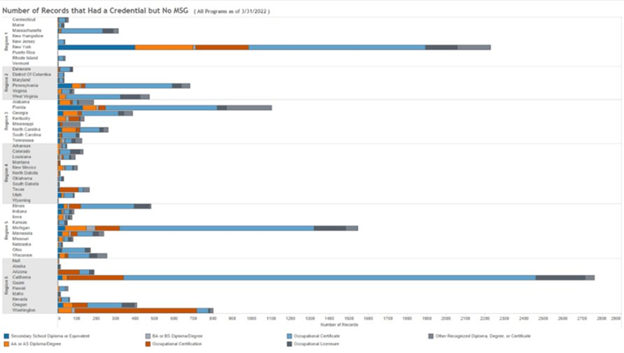
National Numbers of Records that had a Credential but NO Measurable Skills Goal

Slide 34
Questions?
?
?
?
Questions and Answers
?
?
?
?
?
?
?
?

