Slide 1
MOSES Mini Clinic Job Seeker Notes

Slide 2
Mission / Purpose
The purpose of Notes is to supplement information entered in MOSES, the Career Plan, and other places.
Notes entries should reflect the overall goal of helping the Customers to become employed and self-sufficient.
The goal is to provide both quality / substantial services and effective documentation of these services.

Slide 3
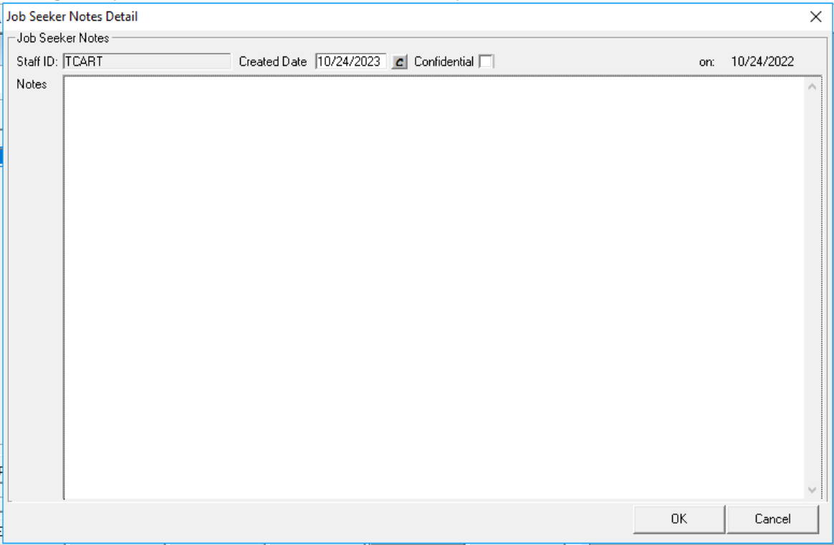
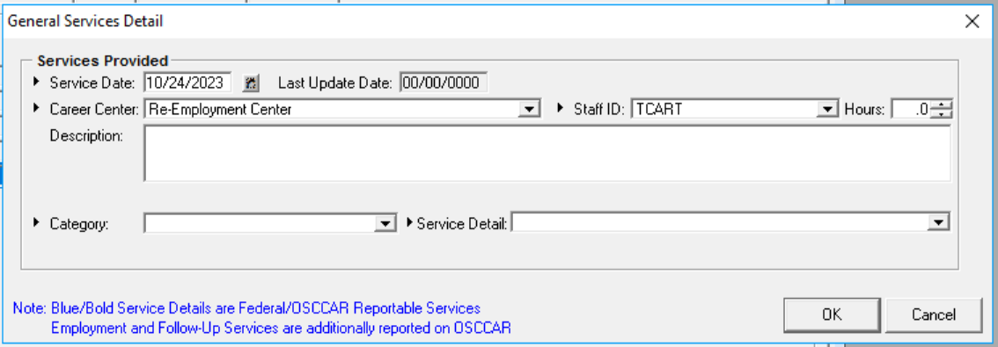
Basics
Notes in Notes
Notes in Services Description Box
255 characters
4,000 characters (about 2 single lined pages)
Preferred location
It need not be in both locations, unless it is required by LOCAL policy.
There is NOT a statewide NOTES policy. But programs may have NOTE Requirements / guidelines.

Slide 4
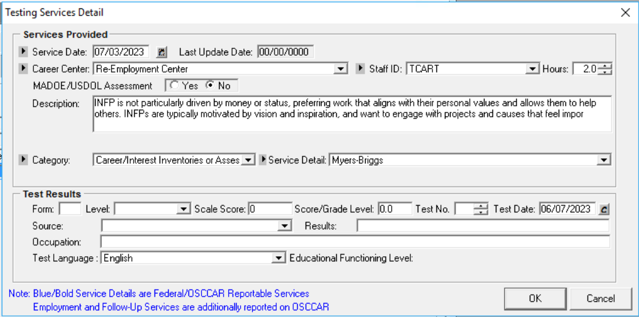
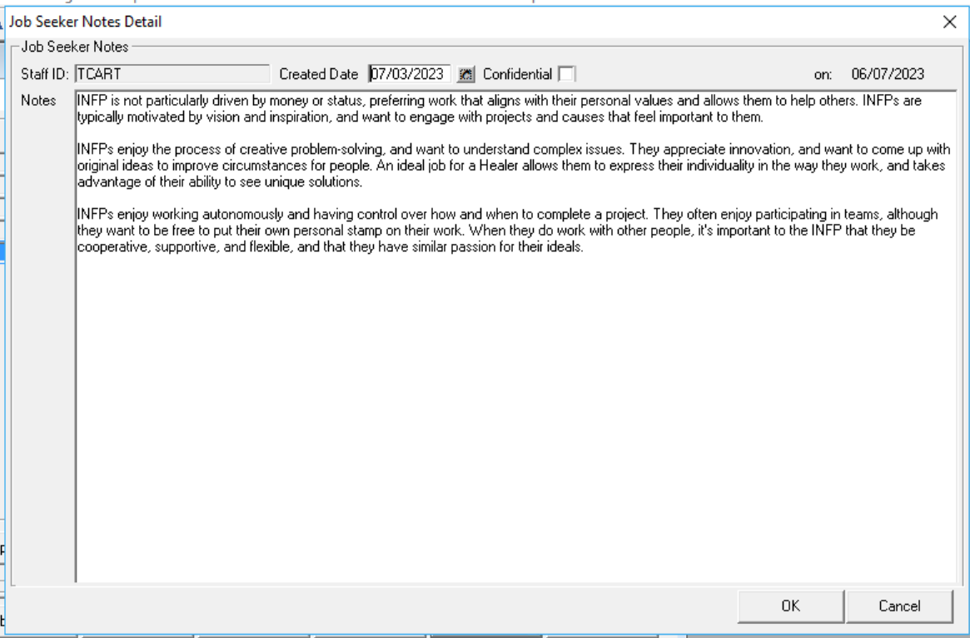
Size Matters & Location

Slide 5
Not Preferred Locations
See Folder
See Email

Slide 6
MOSES Rule
“If it is not in MOSES, it does not exist.”

Slide 7
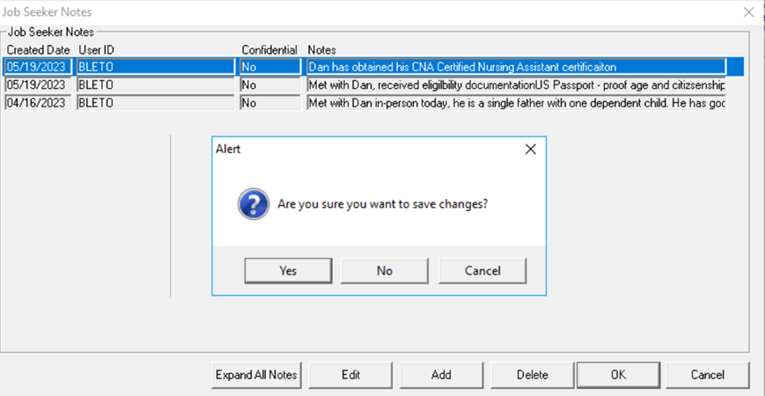
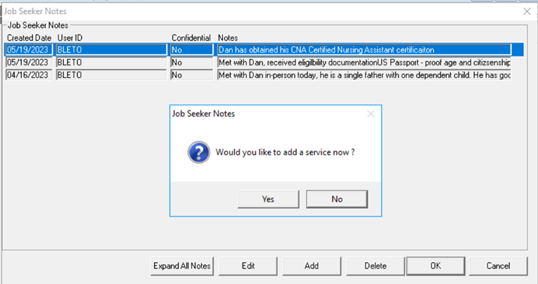
Short Cut / One Stop / Time Saver
In Notes

Slide 8
Time Limits / Backdating
Notes may only be backdated 30 days.
They can be later edited. The edited date will be reflected in the Note. (Last Modified Date: XX/XX/XXXX .)
All Notes must be documented in MOSES in a timely basis.
However, Notes can be edited, updated and completed later.

Slide 9
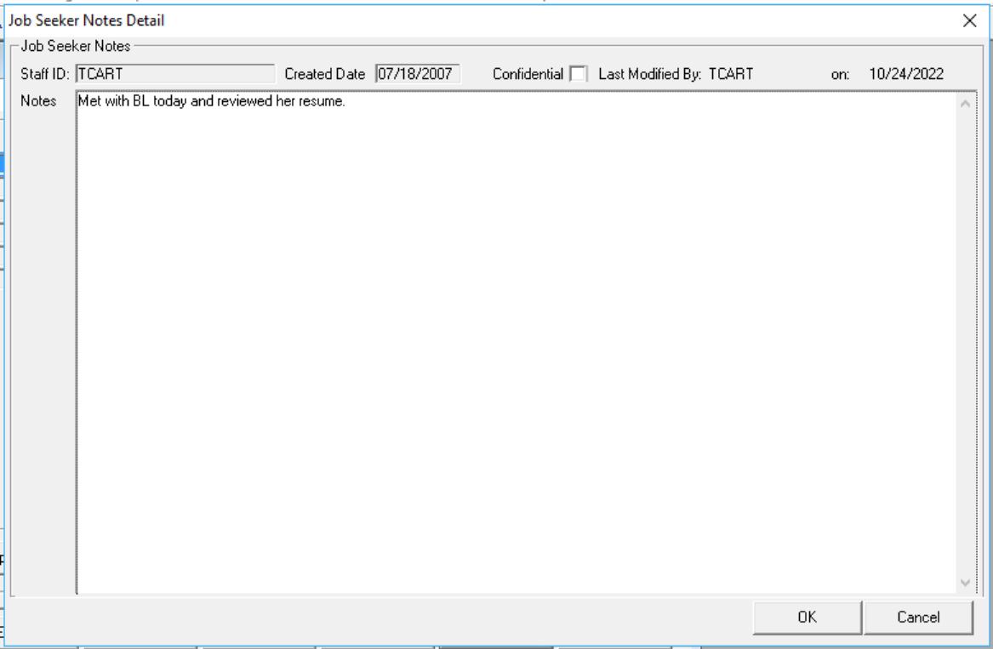
Edited Notes
New modified date

Slide 10
Time Limits / Backdating
Notes may only be backdated 30 days.
All Notes and Services must be documented in MOSES in a timely basis. (Standard Job Seeker Services can be backdated 60 days.)

Slide 11
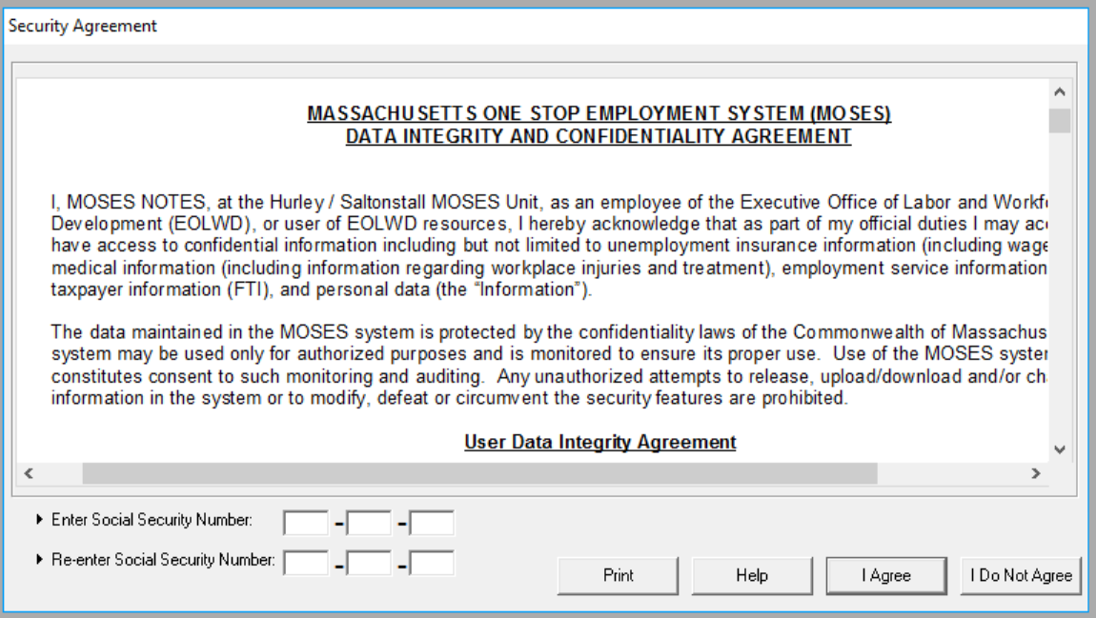
Confidential
Any Staff with Confidential Notes access can read notes. (Supervisors and above.)
Redundancy: Must agree to Confidentiality Agreement to access MOSES
Talk to your supervisor if you feel you need to enter a confidential Note.

Slide 12
Notes can be viewable to Customers
Under the Freedom of Information Act, , 5 U.S.C. § 552, MOSES and NOTES are considered public records.
Customers and/or other interested parties can request copies of these records.
Customers may ask about what you are writing or recording. You are allowed to share and explain why.

Slide 13
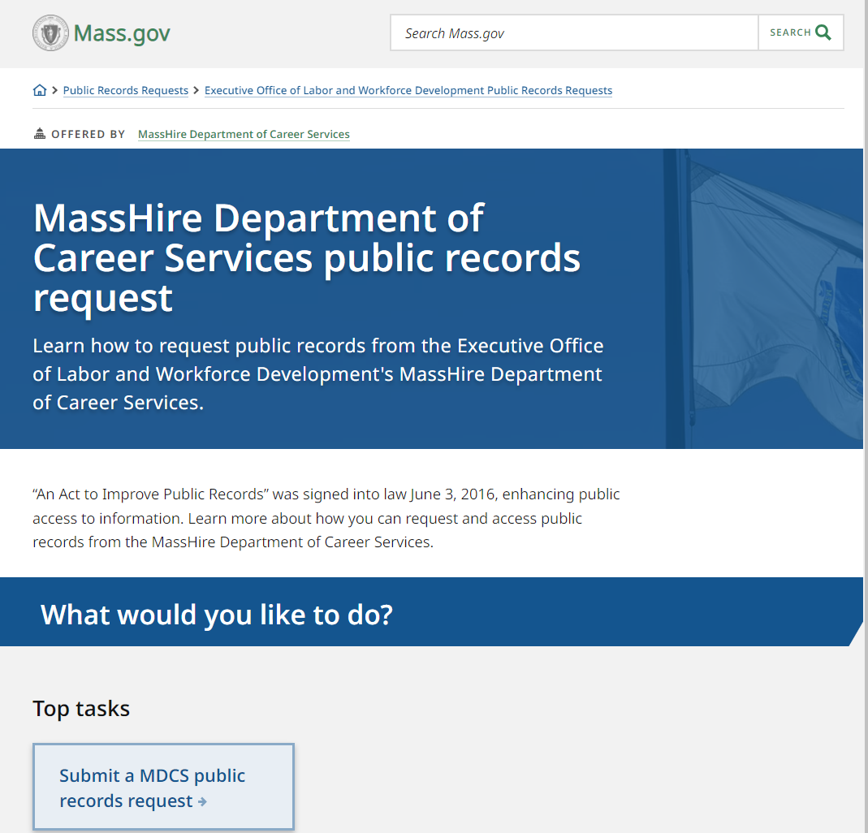
Public Records Request
On bottom of main MDCS home page on Mass.gov
https://www.mass.gov/masshire-department-of-career-services-public-records-request

Slide 14
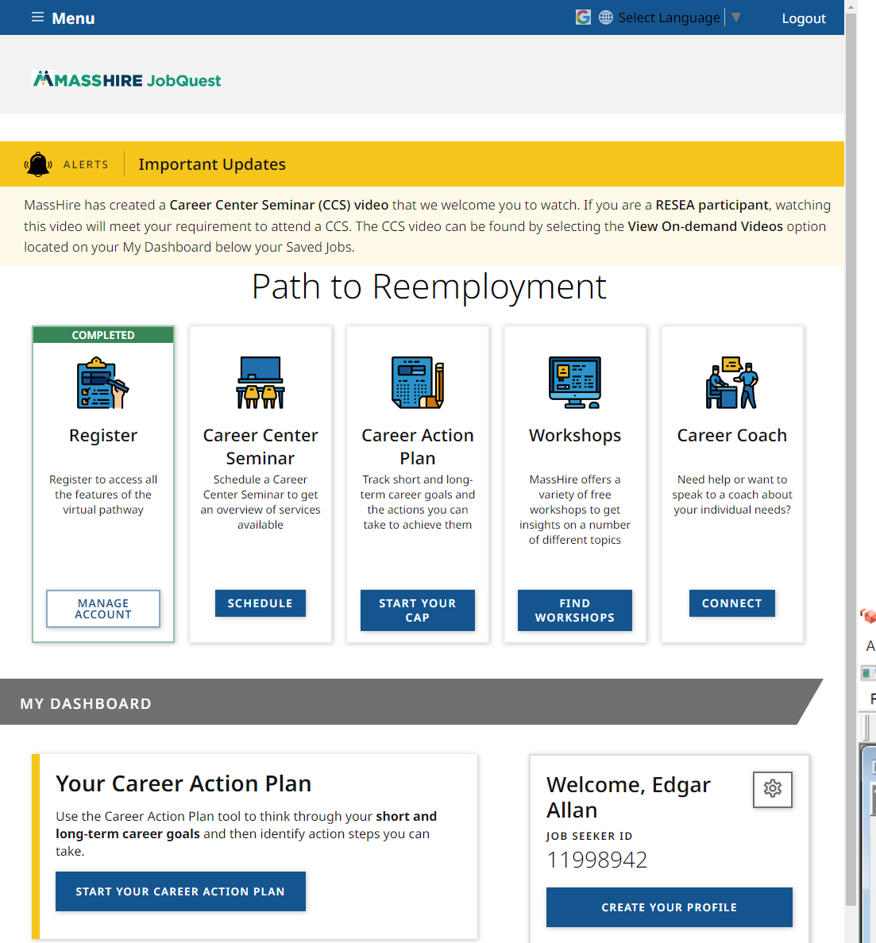
Public Records / JobQuest
Their JobQuest account contains most of their MOSES information.

Slide 15
Notes should…
Tell the entire story.
Be Factual, Observable, and / or Quotable.
Be Relevant to the work we do.
Contain employment and employment barrier resolution work.

Slide 16
Notes should…
Be clear and concisely written.
Demonstrate quality / substantial services were provided.
Not include hearsay or information not received directly from the Customer; unless you are recording what, you accept to be factual information from a vendor, and are quoting the source of information.

Slide 17
Basics
Notes shold be spelled correctly. Reminder, you can write your Notes in Word, spellcheck and then copy and paste them into NOTES.

Slide 18
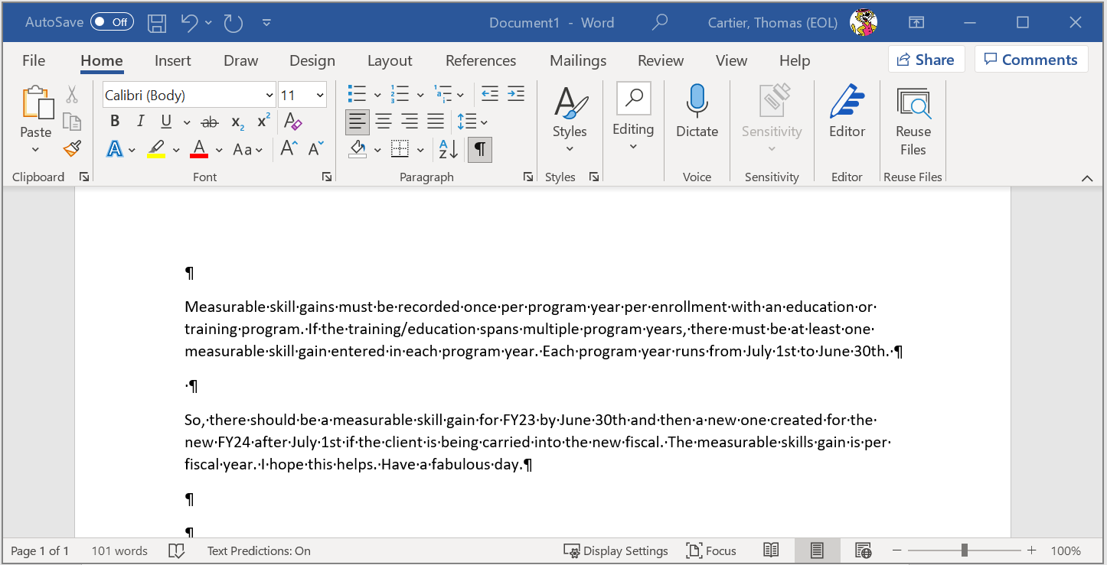
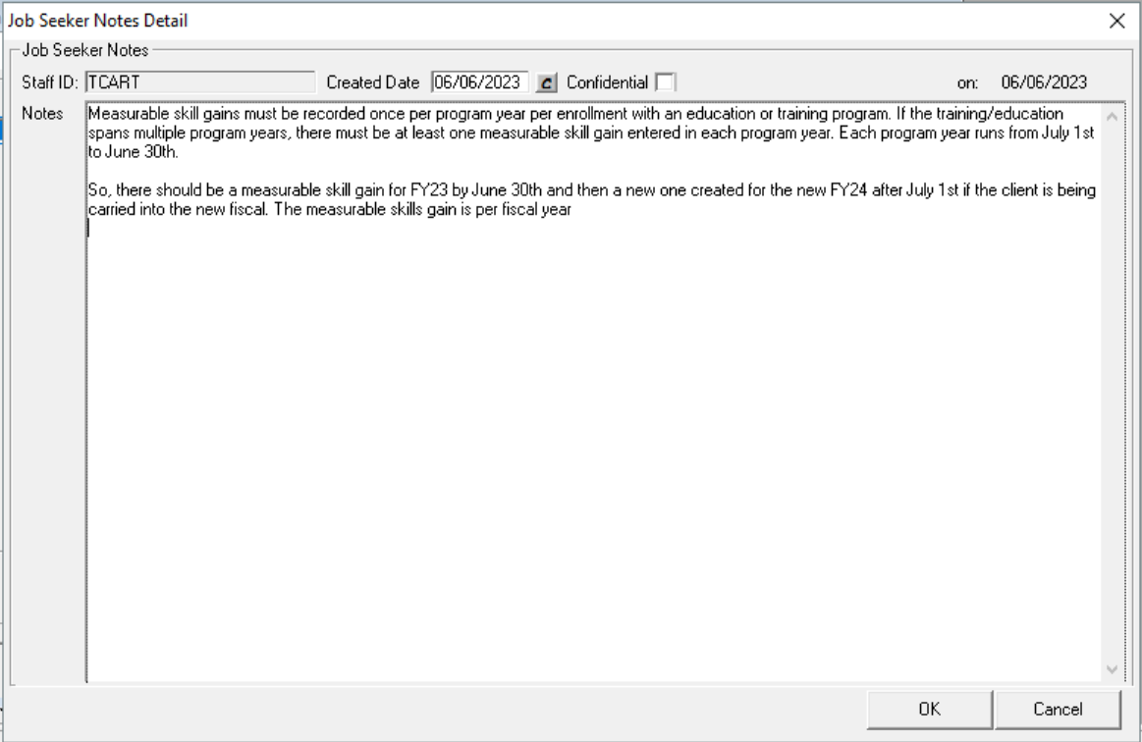
Write in Word / Copy in MOSES
Write in Word , copy into MOSES.
Some formats do not transfer well. (Text / HTML files for example).

Slide 19
Basics
Do not: etc. , i.e. , et al, and e.g. (abbreviate) words or programs. If you abbreviate the program, agency, or subject, then make sure that it is initially spelled out then abbreviated going forward. Slang Words / shorthand should never be used.
BCC , is it Berkshire Community College or Bristol Community College?
WTF is it Workforce Training Fund or Work Time Fun???
DOE is it the Department of Education or Department of Energy?
TAA is it Trade Adjustment Assistance or ???

Slide 20
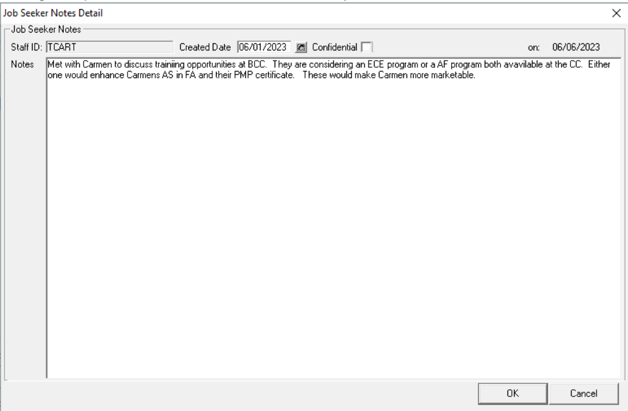
Do Not abbreviate words or programs

Slide 21
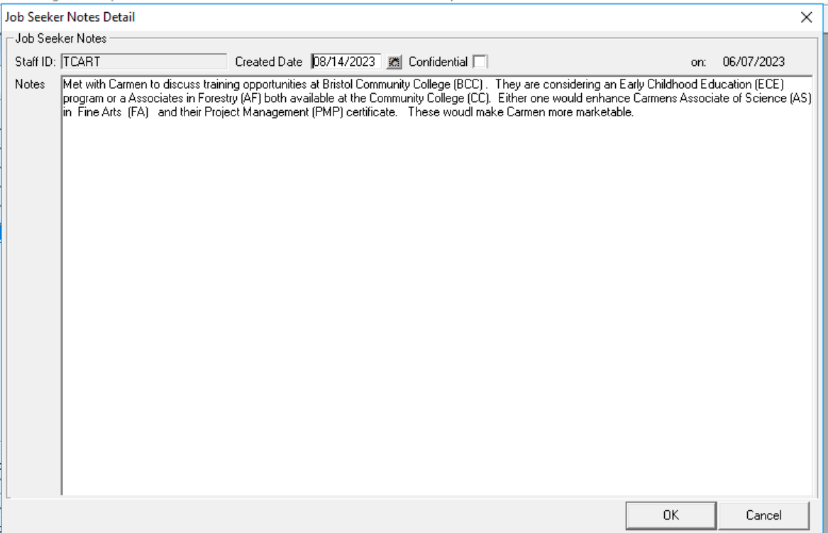
Without abbreviate words or programs

Slide 22
Basics
Do not: Use Slang Words should never be used.
Sic/Sick -Cool or sweet
Lit -Amazing, cool, or exciting
Dope -Cool or awesome
Basic - Boring, average, or unoriginal
Noob/n00b -A person who doesn't know what they’re doing or who is bad at something; in other words, a newbie
Hangry - Hungry and angry
Chill -Relax

Slide 23
Basics
Do not: Using shorthand / text should never be used.
cmb – Call me back
g2cu – Good to see you
omg – Oh my God
brb – Be right back
dkdc – Don’t know, don’t care
n/a – Not available or not applicable
vm – Voicemail
y? – Why?

Slide 24
Who, What, When, Where, Why, and How
Notes should answer the Who, What, When, Where, Why, and How questions
Who: Notes should address whether the contact was with the Customer him/herself, or a training vendor, or other individual.
What: Notes should describe the event or occurrence you are documenting.
When: Notes should address the date in which the contact or event you are documenting occurred.

Slide 25
Who, What, When, Where, Why, and How cont.
Notes should answer the Who, What, When, Where, Why, and How questions
Where: Notes should include the location of the meeting or event that you are documenting. (In person ? Virtual?)
Why: Notes should describe why the Customer is being contacted, or it should be implicitly obvious to the reader why the Case Note is being included.
How: Notes should address whether the contact was in person, via telephone , Zoom , Teams , WebEx , by e-mail, social media or another method.

Slide 26
Staff Identifiers
In writing Notes, consider using initials, MOSES ids or job titles instead of names.
Examples:
TC talked to Case Manager BL regarding training opportunities for customer. They reviewed the file.
Talked to PW at John F. Kennedy High school regarding getting a transcript for youth. PW said they would send it right over.

Slide 27
Attention to Details
Make sure you are recording the information in the correct Customer record.
Be consistent

Slide 28
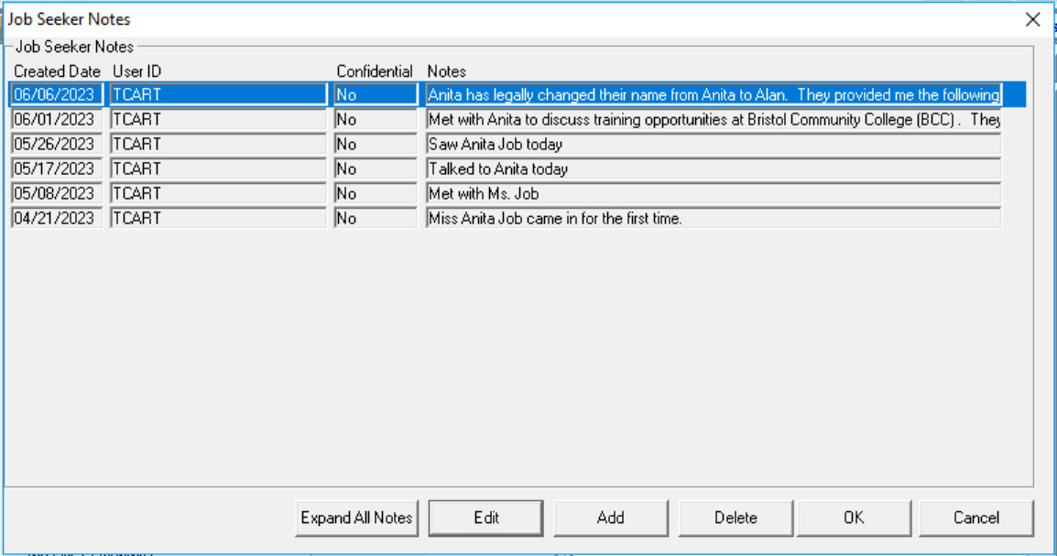
Attention to Details
Name / personal information updates / gender changes

Slide 29
Attention to Details
Write your note immediately after the event / interaction or as soon as possible to avoid forgetting details.
The pronoun (he/she) usage should match the gender of the Customer. Or be non-gender specific (they/them). Adhere to their requested pronouns.

Slide 30
Pronouns
He/Him/His,
She/Her/Hers,
They/Them/Theirs,
Ze/Hir/Hirs.
Using a person’s correct pronouns is essential to mutual respect, basic courtesy, and vital to supporting our coworkers, community of partners and customers. (Mass HRD – ODEO)

Slide 31
Copy and Paste faux pas
It is strongly recommended that Emails / written contacts should not be copied and pasted. Rather the preferred method is that the email should be summarized with the pertinent applicable information mentioned.
Emails / written contact may contain irrelevant information
Too long (multiple emails in one)

Slide 32
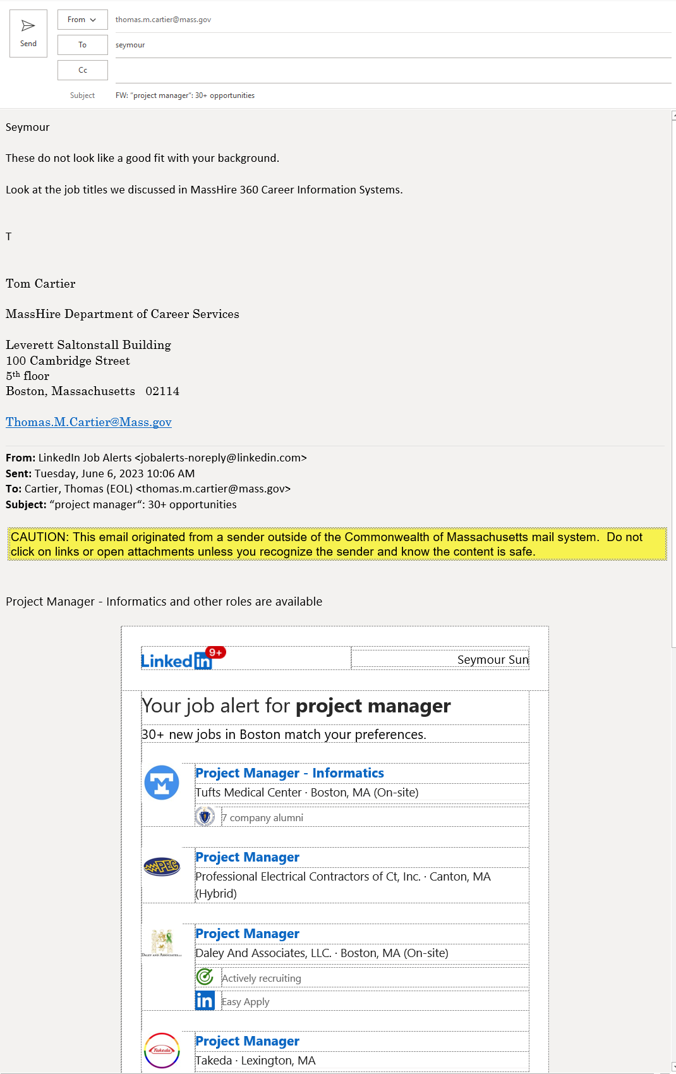
No to Emails
Too much and too many emails strung together.
Prefer brief recap of email in NOTES.

Slide 33
Social Media Notes
All communications conducted with a job seeker or youth customer through email, or any social media must be recorded in MOSES and the appropriate Service entered on the correct Service tab.
Each entry must be accompanied by a Note in the MOSES Notes section that documents the date of the communication and a summary of the content of the communication exchange.
How the summary of information was received must be included in the Note; type of social media: (Email, Facebook, Instagram, Twitter, Zoom, LinkedIn, Snapchat, WeChat, WhatsApp, etc.)

Slide 34
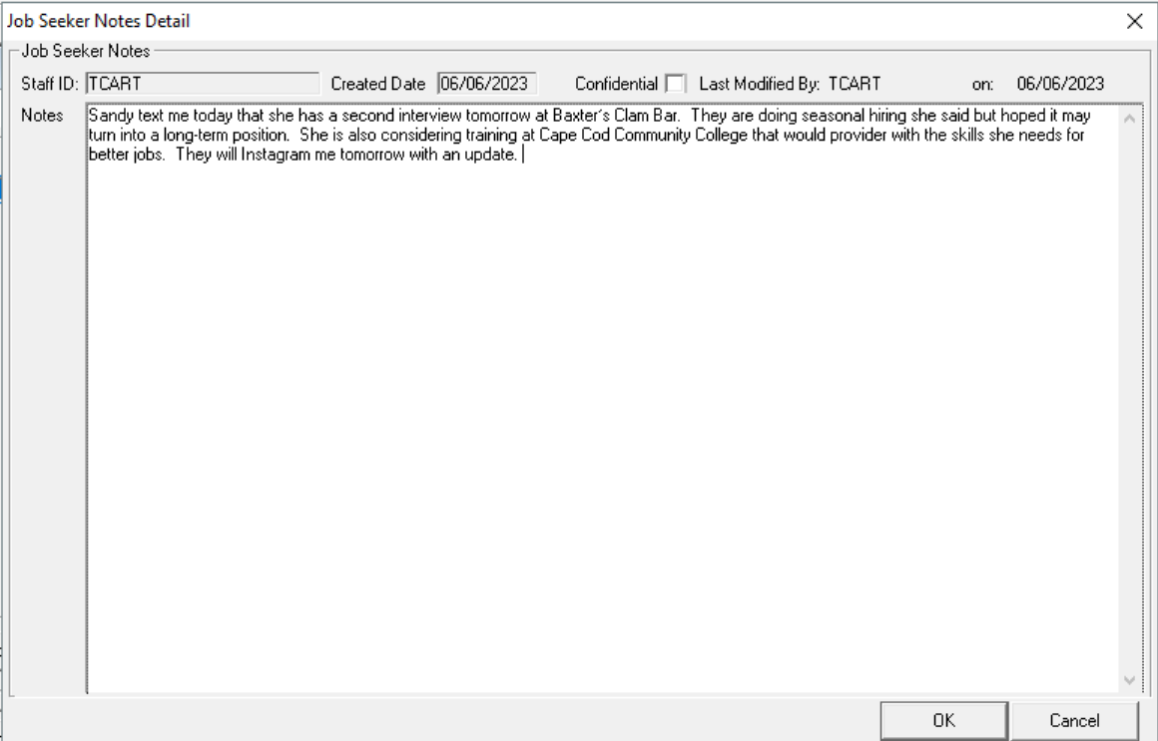
Social Media

Slide 35
Common Problems
Inappropriate Customer information included in MOSES.
Inappropriate information about OSCC included in MOSES; i.e., Manager refused to approve training request.
Case Workers expressing frustration with Customers in MOSES.
Inadvertent appearance of bias; i.e., mentioning ethnicity, race, age, gender, sexual orientation, etc., in Notes.

Slide 36
Common Problems cont.
MOSES Notes are too lengthy and contain unnecessary information.
MOSES Notes are too brief and do not contain adequate information.

Slide 37
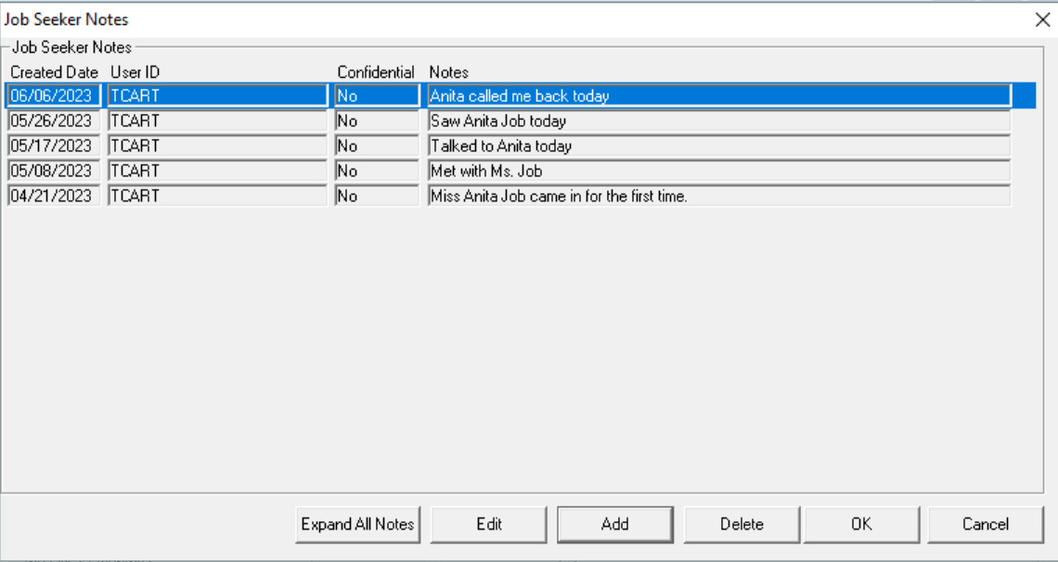
Notes are too brief

Slide 38
Common Problems cont.
Lack of 30 or 60-day contact documented in MOSES.
No follow-up included in Notes.

Slide 39
Follow Up
If the follow-up is not documented in Notes, then it gives the appearance that the One Stop Career Center staff might not have followed-up with the Customers.

Slide 40
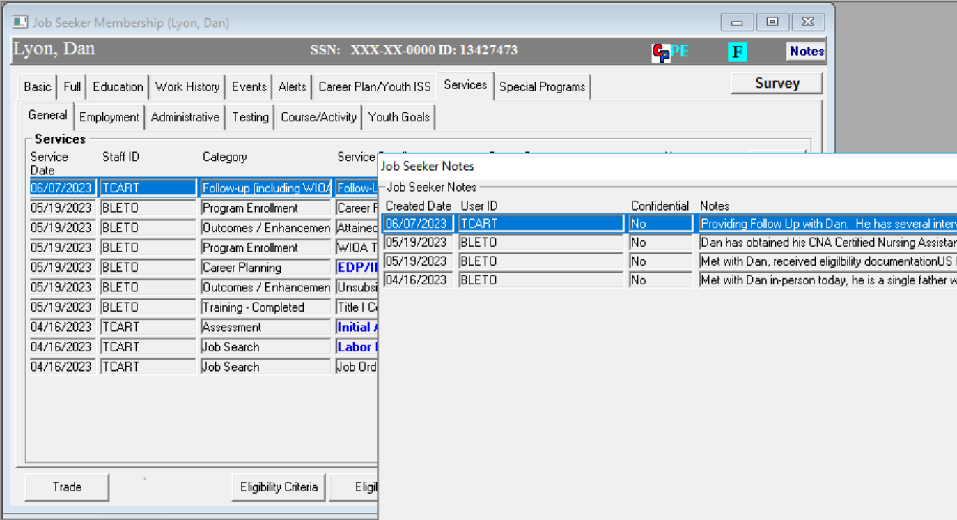
Notes in Sync
Services Provided should have a corresponding Note detailing the interaction.

Slide 41
Timely Manner
Record all appropriate status and/or outcome data and information garnered from Customer contact in a timely manner using Notes for documentation.

Slide 42
Common Problems cont.
Left Message being counted as an actual Customer contact / interaction. (Not a blue service (General Service) , rather an Administrative Service.)
No next steps or action plan listed. When is the next meeting? Does the customer need to research training or supply more documents?

Slide 43
Keep In Mind
Notes should follow
your local office standard practices,
requirements and regulations.
(or program requirements.)

Slide 44
Mandated Reporters
What is a Mandated Reporter? A mandated reporter is a person who, because of their profession and work with protected populations, is legally required to report any suspicion of abuse, endangerment or neglect to the relevant authorities.
Protected classes are:
Youth
Disabilities
Elderly / Older individuals
Other persons who are not mandated to report may choose to file reports of suspected harm. Consult with your supervisor before hand.

Slide 45
Other Things to Consider
Make sure Notes entries into MOSES reflect the overall goal of helping the person to be employed and self-sufficient.
Notes should not include hearsay or information not received directly from the Customer; unless you are recording what, you accept to be factual information from a vendor / partner and are quoting the source of information.

Slide 46
Remember………….
The purpose of Notes is to supplement information entered in MOSES, the Career Plan, and other places.
Notes entries should reflect the overall goal of helping the Customers to become employed and self-sufficient. **
The goal is to provide both quality / substantial services and effective documentation of these services.

Slide 47
Finally (again)
Notes should follow
your local office standard practices,
requirements and regulations.
(or program requirements.)
There is NOT a statewide NOTES policy. But programs may have NOTE Requirements / guidelines.

Slide 48
?
?
?
Questions and Answers
?
?
?
?
?
?
?
?

