Slide 1
Move-In MA Municipal Overview
August 12, 2026

Slide 2
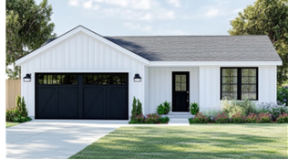
Move-In MA Overview
A novel approach to build new single family homes for first-time home-owners in communities where attainable new construction is often challenging without significant subsidy
Mirrored after ‘Move-in New York,’ CrossMod homes are 1500 sq ft 3 bedroom homes, but cost less to build than traditional construction
MassHousing is launching an initial pilot for around 20 homes, with the goal to grow the program over time if it is successful

Slide 3
Why we are doing this program
In 2021, WBUR estimated that 30% of renters were able to afford to buy an entry-level home. By 2025, that number had dropped to about 15%.
In 2025, Massachusetts ranked 47th out of 50 states, or 4th-lowest in the U.S., at about 174 new housing units permitted per 100,000 residents​
In an increasingly large portion of the state, the cost to build new housing exceeds the appraisal value and so little new housing is built
Over 180,000 Massachusetts have left for other states in the past 6 years, with 25-44 year olds leaving at the fastest rate

Slide 4
Goal: use state financing to spur construction that communities want
MassHousing puts out a formal RFP for developers to build this housing
MassHousing provides a no interest loan to a developer with site control and a formal letter of municipal support
The developer completes site prep and builds a CrossMod, modular, or other cost-effective starter home
The developer will then sell the home to at a particular income level, targeting incomes of 70-130% AMI
Proceeds from that sale (or a portion thereof) are returned to MassHousing. Those funds can then be used to support further development through the program.

Slide 5
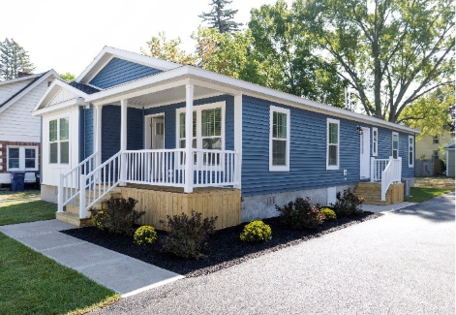
What is a CrossMod?
A CrossMod is a permanently-affixed, HUD Code ‘manufactured home.’
It has nicer architectural features and higher-quality construction materials compared to a typical manufactured home.
It can be appraised as a traditional home and titled as real property, appreciates at a similar rate, and is eligible for FHA-backed mortgage lending products.
To qualify for a mortgage, units typically need to be 3 bedrooms, 2 baths, and 1500 square feet with a stick built garage​.
Energy efficient and can be all-electric.
Modular or other cost-effective housing approaches are also being considered​

Slide 6
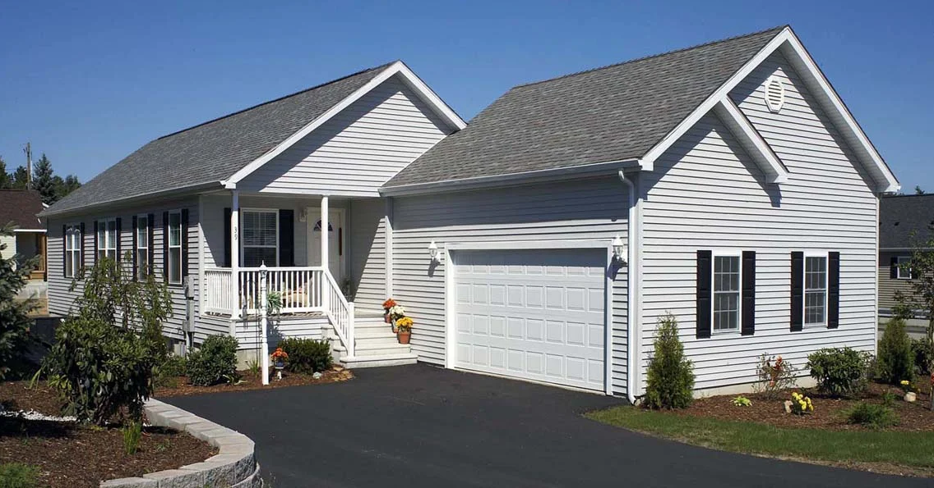
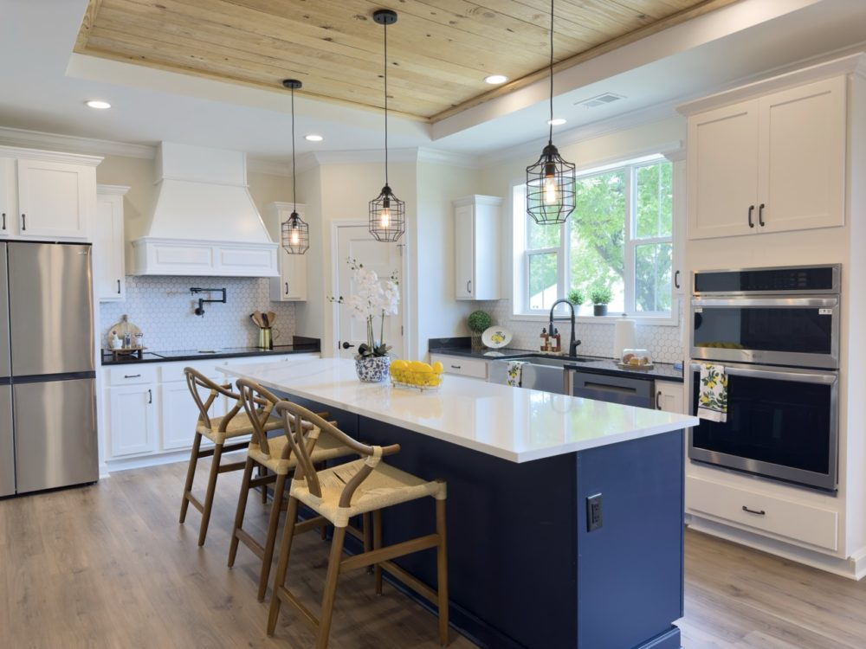
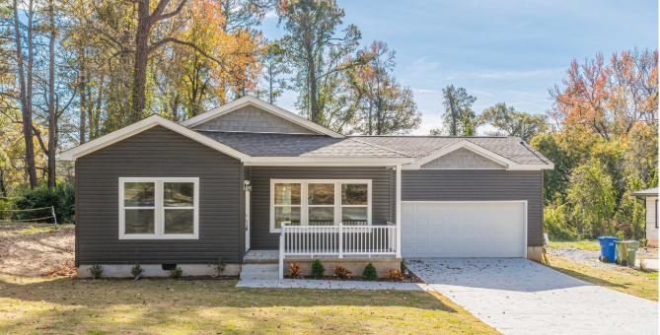
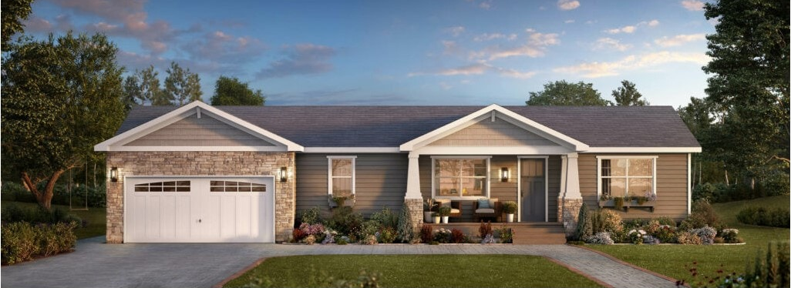
CrossMod photos

Slide 7
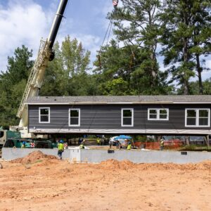
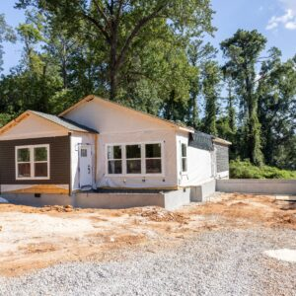
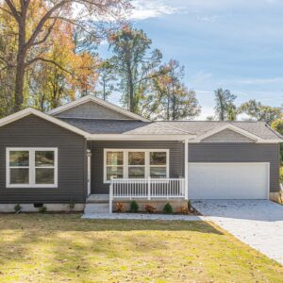
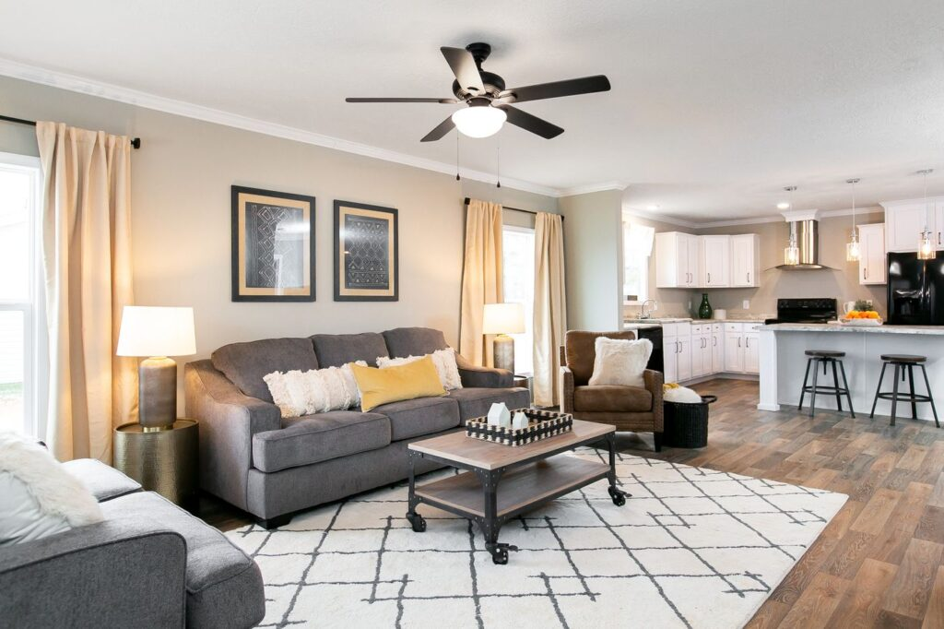
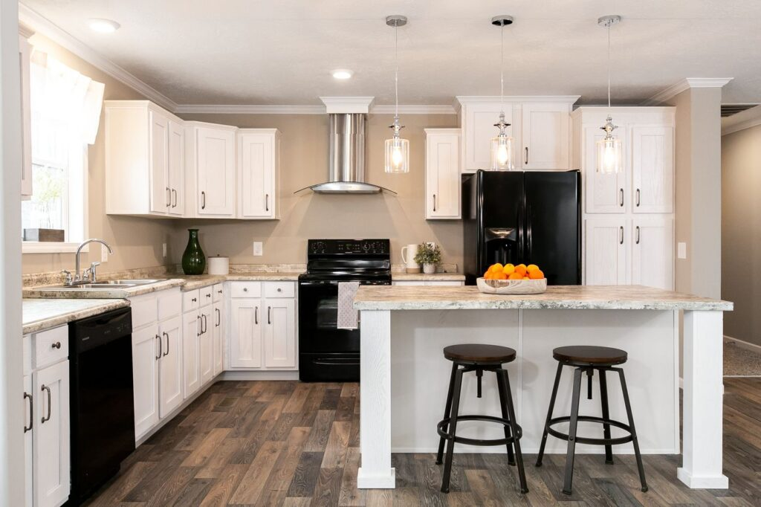
CrossMod Installation

Slide 8
How we want to partner with municipalities
Determine if this program is something your community might be interested in
Identify promising sites, either owned by the municipality or a private entity for this type of project
Consider whether the municipality or affordable housing trust would want to add additional subsidy to make units more deeply affordable or affordable for a longer period of time
Reach out to local developers who may be strong partners for this work
Submit an RFI here by August 28th to show demand!

Slide 9
Site prioritization
HLC is most interested in learning about sites where acquisition, infrastructure, and site preparation needs are less than $25,000-50,000 per home built.
  This could include site grading, septic installation, well installation, utility hookup extensions, or other similar infrastructure improvements needed to make the site ready for a foundation
HLC seeks sites where a developer could have site control within 3 months of being awarded financial assistance, either through a private sale, land donation, or existing ownership.
HLC seeks to prioritize sites where at least 5 homes could be installed on the same site or adjacent sites, to save on labor and logistical costs.

Slide 10
Likely program timeline
August 2026
HLC municipal RFI
MassHousing RFQ engagement
September/ October 2026
Formal RFP launch
Early 2027
MassHousing closes financing with developers of homes
Summer / Fall 2027
Give keys to new occupants and consider program expansion
Program timeline

Slide 11
Questions?

