Slide 1

Moving forward through partnership

Slide 2
How many people in audience….
  Heard a WIOA 101 Presentation in the last year?
  Read the new regs (4,000+ pages)? State Plan (400+ pages)?
  Did a webinar last week on WIOA and the State Plan?
  Are on a regional MOU team?
  Can articulate the top 2-3 things that WIOA will change? In your region?
  Believe there is OPPORTUNITY to get more out of the “system”?
  Feel you know what to focus on going forward?
  OBJECTIVE TODAY

Slide 3
Status Check: Where are we now?
WIOA Combine State Plan – approved
Historical opportunity to leverage strength of Massachusetts delivery systems
  350+ participants today crossing 15 Secretariats/state agencies focused on the new workforce law.
Implementation Phase – New joint policies and practices

Slide 4
What does implementation mean?
  Workforce Boards & Partners: Team Building - MOUs
    Demand-Driven
    Integrated Services Aligned with Career Pathways
    Comprehensive One Stop Career Centers, Shared Costs, Infrastructure Costs
  One-Stop Career Centers Competitive Selection
  Regional Planning (Workforce Skills Cabinet)
  Youth Strategies – Vocational Rehabilitation and WIOA Title I Youth
  TANF/SNAP Planning
  Career Center Branding
  Data and outcomes across systems
….What?

Slide 5





It’s okay to be overwhelmed….

Slide 6

STATE VISION: BREAK IT DOWN
BUILD A TEAM IN THE REGION TO CREATE:
  DEMAND-DRIVEN FRAMEWORK
  INTEGRATED, CUSTOMER-CENTERED MODELS
  CAREER PATHWAYS FOR PRIORITY POPULATIONS
  IMPACT

Slide 7
MA WIOA VISION STATEMENT
All Massachusetts residents will benefit from a seamless system of education and workforce services that supports career pathways for individuals and leads to a more informed, educated, and skilled workforce, which meets the Commonwealth’s businesses’ demands and sustains a thriving economy.

Slide 8
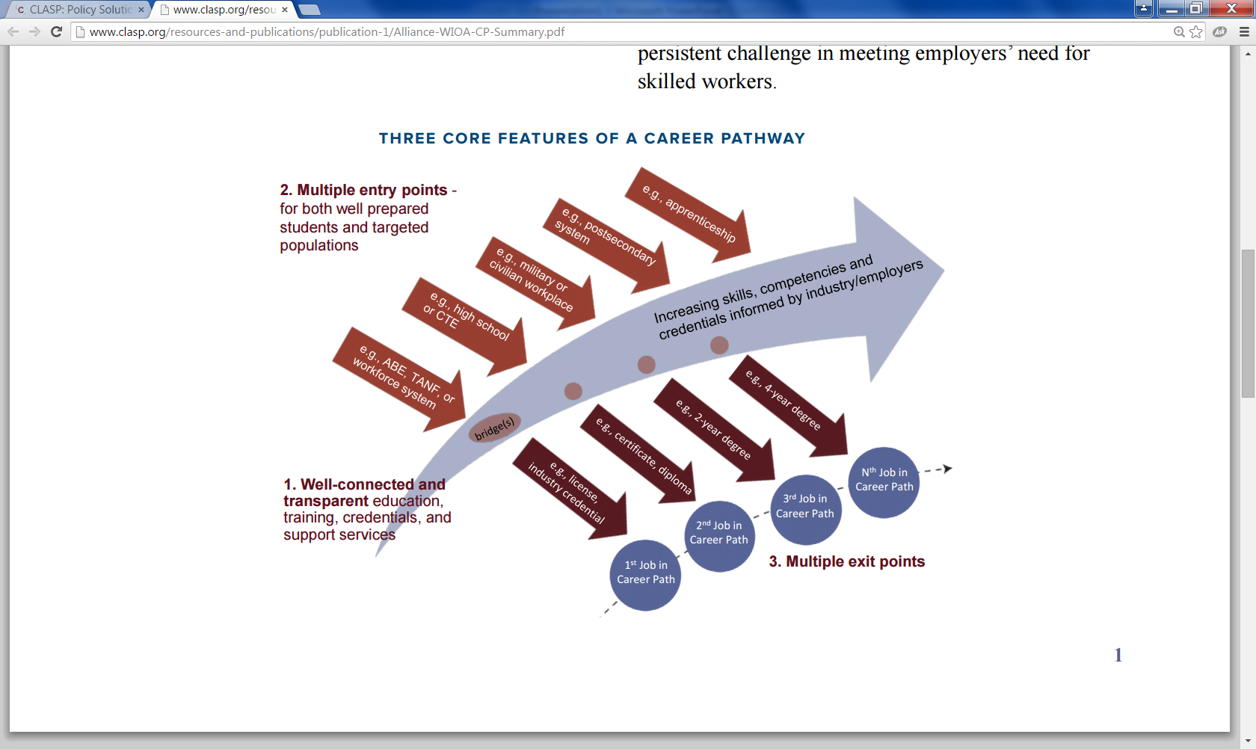
CUSTOMER-FOCUSED CAREER PATHWAY MODEL: CROSS SYSTEMS
CLASP GRAPHIC: http://www.clasp.org/resources-and-publications/publication-1/Alliance-WIOA-CP-Summary.pdf

Slide 9
Integrated Services with Career Pathway
Entry Level
Health Care
Mid-Level
Health Care
Advanced
Health Care
Apprenticeship
Post-Secondary Credentials
HiSet/ ESOL
Sector Model
On-the-Job Training
Skill & Career Assessment/ ITAs/ Job Placement
Free Adult Education
Transition / Pell Funding
Income Support, Child Care, Transportation
Community College
TANF
One Stop Career Center
ACLS

Slide 10
OSCC MANDATED FUNDING PARTNERS
The Adult Program (Title I of WIOA), as part of the Department of Career Services (DCS), Executive Office of Labor and Workforce Development (EOLWD);
The Dislocated Worker Program (Title I), as part of the Department of Career Services (DCS), EOLWD;
The Youth Program (Title I), as part of the Department of Career Services (DCS), EOLWD;
The Adult Education and Family Literacy Act Program (Title II), as part of Adult and Community Learning Services (ACLS), Department of Elementary and Secondary Education (DESE) Executive Office of Education (EOE);
The Wagner-Peyser Act Program (Wagner-Peyser Act, as amended by Title III), as part of DCS, EOLWD; and
The Vocational Rehabilitation Program (Title I of the Rehabilitation Act of 1973, as amended by Title IV), as part of the Massachusetts Rehabilitation Commission (MRC) and Massachusetts Commission for the Blind (MCB), Executive Office of Health and Human Services (EOHHS).
Federal-state unemployment compensation program, as part of the Department of Unemployment Assistance (DUA), EOLWD;
Trade Adjustment Assistance for Workers Programs (Activities authorized under chapter 2 of Title II of the Trade Act of 1974 (19 U.S.C. 2271 et seq.)), as part of DCS, EOLWD;
Jobs for Veterans State Grants Program (Programs authorized under 38, U.S.C. 4100 et. seq.) as part of DCS, EOLWD;
Temporary Assistance for Needy Families Program (42 U.S.C. 601 et seq.) as part of Department of Transitional Assistance (DTA), EOHHS; and
Employment and Training Programs under the Supplemental Nutrition Assistance Program, (Programs authorized under section 6(d)(4) of the Food and Nutrition Act of 2008 (7 U.S.C.2015(d)(4)), as part of DTA, EOHHS.
Senior Community Service Employment Program (Programs authorized under title V of the Older Americans Act of 1965 (42 U.S.C. 3056 et seq.))
Programs authorized under the Second Chance Act of 2007 (42 U.S.C. 601 et seq.)

Slide 11
VOLUNTARY ORGANIZATIONAL PARTNERS
Business
Economic Development
K-12
Vocational Technical Schools
Higher Education, Community Colleges
Housing Organizations
Veteran’s Organizations
Community-Based Organizations
Cities and towns

Slide 12
YOU CAN’T DO IT ALONE: PARTNERSHIP
Business:
Employment/Wage Outcomes and Ultimate “Customer”
Non-Profit/ Community-Based Organization: “Human Scale” Organization
Public Sector: “Large-scale” Organizations (e.g. Community College, Boards, Career Centers, etc.)
Why?
Labor Market Premium on Credentials
Coordinated, Unified Response to Business
Cliff effects: Integrated Support & Service
Funding – DOWN NOT UP
Notes:
If you use this one – include ABE

Slide 13
COLLABORATION:
An unnatural act between unconsenting adults.
- Jocelyn Elders

Slide 14

So what do we do?

Slide 15
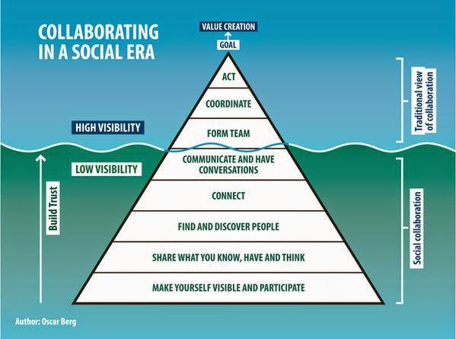

Slide 16



CHANGE-MAKING CONDITIONS
The focus is on change-making conditions and not the minutia of WIOA.
PARTNERSHIP LESSONS
From last year (and the experts):
CHOICE
TEAM
TOOLS

Slide 17

CHOICE

Slide 18
MANDATE VERSUS CHOICE
DEFINITION OF TRUST (Charles Feltman)
  Choosing to make something important to you vulnerable to the actions of someone else.
IT IS THE SMALL MOMENTS (Brene Brown and many other researchers).
  Consistent behavior (marble jar friends)
  Own mistakes AND call out concerns
GENEROSITY
  Old habits, “building the ship in the middle of the ocean” and 1,000 other reasons to not make assumptions.
  The work is hard. High Need, High Stakes Resources

Slide 19


Slide 20


Slide 21
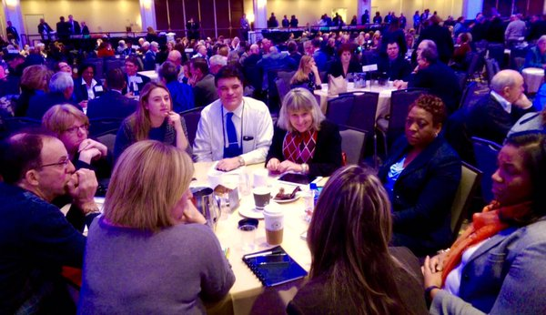
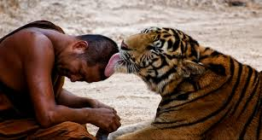
Can you build trust quickly?
Portion of MA WIOA Team in DC at national WIOA convening

Slide 22
DAVID SAWYER & DAVID EHRLICHMAN

Slide 23
TACTICS OF TRUST: KEY POINTS
Know why you are in the game.
Articulate the specific “needs” your organization (you) have to advance.
Identify what you are willing to contribute, share, give up, pay for or do differently to meet that need.
Find common ground.
Understand why each person/ organization is at the table.
Why are they in the game?
Drop past history and stereo types. Try to hit reset.
Layout information (needs and contributions), reframe from “user” end, NOT on TURF.
What are you going to do for me?

Slide 24

TOOLS

Slide 25
FEDERAL RULES
STATE RULES
LOCAL RULES
INNOVATION

Slide 26
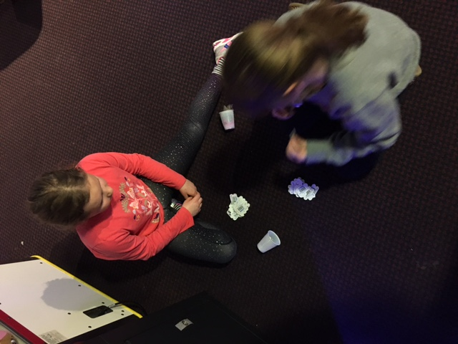
TOOLS
DIVERSE THINKERS: The same conversation with the same inputs will not produce new results.
Diverse team members, customers, community etc.
INFORMATION:
On Shared Customers
On Resources
PEOPLE AND TOOLS TO MAP STUFF:
Vision & Systems
Customer Flows
Assessment, referrals and data
Notes:
CAREER READY STATS – 20,000 USERS

Slide 27
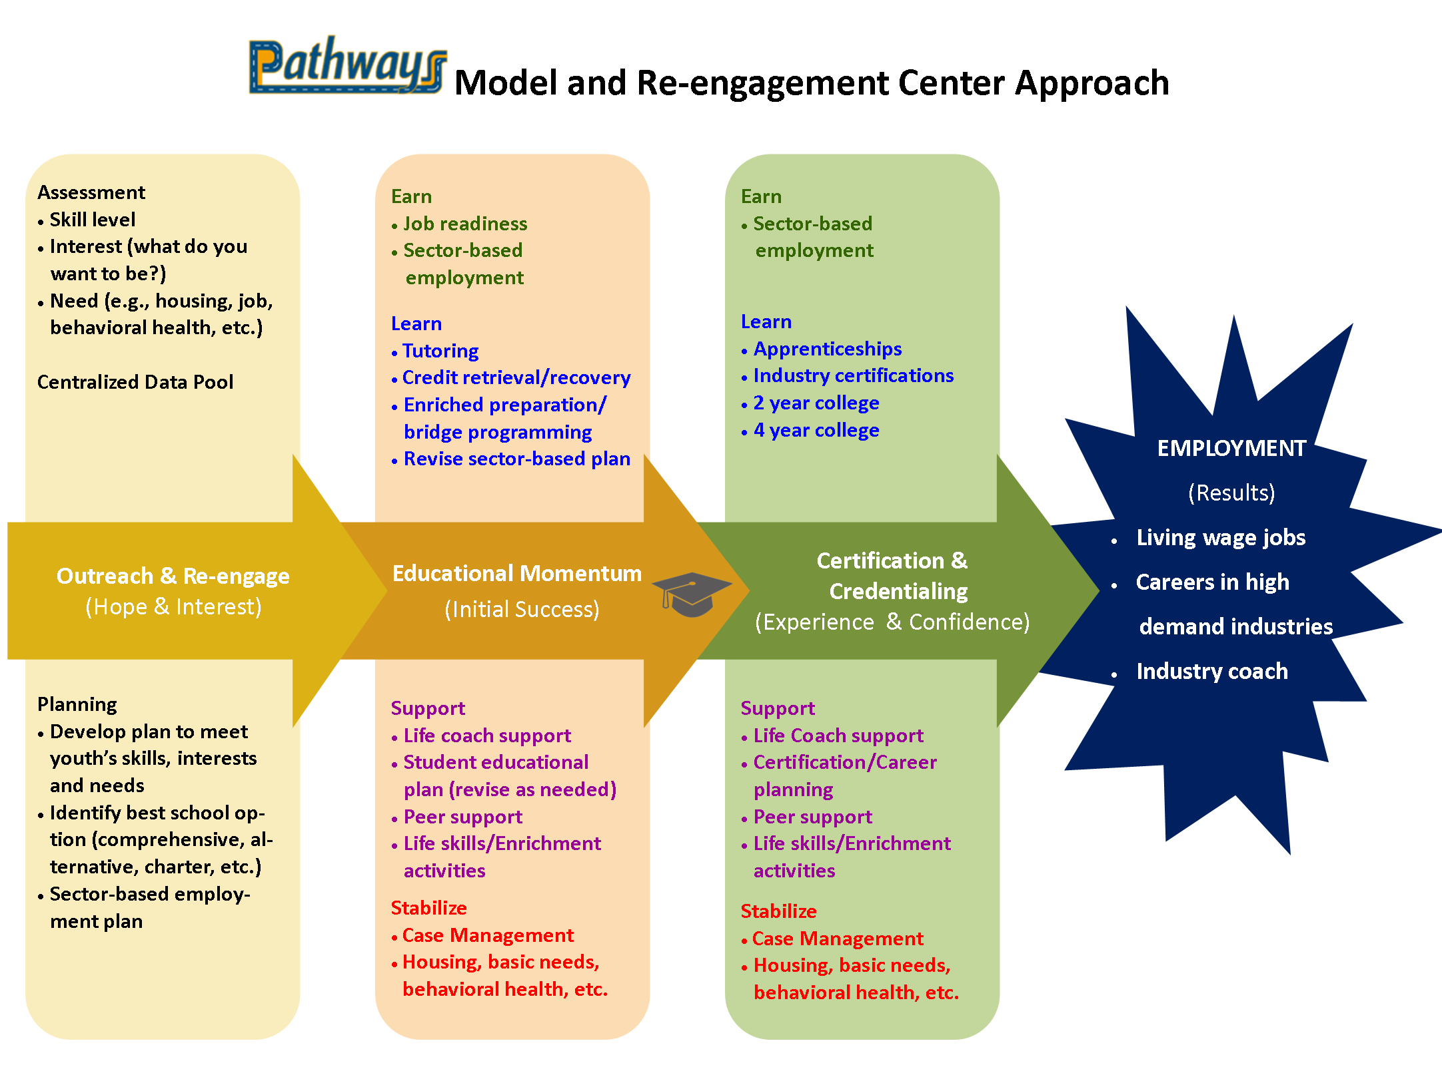
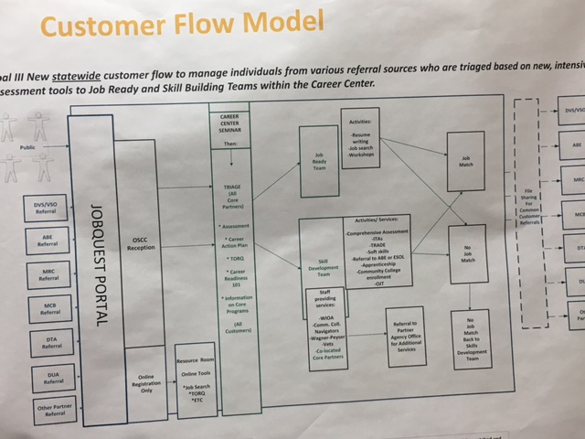
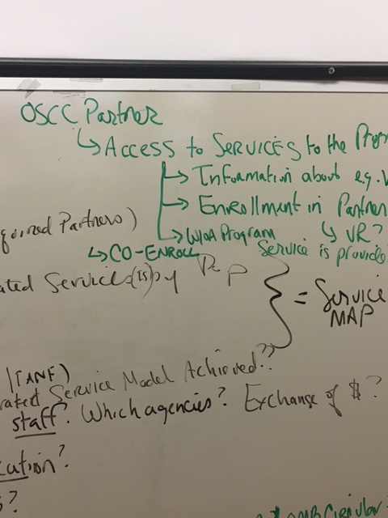
TOOLS

Slide 28
NEXT STEPS
TEAM BUILDING
VISION FOR INTERGRATED, CUSTOMER-CENTERED DESIGN SYSTEM (BUSINESS & POPULATIONS)
GET IDEAS, DIVERSITY OF THINKING, ASK FOR HELP
        ALIGNMENT WITH BUSINESS DEMAND (PLENARY & WORKSHOP)
        ALIGNMENT WITH CAREER PATHWAYS (WORKSHOP)
        CUSTOMER CENTERED DESIGN MODELS (WORKSHOP)
        INTEGRATED AND BUNDLED SERVICES (WORKSHOP)
MOU GUIDANCE & TECHNICAL ASSISTANCE

Slide 29
REGIONAL TEAMS
A team is not a group of people who work together. A team is a group of people who trust each other.
- Simon Sinek

