Slide 1
Navigating the Future How Today’s Technology Impacts Tomorrow’s O&M
Allyson Bull, M.Ed., COMS, TVI
Director, Orientation & Mobility (O&M)
March 28, 2025

Slide 2
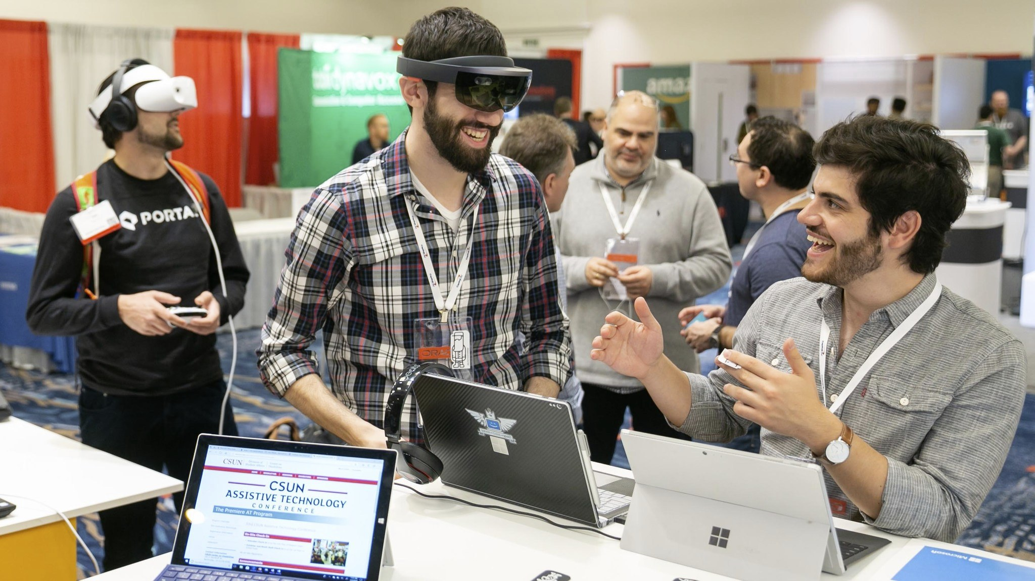
New Equipment
Navigating the ever-changing world of technology
Updates from:
Technology conferences
Sign-up for relevant email distribution lists for sharing updates
Community discussions
Certified Orientation & Mobility Specialists (COMS) training on new equipment
Our community: A top resource for staying up-to-date
Image Credit: Center on Disabilities at CSUN

Slide 3
Glide
Wayfinding and object detection device
Automatic steering and braking
Path detection and guidance
Obstacle avoidance with overhead and drop-off detection.
Primary target detection and guidance (door, crosswalk, stairs, etc.)
Voice input for hands-free control
Companion app for setup, onboarding, device settings and Over-The-Air updates
Uses Artificial Intelligence (AI) for enhanced performance
6+ hours of use on a full battery
Initial retail price: $1,499

Slide 4
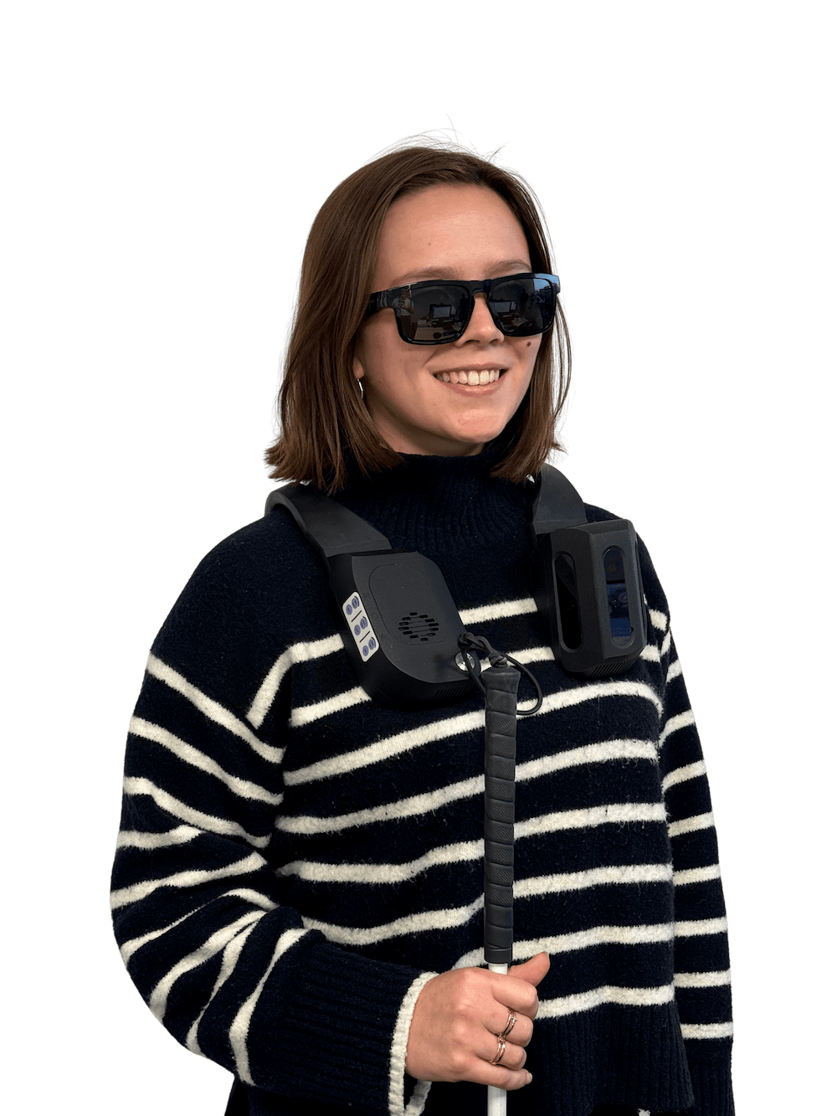
NOA
Navigation Obstacles AI
Designed for use with mobility devices (cane or guide dog)
Uses GPS and provides turn-by-turn directions
3D sound beeping to indicate obstacle
Detects full-body obstacles (cane or guide dog still recommended)
Artificial Intelligence (AI)-powered full scene description
Searches for common objects (door, stairs, etc.)
App available for O&M specialists
Price: $4,990

Slide 5
StellarTrek
"AI-powered GPS / OCR assistant"
Built-in camera with Artificial Intelligence (AI) capabilities
Supports street crossings with enhanced navigation
Assists in identifying:
Street addresses
Entrances
Landmarks
More of an orientation aid compared to previous products
Price: $1,395

Slide 6
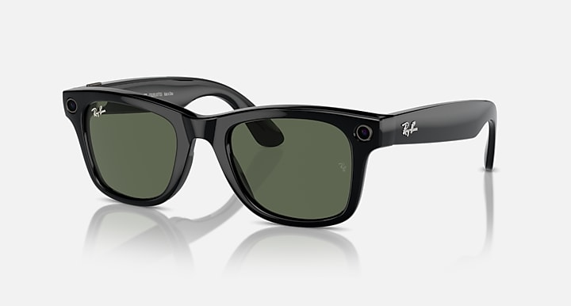
Meta Glasses
Universal design for all users
GPS and Artificial Intelligence (AI) capabilities for enhanced navigation
Connects to phone via Bluetooth for seamless integration
Supports Aira and Be My Eyes for additional assistance
New Meta AI feature (live AI for real-time support)
Ideal for "low-risk" tasks (e.g., daily activities)
Most affordable piece of equipment in this category
Prices starting at $299
Notes:
https://www.meta.com/ai-glasses/shop-all/

Slide 7
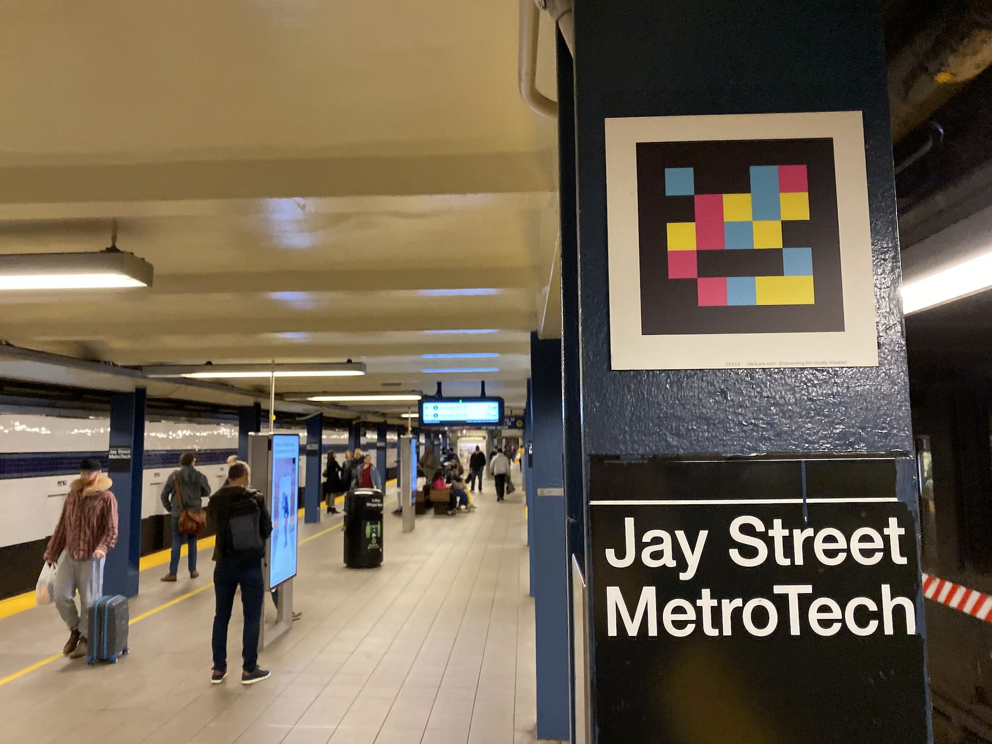
Applications - NaviLens
Uses QR-like codes ("tags“) to provide helpful information to users
App allows users to save an unlimited number of routes
Orientation & Mobility (O&M) uses:
Companies, like the MBTA, can purchase kits and program tags for their facilities
Sensitive tag detection for accurate scanning in the app
Tags provide location and wayfinding information to the user
Scanned tags are saved in the app’s history for easy reference
Notes:
https://www.meta.com/ai-glasses/shop-all/

Slide 8
Applications – EMVI
Similar to Be My AI in functionality
Uses phone's camera to capture pictures and provide feedback
Interactive Artificial Intelligence (AI) feature offers specific feedback on user-interest areas
Reads and translates text, provides screen descriptions, and identifies colors
Practical uses for Orientation & Mobility (O&M):
Reading signs
Indoor orientation
Notes:
https://www.meta.com/ai-glasses/shop-all/

Slide 9
Artificial Intelligence (AI)
Common theme amongst new products
Reliability of AI technology in assisting navigation
AI uses in static vs. dynamic environments
Orientation & Mobility (O&M) skills remain the strongest tool for independent navigation
Social component: How AI is enhancing interaction
Aira and Be My Eyes compared to Be My AI in functionality
The future of technology in mobility and accessibility
Impact on Culture: How technology is shaping societal norms and interactions
Notes:
https://www.meta.com/ai-glasses/shop-all/

Slide 10
Role of the School COMS
Continue supporting foundational Orientation & Mobility (O&M) skills for student independence
Considering technology for a student:
Skill level: Matching tools to the student’s abilities
Item cost: Evaluating affordability
Benefit of tool: Assessing the value for current O&M and future transition out of school
Post-school access: Can the student continue using the technology after graduation?
Notes:
https://www.meta.com/ai-glasses/shop-all/

Slide 11
Transition to Adult Services
MCB's role in providing technology
Technology provided by the department based on individual needs and budget
Assistive Technology (AT) department supplies many pieces of equipment
Consumers should talk with their case managers for personalized support
Use on campus: Technology support for educational environments
Use on jobsite: Technology support for employment and workplace settings
Notes:
https://www.meta.com/ai-glasses/shop-all/

Slide 12
Small Group Discussion
What types of technology, if any, are your students requesting to use?
Have you used any new technology that successfully enhanced Orientation & Mobility (O&M) skills?
What challenges have you encountered when using technology?

Slide 13
Meg Robertson Mobility Award
Accepting nominations now through August 8, 2025
Open to motivated long cane and dog guide users of all ages and abilities
Specifically seeking individuals who demonstrate mobility skills at their current level and use their cane or dog guide to increase their independence
Three categories: Youth, Adult & DeafBlind
Submit a nomination at mass.gov/whitecane
Nomination form must be completed by a Certified Orientation & Mobility Specialist (COMS)
Winners announced at White Cane Awareness Day Celebration in October

Slide 14
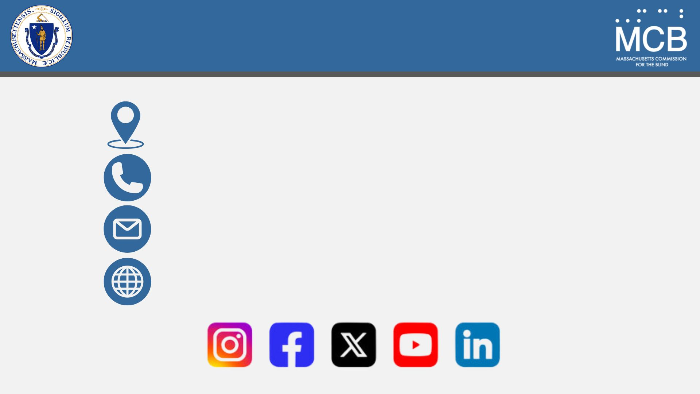
Connect With Us
600 Washington Street, Boston, MA 02111
1-800-392-6450
mcbinfo@mass.gov
mass.gov/mcb

