Slide 1
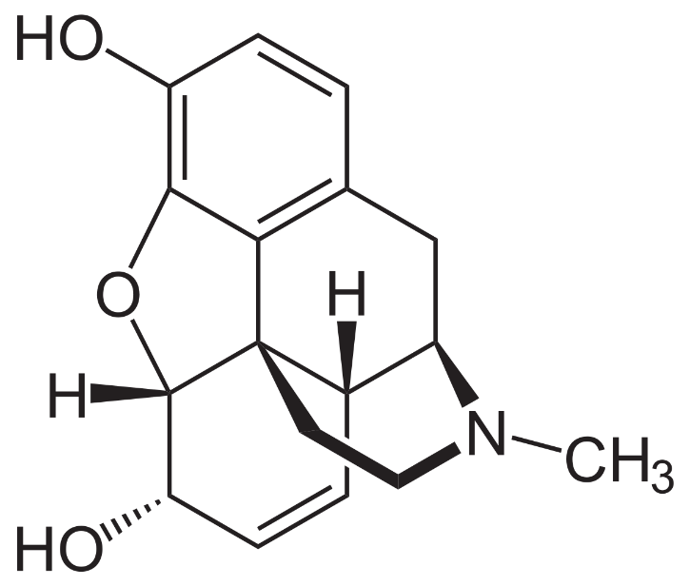
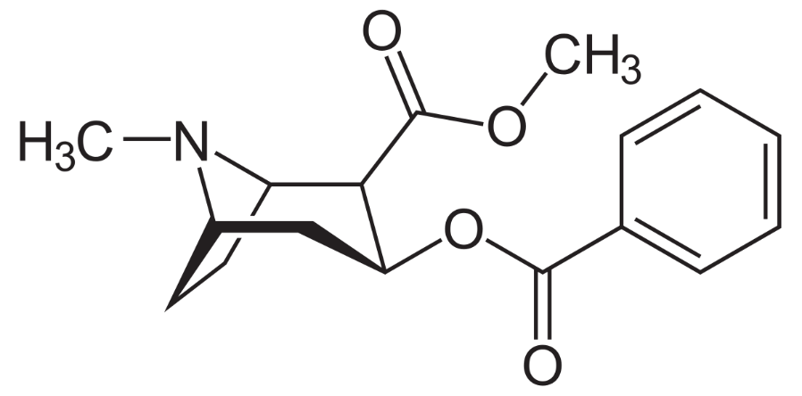
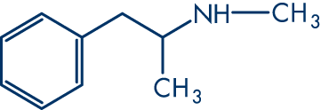
Navigating the New Stimulant Landscape: Consumer Experiences and Illicit Drug Supply Insights from the RACK and MADDS projects in Massachusetts
Traci C. Green, PhD, MSc
Opioid Policy Research Collaborative, The Heller School for Social Policy and Management, Brandeis University

Slide 2
Stimulant Use – National Trends
Nationally, there has been an enormous rise in drug overdose deaths involving cocaine.
About 1 in 5 (13,942; 19.8%) of the 70,237 drug overdose deaths that occurred in the United States in 2019 involved cocaine. This is a 34.4% increase from 2016.
From 2016 to 2017, death rates involving cocaine and psychostimulants increased across age groups, racial/ethnic groups, county urbanization levels, and multiple states.
Opioids were also involved in 72.7% of cocaine-involved deaths, primarily synthetic opioids like fentanyl.
Synthetic opioids appear to be the primary driver of cocaine-involved death rate increases, and recent data point to increasing synthetic opioid involvement in psychostimulant-involved deaths.
Source: Mbabazi Kariisa, PhD; Lawrence Scholl, PhD; Nana Wilson, PhD; Puja Seth, PhD; Brooke Hoots, PhD. Drug Overdose Deaths Involving Cocaine and Psychostimulants with Abuse Potential — United States, 2003–2017. Morbidity and Mortality Weekly / May 3, 2019 / 68(17);388–395

Slide 3
Stimulant Use – Massachusetts
In MA, opioid-related overdose deaths often involve stimulants, namely cocaine
What is unknown is if these drugs were taken in combination, sequentially, or without the user’s knowledge
Source: MDPH

Slide 4
Research and Evidence Base – RACK Consumer Knowledge Study
Rapid Assessment of Consumer Knowledge (RACK)
2019 study funded by CDC and DPH/BSAS which examined trends in cocaine-opioid involved overdose deaths in Massachusetts using data already collected for CDC surveillance from the State Unintentional Drug Overdose Reporting System (SUDORS).
Utilized surveys and interviews specific to cocaine use with people who use drugs living in the communities with the highest burden of cocaine-opioid overdose deaths in the state.
Key findings:
Compared to non-cocaine involved opioid overdoses, cocaine-opioid overdose deaths were:
More likely to be Hispanic and non-Hispanic Black
More likely homeless
Slightly younger (25-34)
More likely to have recently been released from jail/prison
More likely to have recently been released from hospital
Less likely to have been recently released from drug treatment or residential treatment

Slide 5
Research and Evidence Base – Findings on At-Risk Populations
Special Considerations: Men who have Sex with Men (MSM)
New HIV infections in MA: MSM remains predominant exposure mode. Stimulant use is major factor in transmission
Consumption of drugs to facilitate or enhance sexual activity (Party and Play)
10-25% of MSM report using stimulants in context of sex
Mostly smoking of crystal meth but also booty bumping, less so injection
Special Considerations: Reach of services and convergence with social context
Less harm reduction service/syringe service program uptake for meth-related supports, more treatment seeking
Socio-economic status and sex work considerations of meth use
Source: MDPH; RACK study; Colfax G, Shoptaw S. The methamphetamine epidemic: implications for HIV prevention and treatment. Curr HIV/AIDS Rep. 2005;2:194–9
Notes:
Another special consideration is men who have sex with men. Recent HIV infection trends indicate stimulant use is a major factor in transmission
Associated with higher SES, limited sex work considerations/overlap
Interactions with harm reduction organizations are fewer

Slide 6
Research and Evidence Base – Industries and Employees Most At-Risk
Certain industries and employment categories have been impacted by cocaine-involved opioid overdose more than others.
Employment | N | % | Example positions
Construction/Trades | 236 | 28.8 | Construction worker, electrical apprentice, iron worker
Not in workforce | 155 | 18.9 | Disabled, homemaker, student
Accommodation and food services | 94 | 11.5 | Bartender, chef, waitstaff
Healthcare | 55 | 6.7 | Counselor, home health aide, medical assistant
Source: Vital Statistics and SUDORS overdose death surveillance, Massachusetts

Slide 7
Research and Evidence Base – Availability and Cost
Methamphetamine use is uncommon, expensive, comparatively, but those who use it have easy access.
Cocaine and crack, in contrast, are readily available and inexpensive for more people.
Drug availability, across MA communities
Street prices, across MA communities
Perceived Availability of Drugs on the Street n (%)
 | Under 1 hour | A few hours | 1 day or longer
Buprenorphine/ Suboxone (n=33) | 28 (85) | 4 (12) | 1 (3)
Heroin (n=41) | 36 (88) | 3 (7) | 2 (5)
Fentanyl (n=33) | 31 (94) | 2 (6) | --
Benzodiazepines (n=26) | 18 (69) | 5 (19) | 3 (12)
Rx Opioids (n=26) | 13 (50) | 5 (19) | 8 (31)
Cocaine (powder) (n=43) | 31 (72) | 7 (16) | 5 (12)
Crack (n=44) | 38 (86) | 5 (11) | 1 (2)
Methamphetamine (n=20) | 15 (75) | 4 (20) | 1 (5)
Drug | Estimated Street Price
Buprenorphine/Suboxone | $7.45/strip
Heroin | $56.90/gram
Fentanyl | $59.23/gram
Benzodiazepines | $4.30/per pill
Rx Opioids | $.99/per mg
Cocaine | $66.63/gram
Crack | $53.55/gram
Methamphetamine | $71.11/gram
Source: RACK Study, Massachusetts

Slide 8
Research and Evidence Base – Implications and Possible Interventions
Based on the RACK Study’s findings, a number of possible interventions emerged:
Broad-based educational campaigns addressing cocaine, crack users even occasional users
Syringe Service Program/Provider communications focused on cocaine risks
Include fentanyl test strips and education in safe smoking/safe snorting kits
Street distribution level outreach/interventions
Drug checking, education
Packaging protections, prevention plan
Naloxone distribution ambassadors or locales
Engage cut distribution points, especially bodegas in outreach/intervention
Couple with safe syringe sale, distribution
Offer Community Drug Checking: People want to know what’s in their drugs.
Most primary cocaine/crack users indicated that they would avoid fentanyl laced drugs if they could
See following slide for additional details on Community Drug Checking

Slide 9
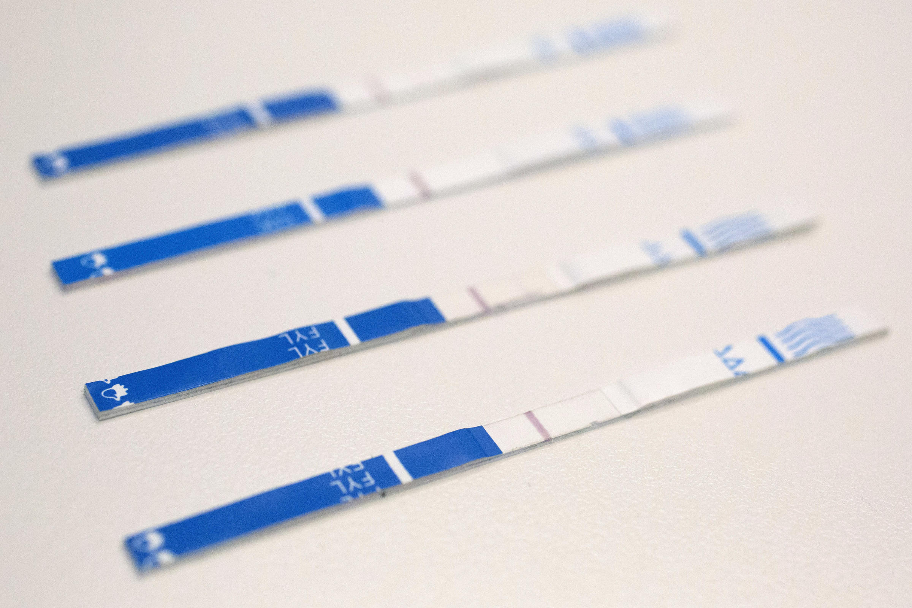
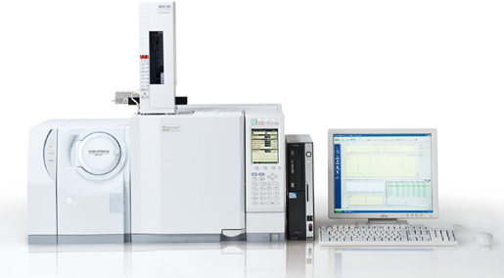
Interventions – MADDS Community Drug Checking
Massachusetts is the first and only state conducting drug supply screenings through the Massachusetts Drug Supply Data Stream (MADDS)
Collect sample from community partner/police department and gather situational and subjective information
Scan sample with FTIR (on-site), test with fentanyl test strips (on-site), send for GC/MS confirmation testing (off-site) and review by medical toxicologist
Report out findings to partners, communities and the state
Notes:
GC/MS = gas chromatography mass spectrometry
FTIR = Fourier transform infrared spectroscopy

Slide 10
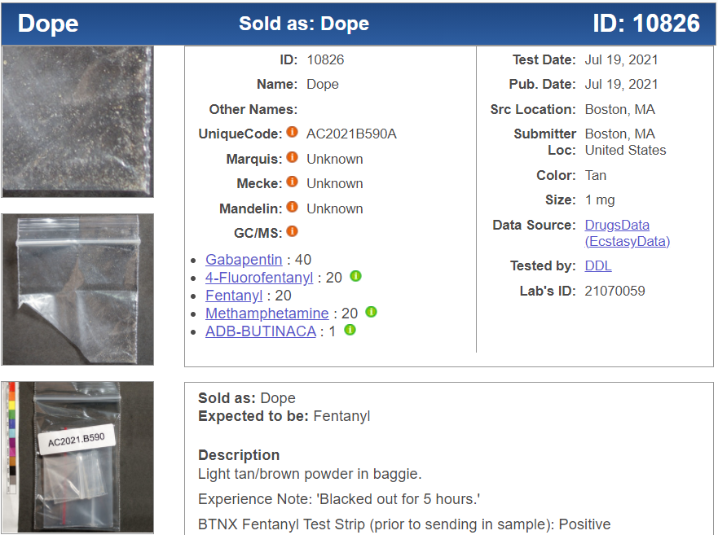
Interventions – MADDS Community Drug Checking Results
Results from the Massachusetts Drug Supply Data Stream (MADDS) from sampling in Quincy, New Bedford, Lynn, Lowell, Boston, Berkshire County indicated a strong presence of fentanyl and in many powder and pill form drugs.
However, 2021 MADDS samples indicated that the current supply contains a more toxic analog, 4-fluorofentanyl, now found in all locations. We note that, in 2021, multiple samples expected to be heroin/dope/fentanyl contained methamphetamine (see example). Rarely were samples expected to be methamphetamine or confirmed to contain methamphetamine also found to contain fentanyl.
Sample MADDS Results, 2021
Substance | Powder Cocaine | Any Pill/ Counterfeit pills | Methamphetamine | Crack | Heroin
Suspected | 19 | 26/16 | 21 | 19 | 161
Unknown, + for column substance | 34 | 12/7 | 2 | 25 | 48
TOTAL | 53 | 38/23 | 23 | 44 | 209
Fentanyl present | 13 (25%) | 6 (16%/26%) | 0 (0%)* | 0 (0%) | 178 (85%)

Slide 11
MADDS Findings – Turning Research into Public Health Policy
From the MADDS study findings, a number of public health interventions were identified, which are either being currently implemented or could be explored
MADDS Finding | Interventions / Public Health Strategy
The heroin drug supply is heavily inundated with fentanyl. Methamphetamine powder products rarely contain fentanyl. Fentanyl products may contain meth. | Naloxone, low-barrier MOUD, harm reduction supplies, wound care, safe places for use, quick detection of overdose, community drug checking, communications to providers/systems about supply
For any given suspected illicit pill, 16% appear to contain fentanyl. If a counterfeit pill is suspected, 26% contain fentanyl | Public service announcements/campaigns to reach people using counterfeit pills or non-prescribed pills urging to get naloxone, obtain fentanyl test strips, Never Use Alone hotline

Slide 12
MADDS Findings – Turning Research into Public Health Policy
MADDS Finding | Interventions / Public Health Strategy
Presently, about 25% of illicit drugs in powder form contain fentanyl, other than suspected heroin which contain higher proportions of fentanyl | Public service announcements/campaigns targeted to important subgroups of people using illicit drugs in powder form. Harm reduction supplies and education, community drug checking, safer smoking and safer snorting kits to promote replacement, fentanyl test strips, naloxone
Illicit drugs may contain other things that can cause unexpected and harmful reactions when consumed. | Remain vigilant, share information about unexpected drug contents with provider, EMS, public safety to calibrate response
Fentanyl exposure is possible through intentional mixing in drug preparation, mislabeled drugs, and reuse or sharing of drug preparation or materials used for administration (i.e., stem, pipe, syringe) | Ensure sufficient supply of new sterile equipment (syringes, stems, etc), encourage community drug checking participation

Slide 13
Tracigreen@brandeis.edu

