Slide 1

Vincent Strully Jr.
Chief Executive Officer and Founder
The New England Center for Children®

Slide 2
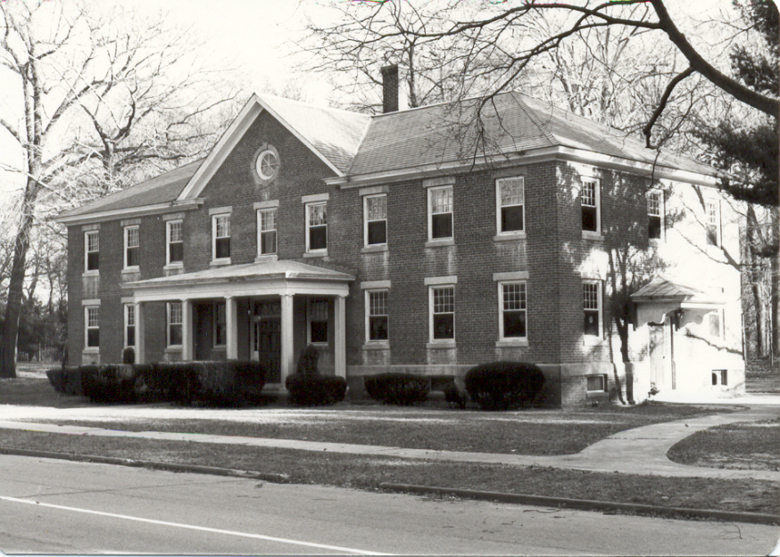
NECC® Then

Slide 3
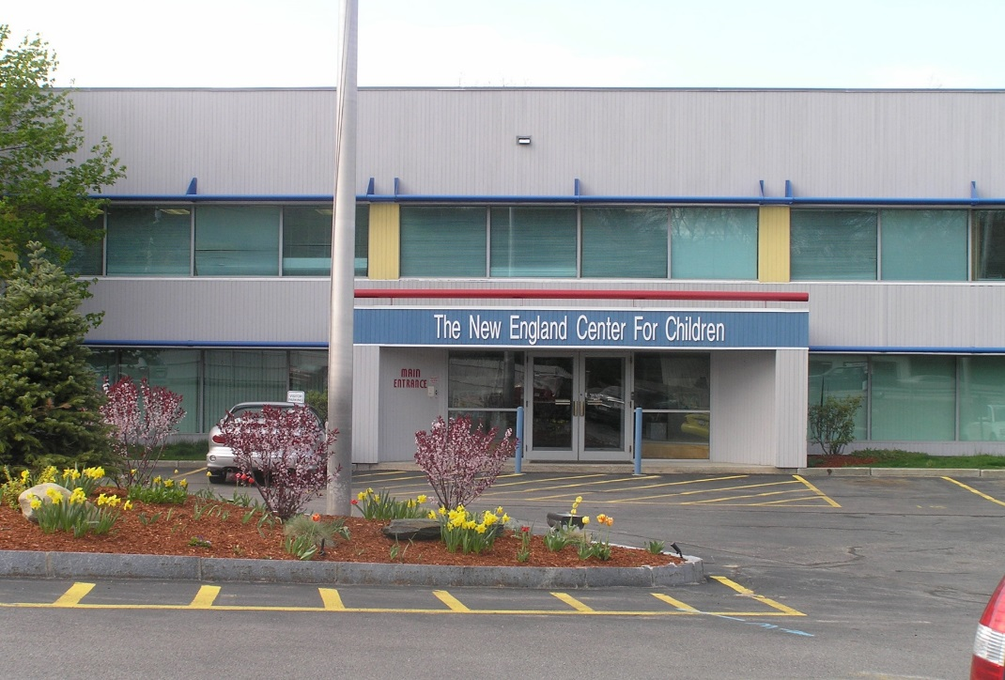

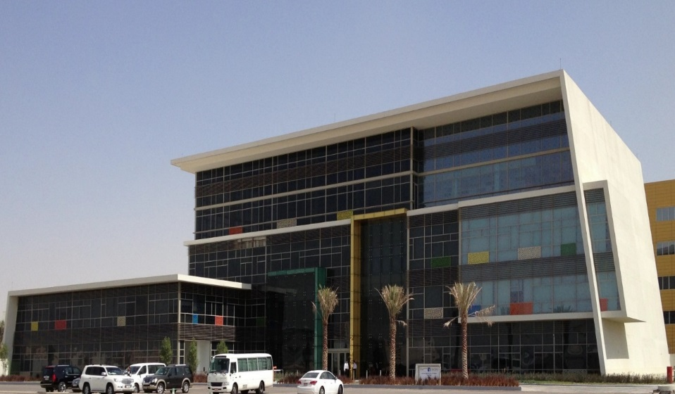
NECC® Now

Slide 4
The New England Center for Children®
The Center serves 686 students (age 18 months through 22 years) diagnosed with Autism Spectrum Disorder.
Located in Southborough, Massachusetts (123,000 ft² central school facility, with 16 residential group homes).
479 employees are currently enrolled in one of our on-site graduate programs through Simmons or Western New England University.
Over 1,300 staff received Master’s degrees from one of these programs since 1987.
We provide consultation services to over 790 students throughout more than 80 schools.
Over 4,050 students at NECC and in public school districts and agencies around the world use the Autism Curriculum Encyclopedia (ACE®) Application, which was developed at NECC.
Our faculty have presented 2,004 times at national and international conferences and have published 245 research articles in peer-reviewed academic journals.
In 2007, we opened a school for children with autism in Abu Dhabi; there are currently 184 students enrolled.

Slide 5




Consulting and Global Dissemination
Kuwait
Qatar
Dubai
Abu Dhabi

Slide 6
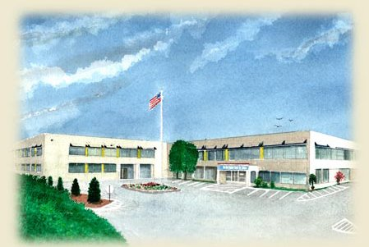
Programs at NECC®
Staff Intensive Unit (SIU)
Residential Program
Intensive Instruction Program (IIP)
Home-Based

Slide 7
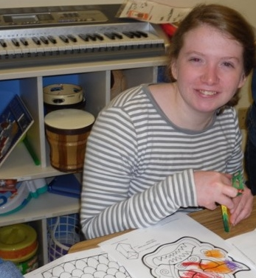
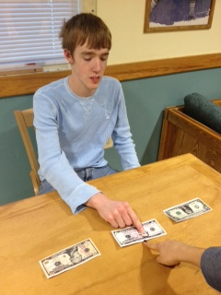
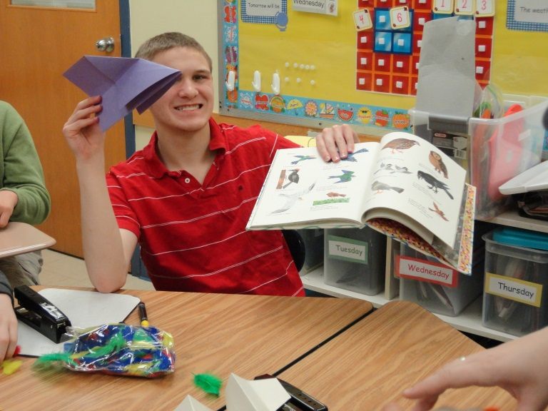
Staff Intensive Unit

Slide 8
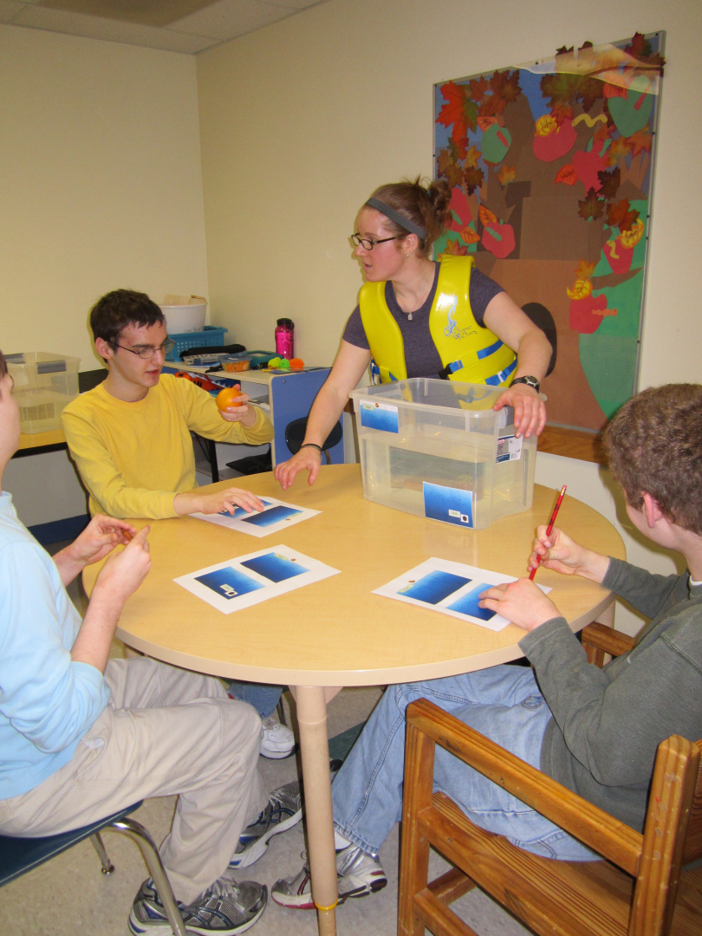
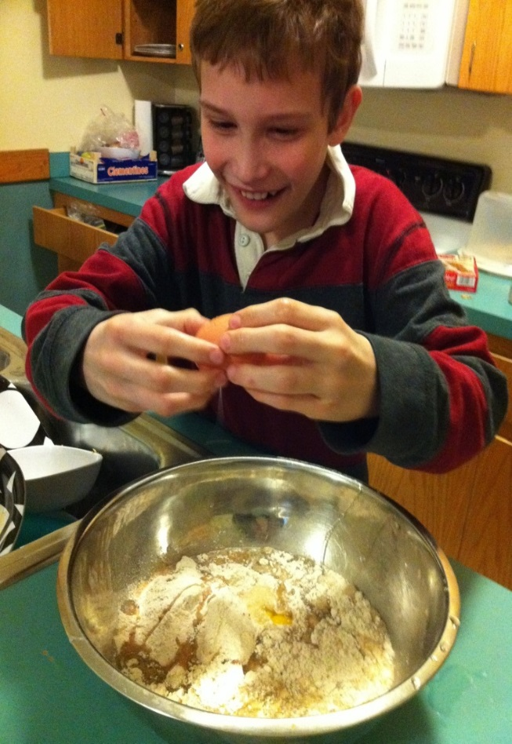
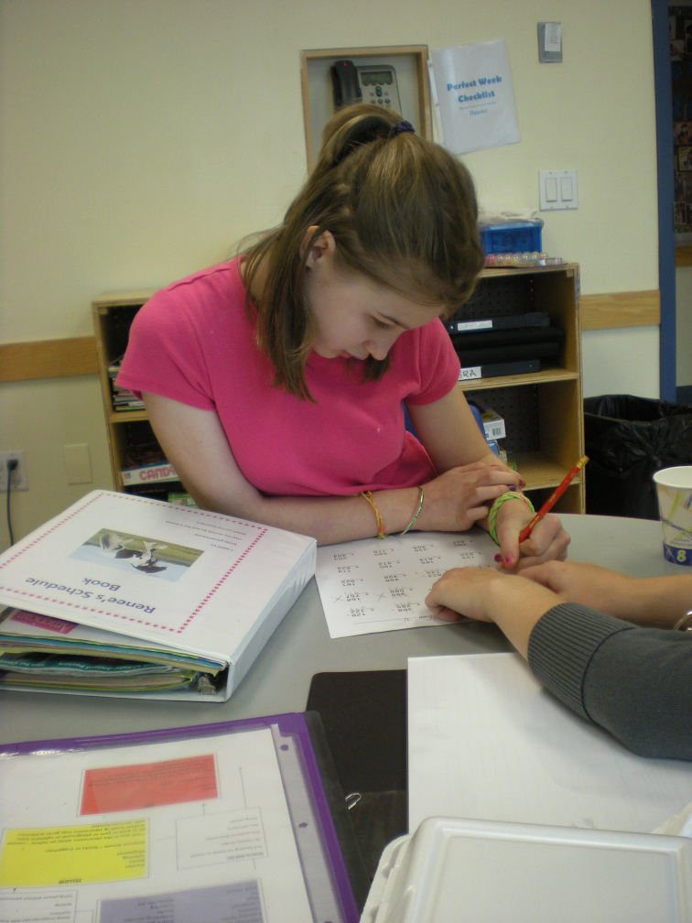
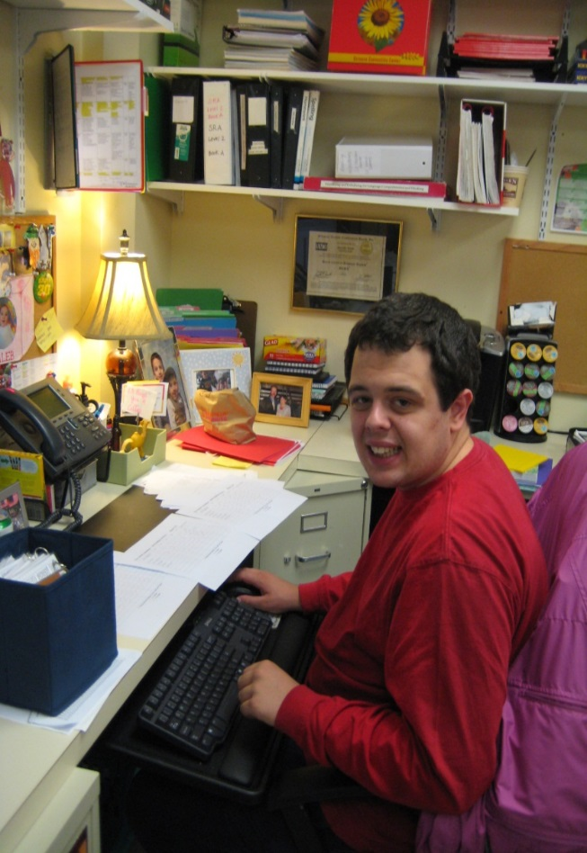
Residential and Intermediate Programs

Slide 9

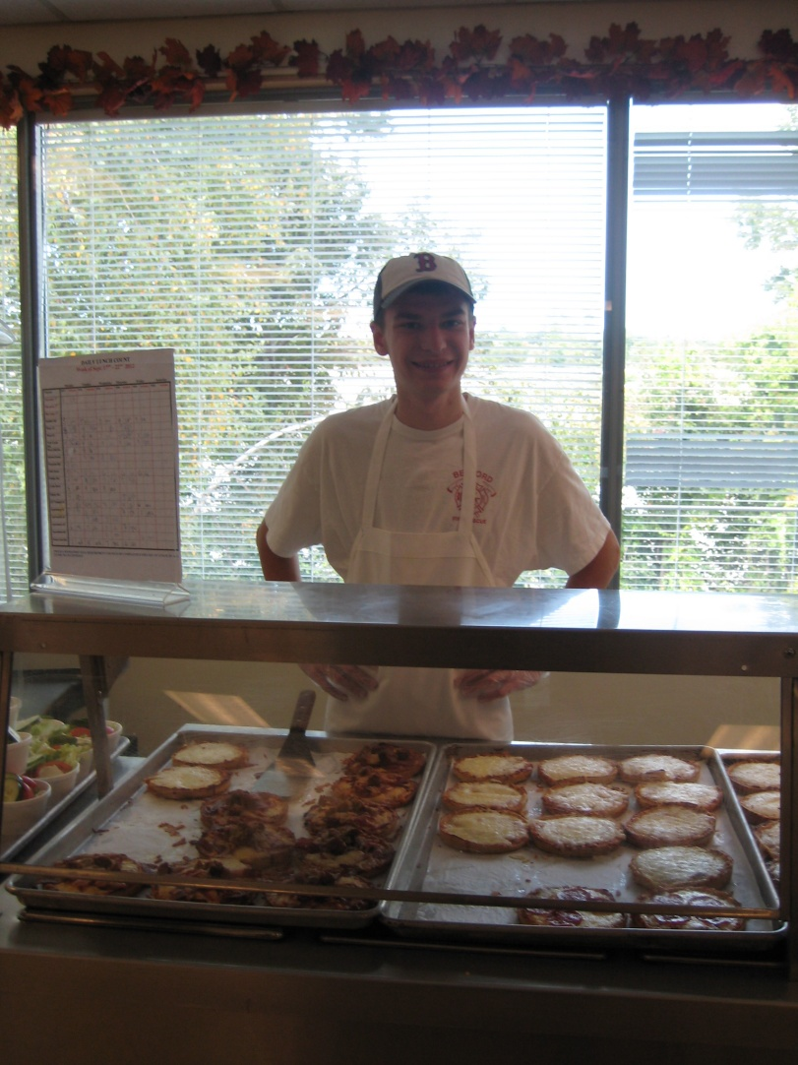

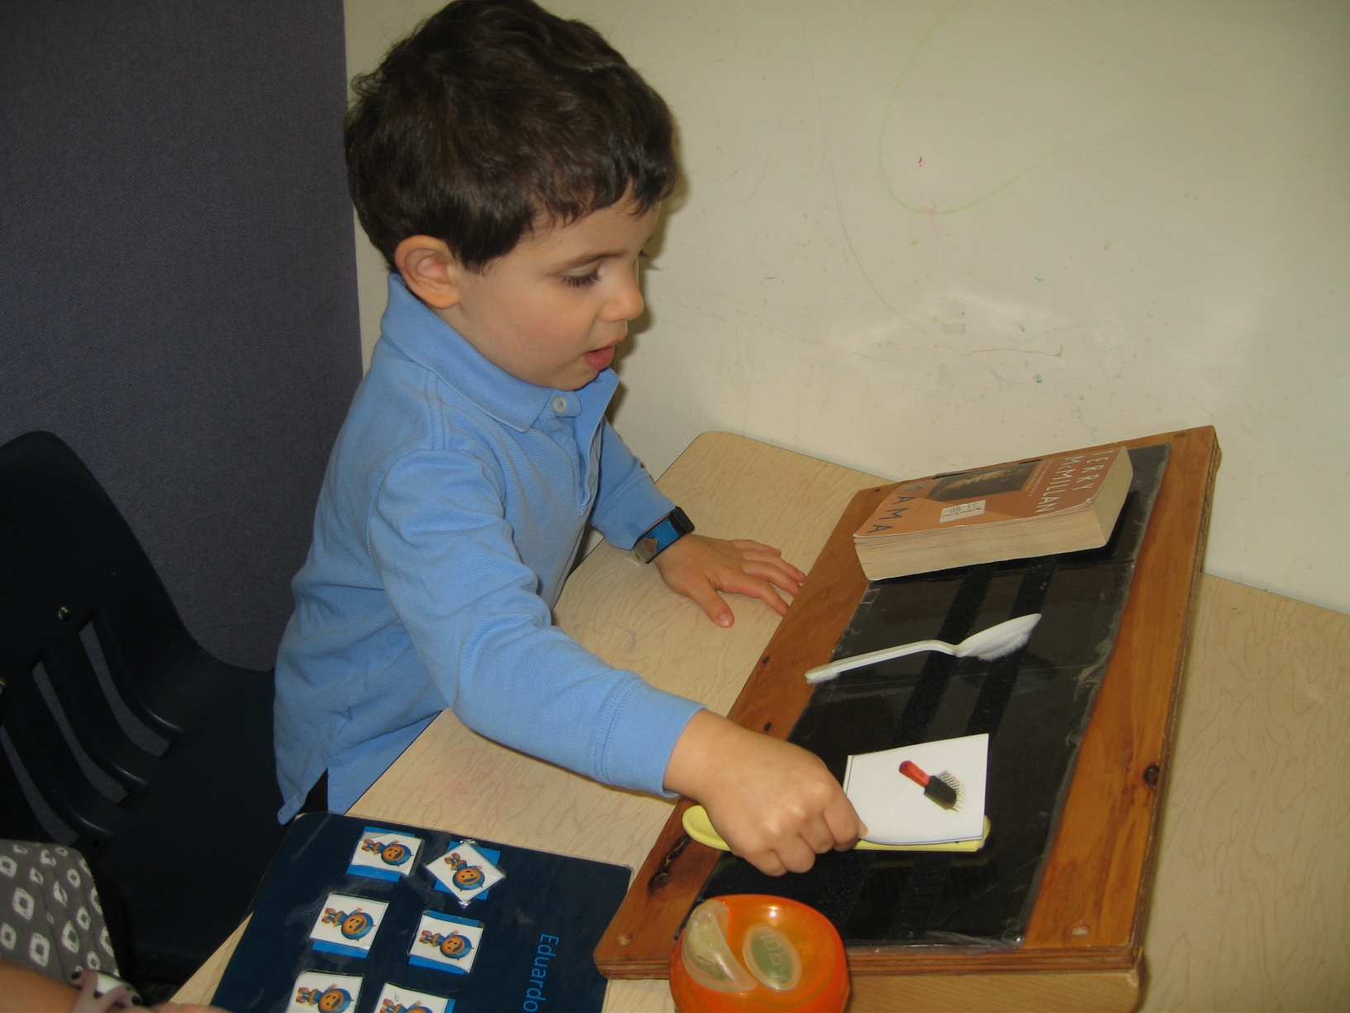
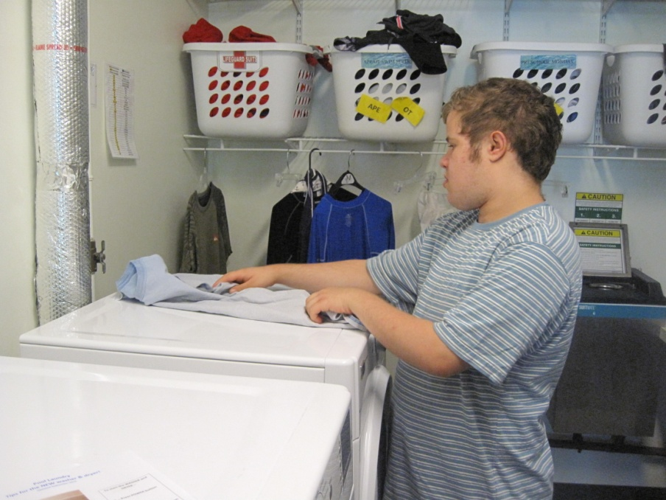
Intensive Instruction Program

Slide 10
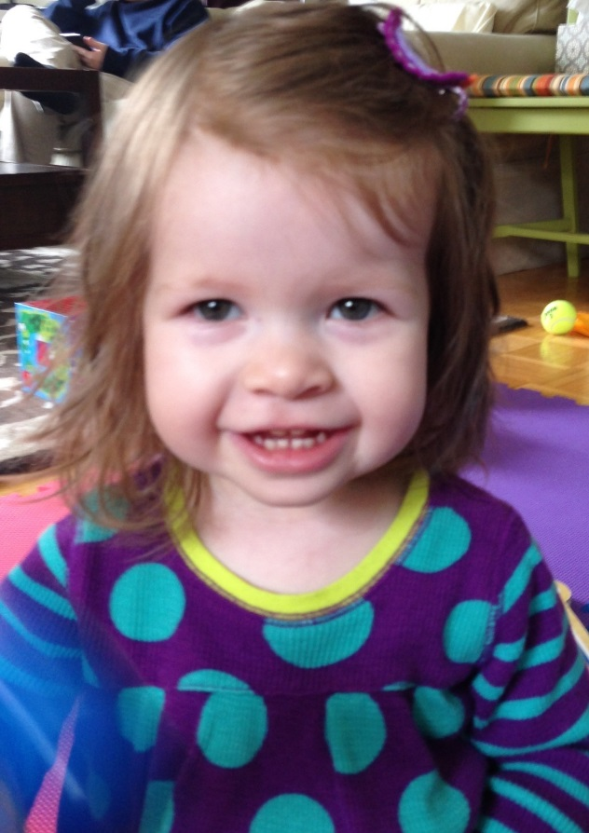
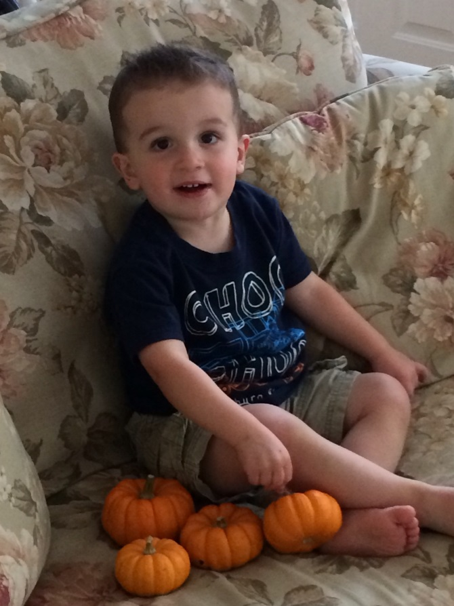
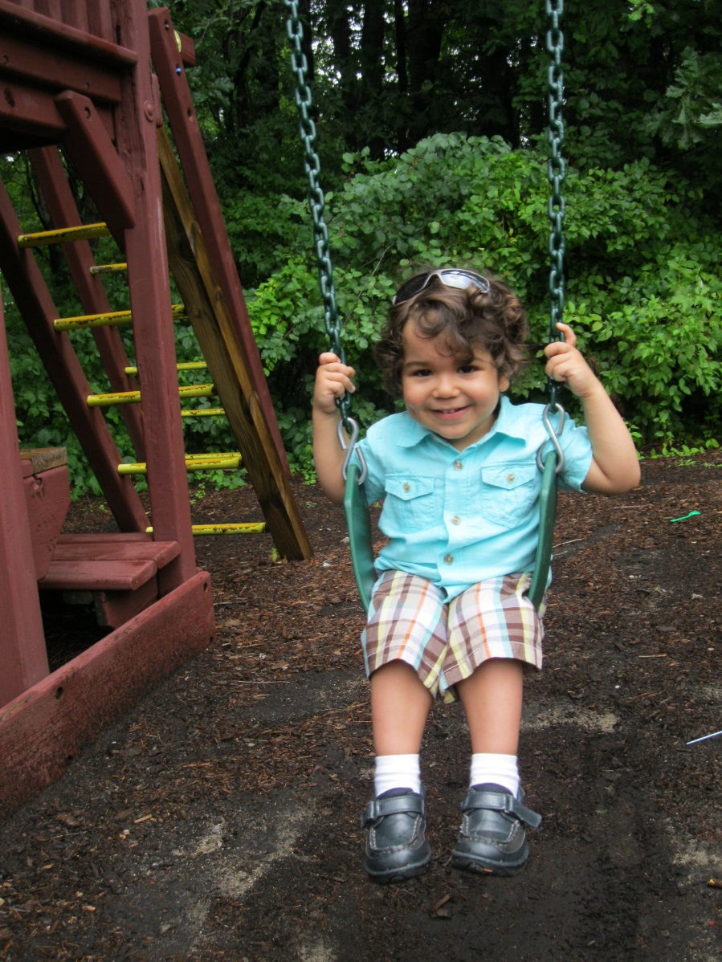
Home-Based Program

Slide 11
Best Practices in Autism Treatment: Research to Practice and Practice to Research
William H. Ahearn
Ph.D., BCBA-D, LABA (MA)

Slide 12
How does NECC conduct research?
Masters and Doctoral training
  WNE (in ABA); Simmons (Sp. Ed.)
10 NECC-based Ph.D. level faculty - WNE
  Over 80 ongoing projects
250 peer reviewed publications
2nd most contributing authors to JABA
Ongoing collaborative relations
  E.K. Shriver Center
  Children’s Hospital/Harvard
  UNH
  UCONN

Slide 13
Applied Behavior Analysis
EIBI/ABA through the lifespan
  Skill deficits/behavioral excesses
Skill deficits
  Function of skills in social environment
  Specific targeting via appropriate teaching procedures
Problem behavior
  Functional assessment to identify cause
  Validated function-based TXs
  Heavily focused on appropriate replacement behavior

Slide 14
ABA is Best Practice
From the early days: Lovaas, 1987; McEachin, Smith, & Lovaas, 1993
Howard et al. 2005; 2014
Meta-analyses – EIBI and techniques
(e.g., Eldevik, Hastings, Hughes, Jahr, Eikseth, and Cross, 2009)
Cochrane review by Reichow, Barton, Boyd, & Hume (2013)

Slide 15
MacDonald, Parry-Cruwys, Dupere, & Ahearn (2014; RIDD)

Slide 16
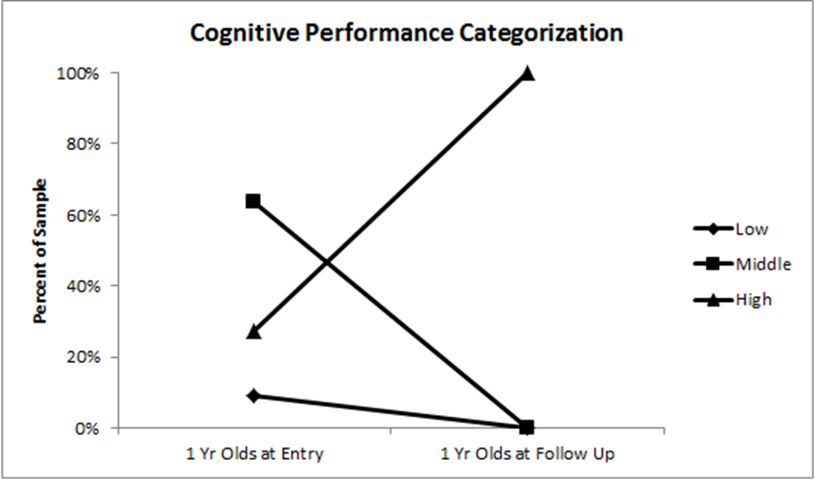

Outcome Analysis – Cognitive Performance by Age

Slide 17
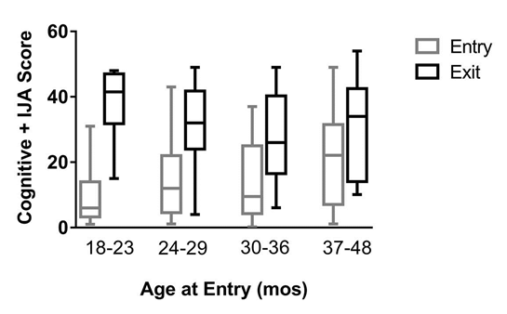
Outcome Analysis – Cognitive Performance

Slide 18
ABA: What we know now
Behavior analysis works across lifespan
Problem behavior
FA and F-B TX is a BP
Skill building
Verbal behavior/Communication skills
Play and social skills
Independent functioning (outcomes)
But, BP evolves constantly

Slide 19
NECC Fosters Best Practice Research
Established groups in areas of need
Provide resources for conducting research
Summarize results and disseminate externally

Slide 20
Treatment Research at NECC
Play Skills/Social Interaction
MacDonald, R.P.F., Sacramone, S., Mansfield, R., Wiltz, K., & Ahearn, W.H. (2009). Using video modeling to teach reciprocal pretend play to children with autism. Journal of Applied Behavior Analysis, 42, 43-55.

Slide 21
Treatment Research at NECC
Awareness of others
Klein, J.L., MacDonald, R.P.F., Vaillancourt, G., Ahearn, W.H., & Dube, W.V. (2009). Teaching discrimination of adult gaze direction to preschool children with autism. Research in Autism Spectrum Disorders, 3, 42-49.

Slide 22
Treatment Research at NECC
Social Preferences
Smaby, K., MacDonald, R.P.F., Ahearn, W.H., & Dube, W.V. (2007). Assessment protocol for identifying preferred social consequences. Behavioral Interventions, 22, 311-318.

Slide 23
Treatment Research at NECC
“Preventing” Severe Behavior
Herscovitch, B., Roscoe, E.M., Libby, M.E., Bourret, J.C., & Ahearn, W.H. (2009). A methodology for identifying precursors to problem behavior. Journal of Applied Behavior Analysis, 42, 697-703.

Slide 24
Treatment Research at NECC
Tx of Stereotypic Behavior
Ahearn, W.H., Clark, K.M., MacDonald, R.P.F., & Chung, B.I. (2007). Assessing and treating vocal stereotypy in children with autism. Journal of Applied Behavior Analysis, 40, 263-275.

Slide 25
MacDonald et al. (2007)

Slide 26
A Case History in BP (NPDC in ASD)
Stereotypic behavior circa 2000
  Little sound TX research
  Manualized recommendations
Examined procedures for redirecting stereotypy in learning environments
  Ahearn et al. (2007; JABA)
Examined procedures for promoting adaptive behavior
  Colon et al. (2012; JABA)

Slide 27
How goals are selected and sequenced when providing educational and clinical services?

Slide 28
Core Skills Assessment (CSA)
Diagnostic evaluations prior to intake
  Additional assessments conducted (e.g., ESAT)
CSA (e.g., Dickson et al., 2014; JADD)
  Foundational skills hierarchically-ordered
  Observational analysis
Skill domains
  Discrimination
  Verbal behavior/Communication
  Social behavior
  Self help
  Health and safety
  Physical education
  Community

Slide 29
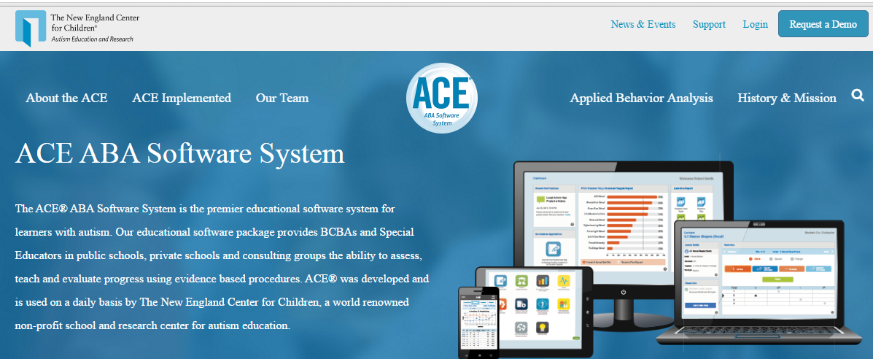
ACE® 4.0
Autism Curriculum Encyclopedia

Slide 30
The ACE®
ASSESS
  Identify Key Factors for Individual Success
TEACH
  Build Independence Across the Life Span
EVALUATE
  Document Success Every Day

Slide 31
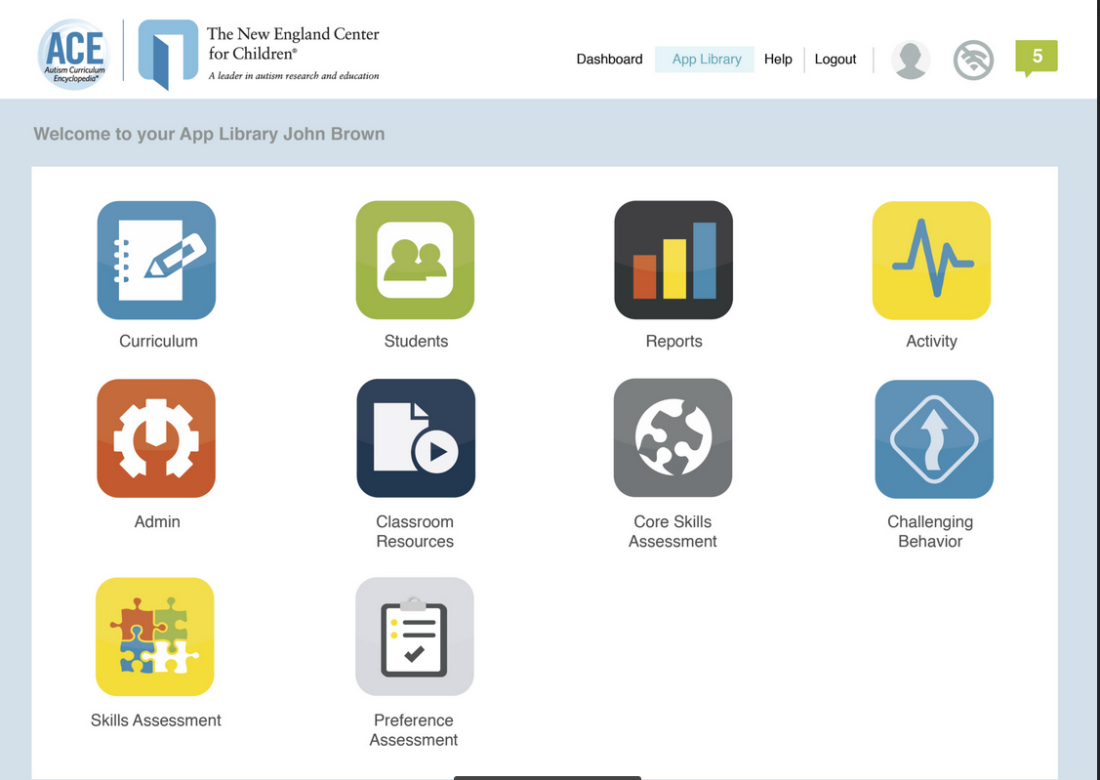
App Library

Slide 32
Core Skills
Basic Matching and Readiness
Sit and attend
Matching Skills
Social Skills
Preferences
Waiting
Conditioned Sr
Imitation
Social Distance
Health and Safety
Medical care skills
Exit given fire alarm
Personal identification
Privacy
Communication
Requesting
Respond to name
Respond to greeting
Request help
Request attention
Request termination
Accept / reject
Respond to “stop”
Follow 1-step directions
Identify body parts
Identify pictures, objects
Label pictures, objects
Community
Walk in community
Ride in vehicles
Self-Help
Dressing, Undressing
Washing hands, face
Showering
Brushing teeth
Eating skills
Washing hands
Toileting
Recreation / Phys Ed
Use schedule
Exercise
Independent tasks
Notes:
To give you a better picture, Here are some examples of skills that are included in the CSA
Communication, like requesting and following simple instructions
Social Skills, like motor imitation
Self-Care skills like hygeine and toileting,
AND Health and Safety skills, like exiting a building upon hearing a fire alarm or providing identification when asked

Slide 33
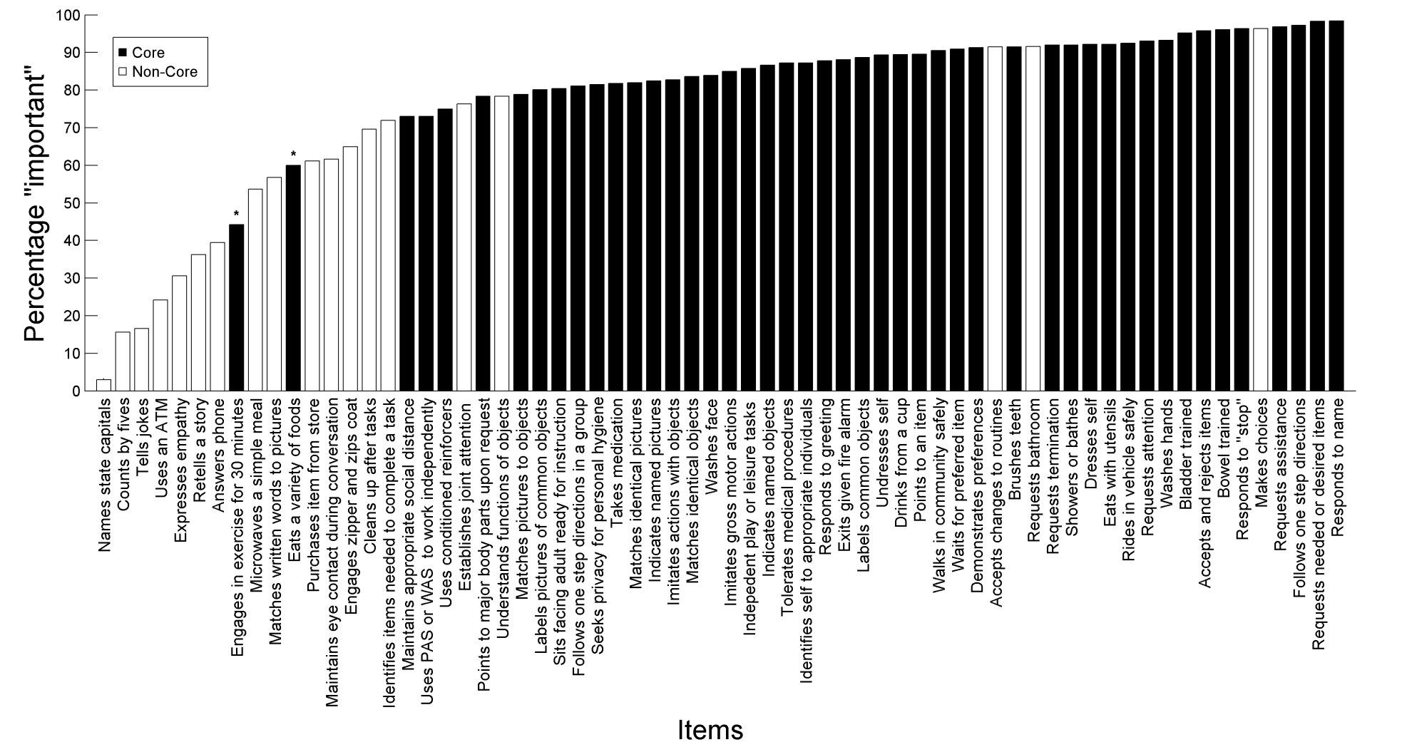
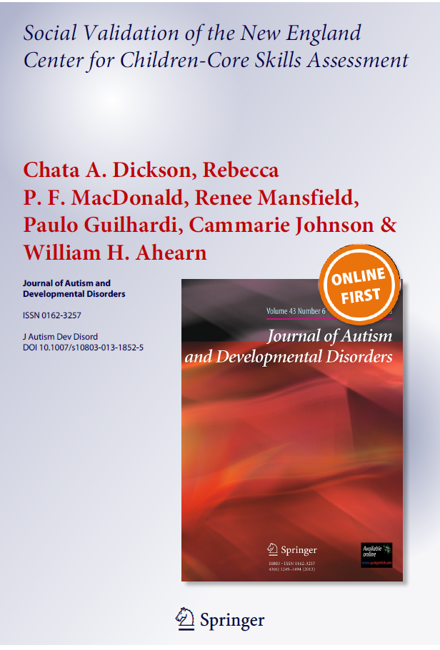
Core Skills Assessment

Slide 34
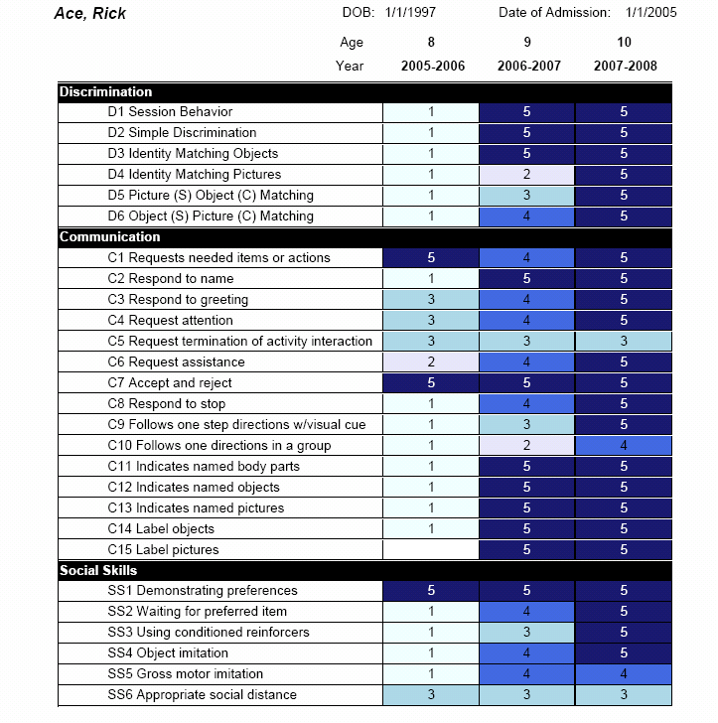
Core Skills Assessment
Core Skills Assessment
Year 1
Year 1
Year 2
Year 3
CSA results allow educators to…
Identify foundational skill deficits
Select ACE curriculum to address areas of need
Monitor progress across years
Notes:
[Click] The results of this assessment allow educators to…
Identify deficits in foundational skills
Select ACE lesson plans to address areas of need
AND Monitor progress across years

Slide 35
App Library

Slide 36
Skills Assessment
The ACE curriculum scope and sequence includes over 1250 skills for learners with autism.
The ACE Skills Assessment is an indirect evaluation of all skills within the scope and sequence, including skills in areas that are not assessed in the CSA.
The ACE Skills Assessment will help users identify broader areas of need than covered in the CSA and provide the “big picture” for curriculum selection.
All skills link to lesson plans within the ACE Curriculum Bank
Our recommendation is that this tool be used on a yearly basis prior to planning a new IEP.

Slide 37
App Library

Slide 38
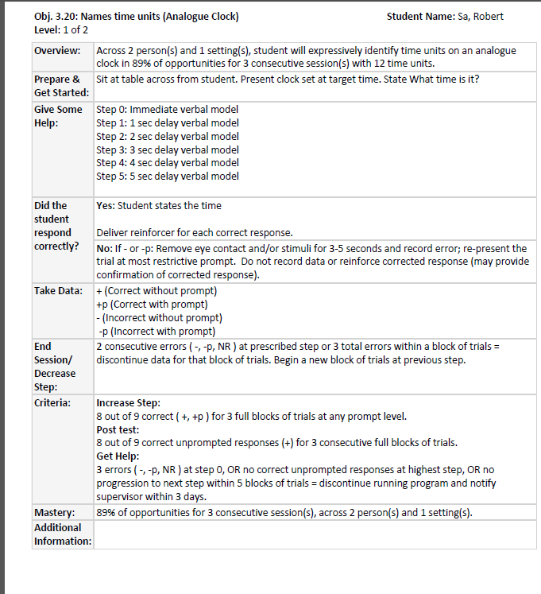
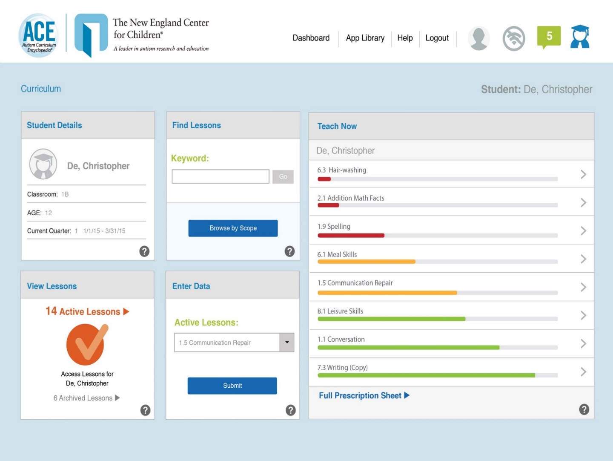
ACE® Curriculum
  ACE Curriculum Bank
  Over 2000 lesson plans linked to
  NECC Scope and Sequence
  Common Core
  MA Curriculum Frameworks
  VBMAPP
  3 lesson formats
    Discrete Trial
    Task Analysis
    Incidental Teaching
Notes:
In 2003 the ACE was born [Click]
The most important feature is the Curriculum Bank. [Click]
Which now contains over 1700 lesson plans linked to the NECC Scope and Sequence. [Click]
And there are three lesson formats They each look a little different, but in each case teachers are provided with
The Instructional Goal
The Materials
Instructions or discriminative stimuli for the student
And Information about
prompting
Consequences
Data Collection
and Criteria to move on or to get help from a supervisor

Slide 39
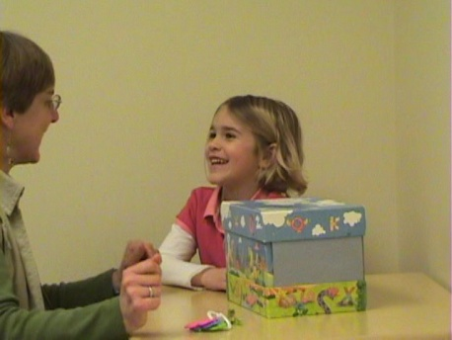
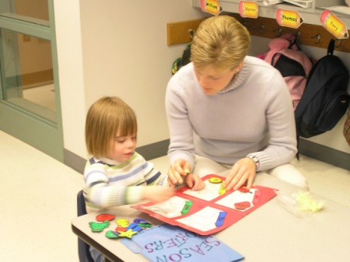

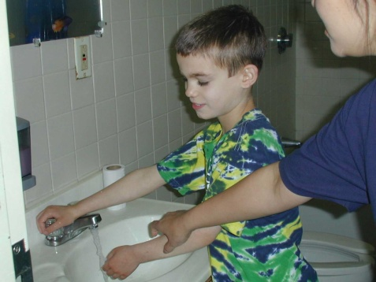
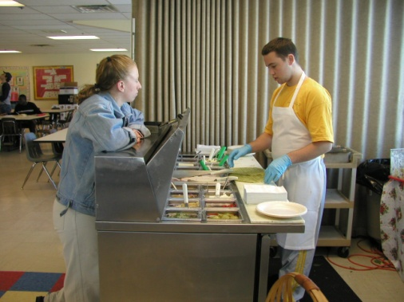
ACE® Curriculum
Discrimination
Communication
Academics
Social Skills
Self-help
Health & Safety
Recreation, Leisure, Play
Community
Vocational
Transition to Adulthood
Notes:
The content of the ACE® curriculum follows the Necc scope and sequence.. Because we serve a large group of students with varying abilities, the scope of the curricula meets the needs of those students working on entry level skills to those working on skills near or at grade level. We provide instruction across many domain areas

Slide 40
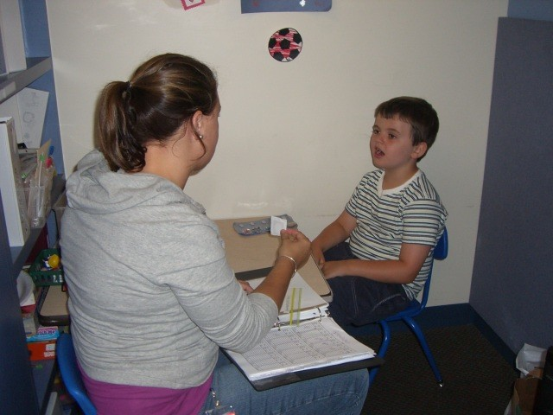
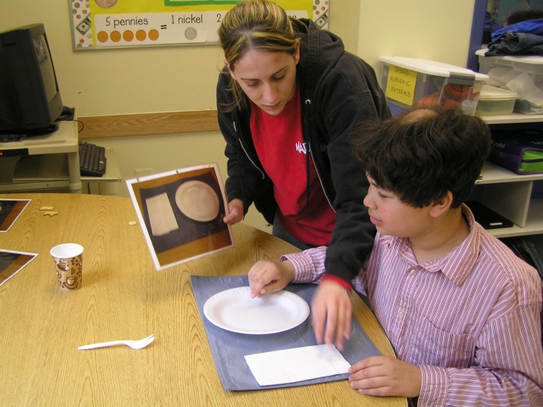
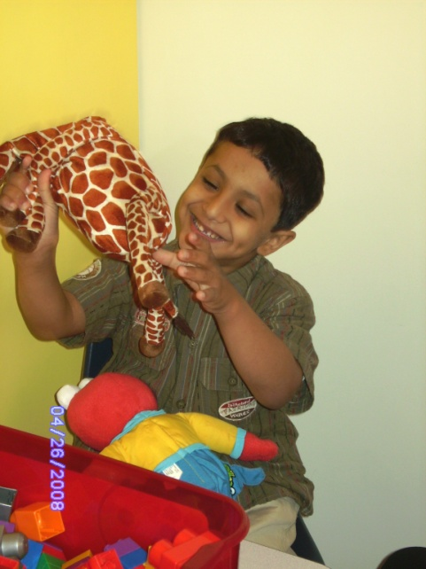
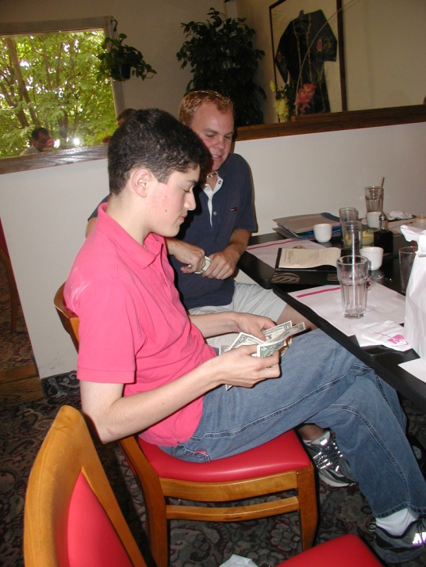
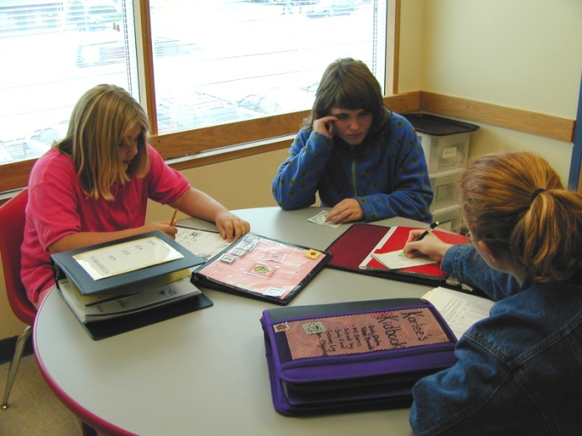
Teaching Formats
Discrete Trial
Task Analysis
Video Modeling
Incidental Teaching
Group Instruction
Notes:
All of the lesson plans contained in the ACE® are reviewed by clinicians and specialists at NECC. The lessons are designed to be taught using best practice teaching methodology. This year we plan to a add group instruction format for those students able learn new skills with other students of similar abilities.

Slide 41


Standardized Lesson Plans
Standardize format and put in database
  Easy to find what you’re looking for
  Increased efficiency
  Allowed for quality control – lesson plans approved and then shared
  Standardized objective writing
    still individualized…
    but ensured that every objective included measureable outcome, generalization component, for example
  Easier to enact changes to practice that would impact everyone (change in default prompting procedure)
Notes:
Finally, someone had the great idea to standardize the format of lesson plans and compile these into a database
Several advantages have come along with this move [Click]
It’s easier for teachers to find what they’re looking for . [Click]
Increases efficiency – so there’s NO time wasted writing a NEW plan when one that works is already available. [Click]
Provides quality control – lesson plans are first approved by a curriculum committee and THEN shared. [Click]
Standardizes and improves how we write our goals– . [Click]
Goals are still individualized, of course, . [Click]
but now we can ensure that every objective includes a measureable outcome and a generalization component, for example. [Click]
And it’s Easier for us to enact changes to practice that would impact everyone (for example a change in the default prompting procedure for a particular type of lesson) . [Click]
So this database was created and it was named the Autism Curriculum Encyclopedia

Slide 42
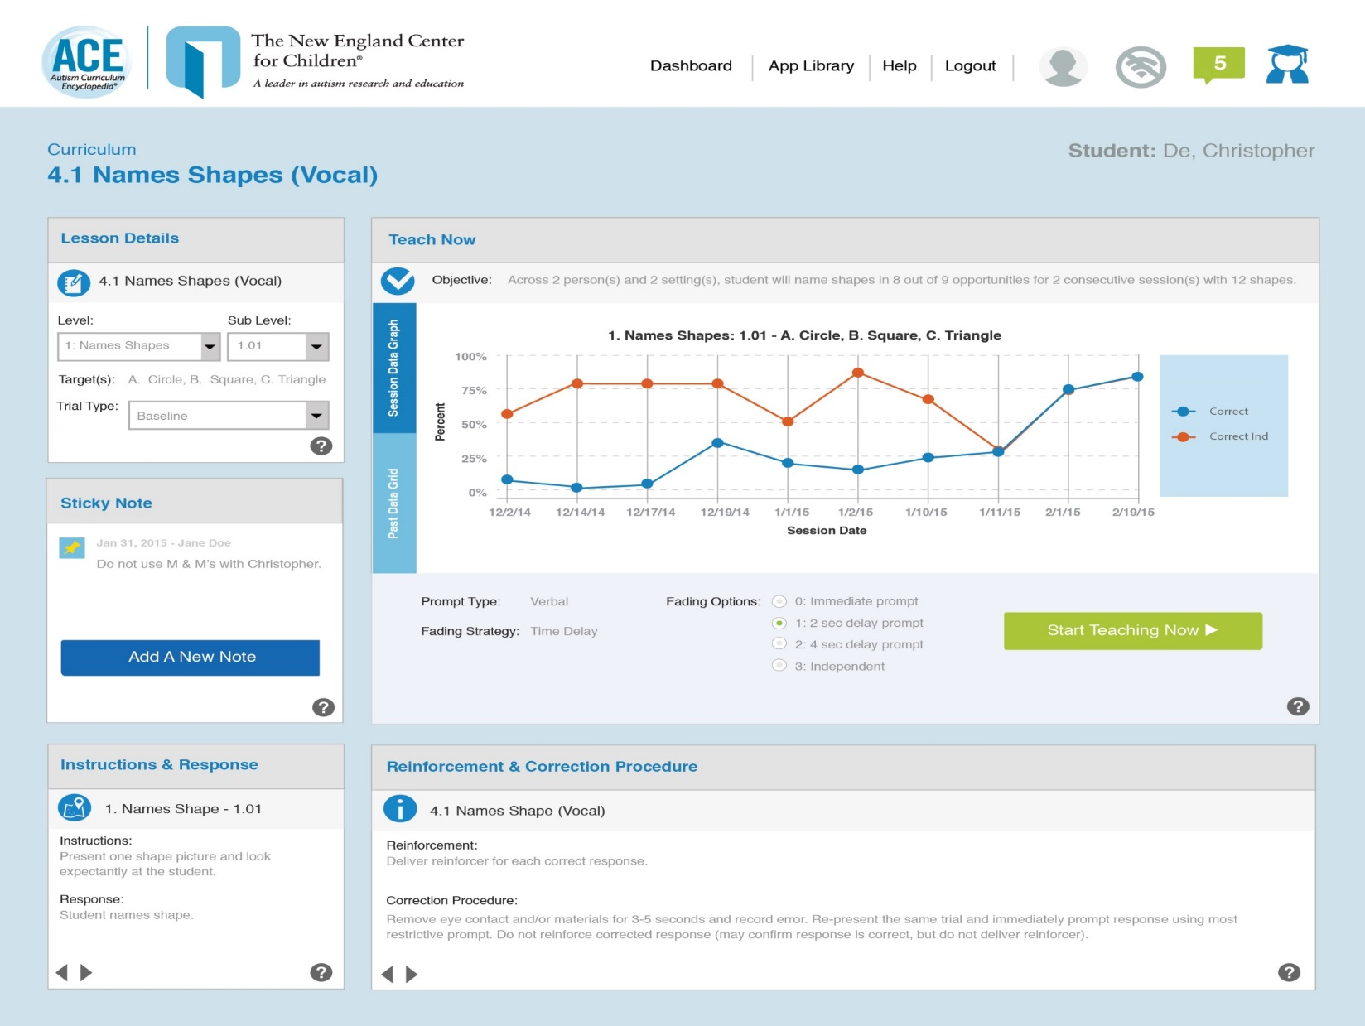
Online Data Collection

Slide 43
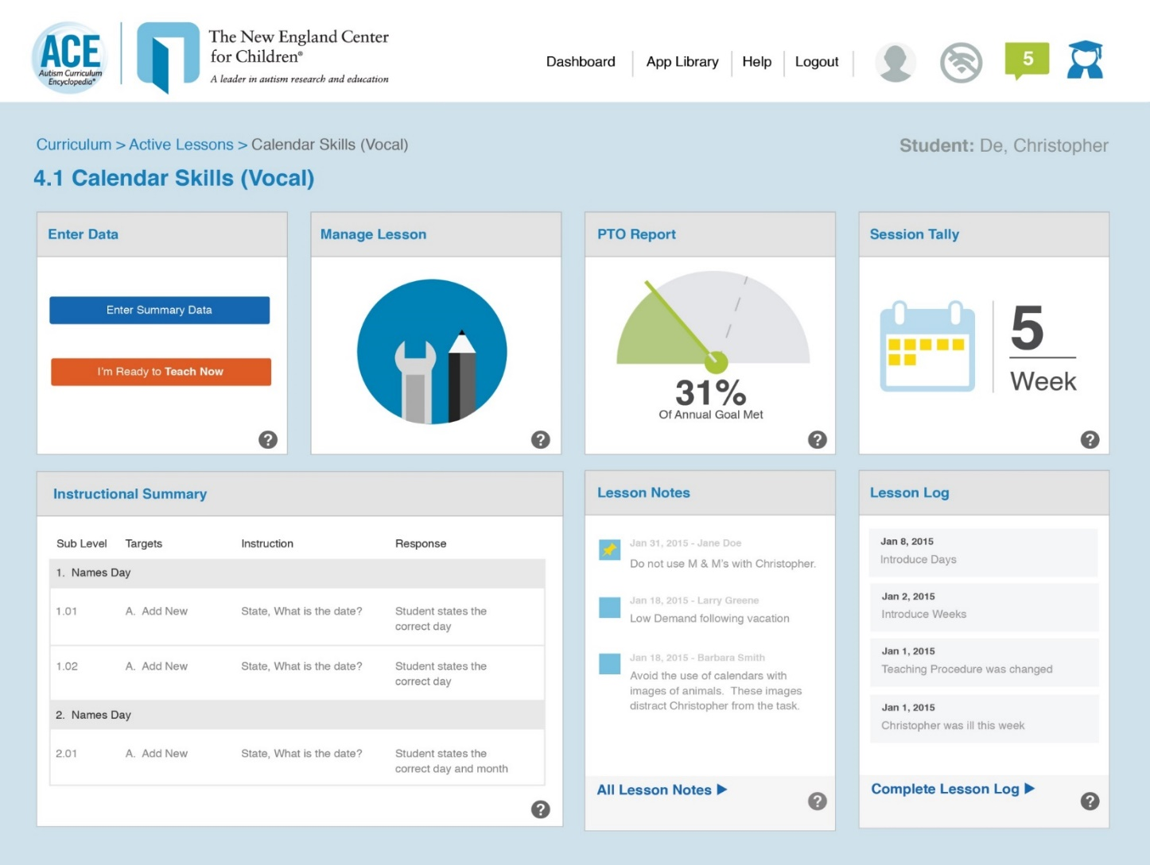
Lesson Plan Monitoring

Slide 44
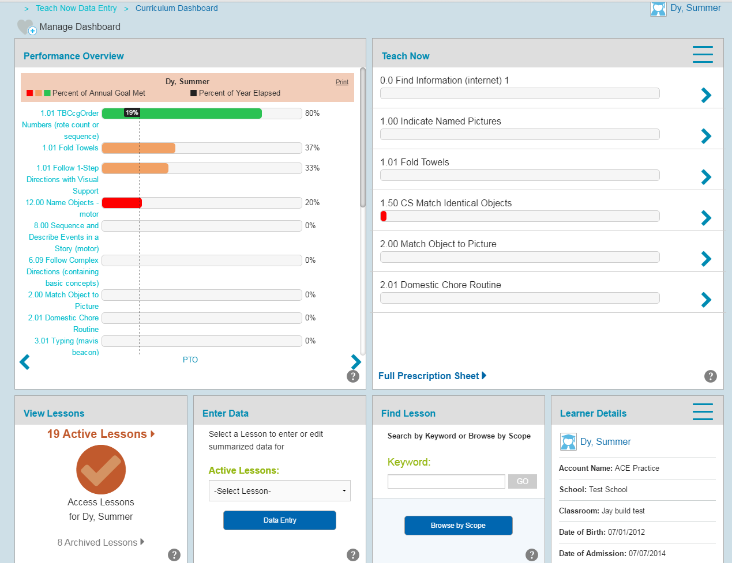
Curriculum Monitoring

Slide 45
App Library

Slide 46
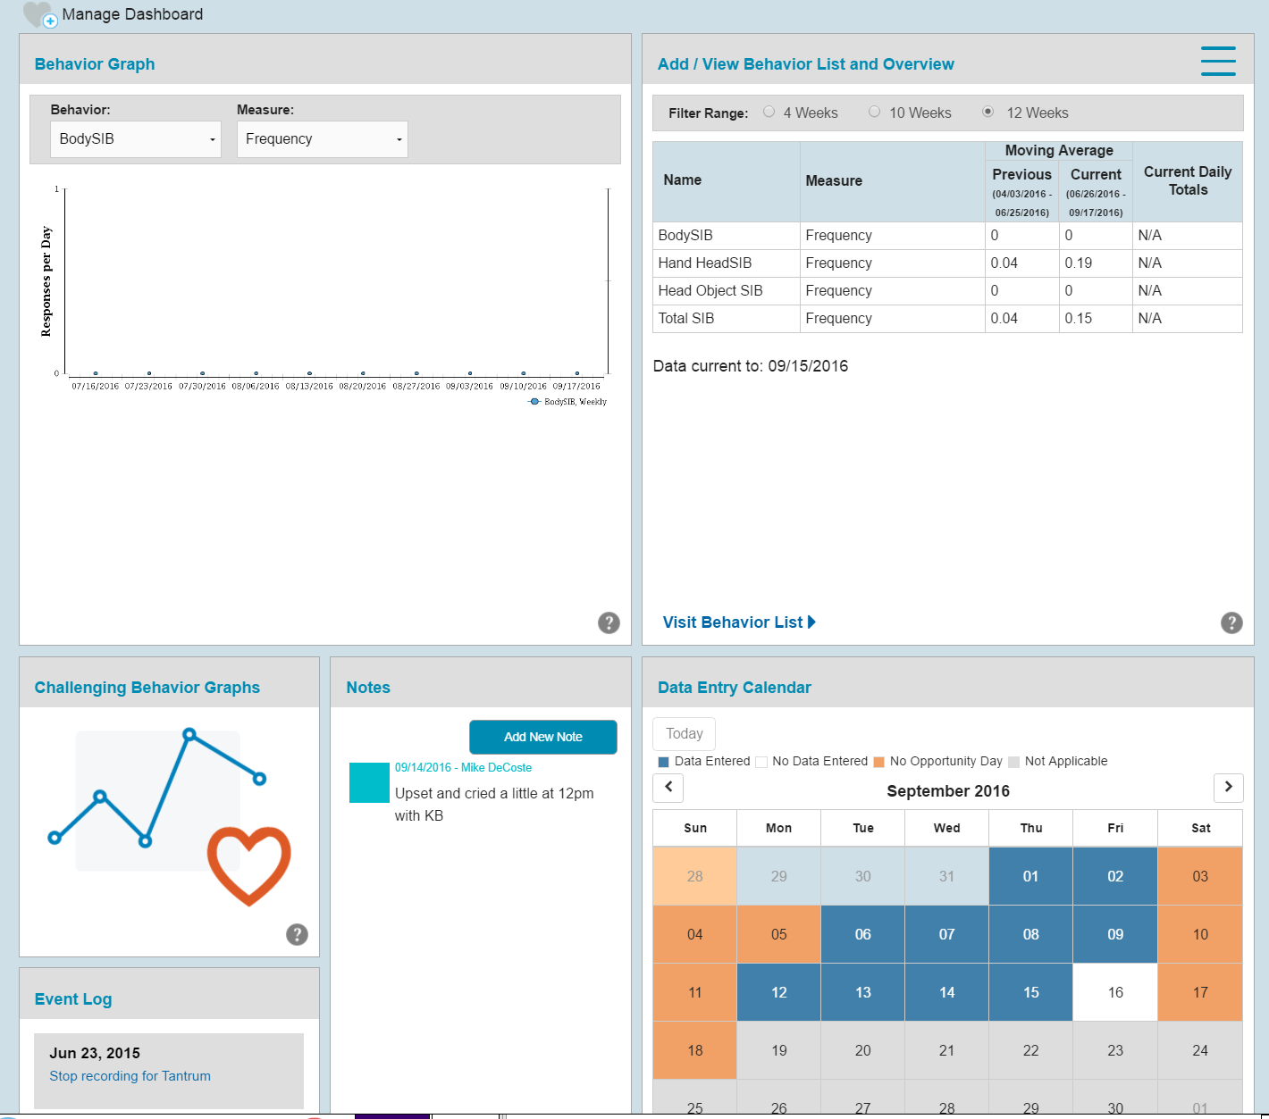
Challenging Behavior
The Challenging Behavior App is used to identify and monitor:
  Challenging behavior (for example, striking others, striking self, spitting).
  Desired behavior (for example, requesting attention, toileting).
The dashboard provides a snapshot view of challenging behavior data that is being tracked for a student and also provides quick links to manage behavior definitions and measurement, data collection, and reports

Slide 47
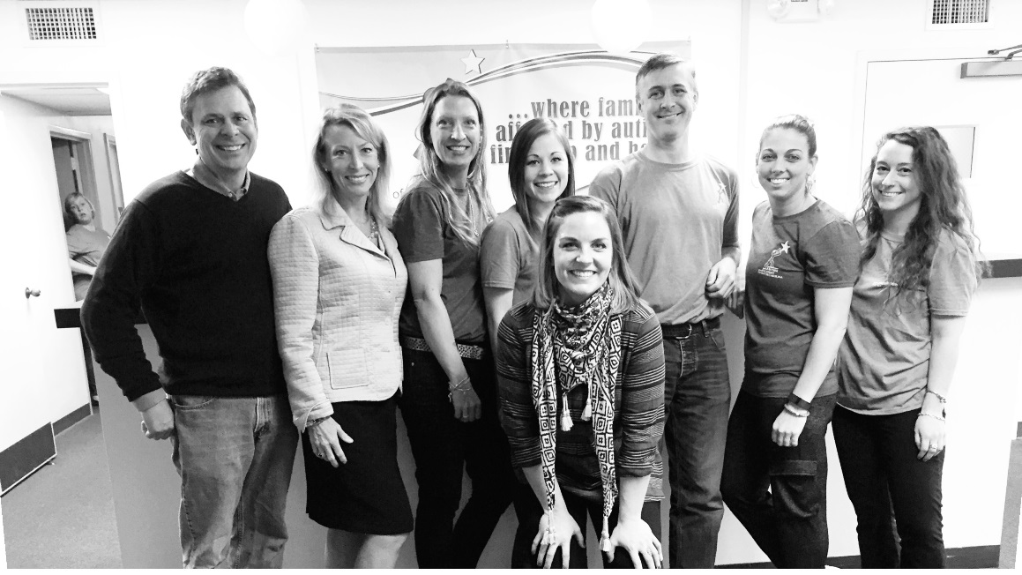
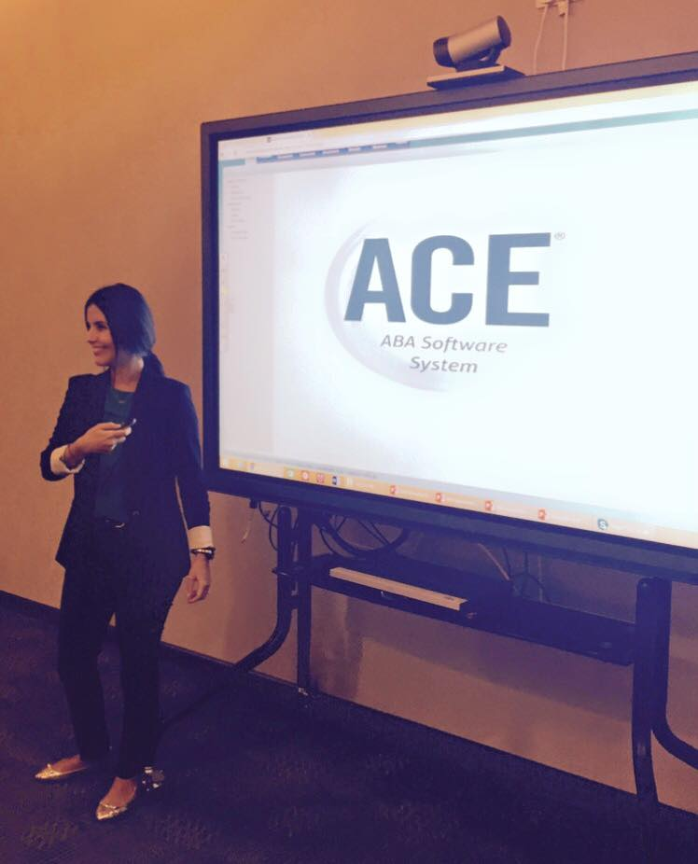
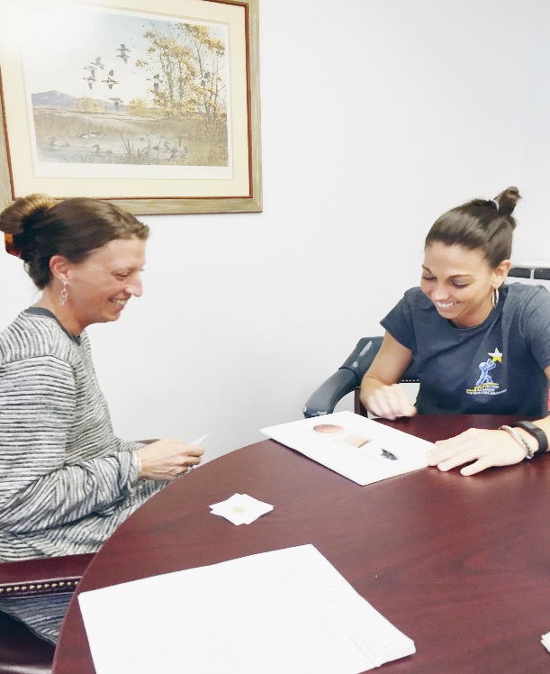
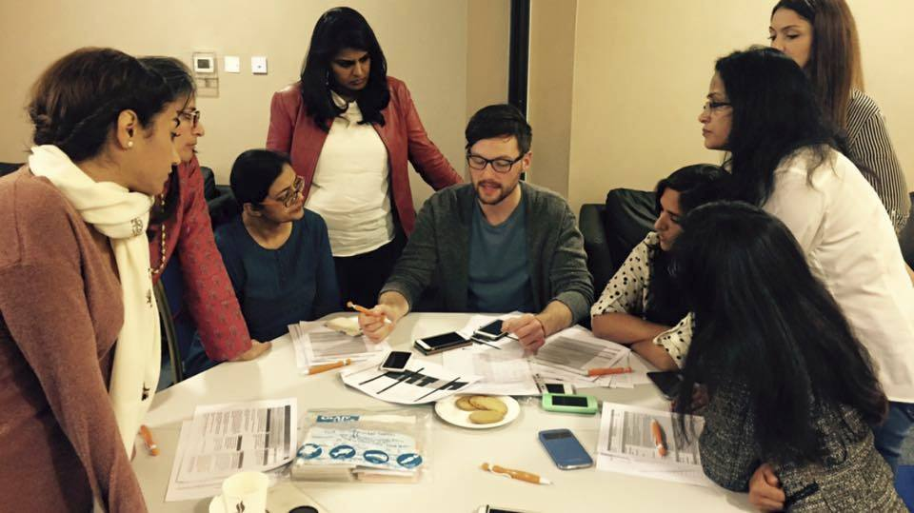
ACE Training and Support
Notes:
Now, whenever possible, we prefer to train our ACE users in-person. Nothing beats the connection you make when meeting face to face, and here are a few action shots of ACE trainings around the world.
(pictures are from Autism Academy of South Carolina and Abu Dhabi)
But with almost 4 thousand users spread so far and wide, in person training is not always possible.
And that’s when we rely on technology to help us reach the educators and “bridge” the distance.

Slide 48
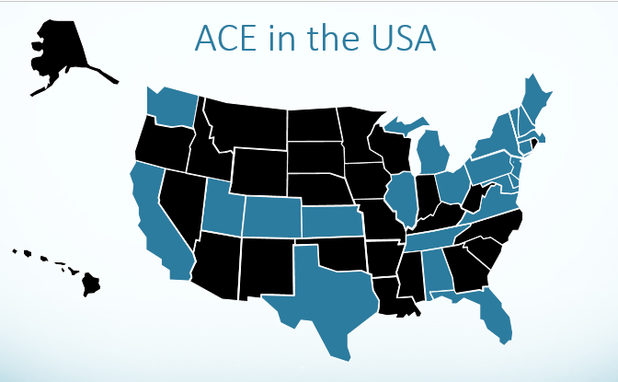

ACE® Status
June 2016:
2,072 | Lessons available | 2,839 | Skills Assessments
52,720 | Lessons activated on the ACE | 5,172 | Preference Assessments
6,773 | Core Skills Assessments | 12,027 | Challenging Behaviors

Slide 49

Public School Services

Slide 50
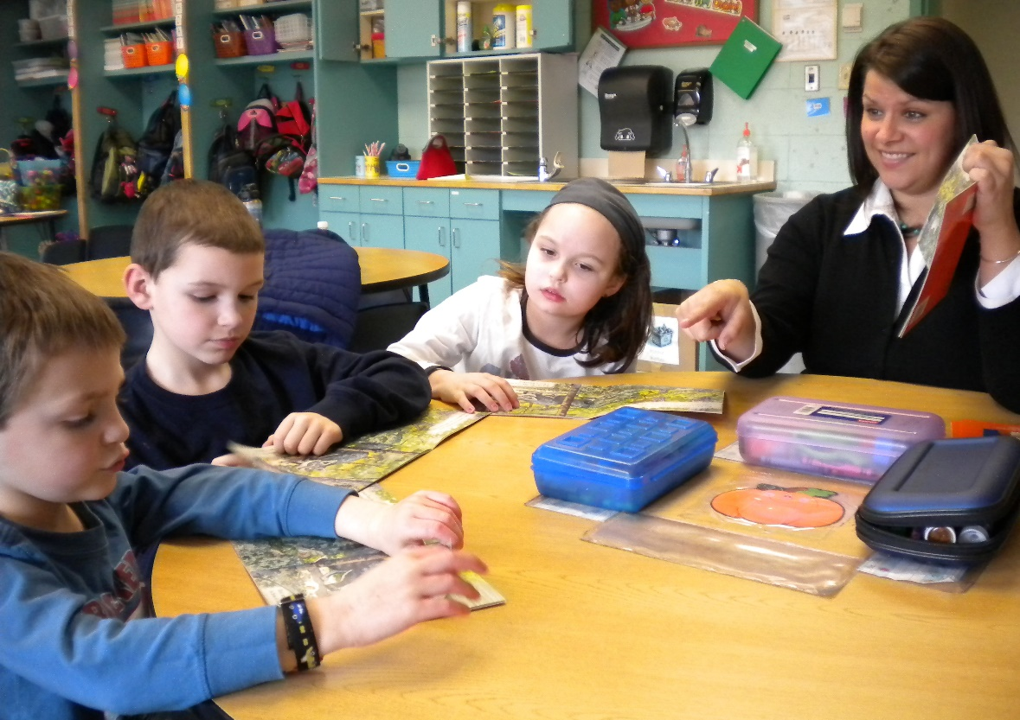
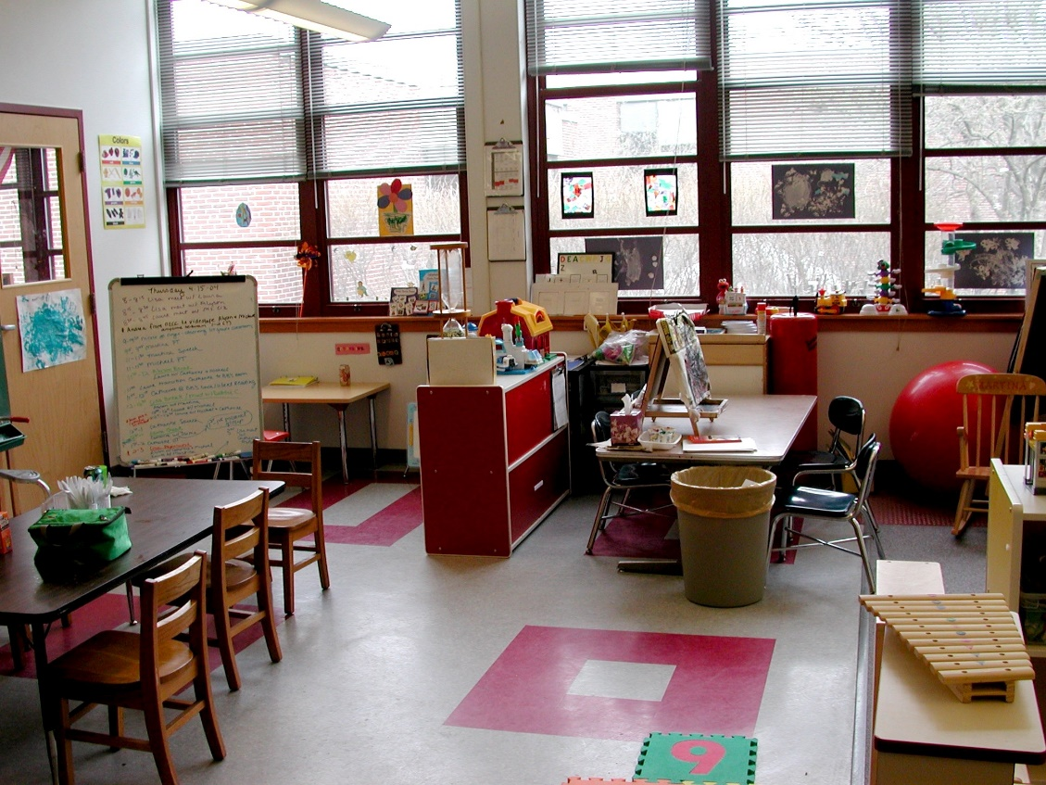


Partner Program
Notes:
Transition paragraph
Paragraph about Autism Institute and training
Paragraph about the first Partner classroom request

Slide 51
Partner Program
Partner Program
Staff Training and Mentorship
ACE®
Classroom Supervisor
Weekly Support from Senior Consultant
Students
Classroom Space
Inclusion Classes
Direct Care Staff
Classroom Systems
NECC Resources
Administrative Support
District Resources
Notes:
Discuss the components

Slide 52
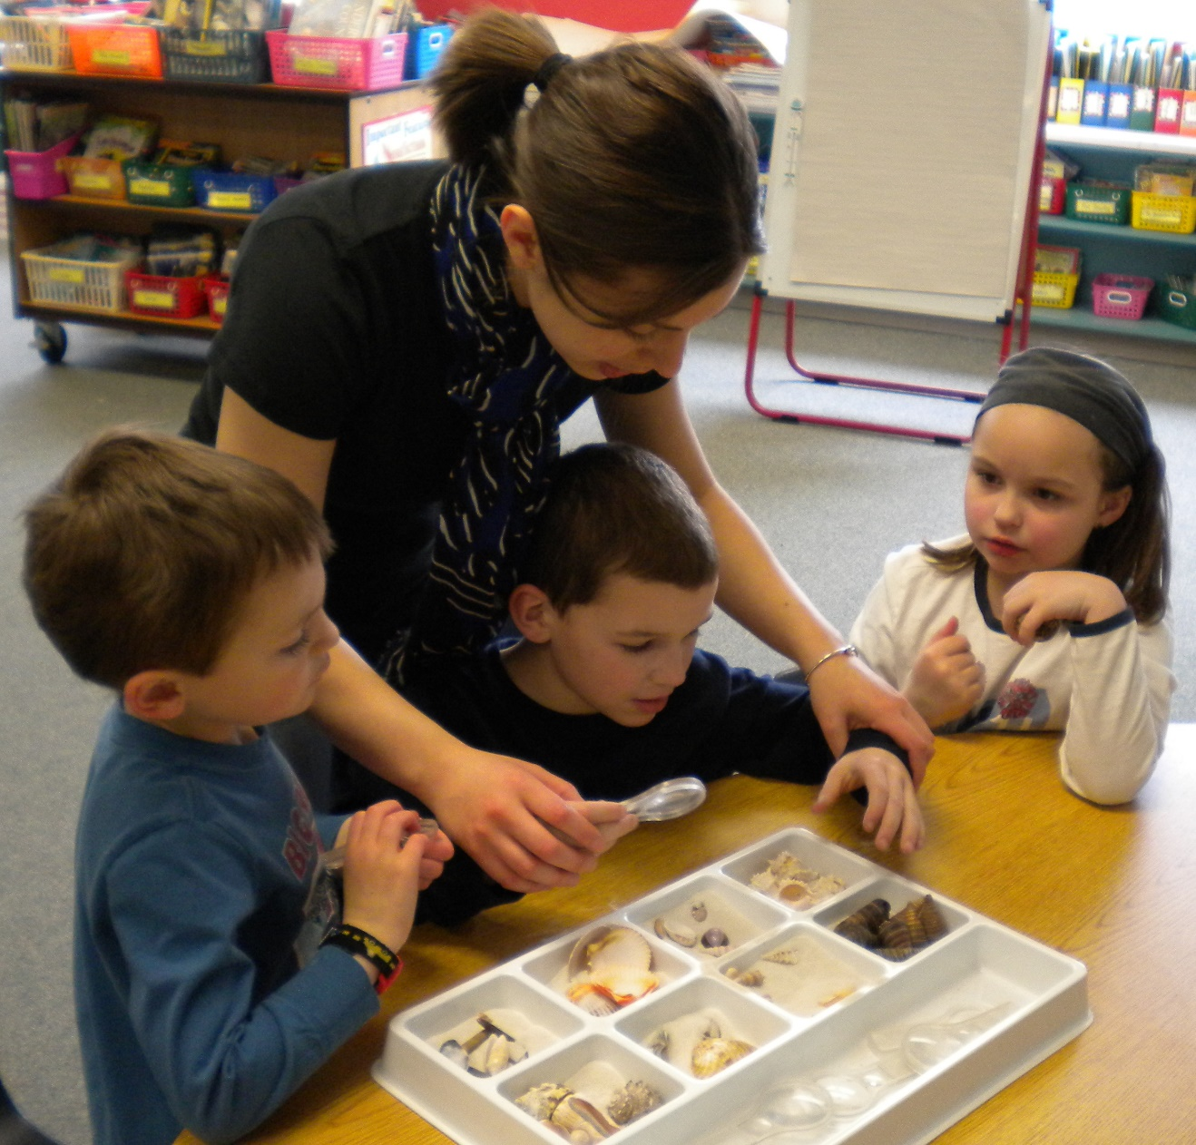
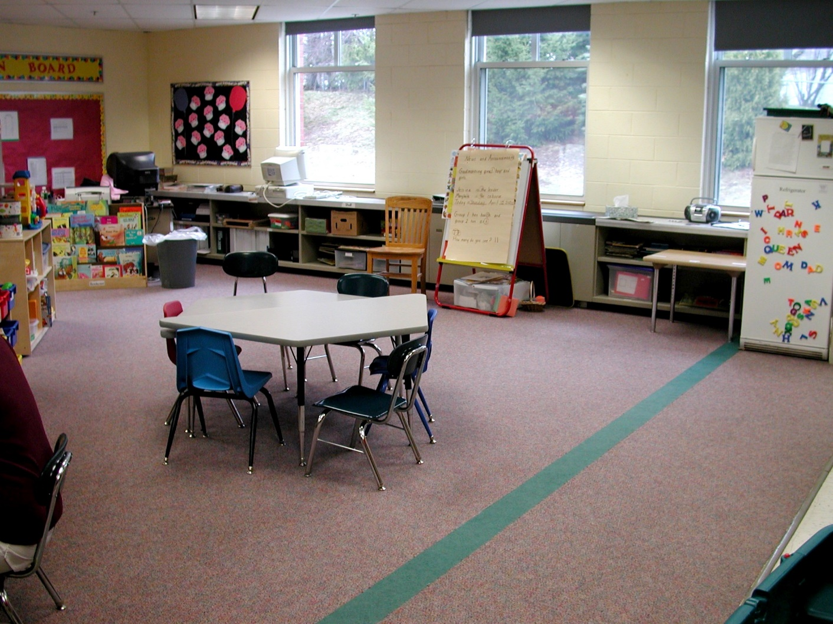
Partner Program

Slide 53

Partner Program
39 Partner Program classrooms
224 students currently served
400+ students served over the past 19 years

Slide 54

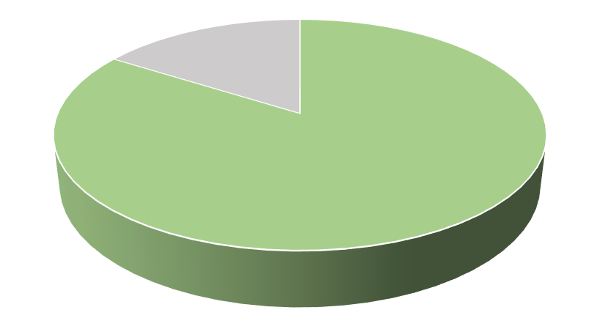

Partner Program
94% of Students’
IEP objectives are met or show progress
91% of Students
In Partner Program are included in
The general education setting
Upon leaving Partner Program
84%
Of students moved to a
less restrictive classroom

Slide 55
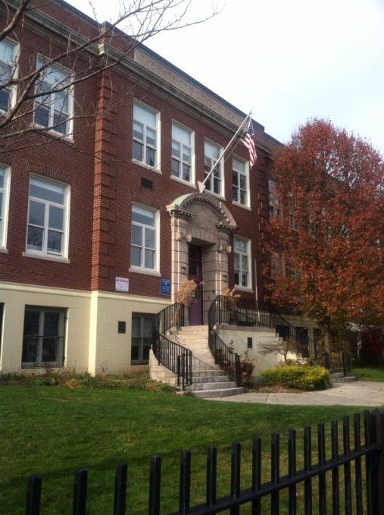



City-Wide Projects

Slide 56

City-Wide Projects
Boston Public Schools Project, 2011-2014
SCHOOL YEAR | PROJECT SITES | FULL-TIME NECC CONSULTANTS | STUDENTS ACCESSING THE ACE®
Year 1 2011-2012 | 1 school 4 classrooms | 1 | 30
Year 2 2012-2013 | 5 schools 19 classrooms | 4 | 150
Year 3 2013-2014 | 14 Schools 76 Classrooms | 3 | 500
Ongoing ACE Use
New York City Public Schools – 400 students across 20 schools
Boston Public Schools – 1100 students across 35 schools

Slide 57








Consultation and Evaluation Services
Serving over 400 students across 60 schools in 5 states
  Individual Students
  Classrooms
  Programs
  Districts
Notes:
In addition to our Partner Program Classrooms and City-Wide projects, Public School Services provides consultation services to over 400 students across 60 schools in 5 states. Our 17 Master’s and Doctoral-level BCBAs work with paraprofessionals, general educators and special educators to build their capacity to effectively serve public school students diagnosed with ASD and related disabilities. Consultants provide regular support and training to teams working with individual students, general and special education classrooms and entire districts. Additionally, PSS conducts evaluations of individuals, special education programs and district-wide ASD services to help administrators develop successful programming for students enrolled in their public schools.

Slide 58


Professional Development
Webinars
BCBA’s, educators, and parents
2015-2016
Over 900 participants
ABA Workshop
Series
CALM Training
Notes:
Professional development sessions are held across the school year and summer including in-person training sessions at NECC’s Southborough campus, presentations at public school professional development days, summer workshop series and web-based trainings. Training participants include paraprofessionals, educators, BCBAs, and parents. During the 2015-2016 school year, over 900 people participated in PSSs professional development offerings.

Slide 59



