Slide 1
NERIS Status Update
May 15, 2025

Slide 2


NERIS Onboarding
Two Phase Process
1
2
Creating Your Account
Reporting
Fire departments can add/update attribute information after they activate their node in NERIS.
A) If using the NERIS collection app - submit when ready.
B) If using a third-party RMS – switch after your RMS is ready

Slide 3

NERIS Integration Partner Program: Vendor Interoperability and Compatibility
The NERIS-compatible badge signifies that a vendor’s software is capable of data exchange with the NERIS platform.
To earn a NERIS compatibility badge, a vendor must:
Create an integration between their software and NERIS
Submit a new incident in the test environment to the FSRI Fire Department
Capture the unique incident number and submit an update to the incident that was created
Establish a station and add a unit to the FSRI Fire Department
As of 5/14/2025: Thirteen (13) unique vendors have successfully completed NERIS data exchange compatibility testing and received the badge.
More information available, https://neris.fsri.org/integration-partners

Slide 4
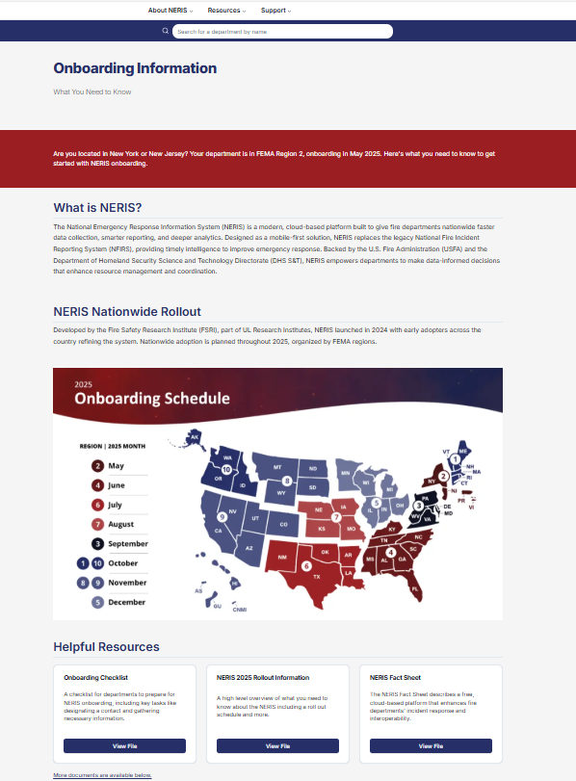
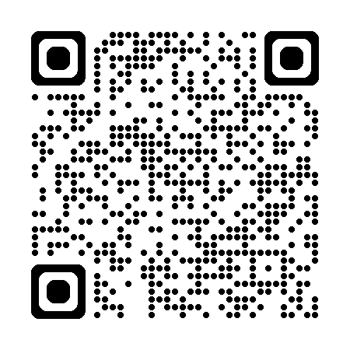
NERIS Onboarding Center
Link: https://neris.fsri.org/onboarding
Or Scan QR Code:

Slide 5
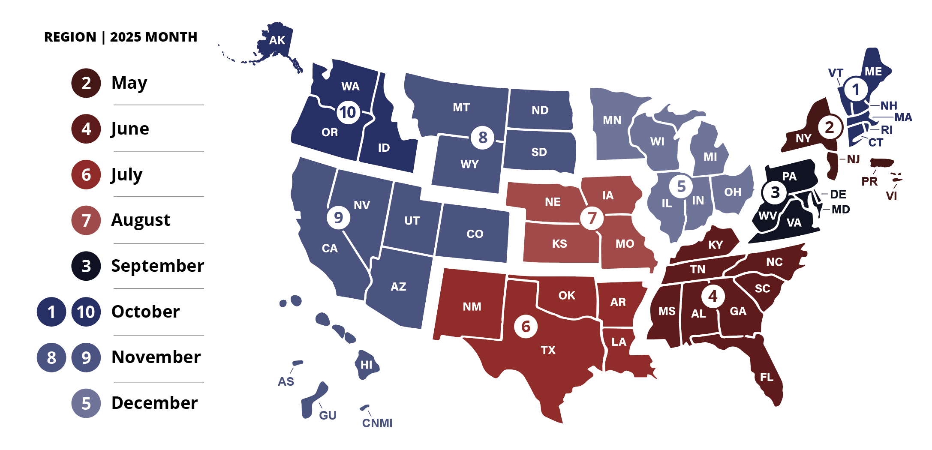
2025 Onboarding Schedule

Slide 6
NERIS Adoption in the Numbers As of 5/14/2025
All 50 State Fire Marshal Offices (or equivalent) onboarded
1,954 local fire departments onboarded, representing all 50 states

Slide 7
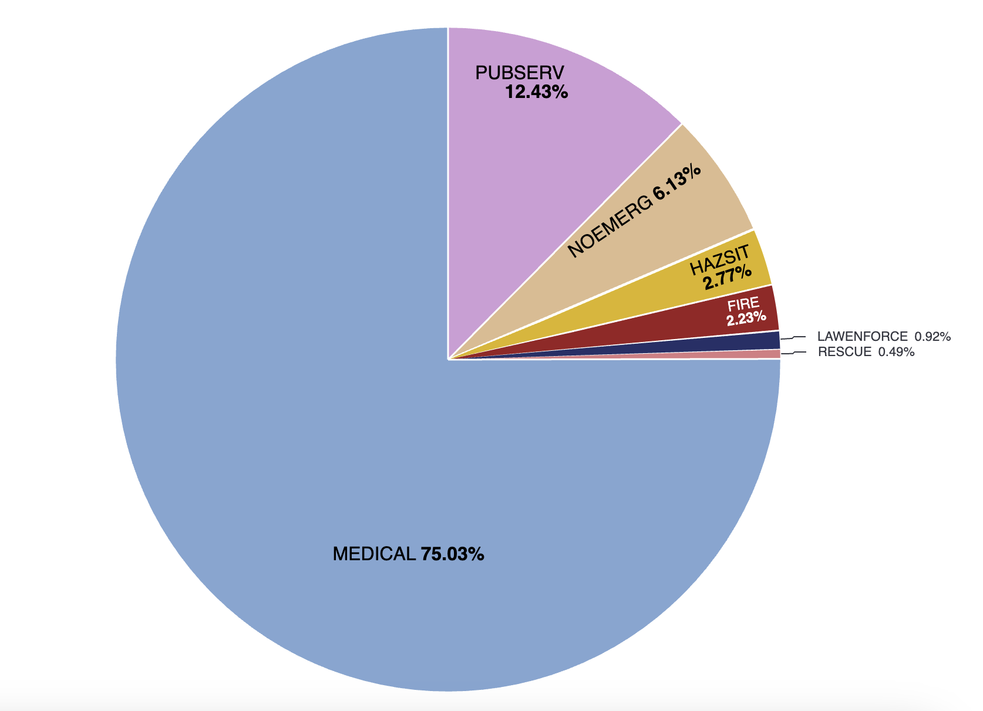
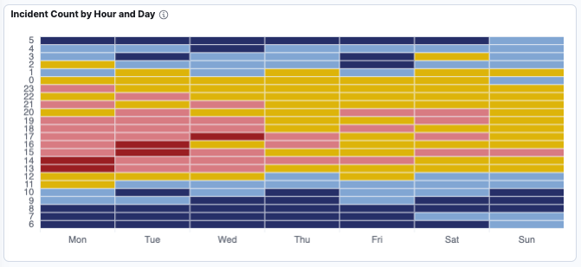
NERIS Incident Data Insights As of 5/14/2025
Incidents Reported by Type
7,242 - Incident reports shared into NERIS from local fire departments
4% of incidents are multiple discipline
64% of responses are at residential structures
2 - local RMS with connections to NERIS automating the sharing of incident reports.
Others slated to connect in June

Slide 8
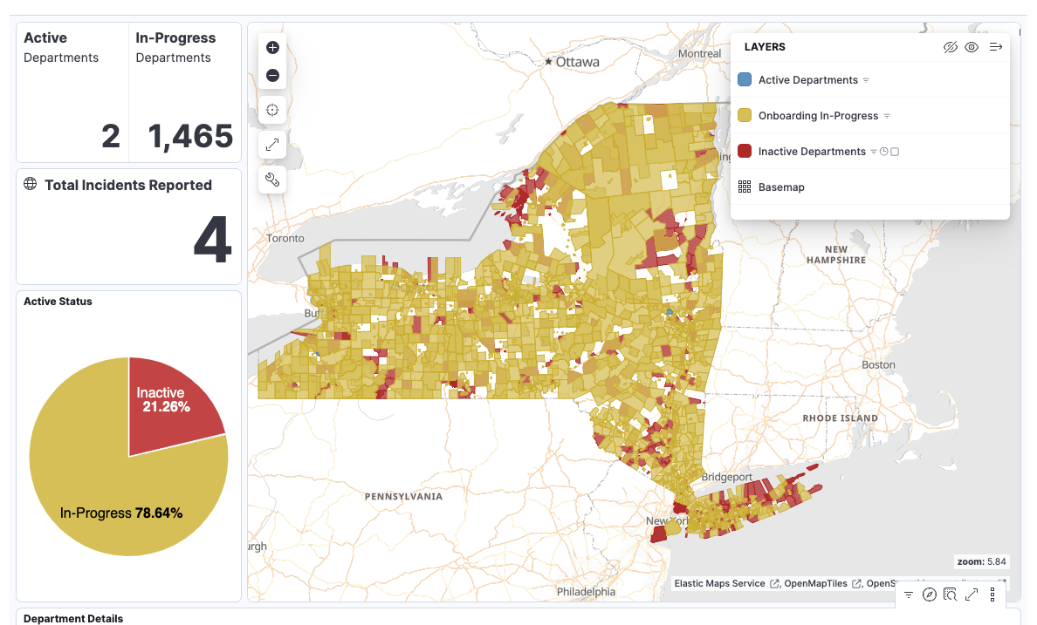
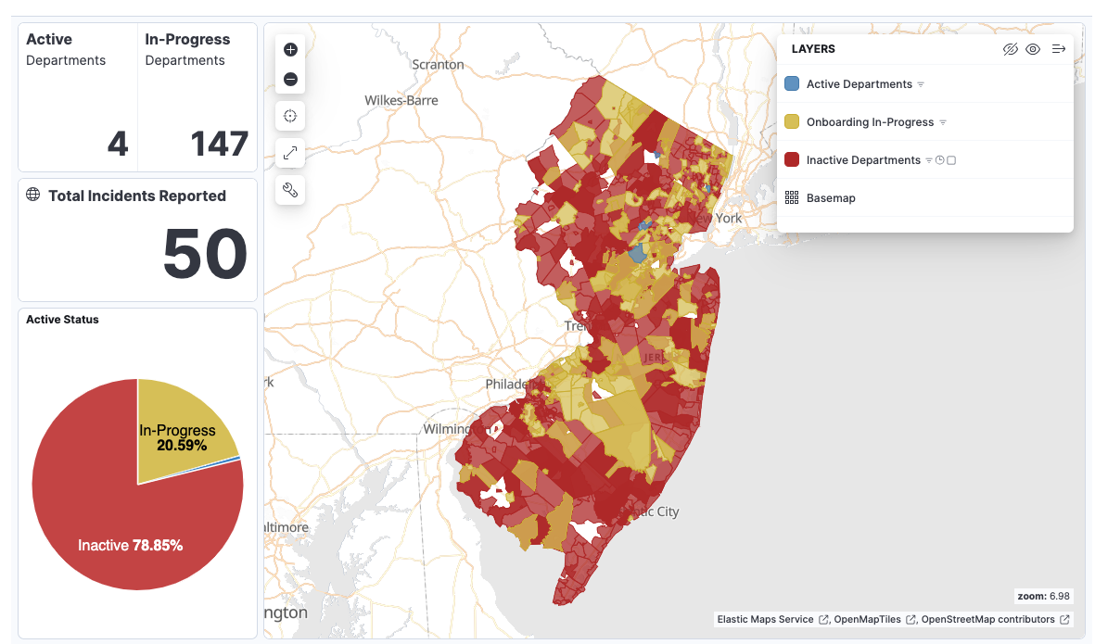
Spotlight: New York and New Jersey Onboarding As of 5/14/2025
On May 1, 2025 – Onboarding opened for all local fire departments in New York and New Jersey.
Within 14 days a total of 1,618 departments from NY and NJ began onboarding onto NERIS
Legend for State Dashboards:
Active: Users in the system and reporting incidents.
In-Progress: Onboarded started and FD has established user(s) in NERIS.
Inactive: Onboarded not yet started in that FD.

Slide 9
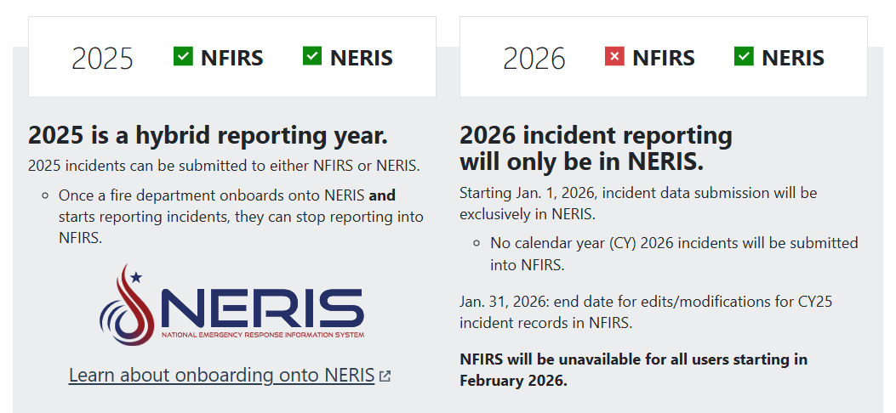
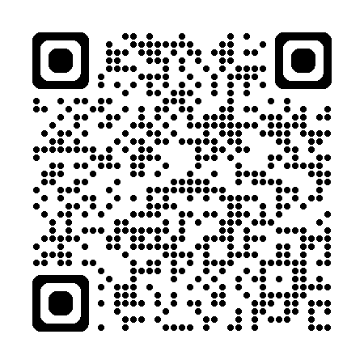
NFIRS Sunset Essentials
More information to prepare your fire department for the sunset of NFIRS, visit https://www.usfa.fema.gov/nfirs/sunset/
Or scan QR code:

Slide 10

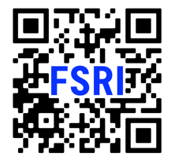



Thank you.
FAQS: HTTPS://WWW.USFA.FEMA.GOV/NFIRS/NERIS/ABOUT-NERIS | NFIRS Sunset: https://www.usfa.fema.gov/nfirs/about/sunset/index.html
WEBSITE: HTTPS://FSRI.ORG/PROGRAMS/NERIS | VIDEO Library: https://vimeo.com/nerisdata
CONTACT US: NERIS@UL.ORG

