Slide 1
Commonwealth of Massachusetts
Lemuel Shattuck Hospital 2024 Relocation Project Overview for East Newton Pavilion Abutters
June 23, 2021
Continuing Shattuck’s Commitment to Providing High Quality Health Care to the State’s Most Diverse, Underserved Patients
Draft for Discussion Purposes Only

Slide 2
Agenda
Welcome – David Stone, President, Blackstone/Franklin Neighborhood Association
Introductions of Leadership & East Newton Pavilion (ENP) Project partners:
- Frank Doyle | Asst. Commissioner | Department of Public Health (DPH)
- Gordon Wrin | Director | Design & Construction, DCAMM
- Rick Polvino | Managing Principal | SLAM, AIA, LEED AP
- Neil Martin | Design Principal | SLAM, AIA
- Jessica Petro | Design Director | SLAM, PLA Landscape Architecture
- Jim Dabrowski | Sr Project Executive | Gilbane Building Company
Todays Objectives
Continue to build trusting, respectful & transparent relationship with our neighbors
Review and respond to comments as discussed at the April 20 meeting
Listen to additional concerns
Take additional concerns back for more detailed review by our team in order to respond at our next meeting
Create an ongoing and reliable feedback loop
Construction Logistics and Schedule
Comments and Discussion
Next Steps
Updated: 6/22/2021
Draft for Discussion Purposes Only ₂

Slide 3
Comments and Topics
Comments & Discussion from April 20th Meeting:
Corrections Van Parking Impacts:
Proximity to Neighborhood, Noise, Fumes, Management of non-authorized Parking
Mitigation Strategies: City of Boston Van parking on E Newton Street
Property Maintenance:
Evergreen trees and shrubs clean-up (completed)
Raised Planter (restricted access / maintenance)
Safety:
Campus Police Patrolling frequency
Camera monitoring: Privacy/Security
DOC Protocols
Patient escape protocols
Noise/Vibration:
Delivery, Trash Pick-up Schedule
Audible back-up signals
Rooftop noise source
Construction Coordination and Neighborhood Interface:
Scheduled for next meeting
Updated: 6/22/2021
Draft for Discussion Purposes Only ₃

Slide 4
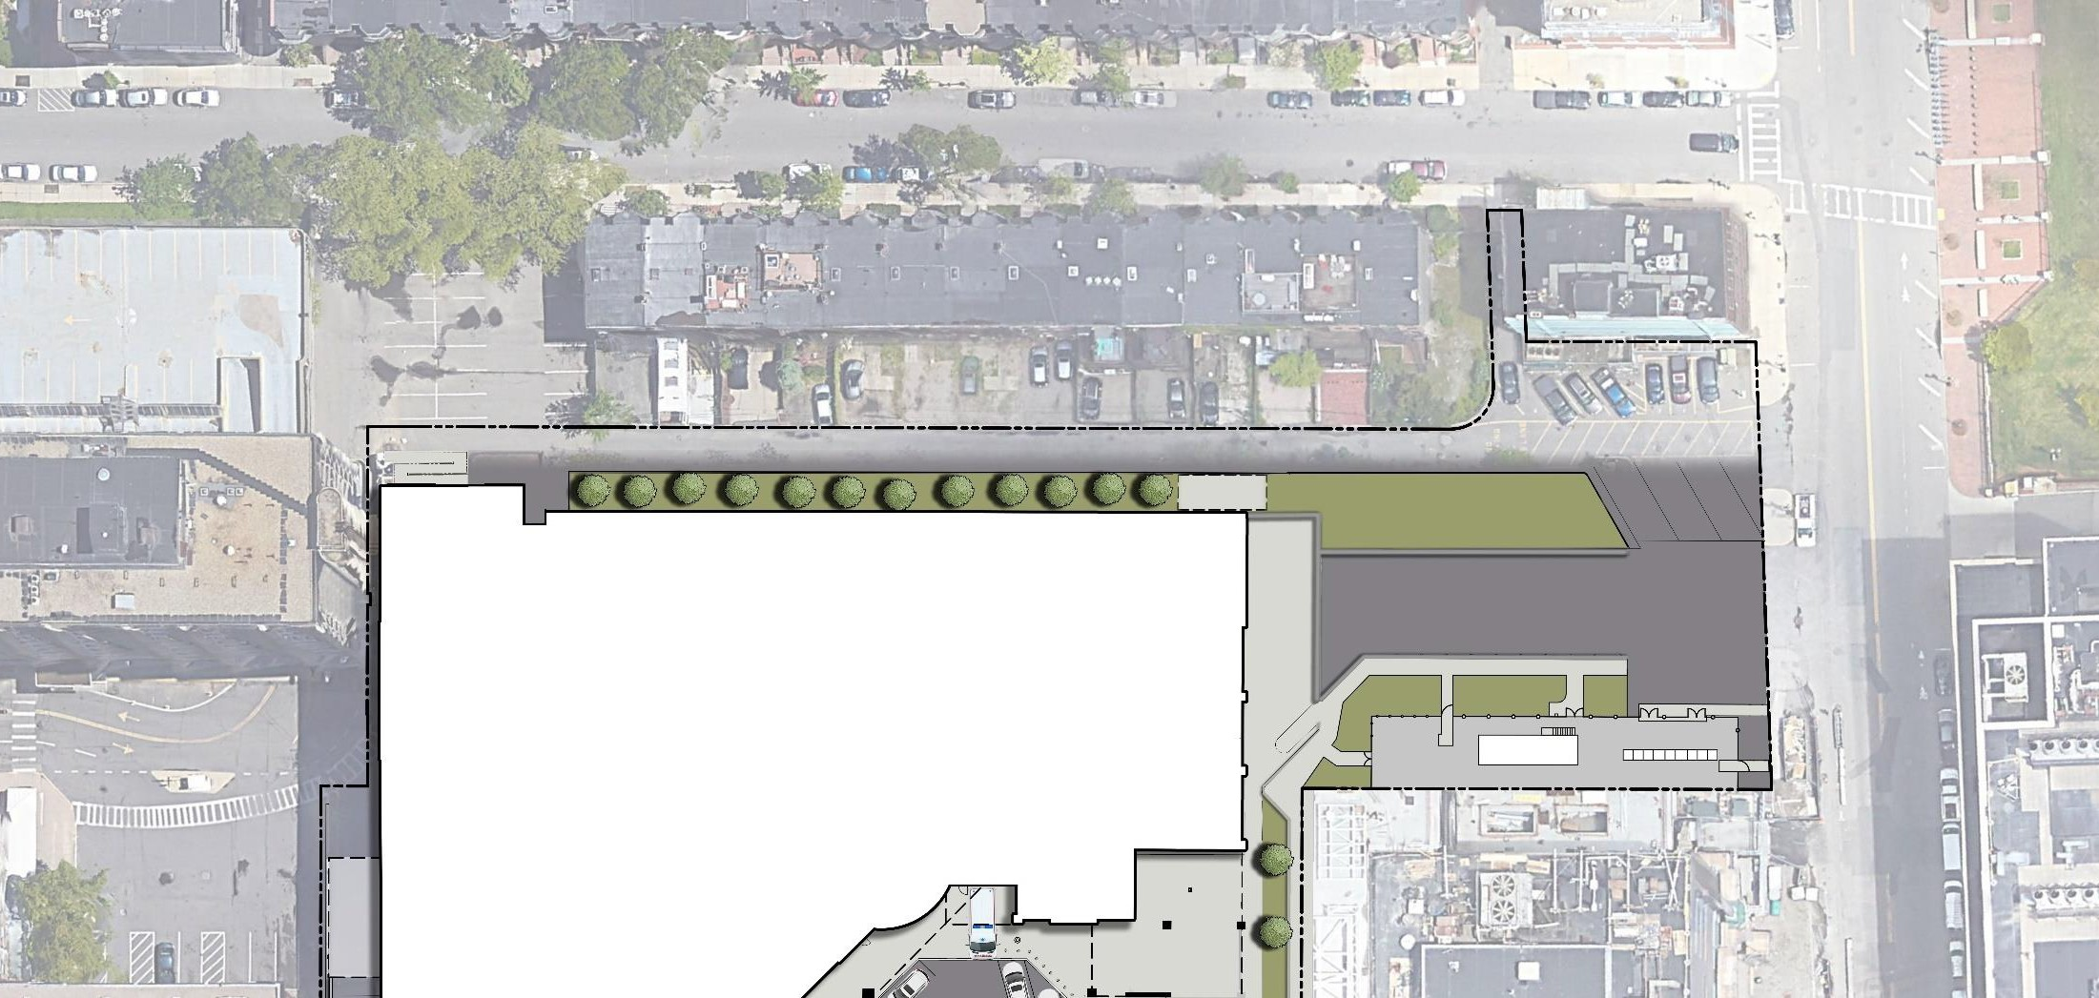
Van Parking: Existing Conditions
Correction Van Parking Impacts
Proximity to Neighborhood, Noise, Fumes, Management of non-authorized Parking
EAST BROOKLINE STREET (one way)
Property Line
Loading Dock
Updated: 6/22/2021
Draft for Discussion Purposes Only ₄

Slide 5
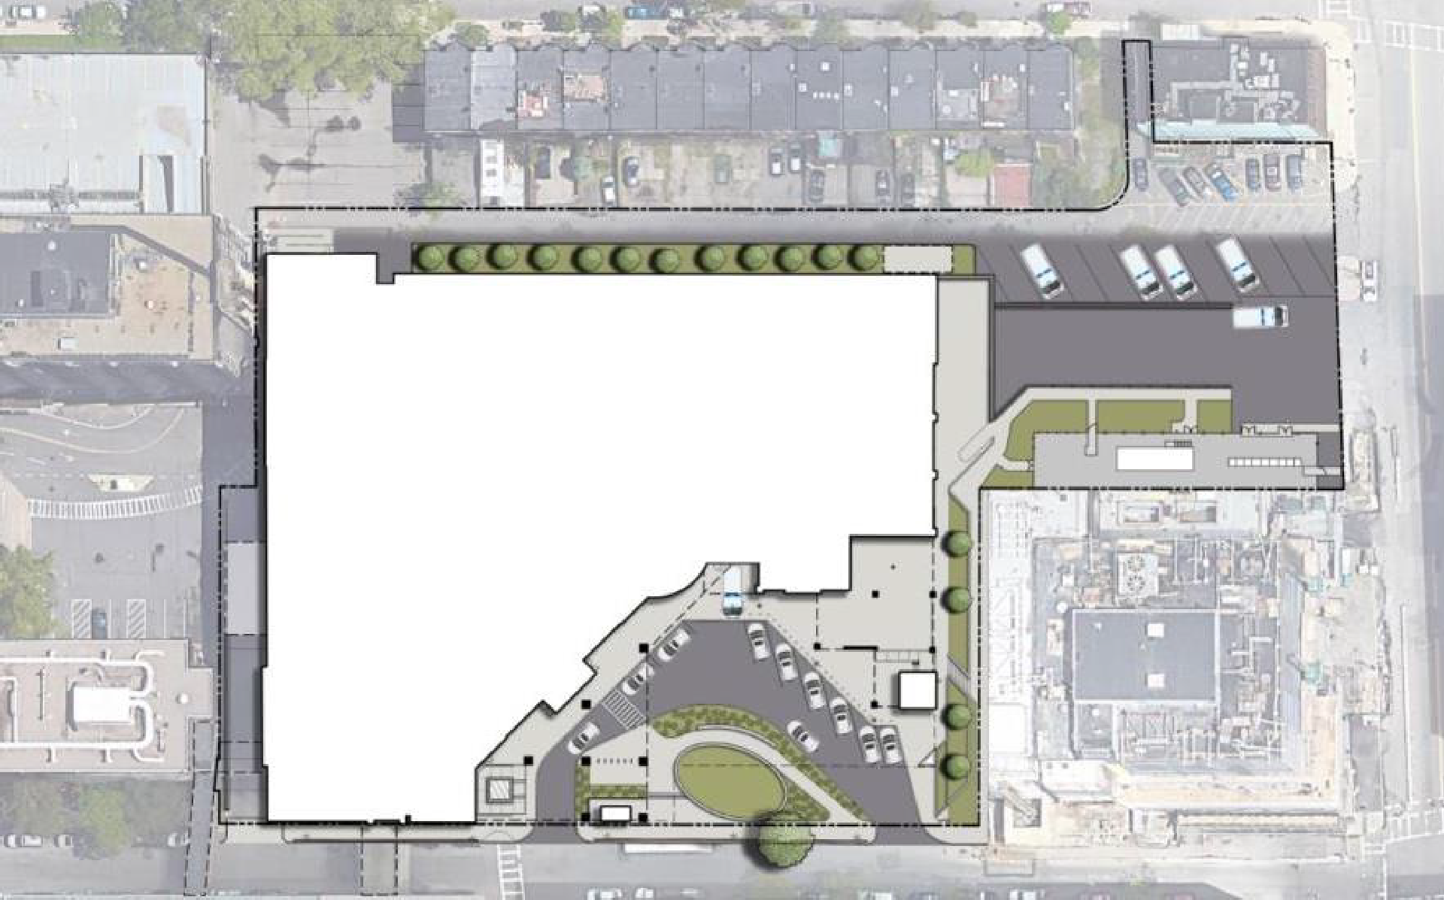
Van Parking: April 20th, 2021
EAST BROOKLINE STREET (one way)
Naval Blood Bank
Parking Lot
Parking Garage
Naval/Blood Bank Parking
Property Line
Fire Lane / Alley
Parking
L. McCall Office Building/Doctors
Office
Loading Dock
Equipment Yard
Ambulance Bay
Corrections Sally Port
Terrace Above
BU Dental School
Main Entrance
Preston Family Building
EAST NEWTON STREET (one way)
On Street Parking
4/20/2021
Updated: 6/22/2021
Draft for Discussion Purposes Only ₅

Slide 6
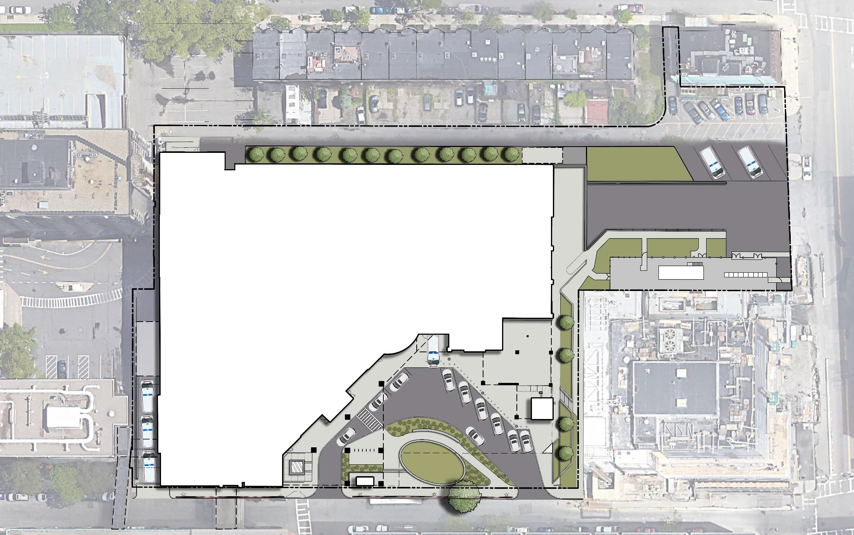
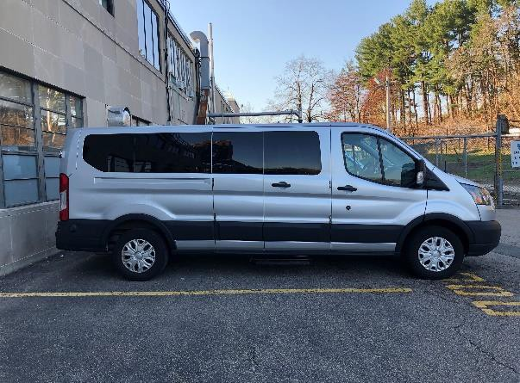
Van Parking: June 23th, 2021
EAST BROOKLINE STREET (one way)
Naval Blood
Bank
Parking Garage
Property Line
Fire Lane / Alley
Parking
L. McCall Office Building/Doctors
Office
Greenspace
Loading Dock
Reduction of
(5) Parking Spaces
Equipment Yard
Ambulance Bay
Corrections Sally Port
Terrace Above
Main Entrance
BU Dental
School
Preston Family Building
EAST NEWTON STREET (one way)
(5) On-street parking spaces
Updated: 6/22/2021
Draft for Discussion Purposes Only ₆

Slide 7
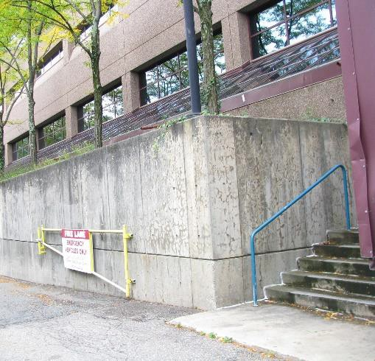
Property Maintenance
Property Maintenance
Evergreen trees and shrubs clean up (completed)
Raised planter (restrict access/clean up)
EAST BROOKLINE STREET (one way)
Property Line
Greenspace
Updated: 6/22/2021
Draft for Discussion Purposes Only ₇

Slide 8
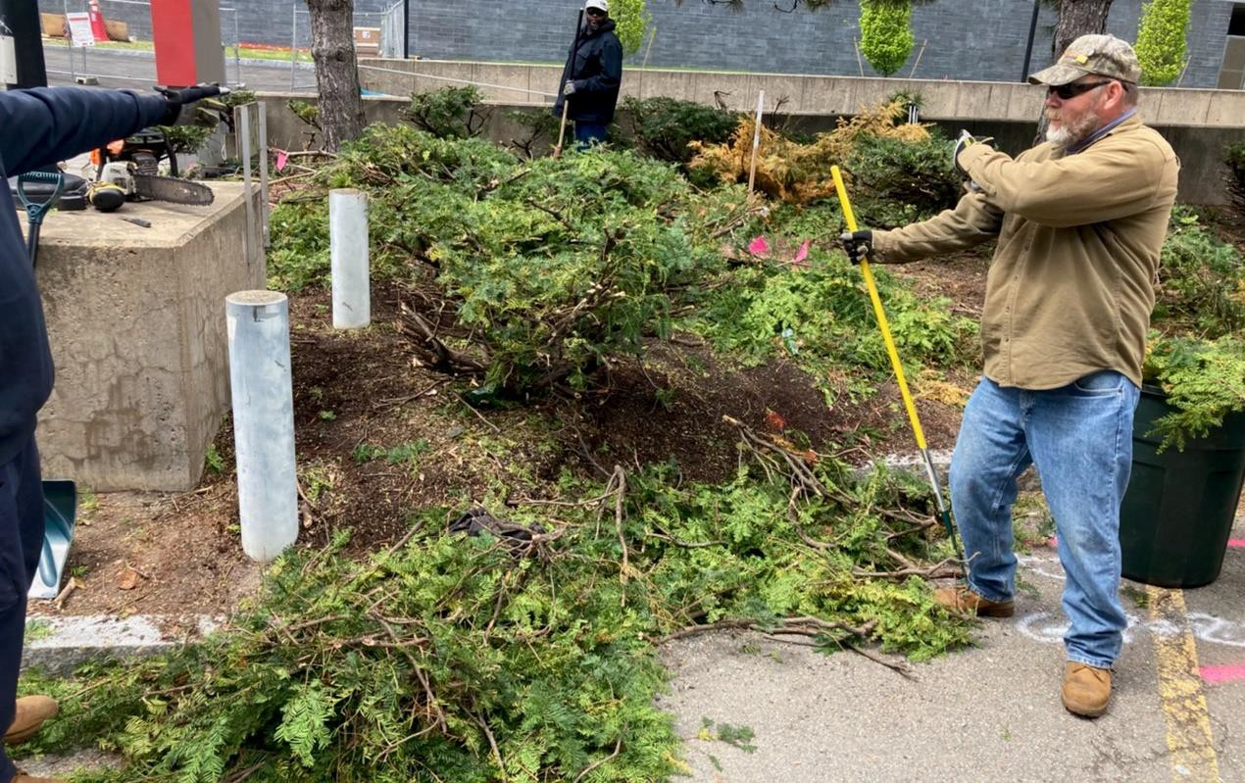
Property Maintenance
Updated: 6/22/2021
Draft for Discussion Purposes Only ₈

Slide 9
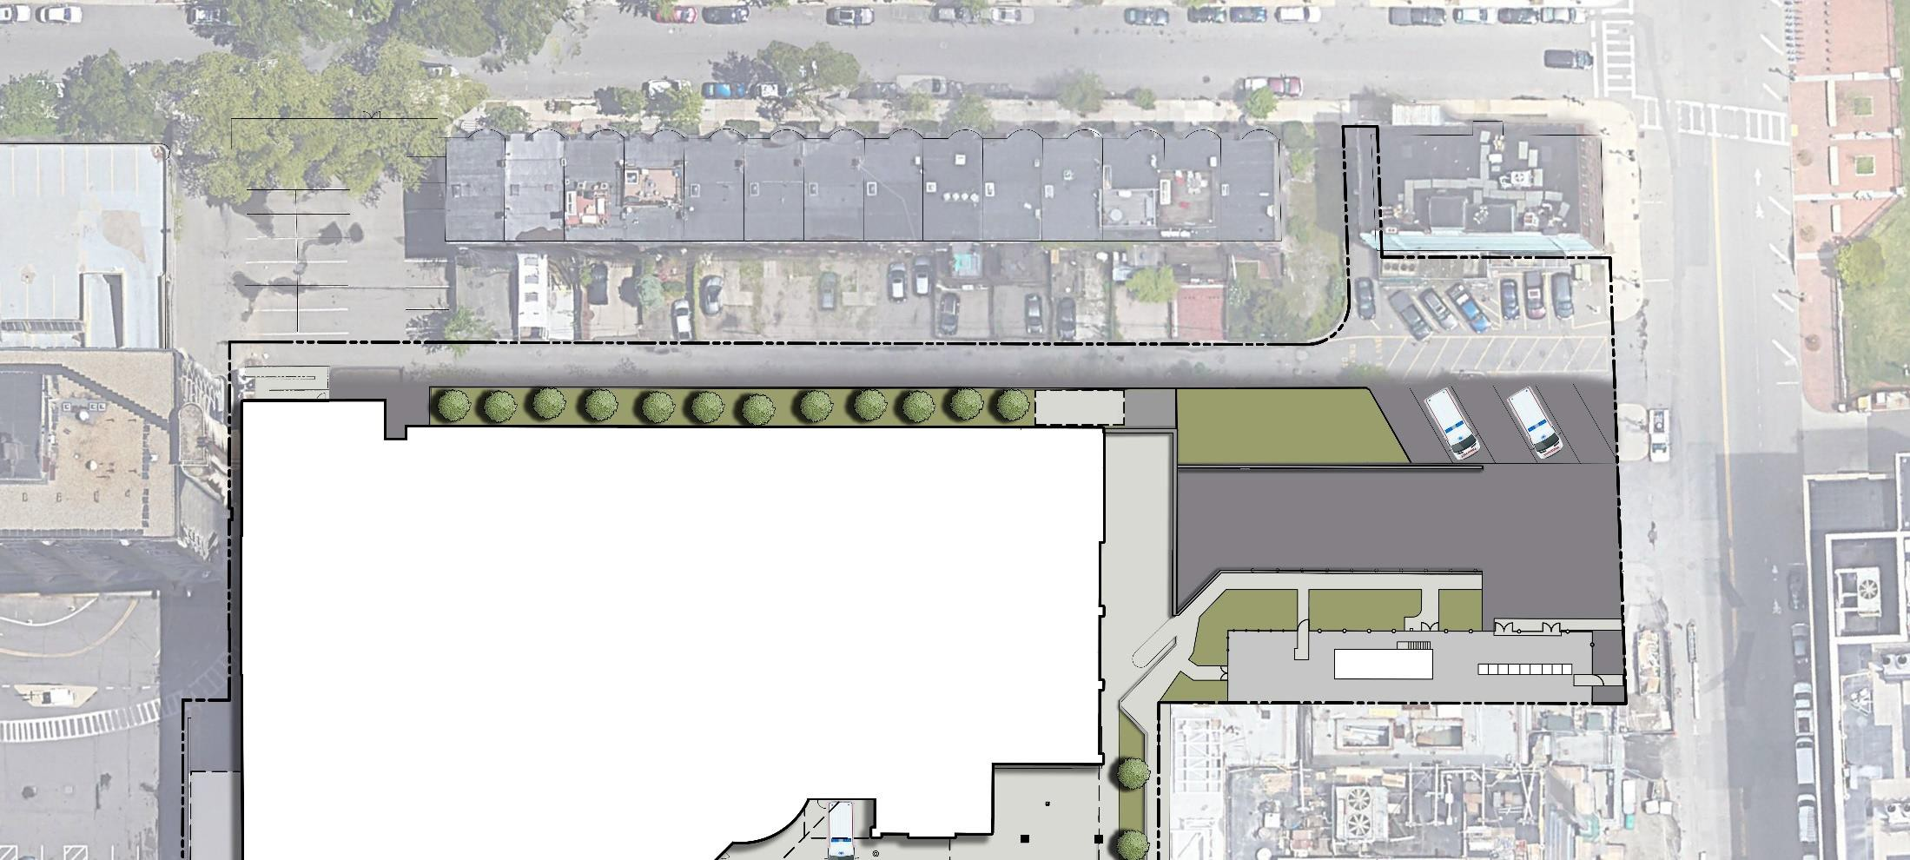
Safety
Safety
Campus Police Patrolling frequency
Camera monitoring: Privacy/Security
DOC Protocols
Patient Escape Protocols
EAST BROOKLINE STREET (one way)
Property Line
Camera, mounting height 15’ typical
Loading Dock
Updated: 6/22/2021
Draft for Discussion Purposes Only ₉

Slide 10
Noise/Vibration
Noise/Vibration
Delivery, Trash Pick-up Schedule
Audible back-up signals
DOC Protocols
Rooftop noise source
EAST BROOKLINE STREET (one way)
Property Line
Fire Pump
Loading Dock
Updated: 6/22/2021
Draft for Discussion Purposes Only ₁₀

Slide 11
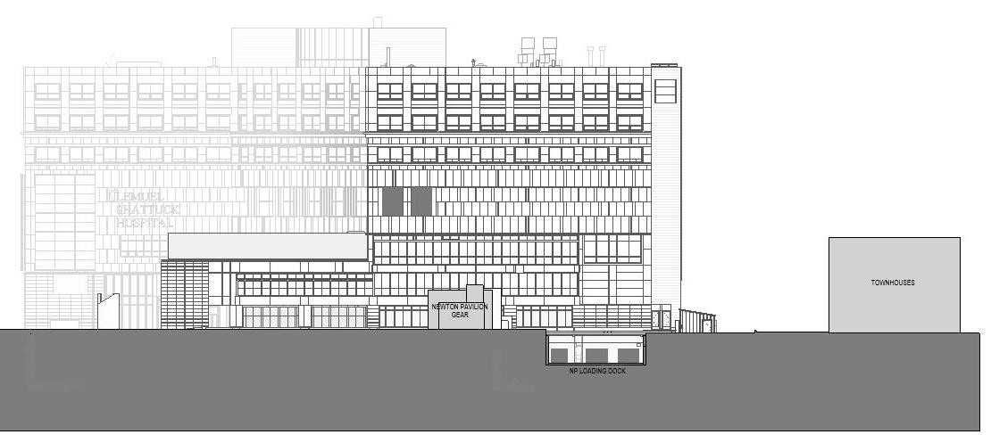
Noise/Vibration
Exhaust Fans
72’
Property Line
98’
15’
Townhome
s
Equipment Yard
Fire Pump/Raised Planter
Loading Dock
Updated: 6/22/2021
Draft for Discussion Purposes Only ₁₁

Slide 12
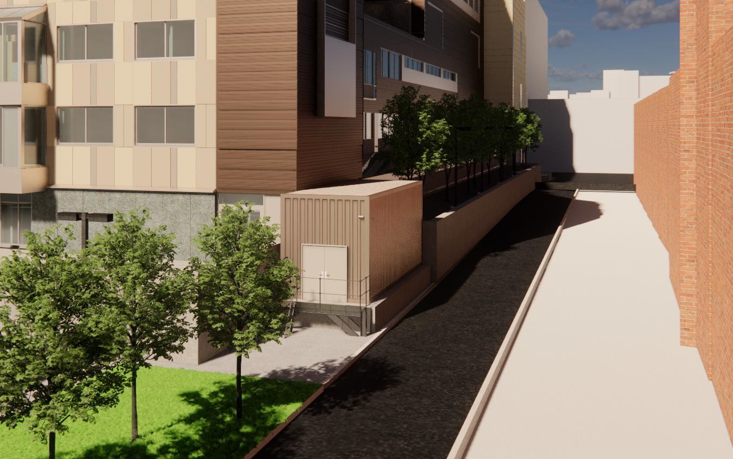
Noise/Vibration
Updated: 6/22/2021
Draft for Discussion Purposes Only ₁₂

Slide 13
Relocation Timeline
Construction Coordination and Neighborhood Interface
Scheduled for next meeting
Construction Exterior Façade
Alley Utility
Improvements
Substantial Completion of Construction
Kickoff
LSH Transition to Newton Pavilion
July 2022
Aug’2021
OND’2023
AMJ’2024
April 2022
JFM’2024
JAS’2024
Interior Demolition & Site Utilities Improvements
Commissioning & Fit Out Activities OND’2023 – AMJ’2024
Interior Renovation
Ongoing project updates are available at www.mass.gov/DPH/ShattuckRelocation
Updated June 14, 2021
Updated: 6/22/2021
Draft for Discussion Purposes Only ₁₃

Slide 14
Leadership & East Newton Pavilion Project partners
Lauren Peters Undersecretary Frank Doyle
Executive Office of Health & Human Services
Asst. Commissioner Department of Public Health
Carol Gladstone Gordon Wrin
Commissioner Director
Department Capital Asset Management & Maintenance Design & Construction- DCAMM
Rick Polvino Neil Martin Jessica Petro
Managing Principal Design Principal Design Director
SLAM, AIA, LEED AP
SLAM, AIA
SLAM, PLA Landscape Architecture
Jim Dabrowski Sr. Project Executive Gilbane Building Company
For updates and more information on the project, please visit our website: https://www.mass.gov/shattuck-hospital-relocation
If you would like to opt in for regular updates, please join our mailing list: https://www.mass.gov/forms/sign-up-for-east-newton-pavilionshattuck-hospital-relocation-project- updates
Updated: 6/22/2021
Draft for Discussion Purposes Only ₁₄

Slide 15
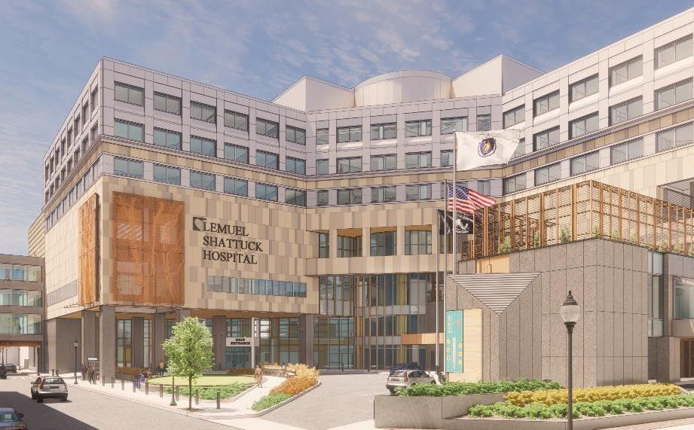
Next Meeting: Late Summer 2021 Questions and Discussion
Updated: 6/22/2021
Draft for Discussion Purposes Only ₁₅

