Slide 1
NextGen Presentation to SRC 3/22/23
Presentation to the ​
Massachusetts Rehabilitation Commission
State Rehabilitation Council​
3/22/2023
​
Michelle Banks NextGen Strategic Director
David Sykes NextGen Director of Operations​
​

Slide 2
Presentation Agenda
Overview of NextGen Careers Practice Model​​
Refresher of the RSA Innovation Grant that funds NextGen Careers​ and the NextGen Careers Practice Model
Enrollment Picture
Outreach and Recruitment Data
Core Components
Pathway from referral to enrollment
Marketing samples

Slide 3
Innovation Grant Overview​
NextGen Careers is funded through an RSA Innovation Grant through June 2026, focused on improving long term career outcomes.​
MRC is utilizing the grant to use implementation science, multi-disciplinary teams including new roles focused on mentoring and family support, and a newly developed Learning Experience all focused on young adults with disabilities between the ages of 18-30 years old. ​
MCB and MCDHH are partners on this grant.
Seeking to serve 1,000 young adults in target geographic areas

Slide 4
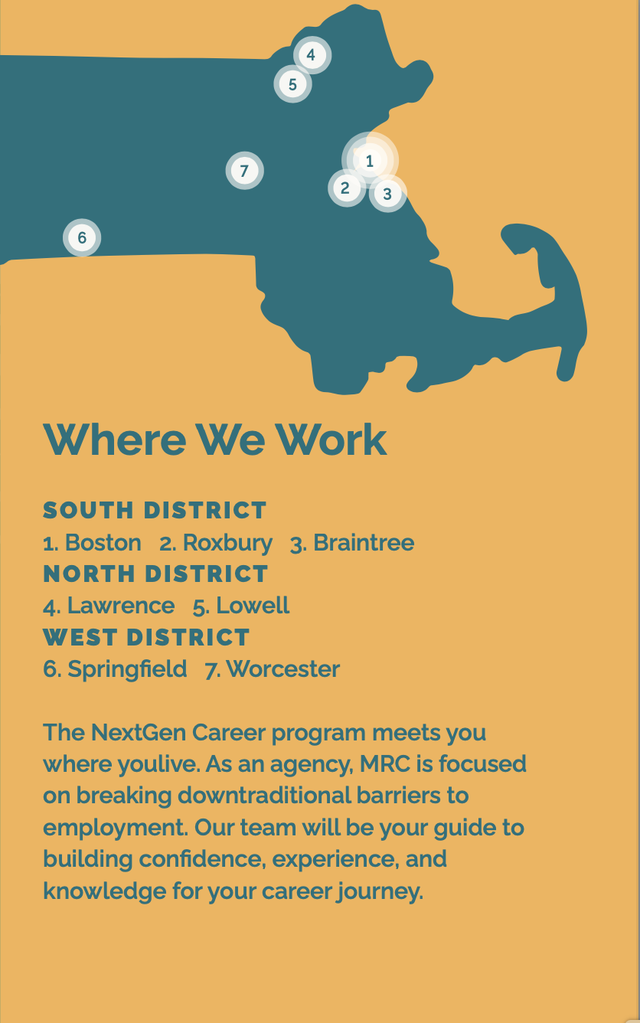
Where is NextGen Careers?
Worcester Office: Auburn, Boylston, Cherry Valley, Holden, Leicester, Paxton, Shrewsbury, West Boylston, and Worcester.
Springfield Office: Agawam, Blandford, Chester, East Longmeadow, Feeding Hills, Granville, Hampden, Huntington, Longmeadow, Montgomery, Russell, Southwick, Springfield, Tolland, West Springfield, Westfield and Wilbraham. Belchertown, Chesterfield, Chicopee, Easthampton, Granby, Holyoke, Ludlow, Middlefield, Monson, Northampton, Palmer, South Hadley, Southampton, Ware, Westhampton, and Worthington.
Lowell Office: Acton, Bedford, Billerica, Boxborough, Burlington, Carlisle, Chelmsford, Concord, Dracut, Dunstable, Lexington, Littleton, Lowell, North Reading, Reading, Tewksbury, Tyngsborough, Westford, Wilmington, and Woburn.
Lawrence Office: Amesbury, Andover, Boxford, Bradford, Byfield, Georgetown, Groveland, Haverhill, Lawrence, Merrimac, Methuen, Newbury, Newburyport, North Andover, Rowley, Salisbury, and West Newbury.
Braintree Office: Braintree, Cohasset, Hingham, Hull, Milton, Norwell, Norwood, Quincy, Randolph, Scituate, Walpole and Weymouth.

Slide 5
Enrollment Picture
Since opening in October:
400 individuals have sought enrollment in NextGen Careers
171 have enrolled in the program
100 additional enrollments are currently in the exploratory or eligibility phase
For those that did not enroll, the most common reason is living out of the NextGen Career service region (43%) followed by the applicant electing General VR to meet their needs (29%).
Enrollment Lessons:
Prior to commencing services, at times multiple meetings and conversations are helpful and frequently involve young adults and their parents/caregivers
QR codes and a simplified enrollment form have received positive feedback and praised by enrollees
Landing page on mass.gov has been tweaked based on feedback from enrollees and partners.
Bi-lingual staff capacity is a necessity to communicate with family members during the Outreach/enrollment process.
Marketing of NextGen is benefitting the larger General VR system, reaching some people who choose to access that service
​

Slide 6
Outreach and Recruitment
Referral Partners:
Self Referred: 37%
Sister Agencies and Partners: 23%
Schools: 15%
MRC VR Counselors 12%
Outreach efforts directly from NextGen Careers staff included over 215 meetings with community partners, state agency representatives, schools, Pre-ETS programs, healthcare providers.
VR and other MRC staff and their networks
Social Media Advertising
Partnership with Dept. of Elementary and Secondary Education and the Federation of Children with Special Needs

Slide 7
Outreach Yield
Target Communities:
Black, Asian, Latinx:
31% are from one or both of these demographics.
Autism and Developmental/Intellectual Disabilities:
70% of NextGeners have one or a combination of these disabilities. Most have an Autism Spectrum Disorder Diagnosis
Sensory Disabilities: 10% have a sensory disability
Note: 12 Referrals have been made by MCB and 100% of them have been enrolled.

Slide 8
NextGen Careers Core Components- Multi-Disciplinary Team​
NextGeners are served by Multi-disciplinary teams consisting of Supervisors, Peer Mentors, Family Partners, Career Counselors, Employment Success Specialists, Specialty Counselors and a Benefits Counselor.
Hired: 2 of 4 Administrative Positions in MRC Administrative Office
16 of 21 Direct Service Positions in NextGen Regional Teams
NextGen Teams are diverse, 8 of the current hired staff of 18 are from diverse backgrounds and 4 are bi-lingual.
Teams bring to the job experience in Vocational Rehabilitation, Social Work, Counseling Psychology, Peer Mentor Training Certification, Post Secondary Education, and lived experience working as and caring for persons with disabilities.
Teams have been trained in the Integrated Resource Team Model in order to engage existing professional and natural supports identified by the NextGener.

Slide 9
NextGen Careers Core Components- Career Preparedness​
In the Fall of 2022, NextGen Careers engaged with Accenture, a Boston based consulting firm, to develop a major component of the NextGen Learning Experience​ known as Self-CAReS.
An assessment tool and development activities were created focused on increasing internal capacities to support career attainment and sustainment. The key areas of Self-CAReS focus:
self-capacity (confidence in their ability to perform a job),​
self-advocacy (ability to direct one’s own life)​
self-realization (understanding of their strengths and limitations), ​
self-sufficiency (ability to be independent)​
Umass Chan School of Medicine, the contracted evaluator for NextGen Careers, developed a survey to measure progress in the Self-CARes areas. NextGeners will complete a baseline survey and two more surveys after 6 and 12 months from the commencement of service.

Slide 10
NextGen Careers Core Components- Career Pathways and Support
NextGen Staff have received significant training and support to utilize the NextGen Careers Toolkit. The toolkit consists of career assessment and evaluation opportunities, career exploration and associated training and certification opportunities, and talent science. Some of the Tools utilized in by NextGen Careers Team Members and NextGeners:
InforTalent
Career Index Plus
MRC Workforce Development Tool (exploration of available training and certification)
Symplicity (Mock Interviews, Resume and Marketing Tools
STEM Focus. NextGeners are educated on opportunities in STEM Careers and if they choose, they are supported to pursue such career paths. Developing opportunities for internships and apprenticeships are the focus of Employment Success Specialists, which are key pathways to STEM Careers. NextGeners are supported in whatever career path they choose.
Career Extended Support. Career Extended Support begins when the participant is employed, and consists of on-the-job problem-solving to help maintain employment, counseling to better prepare for promotional opportunities, and other supports to promote independence.​

Slide 11
STEM Careers
Most STEM jobs are in high demand but suffer from a lack of qualified candidates.
Persons with lived experience with a disability often acquire academic, technical and self-determination skills and find ways to overcome barriers, critical and valued skills in STEM fields.
The Commonwealth Corproration-2019
Over 20% of manufacturing jobs in Massachusetts have become STEM jobs. Business services, financial services, and retailers employ more than 70,000 workers in STEM occupations.
STEM jobs are expected to account for 25% of the total employment growth over the next 10 years

Slide 12
Enrolling in NextGen Careers​
Connect Young Adults with NextGen Careers:
https://www.mass.gov/nextgen-careers
Complete inquiry form by clicking “Enroll Here”
A member of the NextGen team in the young adult’s region will set up an initial meeting
Young Adult and any supporters will discuss NextGen Careers vs. General VR with NextGen Team Member
Young Adult will be assisted to enroll in NextGen Careers or directed to General VR application process
NextGeners are introduced to their Team and provided with introduction videos to view on youtube. (insert sample link)

Slide 13
Young Adults choose their model
MRC General Vocational Rehabilitation (VR) | MRC NextGen Careers
VR Counselor primarily works one-on-one with Young Adult, and partners with other resources. | Young Adult works with a NextGen Team, including a Careers Counselor, Employment Specialist, Peer Specialist, and Benefits Support Specialist; can choose between individual and team support.
Internships and Apprenticeships are not highly utilized | High utilization of apprenticeships and internships; focus on STEM careers
Support is provided for participants currently pursuing Associates/Bachelor’s degrees | Support is provided for participants who want to work imminently and seek shorter term training programs
Peer, family support, if provided is externally sourced | Teams automatically include Peer Mentors & Family Partners
Specialty Counselors operating independently | Specialty Counselors (focused on sensory disabilities) as part of teams

Slide 14
Marketing and Outreach https://www.mass.gov/nextgen-careers

Slide 15
Working with MRC SRC
Help the SRC to be knowledgeable about the purpose and practice of NextGen.
Advise NextGen Careers on recruitment and service strategies.
​Provide the SRC with periodic updates regarding NextGen progress, challenges and opportunities. ​
Receive feedback and recommendations from the SRC that informs NextGen programming and benefits our shared young adult participants.​

Slide 16
Questions, Discussion, and Thank you!

