Slide 1
Non-Emergency Human Service Transportation Task Force
Established by Section 134 of Chapter 24 of the Acts of 2021 (FY22 Budget)
December 1, 2022

Slide 2
Table of Contents
Task Force Overview
Public Input to Task Force Recommendations
Background on HST Services
Task Force’s Overall Findings and Recommendations
Task Force’s Recommendations in Detail
Appendices
Appendix A – Legislative Mandate
Appendix B – List of Task Force Members
Appendix C – Summary of Meetings and Input Provided to the Task Force
Appendix D – Resources Reviewed by the Task Force
Appendix E – Letters Received from Brokers and Stakeholder Groups
Appendix F – Broker Welcome Letters and Postcards
Appendix G – Passenger Assistance Safety and Sensitivity Training Manual
Appendix H – Written Feedback Received from Task Force Members After 11/15/2022
2

Slide 3
Task Force Overview
The Non-Emergency Human Service Transportation Task Force was established in July 2021 with the passage of Section 134 of Chapter 24 of the Acts of 2021 (FY22 Budget) and was charged with exploring ways to better collaborate, improve service and achieve operational and cost efficiencies through the brokerage system and provide the highest quality outcomes for consumers utilizing these services in the Commonwealth. The Task Force was charged with developing recommendations and proposing guidelines on non-emergency human services transportation with the goal of examining and better understanding the Human Service Transportation brokerage program and identifying opportunities for improved service and productivity that provides a strong safety net for vulnerable populations in both rural and urban areas. The Task Force was tasked with submitting its report no later than December 1, 2022.
3

Slide 4
Task Force Overview (cont.)
The Task Force was comprised of a diverse panel of legislators, policymakers, individuals with lived experience, advocates, regional transit authority administrators, and stakeholder organizations and chaired by the Undersecretary for Human Services from the Executive Office of Health and Human Services (EOHHS) (see full membership list in Appendix B).
The Task Force met seven times from November 2021 through November 2022.
This Report is being filed to the Clerks of the House of Representatives and Senate, the House and Senate Committees on Ways and Means, the Joint Committee on Transportation, the Joint Committee on Children, Families and Persons with Disabilities, the Secretary of Health and Human Services, and the Secretary of Transportation no later than December 1, 2022.
While the Task Force had robust discussions of issues and its proposed recommendations in its final meetings, a consensus could not be reached around the package of recommendations, with a few members expressing that there was not sufficient time for the Task Force to complete its work.
Task Force members had several opportunities to recommend changes to the draft report while it was under development. A formal request to extend the report’s date was not submitted by the legislators. Written feedback on the report received from members after the Task Force's final meeting on 11/15/2022 appears in Appendix H.
4

Slide 5
Public Input to Task Force Recommendations
At the Task Force’s recommendation, the HST office convened two public listening sessions on May 16 and 18, 2022 to solicit feedback from HST consumers. These public listening sessions gathered consumers’ feedback on their experiences using HST services since the new contracts with the two Brokers who administer transportation services, the Montachusett Regional Transit Authority (MART) and the Greater Attleboro Taunton Regional Transit Authority (GATRA), went into effect on July 1, 2021.
The HST office promoted the public listening sessions by mailing over 42,000 letters to Massachusetts residents who had utilized HST services since July 2021, in addition to promoting the sessions with HST stakeholders and partners.
Over 40 HST consumers from across the Commonwealth testified during the public listening sessions and 50 individuals submitted written testimony. This feedback from HST consumers was a primary source for the Task Force’s recommendations.
5

Slide 6
Background on HST Services
The Human Service Transportation (HST) office is the second largest public provider of transportation in the Commonwealth, after the MBTA, providing over 6.2 million rides to over 50,000 consumers in FY22. The HST office coordinates transportation for the Commonwealth's most vulnerable citizens to access medical appointments, life sustaining medical treatments, and day services.
The mission of the HST office is to promote access to health and human services, employment and community life by managing a statewide transportation brokerage network for eligible consumers and by providing technical assistance and outreach strategies in support of local mobility and transportation coordination efforts especially for transportation-disadvantaged Massachusetts residents.
6

Slide 7
Background on HST Services (cont.)
The HST office brokers two types of Non-Emergency Medical transportation for eligible MassHealth members:
Demand-Response PT-1 Transportation: transportation provided to eligible MassHealth members to MassHealth covered services such as routine medical appointments and ongoing, life-sustaining medical treatment.
Program-Based Transportation: Transportation to and from a specific destination, such as the site of a day habilitation or clubhouse program, on a regularly-scheduled basis.
The HST office oversees transportation programs for six EOHHS agencies:
MassHealth
The Department of Developmental Services (DDS)
The Department of Mental Health (DMH)
The Department of Public Health – Early Intervention Program (DPH-EI)
The Massachusetts Commission for the Blind (MCB)
The Massachusetts Rehabilitation Commission (MRC)
7

Slide 8
Background on HST Services (cont.)
EOHHS contracts with two Regional Transit Authorities (RTAs) – MART and GATRA – that function as brokers to provide direct transportation services to EOHHS consumers in all cities and towns within the Commonwealth. The service areas of each broker is reflected in the map below.
MART
GATRA
8

Slide 9
Background on HST Services (cont.)
MART and GATRA administer transportation services through subcontracting with qualified transportation vendors within their coverage areas. Collectively the two RTAs subcontract with over 300 different transportation providers in the Commonwealth.
New contracts with MART and GATRA went into effect on July 1, 2021. In response to consumer feedback, these new contracts introduced changes to improve consumer experience and safety:
Complaints process – Requires 95% of complaints resolved within three business days, 100% within 10 business days, HST phone and email publicized for complaints.
Online scheduling – Requires the adoption of new technologies to improve customer service, including smart phone apps and self-service web portals to facilitate transportation scheduling and the reporting of complaints.
Call wait times – Contract requires that all calls be answered in under three minutes.
On-time performance and reliability – GPS systems required on all Demand Response vehicles to provide data on on-time performance.
Driver and vehicle safety standards – Quality and Assurance team within the HST office staffed with four Compliance Officers, tripling the number of field visits.
9

Slide 10
Background on HST Services (cont.)
HST FY22 Trip Volume
FY22 Trip Volume | Montachusett RTA (MART) | Greater Attleboro and Taunton RTA (GATRA) | FY 2022 Total
Total # Number of Trips | 4,805,286 | 1,316,371 | 6,121,657
Demand-Response Trips | 3,021,212 | 857,572 | 3,878,784
Program-Based Trips | 1,784,074 | 458,799 | 2,242,873
Total # of Requests for Rides (Demand-Response only) | 3,798,225 | 1,168,072 | 4,966,297
Requested Rides by Phone | 3,758,346 | 1,161,437 | 4,919,783
Requested Rides in the Portals and Apps | 39,879 | 6,635 | 46,514
10

Slide 11
Background on HST Services (cont.)
HST FY22 Expenditures
HST FY22 Expenditures | Montachusett RTA (MART) | Greater Attleboro and Taunton RTA (GATRA) | FY 2022 Total
Total Expenditure | $171,010,424 | $46,302,856 | $217,313,280
Demand-Response Expenditure | $90,655,989 | $27,443,959 | $118,099,949
Program-Based Expenditure | $80,354,435 | $18,858,896 | $99,213,331
Average Cost Per Trip | $35.59 | $35.17 | $35.50
Average Cost Per Trip: DR | $30.01 | $32.00 | $30.45
Average Cost Per Trip: PB | $45.04 | $41.10 | $44.23
11

Slide 12
Task Force Recommendations
12

Slide 13
Task Force’s Recommendations – Wheelchair Securement
The HST office and Brokers should continue to improve the security, safety and comfort of consumers who utilize wheelchairs. Wheelchair trainings should take into account the different types of equipment used by consumers. The unique circumstances and equipment needs of wheelchair users should continue to be tracked in the consumer’s file and communicated and confirmed by the transportation vendor.
Actions Taken and Recommended
The HST Office instituted a new requirement of annual wheelchair securement training by a certified trainer and mid-year evaluation of all drivers of wheelchair vehicles.
Brokers retraining all wheelchair drivers immediately with deadline of November 30, 2022.
HST compliance officers inspecting all wheelchair vehicles – to be completed by January 1, 2023.
As a part of inspections, inspectors now required to sit in the wheelchair and have drivers to secure them during inspections.
Placards to be posted in all wheelchair vehicles by October 1, 2022 demonstrating proper securement.
Corrective Action Schedule of fines and suspensions implemented for drivers and vendors for failing to properly secure wheelchairs.
Brokers sent email communication to all vendors reminding them of progressive penalties for failure to secure wheelchairs​.
13

Slide 14
Task Force’s Recommendations – Wheelchair Securement (cont.)
Actions Taken and Recommended
For wheelchair users, the medical provider communicates the consumer’s wheelchair and mobility needs in the PT-1 form. Unique circumstances and equipment is then recorded in the consumer’s file and communicated to the transportation vendor who accepts the trip. It was recommended that there be a review of this process to ensure that the unique equipment needs are properly communicated to the vendor.
While there was not unanimous agreement amongst the Task Force members about how best to incorporate consumer involvement into wheelchair securement training due to the complexities of logistical and liability concerns, there was a recommendation that consumers should be provided opportunities to provide feedback on the trainings.
14

Slide 15
Task Force’s Recommendations – Driver Training and Professionalism
Improve driver training and professionalism
Actions Taken and Recommended
Trainings added:
Annual Human Rights and Sensitivity Training
Annual Sexual Harassment Training
Annual Defensive Driving by Certified Trainer
Annual wheelchair securement training
Require drivers to wear nametags visible to consumers. Recommend drivers provide name upon arrival, confirm passenger’s name and that they are medical transportation to the drop-off location.
Reinforce that existing rule that drivers are not permitted to use cell phones while driving passengers.
There should be greater collaboration with The RIDE to share successful strategies and/or protocols that HST could adopt.
Recommend that the trainings include a video featuring a wheelchair user and other consumers with disabilities. During the Task Force's final meeting, members offered to share examples of similar videos with the HST office to help guide development of the video.
15

Slide 16
Task Force’s Recommendations – Unannounced Vehicle Inspections
Conduct more frequent and unannounced vehicle inspections
Actions Taken and Recommended
Following the procurement in 2021, HST hired an additional two Compliance Officers. The HST office is hiring two additional Compliance Officers and will have a total of five full-time and one part-time Compliance Officers reporting to the Manager of Compliance.
GATRA and MART each hiring an additional inspector. MART will have seven Inspectors; GATRA will have three.
HST Compliance Officers and Broker Inspectors conduct unannounced field inspections at programs, homes and facilities. Brokers have a monthly inspection goal of 0.05% of the total volume of one-way trips and must be reported to the HST office. Inspections must include the HST Vehicle Safety Checklist.
HST and Brokers coordinated and scheduled inspections of every wheelchair vehicle.
Additional inspections will be focused on vendors with high complaint volumes.
Announced/pre-planned inspections of vehicle fleets should take place either outside of transportation hours or be coordinated with vendors to minimize disruption to consumer transportation.
16

Slide 17
Task Force’s Recommendations – Encouraging Feedback from Consumers
Encourage and provide more avenues for consumers to submit feedback, which should include both electronic means and phone, to make it accessible to those without internet access.
Improve complaint process and communication of complaint resolution.
Advocates and trade groups should convene a standing group of HST consumers and transportation providers with broad geographic representation to provide consumer and vendor feedback to HST and Brokers. The group should have representation from both program-based and PT-1 consumers and vendors.
Actions Taken and Recommended
HST Compliance Team conducts random telephone surveys to offer consumers the opportunity to share feedback.
Brokers have Quality & Assurance units that resolve and communicate complaint resolution to consumers via phone and text. Additional follow-up is provided per customer request.
Consumers can submit complaints in the smart phone app, the member and facility portals with resolutions sent via email and text, and call the HST office directly.
HST and Brokers should invite feedback from consumers continuously and on multiple platforms – and do so in a way that makes clear “We want to hear from you”. This should include exploring automatic texts or emails following rides and posting information about submitting complaints in places conspicuous to consumers.
17

Slide 18
Task Force’s Recommendations – Complaint Process and Resolutions (cont.)
Actions Taken and Recommended (cont.)
Explore ways to provide consumers with a durable tool (like a magnet or keychain) to remind consumers of the how to provide feedback to the Brokers and HST.
The HST office should solicit random feedback from consumers by providing incentives to regular riders to provide detailed feedback on their HST experience (note that this will require a procurement).
The HST office is working with MassHealth to add information and QR codes to PT-1 Approval and Renewal letters encouraging consumer to provide feedback and providing instructions for doing so. Links to provide feedback are posted on Broker websites and apps.
The Task Force had a robust discussion around whether and when consumers should be able to exclude and preference vendors; however, the Task Force did not reach a firm conclusion or recommendation on this topic.
18

Slide 19
Task Force’s Recommendations – On-time Performance
Improve on-time performance
Actions Taken and Recommended
MART and GATRA implementing GPS tracking of on-time performance. Required to have 90% of trips tracked by GPS by December 31, 2022.
MART and GATRA are required to report on-time performance measured by GPS to the HST office monthly and the data will be posted publicly on an online dashboard.
On-time performance incentive is earned if 90% or more trips are performed on-time.
Brokers should continually evaluate the scheduling algorithm to ensure that its recommended pick-up time allows for enough time to ensure on-time arrival, including drivers’ grace periods.
Recommend having call center staff inform riders that they can adjust their pick-up time within a recommended window to ensure on-time arrival.
19

Slide 20
Task Force’s Recommendations – Accessibility and Booking
Improve and align broker and HST websites and the accessibility and adoption of online booking through apps and portals
Actions Taken and Recommended
Postcard with QR codes promoting the apps and portals sent to all consumers that used transportation in the past year. Postcard included a reminder that three-day advance scheduling is recommended but not required.
Automated Call Center message provides new short URL for the apps and portals.
The Executive Office of Technology Services and Security (EOTSS) engaged to do a review of HST’s Mass.gov website, broker websites, and apps and portals, and make recommendations.
EOTSS conducted consumer interviews to inform improvements to website and apps.
EOTSS has recommended changes to improve website and app accessibility.
EOTSS conducting usability testing with consumers and facilities on the apps and portals to map the user journey and make recommendations for improvements.
20

Slide 21
Task Force’s Recommendations – Accessibility and Booking
Promote the PT-1 service among medical providers and nursing facilities
Actions Taken and Recommended
Explore providing PT-1 transportation information to medical providers to promote PT-1 use for eligible consumers.
Promote PT-1 among skilled nursing facilities (SNF), which were newly eligible to enroll in the brokerage as of April 1, 2022.
MassHealth led the outreach efforts to SNFs through numerous provider bulletins, as well as conducting outreach and training to the ambulance companies that service SNFs. Efforts to educate nursing facilities are ongoing. The most recent communication to SNFs informed them that if they had a wheelchair van or wanted to purchase a wheelchair van to provide transportation to their residents, they could do so and receive payment through the HST brokerage if they contracted with a Broker.
21

Slide 22
Task Force’s Recommendations – Accessibility and Booking
Educate consumers about their rights as HST riders
Actions Taken and Recommended
EOTSS and Brokers created “Single Source of Truth” pages on HST and Broker websites with links to “Know Before You Go” document, a document which enumerates consumers rights and was developed in consultation with the Boston Center for Independent Living (BCIL).
“Know Before You Go” information is prominently displayed on the Broker pages:
GATRA HST webpage
MART HST webpage
The HST office is working with MassHealth and Maximus to include a QR code link for the “Know Before You Go” document on the PT-1 Approval Letter, which is sent to a consumer when they have a new or renewed PT-1 (i.e., it is a member the consumer will regularly receive).
Consumers should receive a “Know Before You Go" pamphlet or booklet outlining their rights as HST Consumers in a clear and concise manner upon becoming an HST user.
22

Slide 23
Task Force’s Recommendations – Call Center Wait Times and Professionalism
Improve call center wait times and professionalism
Actions Taken and Recommended
MART and GATRA have added additional call center capacity through contract with external call center support.
MART’s voice recording and website now informs consumers of call hold time and provides the website address for on-line booking. MART has added and GATRA will have a call back feature by November 30, 2022 allowing consumers to leave a call back number if they do not want to remain on hold.
HST is reviewing call center training and will make suggested improvements, to be reviewed with the brokers to determine feasibility and timeline. Agreed upon improvements and should be posted publicly.
23

Slide 24
Additional Actions Taken by the HST Office
Additional Actions taken by the HST Office
The HST office has issued a Corrective Action Plan with MART and GATRA to include:
Revised “Welcome Letters” to include directions for online booking (See Appendix F) (Completed)
Postcard mailing to all consumers who have used transportation in the past year to promote online booking through the apps and portals (Completed)
Improve functionality, accessibility, and support of the apps and portals (November 2022)
Consistent branding of the apps and portals (November 2022)
Improvements to the Brokers’ webpages to make the “Know Before You Go” more visible and a “single source of truth” page with all of the information needed to receive transportation (Completed)
Improvements to Brokers’ call center’s automated messaging to include URLs for on-line booking and call hold times (November 2022)
Additional reporting metrics to the HST office to include the number of trips cancelled, on-time performance percentages as measured by GPS, etc. (November 2022)
Progressive roll-out of GPS adoption by vendors and drivers to achieve 90% by December 31, 2022.
Monthly review of the Corrective Action Plan to assess progress.
24

Slide 25
Task Force’s Overall Findings and Recommendations
Other Task Force Findings
The Task Force finds that the current process for determining PT-1 eligibility, which places the decision-making authority between consumers and their medical providers, should remain unchanged. Per the MassHealth regulations, this process includes a determination that public transportation is either not accessible or not suitable for the consumer. The Task Force therefore strongly recommends against attempting to provide HST consumers with bus passes or attempting to divert consumers to existing public transportation routes.
MART and GATRA have robust policies in place to ensure that the capital and operating costs for the brokerage and public transit systems are assigned to the appropriate cost center for reimbursement. To effectively manage the cost components of the public transit and brokerage services, MART and GATRA utilize a chart of accounts to segregate revenues and expenses to the appropriate service line - transit or brokerage and specific service type for both operating and capital costs. MART and GATRA utilize the expansive Chart of accounts structure, as well as their Procurement Processes, to designate and delineate all services and expenses that are procured and expended to either a Transit Service account or a Brokerage Service account. Both MART and GATRA have extensive oversight of funding and internal control processes by both state and federal agencies. These oversight activities examine the funding that each agency receives and expends, the overall financial internal control procedures and processes in place to ensure proper allocation and utilization of revenues and expenditures, as well as the eligibility of the costs incurred against the funding utilized for reimbursement. These include: Annual Audits, OMB Circular A-133 Single Audits, EOHHS Annual Desk Audits, Triennial MassDOT Audit, Bi-annual State Audit, and FTA Triennial Review. See Appendix E for more information.
25

Slide 26
Task Force’s Overall Findings and Recommendations
Recommended Areas for Future Study and Review
A thorough, collaborative review is needed of program-based transportation in close collaboration with the HST office, transportation providers, stakeholder groups, and consumers. The review should include:
Whether greater flexibility should be provided to allow vendors and providers to alter routes;
An evaluation of hiring protocols and background check protocols, including whether a positive test for marijuana should disqualify drivers;
Careful planning for the reprocurement of program-based transportation, with the goal of providing visibility to vendors about long-term investments and to minimize consumer disruptions. The planning should take into account supply-chain issues affecting the availability of new vehicles.
The HST office should undertake a financial study of HST services, which should include:
The budget of the program and the cost per ride;
An evaluation of the current methodology of bidding out PT-1 rides to vendors and choosing the lowest cost bidder;
The estimated impact of COVID on vendors and employees;
The impact of COVID and supply chain disruptions on vehicle availability and replacements, especially for wheelchair and accessible vehicles;
Comparison of costs with other states’ PT-1 and program-based transportation, as available, and other state transportation programs, including the RIDE;
Impact of CMS policies on the budget, including policies that prohibit reimbursement for no-show rides.
26

Slide 27
Appendices
27

Slide 28
Appendix A – Legislative Mandate
Chapter 24, Section 131 of the Acts of 2021 (FY22 Budget)
There shall be a task force on non-emergency human services transportation to explore ways to better collaborate, improve service and achieve operational and cost efficiencies through the brokerage system and provide the highest quality outcomes for consumers utilizing these services. The task force shall consist of the following members or their designees: the director of the human service transportation office, who shall serve as chair; 2 members of the house of representatives, 1 of whom shall be appointed by the minority leader of the house of representatives; 2 members of the senate, 1 of whom shall be appointed by the minority leader of the senate; a representative from the Massachusetts Department of Transportation; 3 persons to be appointed by the regional transit authority administrators, all of whom shall be regional transit authority administrators currently administering human services transportation; 2 persons to be appointed by the governor, 1 of whom shall be an expert in human services transportation planning; 1 person appointed by the Association of Developmental Disability Providers; and 6 representatives serving consumers with disabilities through the transportation program, 1 of whom shall be appointed by the Boston Center for Independent Living, Inc., 1 of whom shall be appointed by the statewide independent living council, 2 of whom shall be appointed by Arc Massachusetts, Inc., 1 of whom shall be appointed by the Disability Law Center, Inc. and 1 of whom shall be appointed by the Massachusetts developmental disabilities council.
The task force shall make recommendations and propose guidelines on non-emergency human services transportation with the goal of examining and better understanding the human services transportation brokerage program and identifying opportunities for improved service and productivity that provides a strong safety net for vulnerable populations in both rural and urban areas. The recommendations and guidelines shall include, but not be limited to, the use of existing routes when available, the provision of bus passes to eligible individuals and the need to have strong, transparent and consistent cost allocation systems in place to ensure that the capital and operating costs for both the brokerage and public transit systems are assigned to the appropriate cost center for reimbursement.
The recommendations and guidelines shall be used by the human services transportation office to develop non-emergency human services transportation broker services. The task force shall file a report of its study and its recommendations with the clerks of the house of representatives and senate, the house and senate committees on ways and means, the joint committee on transportation, the joint committee on children, families and persons with disabilities, the secretary of health and human services and the secretary of transportation not later than December 1, 2022; provided, however, that the task force may make a draft report available to the public for comment before filing its final version.
28

Slide 29
Appendix B – List of Task Force Members
Name / Affiliation | Task Force Seat
Elizabeth Denniston (chair) Undersecretary for Human Services, Executive Office of Health and Human Services (EOHHS) | Appointment of the Governor
Tom Cahir Administrator, Cape Cod RTA | Appointment of RTA Administrators (current administrator of HST)
Sean Cristofori Director of Transportation, Center of Hope Foundation | Appointment of The Arc Massachusetts
Mary Ellen DeFrias Administrator, Greater Attleboro-Taunton RTA (GATRA) | Appointment of RTA Administrators (current administrator of HST)
Mindy Domb Massachusetts Representative | Member of the Massachusetts House of Representatives
Bruno Fisher Administrator, Montachusett RTA | Appointment of RTA Administrators (current administrator of HST)
29

Slide 30
Appendix B – List of Task Force Members (cont.)
Name / Affiliation | Task Force Seat
Millie Hernandez Individual with lived experience | Appointment of the Statewide Independent Living Council
Chris Hoeh Individual with lived experience | Appointment of the Disability Law Center
Joe Krajewski Chief Operating Officer, Community Connections | Appointment of the Association of Developmental Disability Providers (ADDP)
Catherine Mick Chief of Staff, Commonwealth Medicine | Appointment of the Governor (expert in Human Service Transportation)
Susan Moran Massachusetts Senator | Member of the Massachusetts Senate
Mathew Muratore Massachusetts Representative | Member of the Massachusetts House of Representatives (minority leader appointment)
30

Slide 31
Appendix B – List of Task Force Members (cont.)
Name / Affiliation | Task Force Seat
Patrick O’Connor Massachusetts Senator | Member of the Massachusetts Senate (minority leader appointment)
Jessica Podesva Community Organizer, Boston Center for Independent Living | Appointment of the Boston Center for Independent Living (BCIL)
Stephen T. Salwak Transportation Director, South Shore Community Action Council | Appointment of the Massachusetts Developmental Disabilities Council
Leo Sarkissian Executive Director, The Arc of Massachusetts | Appointment of The Arc Massachusetts
Meredith Slesinger Rail & Transit Administrator, Massachusetts Department of Transportation | Representative from the Massachusetts Department of Transportation (MassDOT)
Sharna Small Borsellino Director, Human Service Transportation Office | Human Service Transportation Director
31

Slide 32
Appendix C – Summary of Meetings and Input Provided to the Task Force
Presenters | Topics Discussed | Resources and Supporting Documents
November 3, 2021
Elizabeth Denniston (chair) Undersecretary of Human Services, EOHHS | Discussion of the Task Force’s charges, proposed meeting schedule | Task Force Presentation
Sharna Small Borsellino Director, HST office | Overview of HST office | HST Office Overview Presentation
February 14, 2022
Alda Rego Assistant Secretary for Administration and Finance, EOHHS | Overview of HST services | Task Force Presentation
Sharna Small Borsellino Director, HST office | Overview of procurement process | Human Service Transportation Office Broker Procurement Presentation
32

Slide 33
Appendix C – Summary of Meetings and Input Provided to the Task Force (cont.)
Presenters | Topics Discussed | Resources and Supporting Documents
April 28, 2022
Elizabeth Denniston (chair) Undersecretary of Human Services, EOHHS | Discussion of the Task Force’s charges | Task Force Presentation
Elizabeth Sandblom Deputy Assistant Commissioner for Operations Department of Developmental Services (DDS) | Overview of transportation benefits for eligibility DDS consumers | Department of Developmental Services Presentation
Rosana Senise Director of the Quincy Enrollment Center MassHealth Keith West Director of Provider Experience Maximus | Overview of eligibility requirements for MassHealth and PT-1 transportation | MassHealth Eligibility Transportation Overview
33

Slide 34
Appendix C – Summary of Meetings and Input Provided to the Task Force (cont.)
Presenters | Topics Discussed | Resources and Supporting Documents
June 28, 2022
Elizabeth Denniston (chair) Undersecretary of Human Services, EOHHS | Summary of listening sessions and discussion of the Task Force’s draft recommendations | Task Force Presentation
September 22, 2022
Elizabeth Denniston (chair) Undersecretary of Human Services, EOHHS | Discussion of the Task Force’s draft recommendations | Task Force Presentation
October 27, 2022
Elizabeth Denniston (chair) Undersecretary of Human Services, Executive Office of Health and Human Services | Discussion of the Task Force’s findings and working draft of the Task Force’s report | Task Force Charge
November 15, 2022
Elizabeth Denniston (chair) Undersecretary of Human Services, Executive Office of Health and Human Services | Discussion of the Task Force’s findings and working draft of the Task Force’s report | Task Force Charge
34

Slide 35
Appendix D – Resources Reviewed by the Task Force
November 3, 2021
Task Force Meeting Presentation
HST Office Overview Presentation
February 14, 2022
Task Force Meeting Presentation
Human Service Transportation Office Broker Procurement Presentation
MART and GATRA Brokerage Improvements Presentation
April 28, 2022
Task Force Meeting Presentation
Department of Developmental Services Presentation
MassHealth Eligibility Transportation Overview
HST Office Overview of Complaints Process
35

Slide 36
Appendix D – Resources Reviewed by the Task Force (cont.)
June 28, 2022
Task Force Meeting Presentation
September 22, 2022
Task Force Meeting Presentation
October 27, 2022
Task Force Draft Report
November 15, 2022
Task Force Draft Report
36

Slide 37
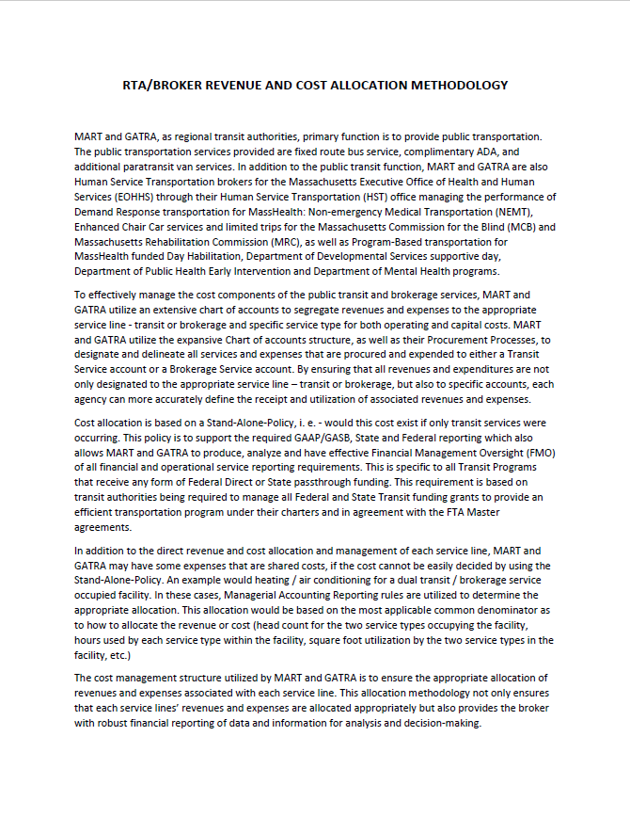
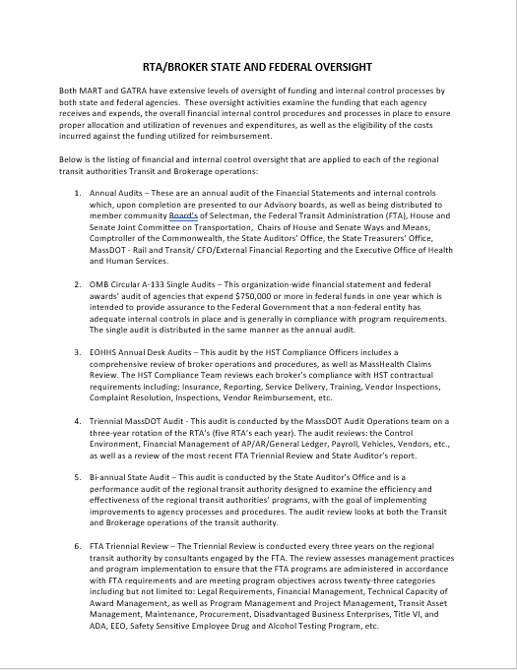
Appendix E – Letters Received from Brokers and Stakeholder Groups (cont.)
MART/GATRA
MART/GATRA
37

Slide 38
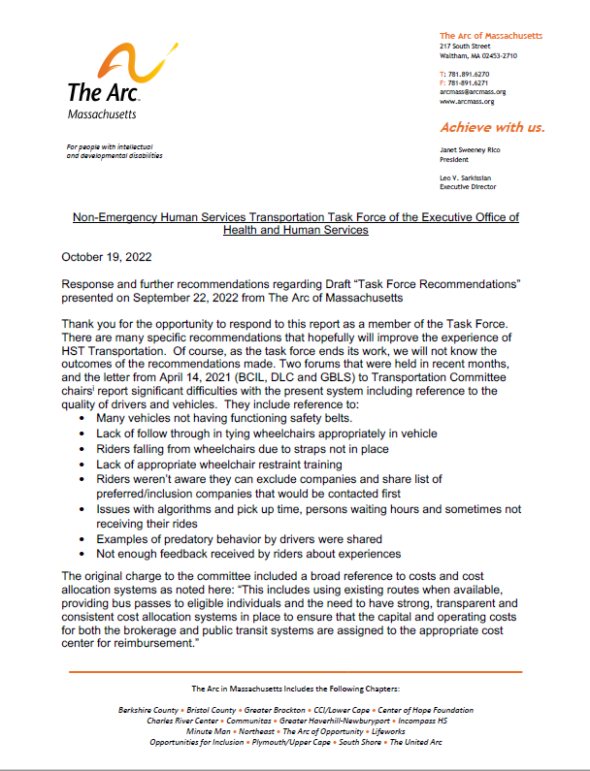
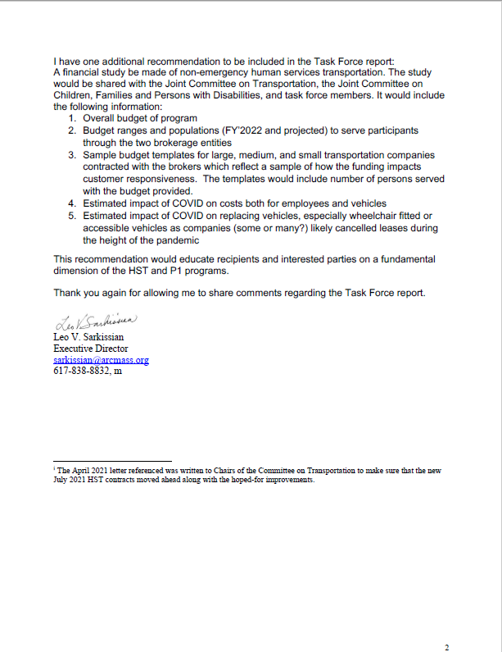
Appendix E – Letters Received from Brokers and Stakeholder Groups (cont.)
38

Slide 39
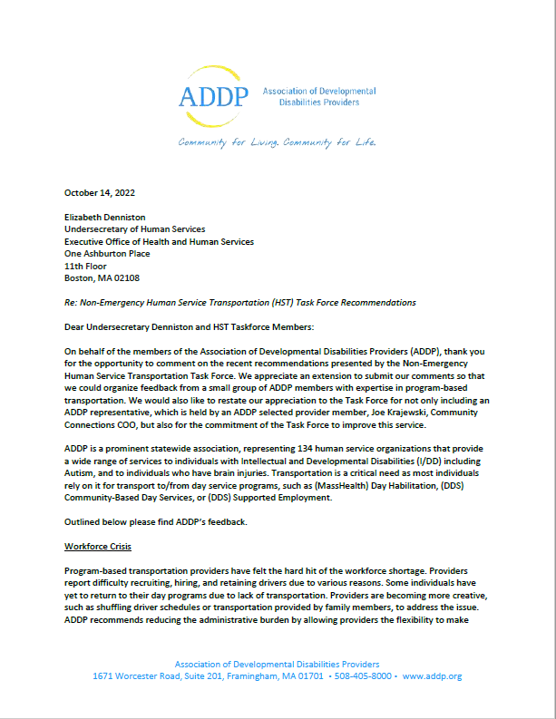
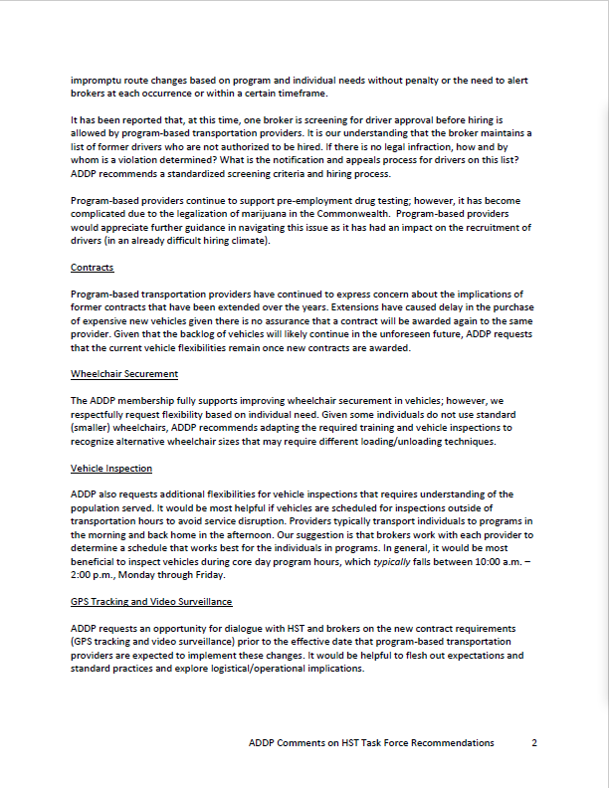
Appendix E – Letters Received from Brokers and Stakeholder Groups (cont.)
39

Slide 40
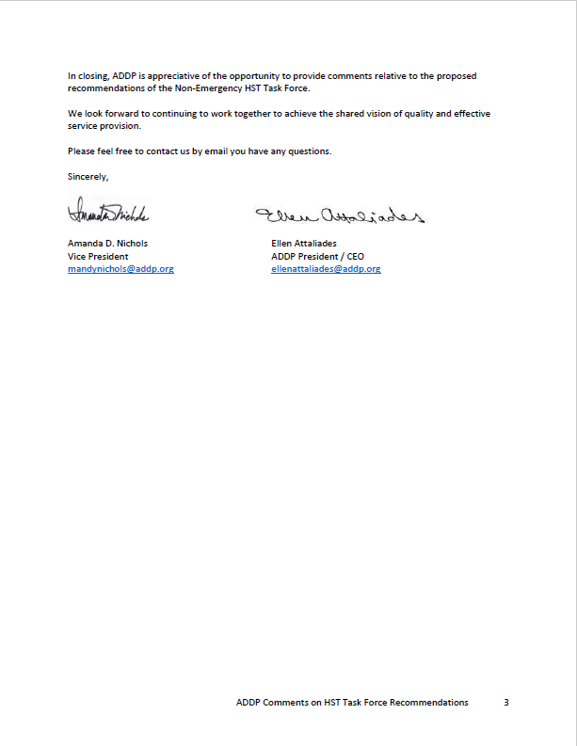
Appendix E – Letters Received from Brokers and Stakeholder Groups (cont.)
40

Slide 41
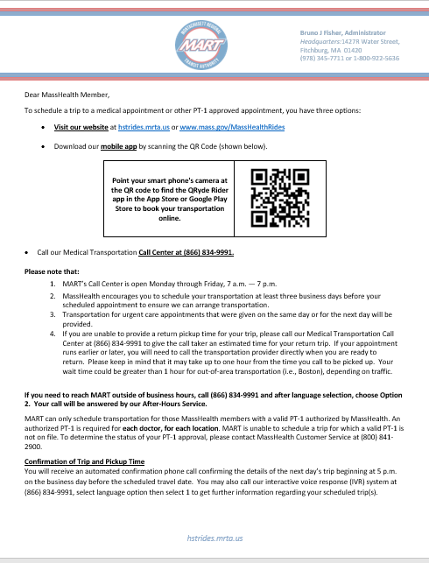
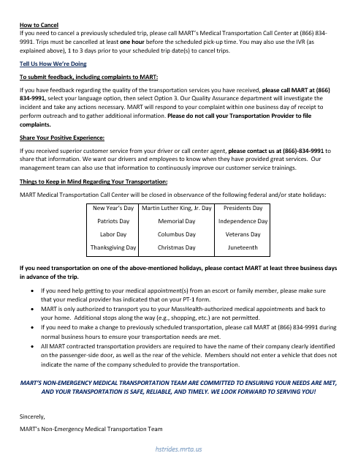
Appendix F – Broker Welcome Letters and Postcards
41

Slide 42
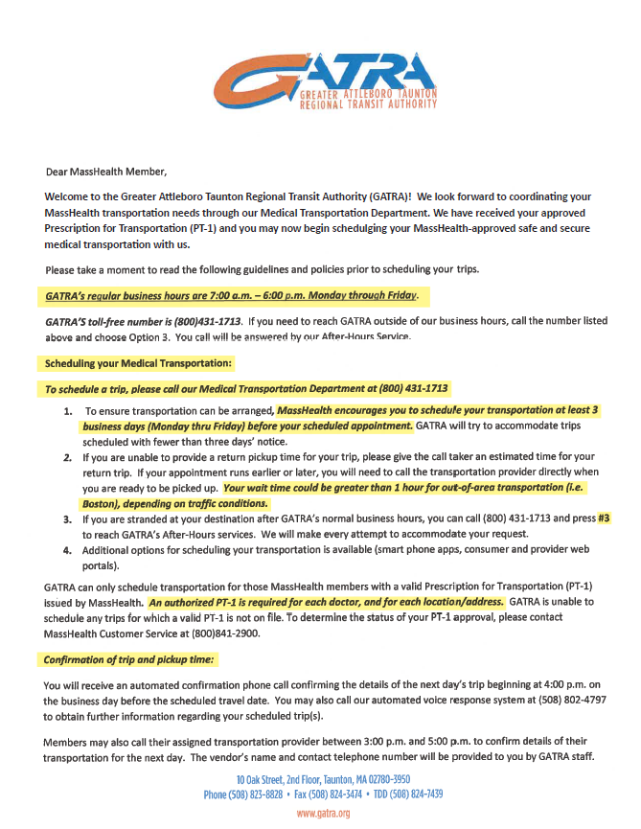
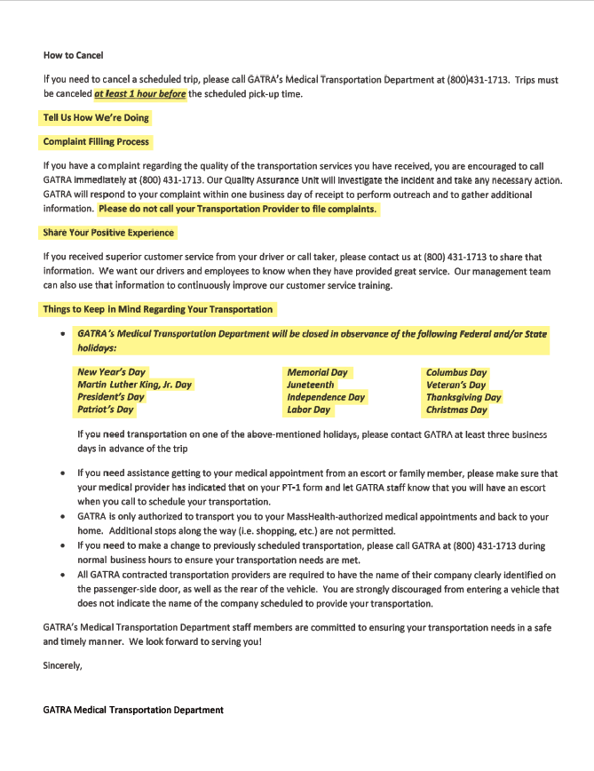
Appendix F – Broker Welcome Letters and Postcards (cont.)
42

Slide 43
Appendix F – Broker Welcome Letters and Postcards (cont.)
43

Slide 44
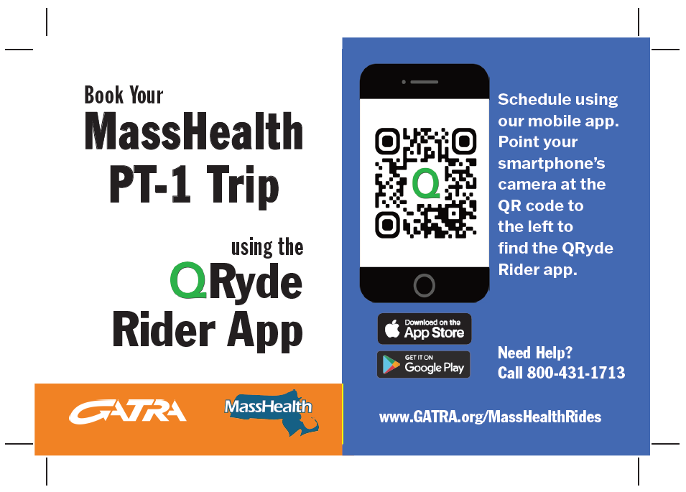
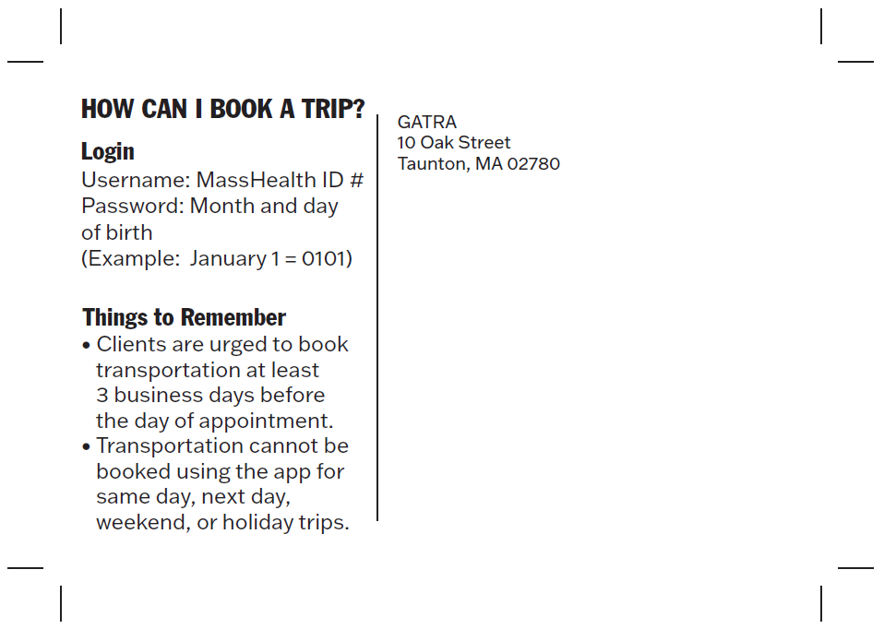
Appendix F – Broker Welcome Letters and Postcards (cont.)
44

Slide 45
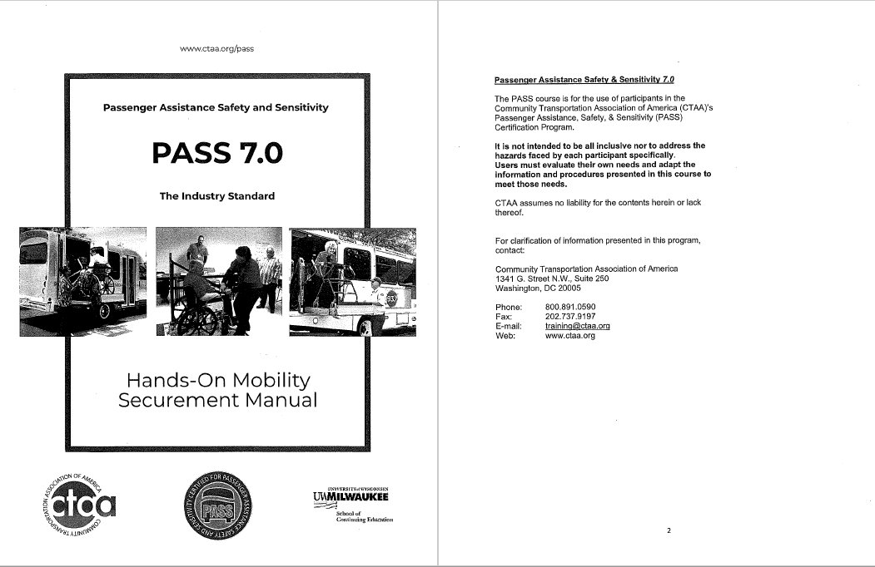
Appendix G – Passenger Assistance Safety and Sensitivity Training Manual
45

Slide 46
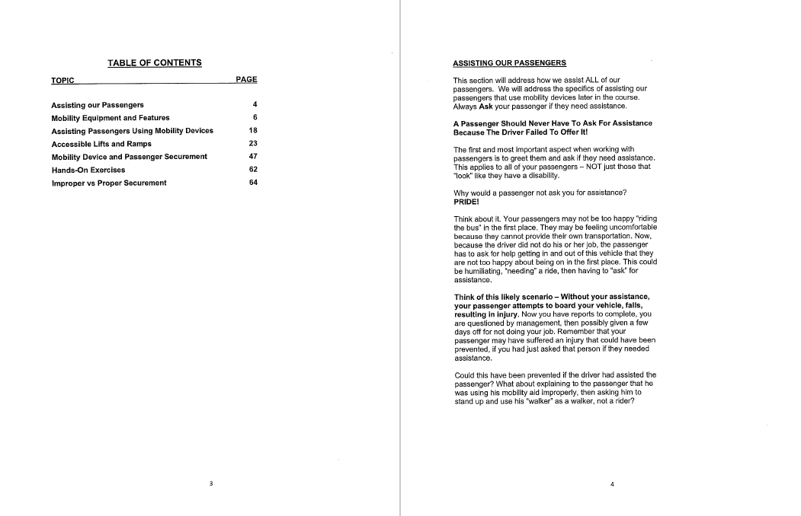
Appendix G – Passenger Assistance Safety and Sensitivity Training Manual (cont.)
46

Slide 47
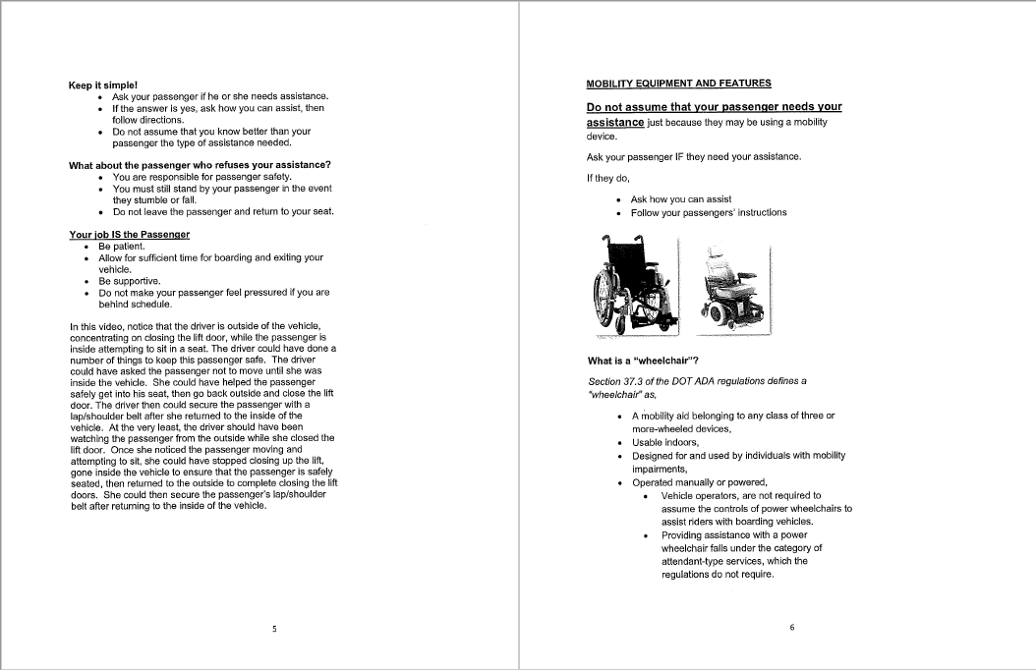
Appendix G – Passenger Assistance Safety and Sensitivity Training Manual (cont.)
47

Slide 48
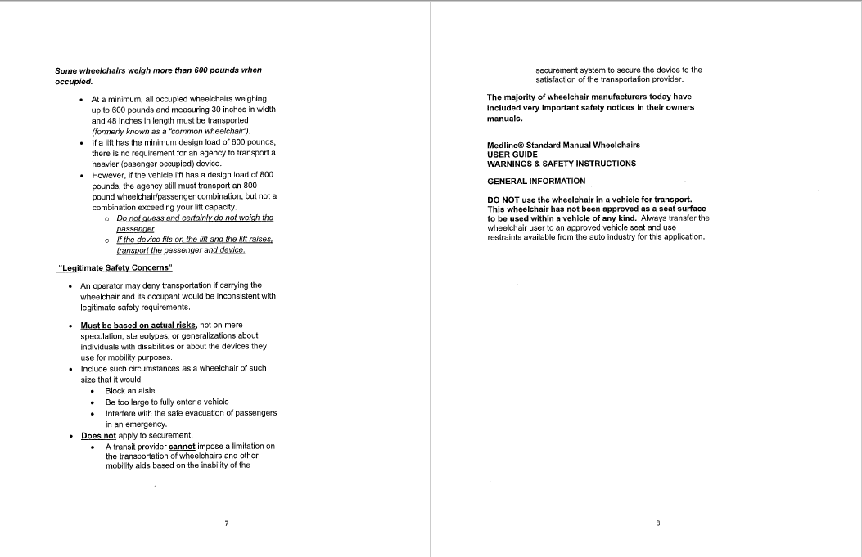
Appendix G – Passenger Assistance Safety and Sensitivity Training Manual (cont.)
48

Slide 49
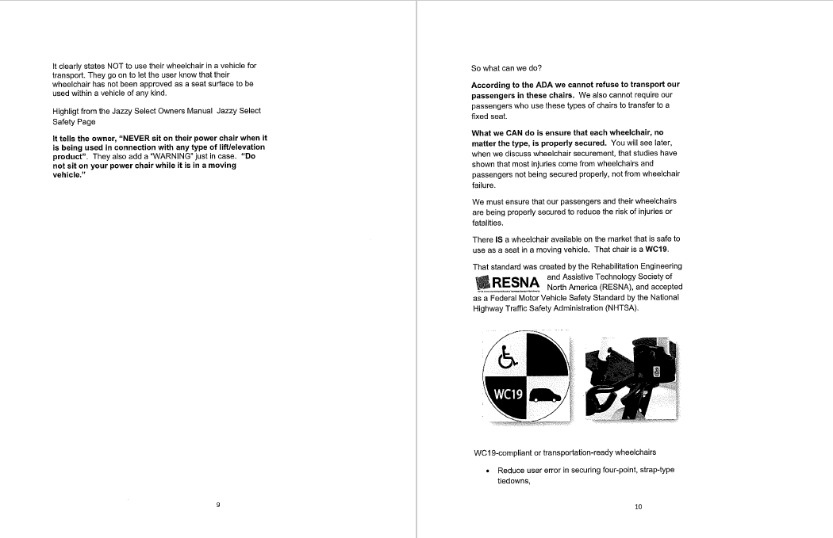
Appendix G – Passenger Assistance Safety and Sensitivity Training Manual (cont.)
49

Slide 50
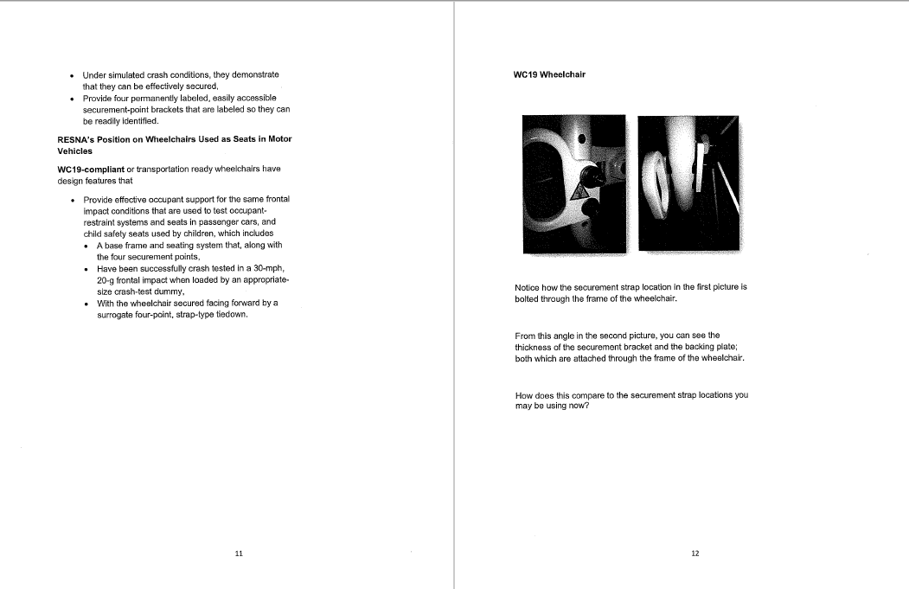
Appendix G – Passenger Assistance Safety and Sensitivity Training Manual (cont.)
50

Slide 51
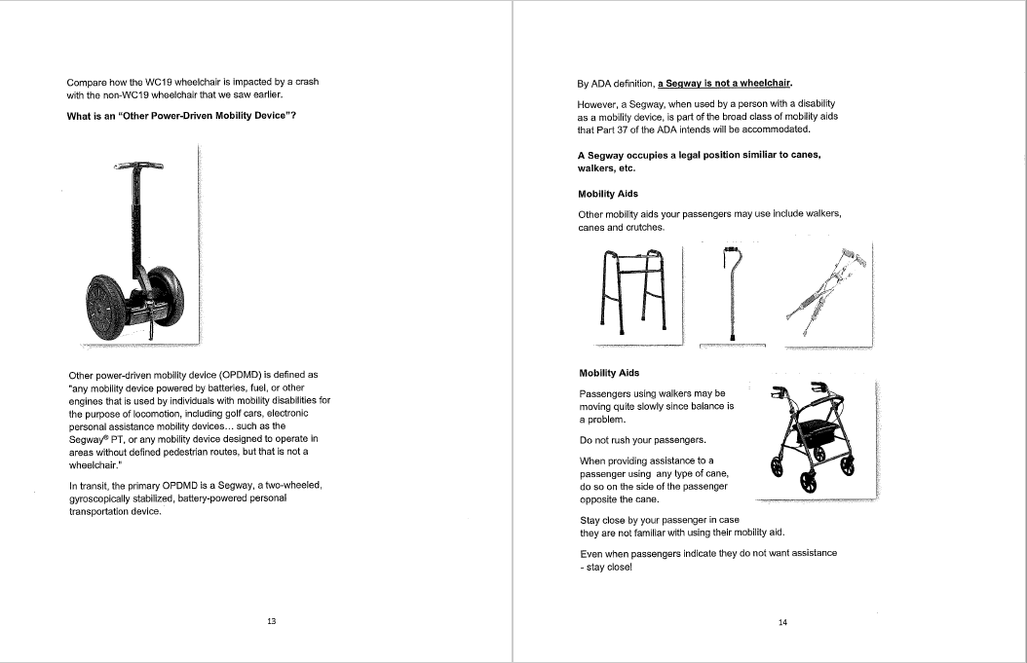
Appendix G – Passenger Assistance Safety and Sensitivity Training Manual (cont.)
51

Slide 52
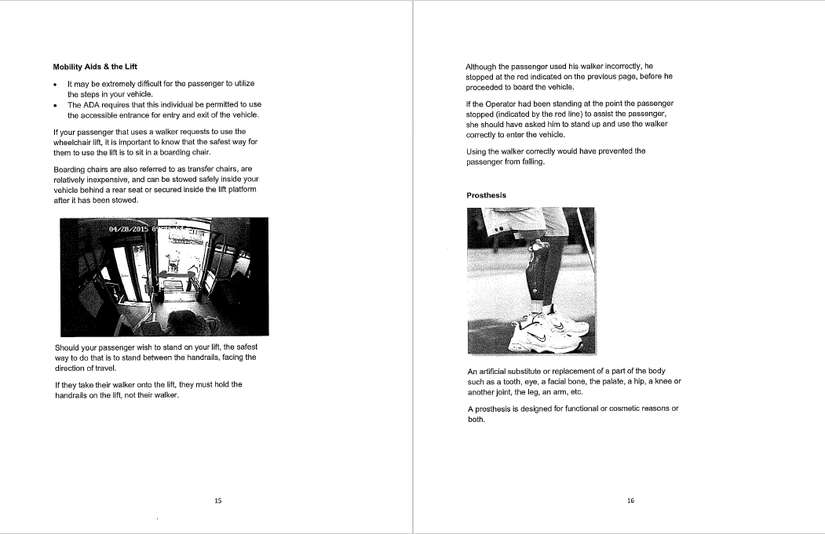
Appendix G – Passenger Assistance Safety and Sensitivity Training Manual (cont.)
52

Slide 53
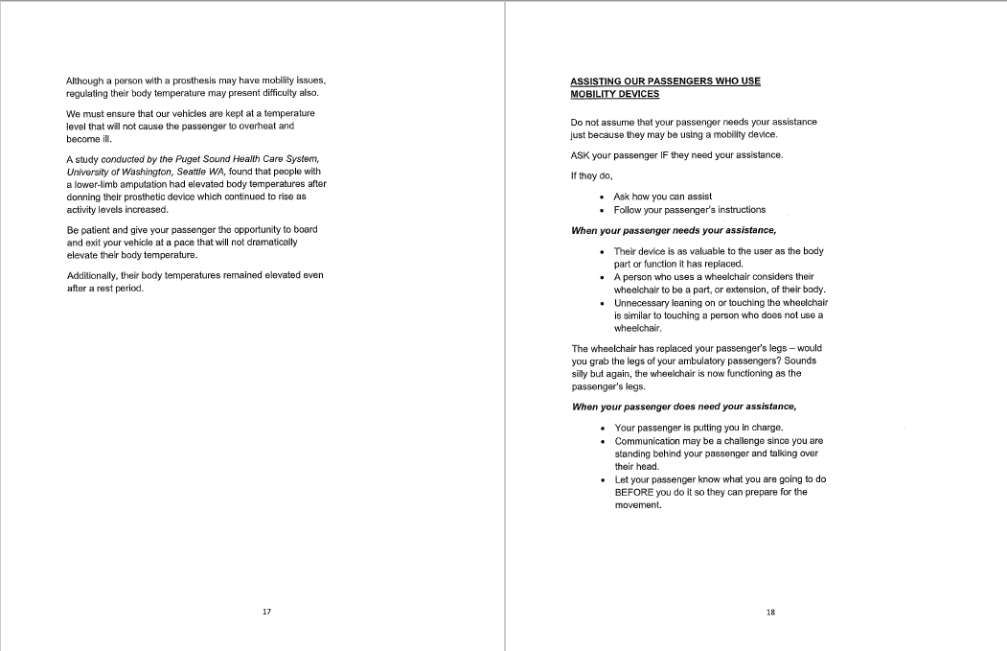
Appendix G – Passenger Assistance Safety and Sensitivity Training Manual (cont.)
53

Slide 54
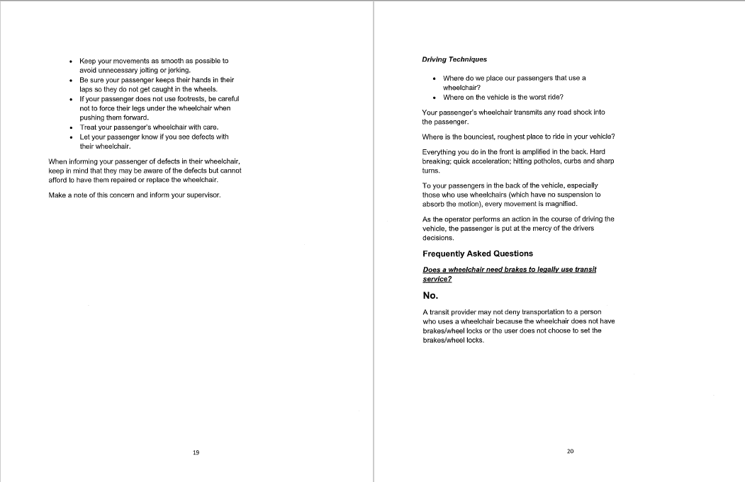
Appendix G – Passenger Assistance Safety and Sensitivity Training Manual (cont.)
54

Slide 55
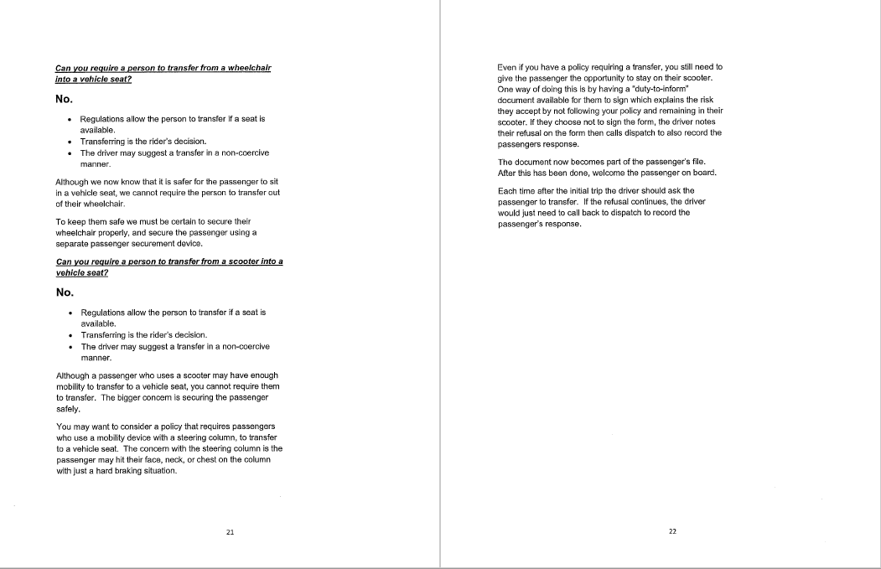
Appendix G – Passenger Assistance Safety and Sensitivity Training Manual (cont.)
55

Slide 56
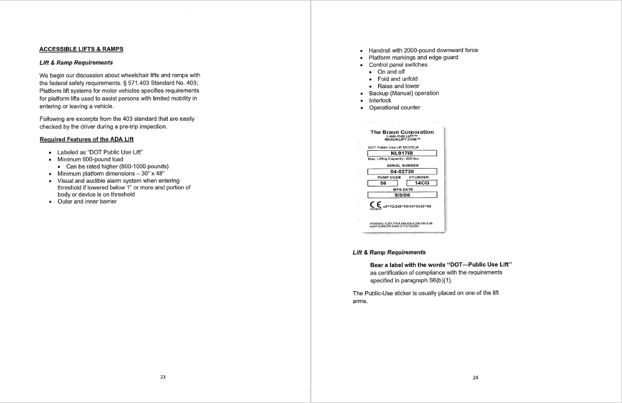
Appendix G – Passenger Assistance Safety and Sensitivity Training Manual (cont.)
56

Slide 57
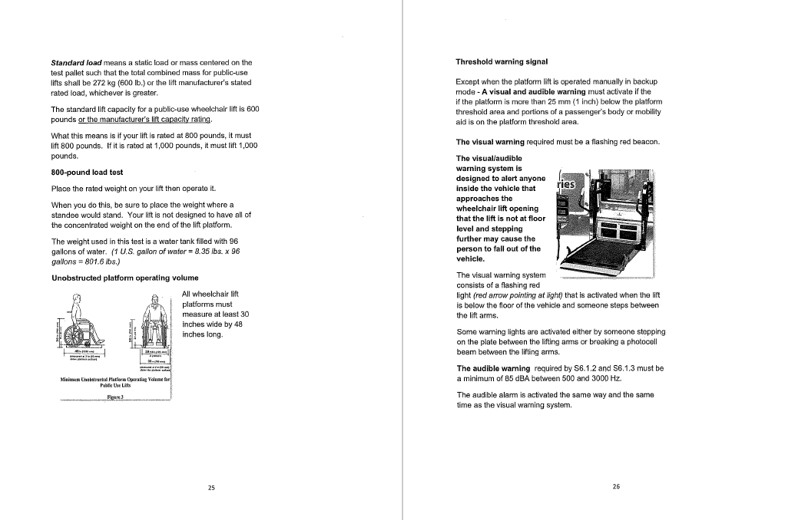
Appendix G – Passenger Assistance Safety and Sensitivity Training Manual (cont.)
57

Slide 58
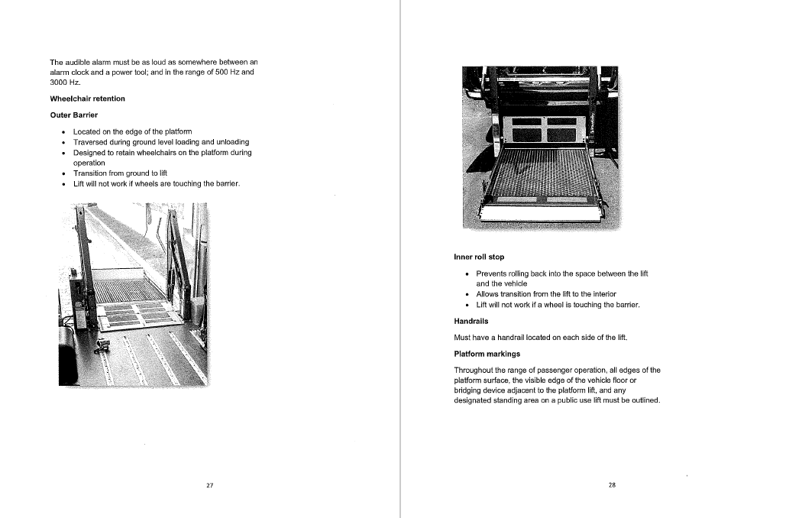
Appendix G – Passenger Assistance Safety and Sensitivity Training Manual (cont.)
58

Slide 59
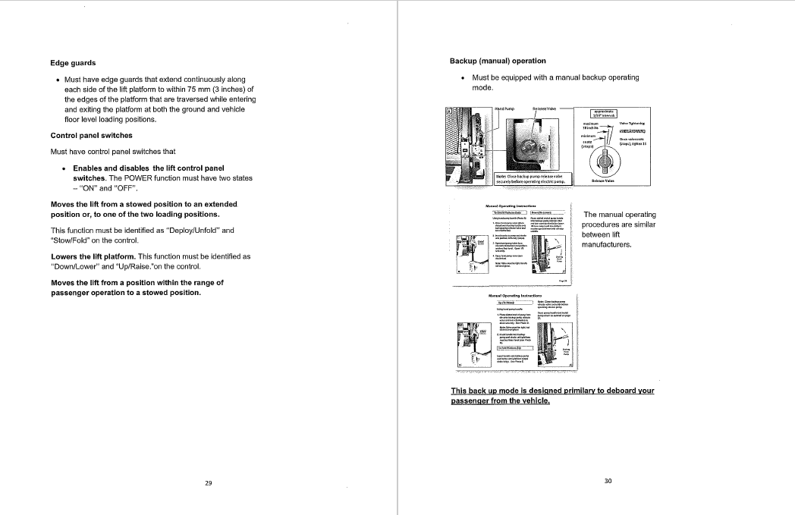
Appendix G – Passenger Assistance Safety and Sensitivity Training Manual (cont.)
59

Slide 60
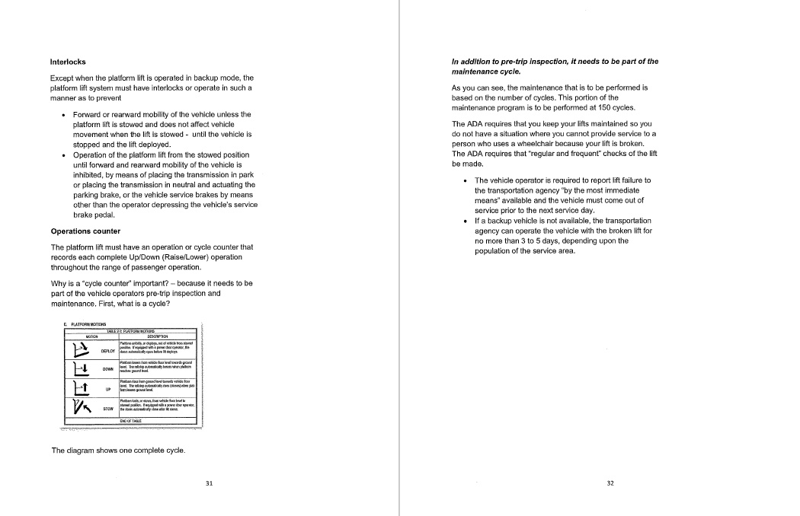
Appendix G – Passenger Assistance Safety and Sensitivity Training Manual (cont.)
60

Slide 61
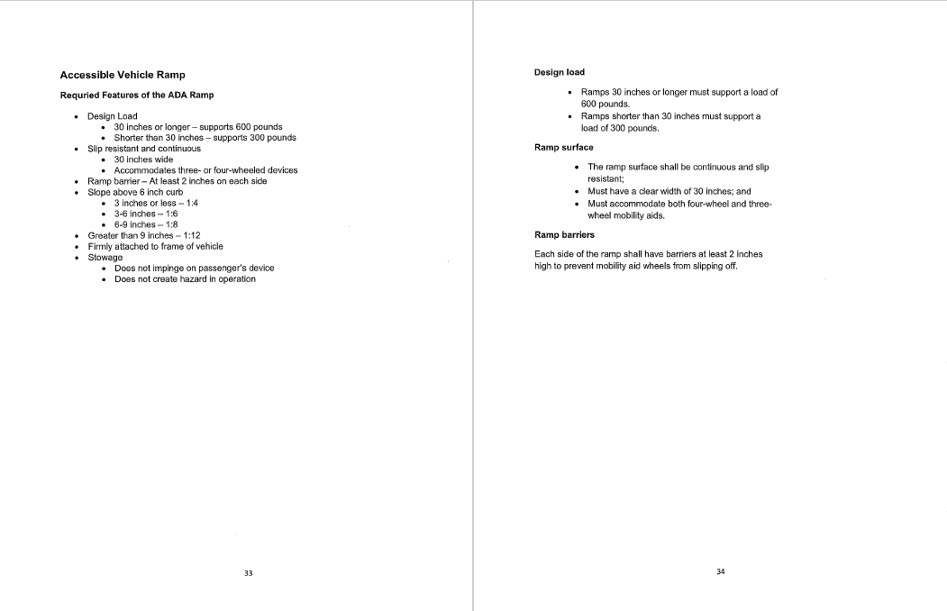
Appendix G – Passenger Assistance Safety and Sensitivity Training Manual (cont.)
61

Slide 62
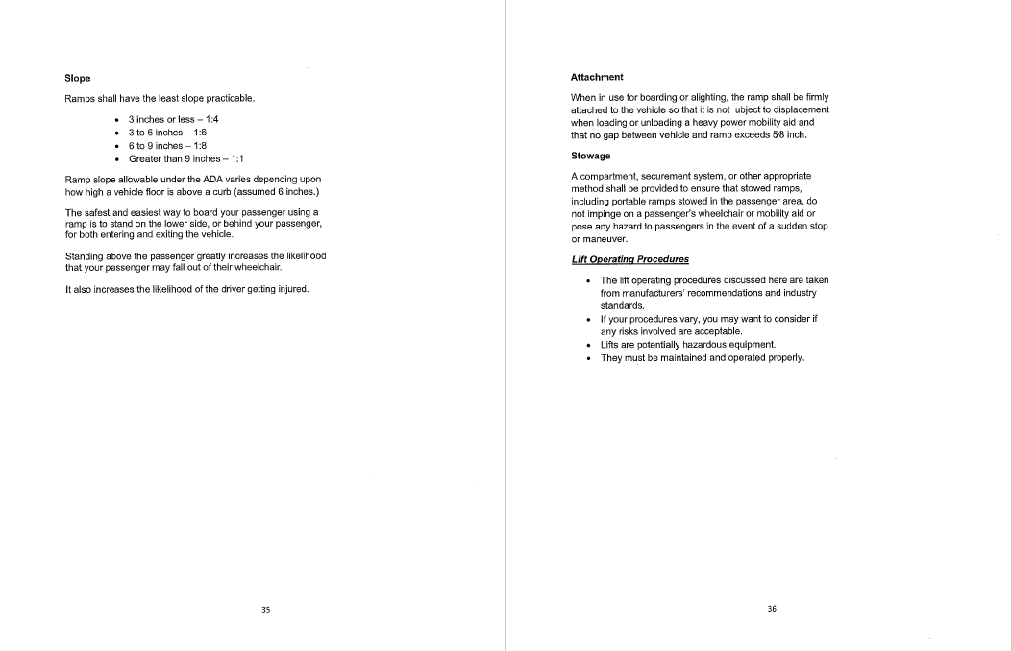
Appendix G – Passenger Assistance Safety and Sensitivity Training Manual (cont.)
62

Slide 63
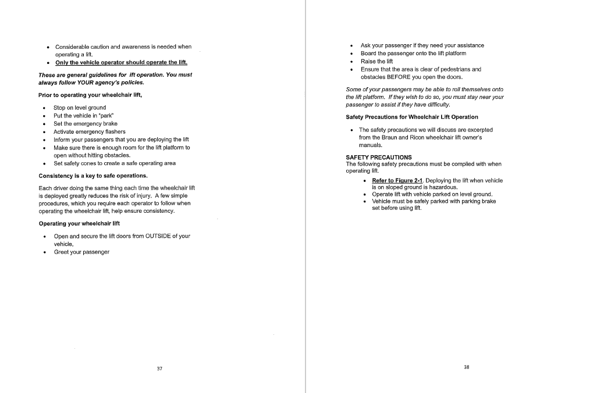
Appendix G – Passenger Assistance Safety and Sensitivity Training Manual (cont.)
63

Slide 64
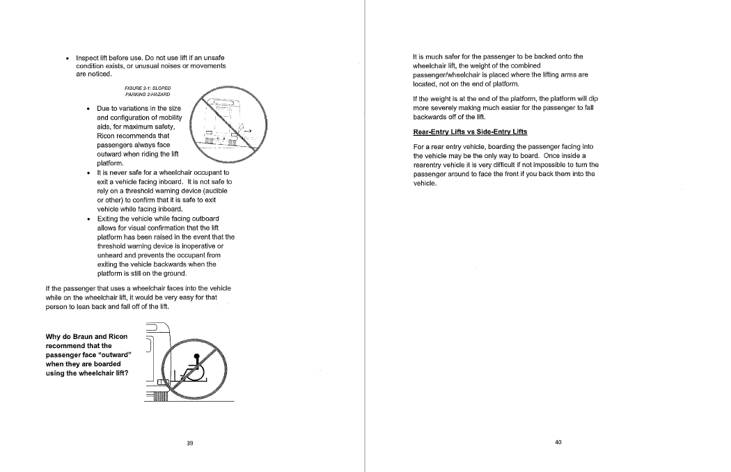
Appendix G – Passenger Assistance Safety and Sensitivity Training Manual (cont.)
64

Slide 65
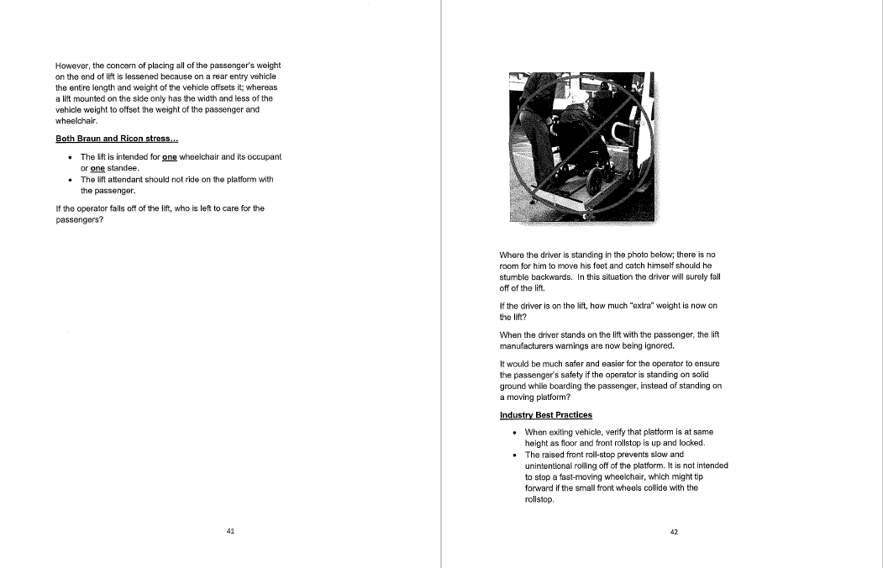
Appendix G – Passenger Assistance Safety and Sensitivity Training Manual (cont.)
65

Slide 66
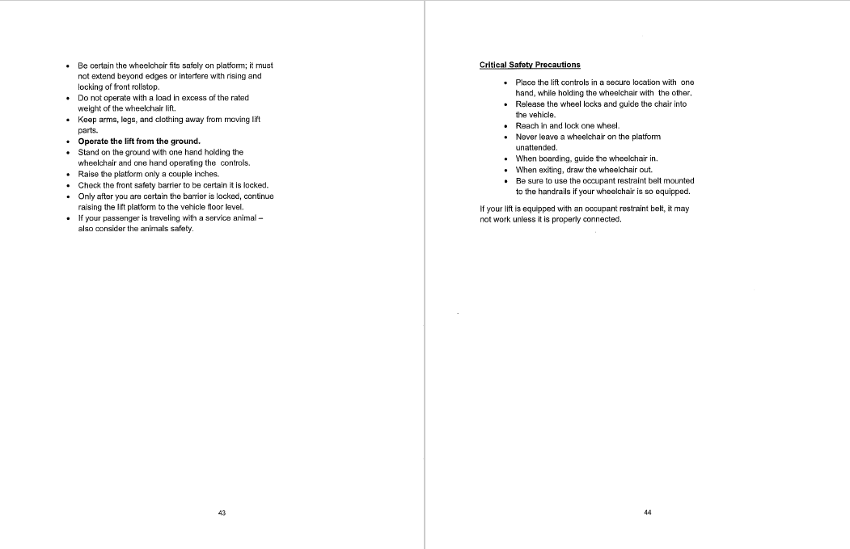
Appendix G – Passenger Assistance Safety and Sensitivity Training Manual (cont.)
66

Slide 67
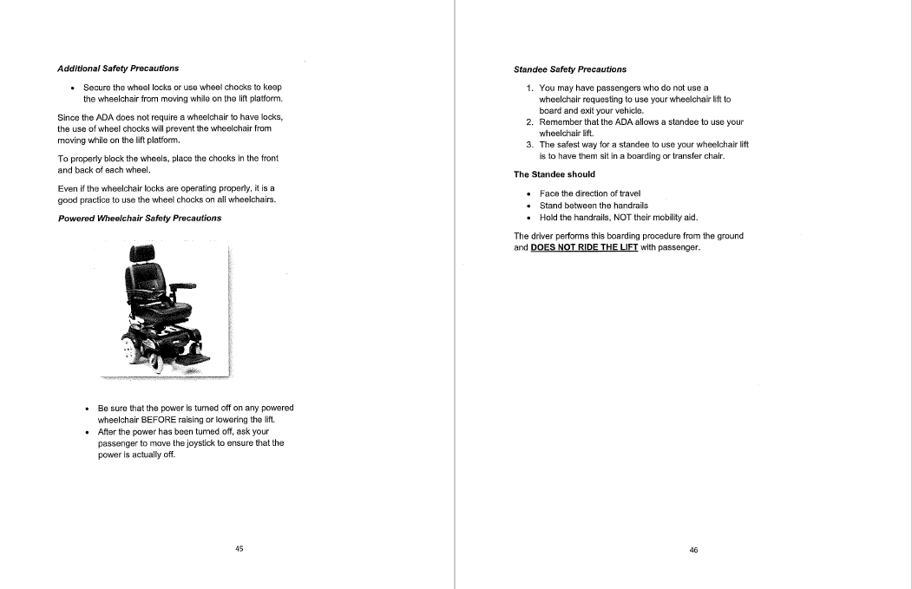
Appendix G – Passenger Assistance Safety and Sensitivity Training Manual (cont.)
67

Slide 68
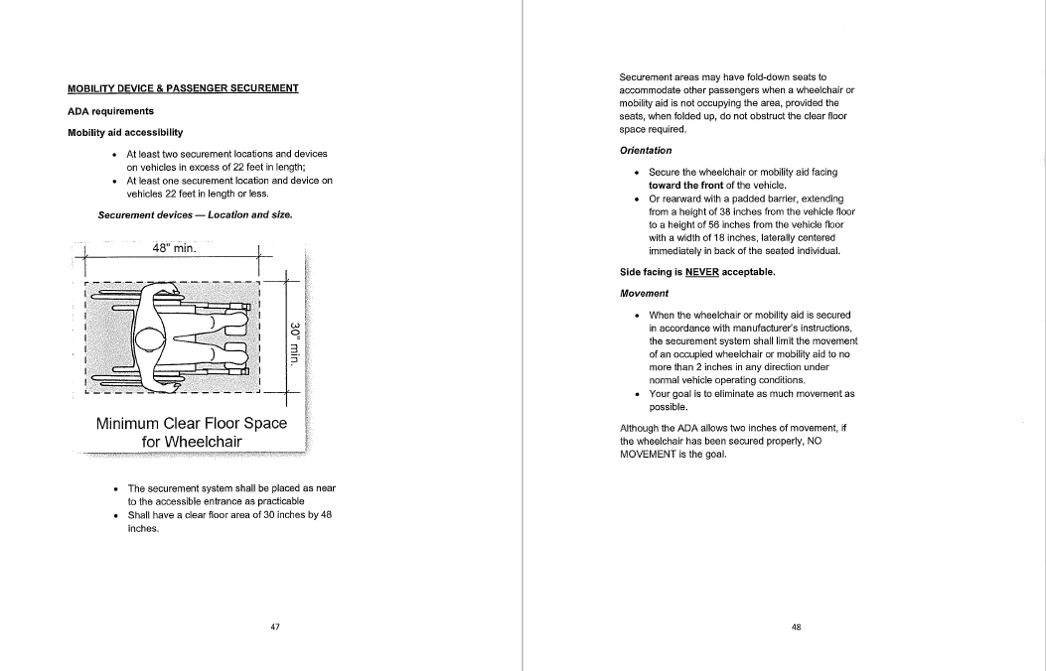
Appendix G – Passenger Assistance Safety and Sensitivity Training Manual (cont.)
68

Slide 69
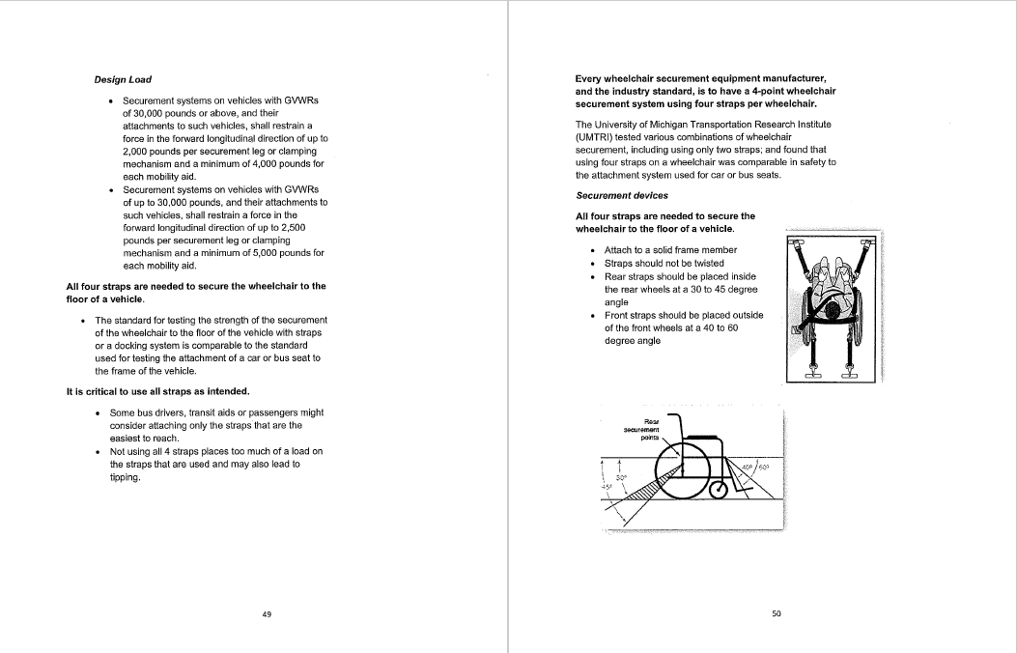
Appendix G – Passenger Assistance Safety and Sensitivity Training Manual (cont.)
69

Slide 70
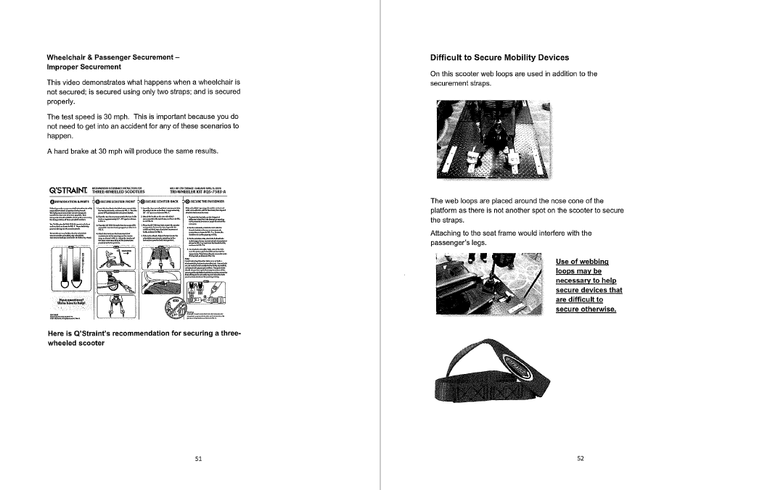
Appendix G – Passenger Assistance Safety and Sensitivity Training Manual (cont.)
70

Slide 71
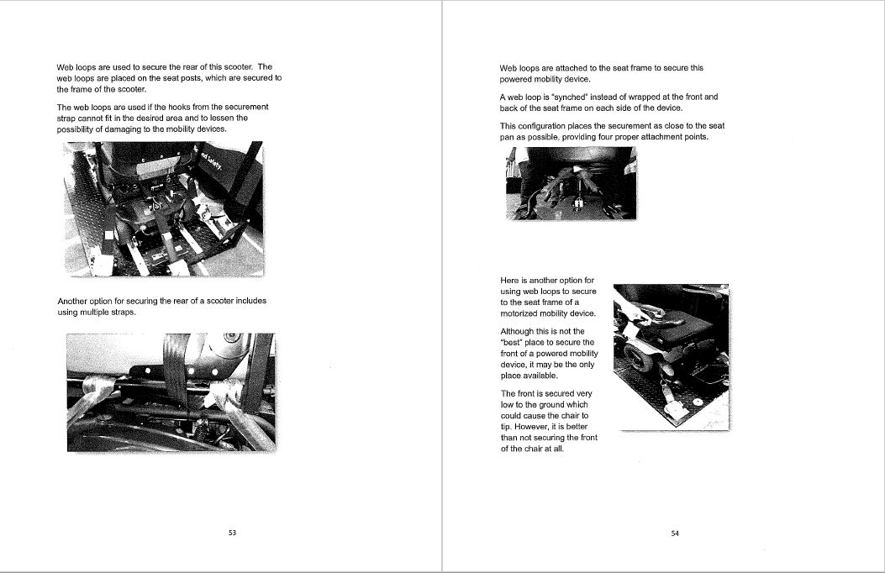
Appendix G – Passenger Assistance Safety and Sensitivity Training Manual (cont.)
71

Slide 72
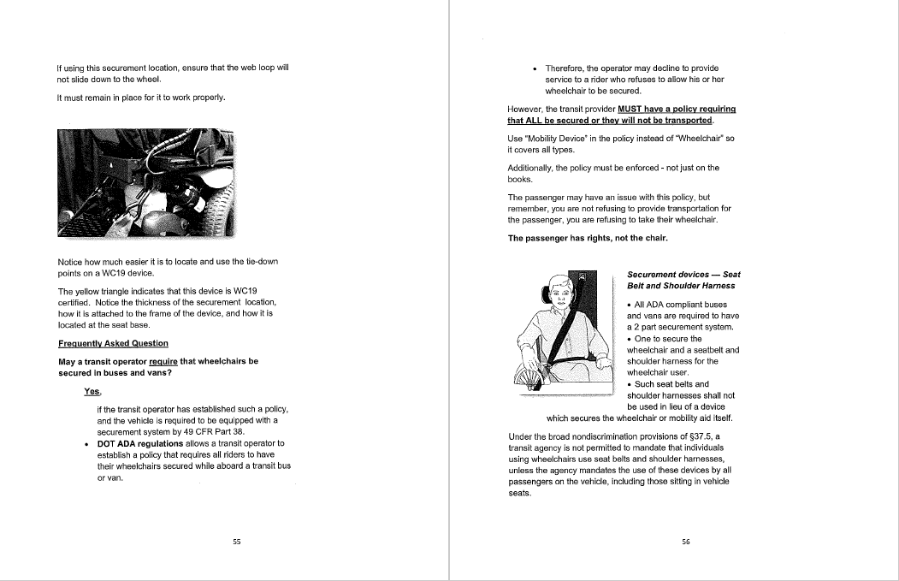
Appendix G – Passenger Assistance Safety and Sensitivity Training Manual (cont.)
72

Slide 73
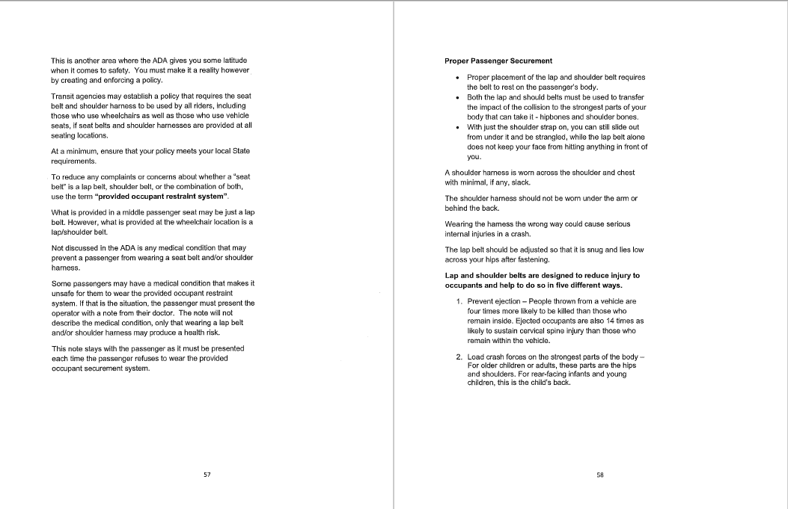
Appendix G – Passenger Assistance Safety and Sensitivity Training Manual (cont.)
73

Slide 74
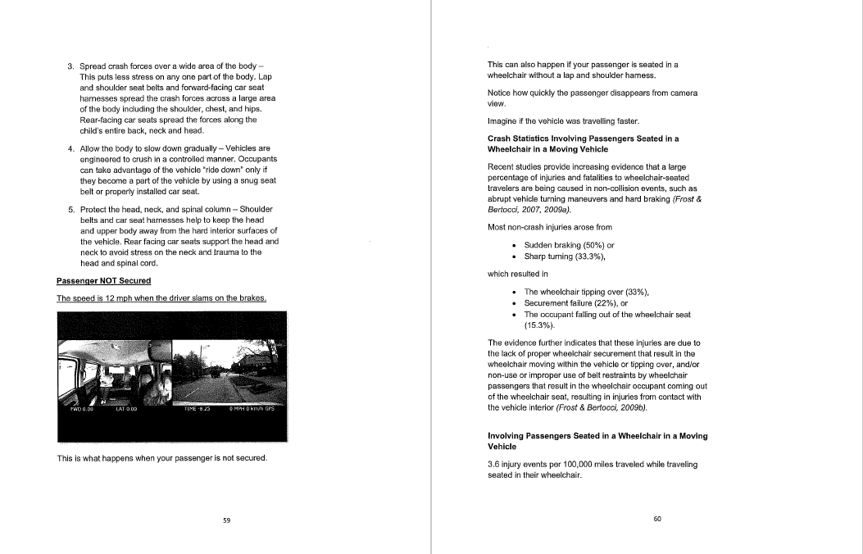
Appendix G – Passenger Assistance Safety and Sensitivity Training Manual (cont.)
74

Slide 75
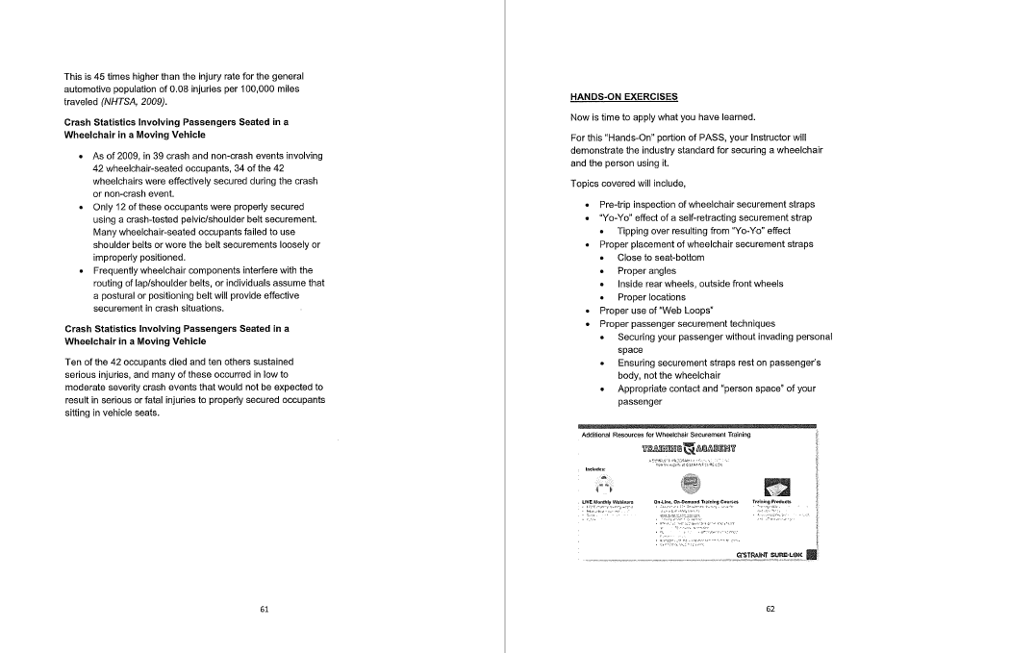
Appendix G – Passenger Assistance Safety and Sensitivity Training Manual (cont.)
75

Slide 76
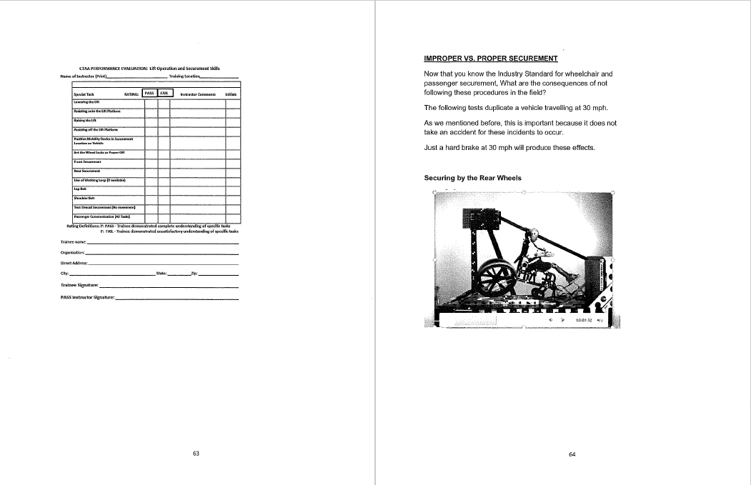
Appendix G – Passenger Assistance Safety and Sensitivity Training Manual (cont.)
76

Slide 77
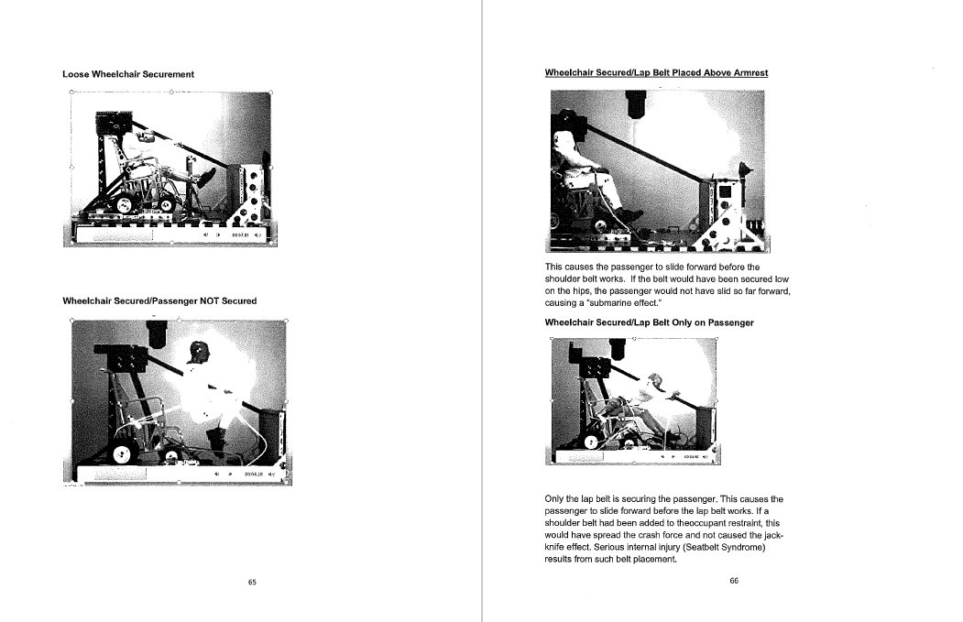
Appendix G – Passenger Assistance Safety and Sensitivity Training Manual (cont.)
77

Slide 78
Appendix G – Passenger Assistance Safety and Sensitivity Training Manual (cont.)
78

Slide 79
Appendix G – Passenger Assistance Safety and Sensitivity Training Manual (cont.)
79

Slide 80
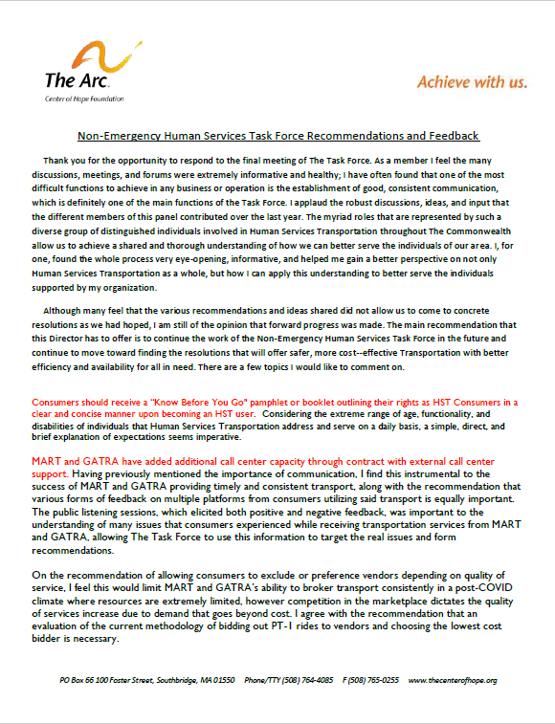
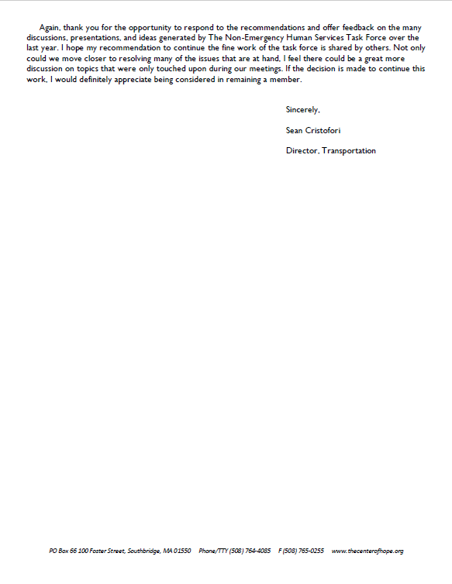
Appendix H – Written Feedback Received from Task Force Members After 11/15/2022
Received 11/25/2022
80

Slide 81
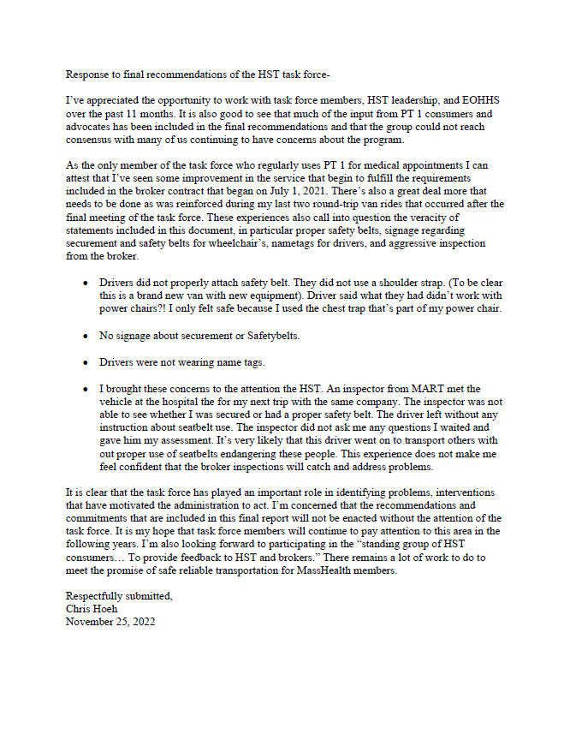
Appendix H – Written Feedback Received from Task Force Members After 11/15/2022
Received 11/25/2022
81

Slide 82
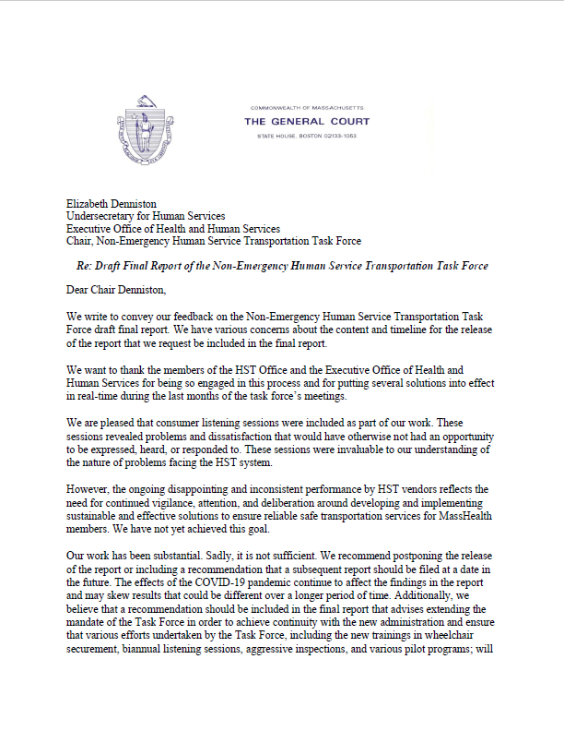
Appendix H – Written Feedback Received from Task Force Members After 11/15/2022
Received 11/29/2022
82

