Slide 1
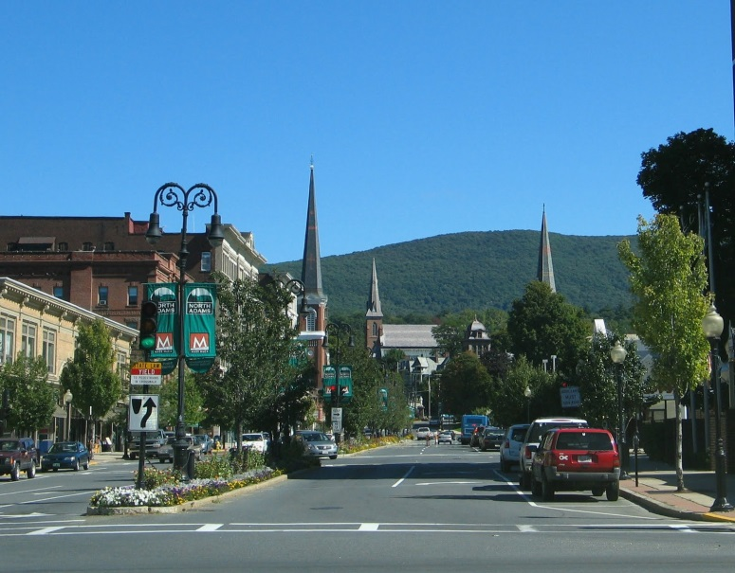
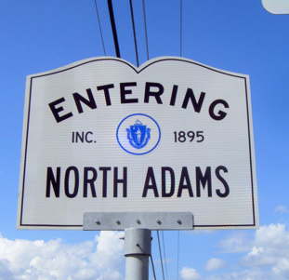
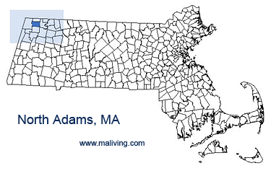

Healthcare Market Assessment: Northern Berkshire County, Massachusetts
Translating Strategy into Facility Solutions
September 17, 2014

Slide 2
Engagement Overview
As a result of the closure of North Adams Regional Hospital (NARH) in March 2014, the Massachusetts Department of Public Health, Office of Rural Health engaged Stroudwater Associates (Stroudwater) to provide an independent and objective third party assessment of the healthcare market in the North Adams region.
The purpose of the engagement is to evaluate the viability of healthcare services considering existing and future healthcare market conditions.
  Stroudwater’s assessment does not include an analysis of factors or decision-making leading to the closure of NARH.
ENGAGEMENT OVERVIEW

Slide 3
Approach included qualitative and quantitative analysis
Several community meetings, group and individual interviews took place throughout the Summer of 2014.
Data and studies completed for North Adams Regional Hospital (NARH), or about the North County service are were reviewed, including:
  2012 and 2013 Community Health Needs Assessments
  2011 Critical Access Hospital analysis
  Northern Berkshire Health Professional Shortage Applications
  NARH volume trends prior to closure
Historical and projected utilization for inpatient and outpatient services generated from the North County service area was analyzed. State and national trends in care delivery were considered.
APPROACH

Slide 4
Industry Overview
Notes:
4

Slide 5
Unsustainable Growth of Healthcare Costs
Projected 2022 US healthcare expenditures reach $5 trillion
Healthcare costs have increased over time to more than 17% of GDP
Since 1999, health insurance premiums and workers’ contributions to premiums have dramatically outpaced inflation and wage growth
The percentage of workers enrolled in high deductible health plans have increased from 10% in 2006 to 38% in 2013, with even greater increases among small employers (3-199 workers)
These factors combine to exert downward pressure on utilization of healthcare services, particularly on elective, inpatient, and high cost procedural and diagnostic services
INDUSTRY OVERVIEW

Slide 6
The effects of changing markets
Increased out of pocket costs results in consumer involvement and “price shopping” on where to get services
Pressures to reduce costs in areas with high utilization will face bigger declines in the future
Payment systems changing to reimburse providers for “population health” brings larger geographic areas together
  Industry changes have results in mergers and acquisitions among hospitals being at historical highs
  Physicians are now most commonly employed by hospitals / health systems
  Health systems are increasingly partnering outside the walls of the hospital with community agencies, primary care, and other providers
INDUSTRY OVERVIEW

Slide 7
Market Assessment
Notes:
7

Slide 8
North County Service Area
The North County Service Area, identified in green in the map at right, includes the towns of:
North Adams
Adams
Williamstown
Cheshire
Savoy
Drury
Rowe
Monroe Bridge
In addition, some use of the local delivery system is from areas outside of Massachusetts, including patients who travel from Vermont and New York ZIP codes, and students and visitors who are permanent residents of another area, yet may need to access the local delivery system. Using historical data, Stroudwater determined this resulted in a 15% “in-migration,” and included this in the study for planning purposes.
MARKET ASSESSMENT

Slide 9
Community Health – What Matters?
80% of the factors impacting community health are not related to access or quality of the healthcare system

Slide 10
North County Community Health Needs Assessment
  Alcohol, substance abuse, obesity, smoking, and mental health are the disease and health risks of greatest concern among members of Northern Berkshire County.
      1/3 of residents said that, “there are times when they cannot go to the doctor when they are sick or need a checkup”
      The need for transportation is the major obstacle, cost and availability of appointments were also barriers for a significant number of people.

Slide 11
Interview Summary
Stroudwater received input from over 100 stakeholders over the course of three visits to the community.
  The interview schedule was organized by the Massachusetts Department of Public Health, State Office of Rural Health.
  A broad spectrum of stakeholders―including consumers, leaders of local organizations, social service agencies, and healthcare professionals formerly practicing at North Adams Regional Hospital―participated in the process.
The most frequent needs cited for local healthcare services were the emergency room and improved access to primary care.
  A number of stakeholders expressed appreciation for Berkshire Medical Center’s (BMC) role in re-establishing emergency services and further developing supporting diagnostic imaging services.
QUALITATIVE ASSESSMENT

Slide 12
Interview Summary
Stakeholder interviews indicated a wide diversity of opinion regarding the need for acute inpatient services to treat medical conditions.
  Obstetrics services were the most commonly cited needs for hospitalization.
  An active part of the community, led by labor unions and former hospital employees, advocates strongly for re-establishing inpatient care.
  Other stakeholders cited the need for technology and access to specialists as examples supporting the consolidation of acute care inpatient services at BMC, where these resources are already available.
QUALITATIVE ASSESSMENT

Slide 13
Market Share Trends – North County
Market share at North Adams Regional Hospital had been steadily declining in the North County. The trends were consistent for both the Medicare population and for the total patient population.
In the past, approximately one of every two hospitalizations of North County residents occurred outside of the North County area. A portion of the services leaving the community would likely be for accessing specialty care that was not available. Patient choice and preferences are likely the other major contributing factors.
Source: Truven Health Analytics
MARKET ASSESSMENT

Slide 14
Average Length of Stay (ALOS) Trends – North County
Historically, North Adams Regional Hospital had a substantially lower average length of stay than North County overall.
This means that residents who received care outside of the community tended to be hospitalized for longer and for more complex conditions. This shows that patients admitted in North County were less sick or had lower “acuity.”
Source: Truven Health Analytics
MARKET ASSESSMENT

Slide 15
Recommendations – Community Coordination
Stroudwater recommends:
  Stakeholders in the North Adams region develop a shared vision of improving the community’s health status by aligning medical services available to the community with social services and other community assets in support of health status improvement.
  Improved coordination between existing groups representing healthcare providers, state programs, payers, and consumers.
  Massachusetts Department of Public Health and other elected officials help to secure funding to support community leaders in pursuing the vision of a healthier North County and in the efforts to improve coordination between existing groups.
  BMC leadership remain involved in North County activities and continue its efforts to engage stakeholders from North County.
RECOMMENDATIONS

Slide 16
Demand for Healthcare Services
Notes:
16

Slide 17
Need for Physicians – Primary Care
A standard approach to evaluating the need for primary care coverage is to apply a ratio of providers to the population of the service area, allowing an incremental percentage to account for in-migration.
Using this methodology, Stroudwater identified a total market need of 33.2 primary care physicians, including family practice, internal medicine, OB/GYN, and pediatrics.
A list of providers in the community provided by the MA Department of Public Health shows that the community needs at least an additional six physicians, based on industry benchmarks. Of that total, the community is particularly underserved in general and family medicine.
DEMAND FOR SERVICES

Slide 18
Recommendations – Primary Care
Stroudwater recommends:
  Full support of Community Health Programs’ grant to expand primary care services and recruit additional providers to the North County’s existing BMC North campus site in a Federally Qualified Health Center.
  The Massachusetts Department of Public Health (MDPH) should work with federal officials to designate North County as a Health Professional Shortage Area.
  State resources be directed to assist North County primary care providers in the transition to a medical home approach, considering the geographic and economic challenges faced by the area.
RECOMMENDATIONS

Slide 19
Emergency Services Demand Summary
From 2010 through 2013, NARH saw a historical emergency department volume of between 20,700 and 19,500 per year, against a projected total North County demand of 26,000 visits. Truven Health Analytics projects that emergency department demand in the area will grow slightly, between 1% and 2% annually.
Emergency department visits fall into two categories: critical emergency care and urgent care. Truven projects the North County distribution to be 58% urgent versus 42% emergent.
  NARH ED volume’s mix has historically been approximately 75% urgent and only 25% emergent.
The analysis shows that emergency services will continue to be in demand for the North County area, but that the distribution of both space and function should skew towards urgent care services, with appropriate policies and procedures in place for transferring or redirecting more acute visits to other regional providers.
DEMAND FOR SERVICES

Slide 20
Ancillary and Outpatient Services Demand Summary
The operation of the freestanding emergency room, the support of primary care, and the provision of accessible, low-acuity services to patients are all factors in assessing ancillary and diagnostic service demand.
Stroudwater’s approach to evaluating the North County market demand was to reflect only those volumes expected to be done at a hospital, hospital outpatient, or emergency department site of service. This excludes procedures and diagnostic services typically provided within the physician’s office.
Sufficient North County need exists to justify providing laboratory, x-ray, computed tomography (CT), and ultrasound at the BMC-North site. There is also significant market demand for other diagnostic imaging modalities, including magnetic resonance imaging (MRI) and mammography.
Ambulatory surgery demand from the primary service area supports the consideration of a surgical program in the North Adams area. The specifics of the program will hinge on the viability of physician recruitment as driven by sufficient procedural volumes to keep physicians practicing efficiently.
DEMAND FOR SERVICES

Slide 21
Recommendations – Locally Delivered Services
Stroudwater recommends:
  Maintaining access to emergency services in North County, as well as diagnostic imaging and laboratory services in support of both the ER and local ambulatory care access,
  Development of urgent care or walk-in primary care services to expand access to low acuity services.
  Expanding outpatient services, disease management, and prevention/ wellness services that can be safely provided in North County, such as screening mammography.
  Re-establishing gastroenterology and ambulatory surgery services at the BMC North campus, provided that physicians can be recruited and retained to practice in the area.
RECOMMENDATIONS

Slide 22
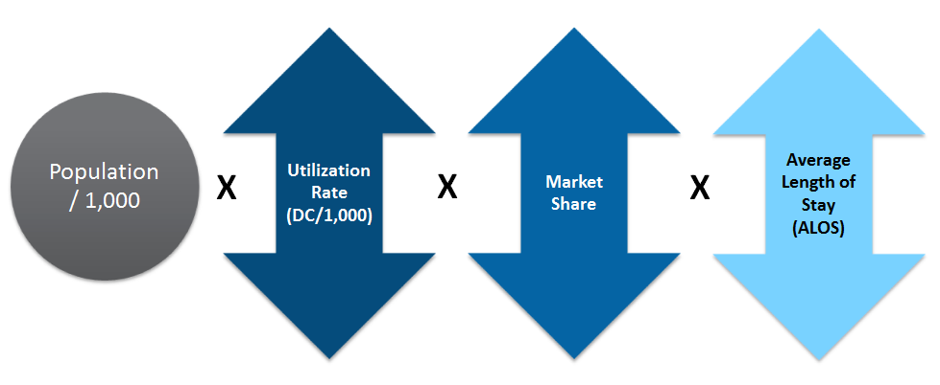
Inpatient Demand
Demand for inpatient services is a function of population, utilization within the population, market share, and the average length of stay.
People typically admitted to rural hospitals are less sick and do not require the regular care of specialists, therefore demand is further adjusted for acuity.
DEMAND FOR SERVICES

Slide 23
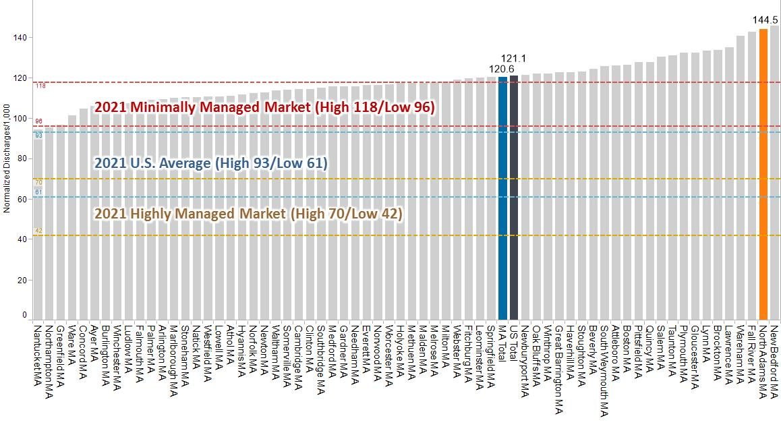
Higher than Average Hospitalization Rate in North County
Current use rates based on Truven Healthcare Analytics population and discharge estimates by Dartmouth Hospital Service Area (HSA).
2021 use rates based on Milliman Governance Institute Presentation (2/2012).
Use rates are normalized to the United States average.

Slide 24
Medical Inpatient Demand
The volumes generated in the North County indicates demand for inpatient medical / surgical of 31 beds. Using an in-migration rate of 15%, the total demand for inpatient beds would equal 35 beds.
This is to accommodate 100% of North County discharges and additional in-migration, excluding OB, substance abuse and psych.
Historically, the market share was 50%-60%, resulting in a demand of 18-21 beds.
Reductions to inpatient utilization reduce the need for medical/surgical beds in the future.
DEMAND FOR SERVICES

Slide 25
Over $2M of Excess Costs to Operate Beds in North County
The costs for meeting the market acute care inpatient demand was compared by potential site of services.
Clinical Staffing Costs
Direct Med/Surg Staffing Costs | $2,327,000
Benefits Costs on Staffing | 652,000
Hospitalist Costs | 1,270,000
 | $4,249,000
Additional Support Staffing Costs
Nursing Administration | $224,000
Pharmacy | 260,000
Dietary | 327,000
 | $811,000
Total Staffing Costs | $5,060,000
Variable Costs/Day | $250
Total Projected Days | 5,475
Total Variable Costs | $1,369,000
Estimated BMC Costs | $4,348,000
Estimated BMC North Costs | 6,429,000
Difference (increased costs) | ($2,081,000)
Stroudwater estimates an annual net increase in costs of $2.1M under a model of providing inpatient medical-surgical care at the BMC North Site. The analysis includes an estimated $5M in staffing costs and $1.4M in variable costs (e.g., supplies, meals, etc.) to care for an average of 15 patients/day. This does not included additional costs for OB.
Increasing costs to deliver lower acuity health care is inconsistent with the trends in the industry.

Slide 26
Recommendations – Inpatient Services
Stroudwater recommends developing a clinically integrated delivery system with BMC, to include limited inpatient services provided at BMC North only if designated as a Critical Access Hospital.
  Designation as a Critical Access Hospital is the only option to cover the additional costs required for providing inpatient services at BMC North. Without this designation, the community need for inpatient services should be provided at BMC to increase efficiency and lower costs.
RECOMMENDATIONS

Slide 27
Obstetrical Demand Summary
Birth rates have been falling nationally and in Massachusetts.
A total of 462 deliveries are projected for the North County service area. Historical deliveries at NARH from the North County ranging from 237 to 223 from 2008 through 2012. Before its closure, two of the three OB/GYN physicians in the area stopped providing delivery services at NARH.
For the total market, the total need for inpatient obstetric services would be 3 LDR labor and delivery rooms and between 6 and 8 postpartum rooms.
Patient choice and referrals of high-risk pregnancies result in less than 100% of this need being served locally; historical market share ranged between 78% and 66%. This reduces the actual demand for obstetric rooms to serve North County residents to approximately 2 labor and delivery rooms per day and between 4 and 6 postpartum rooms.
DEMAND FOR SERVICES

Slide 28
Obstetrical Demand Summary
Some local practitioners identified operational barriers and quality concerns with providing inpatient obstetrics services in North County.
  Cited need to have a minimum of three obstetricians committed to doing deliveries and recruitment challenges and costs of accomplishing this were cited as obstacles.
  Costs and coverage issues for pediatric, neonatal care, and anesthesia personnel to cover call were also cited.
Published studies have indicated that hospitals providing lower volumes of deliveries have poorer outcomes on average when compared to high volume delivery units. In addition, the American Society of Anesthesiologists and The American College of Obstetricians and Gynecologists have concluded that when evaluating the goals for obstetrics care, “deficiencies were most evident in smaller delivery units.” Their findings indicate that 34% of hospitals have fewer than 500 deliveries per year and that “providing comprehensive care for obstetric patients in these small units is extremely inefficient, not cost-effective, and frequently impossible.”
DEMAND FOR SERVICES

Slide 29
Recommendations – Obstetrics services
Stroudwater recommends the development of a coordinated effort for providing locally accessible prenatal care and education, together with a plan for appropriate transportation assistance to other nearby facilities for childbirth and a comprehensive protocol for addressing emergencies.
  It will be important to provide coordinated access throughout the region for a comprehensive range of services needed during pre-conception, prenatal, pregnancy, postpartum and newborn periods for the health of the mother and baby.
RECOMMENDATIONS

Slide 30
Behavioral Health Demand Summary
Accommodating the behavioral health needs of the primary service area, as reported in the June 2014 Statewide Mental Health Advisory Committee Report is going to require a combined effort of community and outpatient services, as well as traditional inpatient services.
  A behavioral health and addiction services trust was recommended for funding community level care and development of a statewide plan to strengthen outpatient behavioral health services.
Assuming NARH’s historical average length of stay for behavioral health patients, for 100% North County market share and 15% additional inmigration, the combined inpatient bed demand for behavioral health and drug abuse is 19 beds.
  Decreasing utilization by 10% or increasing by 10% would produce a range of 17-21 beds, again to accommodate 100% market share.
DEMAND FOR SERVICES

Slide 31
Recommendations – Behavioral health services
Stroudwater recommends the further development of behavioral health and substance abuse services with targeted outreach to at-risk populations, building on the existing capacity of the Brien center services.
  A more detailed analysis of community mental health and drug abuse resources, including those already provided by state and local social service agencies, should be considered.
RECOMMENDATIONS

Slide 32
Acknowledgements
Stroudwater would like to acknowledge the over 100 people in Berkshire County, public and elected officials that contributed their time, energy, resources and perspectives to this study
  Richard Alcombright, the mayor of North Adams, has been very active in providing both direct feedback on community needs as well as organizing opportunities for other stakeholders.
  Other elected officials including Senator Ben Downing and Representative Gailanne Cariddi for their input on the process and perspectives on constituent needs
  The Berkshire Community Coalition for allowing Stroudwater to use space for stakeholder meetings and focus groups, as well as the American Legion for hosting the “Tuesday night meetings” and the Massachusetts College of Liberal Arts for the community meetings
  Secretary John Polanowicz, Cathleen McElligott and their student intern, Peter Bergstrom for identifying stakeholders, scheduling meetings and providing supplemental data to the study
ACKNOWLEDGEMENTS

