Slide 1
EPIA – November 2021 All Ages
Number of referrals in period: 604
Note: One referral was still boarding as of 2/7/2022 and is not reflected in any Time to Placement calculations

Slide 2
Expedited Psychiatric Inpatient Admission Dashboard | Nov-21 |  |  |  |  | Oct-21 |  |  | Nov-20 |  |  |  | Variance (Nov 20 vs. Nov 21) |  | Percent Change (Nov 20 vs. Nov 21)
 | Referrals |  | Time to Placement (Days) |  |  | Referrals |  | ATP³ | Referrals |  | Time to Placement |  | Referrals | ATP³ | Referrals | ATP³
 |  |  | Average | Median | Max |  |  |  |  |  | Average | Max
SUMMARY | 604 |  | 4.01 | 2.00 | 35 | 807 |  | 3.78 | 530 |  | 3.12 | 28 | 74 | 0.89 | 14% | 29%
0-12 | 68 | 11% | 8.06 | 6.00 | 32 | 101 | 13% | 6.49 | 34 | 6% | 3.94 | 20 | 34 | 4.12 | 100% | 105%
13-17 | 182 | 30% | 5.05 | 3.00 | 35 | 216 | 27% | 5.39 | 184 | 35% | 4.55 | 22 | -2 | 0.50 | -1% | 11%
Subtotal: 0-17 | 250 | 41% | 5.86 | 3.00 | 35 | 317 | 39% | 5.74 | 218 | 41% | 4.25 | 22 | 32 | 1.61 | 15% | 38%
18-22 | 40 | 7% | 2.53 | 1.00 | 18 | 49 | 6% | 2.92 | 35 | 7% | 2.31 | 20 | 5 | 0.22 | 14% | 10%
23-64 | 291 | 48% | 2.64 | 1.00 | 22 | 417 | 52% | 2.41 | 241 | 45% | 2.17 | 28 | 50 | 0.47 | 21% | 22%
65+ | 23 | 4% | 3.91 | 2.00 | 23 | 24 | 3% | 3.54 | 36 | 7% | 2.22 | 8 | -13 | 1.69 | -36% | 76%
Commercial | 108 | 18% | 4.45 | 3.00 | 30 | 114 | 14% | 5.68 | 109 | 21% | 4.28 | 22 | -1.00 | 0.17 | -1% | 4%
Health Safety Net | 2 | 0% | 6.00 | 6.00 | 7 | 3 | 0% | 4.33 | 3 | 1% | 2.67 | 4 | -1.00 | 3.33 | -33% | 125%
MassHealth ACO/MCO⁴ | 383 | 63% | 4.01 | 2.00 | 35 | 516 | 64% | 3.44 | 291 | 55% | 2.91 | 28 | 92.00 | 1.10 | 32% | 38%
MassHealth Fee-for-Service | 1 | 0% | 1.00 | 1.00 | 1 | 4 | 0% | 3.00 | 4 | 1% | 1.75 | 3 | -3.00 | -0.75 | -75% | -43%
MassHealth (Unspecified) | 19 | 3% | 2.79 | 2.00 | 13 | 17 | 2% | 1.94 | 10 | 2% | 3.70 | 8 | 9.00 | -0.91 | 90% | -25%
Medicare Only | 8 | 1% | 8.88 | 1.00 | 23 | 16 | 2% | 3.13 | 10 | 2% | 2.70 | 7 | -2.00 | 6.18 | -20% | 229%
Medicaid only - Out of State | 1 | 0% | 3.00 | 3.00 | 3 | 5 | 1% | 6.80 | 1 | 0% | 2.00 | 2 | 0.00 | 1.00 | 0% | 50%
Medicaid-Medicare | 64 | 11% | 2.52 | 2.00 | 19 | 107 | 13% | 3.34 | 79 | 15% | 2.48 | 23 | -15.00 | 0.04 | -19% | 2%
Uninsured | 18 | 3% | 5.89 | 5.50 | 15 | 25 | 3% | 5.12 | 23 | 4% | 2.78 | 13 | -5.00 | 3.11 | -22% | 112%
State Agency Engagement
DCF | 57 |  | 7.80 | 5.50 | 35 | 83 |  | 7.06 | 44 |  | 4.84 | 20 | 13 | 2.96 | 30% | 61%
DDS | 4 |  | 7.50 | 6.50 | 15 | 9 |  | 5 | 7 |  | 4.29 | 8 | -3 | 3.21 | -43% | 75%
DMH | 70 |  | 5.21 | 3.00 | 32 | 67 |  | 5.24 | 49 |  | 4.27 | 28 | 21 | 0.94 | 43% | 22%
DYS | 2 |  | 10.50 | 10.50 | 18 | 4 |  | 4.75 | 3 |  | 3.33 | 4 | -1 | 7.17 | -33% | 215%

Slide 3
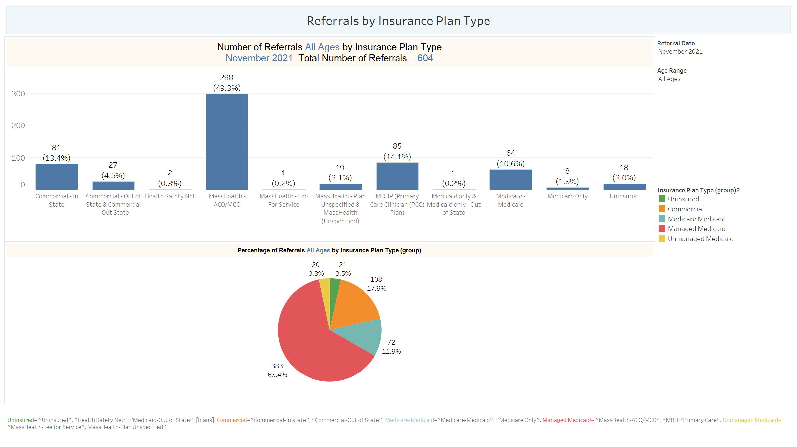

Slide 4
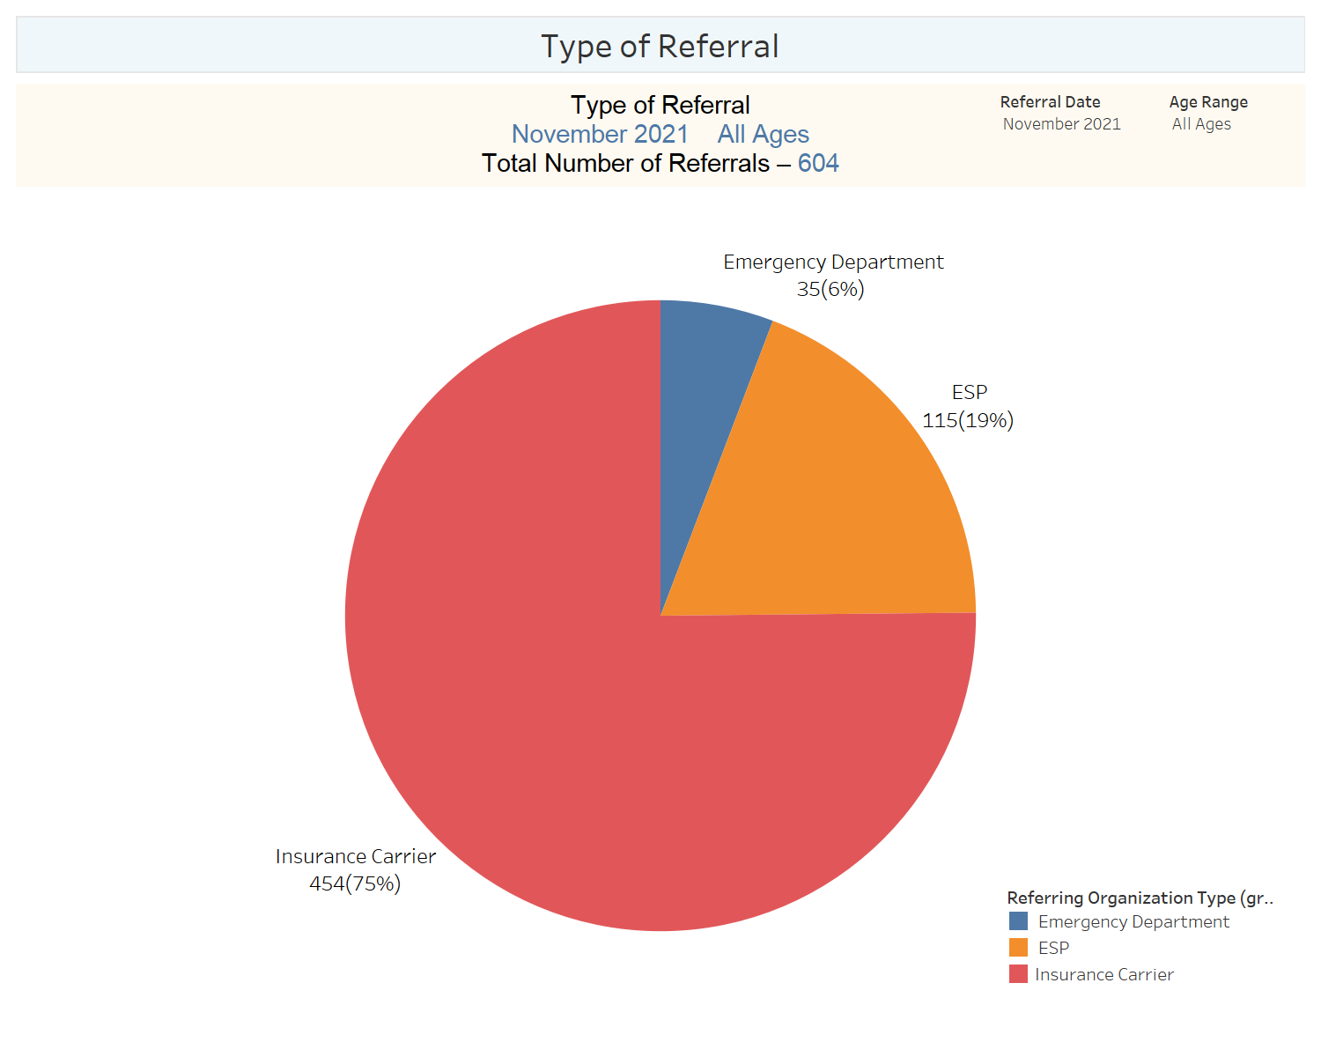

Slide 5
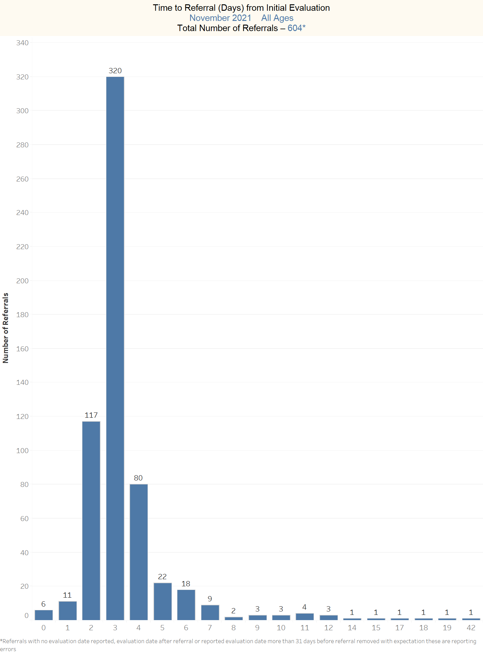

Slide 6
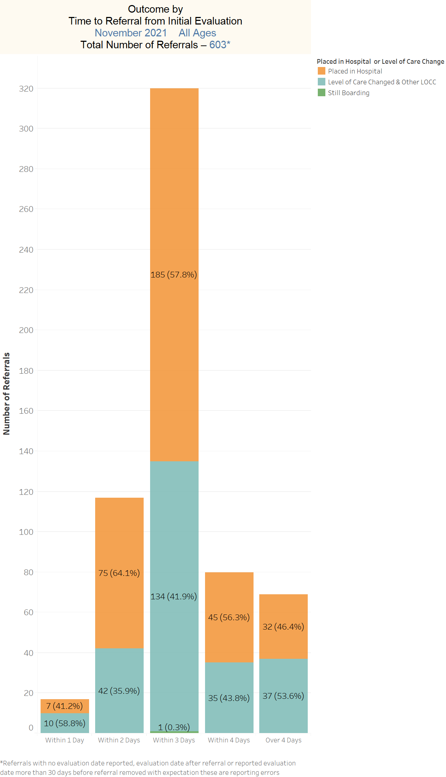

Slide 7
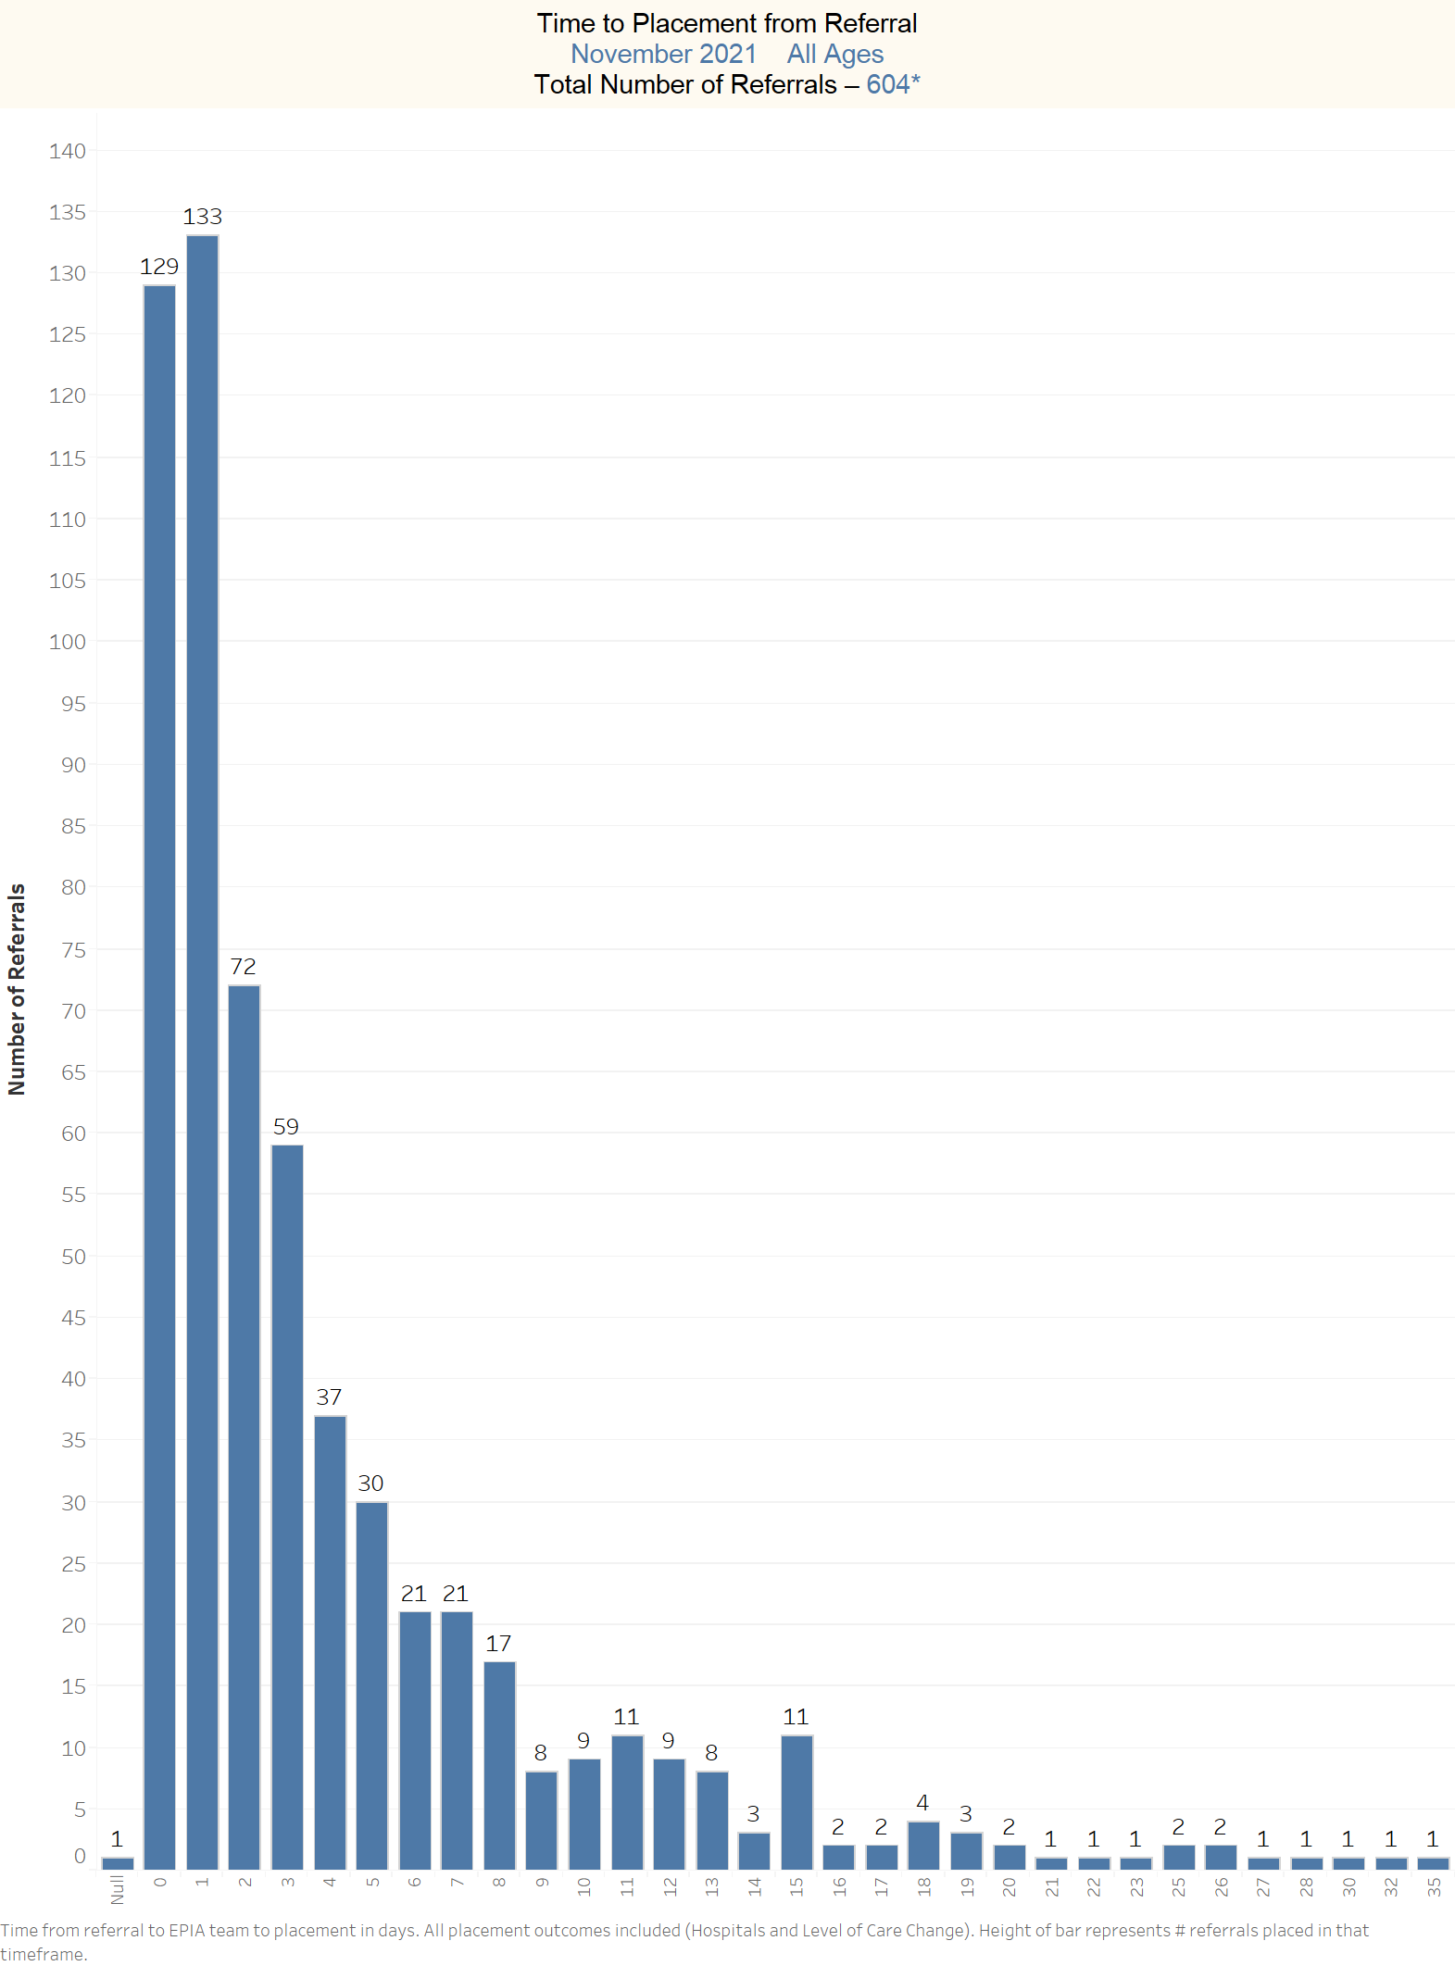

Slide 8
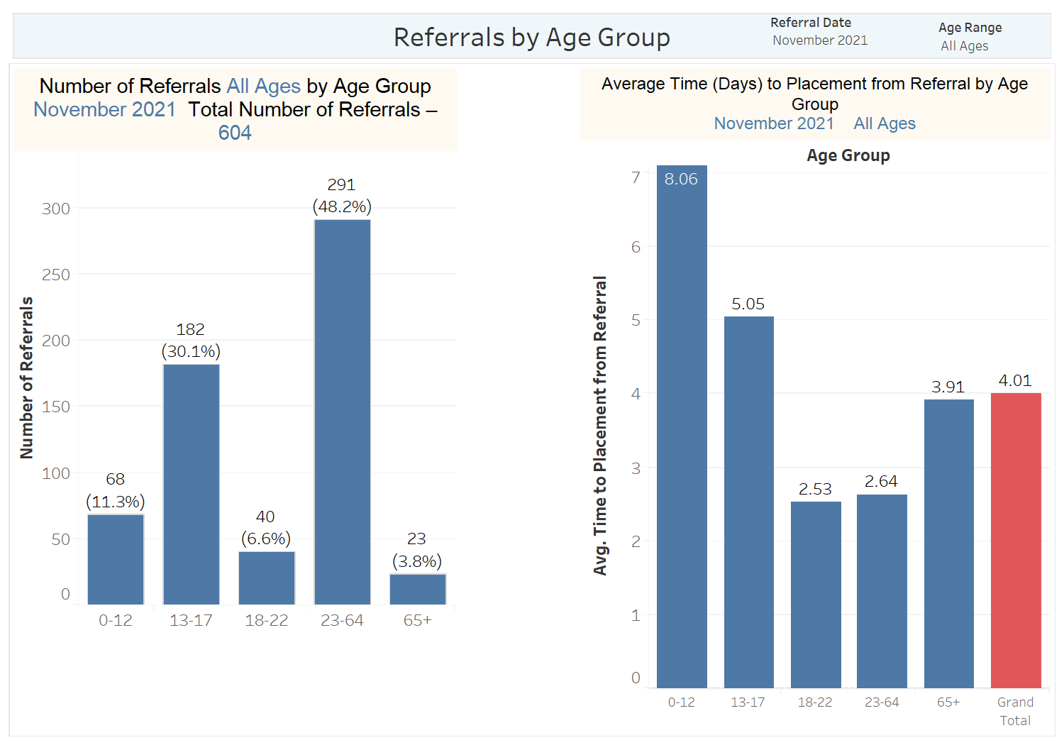

Slide 9
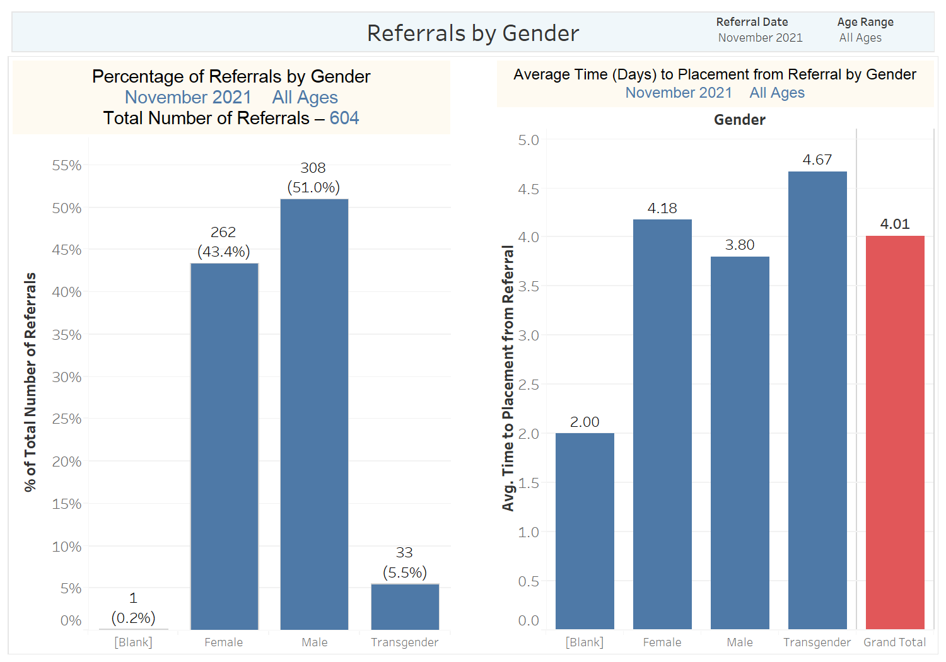

Slide 10
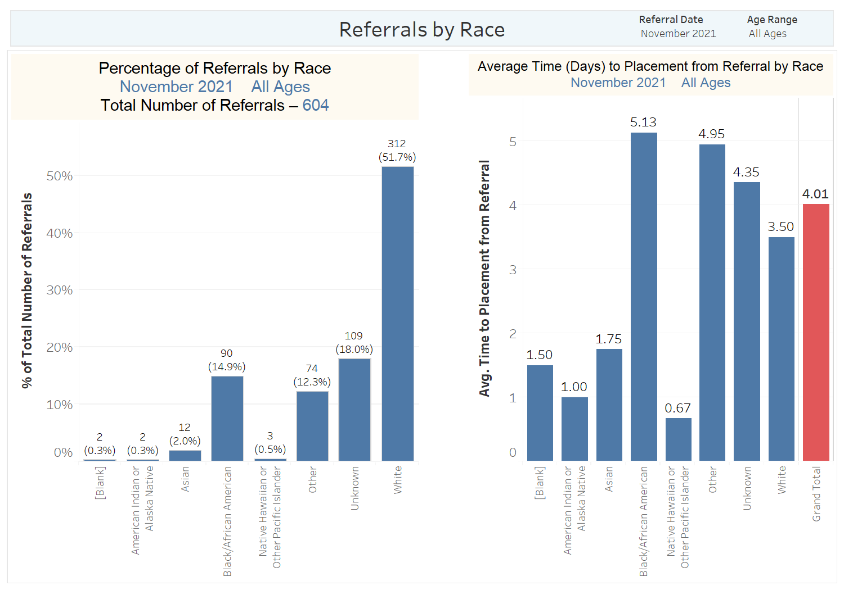

Slide 11
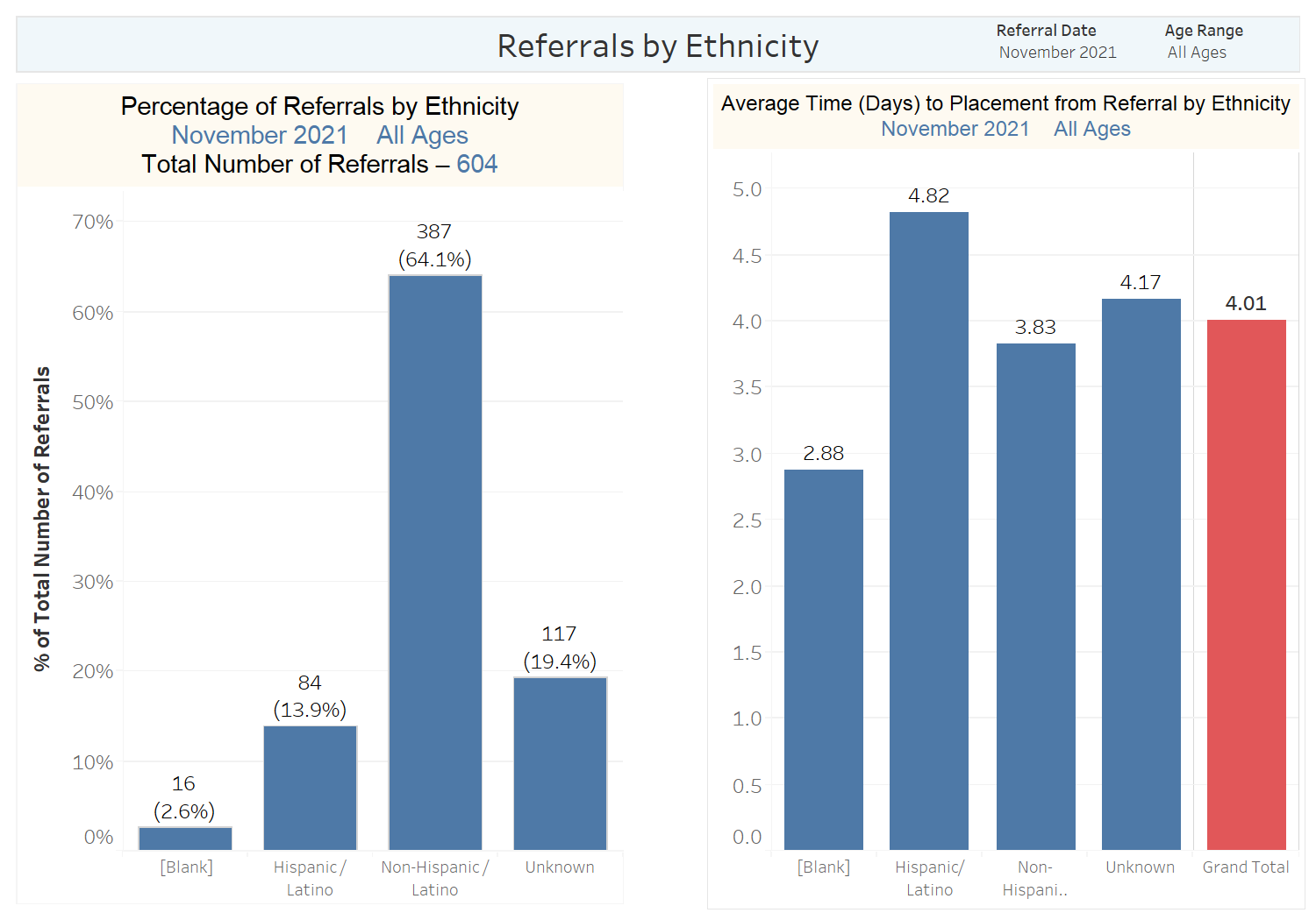

Slide 12
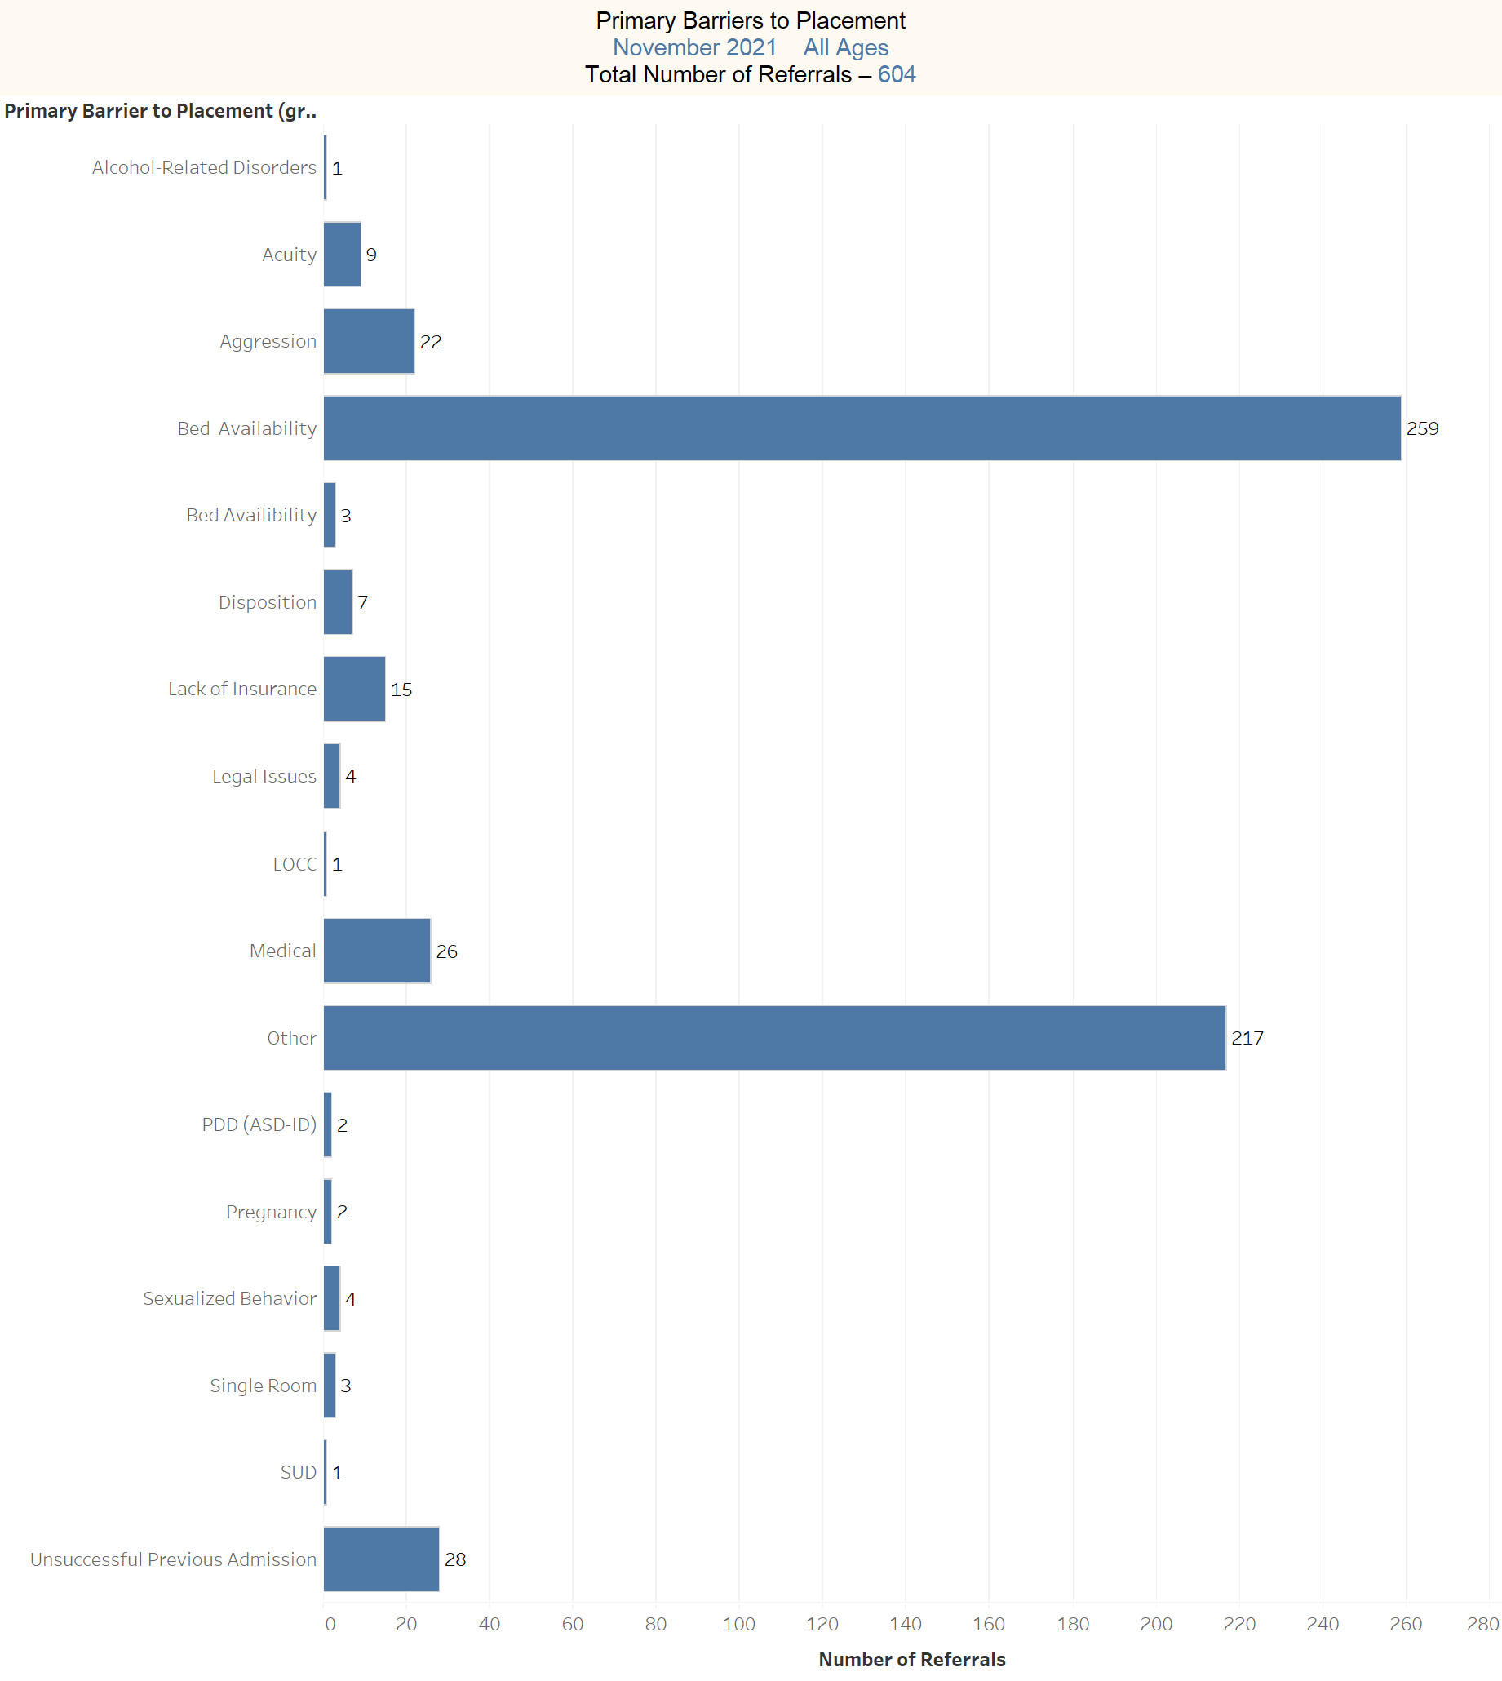

Slide 13
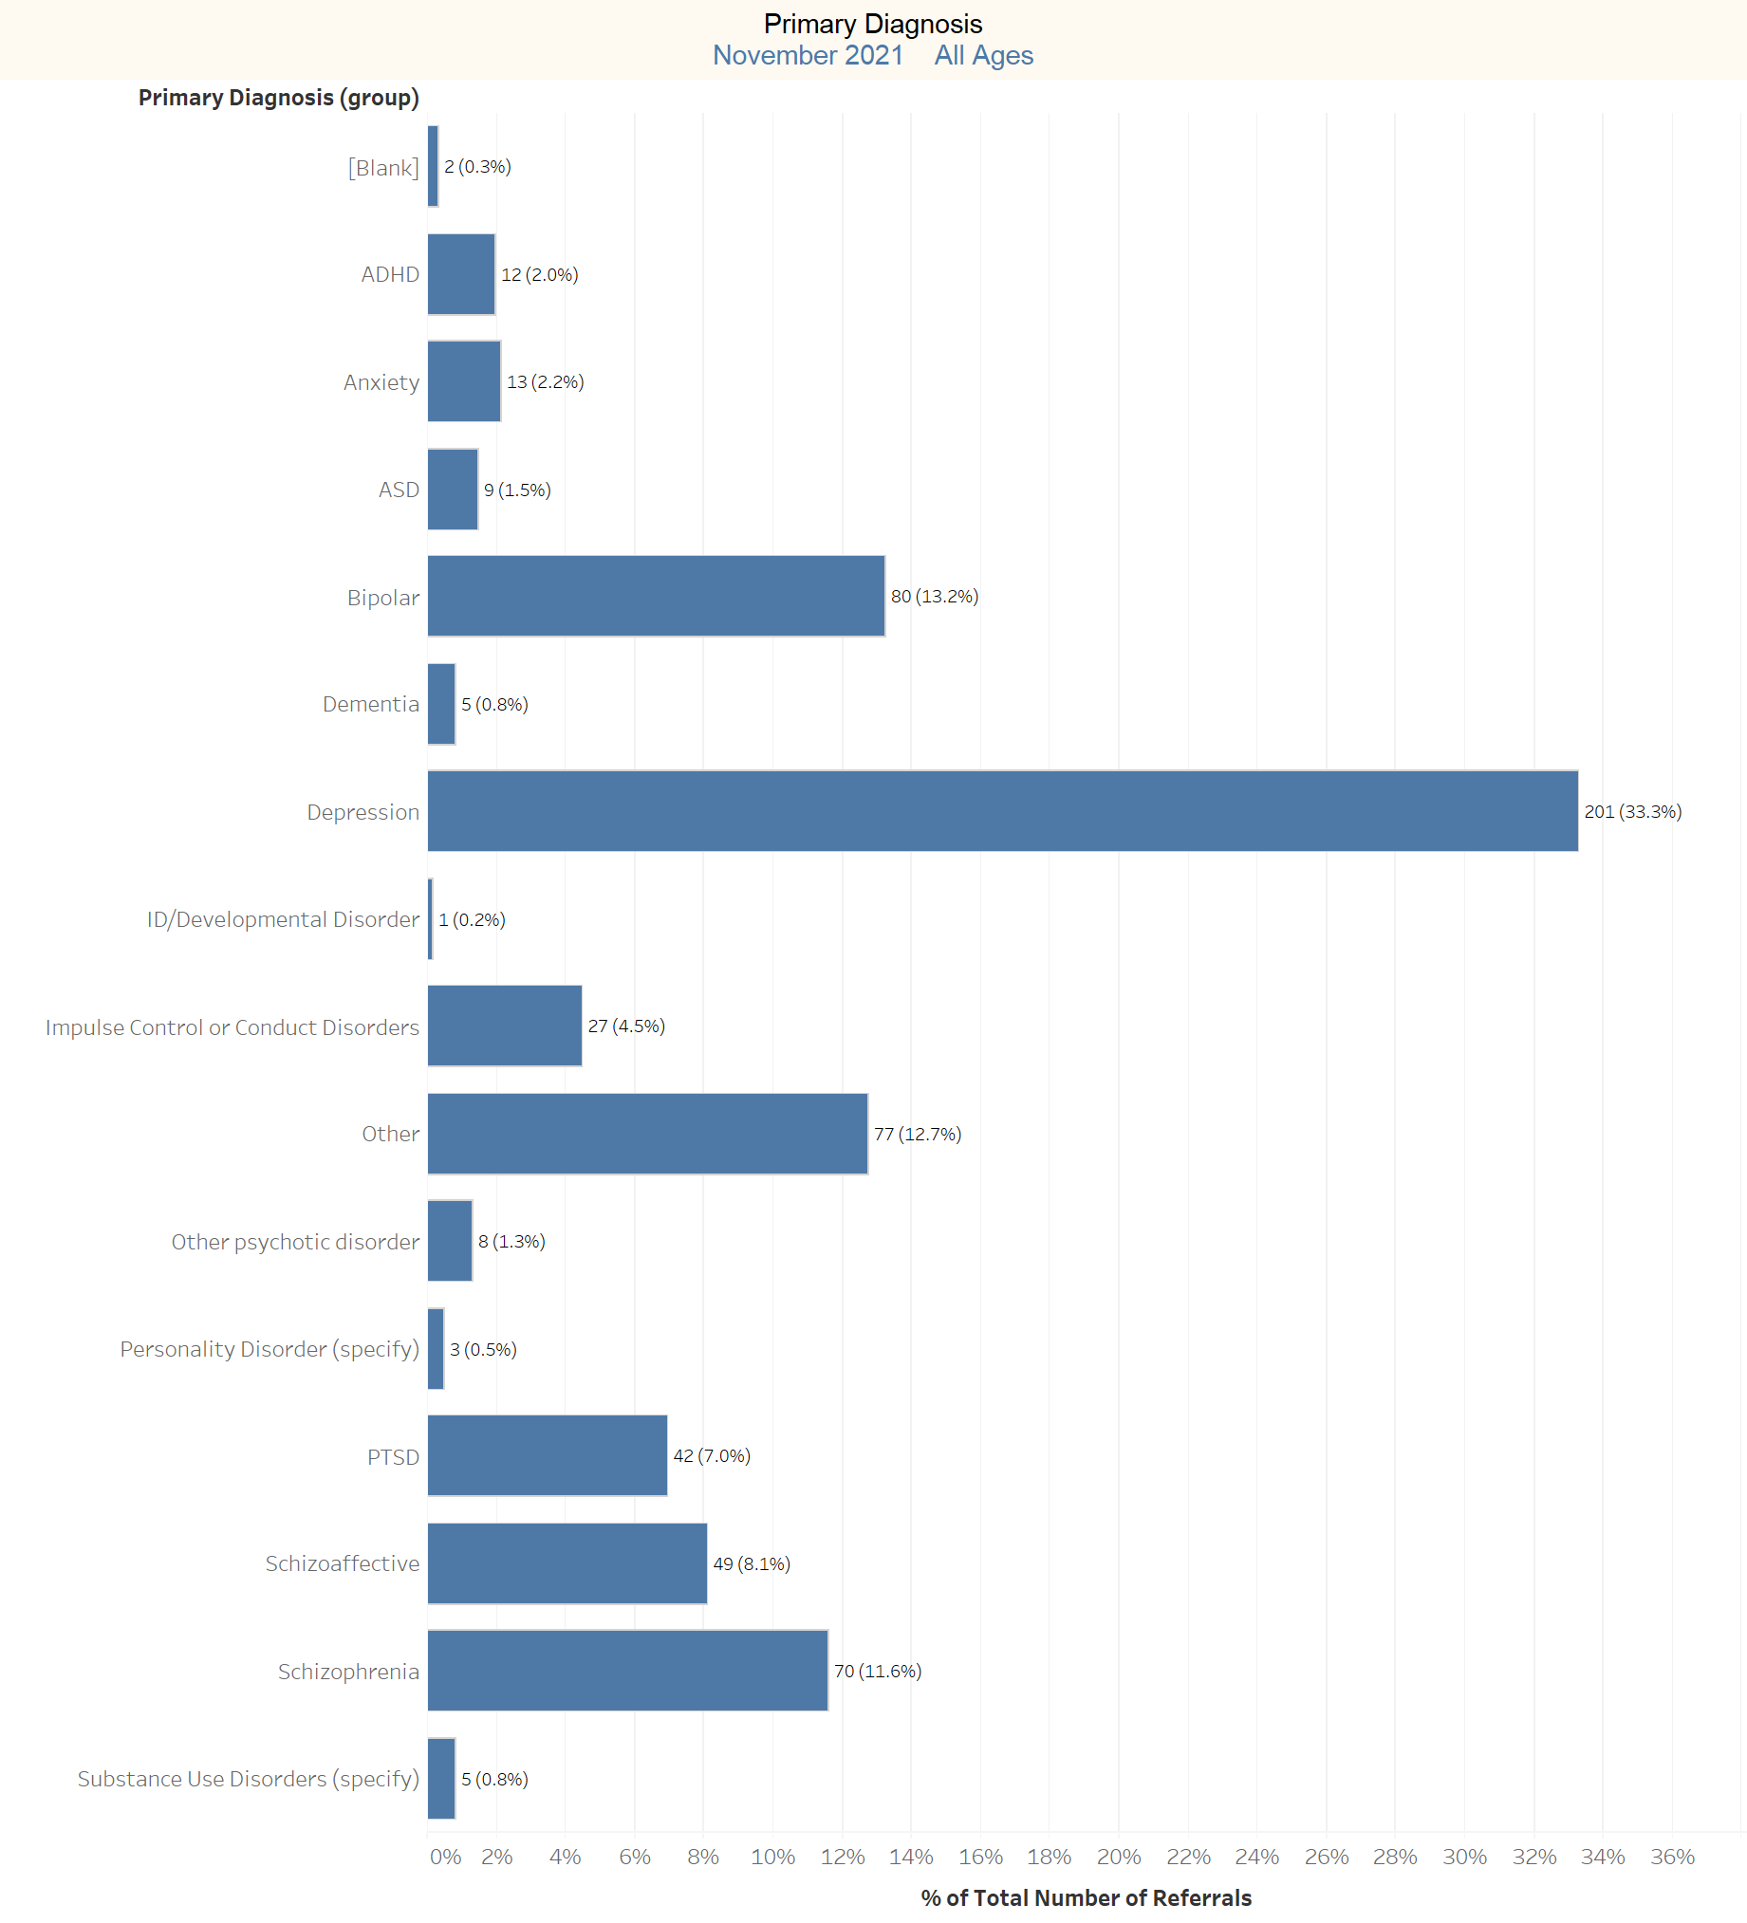

Slide 14
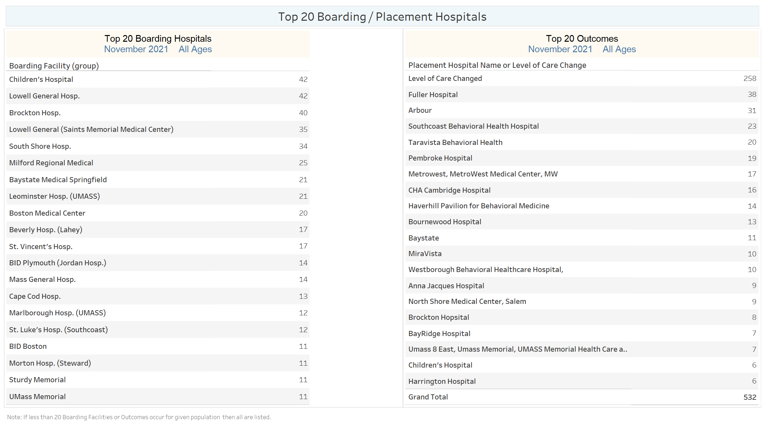

Slide 15
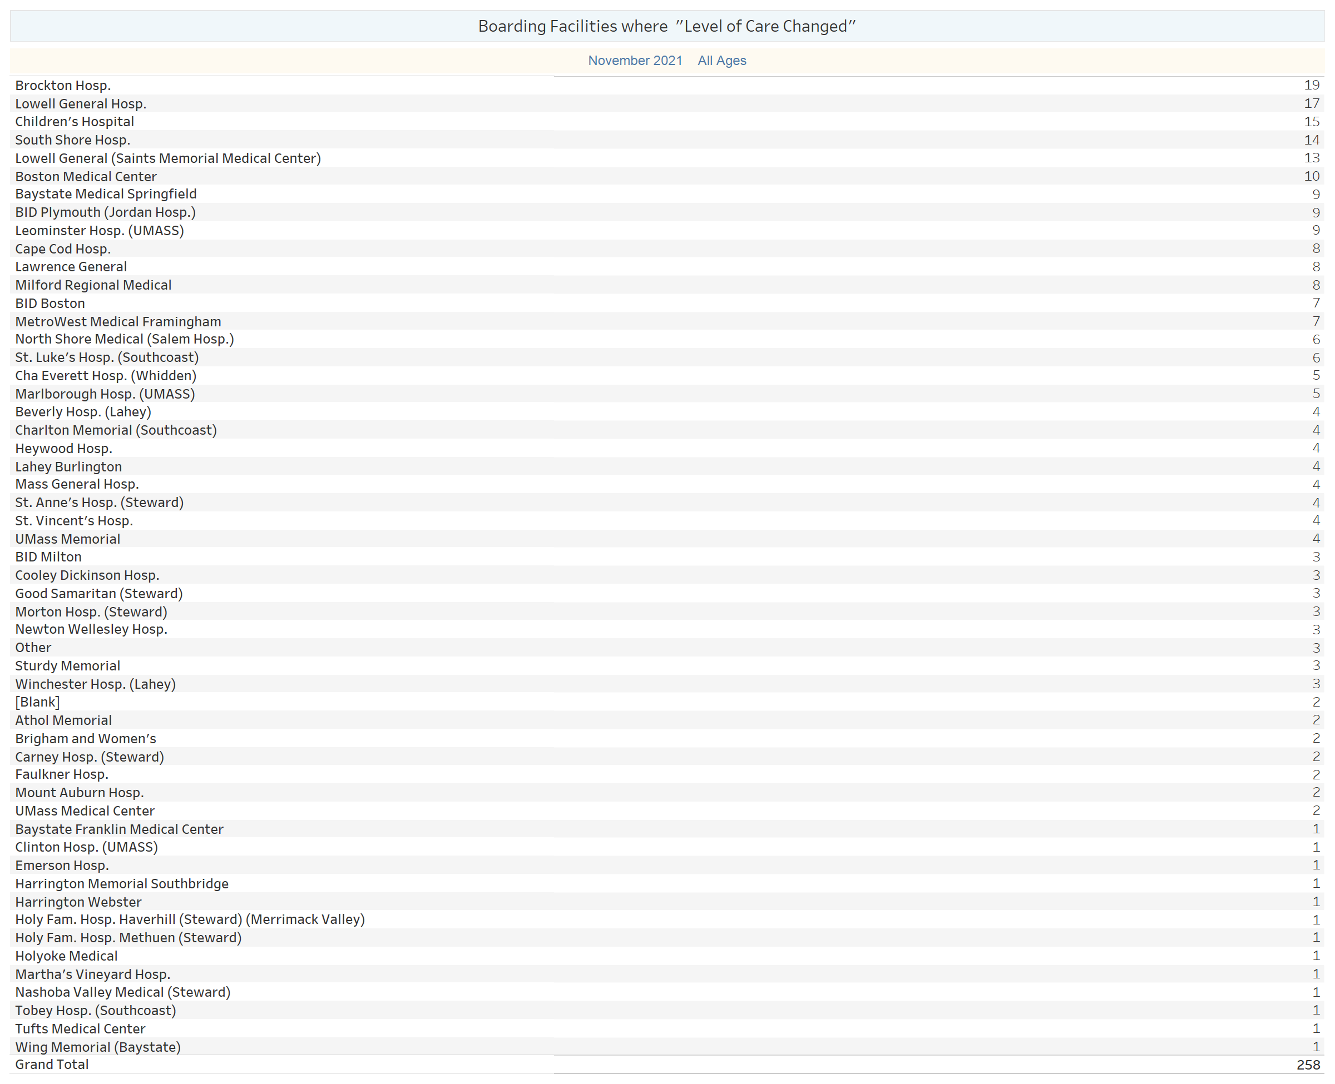

Slide 16
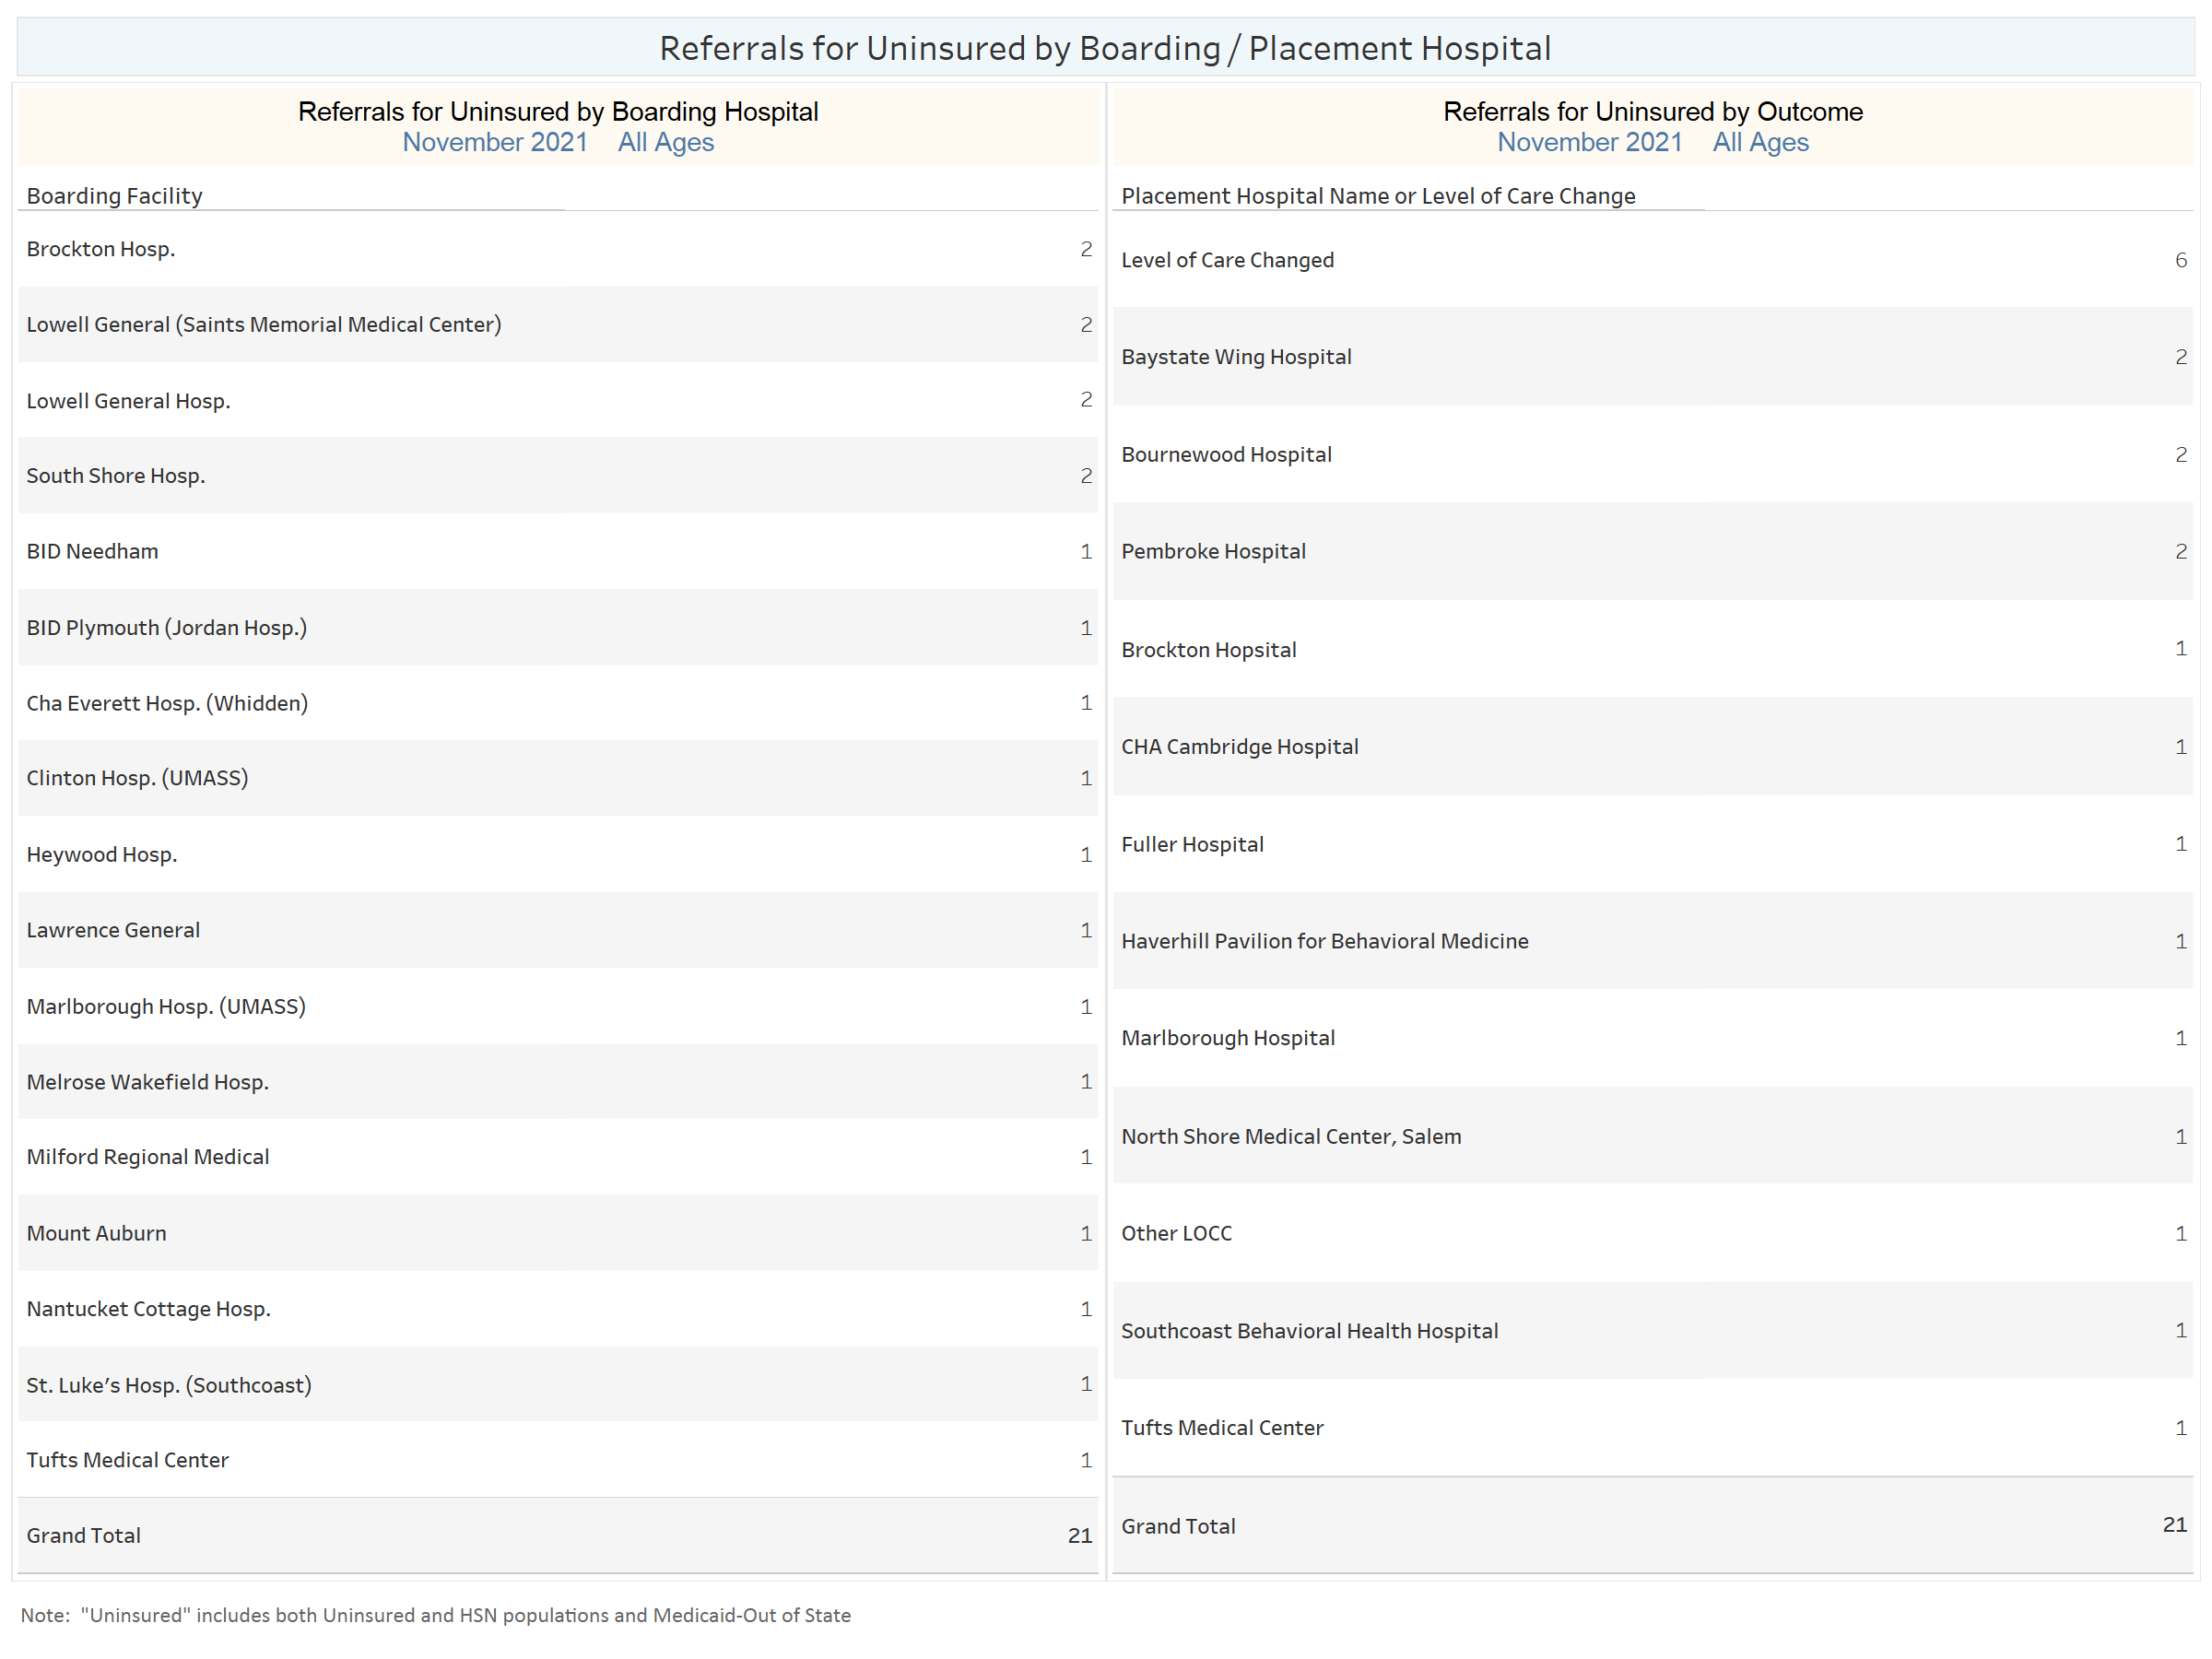

Slide 18
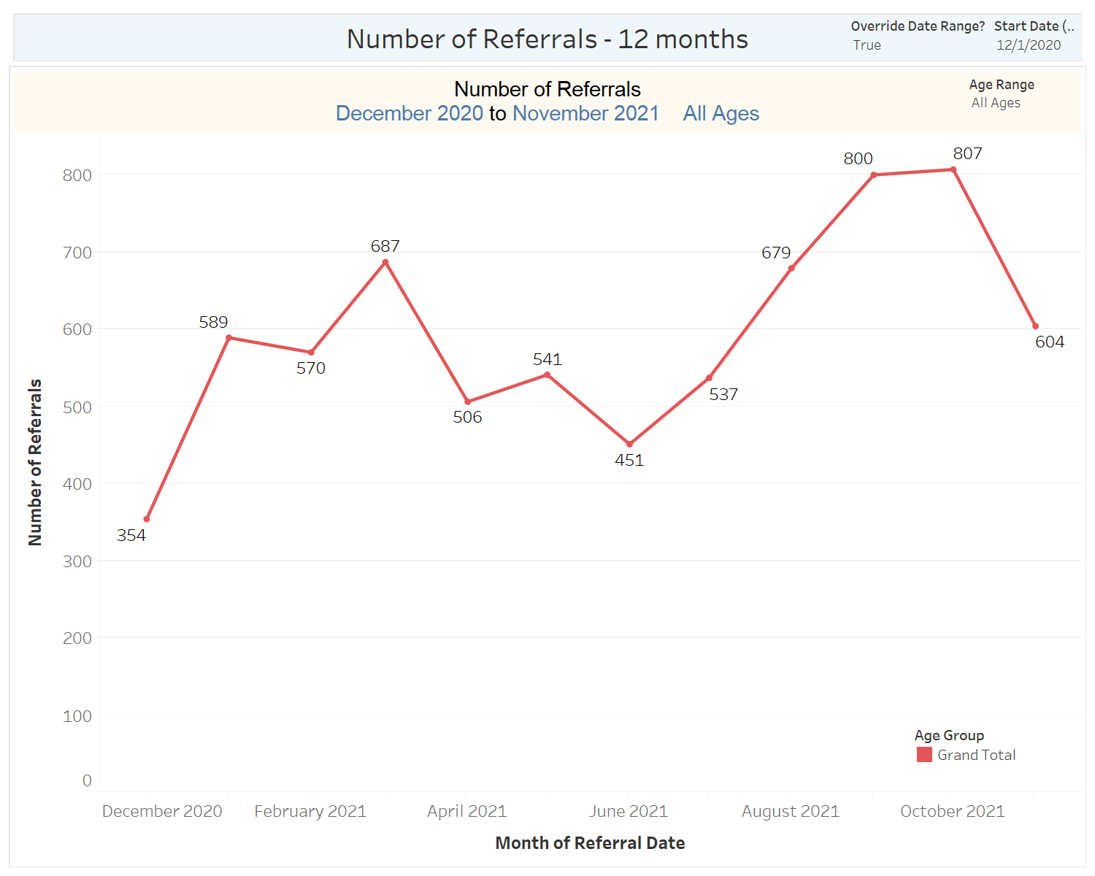

Slide 19
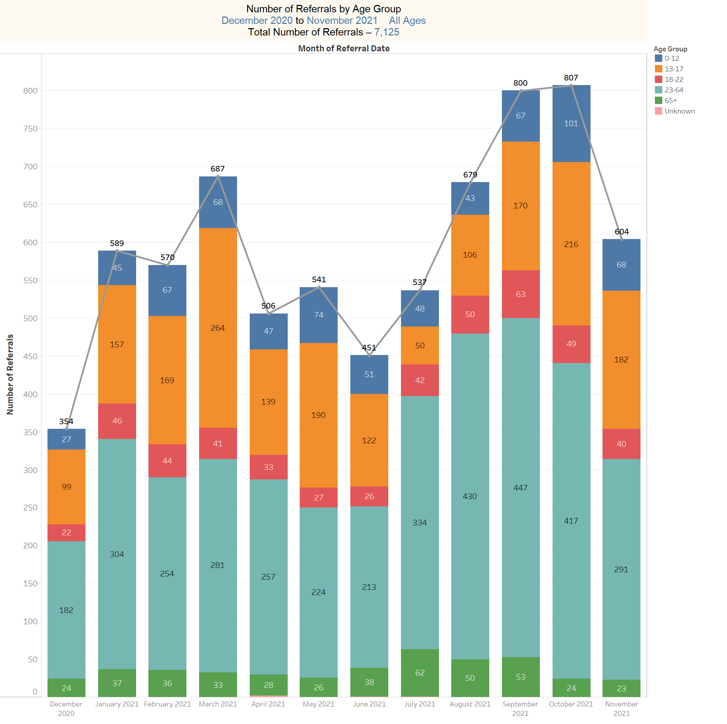

Slide 20
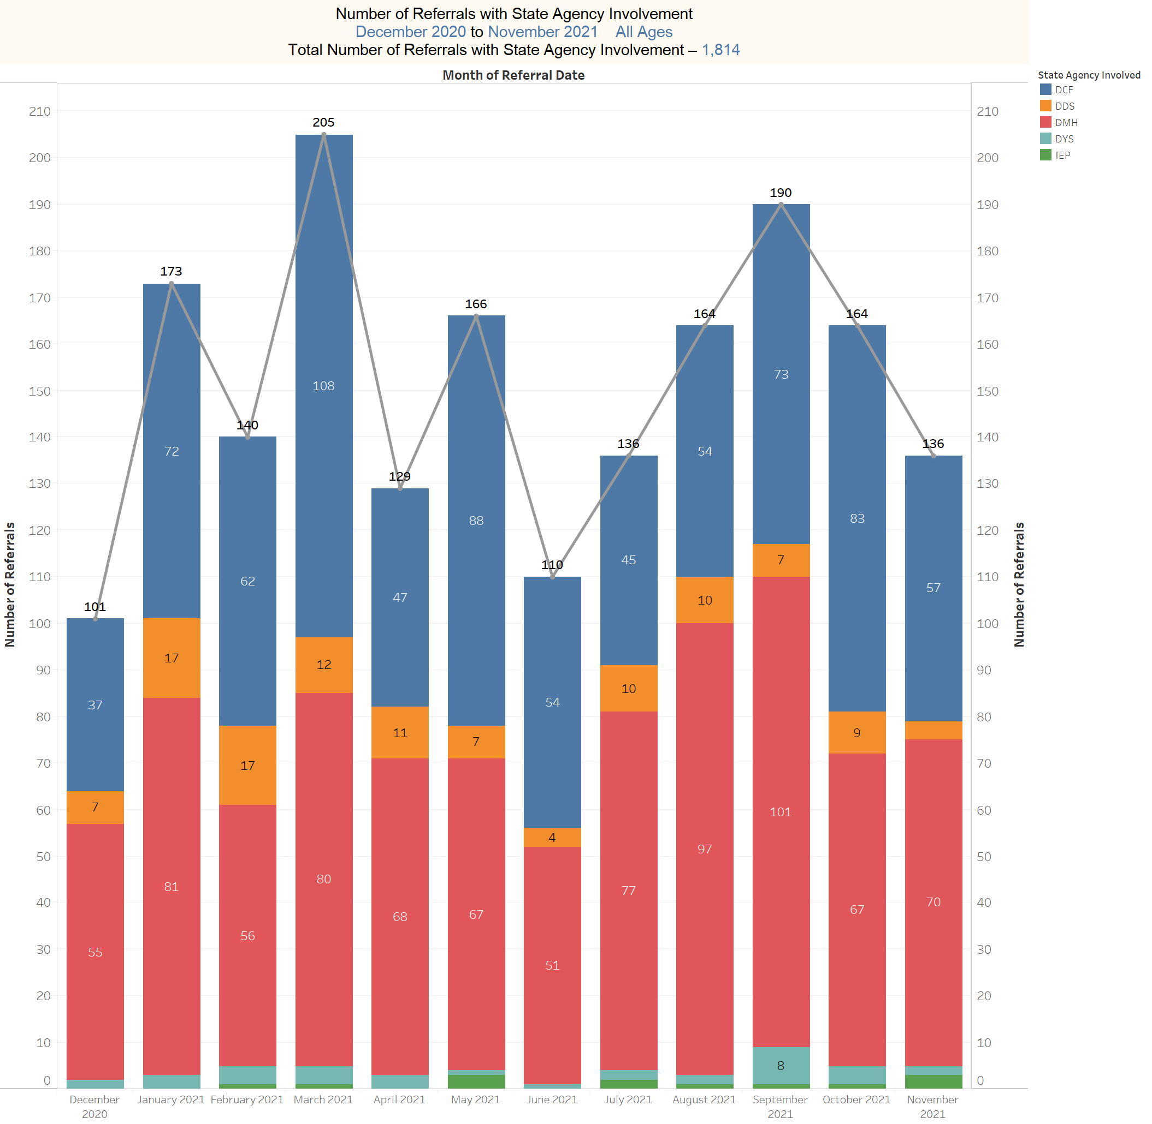

Slide 21
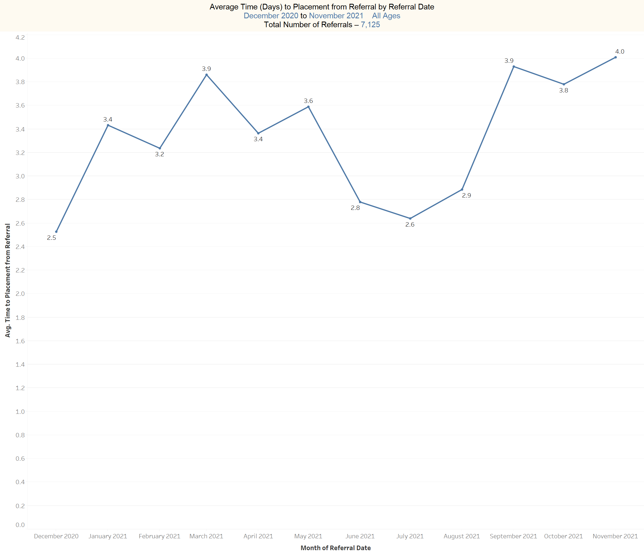

Slide 22
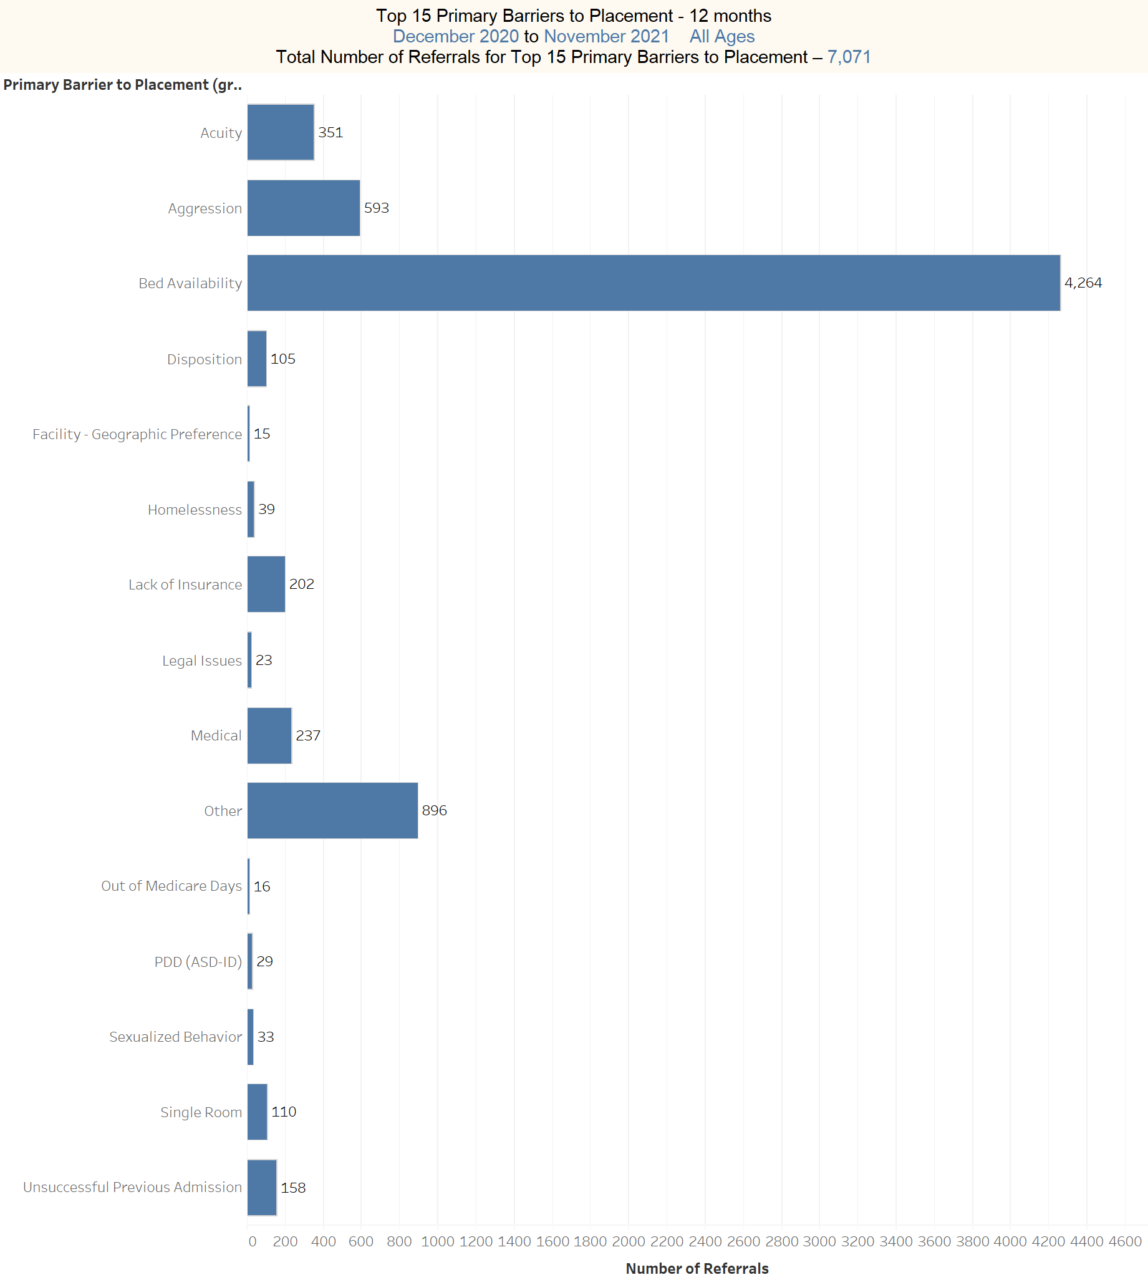

Slide 23
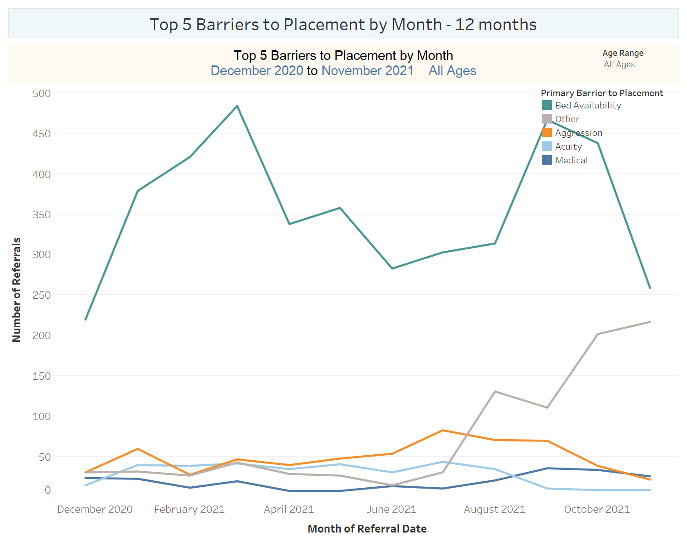

Slide 24
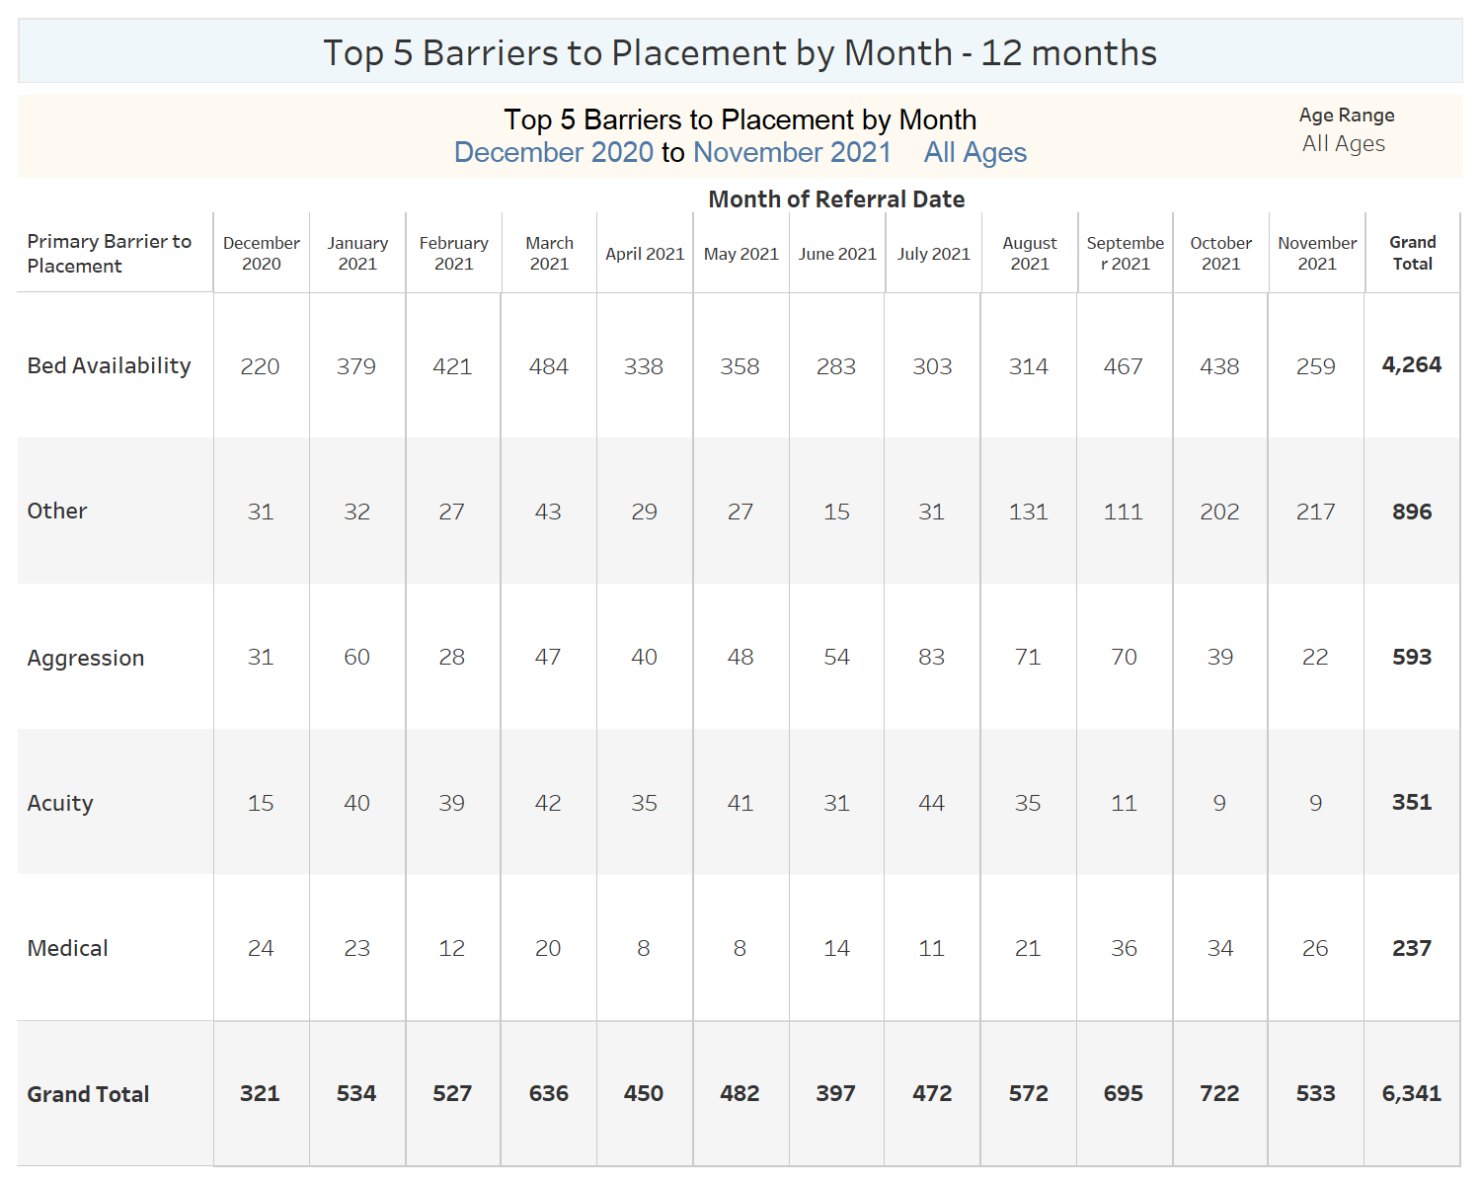

Slide 25
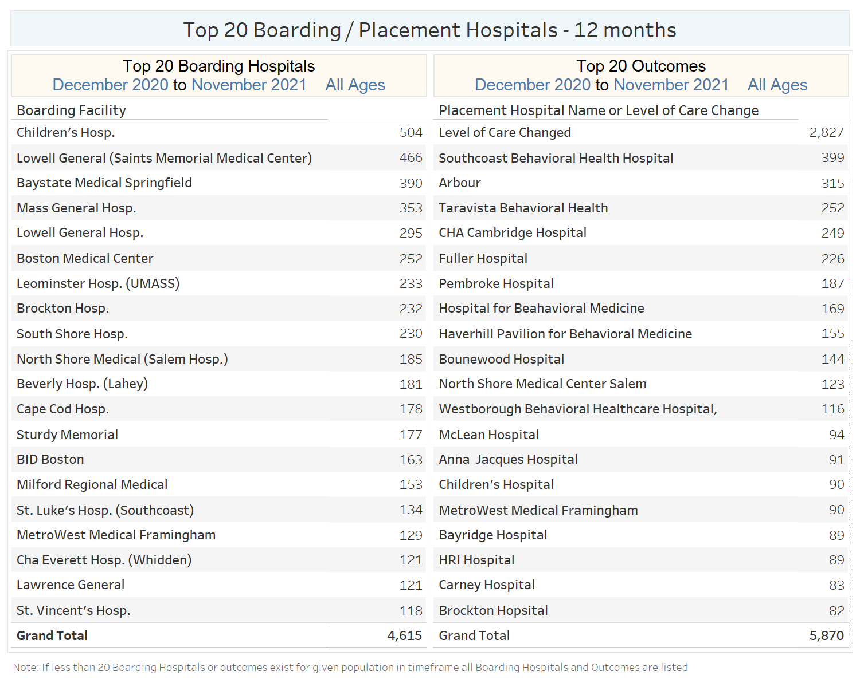

Slide 26
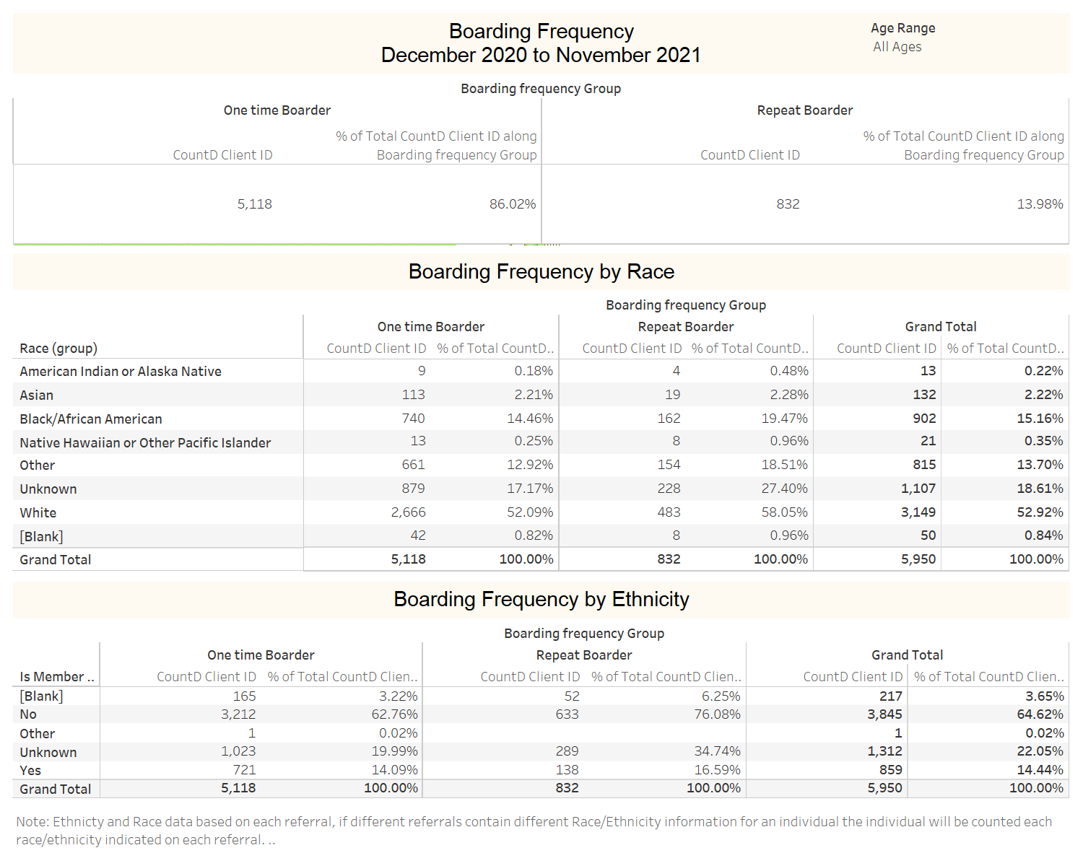

Slide 27
