Slide 1
Baseline report on the Massachusetts nursing facility industry: AN Overview
Presentation to the Nursing Facility Task Force
November 22, 2019
CENTER FOR HEALTH INFORMATION AND ANALYSIS

Slide 2
Agenda
  Background
  Review key findings
  Demonstrate facility profile dashboard
  Questions

Slide 3
Background
  This is the first report from CHIA focused on nursing facilities
  in Massachusetts
  Objectives:
    Advance transparency about the role of these providers in
    the long-term care continuum
    Inform data-driven policy discussions
  Data sources:
    Nursing facility cost reports filed annually with CHIA
    CMS Skilled Nursing Facility Quality Reporting Program
  Data period is calendar years 2013 through 2017

Slide 4
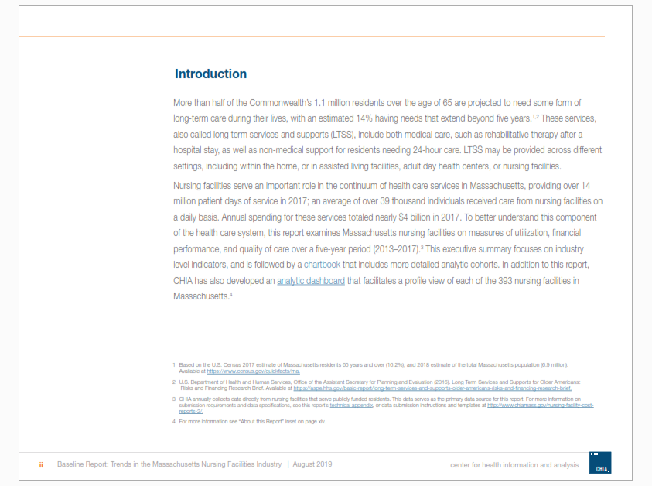
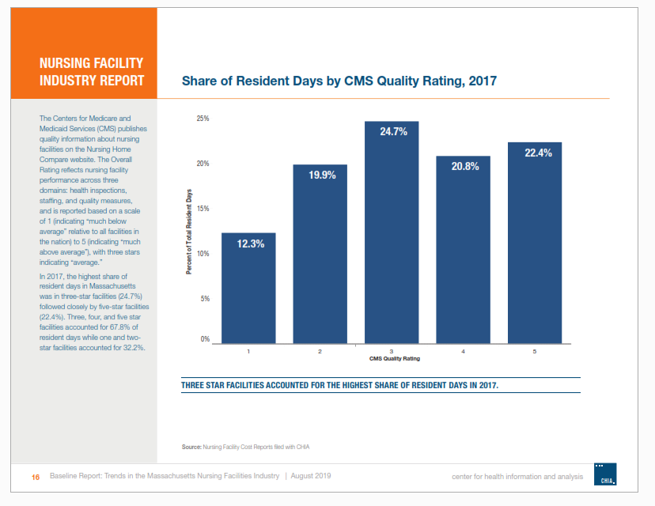
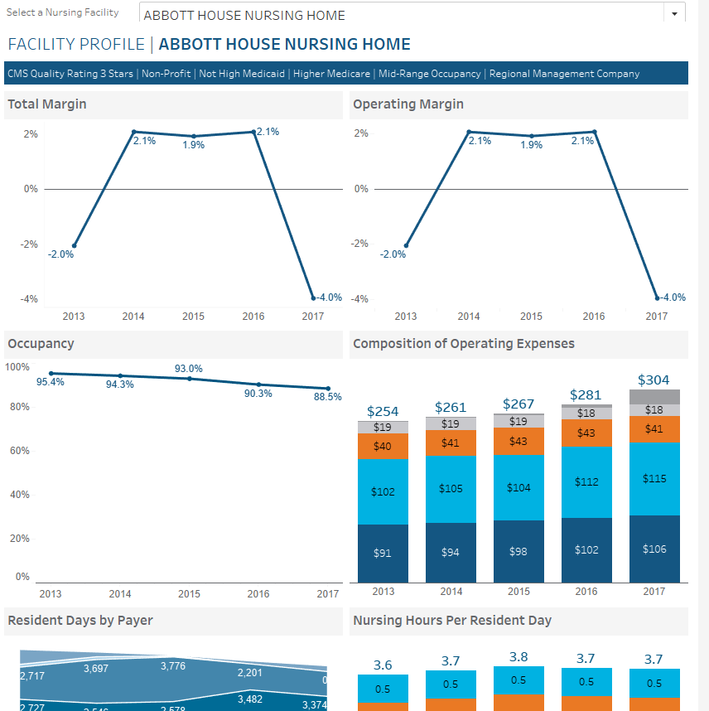
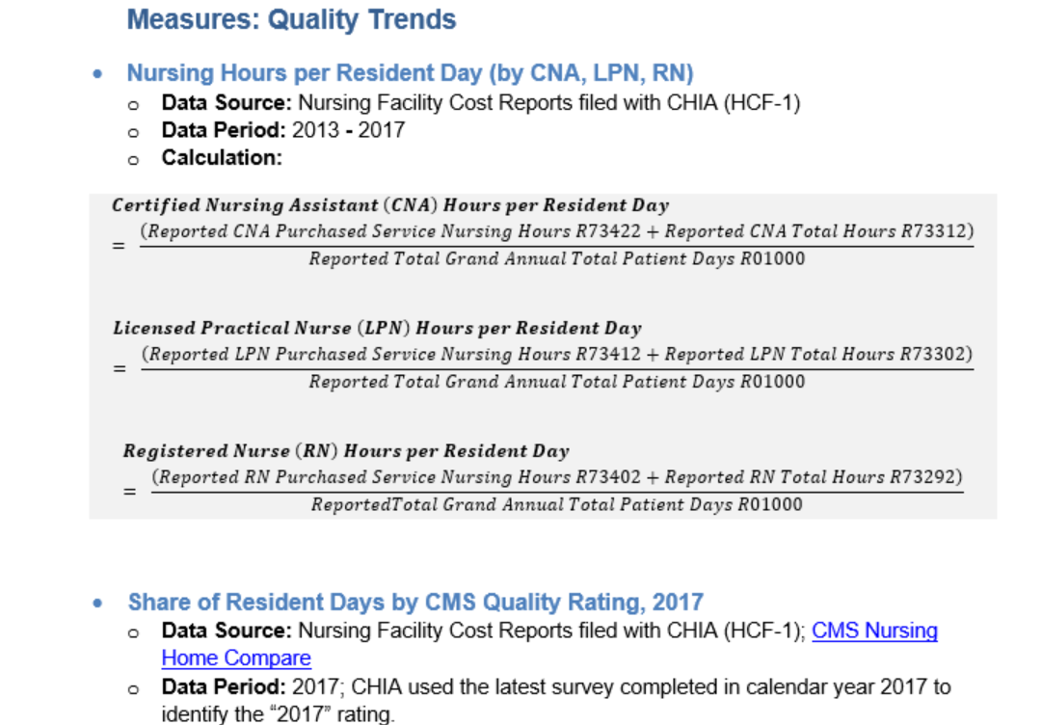
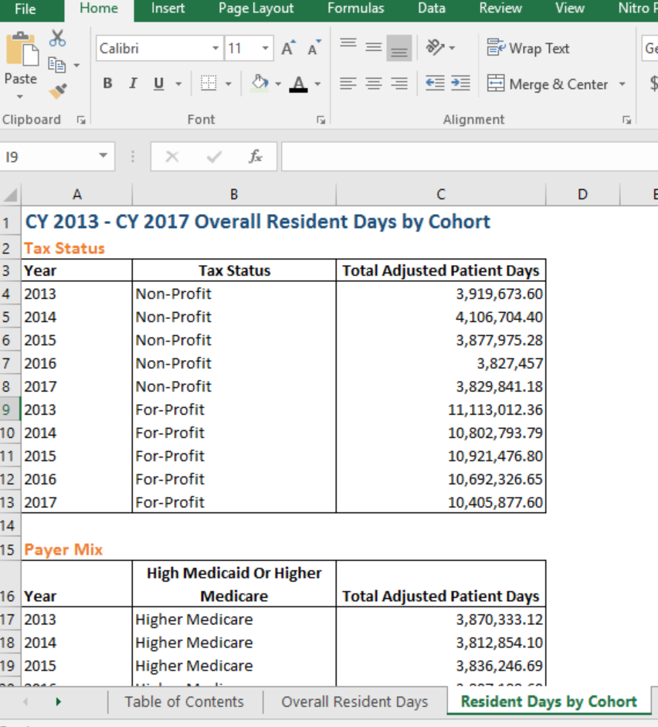
Background
  Report package includes:
    Narrative
    Chartbook
    Interactive dashboard
    Databook
    Technical appendix

Slide 5
Background
  Report presents information across three domains:
    Utilization
    Financial Performance
    Quality Measures
  Information is presented at the industry level, as well as by analytic cohorts derived using cost report data
  Certain facilities were excluded from industry-level and cohort analysis to preserve comparability (n=39)
  In total, 393 facilities included in analysis

Slide 6
KEY FINDINGS

Slide 7
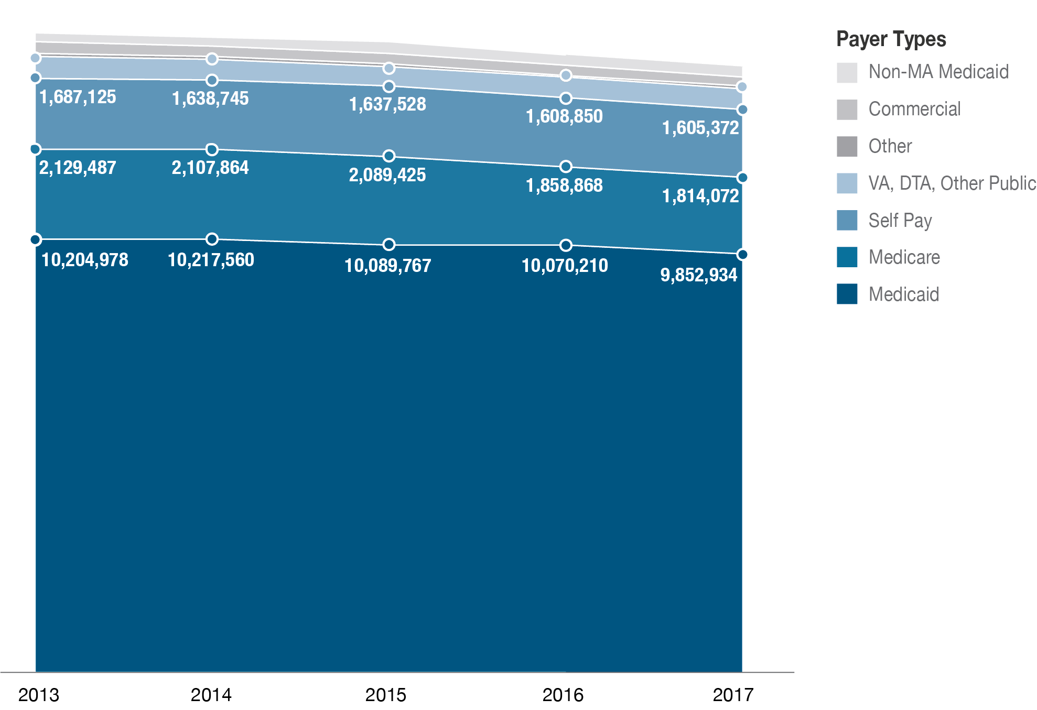
Resident Days by Payer Type

Slide 8
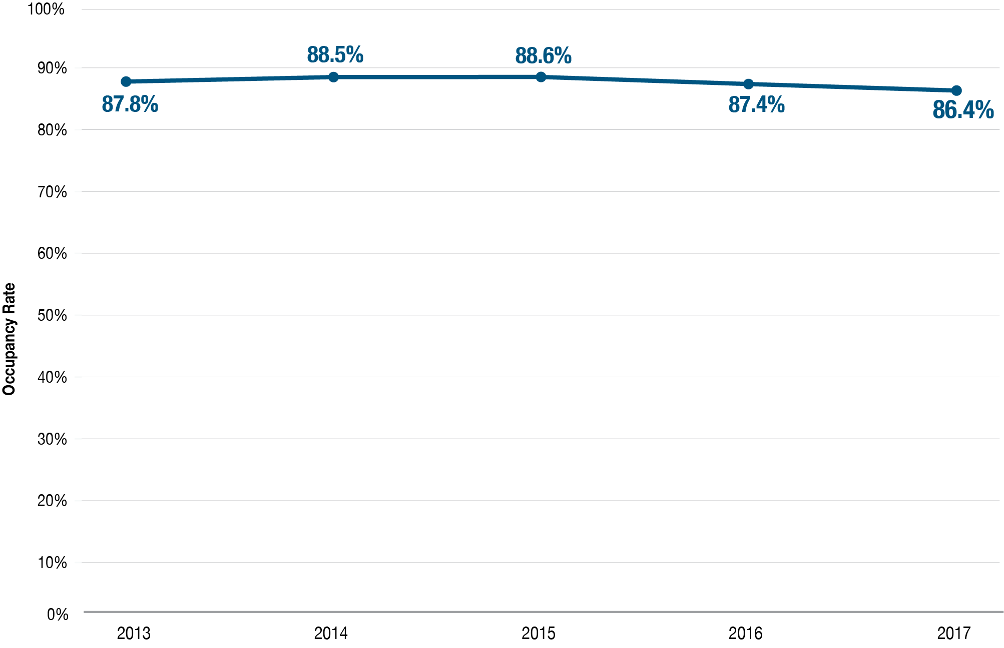
System Occupancy Rates, 2013 - 2017

Slide 9
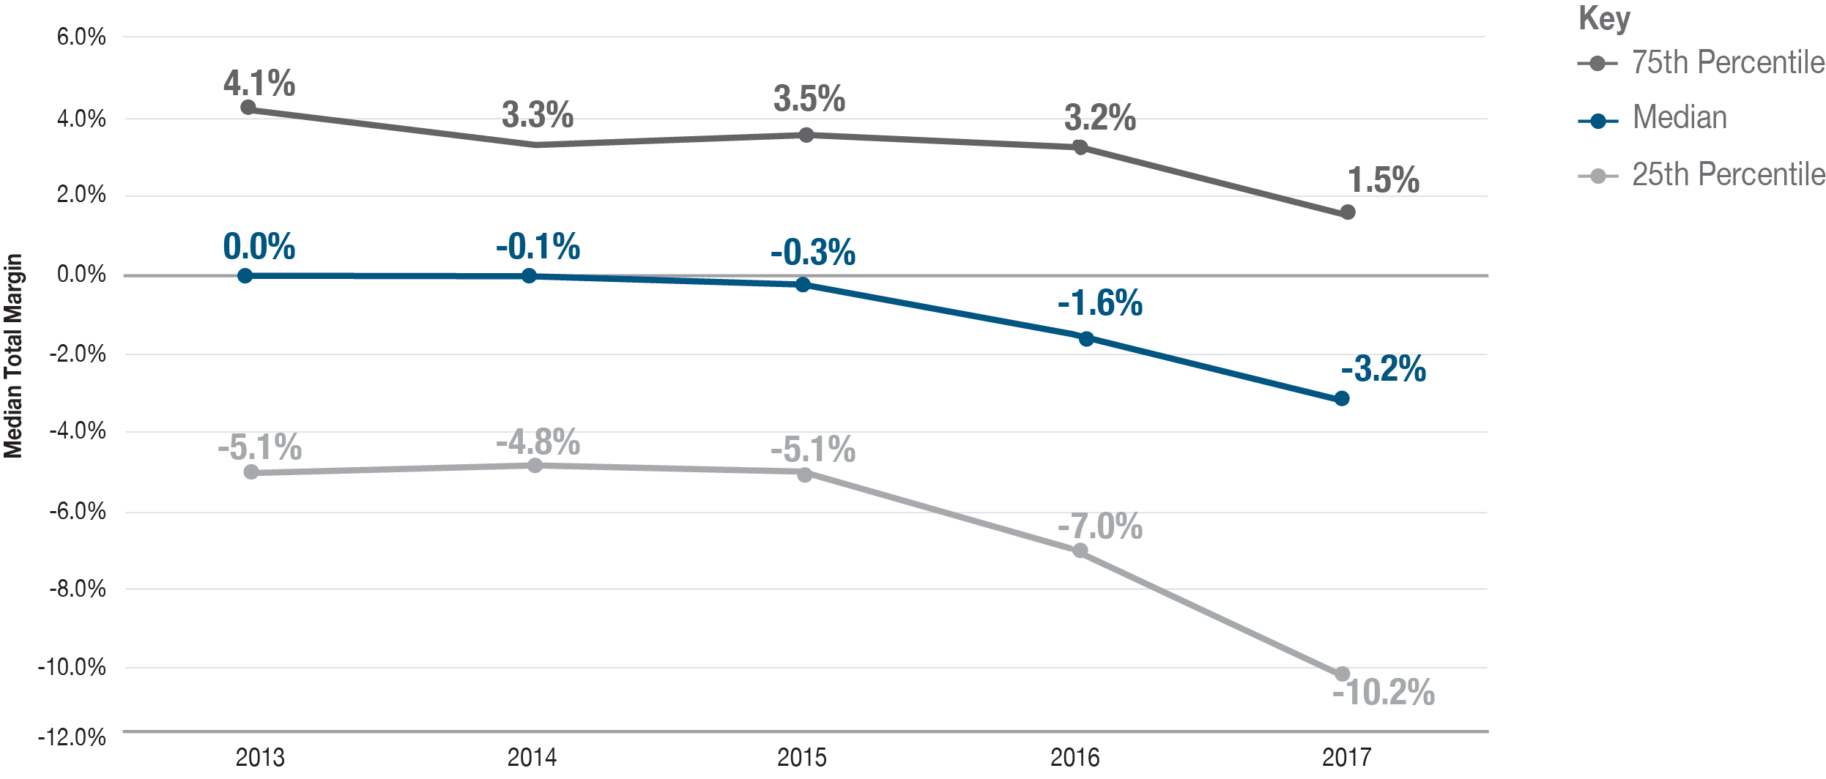
Median Total Margin, 2013 – 2017

Slide 10
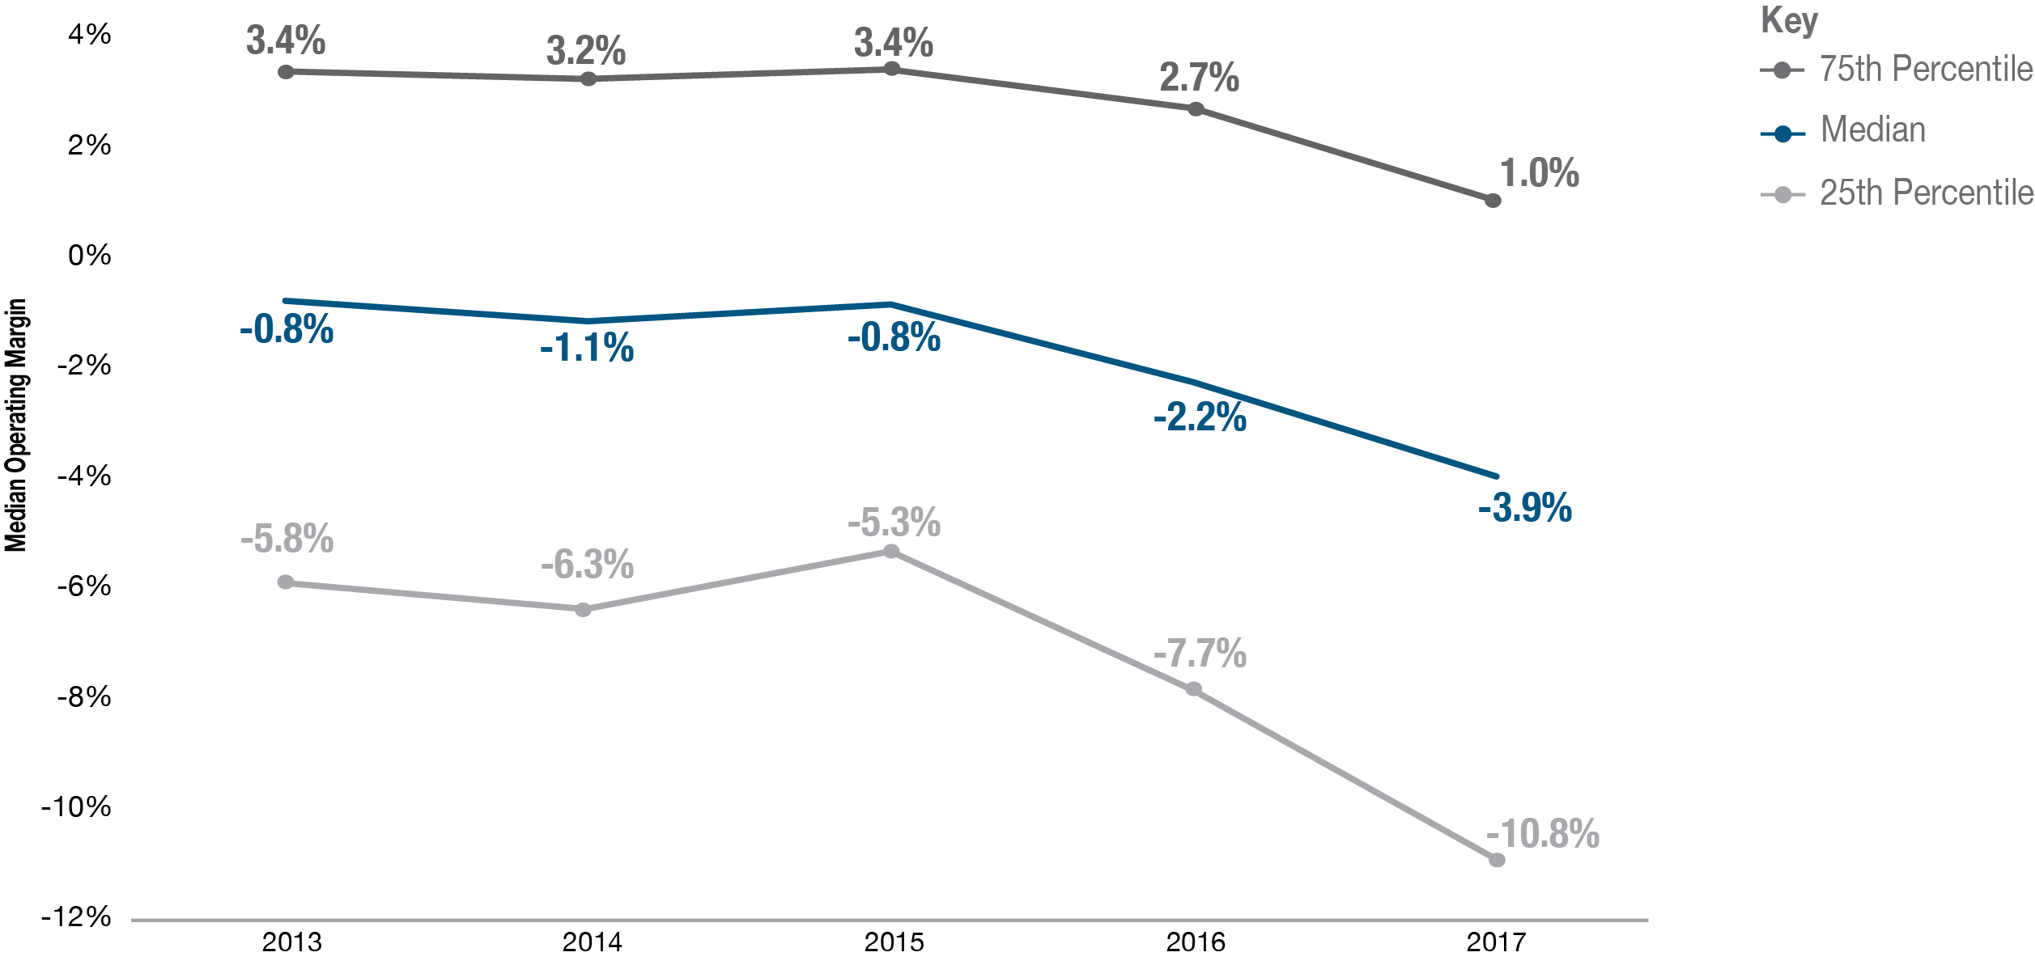
Median Operating Margin, 2013 – 2017

Slide 11
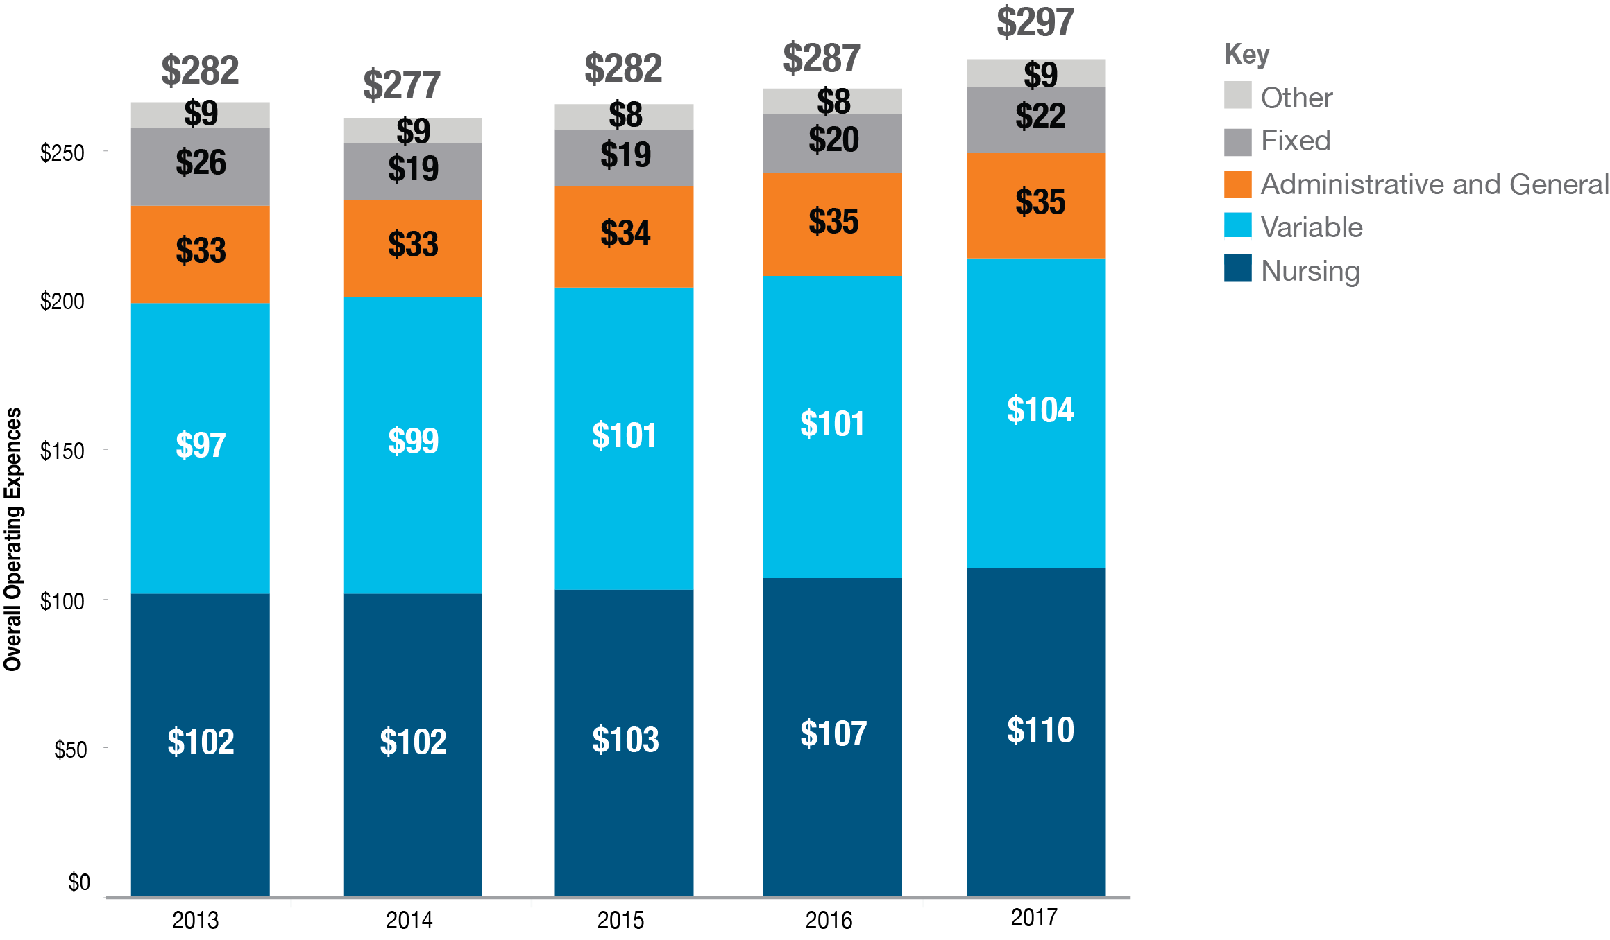
Components of Operating Expenses

Slide 12
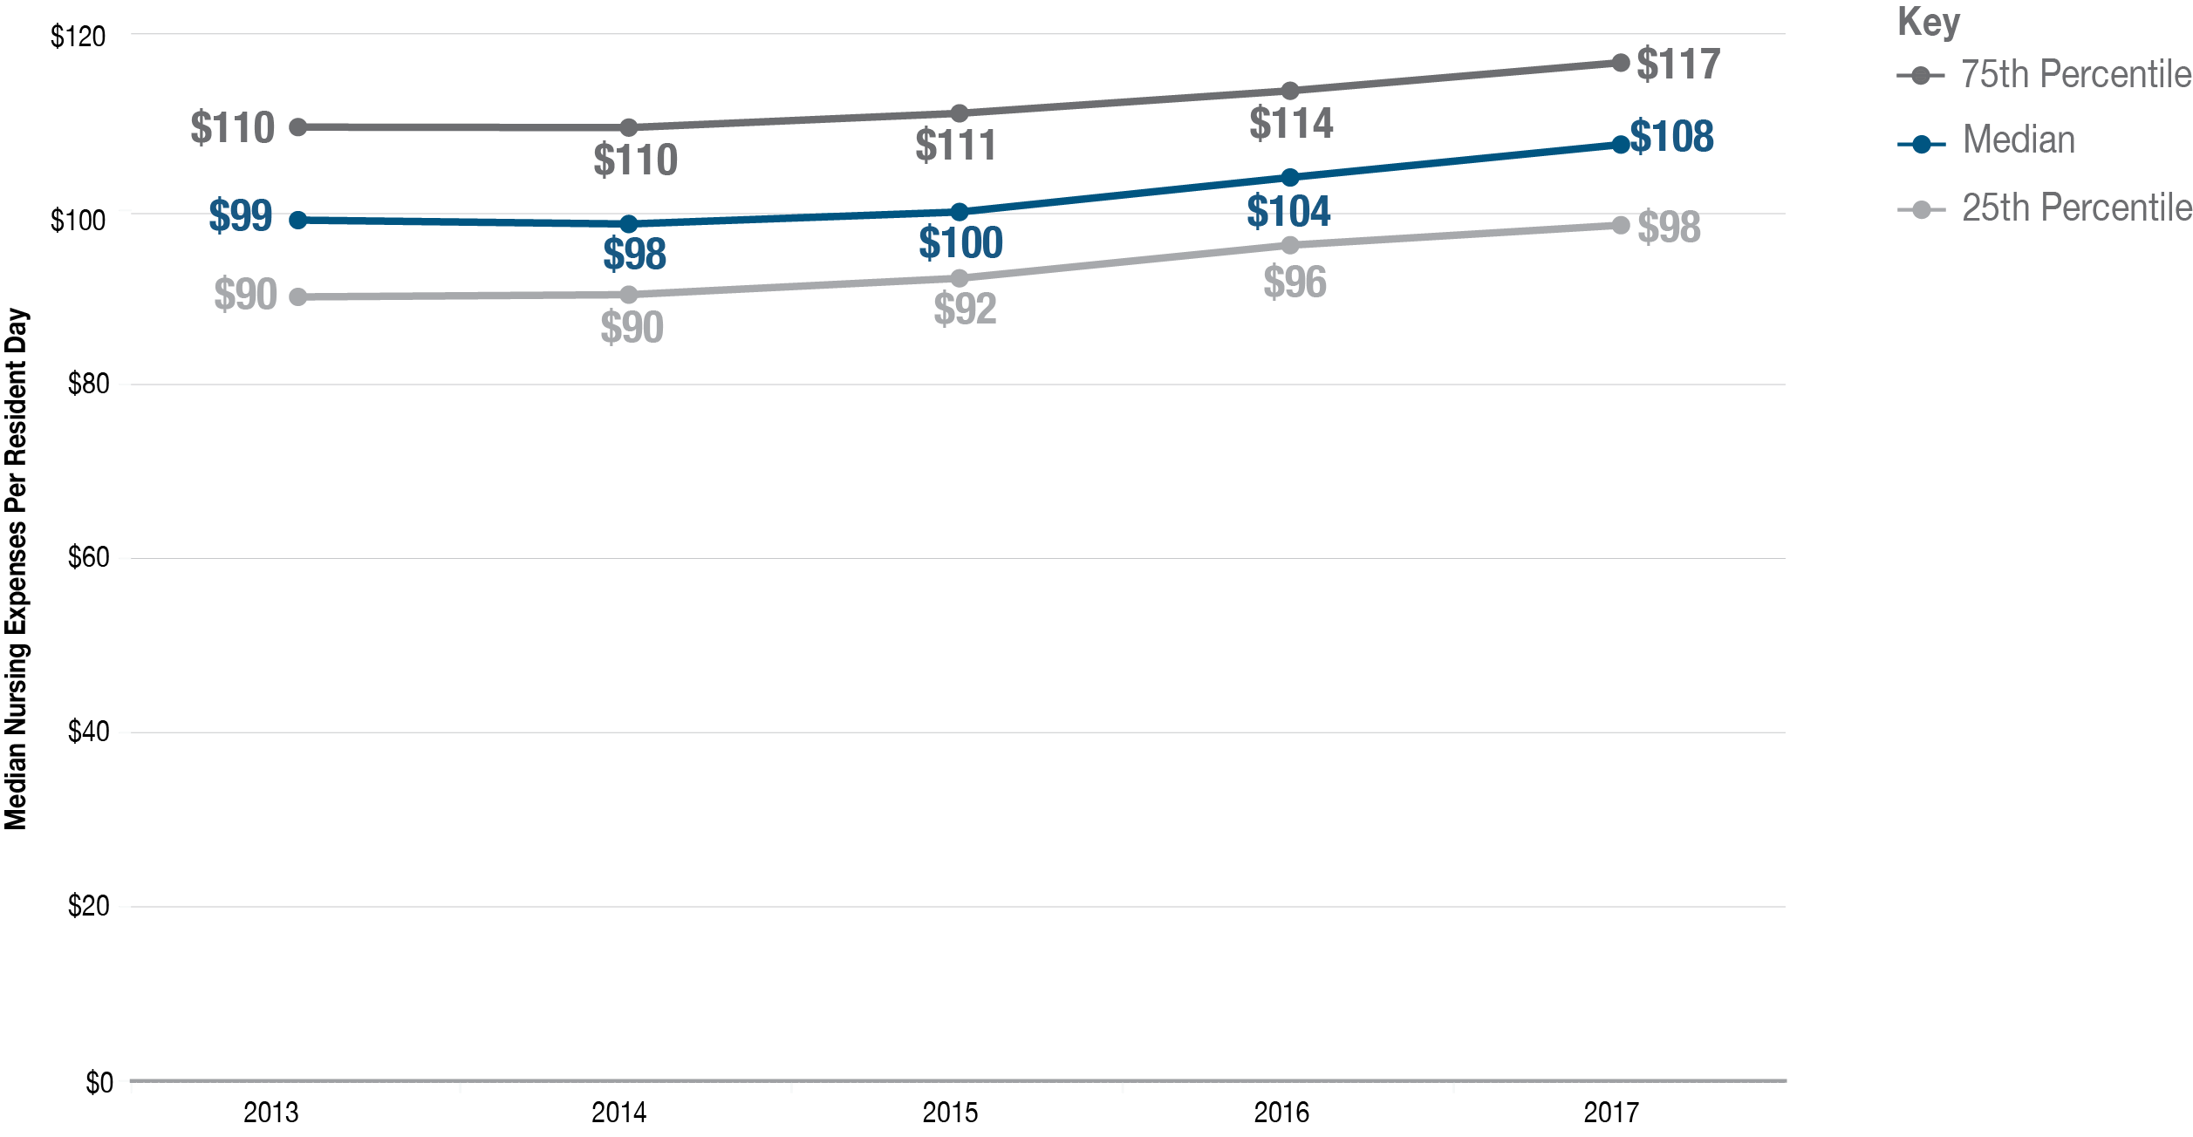
Median Nursing Expenses per Resident Day

Slide 13
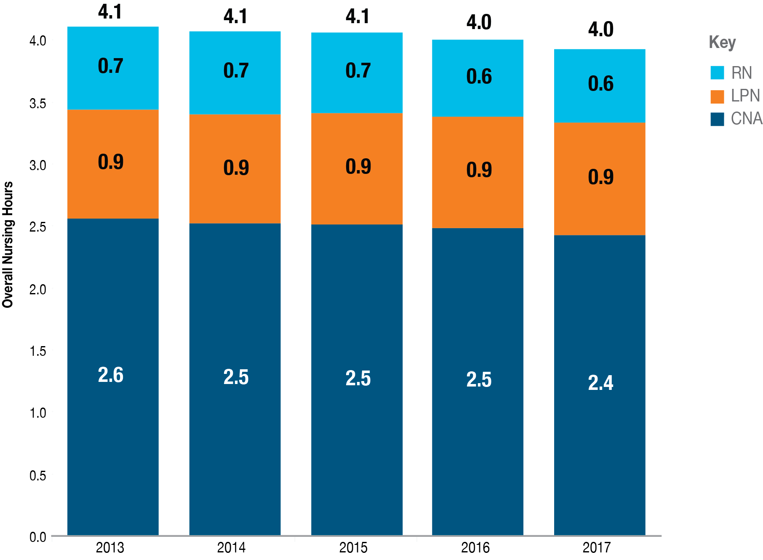
Nursing Hours per Resident Day

Slide 14
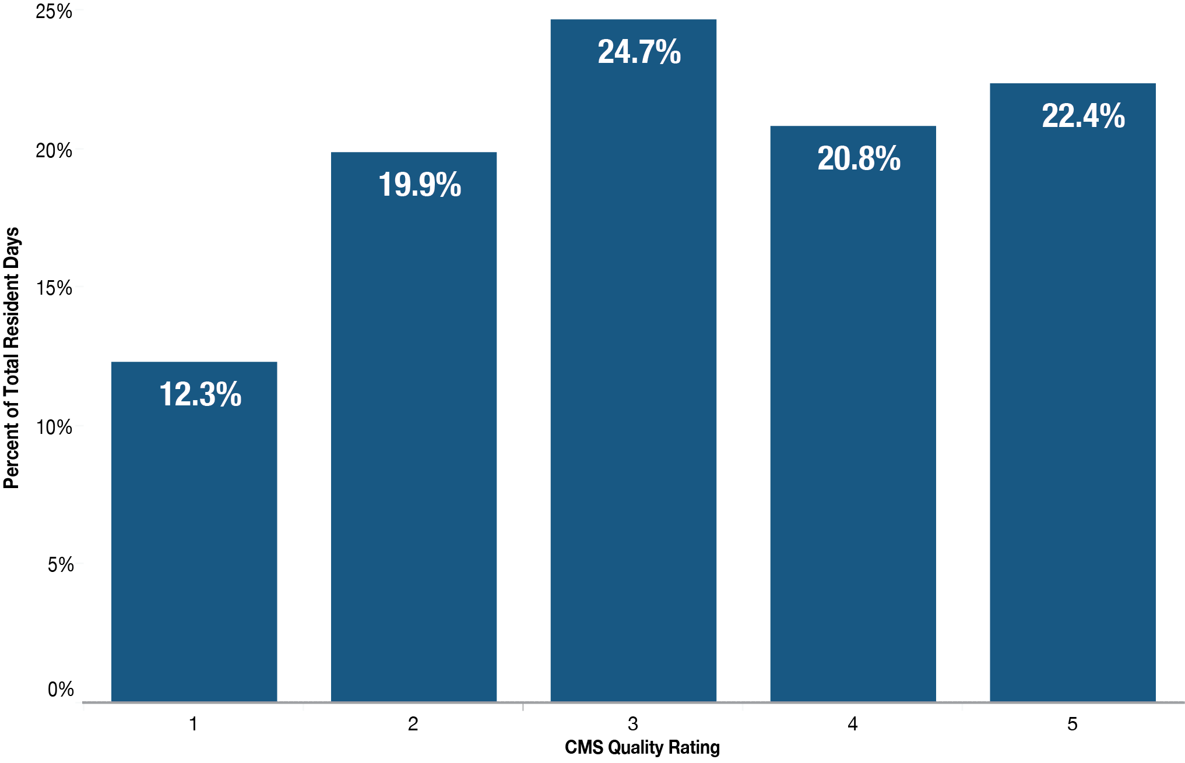
Resident Days by CMS Quality Rating, 2017

Slide 15
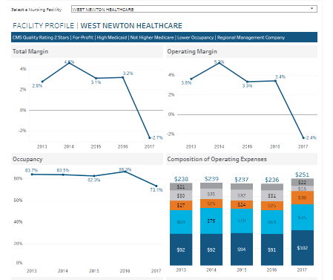
Demonstration: Facility Profiles

Slide 16
Contact
For questions, please contact:
Caitlin Sullivan
Director, Health Informatics & Reporting
(617) 701-8128
caitlin.sullivan2@state.ma.us

