Slide 1


Office of Behavioral Health Promotion and Prevention
Update for the Community Behavioral Health Promotion and Prevention Commission
October 1, 2026
DRAFT & CONFIDENTIAL; FOR POLICY DEVELOPMENT PURPOSES ONLY

Slide 2
Agenda
OBHPP New Staff Introductions
Grant Implementation
Active Workforce Campaign
Other OBHPP Activities
Looking Ahead
Advancing Prevention & Promotion Across the Commonwealth

Slide 3
OBHPP New Staff Introductions

Slide 4


OBHPP Staff
Project and Administrative Coordinator
Kidest Assefa-McNeil, MPH
Intern
Amana Khatib

Slide 5
Grant Implementation

Slide 6
Tier A and B Grantees
Tier A and B grantees have completed contracting and are wrapping up the first quarter of program implementation
TIER A
City of Woburn
Olga's List Inc
Aurora Springs Inc
Berkshire Regional Planning Commission
TCFWC - The Child and Family Wellness Center
Enlace de Familias de Holyoke
Immigrant Family Services Institute
TIER B
Perspectives Health Services, LLC
Treehouse Foundation
Fathers' Uplift
Healing Abuse, Working for Change, Inc.
Lowell Community Health Center
Southeast Asian Coalition of Central MA
Martin Luther King Jr. Family Services, Inc.
Resilience Center of Franklin County
Riverside Community Care Inc
ReUnited Inc

Slide 7
Tier A and B Program Highlights
Reducing Psychological Distress in Immigrant Communities
The Southeast Asian Coalition’s Healthy Aging program provides culturally and linguistically responsive support among immigrant and refugee older adults in Central Massachusetts. The program combines wellness education, social and cultural activities, outreach to homebound individuals, transportation assistance, and multilingual support to strengthen social connections and promote healthy aging. Through trained staff, volunteers, and community partnerships, the initiative will expand access to behavioral health resources and build sustainable, culturally responsive supports for older adults.
Anticipated Impact:
~700 community members via ~400 activities
Olga’s List will provide culturally tailored, trauma-informed family support to Ukrainian refugees in Massachusetts, with a focus on new arrivals. The program will adapt and translate a family strengthening curriculum and train Ukrainian community interventionists to provide home visiting and support focused on family communication, coping skills, caregiver mental health, child well-being, and resilience. Three cohorts serving approximately 30 families will inform an evaluated, sustainable model that can be integrated into Olga’s List services and potentially adapted for other refugee communities.
Anticipated Impact:
~1000 community members via ~50 activities
Supporting Caregivers and Reducing Family Stress
Fathers’ UpLift will provide culturally responsive, trauma-informed behavioral health support to strengthen fathers’ mental well-being, emotional regulation, parenting confidence, and family relationships across Greater Boston. The program will support fathers at different stages of the fatherhood journey through preparation for fatherhood, stress and emotion management, reentry support, peer support, and connections to community resources. Community wellness events and ongoing evaluation will reduce isolation, strengthen protective factors, and improve access to behavioral health and family supports.
Anticipated Impact:
~500-600 community members via ~40 activities

Slide 8
Tier A and B Program Highlights cont.
Promoting Infant, Early Childhood, and Maternal Mental Health
Perspectives Health Services will provide culturally responsive behavioral health promotion and prevention focused on perinatal and infant and early childhood mental health in Boston and Brockton. The program will offer universal mental health screening, education, early identification, and referrals for pregnant and postpartum individuals, while helping caregivers build confidence and strengthen relationships with young children. Through community partnerships and culturally responsive outreach, the initiative will reduce family stress, strengthen caregiver well-being, and promote healthier outcomes for parents, infants, and young children.
Anticipated Impact:
~700 community members via ~36 activities
Lowell Community Health Center will implement the evidence-based ROSE Postpartum Depression Prevention Program to promote maternal mental health among pregnant and postpartum individuals throughout Greater Lowell. The program will combine prenatal and postpartum group sessions with community outreach, education, resource navigation, and referrals to strengthen social support, coping skills, and other protective factors. By expanding access to prevention services and supporting early identification of behavioral health needs, the initiative aims to reduce the risk of postpartum depression and improve maternal well-being.
Anticipated Impact:
~1000 community members via ~180 activities
The City of Woburn will implement the Nurturing Early Support & Thriving Families (NEST) Project to support new parents and caregivers with resources, education, and tools to build confidence, manage stress, and strengthen family well-being. The program will offer Youth Mental Health First Aid, a free six-week training and speaker series, and “Back Pack” kits with essential baby supplies and mental health resources. Childcare support will reduce barriers to participation and help families access NEST’s services and resources.
Anticipated Impact:
~400 community members via ~32 activities

Slide 9
What We are Hearing From Grantees: Q1 Implementation
In Q1 of FY27, grantees have focused on laying the foundation for programming by:
Building their team: Hiring and onboarding staff for roles that will support program implementation and service delivery.
Preparing and training staff: Providing staff with the training, tools, and resources needed to launch programming effectively.
Strengthening partnerships: Establishing and formalizing partnerships (MOUs) with other community organizations and ensuring referral and collaboration pathways are in place.
Building community connections: Connecting with local organizations, residents, and other community partners to expand awareness and engagement.
Some grantees have already begun offering activities and groups, including dance teams, gardening clubs, group trips, after school enrichment, and exercise classes.

Slide 10
Next Steps for the Grant Program
1
Tier C Contracting: Begin contract negotiations with Tier C organizations where we finalize budgets, scope of work, program impacts, and other agreements.
2
Tier C Onboarding: Planning for Tier C onboarding and first welcome calls in November. We have prepared a welcome package and training materials re: mandatory reporting and document submissions.
3
Grantee Activities: Tier A/B grantees are submitting quarterly deliverables which OBHPP will use to monitor progress and collect data on impact. In Q2 of FY27, Tier A/B grantees will continue program implementation. OBHPP also plans to visit grantees in the near future to gain a deeper understanding of their programs and community impact.

Slide 11
Active Workforce Campaign

Slide 12

Workforce Campaign Overview
"Turn your compassion into your career"
Campaign Summary
Live from June through September 2026, the cross-channel workforce campaign promoted behavioral health education and career pathways to strengthen and grow the workforce in the Commonwealth, reaching statewide audiences in 8 different languages and driving them to mass.gov/YourBHCareer.
1
2
3
College and
high school
students
Professionals
People with
relevant
life experience

Slide 13
Campaign Activity Snapshot
June-Sept. 2026
Channel​ | Languages​ | Timeline​
Video streaming ads | English, Spanish | June – Mid Sept.
Audio streaming ads | English, Spanish, Brazilian Portuguese, Vietnamese, Haitian Creole | Mid June – August
Digital & social ads | English, Spanish, Brazilian Portuguese, Arabic, Chinese, English (Indian community) | Mid June – Sept.
Digital billboard ads | English, Spanish | July – Mid August
Community engagement | English, Spanish, Brazilian Portuguese, Vietnamese, Haitian Creole, Arabic, Simplified Chinese, Hindi | End of July – Sept.
Earned media | English, Spanish, Simplified Chinese | End of August –October.

Slide 14
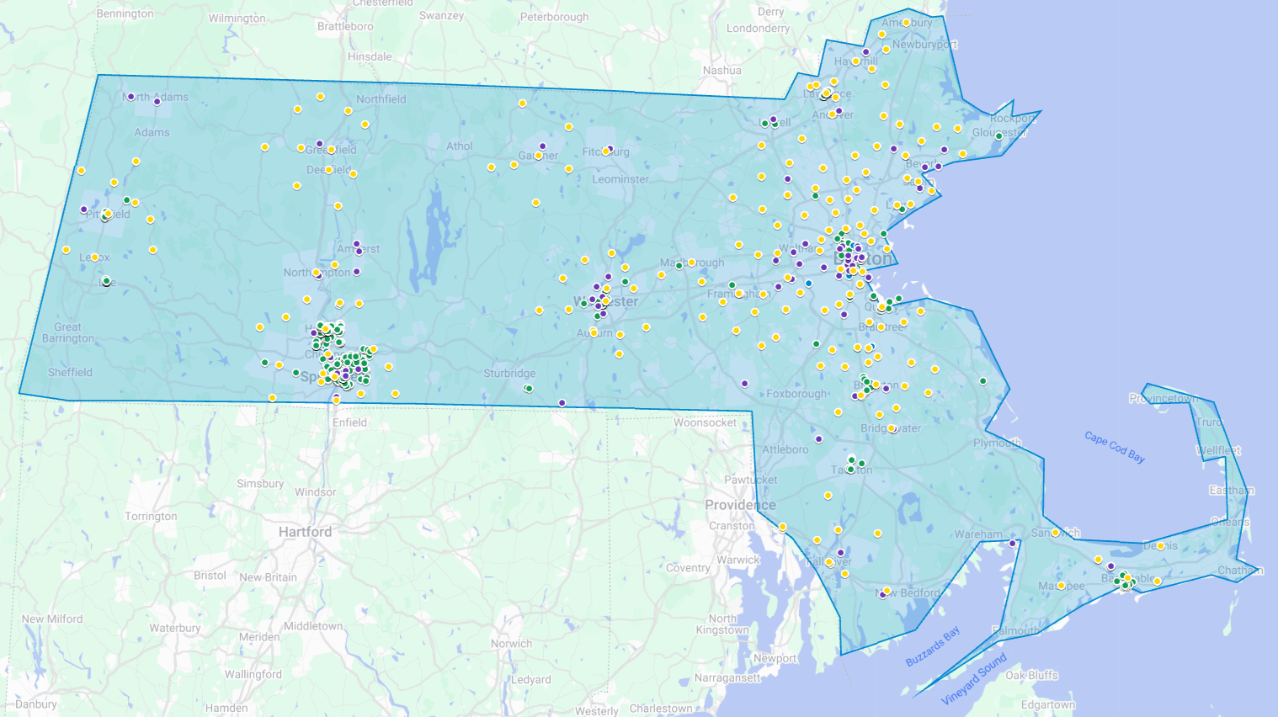
Campaign Reach
See Google map link to explore the campaign’s geographical reach across community engagement, earned media, and paid media.
Workforce Campaign Map
Note: Currently excludes digital and Entravision video streaming advertising data, which will be added once received from vendors per recent flight end dates.
community engagement
colleges & unis for paid targeting
earned media outlets
paid media
Notes:
Editable link with data: https://www.google.com/maps/d/u/0/edit?mid=1CpRSk0lqrTn6S3E85rXRT3nmtCsuUsg&usp=sharing

Slide 15
Campaign Results
3.2 M | digital billboard impressions | 9.1K | materials distributed statewide
3.7 M | Google display impressions | 178 | community organizations contacted and sent campaign digital toolkit
1.4 M | Spotify impressions | 22 | formal partners each received up to 500 pieces of print material to distribute with their audiences
670 K | YouTube impressions | 13 | community events completed across all regions
107 K | video streaming impressions on Entravision, including FIFA | 11 | press hits, including interviews
and more across ethnic media
Note: this report reflects available data to date. It does not include all final campaign results, which will be updated once available.
Notes:
Over 9 million impressions

Slide 16
Activity and Results by Channel

Slide 17
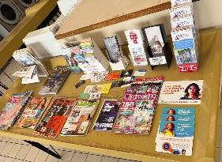
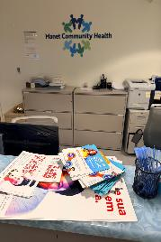
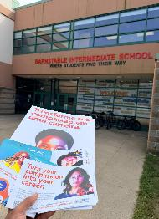
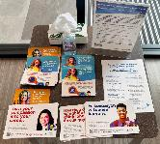
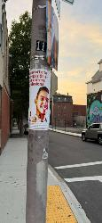
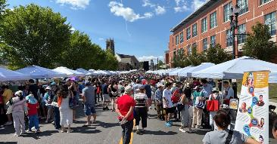







Community Engagement Overview
4 strategic methods of community
engagement, with an estimated total of
9,062 materials distributed statewide in 8 languages
CE image placeholder
Languages include:
English, Spanish, Brazilian Portuguese, Arabic, Haitian Creole, Simplified Chinese, Vietnamese, Hindi
170+ schools, CBOs, and health organizations received digital toolkit
570+ in-person site visits completed in 10 gateway cities to distribute materials at local businesses, CBOs, schools, & health centers
22 confirmed partners spread the
message and distributed materials
13 community events completed with over 1.7K materials distributed (see reports)

Slide 18
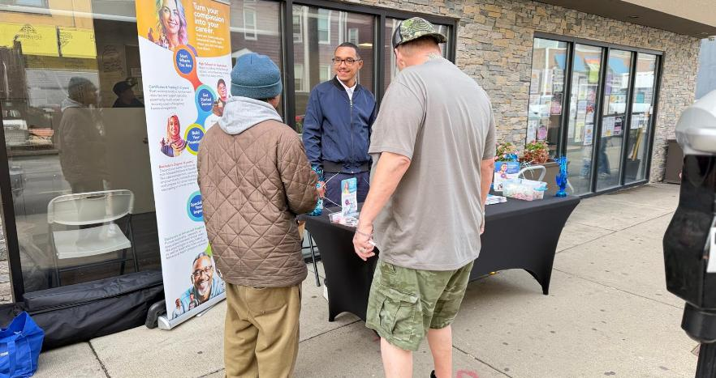
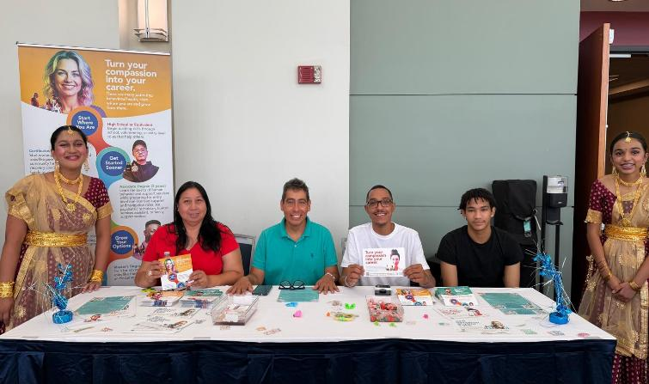
What the Community is Saying …
“
“
CE image placeholder
I didn't even think going to school would be an option for me. I’m gonna look into this and see what y’all got going on. Thanks!
“
“
Wow! Yes! Thank you for being here.
The work you all are doing is so important.
I can’t tell you how great it is to see your stuff in Hindi. You don’t see that often! Really great stuff guys.

Slide 19






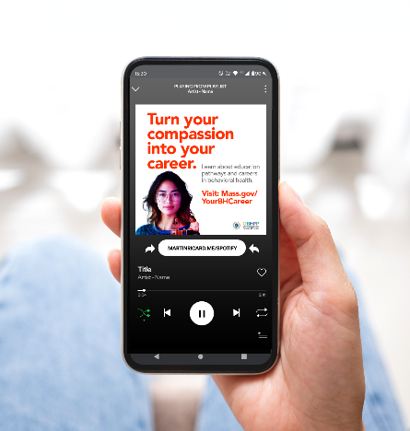
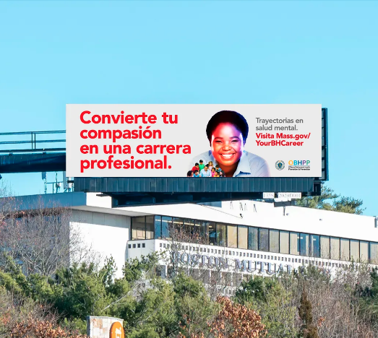

Paid Media Overview
~50
advertising
assets
11
Across
outlets
5
in
marketing
channels
7
different
languages
and
Languages include:
English, Spanish, Brazilian Portuguese, Arabic, Haitian Creole, Simplified Chinese, Vietnamese

Slide 20


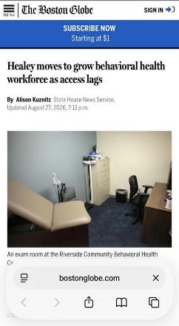
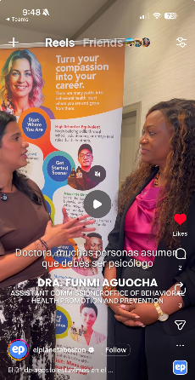

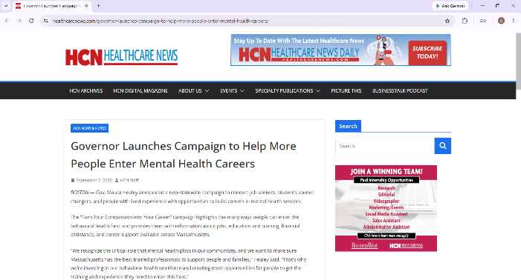











Earned Media Overview
11 high-impact earned media placements across mainstream, local, and ethnic media outlets across the state.
Media interviews engaged loyal audiences, including through trusted ethnic media outlets and community platforms.
A press release and social videos amplified the message statewide with mainstream, local, and ethnic audience reach.
Languages include:
English, Spanish, Simplified Chinese, Haitian Creole, Brazilian Portuguese

Slide 21
Other OBHPP Activities

Slide 22
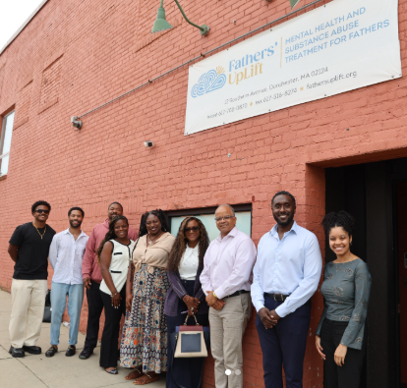
Secretary Mahaniah's Statewide Community Mental Health Tour
Over the next few months, Secretary Mahaniah will visit mental health care access points across the spectrum of prevention, treatment, and recovery to raise public awareness about programs and services available in Massachusetts
Elevate community-based behavioral health work and highlight programs making an impact locally
Raise public awareness of available mental health resources and supports before a crisis occurs
Strengthen connections among state agencies, community partners, and residents across the Commonwealth
OBHPP partnership: The tour includes visits with OBHPP grantees
  September: Visited Fathers' Uplift in Boston
  October: Will visit Sharing Kindness in the Cape

Slide 23
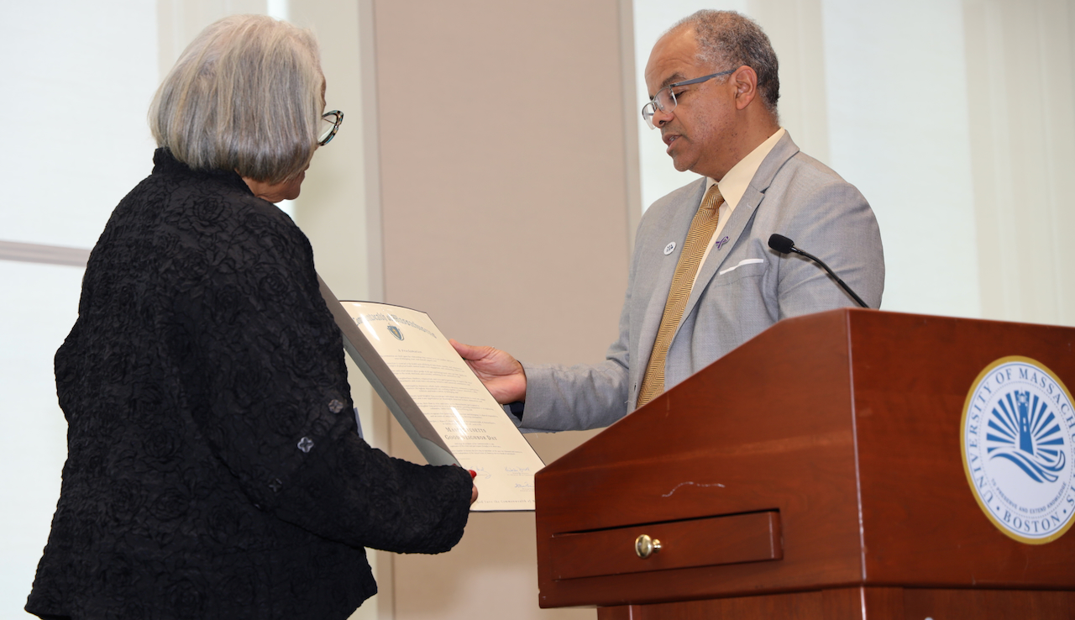
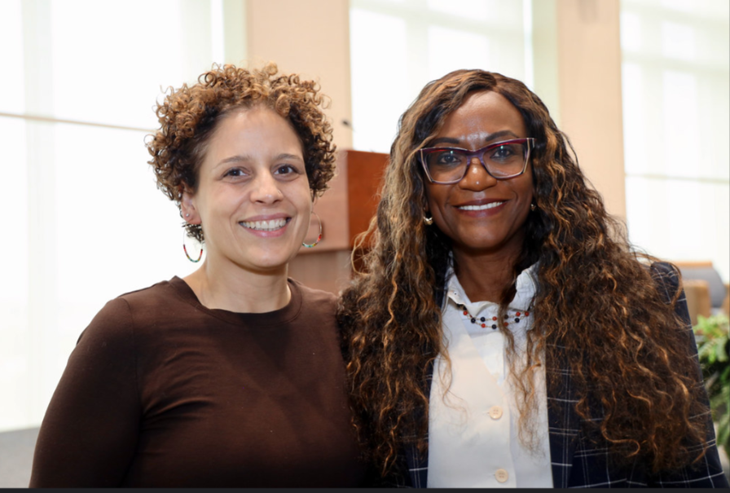
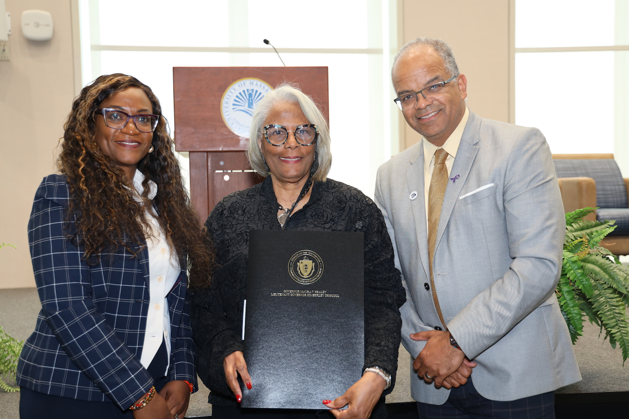
Designing for Belonging: A Massachusetts Summit on Connection & Community
OBHPP and the Massachusetts Coalition to Build Community & End Loneliness partnered to host a summit on September 25th at UMass Boston
This summit brought together leaders from across Massachusetts to examine how loneliness and social disconnection affects health, community well-being, and economic vitality—and how these challenges are shaped by the policies, systems, and spaces we create.
Participants explored connection as a shared responsibility and identified practical ways to work across sectors to foster belonging, launching an ongoing effort to advance this work throughout the Commonwealth.

Slide 24
Looking Ahead

Slide 25
Looking Ahead
1
Hiring: We will be reposting the Program Director position. They will help guide the daily operations of the office, ensuring that priorities are effectively executed and grants are managed with precision.
2
Contract Negotiations with Tier C Grantees: Very excited to begin working with our Tier C grantees through the contract negotiation and onboarding phase.
3
Program Implementation: Grantees will continue moving from program start-up to full implementation, by solidifying programming, deepening community partnerships, and beginning to engage participants.
4
Speaking Engagements: We have a full calendar of speaking engagements related to our Workforce Campaign, encouraging students, professionals, and community members to explore careers in behavioral health and highlighting pathways into the field.

Slide 26
Next Steps: Advancing Promotion & Prevention Across the Commonwealth

Slide 27
Work Group Sign-Ups Since Prior Meeting
Program Development Advise the Office on the development of promotion and prevention initiatives, including program design, evaluation approaches, and strategic planning. | Policy, System, & Advocacy Identify policy and systems-level opportunities to advance behavioral health promotion and prevention, and support coordinated advocacy. | Emerging Evidence & Research Identify and review emerging research, data, and evidence-based practices; bring in presenters and learning opportunities for the Commission
Margaret Hannah* Noel Sierra* | Nancy Scannell Elizabeth Ganz Jacqueline Hubbard Jessica Collins* Margaret Hannah* Noel Sierra* Yaminette Diaz-Linhart* | Sara Whitcomb Jessica Collins* Margaret Hannah* Yaminette Diaz-Linhart*
*These individuals stated potential interest in multiple groups

Slide 28
Next Steps
Identify a group to develop a 1–3 year strategic plan to align the Commission’s role, establish measurable priorities, and identify opportunities to demonstrate impact.
The strategic planning group will be organized around three primary function areas:
  Advise OBHPP: Provide guidance on priorities, programs, grants, and prevention initiatives while bringing forward emerging research and evidence.
  Advise EHS & the Governor’s Office: Elevate behavioral health promotion and prevention priorities and provide recommendations on issues requiring broader executive-branch coordination.
  Support the Commonwealth’s Broader Prevention Strategy: Identify opportunities for the Commission to contribute to statewide prevention goals and connect recommendations to broader population health outcomes.

Slide 29
Thank you!

