Slide 1


Office of Behavioral Health Promotion and Prevention
Update for the Community Behavioral Health Promotion and Prevention Commission
October 9 2025
DRAFT & CONFIDENTIAL; FOR POLICY DEVELOPMENT PURPOSES ONLY

Slide 2
Agenda
OBHPP Updates
Procurement Update & Grant Priority Areas
Public Awareness Campaign Update

Slide 3
OBHPP Updates

Slide 4
OBHPP Major Updates Since August
1
Procurement: We have posted our Request for Applications for our grant program.
2
Campaigns: We have finalized our media plan from October through January.

Slide 5
Procurement Updates

Slide 6
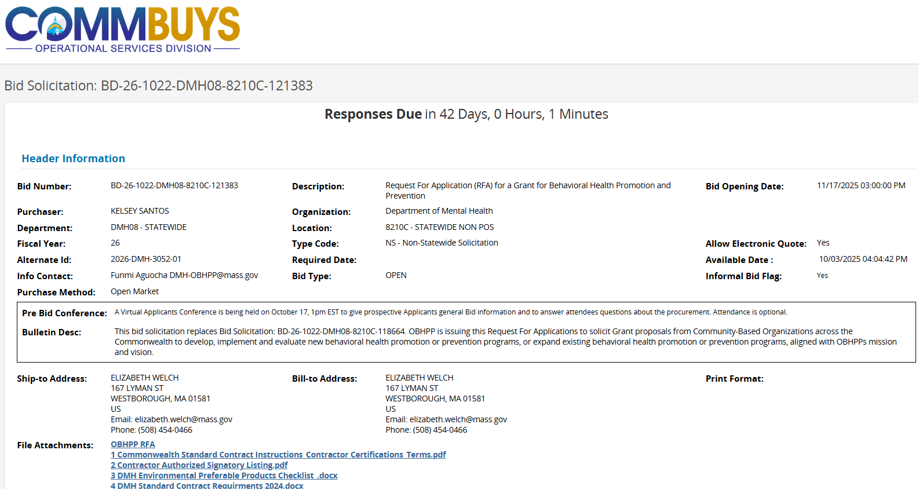
Overview of Request for Applications
We have posted our Request for Applications
on COMMBUYS:
OBHPP is launching a new multi-year grant opportunity;
OBHPP is issuing a procurement; intends to award approximately $3M annually in grants (as funding is available);
Grant funding will support CBOs statewide to develop new programs or expand existing programs across key focus areas.

Slide 7
OBHPP Opportunity Information
Projects must address 1 or 2 of the following Priority Areas:
  Reducing loneliness and social isolation.
  Reducing family stress and supporting caregiver wellbeing.
  Promoting infant, early childhood, and maternal mental health.
  Reducing psychological distress in immigrant populations.
  Promoting early intervention with youth and young adults.
  Reducing family and intimate partner violence.
  Promoting population wellbeing through education, training, and skills development.
Grantee Eligibility:
  Open to Massachusetts-based or serving organizations.
  Must have experience implementing behavioral health promotion and/or prevention initiatives.
  Have experience collecting evaluation and/or reporting data and creating reports.
  Experience incorporating health equity and implementing initiatives to reduce social and structural barriers to mental wellbeing.
  Additional preference: AHEM communities and partnerships between large and small organizations.

Slide 8
OBHPP Opportunity Information
Grant Structure: Three Tiers, each with different funding amounts
  Tier A: Design and development support for emerging programs [100,000 -150,000/year]
  Tier B: Implementation support to launch or scale ready-to-implement programs [150,000 - 250,000/year]
  Tier C: Scaling and sustainability support for established programs. [250,000 - 350,000/year]
Important Dates:
  RFA posted - October 3, 3pm
  Bidder’s Conference - October 17, 1pm (virtual)
  Deadline to submit questions - October 24, 3pm
  Deadline for posting applications – November 17, 3pm
  Anticipated review period (TBC) – November 24 – December 5
  Anticipated start of grants – January 1, 2026

Slide 9
Opportunities for Commission Involvements
1
General Feedback: We welcome general feedback and input throughout the process - can email OBHPP with feedback or questions
2
Review Committee: We are interested in including a small number of Commission members in our review committee - please email us if this is something you're interested in.
Notes:
We want to highlight that we must comply with state procurement and COI laws;
If you are interested in participating in this effort, please let us know via email;
If you believe that an organization that you are involved with may be interested in submitting a proposal for a grant that will be important for us to know, but there may still be a role for you to play. Let us know, so we can work with you to find that role.

Slide 10
High-Level Procurement Information
Commission Input
OBHPP welcomes Advisory Committee Members input and assistance to help make the proposed procurement successful while maintaining compliance with all applicable procurement laws and regulations.
Confidentiality
OBHPP must ensure that the procurement is fundamentally fair for all potential bidders without any appearance of preference, collusion or other form of unfair advantage for a potential bidder. The procurement “playing field” must be kept level. Advisory Committee Members must not disclose any non-public information about the procurement to anyone outside of OBHPP or the Committee to ensure it does not otherwise get to potential bidders or give any potential bidder an advantage over other bidders in the procurement process .
Review Committee
If any Advisory Committee Member wants to sit on a grant review committee, they will need complete the Department Conflict of Interest process to confirm that that they have no real or potential conflict of interests with any of the bidders that submit grant proposals. The review will be done after grant proposals have been received and before review starts.
Conflict of Interest Law
Advisory Committee Members are reminded that for purpose of the State Conflict of Interest law, they are considered to be Special State Employees and are subject to the State Conflict of Interest Law. M .G. L. c 268A. For more information please see, the following summary of the published by the State Ethics Commission

Slide 11
Our Upcoming Campaign

Slide 12
Campaign Overview
We are working with marketing agency ASG to design and implement our first statewide behavioral health awareness campaigns in Fall 2025.
Campaign Purpose:
To promote the importance of behavioral and mental health to overall wellness.
To reduce the stigma surrounding mental health, contributing to a culture of acceptance and support.
To increase health equity by focusing campaigns within prioritized communities as identified by the Advancing Health Equity in Massachusetts (AHEM) Initiative. For more information on the AHEM Initiative see Advancing Health Equity in MA | Mass.gov.
Message Focuses:
Promoting Preventive Behavioral Health Services for members younger than 21 (MassHealth) and up to all the following topics:
Reducing Stigma
Reducing Psychological Distress
Reducing Social Isolation

Slide 13

Campaign Overview – Overarching Concept

Slide 14

Campaign Overview – Multiple Languages

Slide 15




Campaign Imagery – Variety of Faces and Colors

Slide 16



Campaign Overview – What’s on your child’s mind?

Slide 17
Campaign Copy
Psychological Distress
  What's on your mind? Some days feel harder than others. Taking a moment for yourself, reaching out to someone you love, or asking for support can help lighten the load. Learn more about caring for your well-being and mental health screening options at mass.gov/WhatsOnYourMind.
Social Isolation
  What's on your mind? We all feel alone at times. Reaching out to friends or family, giving back to your community, or connecting with a supportive professional can make a real difference. Everyone deserves to feel seen, heard, and cared for. Learn more about social connection and mental well-being at mass.gov/WhatsOnYourMind.
Stigma Reduction
  What’s on your mind? Your mental health is just as important as your physical health, so why is it harder to talk about it? Opening up about whatever you’re going through can help all of us feel more seen, heard, and supported. Visit mass.gov/WhatsOnYourMind to learn more about mental health, mental illnesses, and why talking about it matters.
What’s on your Child’s Mind?
  What’s on your child’s mind? Trust your instincts. If something feels off - like changes in mood, energy, sleep, or connection - starting a conversation can help. Visit mass.gov/WhatsOnYourMind to learn more about supporting your child’s well-being, screening options and connections to care.

Slide 18
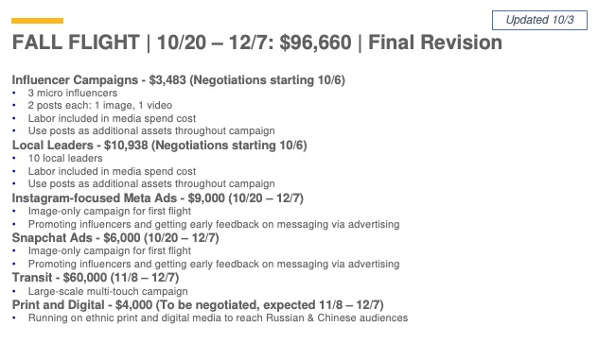
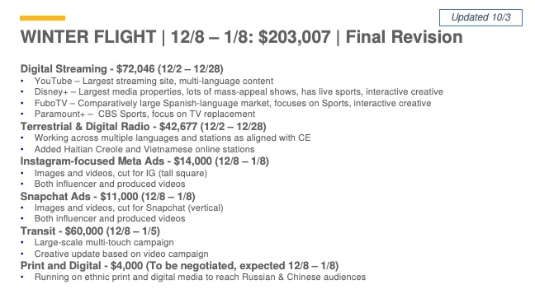
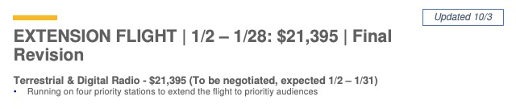
Campaign Media Plan

Slide 19
Looking Ahead
1
Campaign: You will see our first advertisements online and across the state next month.
Data Infrastructure: We have begun identifying relevant MA-wide BHPP data sources with DPH and are building our data infrastructure.
2
Grant Monitoring & Evaluation: We are prepping to align our program reporting and monitoring data so we can evaluate and share insights from OBHPP-funded programs.
3

Slide 20
Thank you!

