Slide 1


Office of Behavioral Health Promotion and Prevention
Update for the Community Behavioral Health Promotion and Prevention Commission
December 11, 2025
DRAFT & CONFIDENTIAL; FOR POLICY DEVELOPMENT PURPOSES ONLY

Slide 2
Agenda
OBHPP Launch Event
RFA Update (246 Applications!)
Campaign Updates

Slide 3
OBHPP Official Launch Event

Slide 4
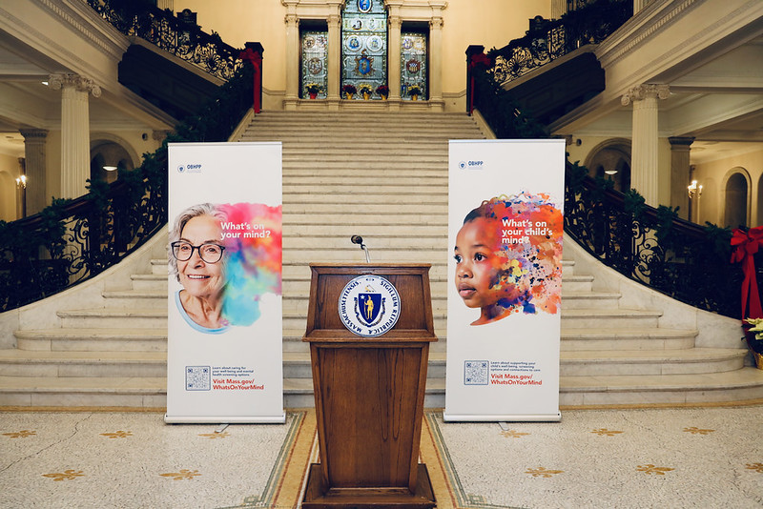
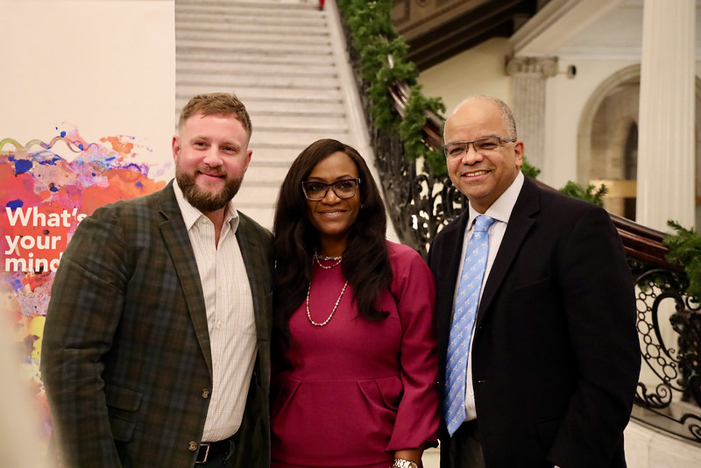
Our Office’s Official Launch Event
We are proud to report that the official launch event for OBHPP was held on Tuesday December 2.
Speakers included Secretary Kiame Mahaniah, Funmi Aguocha, and Senator Julian Cyr.
Members of MA legislature, DMH staff, EOHHS staff, and community partners all came to celebrate the launch of our Office and our campaign.

Slide 5
Our Statewide Campaign

Slide 6
Campaign Overview
We are working with marketing agency ASG to design and implement our first statewide behavioral health awareness campaign from October 2025 – January 2026.
Campaign Purpose:
To promote the importance of behavioral and mental health to overall wellness.
To reduce the stigma surrounding mental health, contributing to a culture of acceptance and support.
To increase health equity by focusing campaigns within prioritized communities as identified by the Advancing Health Equity in Massachusetts (AHEM) Initiative. For more information on the AHEM Initiative see Advancing Health Equity in MA | Mass.gov.
Message Focuses:
Promoting MassHealth Preventive Behavioral Health Services
Reducing Stigma & Increasing Acceptance
Promoting Wellbeing & Positive Mental Health
Reducing Social Isolation & Promoting Social Connection

Slide 7

Campaign Overview – Live on Multiple Statewide Channels

Slide 8

Campaign Overview – Multiple Languages
  Languages:
  English, Spanish, Brazilian Portuguese, Vietnamese, Arabic, Haitian Creole, Simplified Chinese

Slide 9






Campaign Imagery – Variety of Faces and Colors

Slide 10
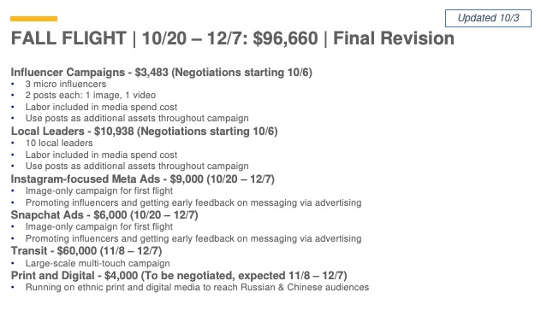
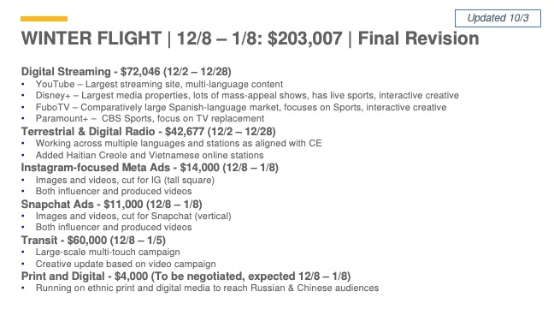
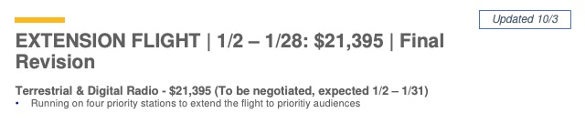
Campaign Media Plan
| 12/12 - 1/12:

Slide 11
Live Campaign Activity
 | Location | Languages
Transit | Montachusett, Worcester, MBTA/Boston area, Merrimack Valley, Berkshire County, Pioneer Valley, Brockton, Fall River/New Bedford, Attleboro/Taunton | English and Spanish
Social | Meta, Snapchat | English, Spanish, Brazilian Portuguese, Vietnamese, Arabic
Community Engagement | Outreach with CBOs in Boston, Springfield, Worcester, Chelsea, Lowell, Auburn, Huntington, Shelburne, Byfield, Cape Cod, Dartmouth, Salem, Amherst, Newton | English, Spanish, Simplified Chinese, Haitian Creole, Brazilian Portuguese, Vietnamese
Streaming | Coming soon – December 2025 through January 2026
Radio

Slide 12

Shareable Campaign Materials
  Campaign Shareables:
  While our campaign is live across the state, we invite you to be a part of it.
  On our website (mass.gov/obhpp) we have uploaded a variety of images, flyers, and posters for you to share in your communities, with your partners, and in your workplaces.
  We also have sample copy and hashtags for social media posts.
  Please feel free to download, print, post, and share widely - we want to bring these messages of positive mental health and wellbeing to everyone.
  We will share this via email following the meeting as well.

Slide 13
RFA Update

Slide 14
RFA Overview
Grant Opportunity
  OBHPP has launched a new multi-year grant opportunity to award ~$3M annually in grants (as funding is available).
  Grant funding will support CBOs statewide to develop new, or expand existing, programs across key focus areas.
Projects must address 1 or 2 of the following Priority Areas:
  Reducing loneliness and social isolation.
  Reducing family stress and supporting caregiver wellbeing.
  Promoting infant, early childhood, and maternal mental health.
  Reducing psychological distress in immigrant populations.
  Promoting early intervention with youth and young adults.
  Reducing family and intimate partner violence.
  Promoting population wellbeing through education, training, and skills development.
Grantee Eligibility:
  Open to Massachusetts-based or serving organizations.
  Must have experience implementing behavioral health promotion and/or prevention initiatives.
  Have experience collecting evaluation and/or reporting data and creating reports.
  Experience incorporating health equity and implementing initiatives to reduce social and structural barriers to mental wellbeing.
  Additional preference: AHEM communities and partnerships between large and small organizations.

Slide 15
OBHPP Opportunity Information
Grant Structure: Three Tiers, each with different funding amounts
  Tier A: Design and development support for emerging programs [100,000 -150,000/year]
  Tier B: Implementation support to launch or scale ready-to-implement programs [150,000 - 250,000/year]
  Tier C: Scaling and sustainability support for established programs. [250,000 - 350,000/year]
Timeline & Process:
  RFA posted - October 3, 3pm
  Bidder’s Conference - October 17, 1pm (virtual)
  Deadline to submit questions - October 24, 3pm
  Deadline for posting applications – November 21, 3pm
  Review period – November 24 – January 15
  Anticipated start of grants – February 2026

Slide 16
Summary of Review Process
Internal Review Process – Preparing for Review
We received a record number of bids – 246!
We have completed preparing and sorting bids.
Applications now with our Review Committee.
Review Committee
Our Review Committee is made up of 36 members
  Special thanks to our Commission members who volunteered for this role – Thank you!
Applications have been shared with Review Committee members for their review.
Consensus meetings will happen in late December and early January.
Contract negotiations will begin in early 2026.
Tier | Applications
Tier A | 61
Tier B | 96
Tier C | 89
Total | 246

Slide 17
Looking Ahead

Slide 18
Looking Ahead
Campaign Winter Flight: You will continue to see transit and social media ads for another month + radio/streaming ads begin in the next few weeks.
1
Data Infrastructure: We have identified relevant MA-wide BHPP data sources with DPH and are building our data infrastructure. We will build grant monitoring data into this as grant programs unfold.
2
Awarding Grants: We will be announcing grantees in early 2026 and are excited to share a summary of the incredible BHPP initiatives we've seen from across the state in February.
3

Slide 19
Thank you!

