Slide 1


Office of Behavioral Health Promotion and Prevention
Update for the Community Behavioral Health Promotion and Prevention Commission
February 5, 2026
DRAFT & CONFIDENTIAL; FOR POLICY DEVELOPMENT PURPOSES ONLY

Slide 2
Agenda
Campaign Updates – Second Flight Complete!
RFA Updates – Review Underway!
Looking Ahead – Grant Evaluation & Data Infrastructure

Slide 3
Campaign Update – Second Flight Complete

Slide 4

Summary
Live from October 2025 through March 2026,
the What’s on your mind? campaign uses a
cross-channel approach to reach our general
population and caregiver audiences statewide to:
1
2
3
To promote psychological wellbeing, reduce stigma and social isolation
Build a culture
of acceptance
and support
Advance health equity by focusing on AHEM communities most impacted by health inequities

Slide 5
Activity
Flight | Channel | Dates | Languages | Messages
Flight 1 10/23 - 1/22 | Outdoor & Transit | 11/8 - 1/15 | English, Spanish | Promoting Psychological Wellbeing(General Adult) Promoting Psychological Wellbeing (Youth/College)
 | Facebook and Instagram | 10/23 - 12/12 | English, Spanish, Brazilian Portuguese, Vietnamese, Arabic
 | Snapchat | 10/30 - 12/7 | English Spanish, Brazilian Portuguese
Flight 2 12/8 - 1/29 | Outdoor & Transit | 12/5 - 1/5 | English, Spanish | Promoting Psychological Wellbeing (Youth/College) Social Isolation Stigma
 | Facebook and Instagram | 12/12 - 1/12 | English, Spanish, Brazilian Portuguese, Vietnamese, Arabic
 | Snapchat | 12/12 - 1/12 | English Spanish, Brazilian Portuguese
Social media and radio flight focusing on Social Isolation and Stigma to run February - March 2026.

Slide 6


Campaign Messages
Promoting Psychological Wellbeing (Youth)
Stigma Reduction
(General Adult)
Social Isolation
(General Adult)
Promoting Psychological Wellbeing (General Adult)

Slide 7






Community Engagement Activities
4 methods of community engagement, with an estimated reach of over 65,000 people statewide
Initial campaign feedback
from 7 community
organizations
In-person outreach and
materials distribution at hubs
in all 26 gateway cities
6 community organization
partnerships to spread the
campaign message
10 events across communities
with over 4.5K campaign
materials distributed

Slide 8








Paid Media Overview
154
advertising
assets
22
Across
outlets
in
marketing
channels
7
different
languages
and
Languages include:
English, Spanish, Brazilian
Portuguese, Vietnamese, Arabic,
Haitian Creole, Simplified Chinese

Slide 9
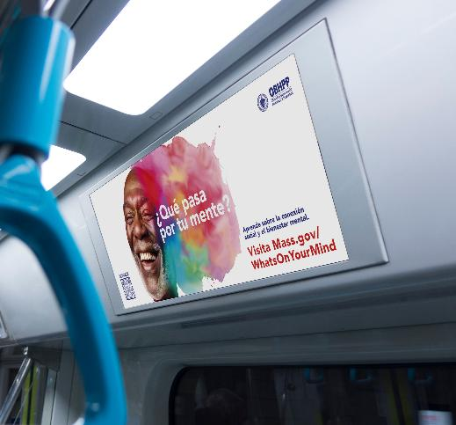
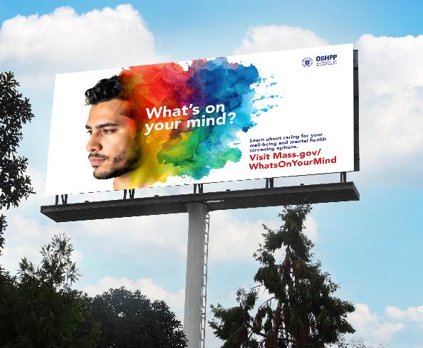

Paid Media Overview
2,582
digital & broadcast
radio spots
642
billboards & transit
ad placements
Languages include English, Spanish, Brazilian Portuguese, Vietnamese, Arabic, Haitian Creole, Simplified Chinese

Slide 10

Paid Media Data Points to Date
5,908,666
social media image and video impressions, leading to
33,541
clicks
to site
2,721,710
OTT streaming video
impressions
Digital streaming: "Stigma Reduction"

Slide 11
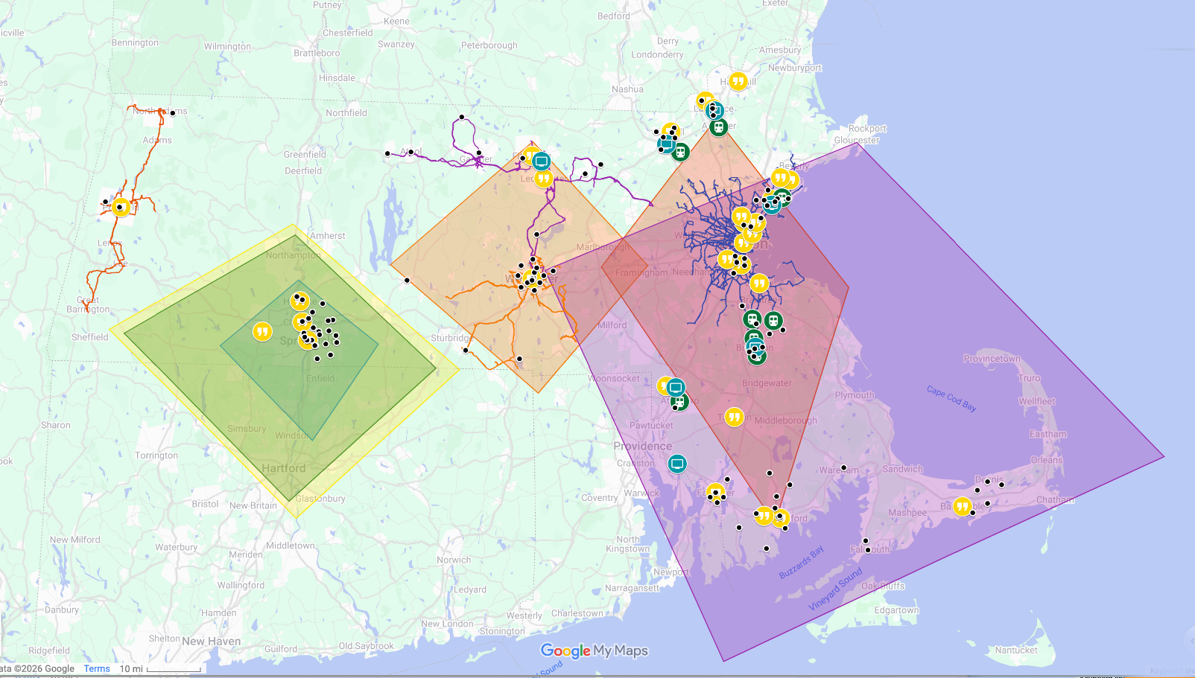
Campaign Geographic Reach
OBHPP Geographic
Campaign Focus
Community
Engagement
Locations
Terrestrial Radio
Broadcast Areas
Outfront/MBTA
Bus Routes
Outfront/MBTA
Commuter Rail Stations
Outfront Billboards
WRTA Bus Routes
GoGraphix/BRTA
Bus Routes
MART Bus Routes
AHEM Zip Codes

Slide 12

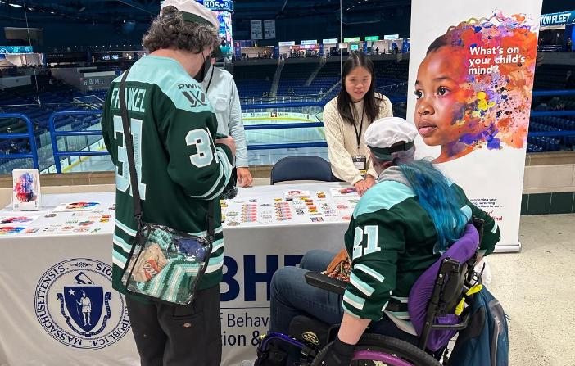
What the Community Is Saying
“
This is such
important work,
I didn’t know Massachusetts
was doing this!”
“
The sun going down at 4 p.m. is really hard for me...
I’m glad people like you are doing this work.”

Slide 13


What the Community Is Saying
“
I like that you used different men of color
in your campaign; they’re often left
out of the conversation, but they are one of the most impacted groups.”
“
The visuals are
a ‘huge step up’
from typical mental
health media”

Slide 14
What the Community Is Saying
“
One of our customers said they were in
a dark place. They said they saw your
card. It had pretty colors on it so they
read it. After going to your website while doomscrolling one night, they decided to
check into a hospital instead of Google
“how to kill yourself”. They were inpatient
over Christmas, but they are better now with medication and therapy. They said it still isn’t easy, but they actually want to be alive now. Thank you for being there!!”
Because of
your sponsorship
at our [Market
on Brussels] Holiday Market,
it saved someone’s life.

Slide 15
RFA Update – Applications Review

Slide 16
RFA Overview – Quick Refresh
Grant Opportunity
  OBHPP has launched a new multi-year grant opportunity to award ~$3M annually in grants (as funding is available).
  Grant funding will support CBOs statewide to develop new, or expand existing, programs across key focus areas.
  Grant funding is structured across 3 Tiers ranging from $150,000 – 350,000/year.
Projects must address 1 or 2 of the following Priority Areas:
  Reducing loneliness and social isolation.
  Reducing family stress and supporting caregiver wellbeing.
  Promoting infant, early childhood, and maternal mental health.
  Reducing psychological distress in immigrant populations.
  Promoting early intervention with youth and young adults.
  Reducing family and intimate partner violence.
  Promoting population wellbeing through education, training, and skills development.
Grantee Eligibility:
  Open to Massachusetts-based or serving organizations.
  Must have experience implementing behavioral health promotion and/or prevention initiatives.
  Have experience collecting evaluation and/or reporting data and creating reports.
  Experience incorporating health equity and implementing initiatives to reduce social/structural barriers to wellbeing.
  Additional preference: AHEM communities and partnerships between large and small organizations.

Slide 17
RFA Timeline
Review Period (November 24 – February 28)
Application Period (October 3 – November 21)
Bidder’s Conference
Deadline to submit questions
Deadline for posting applications
RFA posted
Contracting & Grant Awards (est March – April)
Minimum submissions review
BHPP eligibility
Review committee scoring
Leadership review
Grantee notification
Contract negotiations
Public announcements
Program kickoffs

Slide 18
Summary of Review Process
Internal Review Process – Preparing for Review
We received a record number of bids – 246!
We have completed all internal review steps and are in final deliberation stages between Dr. Funmi Aguocha (awarding authority), and EHS.
Review Committees
Our Review Committees were made up of 36 members from across DPH, DMH, EOVS, and the Commission
  Special thanks to our Commission members who volunteered for this role – Thank you!
We also had 6 notetaker volunteers and 7 Review Committee members who agreed to help Chair a subset of review meetings.
Initial Applications – 246!
Review Committee Scoring & Selections - 87
Minimum Submissions and BHPP Screening - 216
Final Recommendations for Leadership Review – 15-20

Slide 19
Application Summary – Rough Counts
 | Location | Focus Area
Tier A | Western - 15 Central - 15 Northeast - 18 Southeast - 15 Metro Boston - 32 | Social isolation / loneliness- 8 Family stress / caregiver - 7 Infant/early childhood/maternal - 5 Immigrant populations - 7 Youth early intervention - 11 Family / intimate partner violence – 0* Population-wide skill building / education - 19
Tier B | Western - 23 Central - 24 Northeast - 32 Southeast - 23 Metro Boston - 31 | Social isolation / loneliness- 22 Family stress / caregiver - 27 Infant/early childhood/maternal - 12 Immigrant populations -13 Youth early intervention - 15 Family / intimate partner violence -- 6 Population-wide skill building / education - 7
Tier C | Western - 18 Central - 17 Northeast - 15 Southeast - 26 Metro Boston - 34 | Social isolation / loneliness- 20 Family stress / caregiver - 12 Infant/early childhood/maternal - 5 Immigrant populations - 8 Youth early intervention - 19 Family / intimate partner violence - 11 Population-wide skill building / education - 5
*while the main focus was not on DV or IPV, many programs discussed trauma or exposure to violence in family or immigrant focused programs

Slide 20
Looking Ahead

Slide 21
Looking Ahead
1
Awarding Grants: We will be beginning contract negotiations and awarding our first grants in March-April 2026.
Grant Evaluation & Monitoring: We are building out our framework for monitoring and evaluation to consolidate data across key focus areas, track progress, and demonstrate impact.
2
Data Infrastructure: We have identified relevant MA-wide BHPP data sources with DPH and are building our data infrastructure. We will build grant monitoring data into this as grant programs unfold.
3

Slide 22
Thank you!

