Slide 1


Office of Behavioral Health Promotion and Prevention
Update for the Community Behavioral Health Promotion and Prevention Commission
April 2, 2026
DRAFT & CONFIDENTIAL; FOR POLICY DEVELOPMENT PURPOSES ONLY

Slide 2
Agenda
RFA Update - Final Selection Overview
Fall/Winter Campaign - Final Summary
Upcoming Campaign - Initial Concepts for Feedback
Looking Ahead - Q4 Priorities

Slide 3
RFA Update
Applications Review

Slide 4
RFA Timeline
Review Period (November 24 – April est.)
Application Period (October 3 – November 21)
Bidder’s Conference
Deadline to submit questions
Deadline for posting applications
RFA posted
Contracting & Grant Awards (est. April - May)
Minimum submissions review
BHPP eligibility
Review committee scoring
Leadership review
Grantee notification
Contract negotiations
Public announcements
Program kickoffs

Slide 5
Application Summary
 | Location | Focus Area
Tier A | Western - 15 Central - 15 Northeast - 18 Southeast - 15 Metro Boston - 32 | Social isolation / loneliness- 8 Family stress / caregiver - 7 Infant/early childhood/maternal - 5 Immigrant populations - 7 Youth early intervention - 11 Family / intimate partner violence – 0* Population-wide skill building / education - 19
Tier B | Western - 23 Central - 24 Northeast - 32 Southeast - 23 Metro Boston - 31 | Social isolation / loneliness- 22 Family stress / caregiver - 27 Infant/early childhood/maternal - 12 Immigrant populations -13 Youth early intervention - 15 Family / intimate partner violence -- 6 Population-wide skill building / education - 7
Tier C | Western - 18 Central - 17 Northeast - 15 Southeast - 26 Metro Boston - 34 | Social isolation / loneliness- 20 Family stress / caregiver - 12 Infant/early childhood/maternal - 5 Immigrant populations - 8 Youth early intervention - 19 Family / intimate partner violence - 11 Population-wide skill building / education - 5
*while the main focus was not on DV or IPV, many programs discussed trauma or exposure to violence in family or immigrant focused programs

Slide 6
Upcoming Campaign
Final Summary

Slide 7

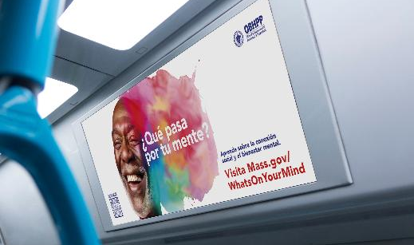
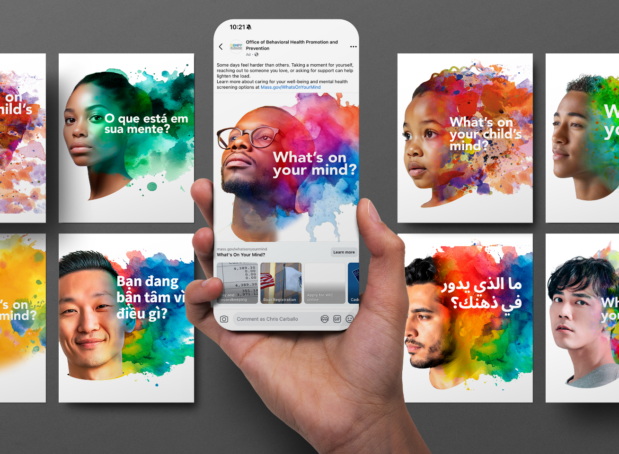
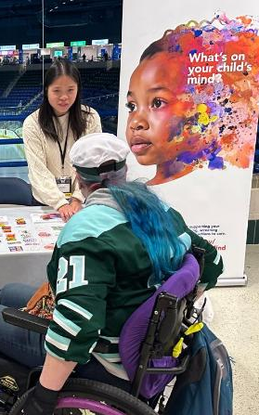

What's On Your Mind? Executive Summary
Campaign Overview and Goal:
The Office of Behavioral Health Promotion and Prevention (OBHPP) launched What’s On Your Mind?—a multilingual, multimedia, and population level campaign promoting mental wellbeing and supporting upstream prevention across the Commonwealth.
What’s On Your Mind? encouraged residents to take simple, proactive steps to care for their mental well-being, reduce stigma, and connect to free, confidential support.
The campaign sought to normalize mental health as a part of everyday health and promote connection to loved ones, community, and care providers as the first step towards wellness.
The web page mass.gov/whats-on-your-mind anchored the campaign with tips and resources for residents to care for their mental well-being and support the people around them.
Approach:
The campaign leveraged a cross-channel approach and attention-capturing creative to reach our general population and caregiver audiences statewide. To build awareness the campaign promoted behavioral and mental health as key to overall wellness and to:
  reduce stigma, social isolation, and psychological distress
  build a culture of acceptance and support
  advance health equity by focusing on AHEM communities most impacted by health inequities.

Slide 8
Paid Media Activity
Flight | Channel | Dates | Languages | Messages
Flight 1 10/23 - 1/22 | Outdoor & Transit | 11/8 - 1/15 | English, Spanish | Psychological Distress (General Adult) Psychological Distress (Youth/College)
 | Facebook and Instagram | 10/23 - 12/12 | English, Spanish, Brazilian Portuguese, Vietnamese, Arabic
 | Snapchat | 10/30 - 12/7 | English Spanish, Brazilian Portuguese
Flight 2 12/8 - 1/29 | Outdoor & Transit | 12/5 - 1/5 | English, Spanish | Psychological Distress (Youth/College) Social Isolation Stigma
 | Facebook and Instagram | 12/12 - 1/12 | English, Spanish, Brazilian Portuguese, Vietnamese, Arabic
 | Snapchat | 12/12 - 1/12 | English Spanish, Brazilian Portuguese
 | Digital Streaming | 12/24 - 1/29 | English
Flight 3 1/9 - 3/31 | Radio | 1/9 - 3/31 | English, Spanish, Haitian Creole, Vietnamese,
 | Digital Streaming | 3/15 – 3/31 | English

Slide 9
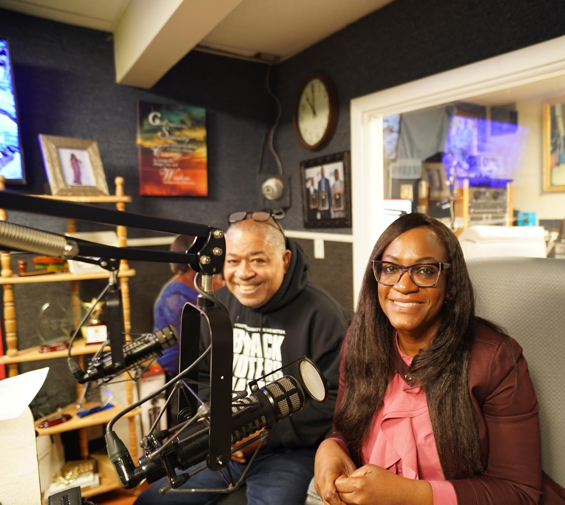
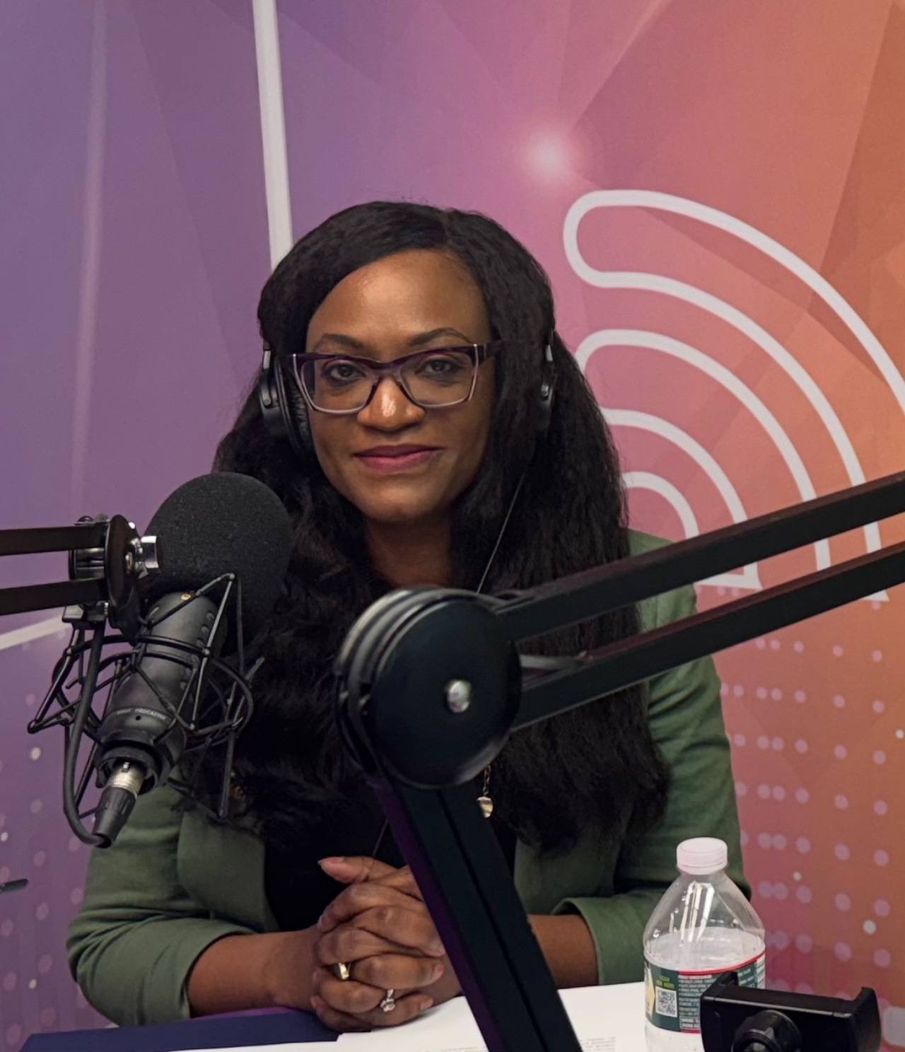
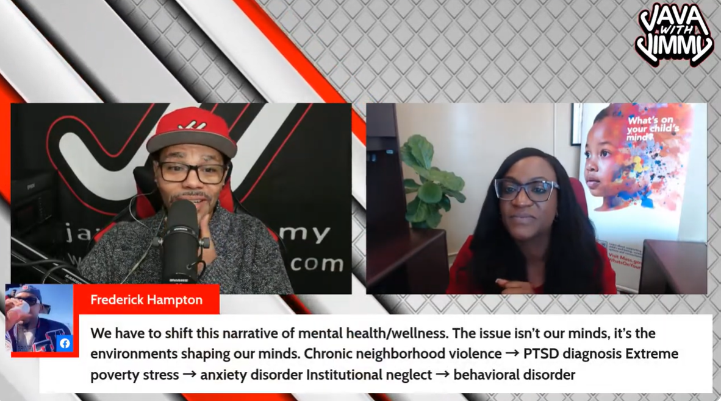



Earned Media - OBHPP Earned Media Reach & Impact
4 High-impact earned media placements across priority outlets.
Media mix included: Radio Planet Compas, Concord, Nossa Radio, and Java with Jimmy.
Interviews generated live audience engagement, including listener questions and community interaction.
Social Media Amplification - Nossa Radio: 63K followers on socials. Estimated morning audience of approximately 20,000 listeners.
Social Media Amplification: Java with Jimmy: 2.7K Facebook likes and 644 YouTube subscribers.

Slide 10
Performance Summary
Performance Summary
Campaign Details
~ 6M | social media impressions
~ 4.5M | streaming video impressions
~ 65K | people reached through community engagement
~ 5K+ | materials distributed
150+ | ads across 22 outlets in 5 channels and 7 languages
29 | cities for on-the-ground outreach (gateway cities focus)
11 | community events
6 | community partnerships
4 | ethnic radio interviews
Duration:
  October 2025 - March 2026, reaching our audience during a time that often presents mental health difficulties like winter, school breaks, and holidays.
Audience:
  The campaign sought to engage the general population across all ages and demographics, including communities most impacted by health inequities, as identified by the AHEM initiative, and caregivers.
Languages:
  English, Spanish, Brazilian Portuguese, Vietnamese, Arabic, Haitian Creole, Simplified Chinese
Channels: The campaign used multiple channels to reach our audiences statewide and build awareness and trust.
  Community Engagement: events, partnerships, and on-the-ground in-person community outreach.
  Paid Media: Outdoor and transit, social media, digital video streaming, and radio advertising.
  Earned Media: Ethnic radio interviews.

Slide 11
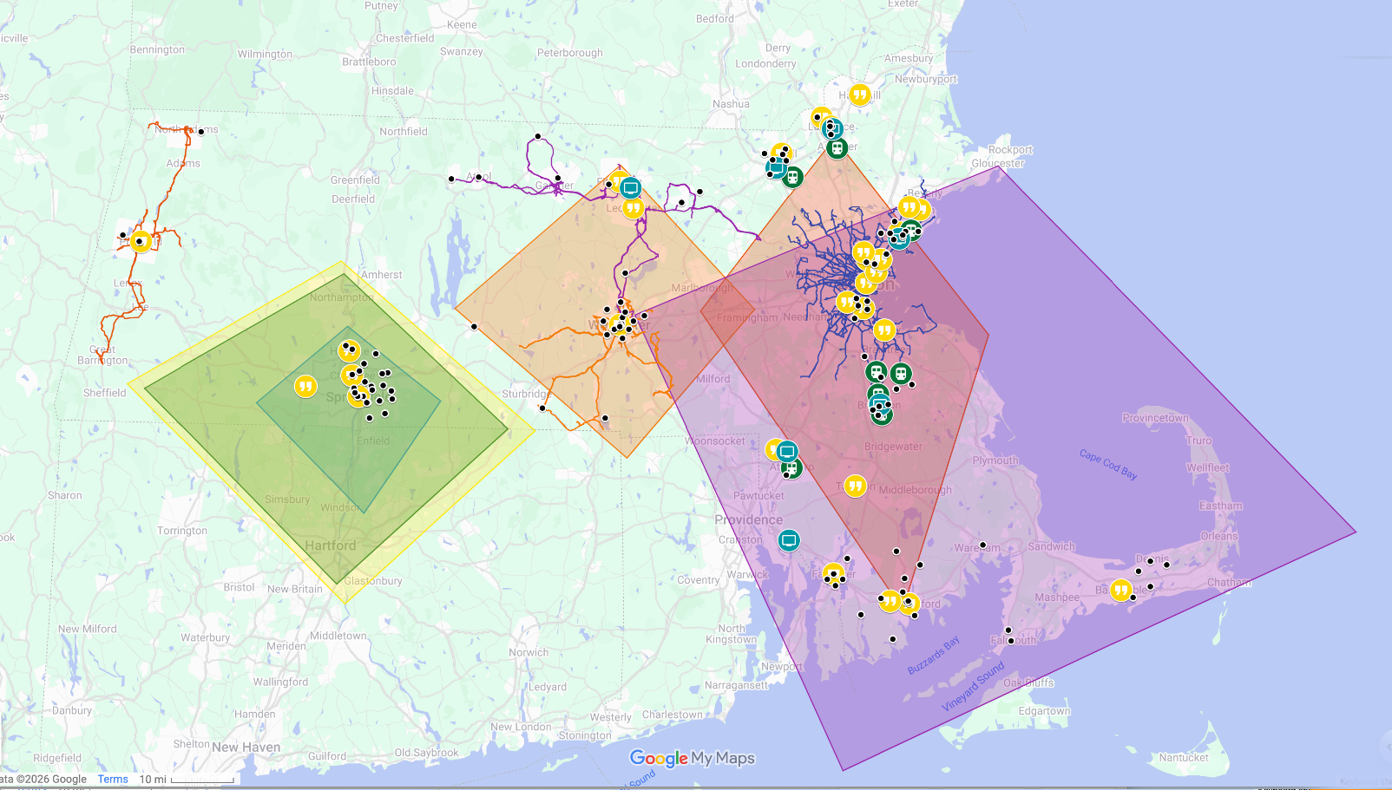
Campaign Geographic Reach
OBHPP Geographic
Campaign Focus
Community
Engagement
Locations
Terrestrial Radio
Broadcast Areas
Outfront/MBTA
Bus Routes
Outfront/MBTA
Commuter Rail Stations
Outfront Billboards
WRTA Bus Routes
GoGraphix/BRTA
Bus Routes
MART Bus Routes
AHEM Zip Codes

Slide 12
Learnings & Recommendations
Learnings
Recommendations
1. Attention-grabbing creative is key. | → | We learned through community feedback that the visuals were striking and stood out. Continuing the use of strong creative and established branding will lead to engagement and action.
2. OTT streaming delivered strong results. | → | Incorporate OTT streaming into future campaign plans, knowing it delivers strong results and reaches our audiences effectively.
3. Community engagement is essential for trust. | → | Between the sensitivity of mental health and wariness regarding government entities, building trust was key. The two-way opportunity community engagement offers to build authentic trust and connection will be important for all future campaigns. Working with Community Based Organizations and partnering with trusted events helped to cement that trust within the community.
4. Ethnic radio is a trusted earned channel. | → | Our audience trusts the shows and their hosts that they tune into daily. Being invite into that space helps us reach out audience in an authentic way through channels they already seek information from.
5. Real time learnings lead to optimization. | → | We learned that planned tactics in execution sometimes present unplanned roadblocks. Being observant, nimble and pivoting to more effective tactics is key to optimizing for the greatest impact.

Slide 13
Workforce Campaign Update
Initial Concepts for Feedback

Slide 14

Workforce Campaign Purpose
To promote and increase awareness of behavioral health career pathways in MA to strengthen and grow the workforce.
Position OBHPP as a trusted statewide source of information for students and early-career professionals seeking meaningful, supported careers in behavioral health.
Identify and partner with healthcare and mental health/behavioral health organizations that advocate for and support workforce development.

Slide 15



Media Channels
Like our previous campaign, this campaign will leverage a multi-channel strategy to best reach audience segments with creative across:
Community Engagement
Paid Media
Earned Media

Slide 16

Why It Works
Future-focused: Connects passion to clear career pathways in behavioral health.
Empowering & aspirational: Positions compassion as the driver of meaningful impact and choice.
Audience connection: Relatable to students/early-career talent: with “where you’re going” mindset.
Visually bold: Painted heart-path overlays photo for instant impact.
Brand Continuity: Question format + human imagery echo “What’s on your mind" Campaign look and feel
Concept 1:
Where will your heart take you?

Slide 17
Concept 1: Alternative Taglines
What’s in your heart?
Make your living making a difference.
Put your heart to work.
Lead with heart, work with purpose.
Follow your heart into your career

Slide 18

Concept 2:
Build a career with purpose.
Why it works:
These visual direction builds directly on the “What’s On Your Mind?” campaign by maintaining the silhouette and color language while evolving the narrative from internal reflection to human connection.
The imagery remains person-focussed while depicting a future vision of a behavioral health career path.

Slide 19

Concept 2 image style:

Slide 20
Concept 2: Alternative Taglines
Find your purpose.
Turn your compassion into your career.
Turn your empathy into expertise.

Slide 21
Looking Ahead

Slide 22
Looking Ahead
Notifying Grantees and Contract Negotiations: Very excited to begin working with our grantees through the contract negotiation phase and announcing our awards in the coming weeks.
1
2
Kicking Off Grant Programs: Outlining program monitoring, evaluation, and technical assistance processes now. Planning to initiate onboarding and OBHPP support in May.
3
Hiring: We are hiring for a Project & Administration Manager role for the Office. They will help project manage our grantee monitoring and support processes, and our broader portfolio of partner initiatives.
4
Writing our Legislative Report: We will be synthesizing our year of progress in this year's Legislative report, including our first and second campaign, launching our grant program, and continuing to strenghten our statewide partnerships.

Slide 23
Thank you!

