Slide 1


Office of Behavioral Health Promotion and Prevention
Update for the Community Behavioral Health Promotion and Prevention Commission
July 9, 2026
DRAFT & CONFIDENTIAL; FOR POLICY DEVELOPMENT PURPOSES ONLY

Slide 2
Agenda
RFA Announcement – Awards & Milestones
Active Workforce Campaign – Overview & Website
Looking Ahead – Into FY27
Advancing Prevention & Promotion Across the Commonwealth – Group Discussion

Slide 3
RFA Announcement

Slide 4
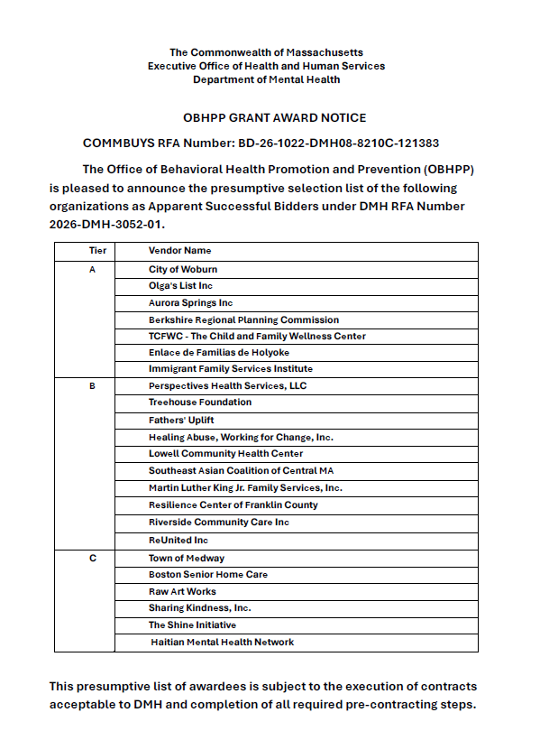
Award Announcement
We are extremely proud to announce that we have selected 23 organizations who will receive grants from our inaugural behavioral health promotion and prevention community grants program.
Thank you to the legislators, staff, and Commission members who have worked so hard to get us to this milestone where we can provide $4.5M in funding to new and expanded programs across the Commonwealth.
Press release link:
Healey-Driscoll Administration Announces $4.5M in Annual Grants for Community-Based Behavioral Health Programs | Mass.gov

Slide 5
Prospective Grantees (contingent on contracting)
TIER A
City of Woburn
Olga's List Inc
Aurora Springs Inc
Berkshire Regional Planning Commission
TCFWC - The Child and Family Wellness Center
Enlace de Familias de Holyoke
Immigrant Family Services Institute
TIER B
Perspectives Health Services, LLC
Treehouse Foundation
Fathers' Uplift
Healing Abuse, Working for Change, Inc.
Lowell Community Health Center
Southeast Asian Coalition of Central MA
Martin Luther King Jr. Family Services, Inc.
Resilience Center of Franklin County
Riverside Community Care Inc
ReUnited Inc
TIER C
Town of Medway
Boston Senior Home Care
Raw Art Works
Sharing Kindness, Inc.
The Shine Initiative
Haitian Mental Health Network

Slide 6
Prospective Grantees (contingent on contracting)
Region | Greater Boston | 7
 | North Shore | 6
 | South Shore & Cape | 6
 | Central MA | 5
 | Western MA | 5
Focus Area | Loneliness and social isolation | 3
 | Family stress and caregiver wellbeing | 3
 | Infant, early childhood, and maternal mh | 4
 | Psychological distress in immigrants | 3
 | Early intervention with youth and young adults | 3
 | Family and intimate partner violence | 3
 | Population wellbeing - education, training, and skills development | 6
Note: counts are greater than 23 because many grantees serve multiple regions or cover multiple focus areas

Slide 7
Pre-Contracting Program Spotlights (to be confirmed)
Program 1:
A culturally responsive behavioral health promotion program serving Vietnamese older adults in the Boston area. The program is designed to reduce loneliness, strengthen social connection, and promote emotional well-being through structured group activities delivered in a welcoming, non-clinical environment. Activities include storytelling, memory and cognitive engagement exercises, culturally relevant discussions, emotional regulation strategies, and intergenerational engagement with trained youth companions.
Anticipated Impact:
~300-400 community members via 35 activities
Program 2:
A Berkshire county-wide model integrating Community EMS (CEMS) outreach with community partners to reduce loneliness and improve older adult (60+) wellbeing through preventive in‑home visits, coordinated referrals, and community-based education, including development of CEMS program protocols, delivery of CEMS wellness checks and behavioral health referrals, and substance use risk reduction through education sessions and targeted outreach campaigns.
Anticipated Impact:
~600 community members via 700 activities
Program 3:
A behavioral health promotion and prevention initiative designed to serve youth ages 10–22 across Greater Boston, including Quincy, Brockton, Randolph, Dorchester, Roxbury, Mattapan, and Norwood. The program integrates sports-based youth engagement, social-emotional learning (SEL), wellness coaching, caregiver support, and leadership development to strengthen protective factors, promote mental wellness, and reduce behavioral health disparities among Black, African American, Haitian, Cape Verdean, Afro-Caribbean, Latinx, Brazilian, immigrant, and multilingual youth.
Anticipated Impact:
~500 community members via ~300 activities (including multi-day sessions)
Program 4:
A skills for healthy relationships prevention program in schools across the North Shore. The program aims to prevent intimate partner violence (IPV) by equipping young people, families, and school communities with the knowledge and skills needed to build healthy, respectful relationships. Key program components include interactive workshops, training for educators, caregiver materials, and workshops for families referred through school partners due to risk factors or demonstrated need.
Anticipated Impact:
~6000 community members via 40 workshops and 10 school-wide initiatives.

Slide 8
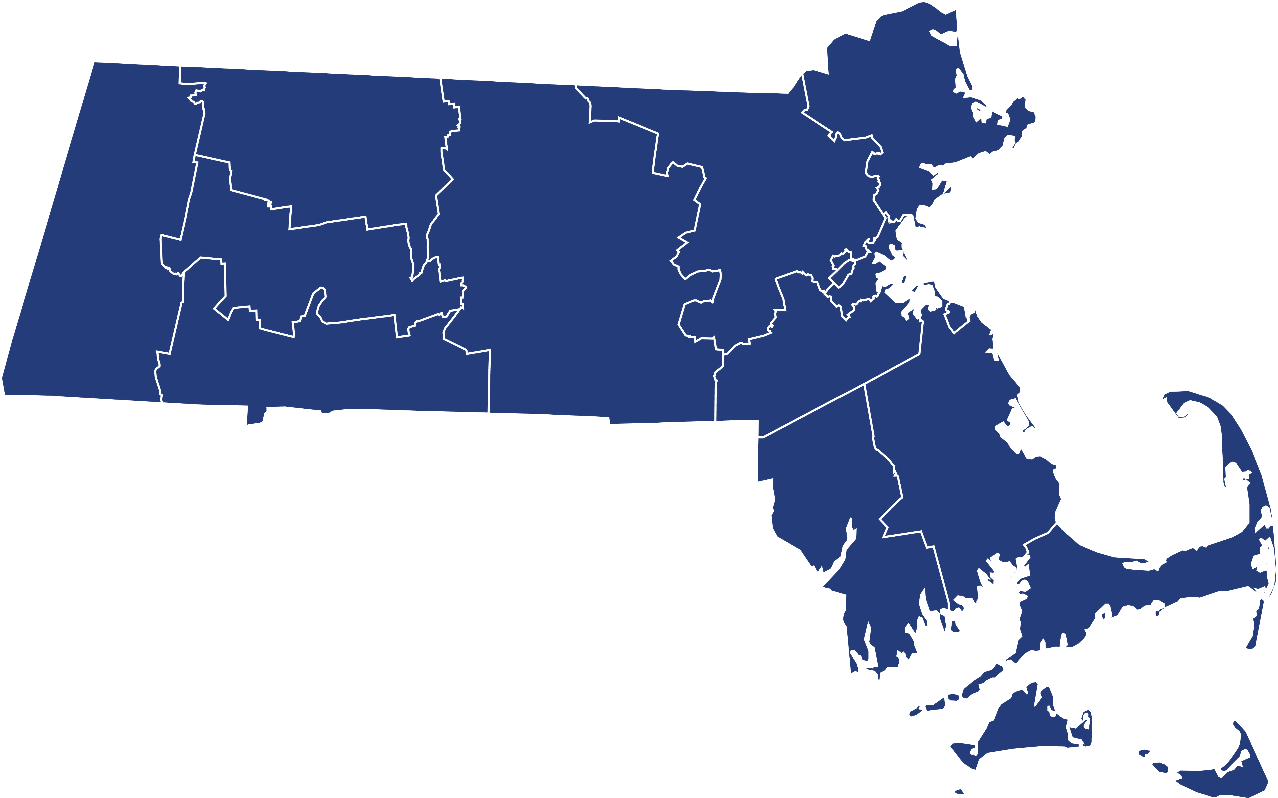
Geographic Spread of Prospective Grantees
Lowell CHC
Resilience Center of Franklin County
HAWC
Berkshire Regional Planning Commission
City of Woburn
Raw Art Works
Olga's List
Aurora Springs
Immigrant Family Services Inc
Fathers Uplift
ReUnited Inc
Boston Senior Home Care
Haitian Mental Health Network
Treehouse Foundation
SE Asian Coalition of Central MA
Enlace de Familias de Holyoke
Martin Luther King Jr. Family Services
The Shine Initiative
TCFWC
Town of Medway
Perspective Health Services
Tier A
a
Tier B
a
Tier C
Note: locations are approximate and many grantees serve multiple regions not reflected
Riverside Community Care
Sharing Kindness

Slide 9
Data Collection & Evaluation Approach
Thank you to the many Commission members who have helped guide our evaluation design process.
Our data collection and evaluation framework is designed to measure progress and impacts on 5 domains:
  OBHPP Activities: Ensure effective administration and monitoring of grant funds and operations.
  OBHPP ➜ CBOs: Strengthening the capacity of community-based organizations (CBOs) to design and deliver effective behavioral health promotion and prevention programming
  CBOs ➜ Communities: Generate community impacts aligned with 7 priority focus areas.
  CBOs ➜ Communities: Promote population mental wellbeing across all grant program activities.
  Broad Overarching Impact of the Program: Advancing behavioral health promotion and prevention across MA.
Data Collection Strategies
  Data is collected via the submission of set deliverables (i.e. track grantee progress), quarterly progress reports (to track grantee progress, capacity, and BHPP advancement), and annual evaluation reports (to report program outcomes, activities, counts);
  Grantees also complete an organizational self-assessment to gauge current capacity needs and growth over time.

Slide 10
Next Steps for the Grant Program
1
Contracting: Currently wrapping up contract negotiations where we finalize budgets, scope of work, program impacts, and other agreements.
2
Onboarding: Planning for onboarding and first welcome calls throughout July. We have prepared a welcome package and training materials re: mandatory reporting and document submissions.
3
First Grantee Activities: In Q1, grantees will be preparing their workplans, completing their organizational self-assessments, and submitting their first quarterly progress reports and invoices.

Slide 11
Active Workforce Campaign

Slide 12

Workforce Campaign Overview
To promote and increase awareness of behavioral health career pathways in MA to strengthen and grow the workforce.
Position OBHPP as source of information for students and early-career professionals seeking meaningful, supported careers in behavioral health.
Identify and partner with healthcare and mental health/behavioral health organizations that advocate for and support workforce development.

Slide 13


Campaign Asset Mock Ups

Slide 14
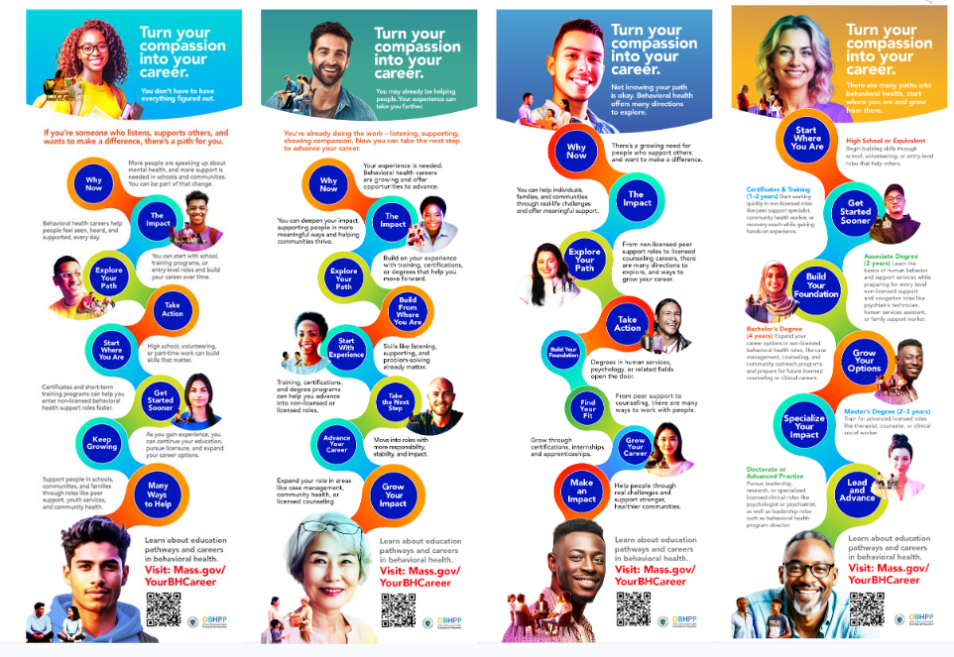
To view infographics in more detail, see the following links:
No. 1
No. 2
No. 3
No. 4

Slide 15
Campaign Activity Snapshot: June – Sept 2026
(specific dates TBC;
additional vendors may be added)
Status | Channel | Type of ads | Outlet | Audience | Languages
Live | Google Display / DV360 | Display ads | Google | Statewide behavioral health audiences | English, Spanish, Portuguese
Mid-July launch | Digital | Display ads | India N.E. News (TBC) | Pan-Indian community | English
Live | Streaming Audio | Audio ad | Spotify | Statewide commuters + working adults | English, Spanish, Portuguese
Live | Streaming Radio | Audio ad | TNT Radio | Vietnamese-speaking audiences | Vietnamese
Mid-July launch | Streaming Radio | Audio ad | Ethnic Vision | Haitian Creole audiences | Haitian Creole
Mid-July launch | Out-of-Home | Digital billboards | Outfront | Statewide commuters + college corridors | English, Spanish
Sept launch | Out-of-Home | Billboards | MassDOT | Statewide commuters | English, Spanish
Live | YouTube (In- Stream + Shorts) | Video ads | Google / YouTube | Statewide youth + early career audiences | English, Spanish
Live | CTV / FIFA (Entravision) | Digital video ads OTT video ads | Entravision | Statewide multicultural audiences | English, Spanish
Mid-July launch | Social Media | Digital Ads | Meta + Chinese TBC | Statewide multicultural audiences | English, Arabic, Simplified Chinese
Active | Community Engagement |  |  | Statewide schools, community organizations, and career fairs | All 7 languages

Slide 16
Copy & Messaging
Messaging in Ad Copy
Copy has been written to appeal to four main audiences: high school students, college students, current professionals looking to change careers, and people with lived experience. An example:
Your experience can help others. If you’ve navigated challenges, cared for family, or helped people through hard moments,
behavioral health could be a path for you. Training, education, certification, and career support can help you take the next step.
Learn about education pathways and careers in behavioral health. Visit Mass.gov/yourBHcareer.
Overview of webpage
As in our previous campaign, all advertisements will direct to a central website with the majority of our information.
This website is being designed to offer information on: i) schools and programs, ii) opportunities to gain field experience, iii) financial support options for continuing education, and iv) job listings and opportunities
In addition, career pathways described span a full behavioral health spectrum from promotion/prevention to peer support to clinical pathways.

Slide 17

Campaign Webpage Overview
Live demo:
Turn your compassion into your career | Mass.gov
Mass.gov/yourBHcareer

Slide 18
Looking Ahead

Slide 19
Looking Ahead
1
Contract Negotiations with Grantees: Very excited to begin working with our grantees through the contract negotiation phase and announcing our awards in the coming weeks.
2
Kicking Off Grant Programs: Outlining program monitoring, evaluation, and technical assistance processes now. Planning to initiate onboarding and OBHPP support in July.
3
Hiring: We are hiring for a new Project & Administration Manager role. They will help project manage our grantee monitoring and support processes, and our broader portfolio of partner initiatives. We are also hiring a Program Director.
4
Finalizing our Legislative Report: We have synthesized our year of progress in this year's Legislative report and will share it for Commission member review. If you have feedback on this report, we would love to incorporate it.

Slide 20
Discussion: Advancing Promotion & Prevention Across the Commonwealth

Slide 21
Prior Commission Work Group Discussions
In our last meeting, we had a conversation about creating new Work Groups centered around program development, policy/advocacy, and emerging evidence-based practices. Thank you to everyone who volunteered to participate in these groups (see list on following slide).
To tie this to our prior work, in FY26, we held meetings with both a school-based Work Group and an early intervention Work Group. We aligned on foundational concepts and discussed possibilities for future Work Group initiatives regarding identification of evidence-based practices. The groups’ work included the refinement of the following definitions:
Behavioral health promotion focuses on helping people acquire the knowledge and skills they need to promote and protect their mental well-being, while simultaneously working to create positive and equitable changes in our shared social environments and systems, where everyone can thrive.
    Examples: Public awareness campaigns, Home visits to new parents, New parent support groups, School-based social-emotional learning (SEL), Stigma-reducing language/campaigns, Access to healthy foods, green spaces, and safe neighborhoods, Community spaces for social connection and play for children, Addressing social determinants of health, Positive childhood experiences (including 7 key factors).
Behavioral health prevention is delivered prior to the onset of a condition; these interventions are intended to prevent or reduce the risk of developing a behavioral health problem.
    Examples: Skills-based instruction and training, Gun violence prevention initiatives (school-based programs that span promotion & prevention), Public awareness campaigns, Family-based programming, upstream prevention initiatives that focus on universal, selective, and indicated prevention in intervention.

Slide 22
Work Group Sign-Ups Since Prior Meeting
Program Development Advise the Office on the development promotion and prevention initiatives, including program design, evaluation approaches, and strategic planning. | Policy, System, & Advocacy Identify policy and systems-level opportunities to advance behavioral health promotion and prevention, and support coordinated advocacy. | Emerging Evidence & Research Identify and review emerging research, data, and evidence-based practices; bring in presenters and learning opportunities for the Commission
Margaret Hannah* Noel Sierra* | Nancy Scannell Elizabeth Ganz Jacqueline Hubbard Jessica Collins* Margaret Hannah* Noel Sierra* Yaminette Diaz-Linhart* | Sara Whitcomb Jessica Collins* Margaret Hannah* Yaminette Diaz-Linhart*
*These individuals stated potential interest in multiple groups

Slide 23
Broader Discussion on Potential Next Steps
Today we would like to open a broader conversation on the bigger picture. Following this discussion, we will be in touch re: next steps, including future Work Groups.
Discussion Questions
What are some strategies that the CBHPP Commission, DMH, and EOHHS could pursue together to advance and expand promotion and prevention across the Commonwealth?
How can we explore and identify emerging practices in behavioral health promotion and prevention from other states?

Slide 24
Thank you!

