Slide 1
EPIA – October 2020 All Ages
Referrals in Time period: 742

Slide 2
Expedited Psychiatric Inpatient Admission Dashboard | Oct-20 |  |  |  |  | Sep-20 |  |  | Oct-19 |  |  |  |  | Variance (Oct 19 vs. Oct 20 |  | Percent Change (Oct 19 vs. Oct 20)
 | Referrals |  | Time to Placement (Days) |  |  | Referrals |  | ATP³ | Referrals |  | Time to Placement |  |  | Referrals | ATP³ | Referrals | ATP³
 |  |  | Average | Median | Max |  |  |  |  |  | Average | Median | Max
SUMMARY | 742 |  | 2.48 | 1.00 | 27 | 547 |  | 1.73 | 163 |  | 1.88 | 1 | 20 | 579 | 0.60 | 355% | 32%
Age Groups
0-12 | 59 | 8% | 4.36 | 2.00 | 27 | 23 | 4% | 2.26 | 28 | 17% | 1.71 | 1 | 6 | 31 | 2.65 | 111% | 155%
13-17 | 180 | 24% | 3.50 | 2.00 | 21 | 68 | 12% | 2.43 | 48 | 29% | 2.13 | 1 | 20 | 132 | 1.37 | 275% | 64%
Subtotal: 0-17 | 239 | 32% | 3.93 | 2.00 | 27 | 91 | 17% | 2.35 | 76 | 47% | 1.92 | 1 | 20 | 163 | 2.01 | 214% | 105%
18-22 | 57 | 8% | 2.35 | 1.00 | 13 | 51 | 9% | 1.16 | 7 | 4% | 2.29 | 1 | 10 | 50 | 0.06 | 714% | 3%
23-64 | 402 | 54% | 1.79 | 1.00 | 18 | 346 | 63% | 1.54 | 50 | 31% | 1.28 | 1 | 3 | 352 | 0.51 | 704% | 40%
65+ | 44 | 6% | 2.30 | 2.00 | 7 | 59 | 11% | 2.31 | 30 | 18% | 2.57 | 2 | 11 | 14 | -0.27 | 47% | -11%
Insurance Coverage
Commercial | 115 | 15% | 3.50 | 2.00 | 21 | 80 | 15% | 2.16 | 34 | 22% | 1.67 | 1 | 11 | 81.00 | 1.83 | 238% | 110%
Health Safety Net | 5 | 1% | 2.60 | 3.00 | 6 | 8 | 1% | 3.88 | 2 | 1% | 2.33 | 1 | 20 | 3.00 | 0.27 | 150% | 12%
MassHealth ACO/MCO⁴ | 423 | 57% | 2.30 | 1.00 | 27 | 255 | 47% | 1.53 | 52 | 33% | 2.64 | 1 | 15 | 371.00 | -0.34 | 713% | -13%
MassHealth Fee-for-Service | 6 | 1% | 3.17 | 3.50 | 6 | 8 | 1% | 1.25 | 1 | 0% | 4.00 | 4 | 4 | 5.50 | -0.83 | 1100% | -21%
MassHealth (Unspecified) | 11 | 1% | 3.46 | 3.00 | 14 | 17 | 3% | 1.00 | 5 | 3% | 1.20 | 0 | 4 | 6.00 | 2.26 | 120% | 188%
Medicare Only | 18 | 2% | 2.50 | 2.00 | 6 | 24 | 4% | 1.50 | 5 | 3% | 2.20 | 2 | 5 | 13.00 | 0.30 | 260% | 14%
Medicaid only - Out of State | 6 | 1% | 3.00 | 1.50 | 11 | 8 | 1% | 2.25 | 0 | 0% | 0.00 | 0 | 0 | 6.00 | 3.00 | N/A | N/A
Medicaid-Medicare | 107 | 14% | 1.88 | 1.00 | 13 | 107 | 20% | 1.79 | 27 | 17% | 1.78 | 1 | 8 | 80.00 | 0.10 | 296% | 6%
Uninsured | 51 | 7% | 2.55 | 2.00 | 12 | 40 | 7% | 1.95 | 30 | 19% | 1.39 | 1 | 4 | 21.00 | 1.16 | 70% | 83%
State Agency Engagement
DCF | 74 |  | 3.96 | 2.00 | 27 | 33 |  | 2.52 | 37 |  | 2.87 | 2 | 20 | 37 | 1.09 | 100% | 38%
DDS | 16 |  | 2.38 | 1.00 | 18 | 11 |  | 1.18 | 3 |  | 2.67 | 3 | 4 | 13 | -0.29 | 433% | -11%
DMH | 78 |  | 2.18 | 1.00 | 27 | 65 |  | 1.89 | 33 |  | 2.19 | 1 | 20 | 45 | -0.01 | 136% | 0%
DYS | 6 |  | 8.83 | 6.00 | 20 | 4 |  | 0.5 | 3 |  | 1 | 1 | 2 | 3 | 7.83 | 100% | 783%

Slide 3
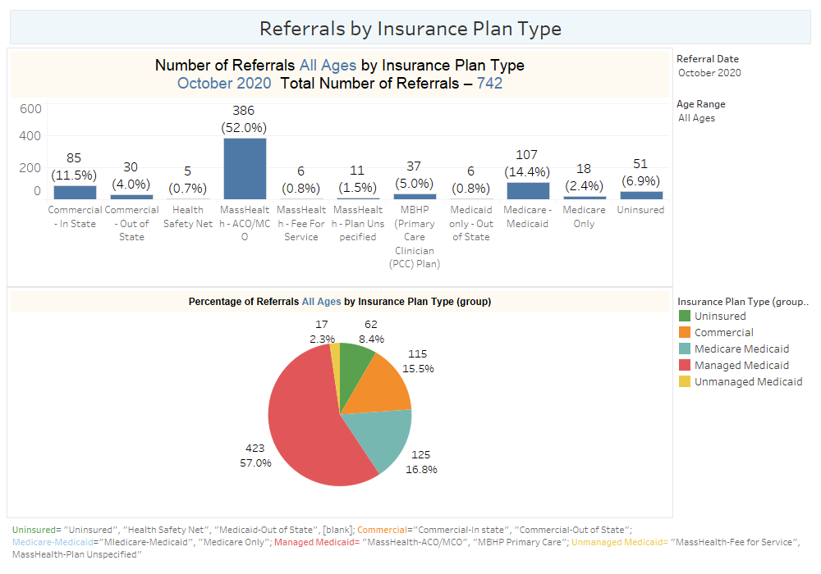

Slide 4
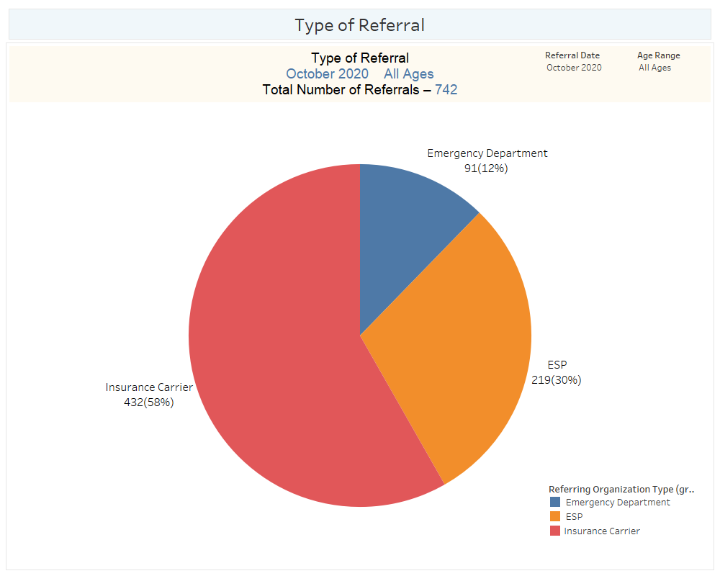

Slide 5
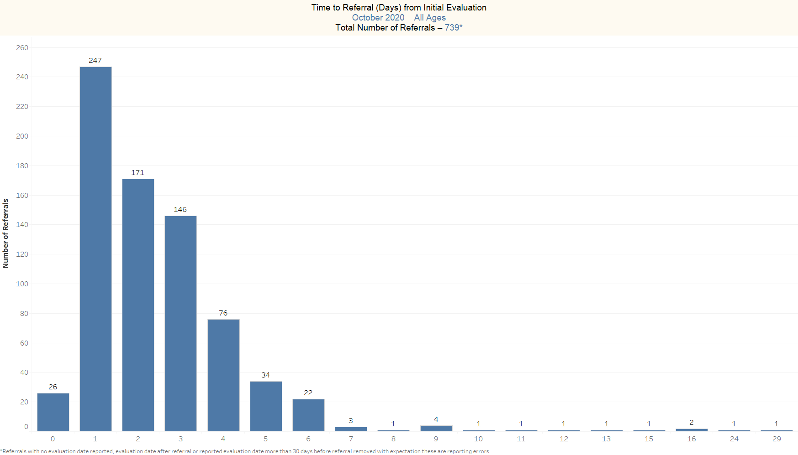

Slide 6
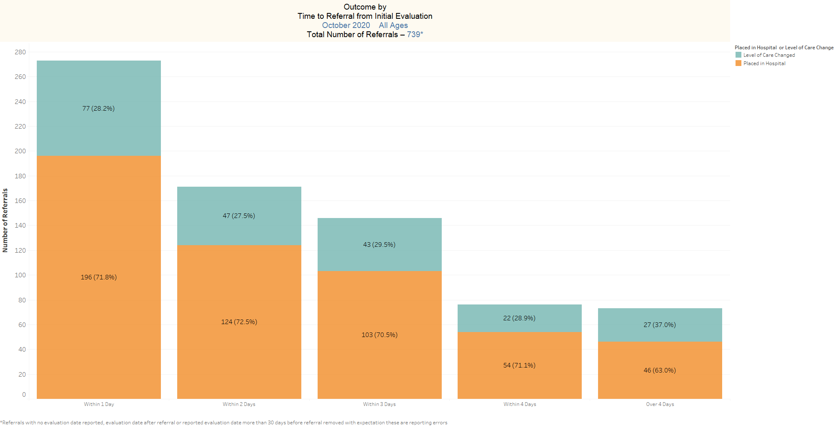

Slide 7
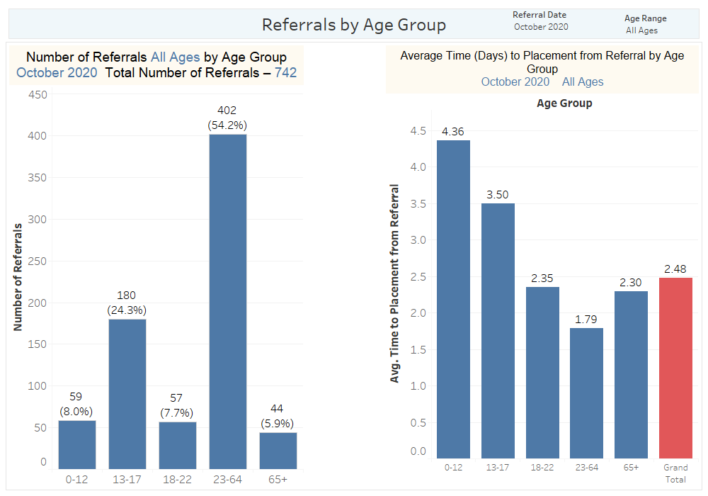

Slide 8
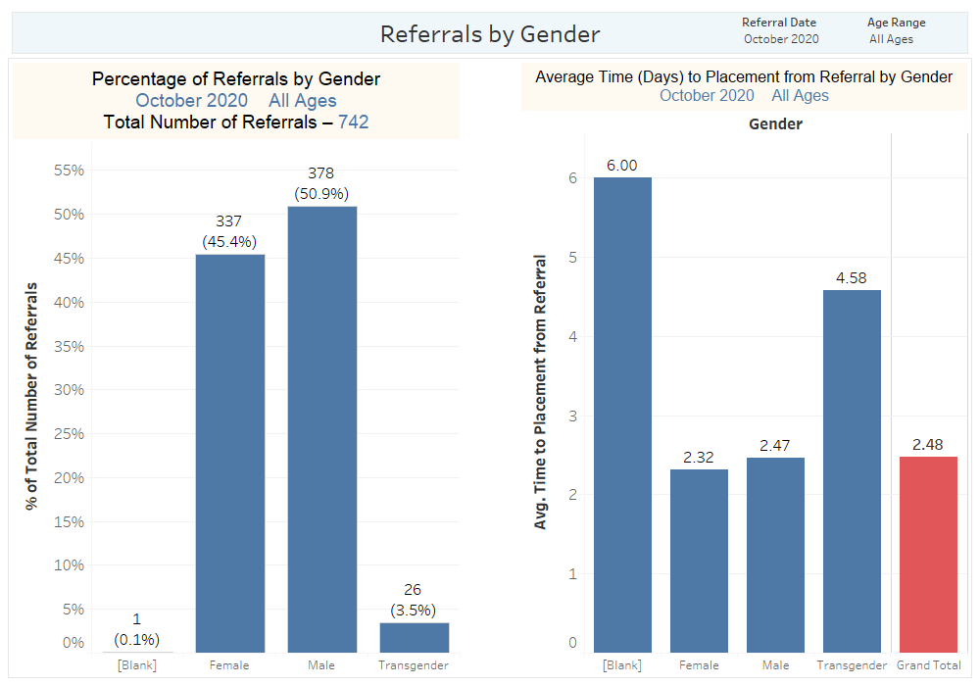

Slide 9
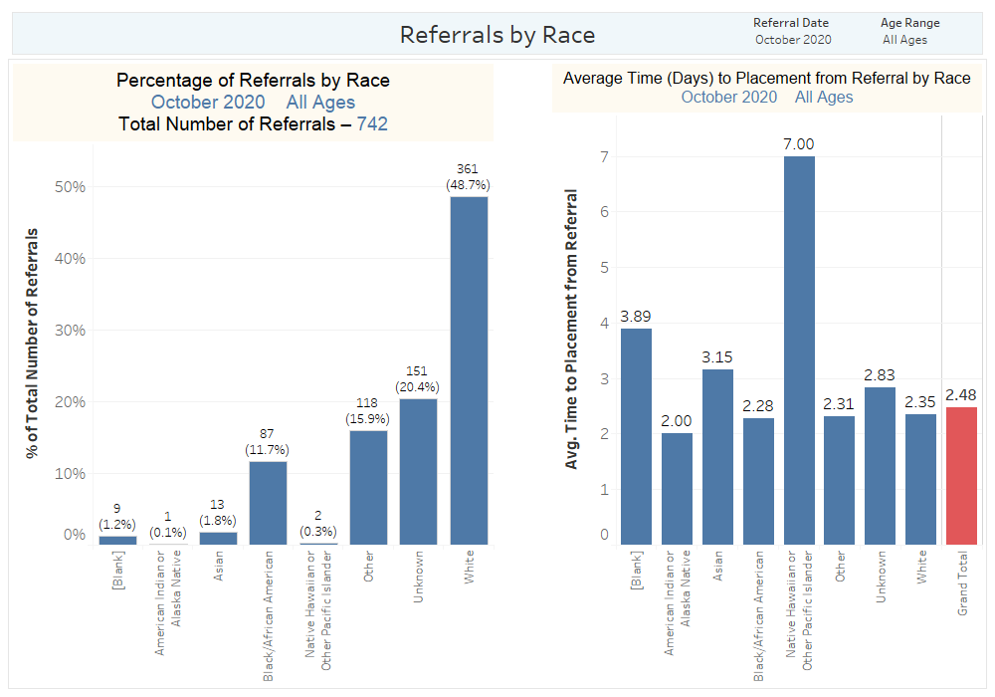

Slide 10
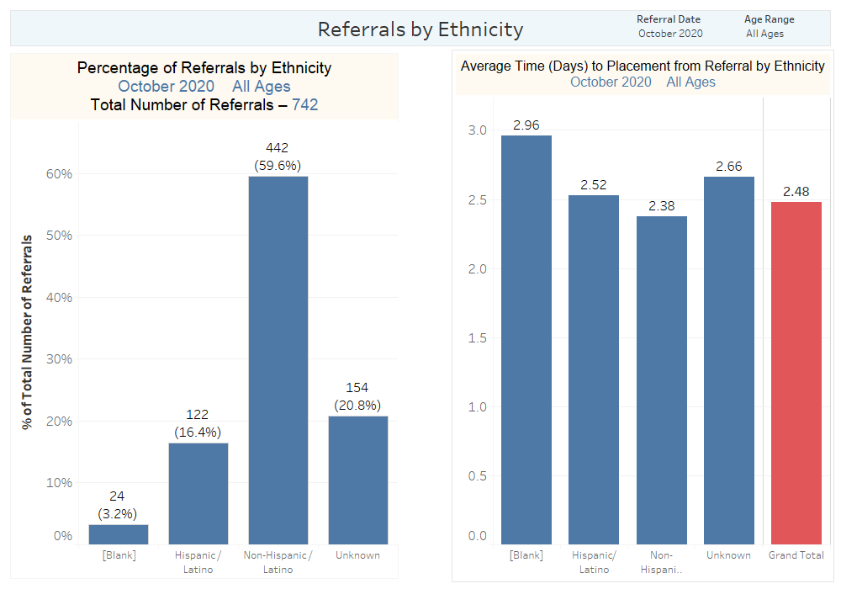

Slide 11
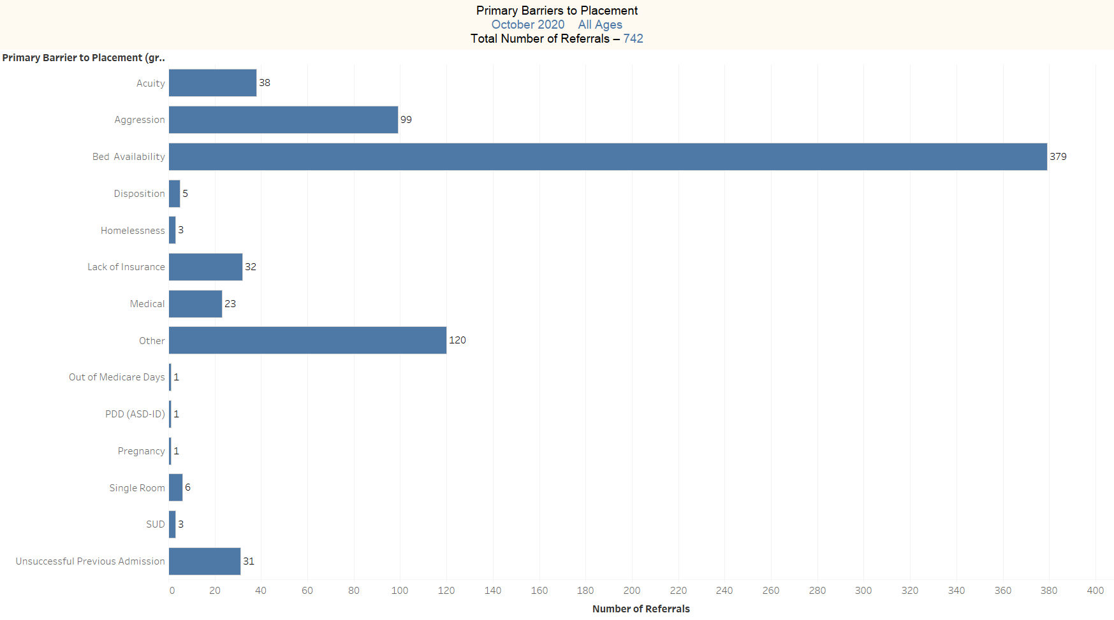

Slide 12
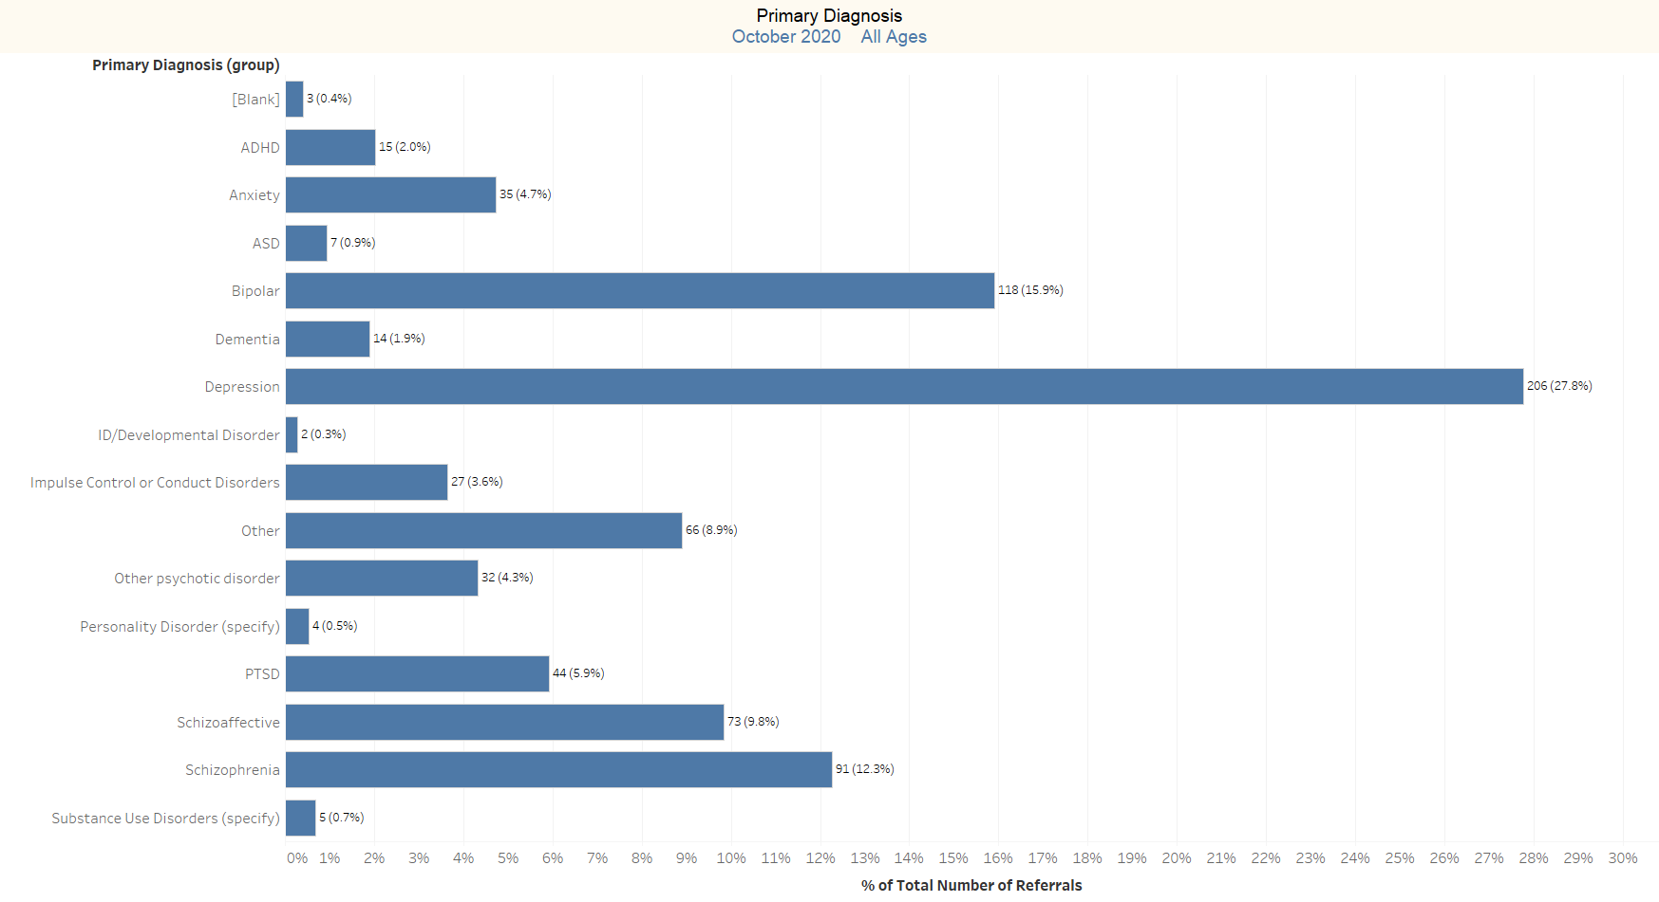

Slide 13
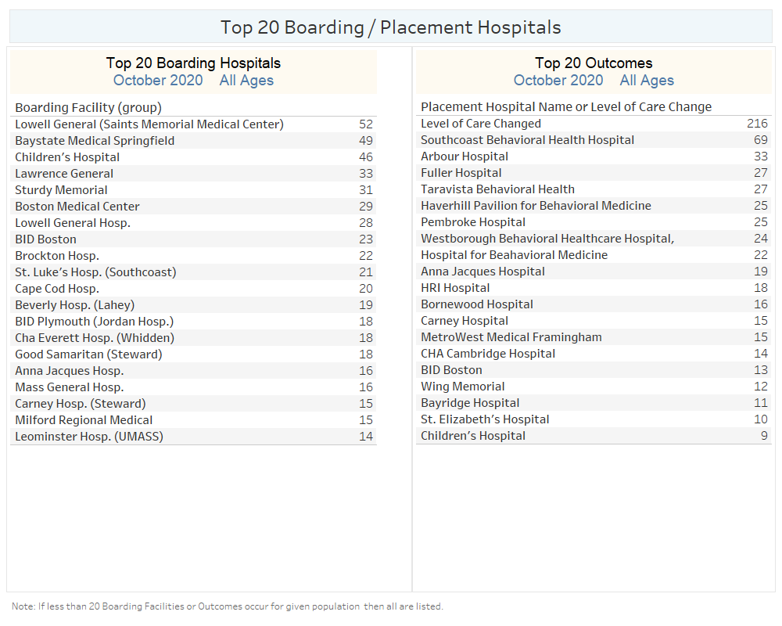

Slide 14
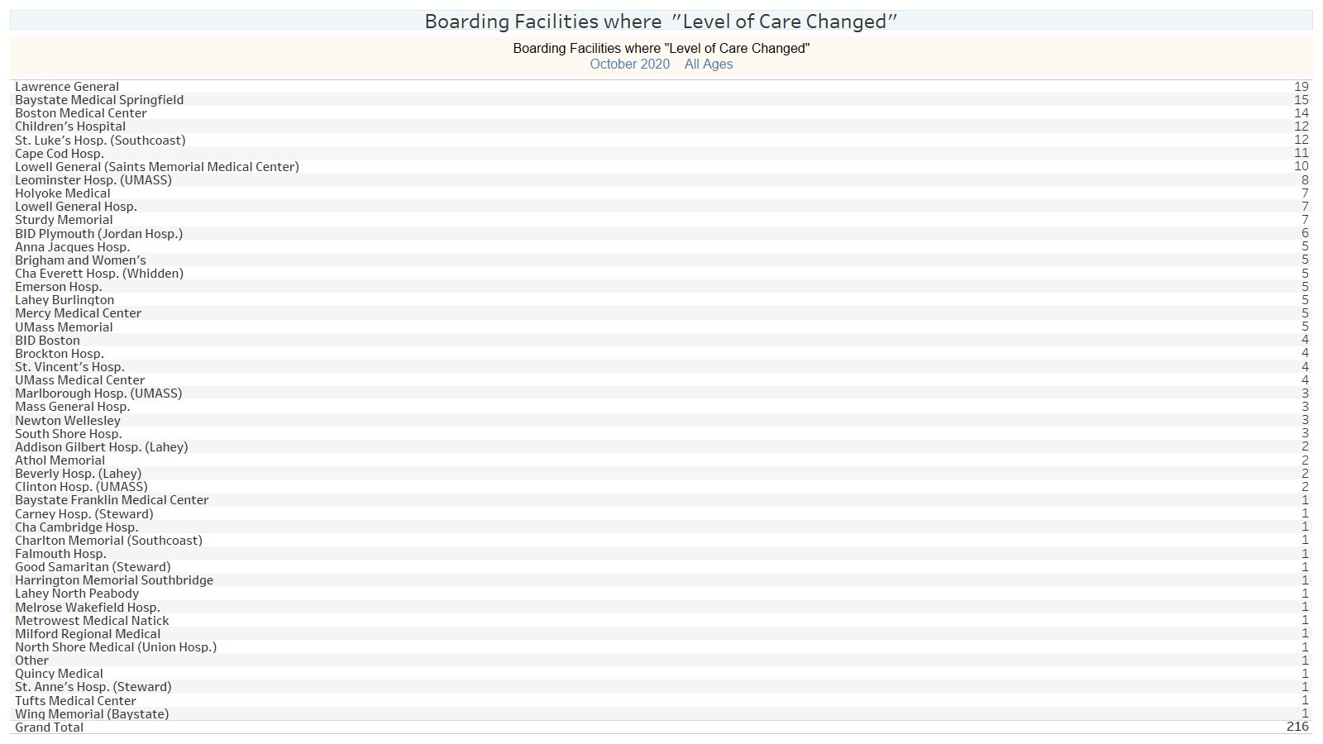

Slide 15
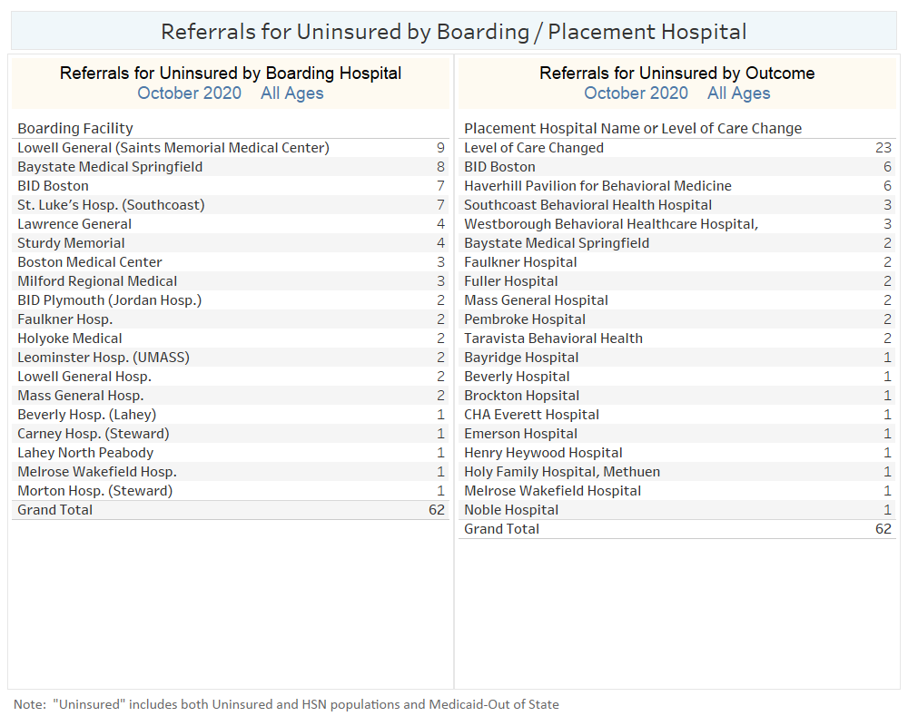

Slide 16
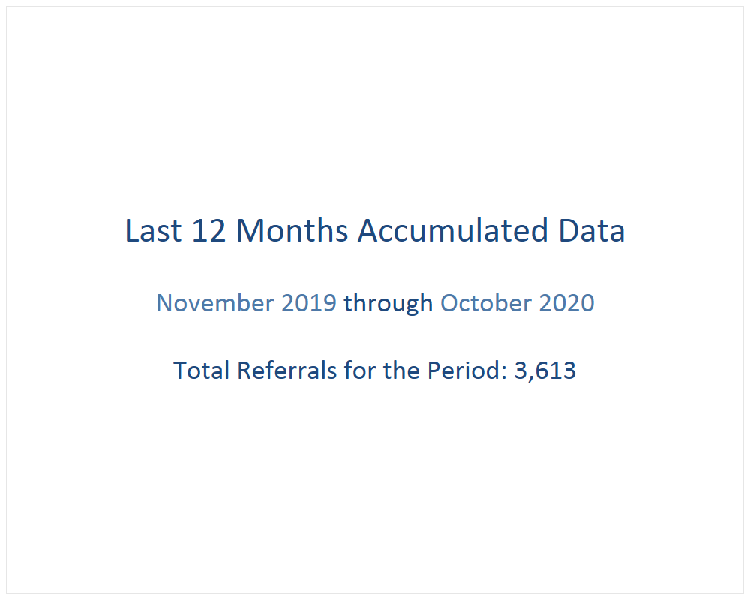

Slide 17
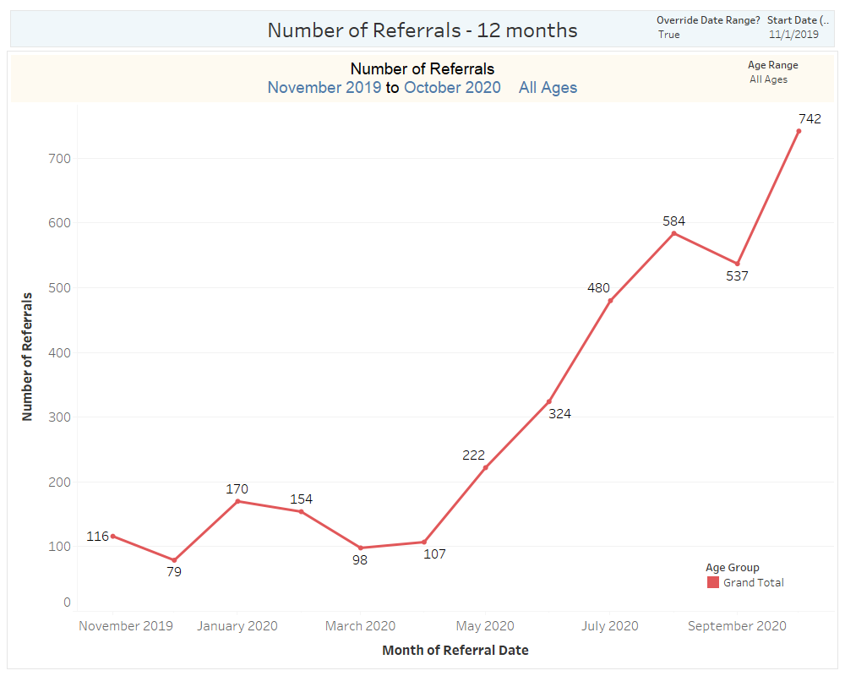

Slide 18
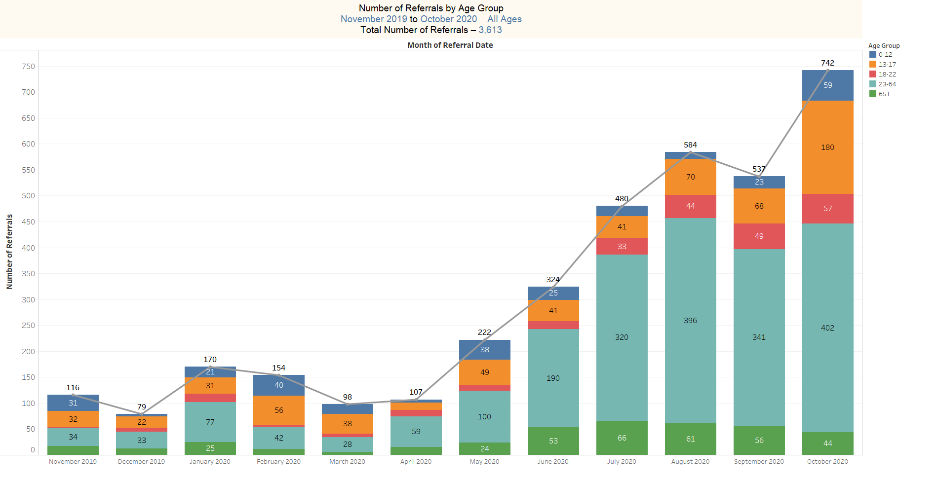

Slide 19
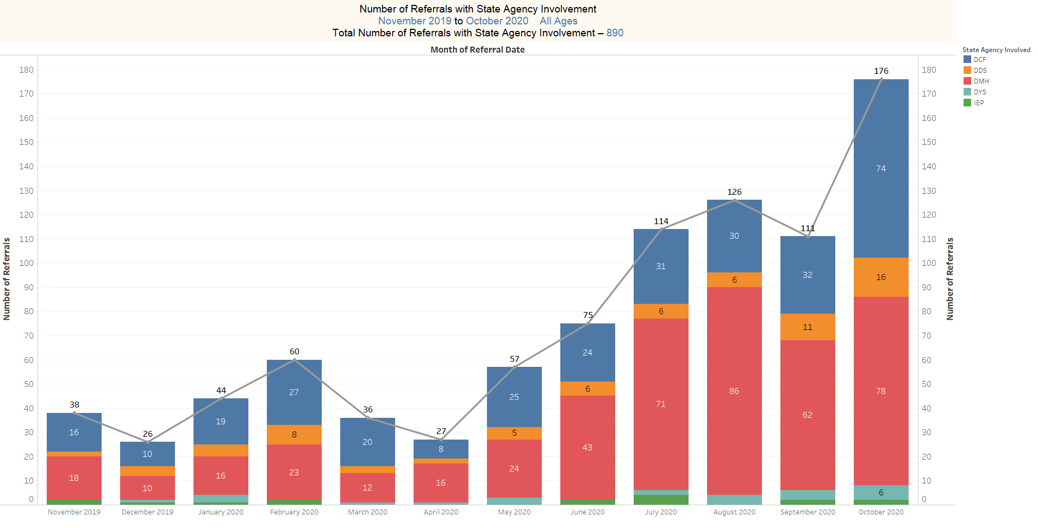

Slide 20
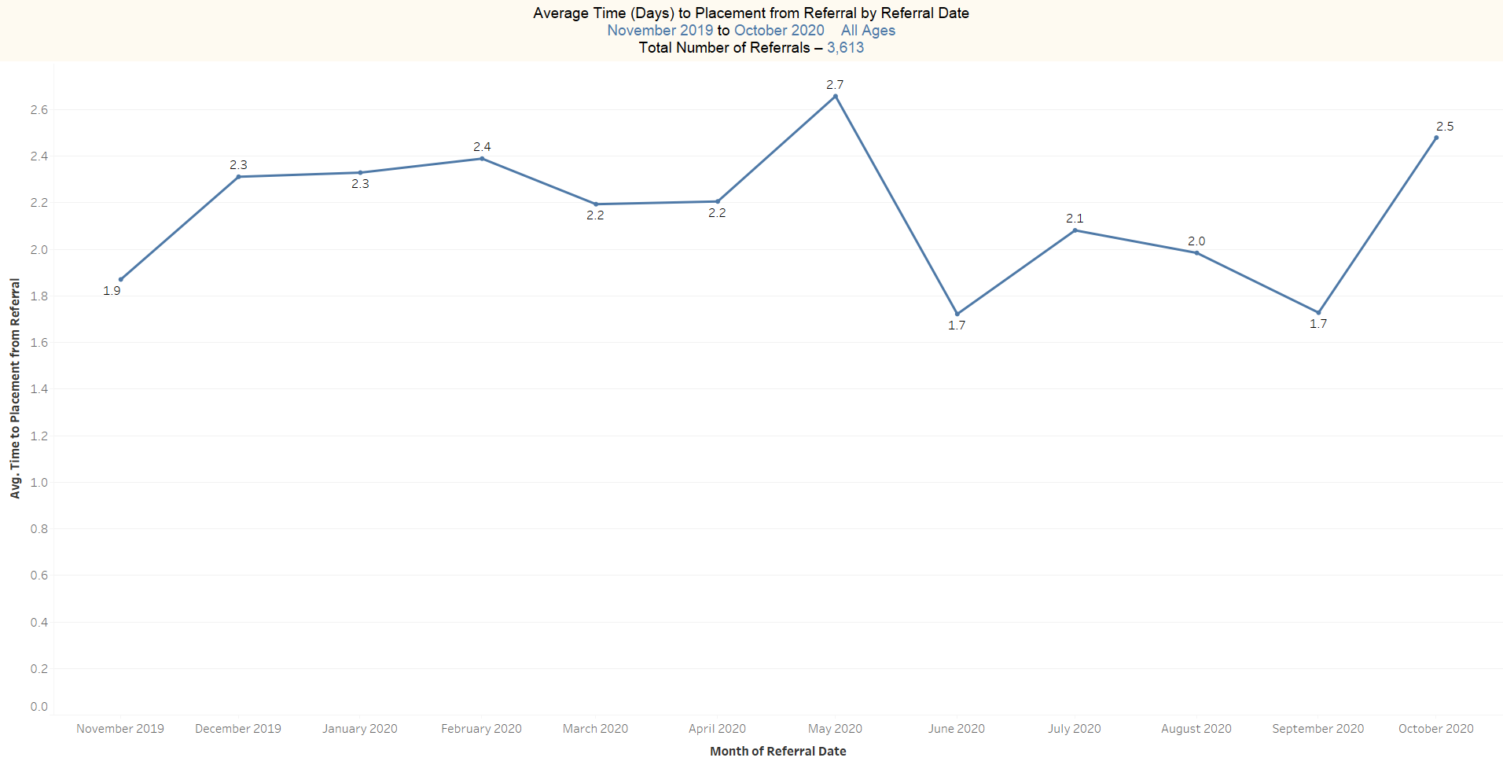

Slide 21
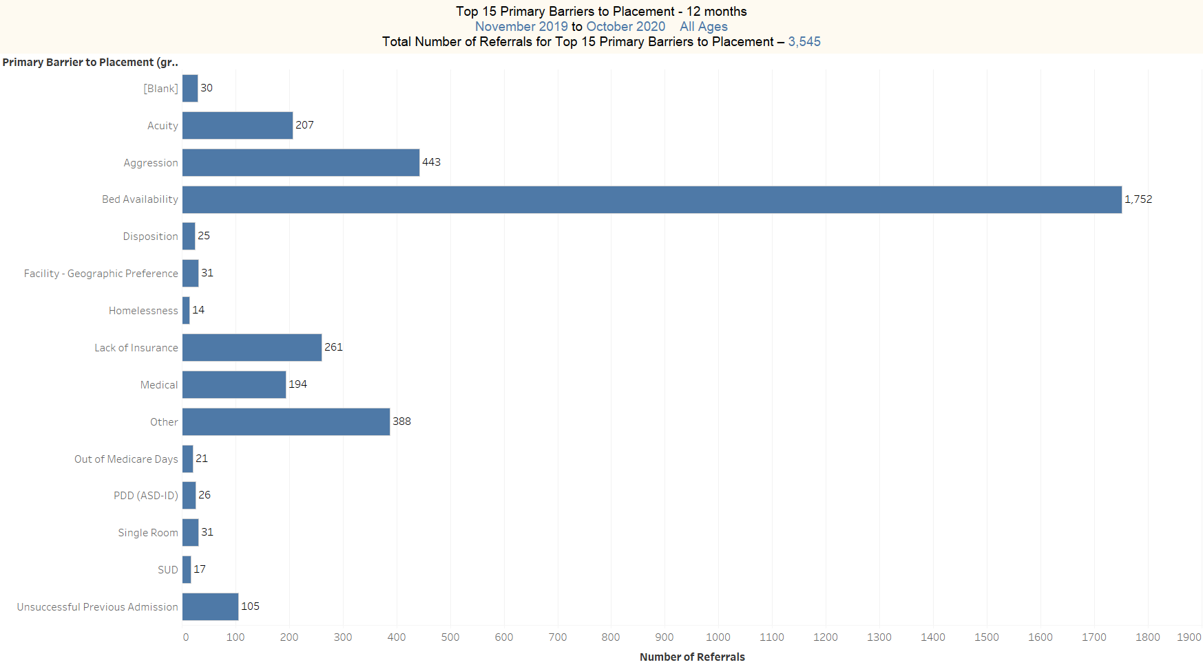

Slide 22
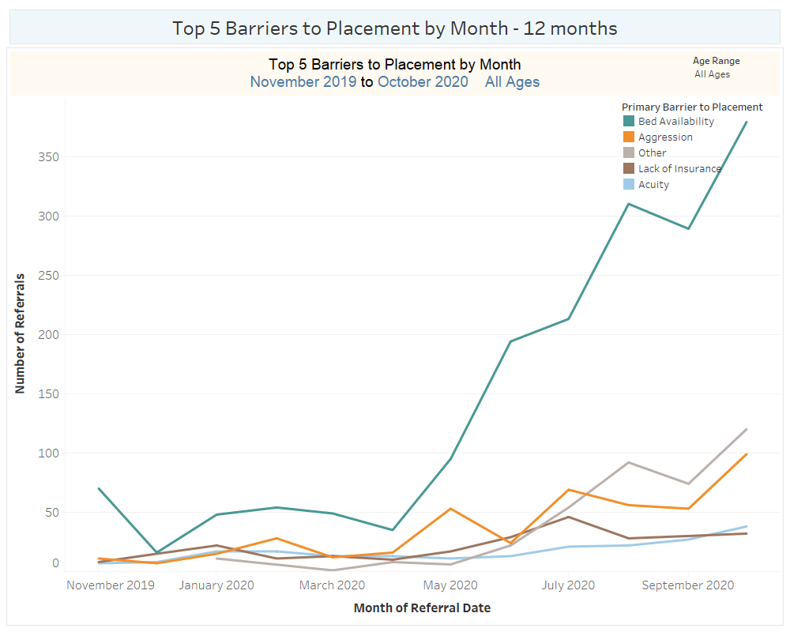

Slide 23
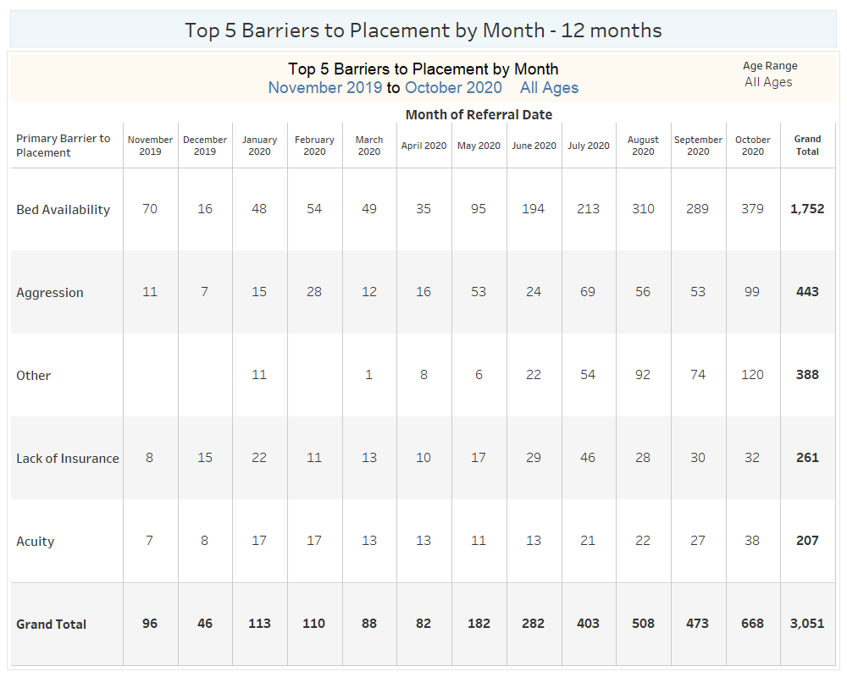

Slide 24
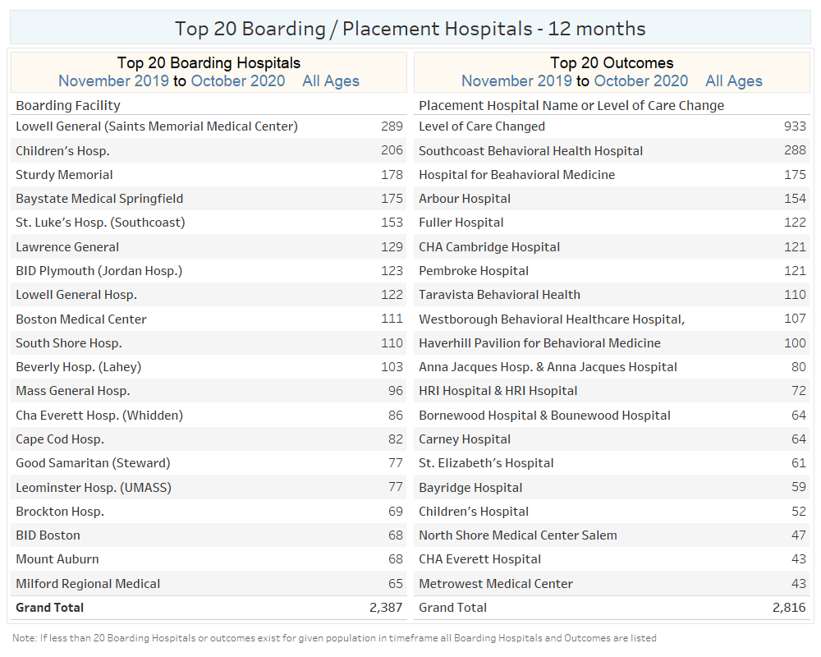

Slide 25
EPIA Repeat Boarders November 2019-October 2020

Slide 26
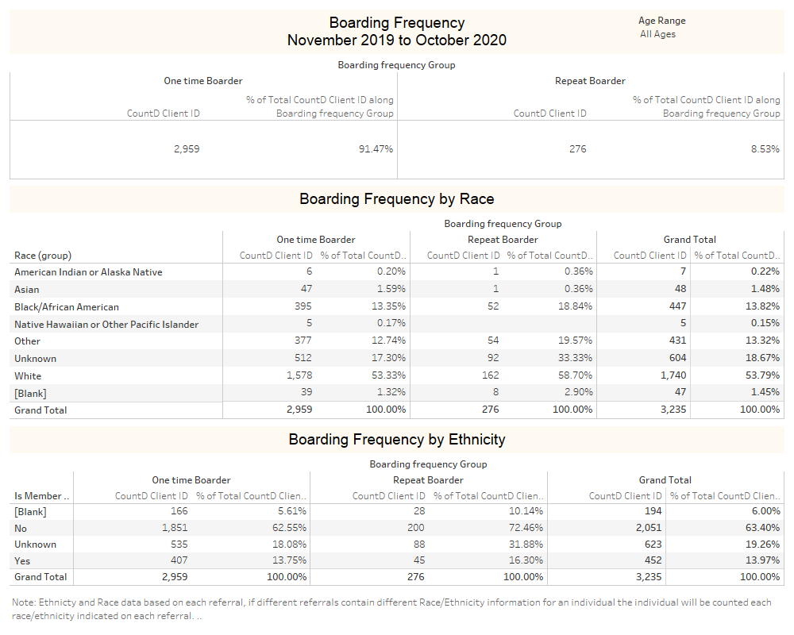

Slide 27
