Slide 1
Commonwealth of Massachusetts
WORKFORCE INNOVATION AND OPPORTUNITY ACT (WIOA)
Early session on OSCC delivery
System for Managers Summer 2015

Slide 2
AGENDA
MA Workforce System Governance
State
Local
WIOA Required Core Partners
One Stop Delivery System
Comprehensive One-Stop Center
Affiliated One-Stop Center
Specialized One-Stop Center
Applicable Career Center Services
Definitions
One Stop Operating Costs
Memorandum of Understanding
How Infrastructure Costs Are Funded
Local Infrastructure Mechanism
State Infrastructure Mechanism

Slide 3
MA Workforce System Governance – State
GOVERNOR
MA Workforce Development Board (State Board)
(51% Private Sector Majority- Required)
Executive Office Labor and Workforce Development
(EOLWD)
Appoints
State Board
Department of Unemployment Assistance (DUA)
Department of Career Services (DCS)
Commonwealth Corporation
Oversight
MA Workforce Development System
WIBs/Career Centers

Slide 4
Workforce System Governance – Region
JOINT LOCAL
GOVERNANCE
Chief Elected Official (CEO) (Grant Recipient)
LOCAL
WORKFORCE
Development BOARD
(Local Board)
(51% Private Sector
Majority- Required)
One-Stop Career Center
APPOINTS
Required Core Partners
Wagner Peyser
Adult Education (ABE/ESOL)
Voc Rehab
TANF
WIOA
WIBs charter OSCCs and build partnerships with the other entities represented in their regions.

Slide 5
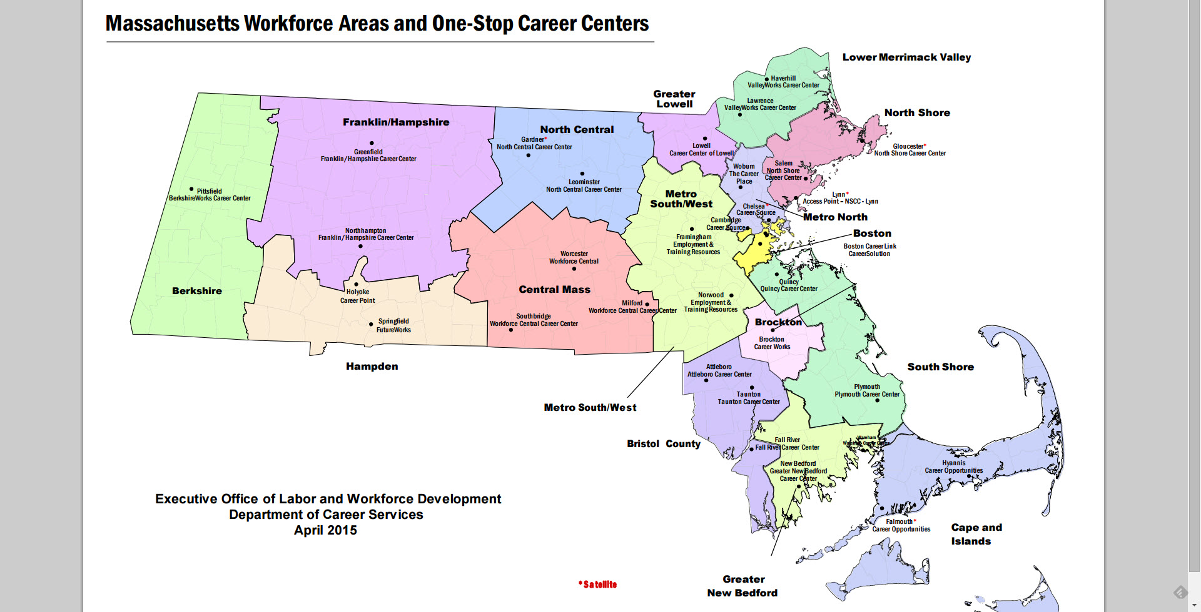
MA Workforce Regions and Career Centers

Slide 6
WIOA Required One Stop Core Partners
WIOA Title I (Adult, Dislocated Worker, Youth, MSFW, TAA)
Wagner Peyser (Employment Service) (Jobs of Veterans State Grant- JVSG)
Adult Education and Literacy
Vocational Rehabilitation
Temporary Assistance for Needy Families (TANF)

Slide 7
General Description of
One Stop Delivery System
Reaffirms the One Stop System and Career Centers as cornerstone of the public workforce system.
Requires Partners to collaborate to support a seamless customer-focused service delivery network.
Requires that programs and providers collocate, coordinate, and integrate activities and information (common intake, assessment, reporting), so that the system as a whole is accessible for individuals and businesses alike.
Ultimate goal is to increase the long-term employment outcomes for individuals seeking services, especially those with significant barriers to employment, and to improve services to businesses.
Required Partners must provide electronic access to programs, activities, and services by electronic means in addition to providing access to services at a physical location. Electronic access should supplement not supplant services.
The Description of the local one-stop delivery system must be included in the Memorandum of Understanding between partners.

Slide 8
One Stop Delivery System
The system must include at least one comprehensive physical center in each local workforce area.
The system may also have additional arrangements to supplement the comprehensive center:
An Affiliated Site
Specialized Centers that address specific needs (ie: youth, industry sectors) or a network of eligible one-stop partners, through which each partner provides one or more of the programs, services, and activities that are linked physically or technologically to an affiliated site or the specialized center.

Slide 9
Comprehensive One Stop Center
A comprehensive one-stop center is a physical location where jobseeker and employer customers can “access” the programs, services, and activities of all required partners
A comprehensive one stop center must provide:
Basic Career Services
Business Services
Access to Training Services
Access to any WIOA Employment and Training Services
Access to Employment Services
Access to Workforce and Labor Market Information
Access to Core Partners Programs and Services
Access to Unemployment Insurance
Customers must have access to these programs and services, and activities during regular business days at a comprehensive center. The Local Board may establish other services hours above and beyond regular business day hours to accommodate customer base
All Comprehensive One Stop Centers must be physically and programmatically accessible to individuals with disabilities.

Slide 10
Affiliated One Stop Center
An Affiliated One Stop Center is a site that makes available to jobseeker and employer customers one or more of the one-stop partners’ programs, services, and activities
An Affiliated site does not need to provide access to every required one-stop partner program
The frequency of program staff’s physical presence in the Affiliated site will be determined at the local level
Affiliated sites are access points in addition to the Comprehensive One-Stop Center in the local workforce area
An Affiliated site should be implemented in a manner to supplement and enhance customer access to services.
If Wagner Peyser Employment Services are provided at an Affiliated site there must be at least one other partner physically present more than 50 percent of the time the center is open. The other partner may not be JVSG or UI staff.
All Affiliated One Stop Centers must be physically and programmatically accessible to individuals with disabilities

Slide 11
Specialized One Stop Center
A Specialized One Stop Center is a Center set up to address specific needs, including those of dislocated workers, youth or key industry sector, or clusters
A Specialized Center must be connected to the comprehensive and any affiliated one – stop center (such as referral process)
Wagner Peyser Employment Services cannot stand alone in Specialized Centers
Specialized Centers must include other programs besides WP, JVSG or UI
All Specialized One Stop Centers must be physically and programmatically accessible to individuals with disabilities

Slide 12
Applicable CAREER SERVICES
One Stop Career Centers provide services to individual customers based on individual needs, including seamless delivery of multiple service to individual customers
There is no required sequence of services
The applicable Career Services that must be provided through the one-stop delivery system by required partners include:
Basic Career Services
Individualized Career Services
Business Services
Follow-up Services

Slide 13
BASIC CAREER SERVICES
Basic Career Services must be made available and at a minimum include:
Eligibility determination
Initial Assessment of skills level
Orientation to full array of programs and services (CCS)
Intake
Outreach
Job Search Placement Assistance
Career Counseling
Provision of information on in demand industry sectors and occupations
Referrals to and coordination with other workforce development programs
Provision of Labor Market Information
Provision of information on Eligible Training Providers
Provision of information on job openings and skills required
Provision of information and assistance regarding filing UI Claim
Promotes use of social media as a career service tool

Slide 14
INDIVIDUALIZED CAREER SERVICES
Individualized career services must be made available if determined to be appropriate in order for an individual to obtain or retain employment. These services include the following services:
Comprehensive and Specialized Assessments
Development of and Individual Employment Plan
Internships and Work Experiences
Workforce preparation activities
Financial literary services
Out-of-area job search assistance
English language acquisition and integrated education & training programs

Slide 15
BUSINESS SERVICES
Business Engagement in local service delivery model
Appropriate recruitment and referrals
Clear Understanding of Hiring Needs
Provision of information on specialized services available (MassBizWork$)
Promote use of industry and sector partnerships to address workforce needs of multiple employers within an industry
Promotes and funds proven strategies: incumbent worker training, registered apprenticeship, OJT, customized training, transitional jobs

Slide 16
FOLLOW – UP SERVICES
For participants in adult or dislocated worker workforce investment activities who are placed in unsubsidized employment, follow-up services must be provided, as appropriate, including: counseling regarding the workplace, for up to 12 months after the first day of employment.

Slide 17
Important Definitions
“Electronic Means” includes Web sites, social media, internet chat features, and telephone
“Access” to programs and services means having either: Program staff physically present at the location; having partner staff physically present trained to provide information to customers about Partner programs or services; or providing direct linkage through technology to program staff who can provide meaningful information or services
“Direct Linkage” means providing direct connection at the one-stop, within a reasonable time, by phone or through real-time Web-based communication to a program staff member who can provide information or services to the customer
“Direct Linkage” does not mean providing a phone number or computer Web site that can be used at an individual’s home; providing information, pamphlets, or materials; or making arrangements for the customer to receive services at a later time or on a different day.
“Meaningful Assistance” means providing assistance on-site using trained staff, providing assistance by phone or via other technology, as long as the assistance is provided by trained staff in a reasonable time.

Slide 18
One Stop Operating Cost
Each partner that carries out a program or activities in a local one-stop center must use a portion of the funds available for the program and activities to maintain the one-stop delivery system including payment of infrastructure costs
Infrastructure costs of one-stop centers are non personnel costs that are necessary for the general operation of the one-stop center including
Premises Costs
Utilities and maintenance
Equipment (including assessment related products and assistive technology for individuals with disabilities)
Technology to facilitate access to one-stop center, including planning and outreach
Payment of infrastructure costs must be in accordance with Federal cost principles, which require that all costs must be allowable, reasonable, necessary, and allocable to the program; and all other applicable legal requirements.

Slide 19
Local Memorandum of Understanding (MOU)
The MOU is the product of local negotiation, and is an agreement developed and executed between the Local Board, with the agreement of the CEO and One-Stop Partners
The infrastructure funding terms will be defined within the local Memorandum of Understanding (MOU) and signed by all parties
The MOU will:
Provide a description of services to be provided through the one-stop delivery system, including the manner in which the services will be coordinated and delivered through the system
Ensure that one-stop partners adhere to State guidance on one stop delivery system infrastructure costs
Address how one-stop partners will achieve consensus and informally mediate any possible conflicts or disagreement among partners
Address how technical assistance to new one-stop partners and local grant recipients will be provided by local board and CEO to ensure partners are informed and knowledgeable of the elements contained in the MOU
Reflect a funding mechanism that meets the requirements of each program’s relevant statutes and regulations
The MOU may include interim plan if needed, on how costs of the services will be funded

Slide 20
How are Infrastructure Cost Funded
Infrastructure costs are funded either through:
A local one-stop infrastructure funding mechanism determined by a local agreement between Local Board, Chief Elected Official (CEO) and one stop partners;
or
A State one-stop infrastructure funding mechanism set by the Governor, after consultation with the CEOs, Local Board and State Board determines the one stop partner contributions

Slide 21
Guidance on Infrastructure Funding
The Governor, must develop and issue guidance for use by local areas to determine funding for the cost of infrastructure; and to assist Local Boards, CEOs and One-Stop Partners in determining equitable methods of funding the costs
The guidance must include:
The appropriate role of one-stop partner programs in identifying one-stop infrastructure costs
Approach to facilitate equitable cost allocation methodology
Timelines regarding notification to the Governor for not reaching local agreement that will trigger State- Infrastructure Funding Mechanism

Slide 22
Local One-Stop Infrastructure Costs Funding Mechanism
In the local One-Stop infrastructure costs funding mechanism; the Local Board, CEO and one-stop partners agree to amounts and methods of calculating amounts each partner will contribute for one-stop infrastructure costs
The infrastructure costs are funded through cash and fairly evaluated in-kind partner contributions
The infrastructure costs should include any funding from philanthropic organizations or other private entities or through alternative financing options (to provide stable equitable funding stream of on-going one-stop delivery system operations)
Contributions must be negotiated between the Local Board, CEOs and One-Stop Partners
One-Stop Partner’s program proportionate share of funding must be based upon a reasonable cost allocation methodology whereby costs are charged to each partner in proportion to relative benefits received, and must be allowable, reasonable, necessary and allocable
Partner shares must be periodically reviewed and reconciled against actual costs incurred

Slide 23
State One-Stop Infrastructure Costs Funding Mechanism
In the State One-Stop infrastructure costs funding mechanism, the Governor consults with State & Local Boards & CEOs and determines the level of contribution by one-stop partners in order to ensure:
Infrastructure costs will still be funded if partners cannot agree
Each one-stop partner will contribute a proportionate share
Consistency with new Uniform Federal cost principles (COFAR)
Limitations for the partner contributions are based upon a percentage of their funding allocation
CAP takes into consideration the PY/FY funding basis and program limitations
Governor may direct local partners to re-enter negotiations to resolve shortages
Failing agreement, the Governor will reduce area’s infrastructure allocation
These limitations do not apply to the local one-stop funding mechanisms
State Board determines how contributed funds will be allocated out to local areas and will allocate those funds only to areas without local funding mechanisms

Slide 24
Workforce System Infrastructure Funding
Infrastructure Costs are determined by:
Local One-Stop Infrastructure funding mechanism
or
State Infrastructure funding mechanism
WIOA Title I
Adult
REA
WIOA
Title I Youth
UI
WIOA Title I Dislocated Worker
WIB
Career Center
ABE
VOC REHAB
Federal Discretionary Grants
NEGs
TANF
Wagner
Peyser
Jobs for Veteran
State Grant
(JVSG)
DOL Funding
ABE Funding
Voc Rehab Funding
TANF Funding

