Slide 1

Commonwealth of Massachusetts
Executive Office of Labor and Workforce Development
Opioid Alternative Treatment Pathway
Department of Industrial Accidents/
Senior Judge Omar Hernández
June 12 2017

Slide 2

Opioid Alternative Treatment Pathway
Too many injured workers in Massachusetts become addicted to prescription opioids. The Department of Industrial Accidents recognized that its current litigation process often failed to adequately address this problem. Therefore, DIA is launching a pilot program called the Opioid Alternative Treatment Pathway (OATP) to address the problem in a timely manner.
  The Opioid Alternative Treatment Pathway would be available in DIA cases where injured workers have settled Workers’ Compensation claims but continue to treat with opioids, and where insurers seek to discontinue payment for the continued use of opioids.
  There are approximately 75-100 DIA cases each year in which insurers seek to discontinue medical treatment or opioids. These cases currently take, on average, a year to settle, while the injured worker continues the use of opioids.
  DIA has reviewed 600 post-lump sum cases filed between Jan. 2015 and July 2016 where the claim was for medical treatment only. Of these injured workers 102 were on opioid-based pain medication and an additional 28 were taking other narcotic pain medications as part of their treatment.

Slide 3
Opioid Alternative Treatment Pathway
Either the Insurer or injured worker can initiate a request to participate in the Opioid Alternative Treatment Pathway. If both parties agree to participate, the insurer incurs the cost of the program including alternative medical treatments for the injured worker.
The DIA incurs minimal cost for the program – staff/ scheduling.
The program aims to be another tool to address the state’s opioid epidemic by giving attorneys, judges, and injured workers within the DIA system quicker access to medical professionals to make treatment decisions.
Massachusetts would be the first Workers’ Compensation system in the country to implement an Opioid Alternative Treatment Pathway (OATP).

Slide 4



Current Process
Many injured workers who have been prescribed opioids, or other pain killers, often find themselves dependent on these drugs.
After spending thousands of dollars on prescription drugs, insurers often move to discontinue opioid treatment, arguing it is not improving the underlying injury.
To stop paying for pain medication, the insurer files a complaint to modify or discontinue medical benefits. The worker may file a claim seeking continuation of medical benefits (pain killers).
Process start to finish can take over one year!
Traditional Dispute
Resolution begins - the conciliation is scheduled
within 14 days.
Conference – A conference before an Administrative Judge (AJ) takes place 8 to 10 weeks after the conciliation. Since AJ are not medical prescribers they are reluctant to terminate or modify drug prescriptions at conference level. The binding order of the AJ is often appealed in these matters.
Hearing - Following an appeal of the conference order, the worker is examined by a DIA-appointed physician and the matter is subsequently scheduled for hearing. The timeframe between conference and hearing is 6-8 months. A year has passed.

Slide 5
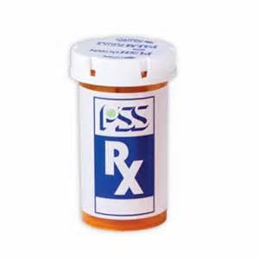

Proposed Opioid Alternative Treatment Process
Traditional DR
OATP
The injured worker continues to need opioids to manage pain and the insurer seeks to end payment of those medications.
The insurers will often initiate the process to discontinue such treatment as it is very expensive and does not improve the worker’s health or quality of life.
Under the new Opioid Alternative Treatment Pathway, either party may request this alternative dispute resolution but both parties have to agree to participate.
Injured Workers would be assigned a care coordinator within 30 days!
OATP Begins
Initial Meeting – The DIA will assign the case to an AJ who will meet with the parties within 30 days. The goal of the initial meeting is to formulate and memorialize an understanding of the OATP goals; the procedure to follow in reaching goals; and the obligations of the parties with regard to participation, payments, time frames, costs, and fees.
Care Coordinator – Injured workers who agree to enter the program will be assigned a specialized nurse (care coordinator), who will oversee care. Insurers will incur costs of the specially qualified nurse.
Move worker away from medication-based treatment – The care coordinator will seek to find viable treatment alternatives to manage worker’s pain without addictive narcotics. Should the process be unsuccessful, either party can unilaterally withdraw and reenter DIA’s traditional dispute resolution process.

Slide 6
Opioid Alternative Treatment Pathway
OBJECTIVES:
Dramatically improve quality of care for those suffering with chronic pain conditions.
Reduce time required to resolve clinical disputes.
Reduce pain, suffering and side effects associate with inappropriate opiate prescribing.
Provide attorneys, hearing officers, judges and injured workers with better tools for appropriate decision-making.

Slide 7
Opioid Alternative Treatment Pathway
The new pathway may be accessed through new online forms: Forms 110A and 108A, either of which will allow the parties to express a desire to explore the Pathway with the filing of their claim or complaint.

Slide 8
Opioid Alternative Treatment Pathway
If the parties agree that they are interested in entering the OATP, then the case will be forwarded to Dispute Resolution with a notation that the parties want to explore the OATP.
Within thirty (30) days a Mediating Judge will be assigned and the parties will then have their first meeting, during which they will begin to negotiate and enter into a Form 19A agreement.

Slide 9
Opioid Alternative Treatment Pathway
The goal of the initial meeting and the initial Form 19A is for the parties to formulate and memorialize their understanding of the initial goals in entering into the OATP, the procedure they plan to follow in reaching those goals; and the obligations of the parties with regard to participation, payments, time frames, costs, and fees.

Slide 10
Opioid Alternative Treatment Pathway
The Employee will execute a comprehensive Medical Authorization and Release at or before the time he or she signs the initial Form 19A and will execute any additional medical authorizations for relevant records as required by the Mediating Judge.
In recognition of the complexities of treating individuals with long-term opioid use, the Medical Authorization and Release will cover the release of medical records and mental health treatment records.

Slide 11
Opioid Alternative Treatment Pathway
The Mediating Judge will have the authority to grant orders for the release of medical records from providers, as warranted. A §13A(3) fee will be due to the Employee’s counsel upon approval of the initial Form 19A by the Mediating Judge.

Slide 12
Opioid Alternative Treatment Pathway
At any time after entering into the OATP, the parties will have the option of leaving the OATP and moving back into the traditional litigation track.
Regardless of how long they have been working through the OATP, or what progress they had reached toward their goals, if either party requests a return to the traditional litigation track, then the case will be removed from the OATP and placed in the queue for a Conference with a different Administrative Judge.

Slide 13
Opioid Alternative Treatment Pathway
The Administrative Judge will not be permitted to inquire about, or make any assumptions or inferences about participation in the OATP or the return to traditional litigation.
The Mediating Judge will retain jurisdiction over the case until the OATP is completed or the case returns to a traditional litigation track. If the case returns to the OATP system in the future, the case may return to the same Mediating Judge.

Slide 14
Opioid Alternative Treatment Pathway
Once the initial Form 19A is signed and approved by the Mediating Judge, the insurer will incur the cost of a specially qualified nurse with knowledge and experience in dealing with issues relating to the long-term use of natural and synthetic narcotics to be the Care Coordinator for the Employee.

Slide 15
Opioid Alternative Treatment Pathway
The Care Coordinator may assist the Employee:
in finding new practitioners in a variety of specialties;
with research into alternative treatment options;
in the coordination of interdisciplinary care;
in scheduling appointments, and;
in navigating the path forward toward the goals set by the parties and memorialized in the Form 19A.

Slide 16
Opioid Alternative Treatment Pathway
The Insurer will pay the costs associated with the Care Coordinator and with treatment, at board rates, in accordance with the agreement of the parties as set forth in the Form 19A.
If need be, a new Form 19A may be negotiated, signed, and approved by the Mediating Judge at any time during the OATP if the parties agree that the original Form 19A is no longer an adequate reflection of the goals and agreements of the parties.

Slide 17
Opioid Alternative Treatment Pathway
When the goals of the Form 19A have been met to the satisfaction of the parties, a final Form 19A will be signed by the parties and approved by the Mediating Judge.
That final Form 19A will set forth the obligations of the parties going forward, with regard to ongoing treatment and payments and with any appropriate time frames.

Slide 18
Opioid Alternative Treatment Pathway
If a treatment plan established through the OATP is to remain in place and progress forward, then the parties should so state in the final Form 19A and specific goals and guidelines should be established in that final Form 19A.
Upon completion of a final Form 19A, the case will be marked “adjusted” and the Employee’s attorney will be paid an attorney’s fee in accordance with G.L. c. 152, §13A(3).

Slide 19
Opioid Alternative Treatment Pathway
This pilot program will run for two years:
  Status updates will be given on a monthly basis to EOLWD and Workers Comp Advisory Council.
  Tracking will be managed by the DIA scheduling unit (positions are already funded).
  A committee will be formed for consultation purposes consisting of stakeholders representing:
    Injured Employees, attorneys that represent them
    Insurers
    Physicians/ Medical personnel
    Alternative treatment community
    EOLWD/DIA
    EOHHS
  Stats will be measured and recorded on a quarterly basis

Slide 20
Opioid Alternative Treatment Pathway
  Metrics that will be used:
    How many employees discontinue the use of opioids
    How many cases enter the pilot
    How many parties opt out and return to the normal litigation process
    Reductions in prescription amounts and corresponding alternative care changes
    Average length of time to resolve cases
    Average cost to insurers (the average cost of continued opioid use compared to the average cost of treatment)
  Vermont and New Hampshire are interested in modeling the pilot.

Slide 21
Appendix

Slide 22
¹Unintentional poisoning/overdose deaths combine unintentional and undetermined intents to account for a change in death coding that occurred in 2005. Suicides are excluded from this analysis.
² Opioids include heroin, opioid-based prescription painkillers, and other unspecified opioids. This report tracks opioid-related overdoses due to difficulties in identifying heroin and prescription opioids separately.

Slide 23
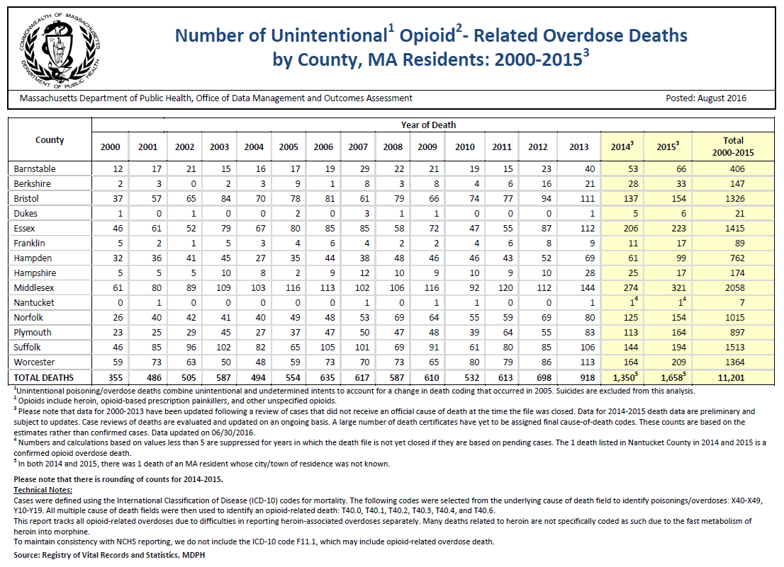
Unintentional Opioid Deaths in Massachusetts 2000-2015

Slide 24
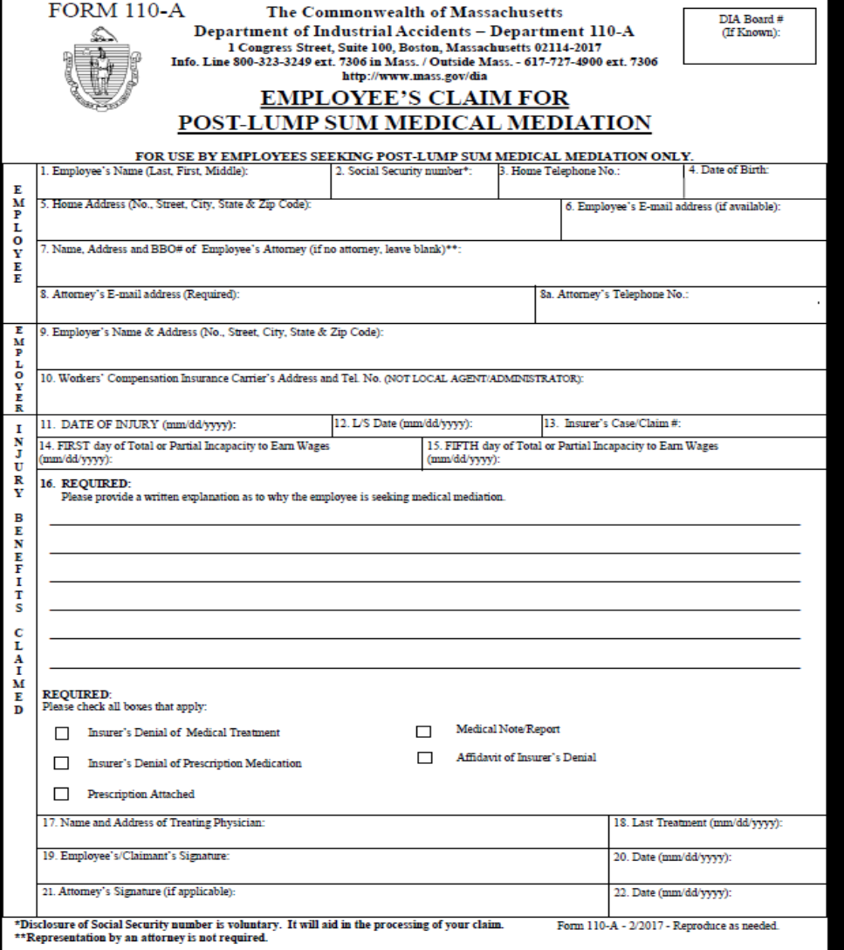

Slide 25
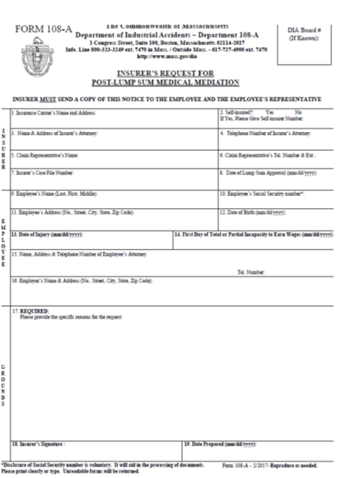

Slide 26
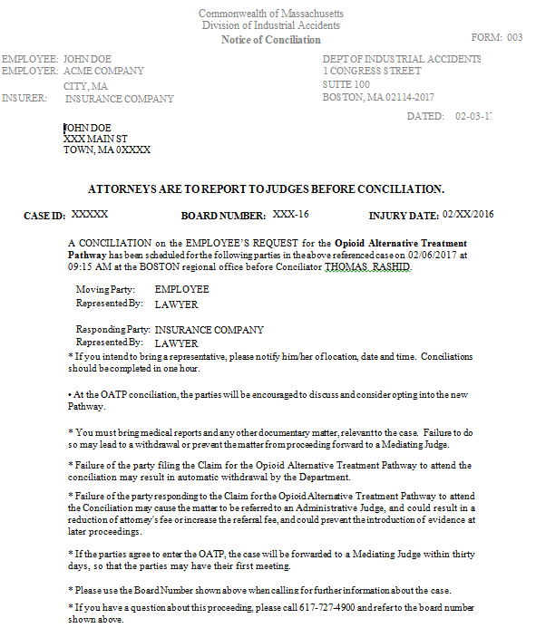

Slide 27
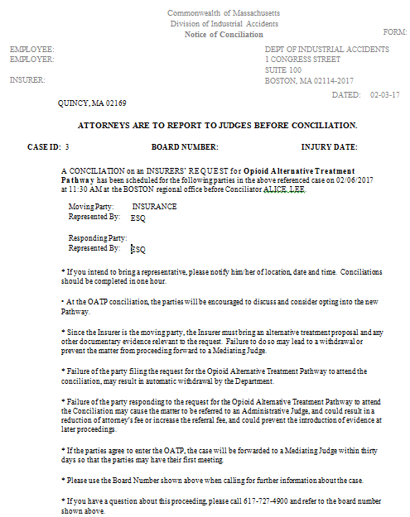

Slide 28
Summary
OATP applies to post-Lump Sum cases
Insurer and Employee counsel agree that current clinical regime is not working.
Key questions for all parties:
  Is current diagnosis accurate?
  Is current treatment plan appropriate for diagnosis?
  What treatment changes should be considered?
  What other therapeutic approaches might be beneficial for the injured worker/patient?
  What are the current risks of the current treatment plan?
  What are the potential barriers to recovery?

