Slide 1
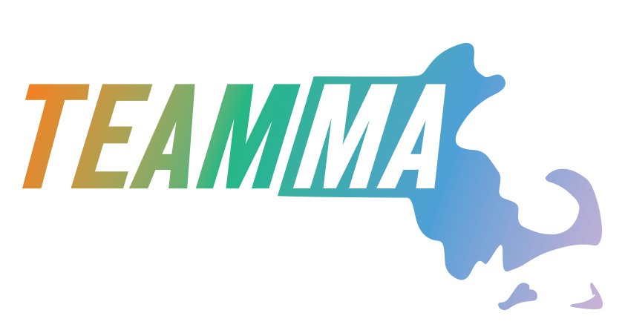
Office of Performance Management & Oversight
Massachusetts Life Sciences Center
Fiscal Year 2025 Report

Slide 2
Agency Goals
Mission: The Massachusetts Life Sciences Center is an economic development and investment agency with a mission of supporting the growth and development of the life sciences in Massachusetts. Through public-private funding initiatives, the Massachusetts Life Sciences Center supports innovation, research and development, commercialization, and manufacturing activities in the fields of biopharma, medical device, diagnostics, and digital health. As a quasi-public agency, Massachusetts Life Sciences Center also offers programs that fund innovation-driven economic and workforce development initiatives in Massachusetts.
Agency Goal 1: Increase investments in innovation infrastructure and maintain cutting-edge capabilities of previous capital investments.
Agency Target for Goal 1: Deploy at least 50 (in new and previously committed projects) community-accessible capital grants that involve at least 15 research universities, academic medical centers, research institutions and incubators for life sciences lab equipment, facilities, and other scientific infrastructure in the areas of biomanufacturing, neurology, microbiome, women’s health, novel therapeutics, and big data. Outputs from these investments should yield at least 30 scientific publications and 5 pieces of IP (intellectual property) filed/licensed/optioned to startups or existing pharma/medtech companies.
Results: In FY25, 29 new awards to 14 non-profit research institutions and incubators were made, resulting in over 70 awards actively advancing their projects and over 150 projects reporting on program success this year. Of these, 163 manuscripts were published in FY25 and contributing to existing scientific knowledge. Additionally, 39 pieces of IP were filed/licensed/optioned in FY25.
Agency Goal 2: Increase educational and workforce development opportunities that enhance and expand the life sciences talent pipeline.
Agency Target for Goal 2: Over 650 paid internships for college and high school students/recent graduates with around 300 organizations; pre-internship lab training programs for at least 150 high school students; at least 25 grants for lab equipment and teacher professional development for high schools and middle schools; and at least 15 workforce capital grants to colleges and post-secondary training organizations.
Results: 669 internships were supported for college and high school students with 299 organizations; 191 students were supported with pre-internship lab training programs; 30 grants were awarded for lab equipment and teacher professional development for public schools; and 18 capital grants were awarded to colleges and post-secondary training organizations for lab equipment and supplies.

Slide 3
Agency Goals
Agency Goal 3: Accelerate native business growth and development of life science companies, and expand the pipeline of out-of-state relocation prospects.
Agency Target 3: With outreach to at least 100 businesses looking to grow and expand their presence in Massachusetts, at least 5 companies will grow their presence by a total of 800 employees (measured in full-time employees) in the Commonwealth.
Results: As a proactive result of following national and international news coverage, conference engagements, and Pitchbook research on companies likely to expand or relocate, the MLSC conducted outreach to 159 out-of-state relocation prospects, in addition to the hundreds of MA-based company engagements over the last year. Based on data from the tax incentive program, at least 33 companies added at least 1,519 new full-time jobs.
Agency Goal 4: Facilitate closing the gap between supply and demand for life sciences employees in Massachusetts by continuing the Pathmaker pilot program in FY25 to train qualified employees to fill specific open entry-level roles.
Agency Target 4: Train at least 150 individuals as part of the pilot program and have at least 50% of them hired by life science companies within 3 months of pilot program graduation.
Results: At the end of June 2025, a total of 860 Pathmaker trainees had graduated or were actively engaged in training. 61% are currently employed at life science companies or continuing their education/training in the life sciences. 102 different companies have hired Pathmaker grads in MA. The 13 different Pathmaker programs are now all oversubscribed, due to increased outreach and recruitment efforts targeting unemployed and underemployed Massachusetts residents, as well as an expanded partnership with EOLWD's MassTalent initiative and the MassHire system.

Slide 4
Agency Goals
Agency Goal 5: Spur regionalization by incentivizing commercial investment in areas of high growth potential; Stimulate placemaking by identifying and promoting the strengths of regional assets.
Agency Target 5: Deploy MLSC programs to incentivize business expansion in the Commonwealth, supporting (via grants, tax incentives, or internships) at least 25 businesses outside of Greater Boston.
Results: Many MLSC programs prioritize regionally diverse investment, and FY24 saw specific direct investments in at least 173 businesses outside Greater Boston (12 tax incentive recipients, 155 internship employers, 6 innovation capital grants). An additional 20+ businesses positively impacted by investments in incubators or other shared resources in their region, or Pathmaker investments in workforce training organizations partnered with 8 companies outside Greater Boston.
Agency Goal 6: Invest in initiatives and policies that accelerate equity and promote diversity and inclusion.
Agency Target for Goal 6: Provide funding and coaching sessions for women/underrepresented entrepreneurs in at least 5 early stage companies through the MassNextGen program; provide equipment and teacher professional development funding to at least 60 low income schools to support innovative life sciences curriculum implementation; provide capital equipment funding to colleges and post-secondary training providers serving large numbers of underrepresented learners; create paid internship opportunities for underrepresented high school and college students (particularly through initiatives such as Project Onramp and the UNCF Ernest E. Just Internship Program); and invest in non-profit organizations offering OST programming serving underrepresented youth.
Results: Awards were made to 4 early-stage companies with underrepresented founders in FY25 as part of the MassNextGen program. These companies are more than halfway through their coaching sessions, which span a year and began in December 2024. Awarded $300,000 across 8 organizations through the Out-of-School Time Grant Program; provided $50,000 to UNCF college to support their intern cohort from HBCUs and other Minority Serving Institutions; provided Life Science Cares with $25,000 to suppport their intern cohort of first-generation/Pell-eligible students through Project Onramp.

Slide 5
Internship Challenge
Program Description: Creates internship opportunities for college students and recent graduates considering career opportunities in the life sciences by enabling small companies to hire paid interns. Companies with 100 or fewer employees are reimbursed up to $9,600 per intern, based on $20/hour for three months. The program also helps employers find talent via an online platform.
Anticipated Program Budget: Up to $3,250,000
Fiscal Year Goal 1: Enable small life sciences companies and research institutions to hire paid college interns and provide them with access to a robust talent pool.
Fiscal Year Target 1: Subsidize 400 internships for at least 250 host organizations.
Results: 413 interns were hosted by 267 organizations.
Fiscal Year Goal 2: Provide students with industry experience and opportunity for entry-level employment post-internship.
Fiscal Year Target 2: At least 60 interns hired for part or full-time employment following their internship.
Results: 70 interns reported as hired post-internship, including 30 for full-time employment.

Slide 6
High School Apprenticeship Challenge
Program Description: Creates internship opportunities for high school students by subsidizing intern stipends for small life sciences companies and academic researchers to enable them to hire paid interns. The program also helps connect employers with students through an online platform and facilitates direct placements for students that participate in MLSC-sponsored pre-internship lab training programs.
Anticipated Program Budget: $1.2 million (includes $250k grant from EOE)
Fiscal Year Goal 1: Provide rigorous lab training opportunity for underserved high school students that prepares them for internships.
Fiscal Year Target 1: 6 cohorts serving a total of at least 120 students.
Results: Supported 8 cohorts that served a total of 191 students.
Fiscal Year Goal 2: Provide paid internship opportunities for high school students to work in academic research labs or life sciences companies.
Fiscal Year Target 2: Over 160 high school interns hired with round 30 host organizations.
Results: 190 interns were hosted by 28 organizations.

Slide 7
Data Science Internship Program
Program Description: Creates advanced data science internship opportunities in the life sciences by enabling research institutions and companies to hire paid interns for up to six months. The program also helps employers search for talent through an online portal.
Anticipated Program Budget: Up to $1,200,000
Fiscal Year Goal 1: Enable research institutions and small life sciences companies to hire paid interns.
Fiscal Year Target 1: Place at least 60 subsidized interns with at least 50 host organizations.
Results: 66 interns were hosted by 59 organizations.
Fiscal Year Goal 2: Provide individuals with real-world experience in the life sciences and opportunity for employment post-internship.
Fiscal Year Target 2: At least 10 interns hired for part or full-time employment following their internship.
Results: 15 interns reported as hired post-internship, including 12 for full-time employment.

Slide 8
Workforce Development Capital Grant Program
Program Description: Enables colleges and non-profit post-secondary institutions to purchase life sciences lab equipment, supplies and technology to effectively train and prepare students for high demand careers in the life sciences.
Anticipated Program Budget: $9,500,000
 | Key Performance Metric | Key Performance Description | Target | Result
1 | Provide state-of-the-art equipment | Award around 20 grants to colleges/post-secondary training organizations.​ | 20 | 18
2 | Increase access to life sciences training | Serve around 4,000 learners.​ | 4,000 | 3,860

Slide 9
STEM Equipment and Professional Development Grant Program
Program Description: Enables low-income public schools, voc-techs, and curriculum providers that serve such schools, to purchase lab equipment, supplies, and technology, as well as provide teacher professional development.
Anticipated Program Budget: $3 million ($2.5M Capital; $500k Investment/Breakthrough Fund)
 | Key Performance Metric | Key Performance Description | Target | Result
1 | Provide state-of-the-art equipment | Award at least 30 grants to schools/districts, and curriculum providers serving around 60 schools.​ | 30; 60 | 49; 131
2 | Increase access to equipment/training | Serve around 25,000 students with training on new equipment/curriculum.​ | 25,000 | 55,957
3 | Increase access to equipment/training | Provide around 350 teachers with training on new equipment/curriculum.​ | 350 | 323

Slide 10
Out-of-School Time Grant Program
Program Description: Seeks to further the development and expansion of life sciences education and training for Massachusetts K-12 students by investing in impactful out-of-school time programs. The MLSC anticipates awarding transformational grants that enable non-profit organizations to implement new or expanded programming offered beyond the traditional school day, predominately serving underrepresented and/or low-income youth.
Anticipated Program Budget: $300,000
 | Key Performance Metric | Key Performance Description | Target | Result
1 | Provide funding to enable the implementation of new/expanded OST programs. | Award around 6 grants to non-profit organizations.​ | 6 | 8
2 | Increase access to life sciences training outside the traditional school day for a large number of low income/underserved youth. | Serve around 800 students across 10 cities/towns. | 800; 10 | 1,230; 16

Slide 11
Tax Incentive Program
Updated by PB 12/16/25
Program Description: This program offers tax incentives to companies engaged in life sciences research and development, commercialization and manufacturing in Massachusetts. The primary goal of the program is to incentivize life sciences companies to create new long-term jobs in Massachusetts. To ensure the Massachusetts’ ecosystem stays the hotbed for life sciences activity, we will continue to make investments through our Tax Incentive program to create jobs, build a robust workforce, and propel the development of new therapies, devices, and scientific advancements that are improving patient health and well-being.
Anticipated Program Budget: up to $40,000,000
Fiscal Year Goal 1: To incentivize life sciences companies to create new long-term jobs in the State.
Fiscal Year Target 1: To support at least 30 companies creating at least 1,500 new jobs in Massachusetts by the end of December 31, 2025.
Results: Awarded $39,980,000 to 48 companies creating 1,972 jobs in Massachusetts by the end of December 2025.
Fiscal Year Goal 2: Continue to spur regionalization by incentivizing companies to create new long-term jobs in various geographic areas of the Commonwealth.
Fiscal Year Target 2: At least 5 of the awards to be made to companies expanding in either Gateway Cities or in one of 10 outlying counties in Massachusetts (Barnstable, Berkshire, Bristol, Dukes, Franklin, Hampden, Hampshire, Nantucket, Plymouth or Worcester).
Results: 6 of the awards were to companies expanding outside of Boston and Cambridge.Fiscal Year Goal 2: Continue to spur regionalization by incentivizing companies to create new long-term jobs in various geographic areas of the Commonwealth.
Fiscal Year Goal 3: Support smaller/start-up companies by providing incentives to help them grow in the Commonwealth
Fiscal Year Target 3: At least 25% of companies receiving an award have <50 total FTEs (Full-Time Equivalent employees)
Results: 35% of the awards were to companies with fewer than 50 FTEs

Slide 12
Pathmaker Workforce Initiative Program
Program Description: Develop and execute on a pilot program to train individuals for life sciences positions at Massachusetts life science companies. The MLSC will partner with these companies to understand specific needs and then work with training providers to implement core competencies.
Anticipated Program Budget: Up to $5 million
 | Key Performance Metric | Key Performance Description | Target | Result
1 | Train new workers for the life sciences | To train one cohort of 20 students | 200 | 454
2 | Facilitate the hiring of the majority of program graduates | 61% of graduates employed or continuing their education in the life sciences | 100 | 276

Slide 13
Massachusetts Next Generation 2.0 (MassNextGen 2.0)
Program Description: The MLSC has launched the next iteration of the MassNextGen initiative to support a larger pool of entrepreneurs with a more inclusive focus. The program will increase funding to $100,000 per awardee, which may include in-kind support from program sponsors, and expand entrepreneurs’ access and network to raise further funding by providing year-round networking sessions with the venture capital community. Awardees will receive non-dilutive grant funding and access to a network of seasoned professionals from the life sciences ecosystem, helping them to refine their business strategies and effectively raise capital.
Anticipated Program Budget: $300,000 in MLSC funding, plus leveraged funding from external sponsorship
Fiscal Year Goal 1: Provide tools to underrepresented entrepreneurs to build their network and raise further funding.
Fiscal Year Target 1: Through the program, support up to five underrepresented entrepreneurs. In addition, companies will raise a combined total of at least $.5 million within 1 year of the conclusion of the program.
Results: Four startup companies led by underrepresented entrepreneurs received financial, coaching, and networking support. The current program will continue until December 2025. The cohort is still within its program year and has thus not yet concluded, however, looking at the broader portfolio MassNextGen companies raised a combined total of $365M in follow-on funds to-date.
Fiscal Year Goal 2: Support the growth of the companies of up to five underrepresented entrepreneurs and expand the company’s hiring in the state.
Fiscal Year Target 2: The companies supported by the program, in aggregate, will hire at least 3 new FTEs within 2 years of the conclusion of the program.
Results: The current cohort will continue through the end of December 2025. The 31 previous MassNextGen companies have hired a combined total of 115 new FTEs to date.
Data to be collected and tracked on an annual basis: Follow-on funding/investment, FTEs hired, scientific publications, intellectual property (filed/optioned/licensed), acquisition/IPO

Slide 14
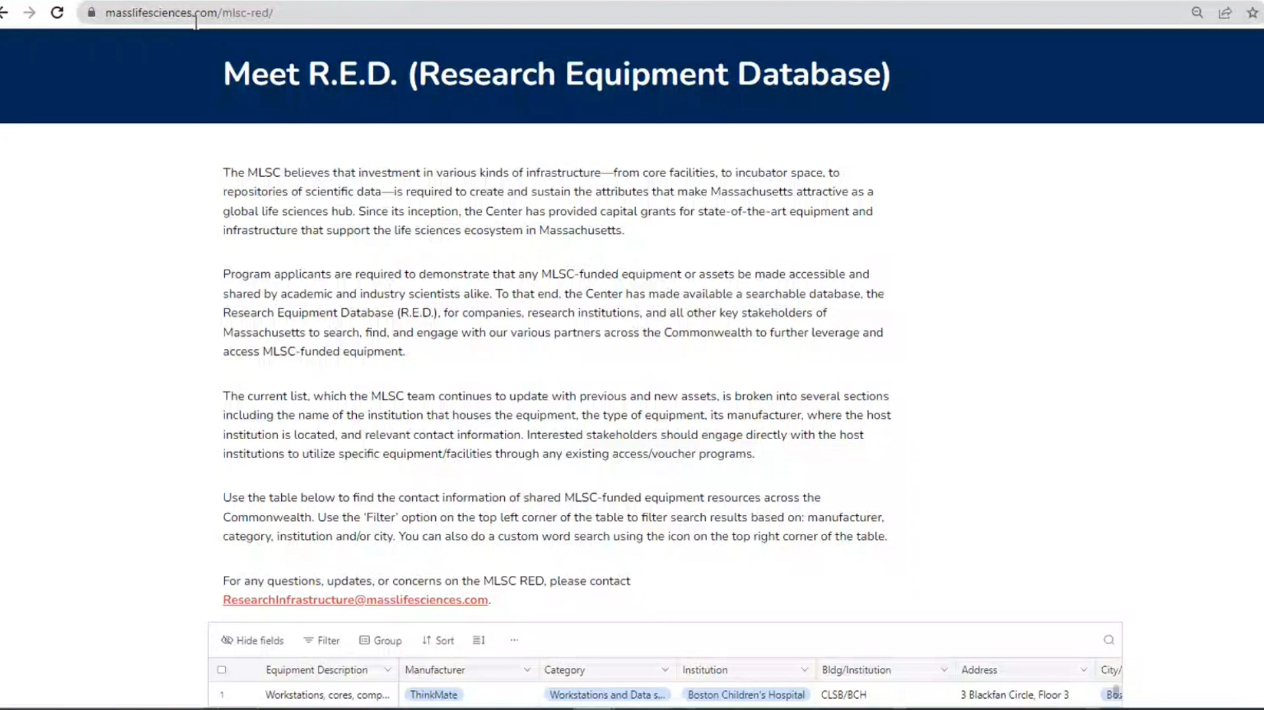
Research Infrastructure Program Overview
  Program Goals :
  Fund state-of-the-art research equipment around the Commonwealth to advance innovative ideas
  Train MA scientists on innovative techniques
  Enable the discovery and advancement of new therapies to improve the quality of life for the citizens of MA
  Project Features :
  $1.5 – $5 million per project for capital equipment/expenses for 1-3 year projects
  All funded equipment must be made publicly available on a fee-for-service basis
  Letters of use from external industry and academic scientists

Slide 15
Research Infrastructure Program
Program Description: The Research Infrastructure program provides grants for capital equipment that enhance the Commonwealth’s collaborative life sciences ecosystem by investing in the resources required to develop technological innovations that deliver life-changing therapies to patients and leading the convergence revolution in digital health, biopharma, medical devices and engineering.
Anticipated Program Budget: Up to $5M
 | Key Performance Metric | Key Performance Description | Target | Result
1 | Fund research institutions/hospitals and hire FTEs | Support projects for at least 2 research institutions/hospitals and hire 1 FTE by FY26. | 2 | 6
2 | Incentivize external users of funded capital equipment | Aim to have at least 15 scientists trained at grant recipient sites beginning in FY27. | 15 | Equipment is being purchased/ installed

Slide 16
Themed Capital Programs Overview
  Bits to Bytes, Novel Therapeutics Delivery, and Women’s Health Collaboration Program Goals:
  Invest in sectors, as well as underrepresented populations, where MLSC support can address disparities in the life sciences
  Train MA postdoctoral scientists on innovative techniques in these fields
  Incentivize collaborative research between academia and industry
  Enable the discovery and advancement of new therapies to improve the quality of life for the citizens of MA
  Project Features:
  Up to $750,000 per project for capital equipment/expenses for 2-3 year projects
  All funded equipment must be made publicly available on a fee-for-service basis
  Data purchased under this award must be made publicly available
  Scientific projects to advance a particular disease/field
  Metrics Collected:
  Two progress reports collected per year during project term, followed by annual progress reports post-term
  Follow-on Funding, Publications, IP Filed/Optioned, # Users, # Trainees

Slide 17
Bits to Bytes
Program Description: Provide grants for capital projects that generate and analyze large datasets to answer pressing life science questions, and to attract and train data scientists in the Commonwealth.
Anticipated Program Budget: Up to $5M
 | Key Performance Metric | Key Performance Description | Target | Result
1 | Support experiments for producing publications | Support experiments that will lead to at least 1 publication by the end of the term per each project. | 1 | FY25 projects are just getting started
2 | Support projects that will lead to follow-on funding to the institutions | Support experiments that will lead to at least $500K follow-on funding by the end of the term per each project. | 500,000 | FY25 projects are just getting started
3 | Hire and train new scientist | Hire and train at least 1 new postdoctoral data scientist per project | 1 | 0 *
4 | Fund research institutions/hospitals | Establish a new scientific relationship between at least one industry partner and the non-profit award recipient | 1 | 5
*FY25 projects must hire net new postdocs by 12/31/25

Slide 18
Novel Therapeutics Delivery
Program Description: Provide grants to foster the development of novel technologies and techniques for the delivery of existing or innovative therapies by working at the intersection of engineering, biology, chemistry, and medicine.
Anticipated Program Budget: Up to $3M
 | Key Performance Metric | Key Performance Description | Target | Result
1 | Fund research institutions/hospitals | Establish a new scientific relationship between at least one industry partner and the non-profit award recipient | 1 | 1
2 | Support experiments for producing publications | Support experiments that will lead to at least 1 publication by the end of the term per each project. | 1 | FY25 projects are just getting started
3 | Support projects that will lead to follow-on funding to the institutions | Support experiments that will lead to at least $500K follow-on funding by the end of the term per each project. | 500,000 | FY25 projects are just getting started
4 | Hire and train new scientist | Hire and train at least 1 new postdoctoral data scientist per project | 1 | 0*
*FY25 projects must hire net new postdocs by 12/31/25

Slide 19
Women’s Health Collaboration
Program Description: The Women’s Health program will support collaborative projects that aim to improve the discovery, technical innovation, and/or analysis of datasets to answer pressing life science questions around women’s health.
Anticipated Program Budget: Up to $2M
 | Key Performance Metric | Key Performance Description | Target | Result
1 | Fund research institutions/hospitals | Establish a new scientific relationship between at least one industry partner and the non-profit award recipient | 1 | 1
2 | Support experiments for producing publications | Support experiments that will lead to at least 1 publication by the end of the term per each project. | 1 | FY25 projects are just getting started
3 | Support projects that will lead to follow-on funding to the institutions | Support experiments that will lead to at least $500K follow-on funding by the end of the term per each project. | 500,000 | FY25 projects are just getting started
4 | Hire and train new scientist | Hire and train at least 1 new postdoctoral data scientist per project | 1 | 0*
*FY25 projects must hire net new postdocs by 12/31/25

Slide 20
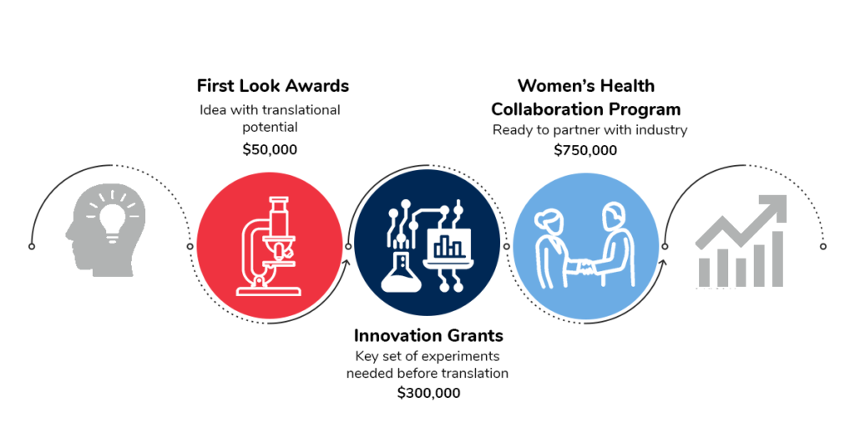
Women’s Health Initiative

Slide 21
Women’s Health Innovation Grants
Program Description: The Innovation Grants support women’s health projects that have the potential to translate into commercially viable opportunities but still need some work prior to partnering with industry or spinning out the technology. The funding provides financial support for the completion of key experiments over two years.
Anticipated Program Budget: Up to $2M
 | Key Performance Metric | Key Performance Description | Target | Result
1 | Support experiments for producing publications | Support experiments that will lead to at least 1 publication by the end of the term per each project. | 1 | FY25 projects are just getting started
2 | Support projects that will lead to follow-on funding to the institutions | Support experiments that will lead to at least $500K follow-on funding by the end of the term per each project. | 500,000 | FY25 projects are just getting started

Slide 22
First Look Awards Program
Program Description: The First Look Awards is a partnership between the MLSC and the Connors Center for Women’s Health at Brigham and Women’s Hospital. The program will provide five Massachusetts researchers with a $50,000 grant for one year that allows them to complete pivotal experiments to further develop the translational opportunity and get closer to further funding.
Anticipated Program Budget: $250,000
Fiscal Year Goal 1: Support early-stage exploratory translational research in women’s health to encourage academic researchers to consider commercial opportunities.
Fiscal Year Target 1: Facilitate at least one “work in progress” meeting with experts identified by the Connors Center per project. Support experiments that will lead to at least 2 publications in aggregate by FY28.
Results: The MLSC awarded five projects in FY25, which are currently executing their grant agreements and working with the Connors Center to identify the date of their work in progress meeting. During FY25, all of the FY24 awardees had their "work in progress" meetings with experts identified by the Connors Center.
Fiscal Year Goal 2: Help researchers develop necessary pilot data to pursue further grant funding.
Fiscal Year Target 2: Projects from completed program rounds will use data generated under this award to attract follow on funding to advance viable ideas. External follow-on funding will average to $100k per program round within the first two years following project completion.
Results: The five projects are at the front end of their lifecycle (grant agreements to be executed in FY26). Over $7.4M in follow-on funding have been reported by First Look Awards Program projects awarded in previous years.

