Slide 1
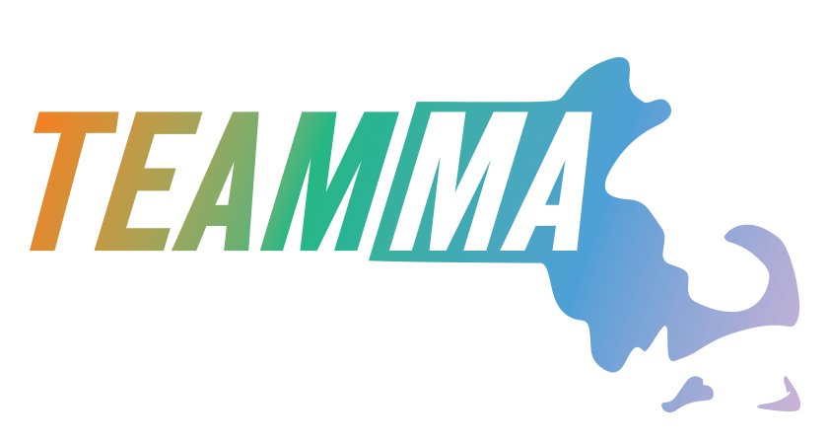
Office of Performance Management & Oversight
Massachusetts Office of Travel & Tourism
Fiscal Year 2025 Report

Slide 2
Regional Tourism Council Assistance Grants
Program Description: Financial assistance to those public or nonprofit agencies which promote or provide services for tourism, convention, travel and recreation in the commonwealth. Funds shall be used to strengthen efforts of tourism, convention, travel and recreation agencies to attract and service visitors to the commonwealth and to better manage and distribute the influx of said visitors. MOTT makes grants to agencies to assist such agencies in planning and carrying out their promotional programs and projects. Grants must be matched 100% by private funds, and reported on effectiveness to the house and senate committees on ways and means. .
Program Budget: $8.1 M
Key Performance Metric | Key Performance Description | Target | Result
Contracts Executed | Must be completed by December 1, 2024 | 16 | 16
Match Requirements fulfilled | 100% match is required for RTC grants | 16 | 16
Audits and year-end reports received | With programming and marketing activities in step with marketing plans | 16 | 16

Slide 3
Destination Development Capital Grants
Program Description: The FY25 Destination Development Capital (DDC) Grant Program is a competitive grant program that will award funds to strengthen the economy of Massachusetts through destination development projects that enhance tourism recovery and have the potential to increase non- resident visitation. Eligible projects will enhance tourism resources and infrastructure and will aid in destination recovery and resiliency. Applications will be accepted for projects that include plans to expand, construct, restore or renovate Massachusetts tourism destinations and attractions. Applicants must demonstrate how the tourism capital project will work to promote the tourism goals of the MA Office of Travel and Tourism and the corresponding Regional Tourism Council. The DDC grant is focused on capital improvements with a direct relationship to tourism, and other physical/structural items with a greater than five-year lifespan. Projects must be completed by June 30, 2025
Program Budget: $6 M
Key Performance Metric | Target | Result
Improvements to at least 61 tourism destinations | 61 | 36
DDC Projects successfully completed and funding spent | 61 | 13

Slide 4
Travel and Tourism Season Extension Grants
Program Description: The Travel and Tourism Season Extension (TTSE) Grant Program is funded by the US Department of Commerce Economic Development Agency. The goal of the TTSE Grant Program is to provide funds to strengthen the Massachusetts economy through the development and enhancement of the Commonwealth’s tourism industry. As part of the COVID19 pandemic recovery package, these funds will assist with marketing projects that promote travel and tourism attractions in Massachusetts during the months November through April, known as the shoulder season. In Dec 2022, MOTT awarded six grants, one in each of Massachusetts’ six regions, to ensure geographic diversity across the Commonwealth. The TTSE Grant was competitive, and one organization per region administers their region’s TTSE Grant. Eligible TTSE Grant funds include marketing content development, website development and optimization, visitor/consumer outreach, digital advertising, language translations, signage, photography and videography, itineraries, and other marketing initiatives. These marketing projects must encourage experiences that are not necessarily season-dependent and can be sustained for more than one annual cycle.
Program Budget: $6 million
Key Performance Metric | Key Performance Description | Target | Result
Increase in shoulder season visitation | Demonstrated percentage increase of November 2024 -April 2025 over November 2023-April 2024 time frame | 5 | Not available at time of report
Increase in shoulder season hotel revenue | Demonstrated percentage increase of November 2024 -April 2025 over November 2023-April 2024 time frame | 5 | -1.4
Increase in shoulder season visitor spending | Demonstrated percentage increase of November 2024 -April 2025 over November 2023-April 2024 time frame | 5 | Not available at time of report

Slide 5
MA 250 Anniversary Grants and Marketing
Program Description: Massachusetts 250 is a statewide initiative to celebrate 250 years of America's independence and Massachusetts' revolutionary legacy. The initiative will highlight the state's rich history and amplify untold stories of the Revolution through hundreds of cultural and community events over the next two years. 1) The Massachusetts 250 creative marketing campaign, launched on September 17, captures the significance of Massachusetts as a force for innovation, a cultural cornerstone, and a foundation of our nation. the campaign will collaborate with municipalities, community groups, businesses, and local organizations. Statewide partnerships and programs will engage locals and visitors in experiences that narrate iconic historical moments. 2) FY2025 of the Massachusetts 250 Grant Program awarded $1.5m to 37 recipients to commemorate the 250th anniversary of the American Revolution in a vibrant and engaging way. Awarded projects highlight the themes of revolution and independence, celebrate significant historical "firsts" in Massachusetts, or utilize creative approaches to showcase the state's rich history. 3) A Massachusetts 250th Anniversary Signature Event planning (event to be held in July 2026)
Program Budget: $10 million
Key Performance Metric | Key Performance Description | Target | Result
Number of 250th events and programs promoted |  | 150 | 635
Completed grant-funded programs |  | 37 | 37
Impressions across MA250 social media channels |  | 75,000 | 880,341

Slide 6
Domestic Marketing
Program Description: MOTT promotes Massachusetts as a four-season destination for domestic travelers for leisure and business travel. MOTT takes a multi-channel approach to domestic marketing to generate awareness, inspiration, and engagement with Massachusetts residents, businesses and target audiences in the six-hour drive market outside of Massachusetts. A core component of MOTT is digital marketing. Visitma.com serves as the foundation for MOTT's promotional efforts. In addition to visitma.com, MOTT utilizes @visitma social media channels (Facebook, Instagram, X, Threads, and YouTube), and email marketing to a consumer subscriber audience and an industry subscriber audience. MOTT works with two procured advertising agencies, Hill Holliday and Proverb, on the deployment of marketing campaigns, which includes the MAde Possible marketing campaign and MA250 marketing campaign. Media channels for these marketing campaigns include Broadcast TV, Out-of-Home Displays, Radio and Podcasts, Paid Social Media, Programmatic Display and Native Advertising, and print. MOTT partners with Trip Advisor, Yankee Magazine, and Hearst Media/Ski Massachusetts on domestic marketing promotional efforts. In addition to these partnerships, MOTT partners with Regional Tourism Councils and other tourism stakeholders to leverage resources and amplify tourism marketing efforts through co-op marketing campaigns, work with content creators, and social media efforts. In addition, MOTT collaborates with state agency partners including MassDOT, MDAR, DCR, Massport, and the Massachusetts Convention Center Authority on various marketing efforts. Additionally, MOTT publishes guides which include: the Massachusetts Travel Guide, the Historic Women Trailblazers of Massachusetts, the Massachusetts Wine and Cheese Trails, the Massachusetts Ice Cream Trail, the Massachusetts Lighthouse Trail, the Massachusetts Sports Trail, and the Massachusetts Scenic Trail. Tradeshows are a key mechanism for interacting with consumers, learning industry best practices, and engaging with the Massachusetts and regional tourism industry. Domestic tradeshows that MOTT exhibits at include: The Big E, Snowbound, Outdoor Expo, Dream Destinations, and American Bus Association. The exhibit booths contain MOTT printed publications as well as various promotional items with the MOTT logo, which are distributed to show attendees. Sports Marketing efforts for FY25 includes a multi-channel partnership with Kraft Sports Entertainment. MOTT fulfills consumer and trade publication requests through a procured fulfillment management company which is managed by the vendor and MOTT staff. Program Budget: $5.2 M
Key Performance Metric | Key Performance Description | Target | Result
Regional Tourism Council co-op participation | How many RTCs participated in MOTT domestic marketing co-op campaigns | 14 | 16
Consumer Fulfilment | Number of MA Travel Guides mailed to consumers. Consumer Fulfillment of Travel Guides and Transportation Maps is a new function for MOTT | 2,500 | 6,602
Social Media Impressions | Impressions across Facebook, X, Threads, Instagram, Youtube, and Linkedin | 1,000,000 | 108,754,745
Blog Posts | Number of blog posts published | 25 | 87
Consumer Newsletter Emails | Number of consumer emails sent | 30 | 102

Slide 7
International Marketing
Program Description: MOTT's international marketing consists of promoting Massachusetts as a destination to traveler markets throughout the world through business-to-business marketing, targeting international travel media, key travel and trade publications, and to major tour operators. MOTT participates as an exhibitor at international trade shows such as IPW, the leading international inbound travel trade show for U.S. destinations, the Discover New England Summit, Brand USA Travel Week, TravMedia's International Media Marketplace, and other tradeshows in key markets through MOTT's partnerhsip with Discover America Canada, Visit the USA Ireland Committee, and Visit the USA-UK. Additionally, both trade and media familiarization trips are an important component of the international program for MOTT, enabling travel agents or journalists to experience Massachusetts firsthand. MOTT also hosts various virtual or in-person trainings, webinars and meetings with tour operators, travel planners and media to increase their understanding of the Massachusetts product. In addition, MOTT partners with and maintains memberships with Discover New England, Brand USA, the US Travel Association, and the US Commercial Service (Tourism). MOTT also partners with and engages Regional Tourism Councils for international media co-op opportunities.
Program Budget: $1 M
Key Performance Metric | Key Performance Description | Target | Result
Visitor trips | Increasing international visitor trips to Massachusetts | 2% increase | data not available at time of report
Economic impact | Increasing economic impact from international tourism to Massachusetts | 2% increase | data not available at time of report
Engage regional tourism councils in international co-op marketing campaigns | How many of the regional tourism councils join MOTT in co-op marketing campaigns | 12 | 16

