Slide 1

Opioid Recovery and Remediation Fund Advisory Council
October 4th, 2022
2:00 - 3:30 pm
Zoom

Slide 2
Agenda
Welcome
Approval of 6/28 Meeting Minutes
Opioid Settlement Update
Trust Fund Update
Annual Report
HEALing Communities Study
Strategic Planning Initiative – Preliminary Findings
Upcoming Meetings

Slide 3
Statewide Opioid Settlement Payment Update
***
Opioid Recovery and Remediation Fund Council
October 4, 2022
***
Gillian Feiner
Senior Enforcement Counsel
Office of the Attorney General

Slide 4
Estimated Distributor and J&J Settlement Payments to ORRF

Slide 5
2022 ORRF Deposits
June 15:
  $12.3M
September 30:
  $13.9M
October 2022 (expected):
  $44.1M
Notes:
Total to ORRF > $70M
An additional amount up to $44M going directly to munis this year

Slide 6
Estimated Mallinckrodt Payments to the ORRF
Notes:
Awaiting an update from the trustees overseeing the MNK bk distributions on timing/amount of expected 2022 payments.

Slide 7
EOHHS Finance Overview of ORRF
Current ORRF Revenue and Expenditure Breakdown for FY22, FY23
Total Revenue | $ 35,447,802.83
Expansion of Harm Reduction Programming | $ (3,400,000.00)
Expansion of Low-Threshold Access to MOUD | $ (3,100,000.00)
Expansion of Low Barrier Housing Options and Supports | $ (2,000,000.00)
Community Outreach and Engagement | $ (750,000.00)
Student Loan Forgiveness | $ (15,000,000)
Strategic Spending Plan | $ (432,700)
Total Funding Available | $ 10,765,102.83
*Admin costs reflect expenses related to Strategic Planning initiative

Slide 8
Update on Initial Allocation for Trust Fund Dollars
Expansion of Harm Reduction Services
Rolled out Community Naloxone Purchasing Program allowing community-based programs to purchase naloxone through the State Office of Pharmacy Services at subsidized, public interest pricing.
Developed a competitive application opportunity for existing harm reduction partners to collaborate, expand through sub-contractual arrangements with organizations that reach historically underserved populations and communities including Black, Indigenous, and people of color (BIPOC) individuals who are at high risk for experiencing overdose.
Increased access to fentanyl test strips by making them available at no-cost through the -newly established Massachusetts Clearinghouse
Increased Access to Medication for Opioid Use Disorder
Increased access to MOUD in underserved areas through opening three new opioid treatment programs in Orange, Holyoke, and Plymouth respectively. The addition of these two sites will build upon existing OTP expansion efforts that have yielded an increase approximately 2,000 OTP patients over the 2-year period since Covid
Expanded access to MOUDs by adding 1 new mobile methadone delivery program.
Notes:
1 Existed = Habit Opco – Brockton (travels to Quincy)
1 Newly Approved Mobile Covering Worcester Area; not yet licensed / operational
2 Pending Applications to Add Mobile OTPs (Habit - Yarmouth that would travel to Wellfleet + Habit – Boston that would serve patients in Mass/Cass area)
BHN has submitted Innovations Application for alternative service delivery option in an underserved geographic area = Ware

Slide 9
Update on Initial Allocation for Trust Fund Dollars
Expansion of Supportive Housing Programs
Expanded statewide capacity of 14 providers that has resulted in a total of 380 units contracted for FY23. As of August, 233 of these units have been filled despite ongoing staffing hiring challenges.
Community Outreach and Engagement
Conducted state and national environmental scan of community outreach programming for people who use opioids. Key findings that there is no existing community outreach model specifically for this population and that Massachusetts is on the cutting edge of innovation in this area by developing a new model
Finalizing a new proposed model for community outreach based off findings from landscape analysis.

Slide 10
Update on Initial Allocation for Trust Fund Dollars
Expansion of Harm Reduction Services - Approved Community Naloxone Purchasing Programs
Vendor | Region | FY22 Contract $ | # of Doses Distributed to Date | FY23 Contract $ | # of Doses Distributed to Date
Multiple | Statewide | $1,700,000 | N/A | $1,700,000 | 3904
Expansion of Harm Reduction Services - Fentanyl Test Strips Clearinghouse
FY22 Contract $ | # Purchased/Distributed | FY23 Contract $ | # Purchased/Distributed to Date
$18,000 (for development and purchase of educational materials) | N/A | $750,000 | 7,900
Increased Access to Methadone - OTP Expansion Contracts
Vendor | Region | FY22 Contract $ | FY23 Contract $
Spectrum Health Systems, Inc | CM | $115,000.00 | $1,078,638.00
Responding RFR Bids* | Statewide | 0 | $1,908,362
Community Outreach and Engagement
Vendor | Region | FY22 Contract $ | FY23 Contract $
TBD** | Statewide |  | $750,000
Long Term Housing
Provider*** | Region | FY22 Slots | FY22 ORRF Funds | FY22 Total Funds **** | FY23 Slots | FY23 ORRF | FY23 Total Funds** | Projected Total # of Units Supported by ORRF
Multiple | Statewide | 299 | 0 | $11,960,000 | 372 | $5,000,000 | $15,000,000.00 | 125
* BSAS currently reviewing responding bids to OTP Expansion RFP.
** RFP scheduled to be posted on January 1st, 2023
*** See Appendix Slide A for breakdown of current providers, slots and funds
**** Total funds supplemented by additional BSAS revenue sources

Slide 11
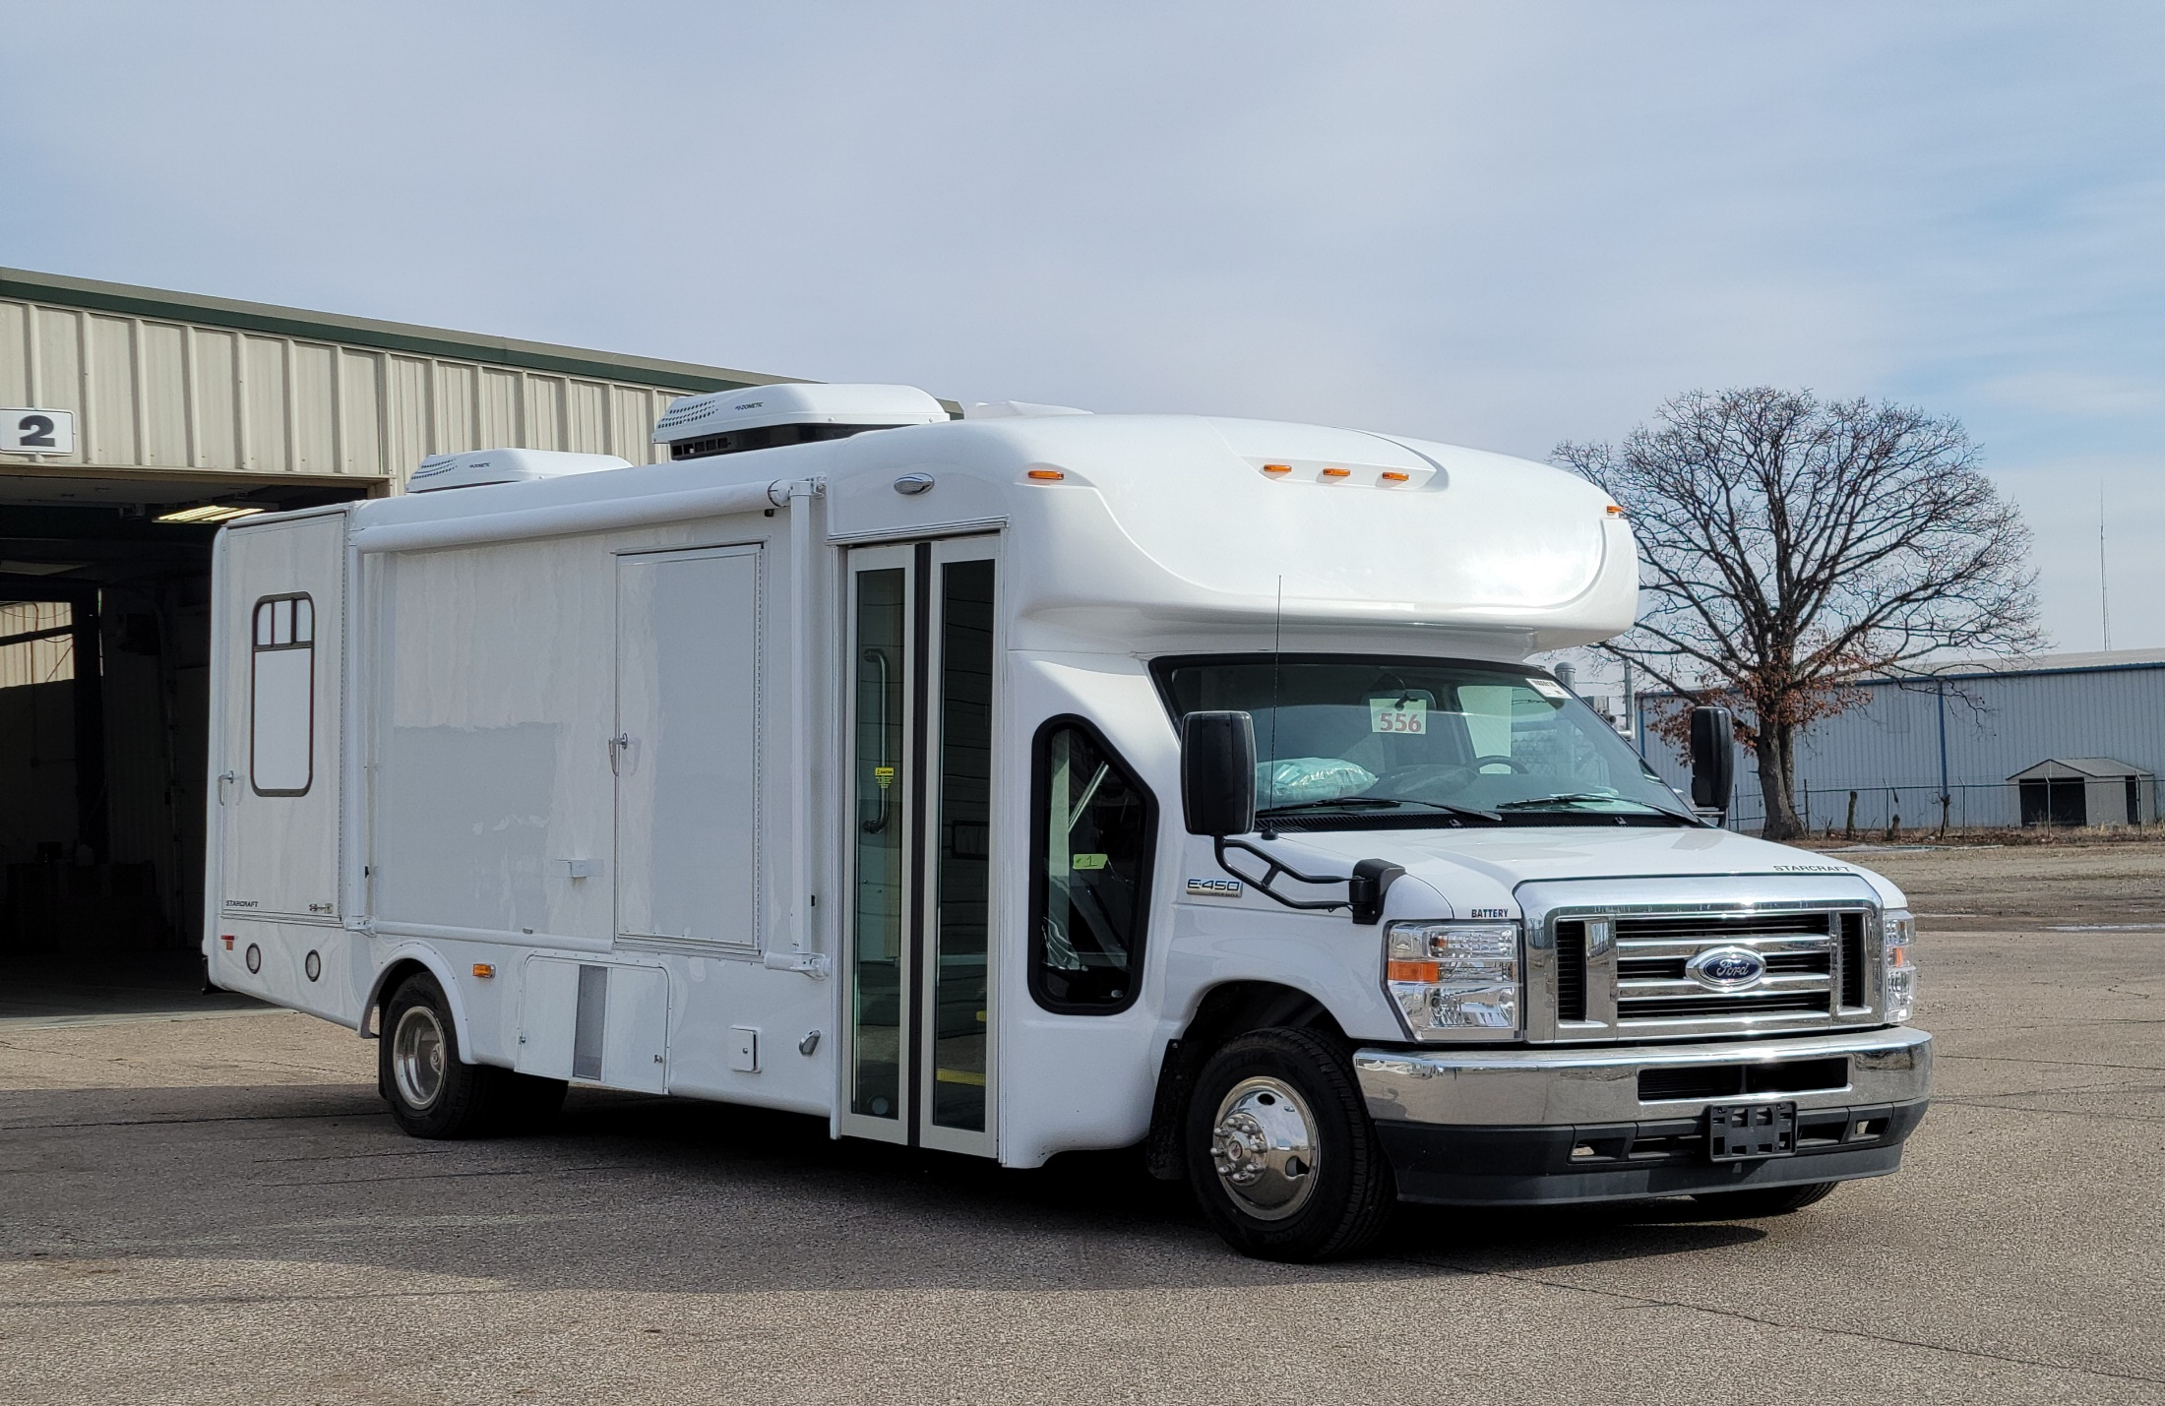
Wellfleet/Yarmouth Mobile Methadone Van

Slide 12
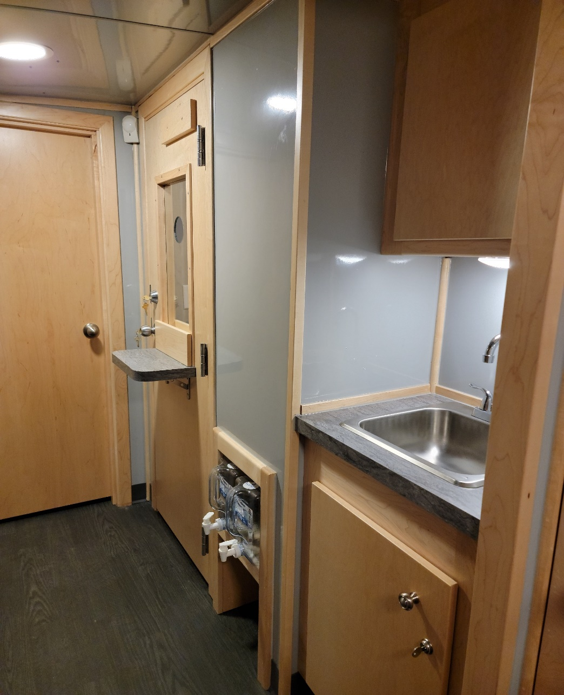
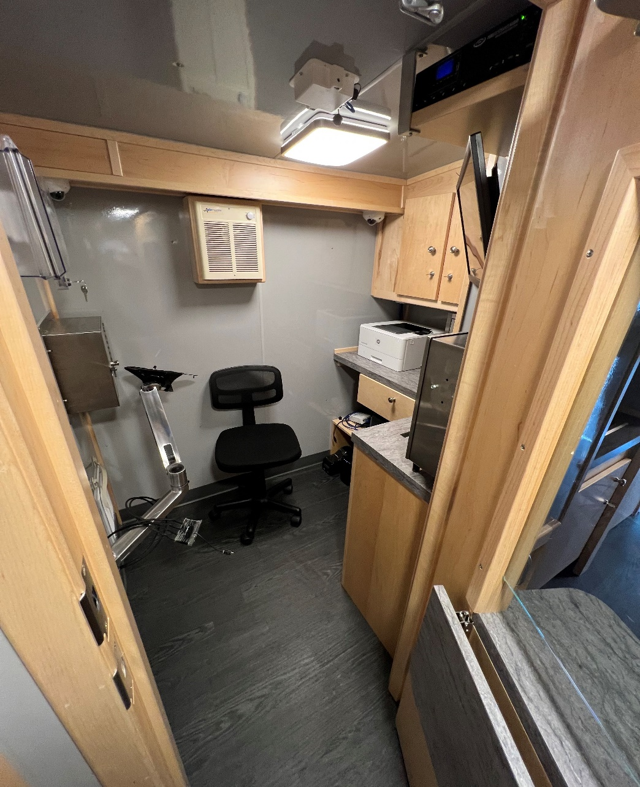
Wellfleet/Yarmouth Mobile Methadone Van

Slide 13
HEALing Communities Study
Jeffrey Samet, MD, MA, MPH
Principal Investigator
Chief, Section of General Internal Medicine, Boston Medical Center
Vice Chair for Public Health, Department of Medicine
Carly Bridden, MA MPH
Project Director
HEALing Communities Study
Boston Medical Center
Jessica Taylor, MD
Assistant Professor of Medicine in General Internal Medicine at the Boston University School of Medicine and Boston Medical Center and a board-certified Addiction Specialist; Community Faculty, HEALing Communities Study
Erin Gibson, MPH
Associate Director of Research Operations, HEALing Communities Study

Slide 14
Pew Charitable Trust Report
On September 19th, Pew Charitable Trusts released a report outlining opioid treatment program (OTPs) regulations by State and potential impacts they have on access to care.
Notable Findings related to Massachusetts:
Only 11 States allow for OTPs to open medication units—including Massachusetts
Massachusetts is 1 of only 9 States that requires OTPs to be open outside normal business hours.
Only Massachusetts and South Dakota are aligned with Federal guidelines by prohibiting administrative discharges due to continued substance use.
Massachusetts is 1 of 17 States to explicitly allow guest dosing for patients at other OTPs.
Notes:
Include link to report in chat: Overview of Opioid Treatment Program Regulations by State | The Pew Charitable Trusts (pewtrusts.org)
Dee will note corrections to report

Slide 15
Massachusetts Executive Office of Health and Human Services
Opioid Recovery and Remediation Trust Fund (ORRF)
Eveline Van Beek,
Principal
Kyle MacDonald,
Senior Associate
Preliminary Findings
October 4, 2022

Slide 16
Agenda
ORRF Strategic Plan Introduction
ORRF Strategic Plan Development Timeline
Gap Analysis and Environmental Scan Overview
Workshop 1 Findings

Slide 17
Introduction
In July 2022, the Massachusetts Executive Office of Health and Human Services (EOHHS), selected KPMG to provide strategic planning services for the Opioid Recovery and Remediation Trust Fund (ORRF) Advisory Council.
The goal of this project is to create a 3-year Strategic Plan in collaboration with EOHHS staff, the Advisory Council, and select external stakeholders. The plan will include:
    A current state assessment and gap analysis of Massachusetts’ landscape of programs and services across the addiction spectrum from prevention to recovery.
    An environmental scan that identifies innovative approaches used by other cities, states, and countries to address the opioid overdose crisis.
    Input from members of the Advisory Council and external stakeholders, gathered from a series of two strategy workshops
    A timeline for the strategic plan implementation
    An operations approach to address program selection process, data collection, progress tracking and program evaluation
    Recommendations for how to update the strategic plan over time

Slide 18
Our journey to develop the Strategic Plan
Current Point
08
11/23: Final Strategic Plan
06
10/4:
Preliminary Findings
04
02
9/7:
Workshop 1
8/12: Environmental Scan
07
05
10/19: Draft Strategic Plan
9/28:
Workshop 2
03
01
8/26:
Gap Analysis
8/4:
Project Kickoff

Slide 19
Highlights from the gap analysis and environmental scan
Data Collection and Performance Management
Program Design
Innovative programs from other jurisdictions included methadone delivery services and overdose spike text alert systems
Downstream, negative, medical outcomes are common KPIs
Most MA data is presented as static, tabular reports without qualitative data
Other
Gap Analysis and Environmental Scan
Legislation and Regulation
Many innovative strategies would require legislative changes or exemptions from the federal government.
Most states are creating similar settlement funds and advisory councils as MA.
Community Engagement and Health Equity
Funding Approaches
Hiring people with lived experience as advisors and co-researchers
Integrate community engagement and equity into every program
All states use a multi-pronged approach
Without a central database of programs, it is difficult to determine what MA has trialed and how success was measured.
Notes:
Data Collection and Performance Management: None of the states reviewed captured more upstream and qualitative metrics to elevate the role of monitoring positive outcomes. For data visualization, BSAS is developing a data dashboard.
Legislation and Regulation: Most states are in the initial planning stages and have not yet identified priorities or allocated funds.
Funding Approaches: Compared to some other states, investing in new data collection and research was less pronounced in MA.
Community Engagement and Health Equity: Funding small, community-based, grassroots initiatives, particularly those led by women and people of color, could be an important strategy to reduce disparities across communities.

Slide 20
Opportunities identified in Workshop 1
Identify subpopulations
Fund non-programmatic areas
Redefine success
Create a more specific set of target populations within the current broad definitions to allow for more precise targeting and impact measurement
e.g., Native Americans and older adults.
Allocate percentage of funds toward non-programmatic efforts.
e.g., workforce development, increasing wages and paying community members for their expertise, data collection, and new technology concepts.
Create definitions of success (e.g. by program type) to help streamline data collection and evaluation. Consider including (new) upstream, positive, data-driven KPIs rooted in the social determinants and equity incorporating qualitative data.
Institutionalize community engagement and equity
Operationalize equity
Prioritize innovation
Develop structured equity review processes and measurements to include in the review and evaluation of every program/project.
Make funding innovative, evidence-informed solutions, that have not yet been tried in Massachusetts, a priority.
Integrate principles of community engagement and health equity into every policy, program, and service rather than fund them separately.

Slide 21
Thank you!

Slide 22
Appendix
Gap Analysis and Environmental Scan Highlights

Slide 23
Highlights from the gap analysis and environmental scan
Topic | Highlights
Data Collection and Performance Management | All states reviewed continue to measure the opioid overdose crisis through mostly downstream, negative medical outcomes. None of the states reviewed captured more upstream and qualitative metrics to elevate the role of monitoring positive outcomes. Massachusetts largely publishes data on the opioid crisis in static, tabular reports, which differs from several other states and jurisdictions where access to KPIs is more interactive (e.g., using Tableau dashboards).
Legislation and Regulation | The majority of states have introduced legislation to create opioid settlement funds and advisory councils similar to Massachusetts’ approach to the ORRF Advisory Council and its funding priorities. Most states are in the initial planning stages and have not yet identified priorities or allocated funds.
Funding Approaches | All states reviewed use a multipronged, interagency approach. Two areas that are not as pronounced in the Massachusetts funding strategy and have been observed in other states are investments in new data collection and research. Without a central database of programs and services, it is challenging to identify which initiatives Massachusetts has already trialed, how success was measured, and which ones would represent new options to complement existing efforts.
Program Design | Several innovative examples of programs from other states were found in prevention efforts, interagency collaboration, treatment, and recovery for the ORRF to consider as it works to finalize its strategic plan initiative. Innovative examples included methadone delivery services and overdose spike text alerts.
Community Engagement and Health Equity | In some jurisdictions, community members are being hired as experts and co-researchers, which is an expansion of the more traditional role of providing input. Funding small, community-based, grassroots initiatives, particularly those led by women and people of color, could be an important strategy to reduce disparities across communities.
Other | Many of the innovative strategies used by peer nations would require Massachusetts to consider legislative changes and/or to seek waiver authority from the federal government to initiate pilots.

Slide 24
Upcoming Meetings
Date | Time | Location
December 6th, 2022 | 3:00-4:30 | Zoom
March 2023 | TBD | TBD
June 2023 | TBD | TBD
September 2023 | TBD | TBD

Slide 25
Appendix A: Long-Term Housing Initiative Overview by Vendor
Long Term Housing Vendor Overview
Vendor | Region | #Slots FY22 | FY22 Contract $ | Proposed #Slots FY23 | FY23 Proposed* | Proposed #Slots FY24 | FY24 Proposed | Proposed #Slots FY25 | FY25 Proposed
Amherst Community Connections | Western | 10 | 400,000 | 10 | 400,000 | 10 | 400,000 | 10 | 400,000
Center for Human Development | Western | 45 | 1,800,000 | 45 | 1,800,000 | 45 | 1,800,000 | 45 | 1,800,000
Commonwealth Land Trust | NE | 8 | 320,000 | 11 | 440,000 | 12 | 480,000 | 12 | 480,000
Commonwealth Land Trust | Boston | 30 | 1,200,000 | 30 | 1,200,000 | 30 | 1,200,000 | 30 | 1,200,000
Clinical Support Options | Western | 70 | 2,800,000 | 100 | 4,000,000 | 100 | 4,000,000 | 100 | 4,000,000
Eliot CHS | NE |  |  | 24 | 960,000 | 52 | 2,080,000 | 76 | 3,040,000
Father Bill’s & Mainspring | MW, SE | 20 | 800,000 | 20 | 800,000 | 20 | 800,000 | 20 | 800,000
Health Imperatives | Boston |  |  | 10 | 400,000 | 10 | 400,000 | 10 | 400,000
Justice Resource Institute | Boston | 24 | 960,000 | 30 | 1,200,000 | 30 | 1,200,000 | 30 | 1,200,000
River Valley | Western | 20 | 800,000 | 20 | 800,000 | 20 | 800,000 | 20 | 800,000
South Middlesex Opportunity Council | NE/Central | 14 | 560,000 | 14 | 560,000 | 14 | 560,000 | 14 | 560,000
South Middlesex Opportunity Council | Worcester | 14 | 560,000 | 14 | 560,000 | 14 | 560,000 | 14 | 560,000
South Middlesex Opportunity Council | Springfield | 14 | 560,000 | 14 | 560,000 | 14 | 560,000 | 14 | 560,000
Victory Programs | Boston | 30 | 1,200,000 | 30 | 1,200,000 | 30 | 1,200,000 | 30 | 1,200,000
TOTALS |  | 299 | 11,960,000 | 372 | 14,880,000 | 401 | 16,040,000 | 425 | 17,000,000

