Slide 1
Opioid Recovery and Remediation Fund Advisory Council
Marylou Sudders, Secretary
Executive Office of Health & Human Services
June 21, 2021
12:00 - 1:30 pm
WebEx

Slide 2
Agenda
Welcome and Introductions
Approval of 5/14 Meeting Minutes
BSAS Overdose, Service Utilization Data, and Youth and Young Adult Services
Trust Fund Update and Distribution Methodology
Upcoming Meetings and Next Steps

Slide 3
BSAS Overdose, Service Utilization Data, and Youth and Young Adult Services
Deirdre Calvert
Hermik Babakhanlou-Chase
Sarah Ruiz
Brian R. Jenney
Rebecca Butler
Bureau of Substance Addiction Services
Massachusetts Department of Public Health

Slide 4
Trust Fund Update and Distribution Methodology
New Revenues Added to the Trust Fund:
~$10M received from McKinsey
~$1.5M received from the Injured Worker’s Pharmacy
State Procurement Law
Applies to expenditures from the Opioid Recovery and Remediation Fund
These expenditures are made by the Executive Office of Health and Human Services. MGL ch. 10 s. 35OOO(a)
State procurement regulations apply to all executive office procurements of goods and services
Ethics Considerations
Council members are subject to the Conflict of Interest Law and are encouraged to contact the State Ethics Commission regarding any matters that might require the filing of a written disclosure

Slide 5
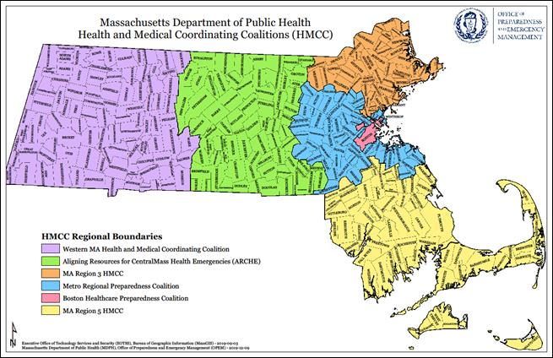
Trust Fund Update and Distribution Methodology
For Discussion: Principles and Metrics to Inform Trust Fund Expenditures
Distribution across the six (6) HMCC regions
OUD prevalence
Fatal and non-fatal overdose rates
Racial equity lens
Other metrics for consideration?

Slide 6
Upcoming Meetings
Date | Time | Location
July 19, 2021 | 2:00 - 3:30 pm | WebEx
September 17, 2021 | 2:00 - 3:30 pm | WebEx
October 1, 2021 – Submission of Annual Report to the Legislature
December 2021 | TBD | TBD
March 2022 | TBD | TBD
June 2022 | TBD | TBD
September 2022 | TBD | TBD
October 1, 2022 – Submission of Annual Report to the Legislature

