Slide 1
Opioid Recovery and Remediation Fund Advisory Council
July 19, 2021
2:00 - 3:30 pm
WebEx

Slide 2
Agenda
Welcome
Approval of 6/21 Meeting Minutes
Trust Fund Update
BSAS Updates
Member Responses on Principles, Metrics, and Distribution Methodology
Upcoming Meetings and Next Steps

Slide 3
Council’s Charge
Legal Authority: Chapter 309 of the Acts of 2020, An Act Establishing the Opioid Recovery and Remediation Trust Fund
Key Provisions:
There shall be an Opioid Recovery and Remediation Fund. Expenditures from the fund shall be made by the Executive Office of Health and Human Services, without further appropriation and consistent with the terms of settlements made in connection with claims arising from the manufacture, marketing, distribution or dispensing of opioids, as applicable.
The Secretary of Health and Human Services, in consultation with the Opioid Recovery and Remediation Fund Advisory Council, shall administer the fund.
The fund shall be expended to mitigate the impacts of the opioid epidemic in the Commonwealth, including, but not limited to, expanding access to opioid use disorder prevention, intervention, treatment and recovery options.
There shall be credited to the fund: (i) amounts recovered by the Commonwealth and credited thereto in connection with claims arising from the manufacture, marketing, distribution or dispensing of opioids; (ii) transfers from other funds authorized by the general court and so designated; (iii) funds from public or private sources, including, but not limited to, gifts, grants, donations, rebates and settlements received by the Commonwealth designated to the fund; and (iv) any interest earned on such amounts.
There shall be an Opioid Recovery and Remediation Fund Advisory Council regarding the expenditures from the fund.
The council shall hold no fewer than 4 meetings annually and the council shall make its recommendations upon a majority vote.
Annually, not later than October 1, the Secretary of Health and Human Services shall file a report on the activity, revenue and expenditures to and from the fund in the prior fiscal year with the Clerks of the Senate and the House of Representatives, the House and Senate Committees on Ways and Means and the Joint Committee on Mental Health, Substance Use and Recovery and made available on the Executive Office of Health and Human Services’ public website.
The report shall include, but not be limited to: (i) the revenue credited to the fund; (ii) the amount of expenditures attributable to the administrative costs of the executive office; (iii) an itemized list of the funds expended from the fund; and (iv) data and an assessment of how well resources have been directed to vulnerable and under-served communities.

Slide 4
Trust Fund Update
Current Revenues
$11.5 million (as of 7/14)
Ethics Considerations
Council members are subject to the Conflict of Interest Law and are encouraged to contact the State Ethics Commission regarding any matters that might require the filing of a written disclosure

Slide 5
BSAS Updates
Deirdre Calvert
Director, Bureau of Substance Addiction Services
Massachusetts Department of Public Health

Slide 6
BSAS Updates
Housing Programs:
Housing First – Provides low-threshold housing for adults experiencing homelessness and who are also at high risk for HIV, where sobriety is not a requirement of residence.
Triage, Engagement, and Assessment (TEA) Model – Shelter for individuals experiencing homelessness who are actively suffering from SUD and present as behaviorally difficult to manage.
Housing Stability Support Program – Reinforces participants’ recovery from addiction by establishing community-based supports to maintain ongoing goals in the recovery process and reduce the risk of relapse/overdose.
Mobile Addiction Services:
Utilizing mobile vans, Mobile Addiction Services programs target high-risk individuals not currently engaged in care, including initiating or continuing MAT, providing harm reduction services like overdose education and naloxone distribution, and linkage to long-term, comprehensive, community-based care in order to prevent overdoses/death, support long-term recovery, and improve health/quality of life by increasing access to integrated addiction/primary care.
The Drug Enforcement Administration (DEA) has also recently issued new regulations allowing for licensed OTPs to offer mobile methadone, which is expected to allow for expansion of mobile services in FY21/22.
Notes:
TEA
TEA programs include a comprehensive admissions intake process covering
Safety assessments,
Triaging for medical and mental health referral purposes,
Comprehensive physical and psychosocial needs assessments, and
Referrals to substance use disorder treatment services, emergency services, housing resources, and/or specific community-based resources where appropriate.
TEA programs also:
Connect with unhoused individuals suffering from addiction in settings most familiar to them, such as meal centers, soup kitchens or food pantries, as well as drop-in shelters and day program sites,
Coordinate with local health care resources to address participants’ chronic health conditions,
Assist them with access to health insurance and medical, addiction, and mental health care,
Provide ongoing education on addiction and overdose prevention, and
Collaborate with local police departments, hospitals, multi-service centers, and human services agencies to address participants needs and concerns.

Slide 7
BSAS Updates
Fentanyl Test Strips (FTS):
FTS are easy to use tests that determine whether fentanyl is present in drugs.
Offering FTS as part of the current suite of harm reduction resources has the potential to engage individuals who may use non-opioid drugs (such as methamphetamine and cocaine) in risk reduction counseling and overdose prevention education, which can lead to increased interest in further addiction treatment and recovery support services.
DATA Waiver:
Recent changes to buprenorphine prescribing requirements at the federal level have eliminated additional training requirements for providers serving 30 patients or less, which has reduced the barriers to buprenorphine prescribing and increased the available pool of eligible providers who can prescribe this life-saving medication, as well as making it possible for smaller community healthcare providers to augment their existing services.
BSAS is working to implement expansion of the Commonwealth’s prescriber population by increasing the availability of training and technical assistance.

Slide 8
Member Responses on Principles, Metrics, and Distribution Methodology
Summary of Member Responses
Council members were asked for feedback on the principles and metrics that might inform expenditures from the Trust Fund.
Responses were received from 10 Council members.
Among the varied responses, a number of themes emerged, which were bucketed into three categories (Criteria, Services, and Structure) with the goal of identifying actionable items for the Council to consider.

Slide 9
Member Responses on Principles, Metrics, and Distribution Methodology
CRITERIA and/or principles for directing Trust Fund dollars:
Support for a county/community-level approach over a broader, regional focus.
Support for utilizing rate of overdoses (fatal and non-fatal) and EMS incidents to guide future spending.
Specific demographic information, eg, age, ethnicity, should be considered to direct resources to historically underserved communities and those most impacted by the opioid crisis.
Increased focus on prevention, harm reduction, emergency shelter, and community outreach regarding opioid use disorder.
Create a standard of care that spans 60-90 days of inpatient care and the ability to then have access to housing, jobs and education.
Support for women and families impacted by opioids, as well as those with substance use disorder and co-occurring mental health disorders.
Support for justice-involved involved individuals with history of substance use, both currently and recently incarcerated.

Slide 10
Member Responses on Principles, Metrics, and Distribution Methodology
SERVICES (new or existing) that could be supported by Trust Fund dollars:
Residential programs serving Black and Latinx communities.
Strengthened pipelines for mental health clinicians of color and addiction care.
Funding for trauma-informed services associated with outreach and continued trauma-informed care accessible to those in recovery.
Additional funding for syringe exchange programs.
Advocate and legalize supervised injection sites across impacted cities.
Dedicate additional resources to ensure accessibility and affordability of Narcan supply for all outreach workers and recovery coaches.
Sober living scholarships to support those with extreme financial need.
Technical assistance to help organizations design and implement effective addiction prevention and treatment programs.

Slide 11
Member Responses on Principles, Metrics, and Distribution Methodology
STRUCTURE of services and/or providers:
No clear consensus on the length of grants or type of organizations funded, eg, well-established, comprehensive programs vs. start-ups.

Slide 12
Member Responses on Principles, Metrics, and Distribution Methodology
The Commonwealth has been committed to bringing together public health professionals, policymakers, and people with lived experience to develop strategies to combat the opioid epidemic.
Council members are encouraged to review the past work of the commissions and working groups that have been convened to develop proposals to mitigate the opioid crisis and guide the Commonwealth’s response.
Governor’s Opioid Addiction Working Group (2015)
https://www.mass.gov/lists/governors-opioid-addiction-working-group
Harm Reduction Commission (2019)
https://www.mass.gov/orgs/harm-reduction-commission
Behavioral Health Roadmap (2021)
https://www.mass.gov/doc/stakeholder-presentation-on-the-roadmap-for-behavioral-health-reform/download

Slide 13
2015 Working Group Overview

Slide 14
2015 Working Group Overview (cont’d)

Slide 15
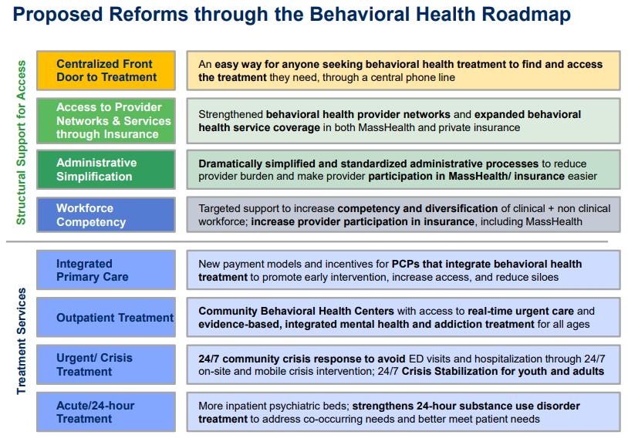
2021 Behavioral Health Roadmap Overview

Slide 16
Upcoming Meetings
Date | Time | Location
September 30, 2021 | 11:00 am - 12:30 pm | WebEx
October 1, 2021 – Submission of Annual Report to the Legislature
December 2021 | TBD | TBD
March 2022 | TBD | TBD
June 2022 | TBD | TBD
September 2022 | TBD | TBD
October 1, 2022 – Submission of Annual Report to the Legislature

