Slide 1

Opioid Recovery and Remediation Fund Advisory Council
September 30, 2021
11:00 am - 12:30 pm
WebEx

Slide 2
Agenda
Welcome
Approval of 7/19 Meeting Minutes
Trust Fund Update
Review of Draft Initial Proposal to Utilize A Portion of the Trust Fund Dollars
Review of Draft Annual Report
Upcoming Meetings

Slide 3
Trust Fund Update
Current Revenues
$11.5 million (as of 9/22)
Ethics Considerations
Council members are subject to the Conflict of Interest Law and are encouraged to contact the State Ethics Commission regarding any matters that might require the filing of a written disclosure

Slide 4
Opioid Recovery and Remediation Fund Advisory Council
September 2021
Initial Proposal to Utilize A Portion of the Trust Fund Dollars

Slide 5
Opioid Recovery and Remediation Fund
Executive Summary
The impact of the opioid epidemic on individuals and families across the Commonwealth has been widespread, particularly in historically-underserved communities, which have experienced a disproportionately high rate of opioid-related overdose deaths.
The Opioid Recovery and Remediation Fund Advisory Council was established through Governor Baker’s signing into law of Chapter 309 of the Acts of 2020 and is charged with developing recommendations for the expenditure of the Opioid Recovery and Remediation Trust Fund to mitigate the impacts of the opioid epidemic in the Commonwealth.
The initial proposal outlined in this document aligns with the principles and criteria developed by the members of the Advisory Council and broadly fall under four categories:
    Expansion of Harm Reduction Services
    Increased Access to Methadone
    Expanding Supportive Housing Programs
    Case Management and Engagement

Slide 6
Background
Anticipated Revenues in the Trust Fund
Revised Principles and Criteria for Trust Fund Expenditures
Initial Proposal to Utilize A Portion of the Trust Funds

Slide 7
Background – Opioid Epidemic in the Commonwealth
Background
While the Commonwealth has made significant strides in combatting the opioid epidemic, the impact on individuals and families across the Commonwealth has been widespread, particularly in historically-underserved communities.
Preliminary data from the Department of Public Health (DPH) shows an estimated 5% decrease in confirmed and estimated opioid-related overdose deaths in the first six months of 2021 compared with the same period in 2020.
In addition, between 2019 and 2020, Black non-Hispanic men experienced a significant increase in the rate of opioid-related overdose deaths (73% increase).
Fentanyl remains a key factor in opioid-related overdose deaths, present in 92% of toxicology screens in 2020.
See following slides for additional details

Slide 8
Background – Opioid Epidemic in the Commonwealth
Preliminary data show 1,038 confirmed and estimated opioid-related overdose deaths in the first six months of 2021, an estimated
5% decrease compared with the same period in 2020
Estimated 1,089 deaths
Estimated 1,038 deaths

Slide 9
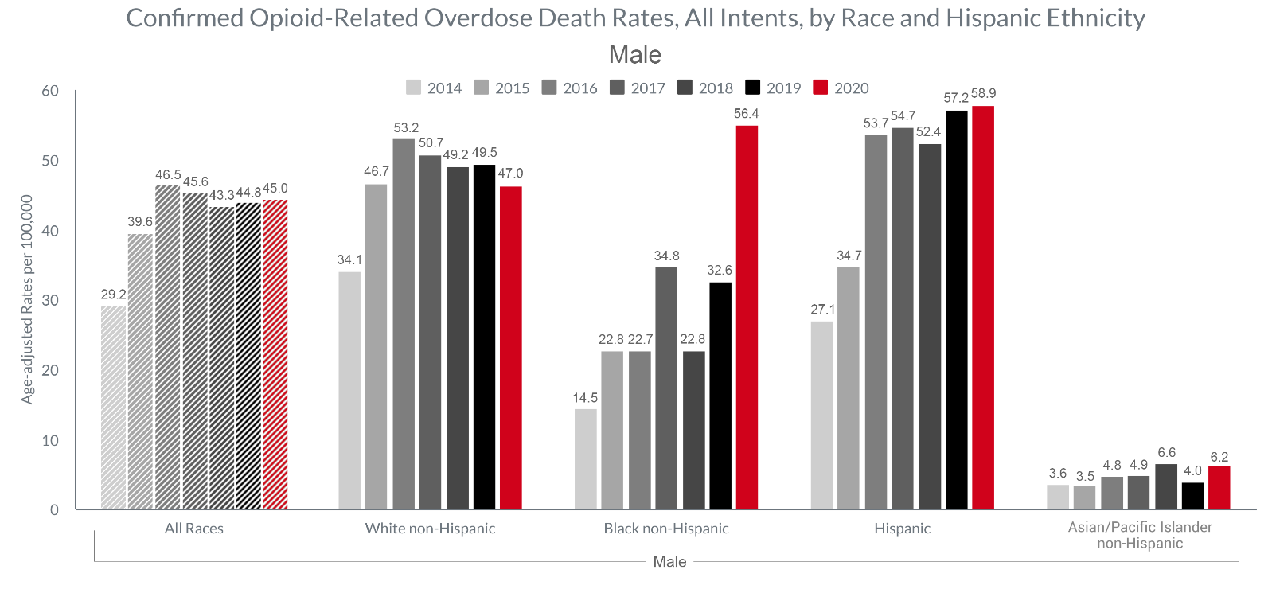
Background – Opioid Epidemic in the Commonwealth
Between 2019 and 2020, the confirmed opioid-related overdose death rate for Black non-Hispanic men increased significantly at 73%

Slide 10
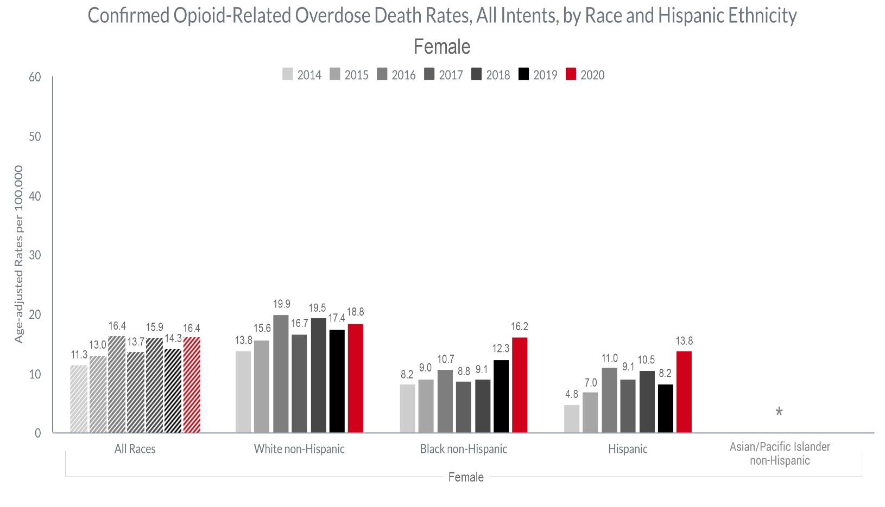
Background – Opioid Epidemic in the Commonwealth
The confirmed opioid-related overdose death rate for women increased in 2020 compared with 2019, with the greatest increases among Hispanic (68%) and Black non-Hispanic (32%) populations

Slide 11
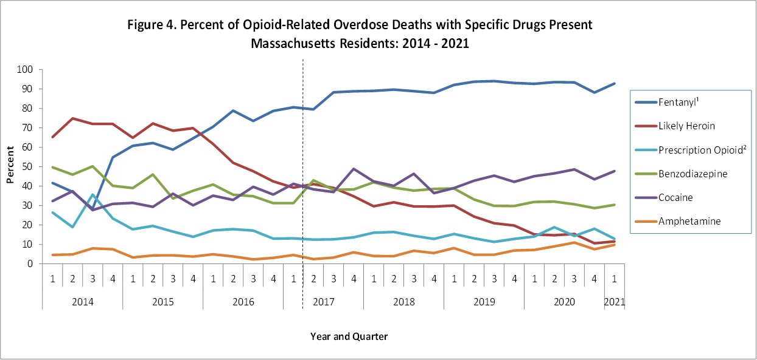
Background – Opioid Epidemic in the Commonwealth
Fentanyl remains a key factor in opioid-related overdose deaths (92% present in toxicology screens in 2020)

Slide 12
Background - Previous Commissions and Working Groups
  The Commonwealth has been committed to bringing together public health professionals, policymakers, and people with lived experience to develop strategies to combat the opioid epidemic.
  A number of commissions and working groups have been convened to develop proposals to mitigate the opioid crisis and guide the Commonwealth’s response.
  Governor’s Opioid Addiction Working Group (2015)
  https://www.mass.gov/lists/governors-opioid-addiction-working-group
  Harm Reduction Commission (2019)
  https://www.mass.gov/orgs/harm-reduction-commission
  Behavioral Health Roadmap (2021)
  https://www.mass.gov/doc/stakeholder-presentation-on-the-roadmap-for-behavioral-health-reform/download

Slide 13
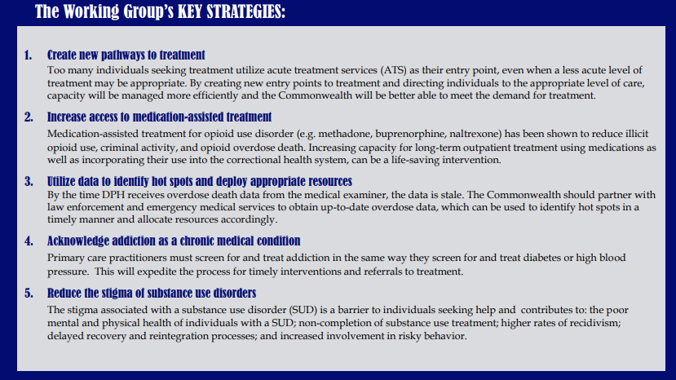
2015 Working Group Overview

Slide 14
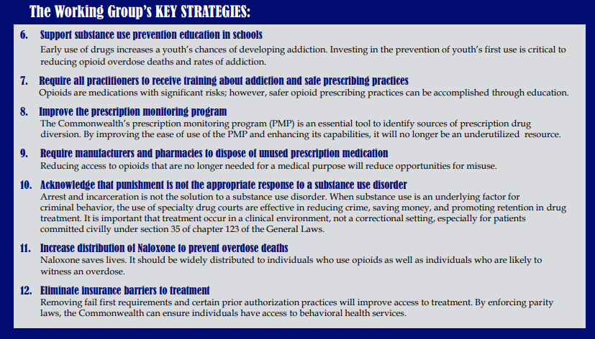
2015 Working Group Overview (cont’d)

Slide 15
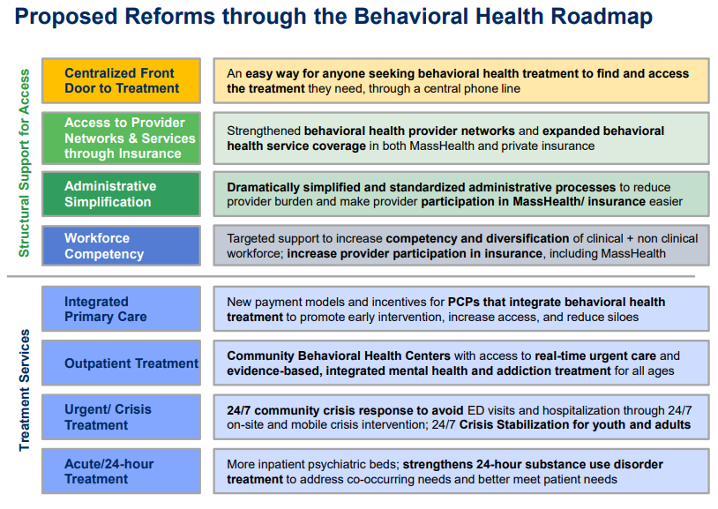
2021 Behavioral Health Roadmap Overview

Slide 16
Background – BSAS Initiatives Addressing Health and Racial Equity
Building off the recommendations of past commissions and work groups, the Bureau of Substance Addiction Services (BSAS) has dedicated a significant portion of supplemental funding from SAMHSA’s Substance Abuse Prevention & Treatment Block Grant towards addressing racial equity, including:
  Increasing behavioral healthcare workforce diversity, recruitment, and retention through workforce development initiatives;
  Funding community-led programming in communities of color through grant making and support for increasing community-based organizations’ ability to contract with the Commonwealth;
  Increasing the number of culturally-specific programs across the continuum of prevention, outreach/engagement, treatment, and recovery support services;
  Increasing investments in pre-arrest diversion/co-response models, in order to divert people with SUD from the criminal justice system, in partnership with the Department of Mental Health (DMH); and
  Increasing funding for low-threshold housing/housing first models in Suffolk County, with program expansions in Merrimack Valley, Springfield, and Worcester to address communities in need.

Slide 17
Background – BSAS Initiatives Addressing Health and Racial Equity
Current BSAS programs dedicated to addressing overdoses in the Black/Latinx community include:
  Recovery-Based Re-Entry Services for Black and Latino Men, a pilot program for Black and Latino men leaving incarceration, provided by the following partner agencies:
    Fathers’ Uplift
    Casa Esperanza
    Legendary Legacies
    New North Citizens’ Council
    Greater Lawrence Family Health Center/Lynn Community Health Center
  Increased investments in the Black Addiction Counselor Education (BACE) and Latinx Addiction Counselor Education (LACE) programs to support Black and Latinx people seeking to enter the SUD workforce.

Slide 18
Background – Additional BSAS Initiatives
DPH/BSAS has aggressively maximized access to SUD treatment during the COVID-19 pandemic, through:
Increasing access to naloxone – from March 2020 to April 2021, over 110 thousand naloxone kits were distributed to Opioid Treatment Providers, Syringe Service Programs (SSP), community health centers, hospital emergency departments, and county Houses of Correction.
Implementing a new standing order for naloxone allowing providers/organizations such as first responders, co-response/jail diversion teams, criminal justice personnel, and health and human services workers (such as those in homeless shelters, drop-in centers, and soup kitchens) to give naloxone to individuals at risk and their friends/family.
Obtaining a blanket exception from SAMHSA on behalf of Massachusetts Opioid Treatment Programs (OTP) for take home doses of Medication for Opioid Use Disorder (MOUD). As of December 2020, 48.5% of OTP patients are receiving take home doses, compared to the pre-COVID average of 15.6% in December 2019.
Implementing the broad adoption of a DEA waiver allowing prescriptions for buprenorphine and naltrexone to patients for whom providers have conducted telehealth sessions, as well as induct patients on buprenorphine and naltrexone.
Reimbursing contracted Office Based Opioid Treatment (OBOT) providers for cell phones and data plans to maintain patients’ ability to keep in contact with their providers for telehealth.
Establishing COVID+ ATS and CSS units to facilitate positive patient transfers and maintain capacity within the rest of the treatment system.
Leveraging the second round of State Opioid Response (SOR) funding from SAMHSA to increase access in Massachusetts to all FDA-approved forms of MOUD, reduce unmet treatment needs, and reduce opioid/stimulant misuse and overdose.
Working with programs to prevent and mitigate the spread of COVID-19, including distributing guidance on surveillance testing, screening and isolation of patients/staff, and increased flexibility in bed allocation between different service settings to accommodate changing patient needs at individual programs.

Slide 19
Background – Additional EOHHS Initiatives
MassHealth recent investments in SUD treatment:
  Rate increases for Community-based Behavioral Health treatment:
    $104M gross over 4 months (April-July 2020)
      Supplemental payments equal to 50% of pre-COVID monthly revenues for CMHCs ($95M)
      10% increase for ATS/CSS, RRS, OTP, CBHI, ABA, and other BH services (~$9M)
    $52M gross over same period (April-July 2020) for supplemental payments for CHCs equal to 50% of pre-COVID monthly revenues
    Permanent rate increase effective July 1, 2021 of 20-48% for 24-hour SUD services, including ATS, CSS, RRS
    10% across-the-board workforce stabilization rate increases for July-Dec 2021 to community-based and 24-hour SUD services
  Increased flexibilities for pharmacists to perform certain responsibilities of nurses and OTPs for MAT purposes, in accordance with DPH guidance
  Payment for all medically-necessary covered opioid treatment services provided via take-homes, in accordance with DPH guidance
  Payment for cases where a member is receiving services in a 24-hour SUD facility and cannot be discharged due to quarantine or other COVID related impact
  Payment for delivery of medications to members
  Suspension of MCE prior authorization for admission to BH 24-hour levels of care

Slide 20
Background
Anticipated Revenues in the Trust Fund
Revised Principles and Criteria for Trust Fund Expenditures
Initial Proposal to Utilize A Portion of the Trust Funds

Slide 21
Anticipated Revenues in the Trust Fund
Current Revenues in the Opioid Recovery and Remediation Trust Fund:
$11.5M (as of 9/22)
Additional Funds Expected by the End of the Year:
$1.5M expected during the Fall
Revenues Expected in Future Years:
$1.7M from settlement with McKinsey, disbursed over 3 years (2022-24). With the initial $10M deposited in 2021, approx. $11.7M anticipated in total revenues
$90M over the next 9 years from the Attorney General’s settlement with Purdue Pharma
Discussions with Johnson & Johnson regarding settlement amounts are ongoing

Slide 22
Background
Anticipated Revenues in the Trust Fund
Revised Principles and Criteria for Trust Fund Expenditures
Initial Proposal to Utilize A Portion of the Trust Funds

Slide 23
Revised Principles and Criteria for Trust Fund Expenditures
  Written feedback submitted by members, as well as suggestions raised during the Council’s 7/19/2021 meeting, were incorporated into a revised set of criteria for directing Trust Fund dollars.
  Proposed criteria and principles for directing Trust Fund dollars:
  Support for a county/community-level approach over a broader, regional focus.
  Support for utilizing rate of overdoses (fatal and non-fatal) and EMS incidents to guide future spending.
  Specific demographic information, eg, age, ethnicity, should be considered to direct resources to historically underserved communities and those most impacted by the opioid crisis.
  Increased focus on prevention, harm reduction, emergency shelter, and community outreach regarding opioid use disorder, particularly innovative approaches that might fall outside the scope of state and federal funding.
  Create a culturally-responsive standard of care that spans 60-90 days of inpatient and outpatient care and outreach services and the ability to then have access to housing, jobs and education.
  Support for women and families impacted by opioids, as well as those with substance use disorder and co-occurring mental health disorders.
  Support for justice-involved involved individuals with history of substance use, both currently and recently incarcerated.
  Support for individuals with disabilities, particularly the brain-injured population.

Slide 24
Revised Principles and Criteria for Trust Fund Expenditures
  Similarly, feedback from Council members was incorporated into a revised list of potential services that could be supported by the Trust Fund.
  Proposed services (new or existing) that could be supported by Trust Fund dollars:
  Residential programs serving Black and Latinx communities.
  Strengthened pipelines for mental health clinicians of color and addiction care.
  Funding for multi-cultural, trauma-informed services associated with outreach and continued trauma-informed care accessible to those in recovery.
  Additional funding for syringe exchange programs.
  Advocate and legalize supervised consumption sites across impacted cities.
  Dedicate additional resources to ensure accessibility and affordability of Narcan supply for community-based organizations.
  Deploy a multi-prong approach to increase access to methadone.
  Sober living scholarships to support those with extreme financial need.
  Technical assistance and training to help organizations implement effective addiction prevention and treatment programs.

Slide 25
Background
Anticipated Revenues in the Trust Fund
Revised Principles and Criteria for Trust Fund Expenditures
Initial Proposal to Utilize A Portion of the Trust Funds

Slide 26
Initial Proposal for Trust Fund Dollars
  A number of evidence-based, opioid abatement strategies targeting health and racial inequities and prioritizing disproportionately-impacted populations and communities could be initiated or expanded with Trust Fund dollars.
  Data collection and evaluation would complement these proposed strategies, which conform with Council members’ criteria, falling under four distinct categories of unmet need:
    Expansion of Harm Reduction Services
    Increased Access to Methadone
    Expansion of Supportive Housing Programs, including low threshold
    Community Outreach and Engagement

Slide 27
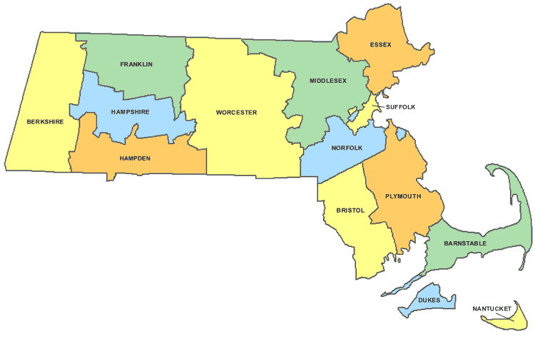
Initial Proposal for Trust Fund Dollars
  Harm Reduction Services
  DPH currently licenses 30+ Syringe Services Programs (SSP) across the Commonwealth, including 10 mobile units, where persons who inject drugs can receive sterile needles and syringes free of cost, dispose of used needles and syringes, and access other services such as testing for hepatitis C, HIV and other sexually transmitted infections, overdose education, and Narcan (naloxone).
  SSPs operate within cities/towns in which local boards of health have provided prior approval.
  Proposal
  $3.4 m (annually) in Trust Fund dollars to expand harm reduction programming at SSPs to include services not currently covered by federal funding, such as access to non-injection harm reduction services and supplies and additional education and information on the proper use of fentanyl test strips.
  Following Council approval, contracts with existing Overdose Education and Naloxone Distribution (OEND) providers through the Office of HIV/AIDS would be amended to include additional funds for staffing, purchasing of non-injection harm reduction supplies, and fund additional trainings for engagement of high-risk populations.
Existing Syringe Service Providers
SSP
Mobile unit

Slide 28
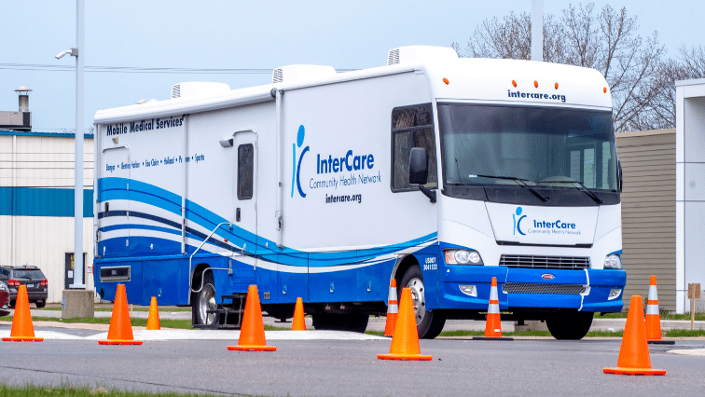
Initial Proposal for Trust Fund Dollars
  Opportunities to Increase Access to Methadone
  On June 28, 2021, the Drug Enforcement Agency (DEA) released new rules that allow DEA-registered opioid treatment providers (OTP) to establish and operate mobile methadone vans without obtaining a separate DEA registration for each mobile component.
    The rule change authorizes treatment providers the opportunity to improve access and treatment retention for underserved and marginalized populations, including Black and Latinx communities, and those whose transportation challenges to methadone treatment would otherwise be out of reach.
  Federally Qualified Health Centers (FQHC) and Community-Based Hospitals are additional potential locations for new OTPs that could access underserved communities and improve care through smaller, more individualized programs integrated into community-based settings.
  Proposal
  $3.1 m (annually) in Trust Fund dollars to expand low-threshold MOUD access including the procurement of mobile methadone vans or trailers for existing licensed OTPs.
  BSAS would update the Opioid Treatment Program RFR to include the purchase of 10-12 mobile methadone vans or trailers for existing licensed OTPs.
  Both new and existing brick-and-mortar OTPs would be eligible, with priority given to those sites working with underserved populations and high-risk communities.

Slide 29
Initial Proposal for Trust Fund Dollars
  Expanding Supportive Housing Programs
  To provide stability and supportive treatment options for high-risk populations, BSAS is implementing a number of low-threshold housing options for adults:
    Housing First model, comprised of low-threshold housing options and intensive case management services for adults experiencing homelessness and who are also at high risk for HIV, where sobriety is not a requirement of residence.
    Triage, Engagement, and Assessment (TEA) Model – Increases access to the continuum of SUD services for individuals experiencing homelessness who are active in their addiction and/or co-occurring substance use and mental health disorders, by providing addiction-specific support services within a low-threshold homeless drop-in or shelter setting. Assessment and engagement services include on-site addiction education, non-clinical assessment, and referral services.
    Housing Stability Support Program – Reinforces participants’ recovery from addiction through provision of services within permanent or transitional housing settings designed to establish community-based supports that help individuals, families, and young adults maintain ongoing goals in the recovery process, reduce the risk of relapse/overdose, and increase self-sufficiency.
  Proposal
  $2 m (annual) in Trust Fund dollars to expand low-barrier, recovery housing options and other basic needs support, including access to technology and transportation for high-risk populations in historically-underserved communities such as Fall River, Greenfield, and Pittsfield.
  Funding is estimated at ~$40K per person annually
  Utilizing the current RFR would enable expedited implementation of this proposal for some beds; further development could commence in FY23.

Slide 30
Initial Proposal for Trust Fund Dollars
  Community Outreach and Engagement
  Multi-disciplinary Community Outreach (MDCO) teams, similar in design to Programs for Assertive Community Treatment (PACT) teams, are a community-based, multi-disciplinary approach, which would provide treatment, rehabilitation, and supportive services to adults with severe and persistent mental illness and substance use disorder. Services would be offered in home and community settings, and for those experiencing homelessness.
  MDCO teams could include medical professionals, vocational/employment specialists, social workers, and/or recovery coaches. Their goal would be to provide multiple touches per week to keep high-risk individuals engaged and stable.
  Multi-disciplinary outreach models can be adapted for different populations, such as those who are at risk for overdose, substance use-related hospitalization, loss of child custody, or are at risk for involvement with the criminal justice system.
  The multi-disciplinary approach promotes independent living and an individual process of recovery, geared towards increasing tenure in the community and providing stabilizing support.
  Proposal
  $1.5m (annual) in Trust Fund dollars to develop MDCO teams for BSAS clients with high acuity of need who may not meet criteria for other programs and whose needs might not be met in a traditional care setting.
  Agencies that offer a range of behavioral health/SUD services including medical care could be funded to deploy MDCO teams, in collaboration with local partners to both receive referrals and coordinate care.

Slide 31
Current and Proposed Investments
Area | Current DPH Funding (Annual) | ORRF Proposed Investment (Annual)
Harm Reduction Services | $6.75M | $3.4M
Access to Methadone | $97.5M (OTP) $4.7M (OTP MAT enhanced) | $3.1M
Low-threshold Housing | $5.2M ($26M over 5 yrs) | $2.0M
Community Outreach and Engagement Team | - | $1.5M
 |  | Total: $10M

Slide 32
Vote to Adopt Proposals
  If there is consensus among members, the Council may adopt these proposals through a vote at the September 30, 2021 meeting, as follows:
  Motion that the Council recommend that the Secretary of Health and Human Services spend funds from the Opioid Recovery and Remediation Trust Fund consistent with the proposals outlined in this document and the Council’s discussions on September 30, 2021

Slide 33
Review of Draft Annual Report
The Secretary of the Executive Office of Health and Human Services is required by statute to submit an annual report to the Legislature no later than October 1st each year summarizing the activity, revenue, and expenditures to and from the Trust Fund during the prior fiscal year.
A draft report was shared with members last week, which will be submitted to the Legislature following today’s meeting.
Copies of the report will be posted to the EOHHS and Council webpages on Mass.gov

Slide 34
Upcoming Meetings
Date | Time | Location
October 1, 2021 – Submission of Annual Report to the Legislature
December 15, 2021 | 1:00 to 2:30 pm | WebEx
March 2022 | TBD | TBD
June 2022 | TBD | TBD
September 2022 | TBD | TBD
October 1, 2022 – Submission of Annual Report to the Legislature

