Slide 1
OTA Services
Tiffany Skogstrom, MPH
Director, Massachusetts Office of Technical Assistance
Spring 2026 Form S Training

Slide 2
Toxics Use Reduction Act (TURA) of 1989
Who reports?
What TURA requires
Massachusetts manufacturers who:
  Operate under certain Standard Industrial Classification (SIC) codes
  Have >10 employees
  Manufacture or process ≥25,000lbs
  (or otherwise use ≥10,000lbs)
  of listed substances
This covers a little over 400 Massachusetts facilities
Report to the state
Pay a fee
Create a Toxics Use Reduction Plan every two years
TURA does not prohibit companies from using listed chemicals.

Slide 3
TURA Program Implementation
MassDEP
Regulatory
TURI
Research & Grants
OTA
Confidential Technical Assistance
The TURA Program is co-implemented by:
  The Massachusetts Department
  of Environmental Protection
  The Massachusetts Office
  of Technical Assistance
  The Toxics Use Reduction Institute
  at UMass Lowell
TURA is a state law, not a federal law.
OTA, DEP, and TURI are not part of EPA.

Slide 4
Office of Technical Assistance (OTA)
  Non-regulatory agency
  Provides free, confidential technical and compliance assistance to MA businesses that use toxic substances
  Gives concrete recommendations for toxics reduction and resource conservation
  OTA has conducted 3,500 site visits at 1,500 facilities,
  reducing millions of pounds of toxic chemicals
  and millions of dollars in operating costs.

Slide 5

OTA Technical Assistance
OTA can assist facilities with:
  Toxics use reduction
  Environmental compliance
  Energy efficiency
  Resource conservation
Both onsite and remote
assistance are available
After a site visit, OTA delivers tailored recommendations

Slide 6
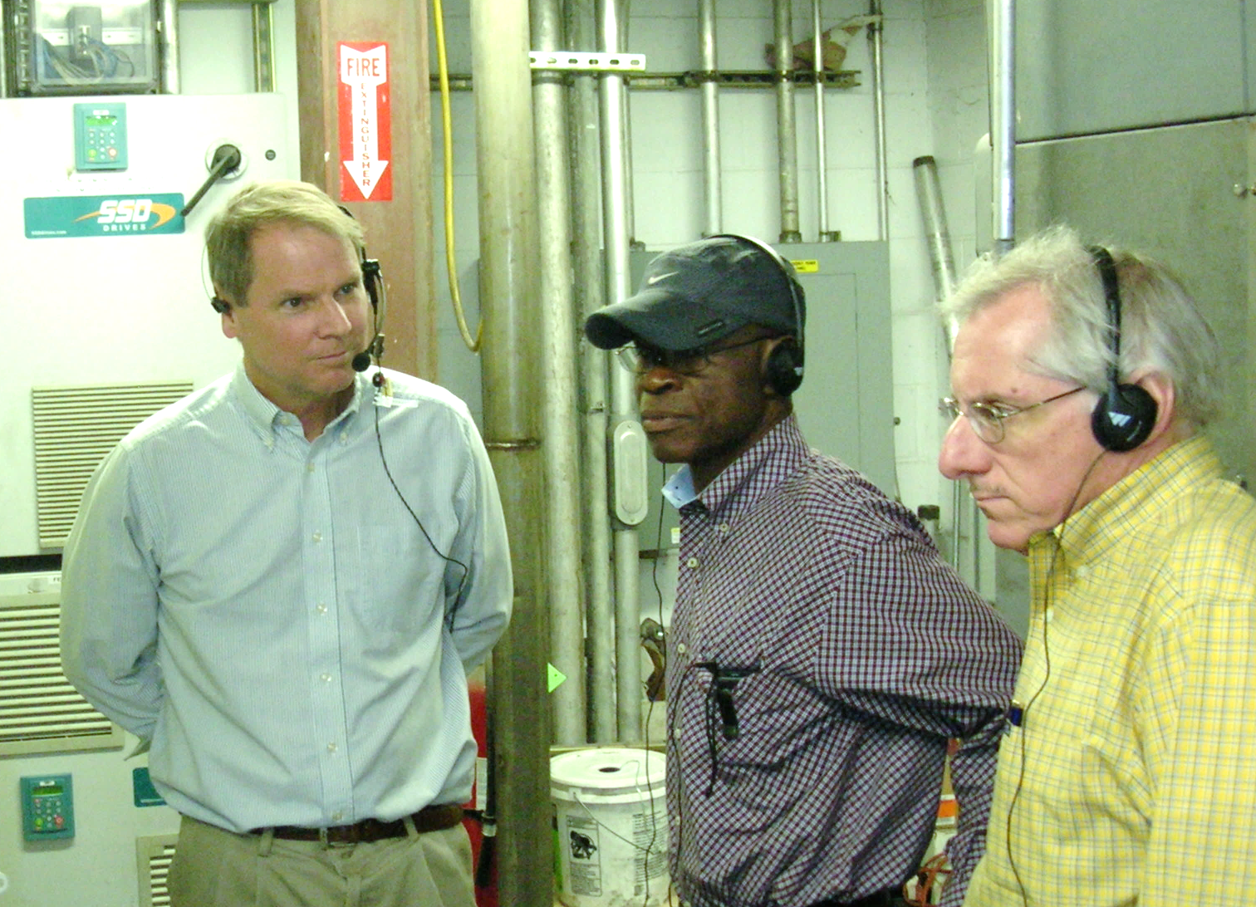
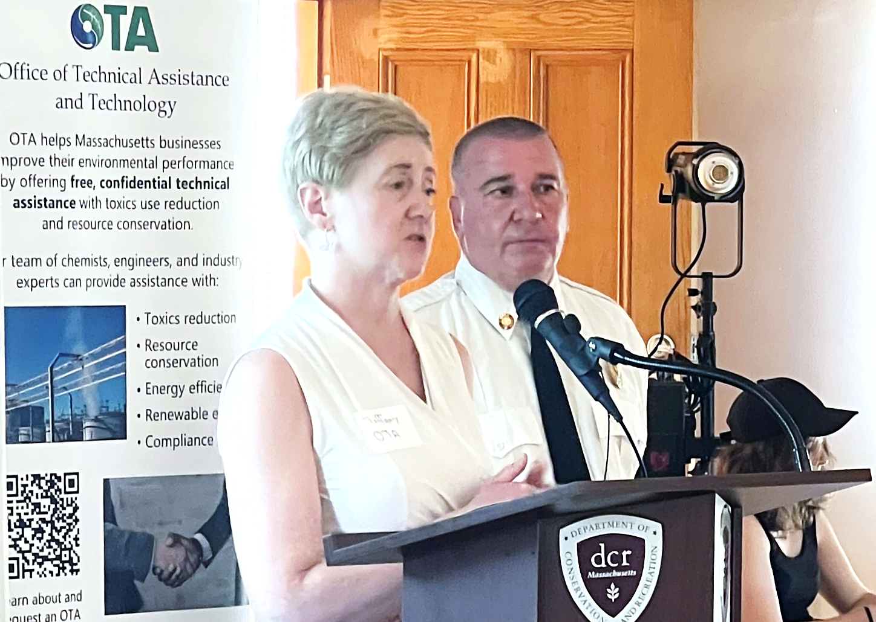
OTA Staff
Chemists, engineers, and public health professionals
Hands-on manufacturing experience
OTA understands:
Health and safety
The bottom line
Regulatory requirements
How to implement change

Slide 7

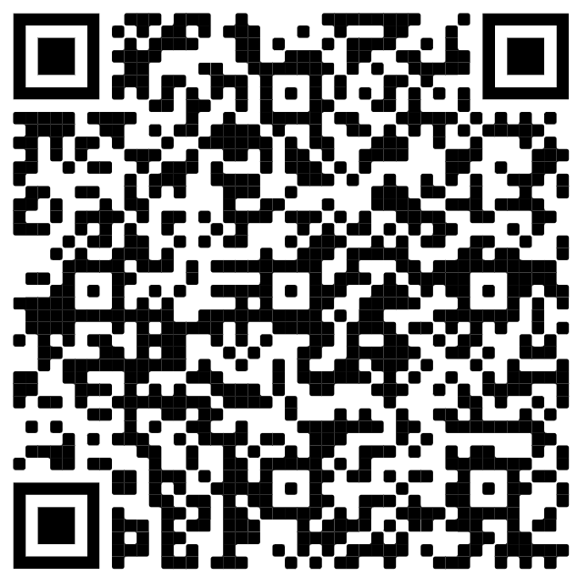
Contact Us
Tiffany Skogstrom, MPH
Director
tiffany.skogstrom@mass.gov
Website: mass.gov/ota
Office of Technical Assistance
Sign up for OTA’s newsletter!
Scan this QR code:
Or visit
bit.ly/OtaNewsletter

