Slide 1

An Overview of
Self-Determination and
DDS Service Models
ANNUAL REVIEW FOR ALL DDS STAFF
2017

Slide 2

All DDS staff are required to be familiar with the concepts of self determination and DDS’s service models that provide options for individuals to direct their own supports.
This training provides an information overview. DDS staff have a variety of opportunities to learn more about self direction.

Slide 3
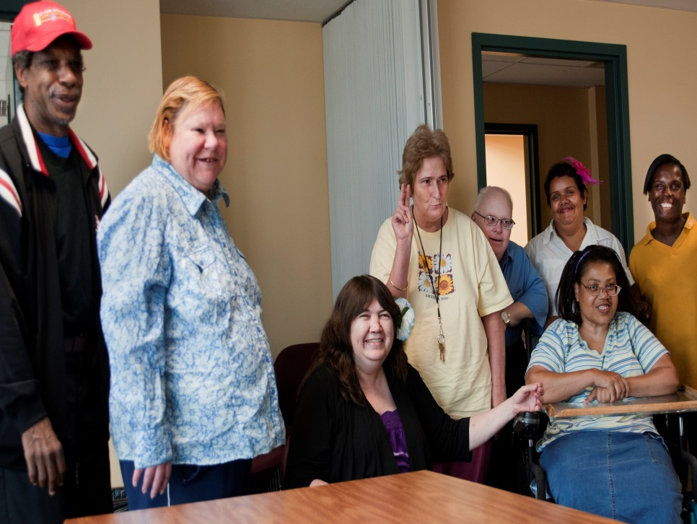
Introduction
Self-Direction is a way of providing supports to individuals that promotes personal choice and control. Individuals and/or families decide who provides those supports and how they are delivered.
Self-Direction is based on the
idea that individuals and
families are in the best
position to know about
their needs.

Slide 4
Self-Direction
Self-Direction enables individuals to be more engaged in managing their own services. Participants feel empowered and in charge of their lives.
Self-Direction encourages providers
to listen and respect the choices and
decisions that individuals make. By
self-directing their supports individuals
now have greater control and responsibility
and enjoy a greater quality of life.

Slide 5

Options in Self-Direction
DDS now offers two Self-Directed models in addition to the Traditional Model
Agency with Choice
Participant Directed Program
Both Self-Directed models offer the opportunity to tailor supports and services to the individual’s needs and circumstances.

Slide 6
Real Lives Law
Through Advocacy and legislative action, The Real Lives Law was passed on August 6, 2014.
Gives people the opportunity to use their allotted budget to purchase supports and services that meet their needs and goals.
Training will be provided to all DDS staff annually as required by the Real Lives Law.
The law established a 22 person advisory board to advise DDS on matters relevant to Self determination. The board began meeting in January of 2015.
  *HB4237 (Chapter 255 0f 2014)

Slide 7

What Will I Learn From This Presentation?
The principles of Self-Determination arose from local, state and national self advocacy and family advocacy movements and have led to human services system changes across the country.
The concept of Self-Determination.
The differences between Traditional Model and the two Self-Directed Models, Agency with Choice and Participant Directed Program.

Slide 8
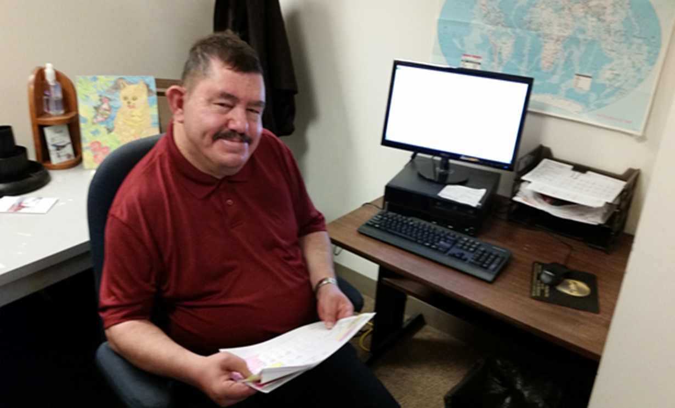
What Is Self-Determination?
Self-Determination is having control in your life to make choices based on preferences, beliefs and abilities to influence your future.
The process of designing and creating the services is called Self-Direction.

Slide 9
Principles of Self-Determination*
  Freedom to decide how one wants to live his or her life
  Authority over a targeted amount of dollars
  Support to organize resources in ways that are life enhancing and meaningful to the individual
  Responsibility for wise use of public dollars and the recognition of the contributions individuals across disability and aging can make to their communities
  Confirmation of the important roles individuals must play in the newly designed system
*From the website www: centerforself-determination.com

Slide 10

Why Were Self-Directed Models Developed?
The principles of Self-Determination arose from local, state and national self advocacy and family advocacy movements and have led to human services system changes across the country.
Many individuals and families sought alternatives to the traditional service delivery system. They wanted to take more control of their lives to make service decisions, choose their provider, and hire their staff.

Slide 11
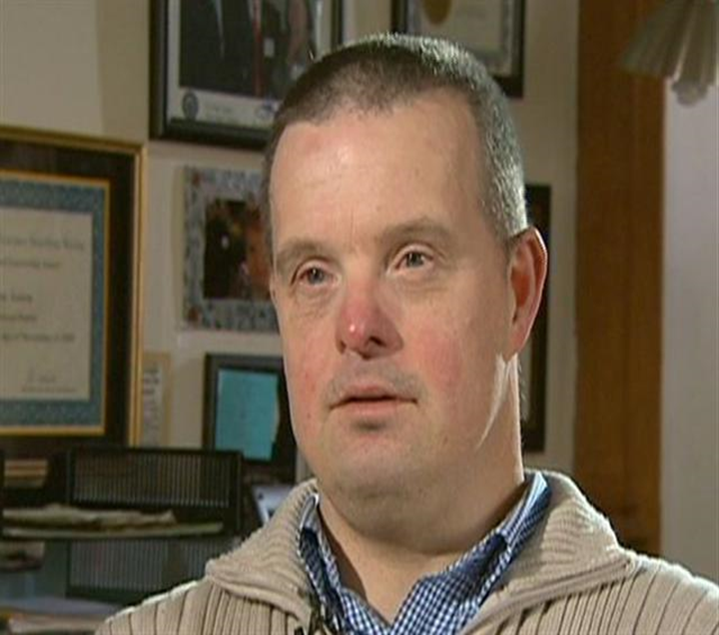
“Self-Determination is our Right!
“We need to have control over our choices.
Not to be told what we can and cannot do!” John Anton, Self Advocate
We want what everyone else wants:
Meaningful relationships, being valued, being included, meaningful work!
If we are not at the table in the plans about our lives, we may end up with a menu of services we do not want.
We can have these things even if we need support.”

Slide 12
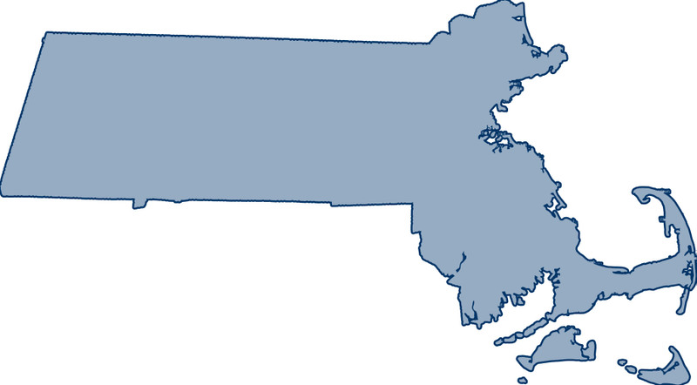
Massachusetts, and most other states, began incorporating Self-Direction into the service delivery system in the 1990s. Experience has demonstrated that offering a range of models is cost effective and most importantly, results in outcomes for many individuals that are positive and fulfilling.

Slide 13


What Is The Traditional Model of Service Delivery?
The Traditional Model of community supports began with the closing of large state institutions and has been available to individuals/families for almost a half a century. It is the most commonly used model in Massachusetts.
In this model, the agency contracts directly with DDS to deliver a specific range of supports (e.g. shared living, group homes, employment and day programs) to the individual. The agency has full authority and is responsible for hiring, training, supervising and paying employees.

Slide 14
How Does The Traditional Model Of Service Delivery Work?
Individuals, families and teams develop Individual Support Plans (ISP) and provide input on day to day decisions (e.g. activities in and out of home, meal choices and the time of meals, bedtime, furnishings etc.)
The provider agency has the responsibility for managing all aspects of the budget so that the services in the contract and ISP are provided according to applicable federal and state laws, DDS and other state regulations, as well as other DDS requirements.

Slide 15
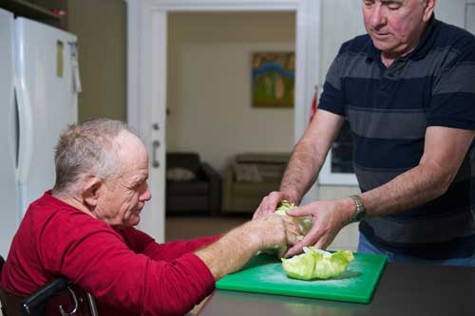
Who Can Receive Traditional Services?
To receive Traditional Services a person must:
Be eligible for DDS supports
Have an assessed need for the services to be provided
If applicable, be prioritized for DDS services

Slide 16

Example Of A Traditional Model
Christine is a 52 year old woman who lived at home with her family for most of her life. She was involved in all of the family activities until her parents became too frail to care for Christine. Initially she moved into a family owned apartment and her siblings provided care for her. DDS provided additional home supports and Christine received Personal Care Assistance (PCA’s). As Christine’s health changed, and her family was less able to continue providing care, more services were requested and Christine was prioritized for Residential Supports. With her changing needs the team determined that Christine would best be cared for in a 24 hour group home.

Slide 17
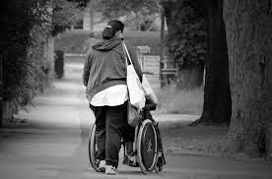
Christine’s Story
Christine moved into this Agency run group home and has actually been able to become more active in her community again. Staff provide her with the 24 hour care she needs as well as opportunities to participate in local activities. Christine’s family feel that she is doing well in her new home, she enjoys the companionship of her housemates, and has settled in nicely in her new home.

Slide 18
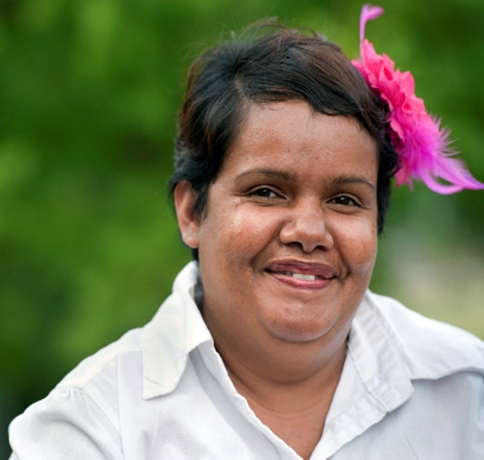
DDS Offers two Self Directed Models
Agency with Choice
Participant-Directed Program
Both Self-Directed models offer the opportunity to tailor supports to individual needs and circumstances and to exercise Self- Determination in their lives.

Slide 19

What Is Agency With Choice?
The Agency with Choice Program enables individuals and families to share responsibilities with a qualified Provider. The Individual/family is responsible for selecting their employees, setting work hours, and managing the day to day service delivery. Evaluation and training is shared between the Agency and the individual. The Agency employees and pays the worker, assumes payroll, withholdings, taxes and workers compensation responsibilities.

Slide 20
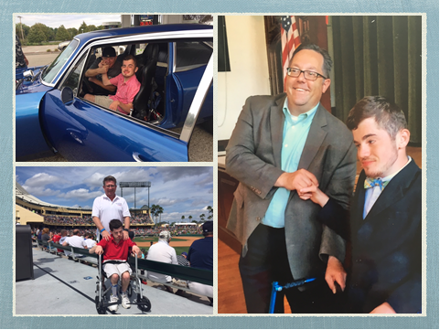

Agency With Choice
Offers an opportunity for people to have more involvement to share the responsibilities with a qualified provider.
The individual/family is responsible for selecting their employee.
Agency employs and pays the worker assumes payroll withholding, tax and workers compensation responsibilities
Agency monitors Budget and provides a monthly statement to individual
AWC can support individuals to find particular activities that fit their lifestyle and schedule. A chance for new opportunities.
Offers connections and social options

Slide 21
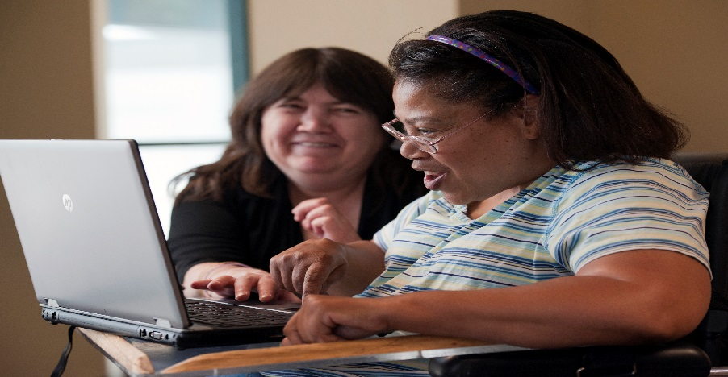
Who Can Choose the AWC Model?
To participate in AWC supports, a person must:
Be eligible for DDS supports
Have an assessed need and be prioritized for DDS services
Be willing and able to work cooperatively
with the provider agency
Be responsible for the day-to-day
management and supervision of
the employees

Slide 22
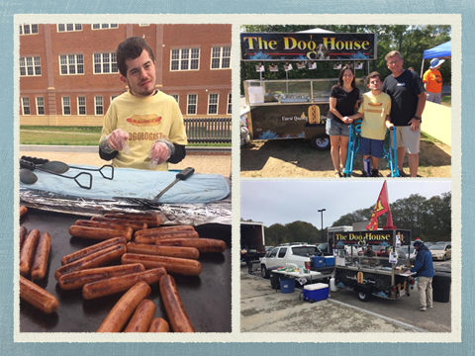
Example of Agency With Choice
John is supported to a have his own small business with the supports he has through the Agency with Choice model.
Johns job goal was to “sell hot dogs at Fenway”. A good compromise was to buy a hotdog cart and sell hot dogs at local community events. With assistance from his Support Workers, John is a valued member of his community. He is cooking and selling hot dogs at High school football games, public events and parties.

Slide 23
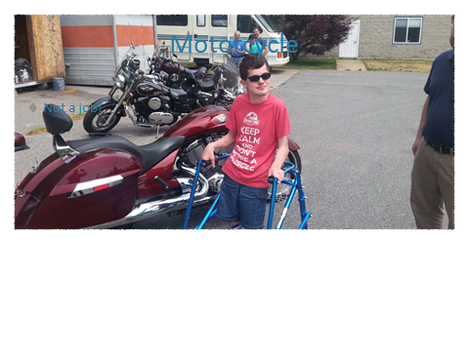
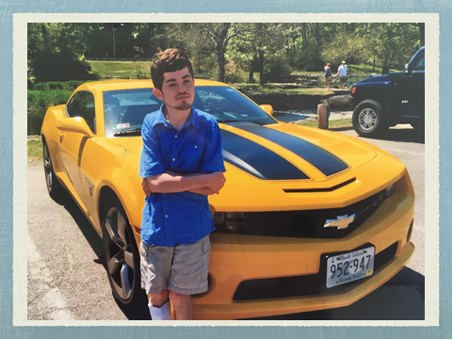
John’s Story
John is an active 22 year old man who wanted to be physically, mentally and socially active and have a meaningful and purposeful life.
The self-directed model, Agency with Choice, has enabled him to participate in other activities as well, including; volunteering for meals on wheels and his Church. John exercises at the YMCA, is learning to cook, explores his community, paints and would like to do public speaking.

Slide 24
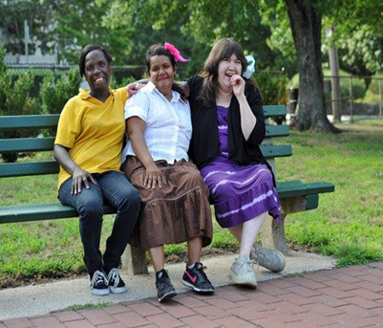
What Is The Participant Directed
Program Model?
The Participant Directed Program (PDP) offers the individual/family the most flexibility to arrange and customize their supports based on the individual’s needs and preferences. The individual can hire their own support staff, design their schedule and make other decisions about how to use their DDS funded allocation.

Slide 25


Participant Directed Program
The person self-directing makes his or her own decisions, determines how their DDS funding is spent for services, supports and goods (within DDS guidelines), and takes responsibility
for the decision he or she makes.
They work closely with their DDS Support Broker.

Slide 26

Participant Directed Program
A fiscal intermediary (FI) serves as the agent for individuals and families and is responsible for all payments. The FI pays support workers, and for other goods and services in accordance with the person’s budget. The FI provides financial monitoring and reporting and ensures compliance with all applicable federal and state laws, DDS and other state agency regulations, and with other DDS requirements.

Slide 27
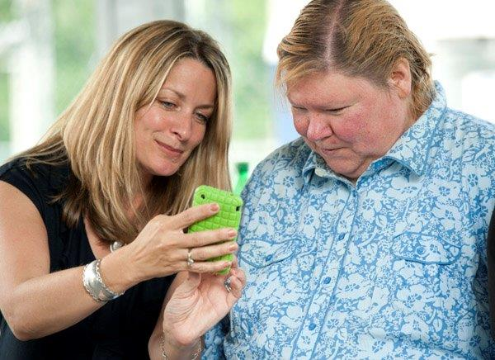
Participant Directed Program
A Support Broker, typically a DDS Service Coordinator, helps the person define his or her needs and vision through a person centered planning process that leads to an Individual Support Plan. The Support Broker helps the individual create and manage a budget within the allocated resources, and develop a network of services/supports. The Support Broker also acts on behalf of the individual to arrange for needed services, to provide information on resources and to support the individual in evaluating the effectiveness of supports.

Slide 28

Other Key Components of the Participant Directed Program
The Individual Budget enables a participant to direct and manage the delivery of services he or she is authorized to use.
By utilizing the budget an individual has:
control of a specific amount of funds and
the responsibility and freedom to purchase supports, services and goods from a variety of sources.

Slide 29

Other Key Components Of The PDP Model
DDS completes the process to qualify staff hired by the individual. All staff employed in this model must:
  be at least 18 years old
  have a CORI (Criminal Offender Record Information)
  have a high school diploma or GED (General Education Development) Certificate
  A driver’s license is frequently required.
  Other education, credentials, and/or experience
  may be required for some services (e.g. nursing
  and other therapeutic services).

Slide 30
Who Can Enroll in the Participant
Directed Program?
To enroll in the Participant Directed Program, a person must:
be eligible for DDS supports
have an assessed need for the services to be provided
if applicable, be prioritized for DDS services
receive a DDS allocation
be willing and able to work cooperatively with a Support Broker
be responsible, working closely with a Support Broker, to manage their services and budget
Individuals meeting the above criteria in adult services, children in the Department of Elementary and Secondary Education (DESE) program, and adults in the Autism Services Division may choose the Participant Directed Program as their method of service delivery. All participants in the Children's Autism Waiver program direct their services.

Slide 31
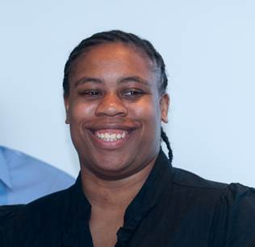
Example of Participant Directed Program
Lisa says, “ I feel more like an adult!”
Lisa is a 34 year old woman with a million
dollar smile that lights up a room. She was
adopted by her foster mother who bought a
building with a separate apartment. Lisa had an
opportunity to move there and become more
independent.
She decided to direct her own services through the Participant Directed Program. She uses Individualized Home supports and hired a worker to visit each week and help her stay on track with her goals.

Slide 32

Lisa’s story
Although her first worker didn’t work out so well. She interviewed and hired a different person. With her current worker’s assistance, she has grown by leaps and bounds. For example, after taking a cooking class Lisa decided she wanted to cook more independently at home. Previously she never had any real interest in cooking and relied on others to prepare meals for her. Lisa set her mind to it and now cooks meals at home on a regular basis. A few years ago she joined a Zumba class. That experience brought out the natural born leader in Lisa and she is very helpful with others that need more assistance. She is always willing to lend a hand to teach someone something.

Slide 33

Lisa’s story
Being able to make her own choices through self-direction has strengthened Lisa’s confidence and willingness to try new things.
Lisa feels her biggest accomplishment is her comfort in negotiating with her mother. Lisa used to doubt herself, now she can talk with her mother about decisions she is making.

Slide 34
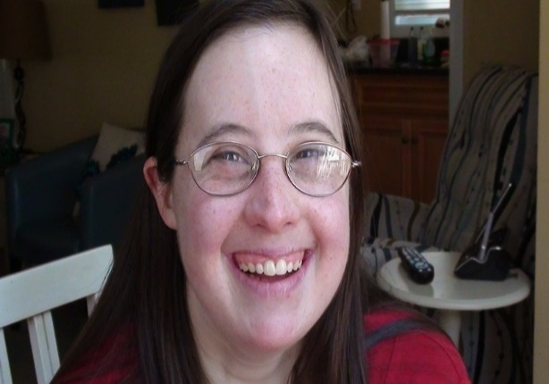
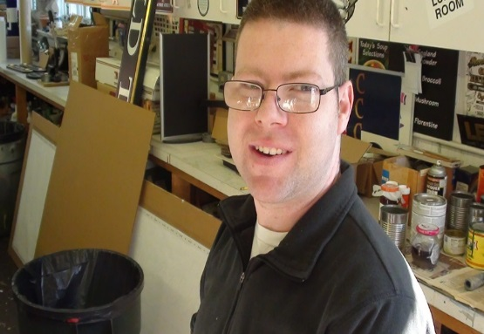
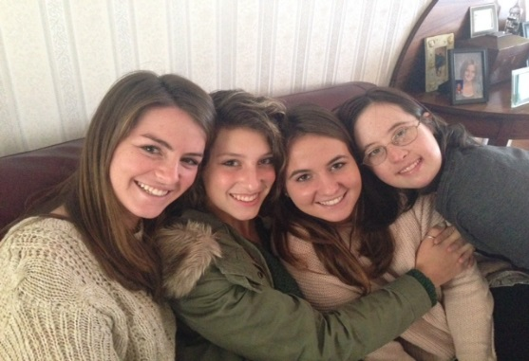
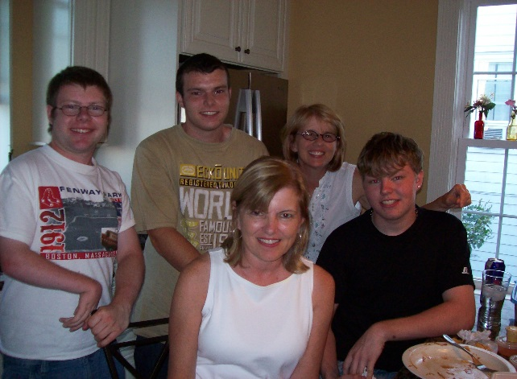
Comments From Family Members
About Self-Direction
“My daughter needed the flexibility available in Self-Directed supports. Without it, her quality of life wouldn’t be possible.”
“Self-Direction gives my son more confidence and esteem because he has a real voice.” " My son sees his siblings doing all kinds of things. He wants to have the same opportunities and choices that they have. I just want him to be happy."

Slide 35

Comments from Family Members on
Self-Direction
The following are quotes from families regarding self-direction.
“The flexibility of participant direction makes it possible to quickly make things happen.”
“You don’t have to wait for someone at an agency to give you prior approval to address a given need.”
“My son is in control, he chooses what
he wants to do…”

Slide 36

Review of Terms
Self-Determination is the concept of having control in one’s life to make choices based on preferences, beliefs and abilities to influence one’s future.
Self-Direction is a process that enables individuals to have control over an allocation of funding to arrange their own customized supports and to give the authority to hire and fire the staff who provide those supports.
  The two model which individuals can choose to Self-direct their services are:
    Participant Directed Program (PDP)
    Agency with Choice

Slide 37

Review Of Terms
In Agency With Choice the individual works collaboratively with a qualified agency to design his/her services and directs their staff while the Agency is responsible for the administrative and paperwork responsibilities associated with being an employer and managing a budget.

Slide 38

Review Of Terms
Participant Directed Program offers the individual the most control, flexibility and control to arrange and customize the supports based on needs and preferences. You can hire your own support workers, design their schedule and make decisions on how to use your DDS allocation. You have the assistance of a Fiscal Intermediary to monitor the budget, manage paperwork, and maintain accounting and compliance responsibilities.

Slide 39
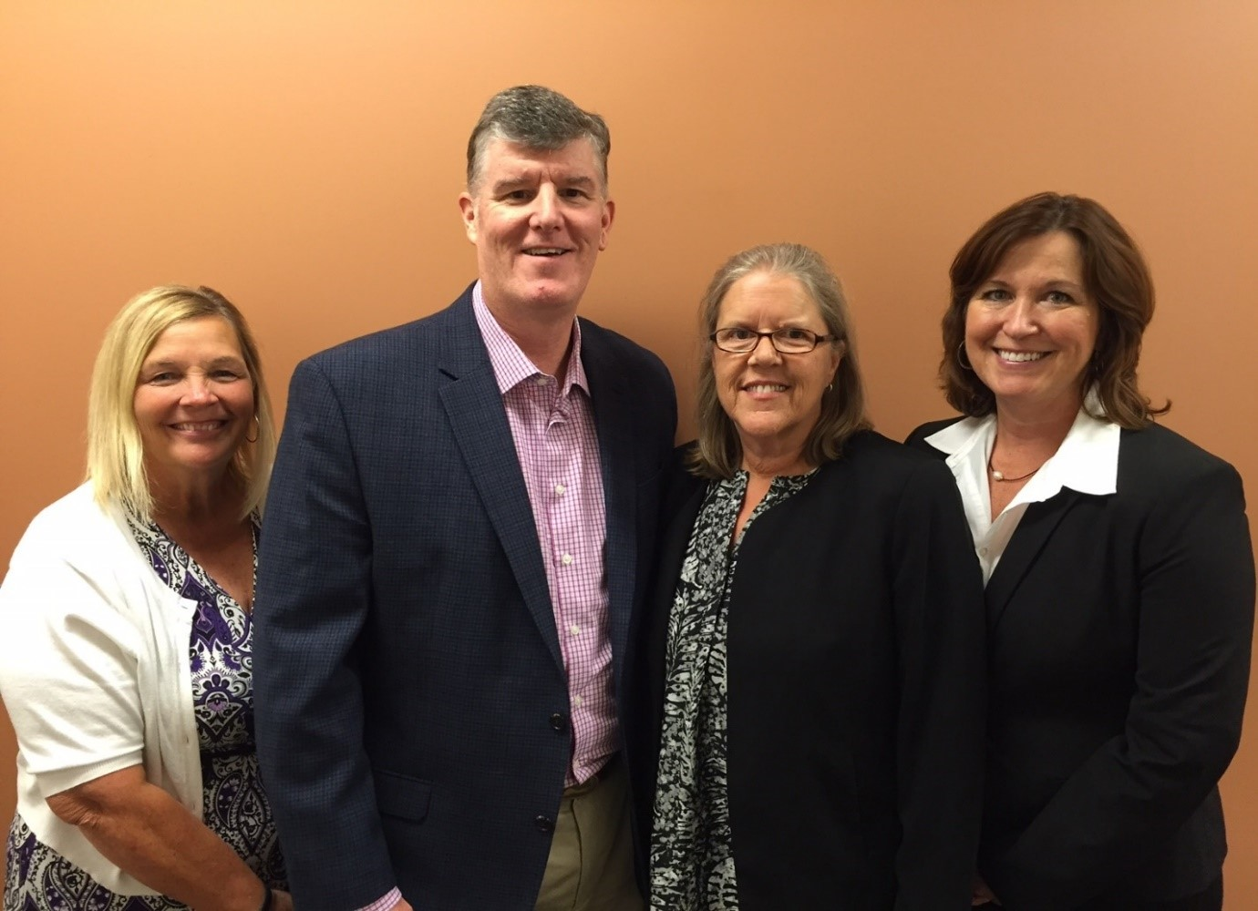
Expanding Self-Determination and the Use of Self-Directed Supports
DDS is taking a number of steps to help ensure the integration and full support of these options for the people it supports including the addition of four Regional Self-Direction Managers.
These four Regional Managers work together to provide consistent leadership, coordination, management and oversight in the effort to develop and expand the use of self-direction in their regions. They also play a key role in working with Area and provider agency staff to identify and encourage individuals who want to explore the self-direction options available.

Slide 40
More Training opportunities
DDS Regional Training Departments offer training opportunities for all staff throughout the year on various aspects of self determination and self directed services. Using the web browser Chrome go to:
www.DDSLearning.com to refer to your Regional Training Calendar for more information.
New Service Coordination hires are offered a classroom training on self directed supports as part of SC1 orientation. Please refer to training announcements from The Service Coordinator Institute available on Chrome at www.DDSLearning.com
Also, see DDS’s Learning and Development website for new training and development opportunities at www.DDSLearning.com.

Slide 41
For More Information On
Self-Determination in DDS
Go to mass.gov/ehhs/dds. Left column and click on Self-determination or Self Directed Supports.
On these sites you will find documents related to DDS work on self-determination from the past several years as well as links to the Real Lives Law, the SDAB membership list, the Work Plan related to the law, links to provider agency information and much more.
You can also provide feedback to DDS via this website and through the feedback form for this review.
Thank you for your time and attention!

