Slide 1
Surveillance Data Overview of Sexually Transmitted Infections, Massachusetts, 1990-2019
Massachusetts Department of Public Health
Bureau of Infectious Disease and Laboratory Sciences
Notes:
Picture description: logo for the Massachusetts Department of Public Health

Slide 2
Outline
Sexually Transmitted Infection (STI) Trends and Descriptions:
General STI trends through 2019
Chlamydia
Gonorrhea
Infectious syphilis
Descriptions of 2019 STI Cases
HIV/STI and Sexual Risk
Technical Notes

Slide 3
Massachusetts STI Trends
Notes:
Picture description: logo for the Massachusetts Department of Public Health

Slide 4
Confirmed Chlamydia Cases, Massachusetts, 2000 to 2019
Chlamydia cases have increased 32% from 2015 to 2019
Data are current as of 9/9/2020 and are subject to change.
Data Source: Massachusetts Department of Public Health/Bureau of Infectious Disease and Laboratory Sciences/ Division of STD Prevention
Note: Case counts prior to 2000 are not presented due to the changes in testing methods.
Notes:
Confirmed Chlamydia Cases, Massachusetts, 1990 to 2019
Graph depicts the number of confirmed cases of chlamydia in Massachusetts between 2000 and 2019. It begins at low of 9,872 in 2000 and then climbs to a high of 31,634 in 2019. There is a text box that indicates a 32% increase in chlamydia cases between 2015 and 2019.

Slide 5
Confirmed Chlamydia Cases by Gender Identity,* Massachusetts, 2010 to 2019
From 2015 to 2019 male cases increased 44%
and female cases increased 25%
Data are current as of 9/9/2020 and are subject to change.
Data Source: Massachusetts Department of Public Health/Bureau of Infectious Disease and Laboratory Sciences/ Division of STD Prevention
*There were cases reported among transgender individuals in 2014 through 2019. In 2019, there were 51 cases of chlamydia among transgender individuals not included on this slide
Notes:
Confirmed Chlamydia Cases by Gender Identity, Massachusetts, 2000 to 2019
Graph depicts the number of confirmed cases of chlamydia in Massachusetts by gender identity between 2000 and 2019. There are two lines, one for females that begins at 7,602 in 2000 and climbs to 19,370 in 2019 and another for males that begins at 2,270 in 2000 and climbs to 12,512 in 2019. A text box indicates that the number of cases between 2015 and 2019 increased 25% for females and 44% for males.
Note: There were cases reported among transgender individuals in 2014 through 2019. In 2019, there were 51 cases of chlamydia among transgender individuals not included on this slide

Slide 6
Confirmed Gonorrhea Cases, Massachusetts, 1990 to 2019
Gonorrhea cases have increased 99% from 2015 to 2019
Data are current as of 09/11/2020 and are subject to change.
Data Source: Massachusetts Department of Public Health/Bureau of Infectious Disease and Laboratory Sciences/ Division of STD Prevention
Notes:
Confirmed Gonorrhea Cases, Massachusetts, 1990 to 2019
Graph depicts the number of confirmed cases of gonorrhea in Massachusetts between 1990 and 2019. It begins at 7,531 in 1990, drops to a low of 1,518 in 2009 and climbs to a high of 7,667 in 2018 and a decrease to 7,172 in 2019. There is a text box that indicates a 99% increase in gonorrhea cases between 2015 and 2019.

Slide 7
Confirmed Gonorrhea Cases by Gender Identity,* Massachusetts, 2000 to 2019
From 2015 to 2019 male cases increased 89% and female cases increased 126%
Data are current as of 09/11/2020 and are subject to change.
Data Source: Massachusetts Department of Public Health/Bureau of Infectious Disease and Laboratory Sciences/ Division of STD Prevention
*There were cases reported among transgender individuals in 2014 through 2019. In 2019, there were 41 cases of gonorrhea among transgender identified individuals not included on this slide
Notes:
Confirmed Gonorrhea Cases by Gender Identity, Massachusetts, 2000 to 2019
Graph depicts the number of confirmed cases of gonorrhea in Massachusetts by gender identity between 2000 and 2019. There are two lines, one for females that begins at 999 in 2000 and climbs to 2,113 in 2019 and another for males that begins at 935 in 2000 and climbs to 5,008 in 2019. A text box indicates that the number of cases between 2015 and 2019 increased 126% for females and 89% for males.
Note: There were cases reported among transgender individuals in 2014 through 2019. In 2019, there were 41 cases of gonorrhea among transgender identified individuals not included on this slide

Slide 8
Confirmed and Probable Infectious Syphilis* Cases, Massachusetts, 1990 to 2019
Infectious syphilis cases have increased 56% from 2015 to 2019
Data are current as of 9/9/2020 and are subject to change.
Data Source: Massachusetts Department of Public Health/Bureau of Infectious Disease and Laboratory Sciences/ Division of STD Prevention
*Infectious syphilis is defined as primary, secondary and early latent stages of syphilis within one year of infection.
Notes:
Confirmed and Probable Infectious Syphilis Cases, Massachusetts, 1990 to 2019
Graph depicts the number of confirmed and probable cases of syphilis in Massachusetts between 1990 and 2019. It begins at 1,175 in 1990, drops to a low of 103 in 1999 and climbs to a high of 1,243 in 2019. There is a text box that indicates a 56% increase in syphilis cases between 2015 and 2019.
Note: Infectious syphilis is defined as primary, secondary and early latent stages of syphilis within one year of infection.

Slide 9
Confirmed and Probable Infectious Syphilis* by Gender Identity,** Massachusetts, 2010 to 2019
From 2015 to 2019 male cases increased 50% and female cases increased 125%
Data are current as of 9/9/2020 and are subject to change.
Data Source: Massachusetts Department of Public Health/Bureau of Infectious Disease and Laboratory Sciences/ Division of STD Prevention
*Infectious syphilis is defined as primary, secondary and early latent stages of syphilis within one year of infection.
**Transgender identified individuals are reported on the next 2 slides.
Notes:
Confirmed and Probable Infectious Syphilis by Gender Identity, Massachusetts, 2000 to 2019
Graph depicts the number of confirmed and probable cases of syphilis in Massachusetts by gender identity between 2000 and 2019. There are two lines, one for females that begins at 47 in 2000 and remains relatively with a low of 19 in 2009 and a high of 126 in 2019 and another for males that begins at 94 in 2000 and climbs to 1,106 in 2019. A text box indicates that the number of cases between 2015 and 2019 increased 125% for females and 50% for males.
Note: Infectious syphilis is defined as primary, secondary and early latent stages of syphilis within one year of infection.

Slide 10
Confirmed and Probable Infectious Syphilis * among Transgender Identified Individuals, Massachusetts, 2015 to 2019
Data are current as of 9/9/2020 and are subject to change.
Data Source: Massachusetts Department of Public Health/Bureau of Infectious Disease and Laboratory Sciences/ Division of STD Prevention
*Infectious syphilis is defined as primary, secondary and early latent stages of syphilis within one year of infection.
Note: Value suppressed due to small population and case counts <5 in accordance with confidentiality and security requirements.
Notes:
Confirmed and Probable Infectious Syphilis among Transgender Identified Individuals, Massachusetts, 2015 to 2019
Graph shows the number of confirmed and probably infectious syphilis cases among transgender individuals in Massachusetts between 2015 and 2019. The case counts are eight, six, less than five, twenty and twelve for 2015, 2016, 2017, 2018, and 2019 respectively.
*Infectious syphilis is defined as primary, secondary and early latent stages of syphilis within one year of infection.
Note: The 2017 value is suppressed due to small or unknown population size and case counts less than 5 observations in accordance with confidentiality and security requirements. Infectious syphilis is defined as primary, secondary and early latent stages of syphilis within one year of infection.

Slide 11
Confirmed and Probable Infectious Syphilis * among Transgender Identified Individuals, Massachusetts, 2019
Of the 12 cases reported,
Majority (>90%) of cases were sex assigned male at birth, with current gender identity female
Majority (>80%) of cases were in their 20s and 30s.
Majority (>80%) of cases were US born
42% were Hispanic/Latinx
25% were HIV-infected at the time of syphilis diagnosis
Data are current as of 9/9/2020 and are subject to change.
Data Source: Massachusetts Department of Public Health/Bureau of Infectious Disease and Laboratory Sciences/ Division of STD Prevention
*Infectious syphilis is defined as primary, secondary and early latent stages of syphilis within one year of infection.

Slide 12
Description of 2019 STI Cases
Geographic Distribution
Age, Gender, Sexual Risk Categories, and Race-Ethnicity
Notes:
Picture description: logo for the Massachusetts Department of Public Health

Slide 13
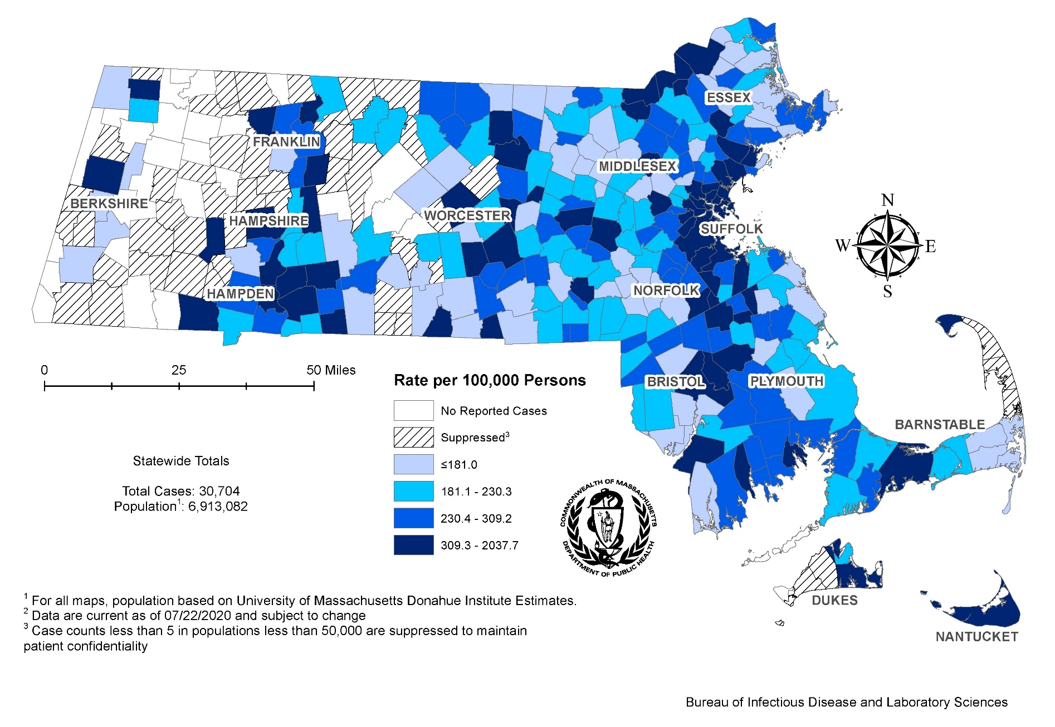
Incident Rate of Confirmed Chlamydia Cases, per 100,000 Persons¹ by City/Town, Massachusetts, 2019^{2,3}
Notes:
Incident Rate of Confirmed Chlamydia Cases, per 100,000 Persons by City/Town, Massachusetts, 2019
Map of Massachusetts cities and towns color-coded to indicate the areas of the state with the highest chlamydia case rates in 2019. The cities that have the highest rates (greater than 500 per 100,000 persons) are Provincetown, Lawrence, Brockton, Springfield, Boston, Chelsea, Everett, Randolph, Holyoke, Lowell, Lynn, Revere, Worcester, Tisbury, New Bedford, Malden, Amherst, Somerville, Salem, Fitchburg, Chicopee, Medford, Methuen, Granville, Framingham, Haverhill, and Middleton.

Slide 14
Confirmed Chlamydia Case Rates per 100,000 Population by Gender and Age, Massachusetts, 2019
N=31,634
Total
Data are current as of 9/9/2020 and are subject to change.
Data Source: Massachusetts Department of Public Health/Bureau of Infectious Disease and Laboratory Sciences/ Division of STD Prevention
Due to small counts, transgender cases are not included as a gender category
Individuals less than 15 years of age were excluded from this graph due to small numbers. Those cases with unknown or transgender identity were excluded due to small numbers.
Notes:
Confirmed Chlamydia Case Rates per 100,000 Population by Gender and Age, Massachusetts, 2019
Graph depicts CT rates by age categories for the overall state, males, and females. For the overall state, the highest rate is among those 20-24 years. When looking at the gender specific rates, the age categories with the highest rates are 20-24 years for both males and females.

Slide 15
Average Age of Confirmed Chlamydia Cases by Year, Massachusetts, 2000 to 2019
N=31,634
In 2019, 58.8% of confirmed chlamydia cases were reported among 15-24 year olds.
To view tables showing chlamydia morbidity by town please visit https://www.mass.gov/lists/STD-data-and-reports
Data are current as of 9/9/2020 and are subject to change.
Data Source: Massachusetts Department of Public Health/Bureau of Infectious Disease and Laboratory Sciences/ Division of STD Prevention
Notes:
Average Age of Confirmed Chlamydia Cases by Year, Massachusetts, 2000 to 2019
Graph depicts the average age of confirmed chlamydia cases by year between 2000 and 2019. The lowest average age is 22.8 for the years 2001, 2002, and 2003 then rises to a high average age of 25.0 in 2018. The average age of chlamydia cases in 2019 was 25.3.

Slide 16
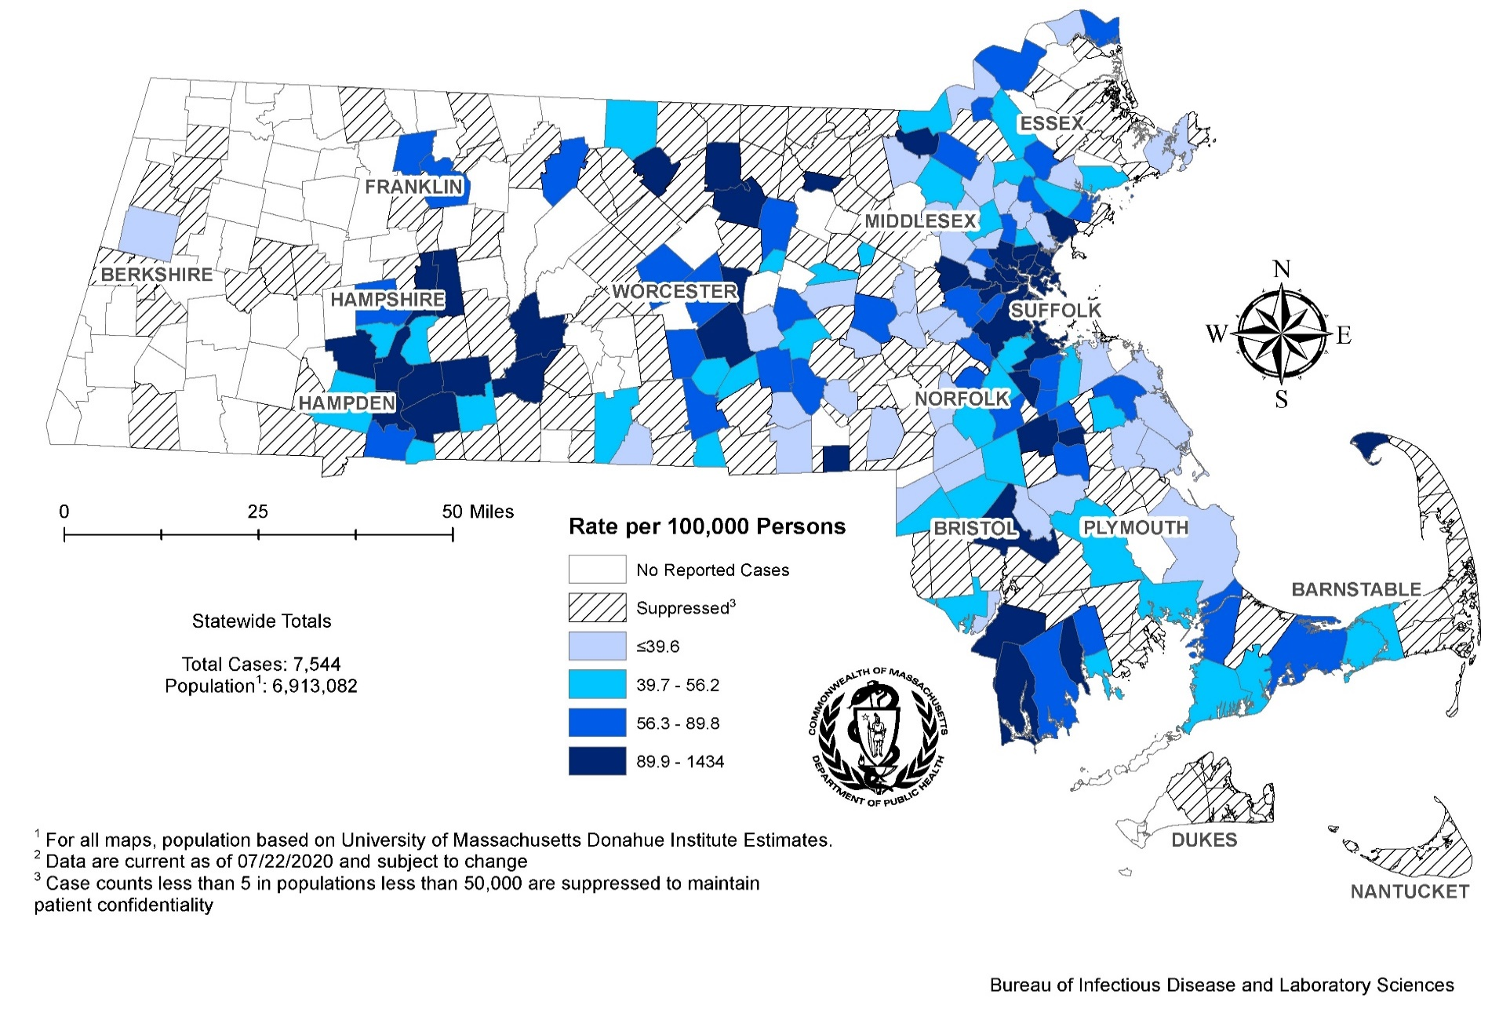
Incident Rate of Confirmed Gonorrhea Cases, per 100,000 Persons¹ by City/Town, Massachusetts, 2019^{2,3}
Notes:
Incident Rate of Confirmed Gonorrhea Cases, per 100,000 Persons by City/Town, Massachusetts, 2019
Map of Massachusetts cities and towns color-coded to indicate the areas of the state with the highest gonorrhea case rates in 2019. The city with the highest rate (>500 per 100,000 persons) is Provincetown. Other cities that have the high rates (greater than 200-500 per 100,000 persons) are Boston, Springfield, Chelsea, Holyoke, Brockton, and Fitchburg.

Slide 17
Confirmed Gonorrhea Case Rates per 100,000 Population by Gender and Age, Massachusetts, 2019
N=7,172
Rate per 100,000
Age Groups
Data are current as of 9/11/2020 and are subject to change.
Data Source: Massachusetts Department of Public Health/Bureau of Infectious Disease and Laboratory Sciences/ Division of STD Prevention
Due to small counts, transgender cases are not included as a gender category
Individuals less than 15 years of age were excluded from this graph due to small numbers. Those cases with unknown or transgender identity were excluded due to small numbers.
Notes:
Confirmed Gonorrhea Case Rates per 100,000 Population by Gender and Age, Massachusetts, 2019
Graph depicts GC rates by age categories for the overall state, males, and females. For the overall state, the highest rate is among those 30-34 years
When looking at the gender specific rates, the age categories with the highest rates are 30-34 for males and 20-24 for females.

Slide 18
Confirmed Gonorrhea Case Rates per 100,000 Population by County, Massachusetts, 2017-2019
To view tables showing gonorrhea morbidity by town please visit https://www.mass.gov/lists/STD-data-and-reports
Data are current as of 9/11/2020 and are subject to change.
Data Source: Massachusetts Department of Public Health/Bureau of Infectious Disease and Laboratory Sciences/ Division of STD Prevention
Notes:
Confirmed Gonorrhea Case Rates per 100,000 Population by County , Massachusetts, 2017-2019
Graph depicts the confirmed case rates for gonorrhea by county in Massachusetts with clustered bars (a cluster of three for each county) that compare the rates in 2017, 2018, and 2019. Two counties, Hampden and Suffolk are roughly twice as high as the other counties. The case rates by year for Hampden county (per 100,000 persons) are 228.2, 206.3, and 173.1 for 2017, 2018, and 2019, respectively. The case rates by year for Suffolk county (per 100,000 persons) are 246.8, 284.9, and 285.2 for 2017, 2018, and 2019, respectively. The remainder of the counties cluster around the Massachusetts average case rate (per 100,000) of 105.6, 110.4, and 103.0 for 2017, 2018, and 2019, respectively.

Slide 19
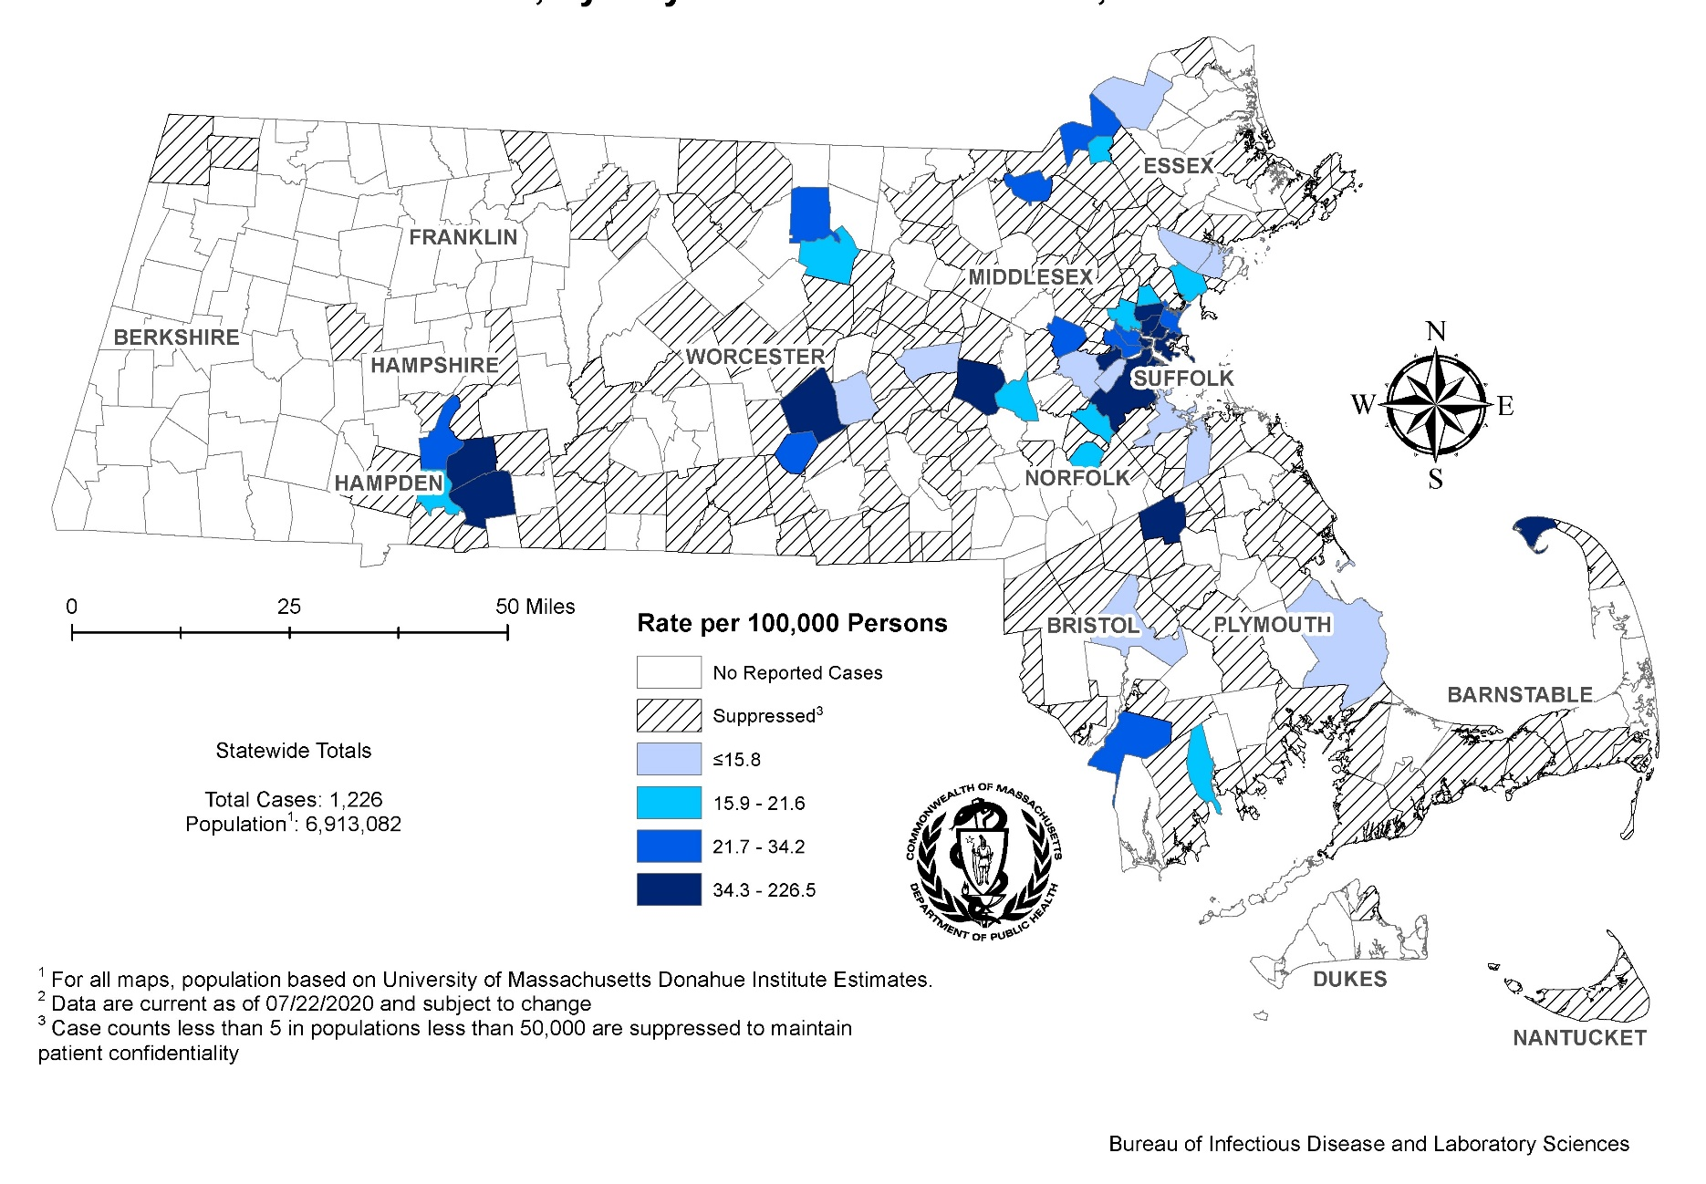
Incident Rate of Infectious Syphilis * Cases, per 100,000 Persons¹ by City/Town, Massachusetts, 2019^{2,3}
*Infectious syphilis is defined as primary, secondary and early latent stages of syphilis within one year of infection.
Notes:
Incident Rate of Infectious Syphilis Cases, per 100,000 Persons by City/Town, Massachusetts, 2019
Map of Massachusetts counties color-coded to indicate the areas of the state with the highest chlamydia case rates in 2019. The cities that have the highest rates (greater than 40 per 100,000 persons) are Provincetown, Truro, Plainfield, Chesterfield, Granville, Nahant, Chelsea, Ayer, Stockbridge, Boston, Everett, Hubbardston, Middleton, and Somerville.

Slide 20
Confirmed and Probable Infectious Syphilis * Case Rates per 100,000 Population by County, Massachusetts, 2019
N=1,243
Rate per 100,000
Age Groups
Data are current as of 9/9/2020 and are subject to change.
Data Source: Massachusetts Department of Public Health/Bureau of Infectious Disease and Laboratory Sciences/ Division of STD Prevention
Due to small counts, transgender cases are not included as a gender category
Individuals less than 15 years of age were excluded from this graph due to small numbers. Those cases with transgender identity were excluded due to small numbers.
*Infectious syphilis is defined as primary, secondary and early latent stages of syphilis within one year of infection.
Notes:
Confirmed and Probable Infectious Syphilis Case Rates per 100,000 Population by County, Massachusetts, 2019
Graph depicts infectious syphilis rates by age categories for the overall state, males, and females. For the overall state, the highest rate is among those 25 to 29 years.
When looking at the gender specific rates, the age categories with the highest rates are 25 to 29 for males and 20-24 for females.

Slide 21
Comparison of the Rate of Infectious Syphilis * Cases by Race and Ethnicity, Massachusetts, 2019
N=1,243
Rate per 100,000
Data are current as of 9/9/2020 and are subject to change.
Data Source: Massachusetts Department of Public Health/Bureau of Infectious Disease and Laboratory Sciences/ Division of STD Prevention
Due to small counts cases with races other than white or black they were complied into other and unknown non-Hispanic category. Unknown race/ethnicity represents less than 10% of the total number of reportable infections syphilis cases.
Population percentages are based on 2018 estimates, most recently available
Individuals less than 15 years of age were excluded from this graph due to small numbers.
*Infectious syphilis is defined as primary, secondary and early latent stages of syphilis within one year of infection.
Notes:
Comparison of the Rate of Infectious Syphilis Cases by Race and Ethnicity, Massachusetts 2019
Graph depicts infectious syphilis rates by age and race/ethnicity categories for the overall state, males, and females. For all infectious syphilis cases, the highest rate is among black non-Hispanic/Latinx.
When looking at the age specific rates, the race/ethnicity categories with the highest rates are black non-Hispanic/Latinx age 30-34 and 20-24

Slide 22
Primary and Secondary Syphilis Cases by Gender of Sex Partners, Massachusetts, 2015 to 2019
N=1,243
Data are current as of 9/9/2020 and are subject to change. See data notes on slide 4 for label abbreviations.
Data Source: Massachusetts Department of Public Health/Bureau of Infectious Disease and Laboratory Sciences/ Division of STD Prevention
Categories: MSM = Men with males sex partners with or without other sex partners , MSW = Men with female sex partners, WSM = Women with male sex partners, Other = transgender individuals and women with non-male sexual contacts.
Notes:
Primary and Secondary Syphilis Cases by Sexual Risk Category, Massachusetts 2015 to 2019
Graph depicts the percentage of primary and secondary syphilis by sexual risk category by year in Massachusetts using “100% bars” for the years 2015-2019. The MSM risk group contributes the majority of cases in each year is MSM which contributes 74%, 71%, 79%, 64%, and 71% of cases in 2015, 2016, 2017, 2018, and 2019, respectively. The next-highest sexual risk group is MSW which contributes 7%, 10%, 9%, 11%, and 9% of cases in 2015, 2016, 2017, 2018, and 2019 respectively.
Categories: MSM = Men with males sex partners with or without other sex partners , MSW = Men with female sex partners, WSM = Women with male sex partners, Other = transgender individuals and women with non-male sexual contacts.

Slide 23
Congenital Syphilis Cases and Rate of Confirmed and Probable Infectious Syphilis * Among Females Age 15 to 44 Years, Massachusetts, 2010-2019
Data Source: Massachusetts Department of Public Health/Bureau of Infectious Disease and Laboratory Sciences/ Division of STD Prevention. Data are current as of 5/28/2020 and are subject to change.
* Infectious syphilis is defined as primary, secondary and early latent stages of syphilis within one year of infection.
Note: National Notifiable Diseases Surveillance System (NNDSS) Congenital Syphilis case definition was updated in 2014
Notes:
Congenital Syphilis Cases and Rate of Confirmed and Probable Infectious Syphilis * Among Females Age15 to 44 Years Massachusetts, 2010-2019
Nationally we have seen an increase in congenital syphilis cases and in Massachusetts as well. As the rate of infectious syphilis cases among females age 15 to 44 years has increased as the number of reportable congenital cases has increased.
In 2019, Massachusetts saw a dramatic increase in the number of reportable congenital syphilis cases. This included 3 syphilitic still births and 6 probable cases.
Infectious syphilis is defined as primary, secondary and early latent stages of syphilis within one year of infection.
The National Notifiable Diseases Surveillance System (NNDSS) Congenital Syphilis case definition was updated in 2014.

Slide 24
Highlights of Massachusetts 2019 Reportable Congenital Syphilis Cases
In 2019, reportable congenital cases increased from less than 5 cases per year to 9 cases
2 of 3 stillbirths were associated with syphilis infection and substance use disorder
6 probable congenital cases did not have symptoms but met case definition because maternal treatment was not initiated 30 days prior to delivery
7 of 9 cases were born to non-U.S. born women, 4 of whom immigrated to the U.S. in the 6 months prior to delivery
7 of 9 cases were born to women residing in southeastern Massachusetts
The majority of congenital syphilis cases were born to women experiencing late or inconsistent prenatal care.
Overall increases in infectious syphilis rates in women 15 – 44 years have led to a DPH recommendation for Universal third trimester screening, in addition to first trimester screening for syphilis for pregnant individuals in Massachusetts
To View the 2020 Congenital Syphilis Clinical Alert please visit https://www.mass.gov/doc/congenital-syphilis-clinical-alert-6-30-2020
Data Source: Massachusetts Department of Public Health/Bureau of Infectious Disease and Laboratory Sciences/ Division of STD Prevention. Data are current as of 5/28/2020 and are subject to change.

Slide 25
HIV/STI Co-infections
Notes:
Picture description: logo for the Massachusetts Department of Public Health

Slide 26
STI Co-infected with Confirmed HIV and Multiple bacterial STIs, Massachusetts, 2019
Chlamydia
2% of cases were co-infected with HIV* in 2019 (601/31,639)
Gonorrhea
9% of cases were co-infected with HIV* in 2019 (620/7,175)
Individuals with multiple STIs (chlamydia, gonorrhea, and infectious syphilis**)
8.5% of individuals reported with STI have more than 1 reported STI in 2019 (2,457/28,856 individuals)
13.3% of individuals with repeated infections had 3 or more STIs reported in 2019
Data Source: Massachusetts Department of Public Health/Bureau of Infectious Disease and Laboratory Sciences/ Division of STD Prevention. Data are current as of 9/11/2020 and are subject to change.
* HIV status is based on a full of year match with eHARS
** Infectious syphilis is defined as primary, secondary and early latent stages of syphilis within one year of infection.

Slide 27
Confirmed and Probable Infectious Syphilis * Cases with HIV** Co-Infection, Massachusetts, 2015 to 2019
HIV Co-Infection Among Reported Infectious Syphilis Cases, 2015 to 2019
Year | HIV Positive | Cases Not Known to be HIV Positive | Total
2015 | 285 (36%) | 507 (64%) | 792
2016 | 405 (39%) | 624 (61%) | 1033
2017 | 407 (37%) | 684 (63%) | 1091
2018 | 370 (32%) | 792 (68%) | 1162
2019 | 404 (33%) | 839 (67%) | 1243
Data Source: Massachusetts Department of Public Health/Bureau of Infectious Disease and Laboratory Sciences/ Division of STD Prevention. Data are current as of 9/9/2020 and are subject to change
*Infectious syphilis is defined as primary, secondary and early latent stages of syphilis within one year of infection.
** HIV status is based on a full year match with eHARS.

Slide 28
Percent of Infectious Syphilis * Cases with HIV Co-Infection by Race/Ethnicity, Massachusetts, 2019
N = 404
Data are current as of 9/9/2020 and are subject to change
HIV status is based on a full year match with eHARS.
Data Source: Massachusetts Department of Public Health/Bureau of Infectious Disease and Laboratory Sciences/ Division of STD Prevention
*Infectious syphilis is defined as primary, secondary and early latent stages of syphilis within one year of infection.
Notes:
Percent of Infectious Syphilis Cases with HIV Co-Infection by Race/Ethnicity, 2019
Graph depicts proportion of infectious syphilis cases co-infected with HIV by race/ethnicity categories compared to the total proportion of HIV co-infection syphilis cases. The highest proportion of HIV co-infection syphilis cases was among Black non-Hispanic/Latinx individuals with 38% of cases co-infected. State-wide 32% of cases were co-infected

Slide 29
Summary
Chlamydia cases increased by 32% between 2015 and 2019
The 2019 Massachusetts state rate was 455.3 per 100,000
Gonorrhea cases increased by 99% between 2015 and 2019
In 2019 the state rate was 103.2 per 100,000
This increase was reported primarily among men
Infectious Syphilis cases increased by 56% between 2015 and 2019
The 2019 Massachusetts state rate was 17.9 per 100,000
2015 and 2019, approximately 30 and 40% of infectious syphilis cases were co-infected with HIV
Reported congenital syphilis cases increased in 2019
Although the majority of congenital syphilis cases were born to women experiencing late entry into prenatal care, overall increases in infectious syphilis rates in women 15 – 44 years have led to a recommendation for third trimester screening, on top of routine screening for syphilis upon entry into prenatal care in Massachusetts

Slide 30
Technical Data Notes
STI and HIV specific laboratory and case management information are reported directly to the Department of Public Health and maintained in the Massachusetts integrated disease surveillance and case management system, MAVEN
The majority (>85%) of laboratory test results are reported via electronic laboratory reporting
Case management information is reported via electronic medical record feeds, case reporting forms and collected by epidemiologists
Data are routinely reviewed, cleaned, and analyzed by surveillance epidemiologists
Routine reports are shared with internal and external stakeholders
All data are collected and maintained according to strict confidentiality and security requirements
If you have questions or to request more information: call the Massachusetts Department of Public Health, Division of STD Prevention, at 617-983-6940

Slide 31
Technical Data Notes for this Study
Case classifications (confirmed, probable or suspect) are based on CSTE/CDC case definitions for nationally notifiable infectious diseases.
For full STI case classifications, see: https://www.cdc.gov/std/statistics/2019/case-definitions.htm
All data in this report are accurate as of their analysis date and are subject to change. Common reasons for data changes include amendments to reporting and routine data cleaning.
Transgender individuals are included in current gender identity categories, except where noted. Non-binary gender identity is captured, but suppressed according to Massachusetts privacy and confidentiality rules. Collection of transgender data categories began in mid-2014.
Sexual risk categories for this report include: MSM = men who have sex with men, MSW = men who have sex with women, WSM = women who have sex with men, Other = include transgender sexual risk categories and females who have sex with females or both male and female partners, and Unknown are cases reported without sexual risk. These categories are based on patient and provider report and do not necessarily reflect an individual’s sexual identity in relation to gender (i.e. gay, bisexual, heterosexual, etc).

