Slide 1
Surveillance Data Overview of Sexually Transmitted Infections, Massachusetts,
2000-2022
Notes:
Picture description: logo for the Massachusetts Department of Public Health

Slide 2
Outline
Sexually Transmitted Infection (STI) Trends and Descriptions:
General STI Trends Through 2022
Chlamydia
Gonorrhea
Infectious syphilis
Descriptions of 2022 STI Cases
Social Vulnerability Index Trends (2022)
HIV/STI Co-infection and Sexual Risk (2022)
Summary
Technical Notes

Slide 3
Preliminary Massachusetts STI Trends
Chlamydia, Gonorrhea, and Infectious Syphilis:
Years 2000 to 2022
Notes:
Picture description: logo for the Massachusetts Department of Public Health

Slide 4
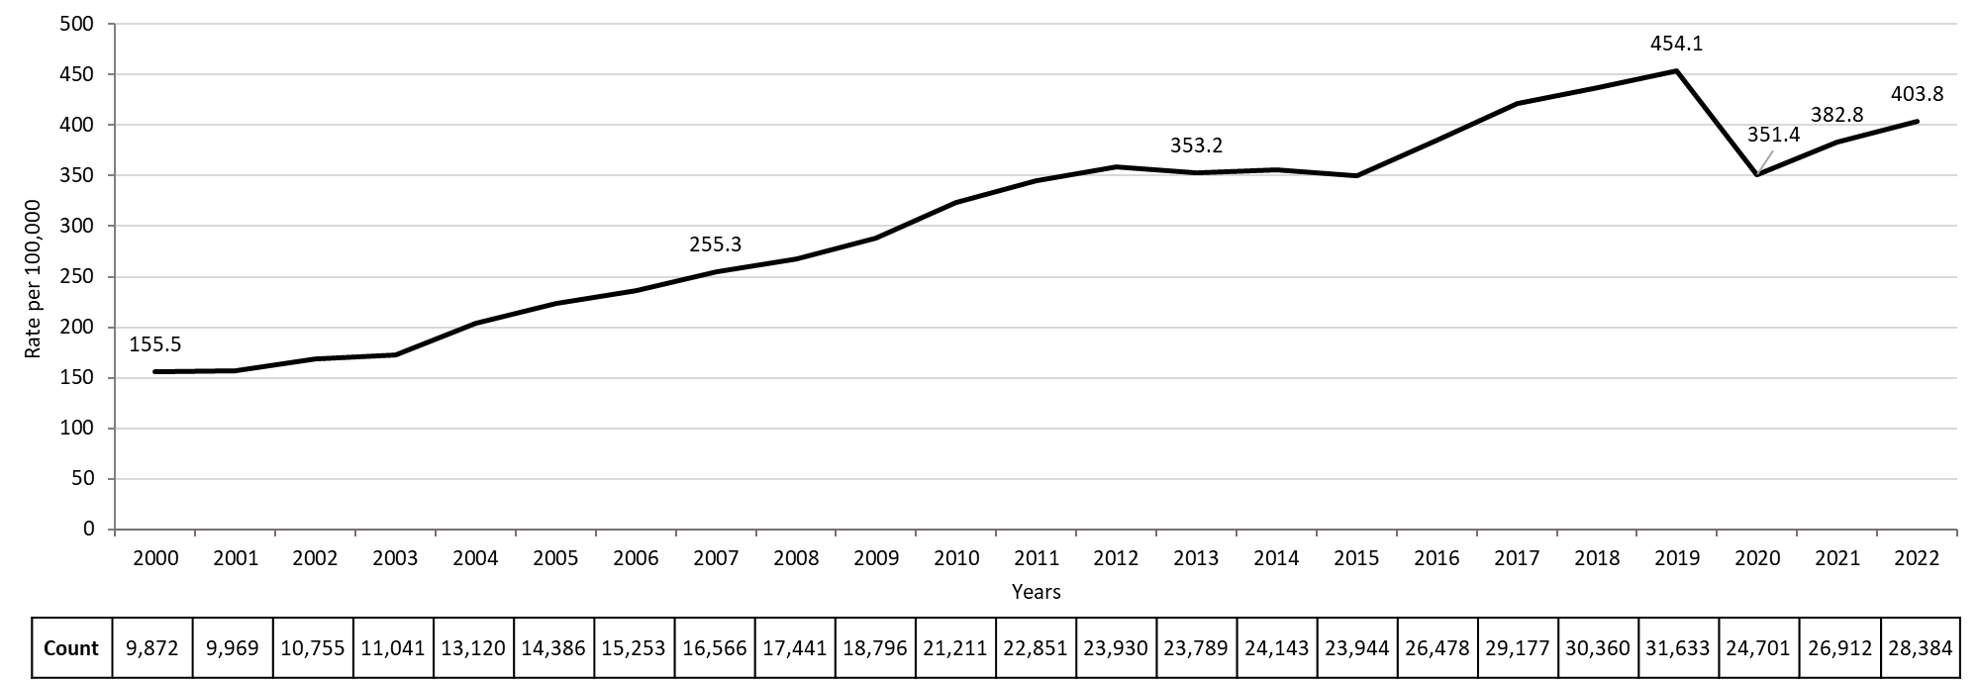
Rate of Confirmed Chlamydia Cases, Massachusetts, 2000 to 2022¹
Data are current as of 07/18/2023 and are subject to change.
Data Source: Massachusetts Department of Public Health/Bureau of Infectious Disease and Laboratory Sciences/ Division of STD Prevention and STD-HIV Surveillance.
Population denominators estimated by the University of Massachusetts Donahue Institute using a modified Hamilton-Perry model (Strate S, et al. Small Area Population Estimates for 2011 through 2020 report, Oct 2016).
1. Please consider the impact of the COVID-19 pandemic on infectious disease screening, treatment and surveillance in the interpretation of 2020-2022 data.
Notes:
Rate of Confirmed Chlamydia Cases, Massachusetts, 2000 to 2022
Graph depicts the rate per 100,000 population of confirmed cases of chlamydia in Massachusetts between 2000 and 2022. It begins at low of 155.5 in 2000 and then climbs to a high of 454.1 in 2019. It drops to 382.8 in 2021, followed by a rise to 403.8 in 2022.

Slide 5
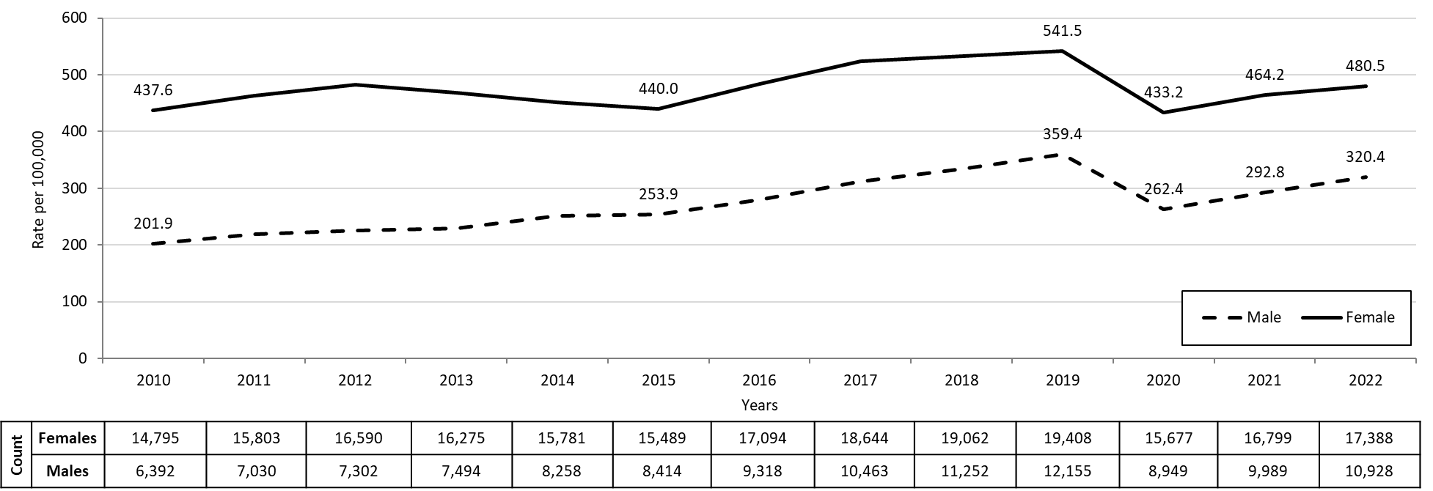
Confirmed Chlamydia Rates by Gender¹, Massachusetts, 2010 to 2022²
Data are current as of 07/18/2023 and are subject to change.
Data Source: Massachusetts Department of Public Health/Bureau of Infectious Disease and Laboratory Sciences/ Division of STD Prevention and STD-HIV Surveillance.
Population denominators estimated by the University of Massachusetts Donahue Institute using a modified Hamilton-Perry model (Strate S, et al. Small Area Population Estimates for 2011 through 2020 report, Oct 2016).
1. In 2022, there were 38 individuals of transgender experience reported in our data system who do not have current gender documented. These cases were excluded since population estimates for individuals of transgender experience are not available at this time.
2. Please consider the impact of the COVID-19 pandemic on infectious disease screening, treatment and surveillance in the interpretation of 2020-2022 data.
Notes:
Confirmed Chlamydia Rates by Gender, Massachusetts, 2010 to 2022
Graph depicts the rates per 100,000 population of chlamydia in Massachusetts by gender identity between 2012 and 2022. There are two lines, one for females that begins at 437.6 in 2010 and climbs to 541.5 in 2019 and another for males that begins at 201.9 in 2010 and climbs to 359.4 in 2019. In 2022, females had a rate of 480.5 and males had a rate of 320.4.
Note: There were cases reported among transgender individuals in 2014 through 2022. In 2022, there were 38 cases of chlamydia among transgender identified individuals not included on this slide.

Slide 6
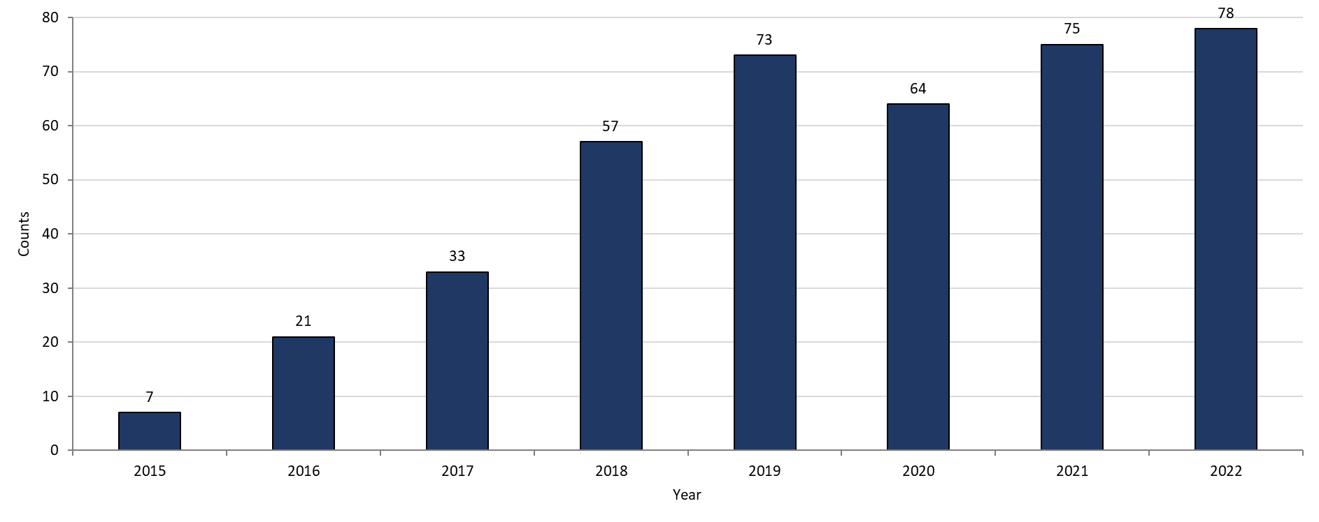
Chlamydia Among Individuals of Transgender Experience,^{1, 2} Massachusetts, 2015 to 2022³
Data are current as of 07/18/2023 and are subject to change.
Data Source: Massachusetts Department of Public Health/Bureau of Infectious Disease and Laboratory Sciences/ Division of STD Prevention and STD-HIV Surveillance.
Prior to 2015 MA DSTDP was not able to capture expanded gender identity including individuals of transgender experience within our data system.
All individuals of transgender experience are included in this graph regardless of current gender.
Please consider the impact of the COVID-19 pandemic on infectious disease screening, treatment and surveillance in the interpretation of 2020-2022 data.
Notes:
Chlamydia among Individuals of Transgender Experience, Massachusetts, 2015 to 2022
Graph shows the number of chlamydia cases among transgender individuals in Massachusetts between 2015 and 2022. The case counts 7, 21, 33, 57, 73, 64, 75, and 78 for 2015, 2016, 2017, 2018, 2019, 2020, 2021 and 2022, respectively.

Slide 7
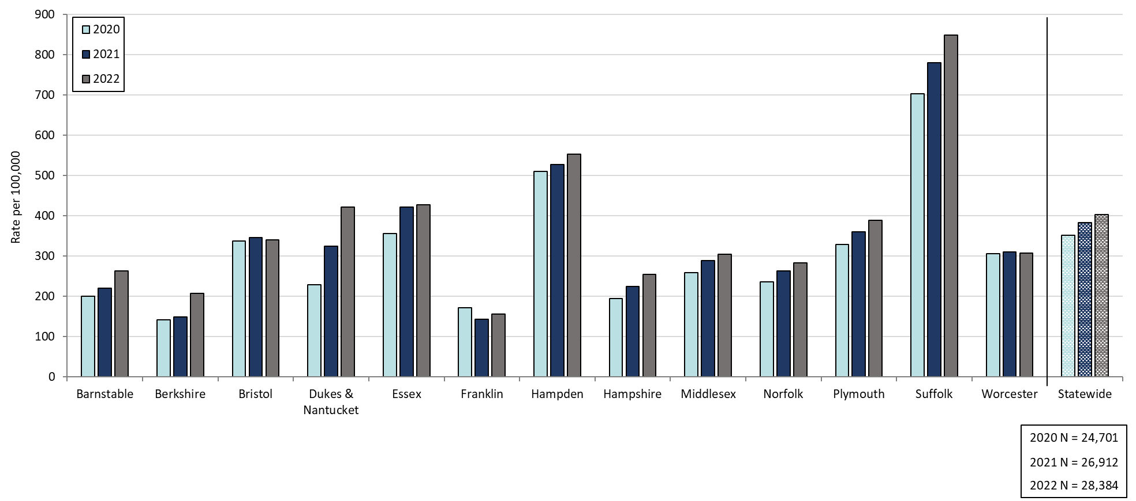
Confirmed Chlamydia Rates by County and Statewide, Massachusetts, 2020-2022¹
Data are current as of 07/18/2023 and are subject to change.
Data Source: Massachusetts Department of Public Health/Bureau of Infectious Disease and Laboratory Sciences/ Division of STD Prevention and STD-HIV Surveillance.
Population denominators estimated by the University of Massachusetts Donahue Institute using a modified Hamilton-Perry model (Strate S, et al. Small Area Population Estimates for 2011 through 2020 report, Oct 2016).
1. Please consider the impact of the COVID-19 pandemic on infectious disease screening, treatment and surveillance in the interpretation of 2020-2022 data.
Notes:
Confirmed Chlamydia Rates by County and Statewide, Massachusetts, 2020-2022
Graph depicts rate per 100,000 population of chlamydia cases reported in Massachusetts by county comparing 2020 through 2022. The rate is highest in Suffolk county with a rate of 848.3 in 2022 followed by Hampden county with a rate of 553.2 in 2022. The lowest rates were in Franklin and Berkshire county.

Slide 8
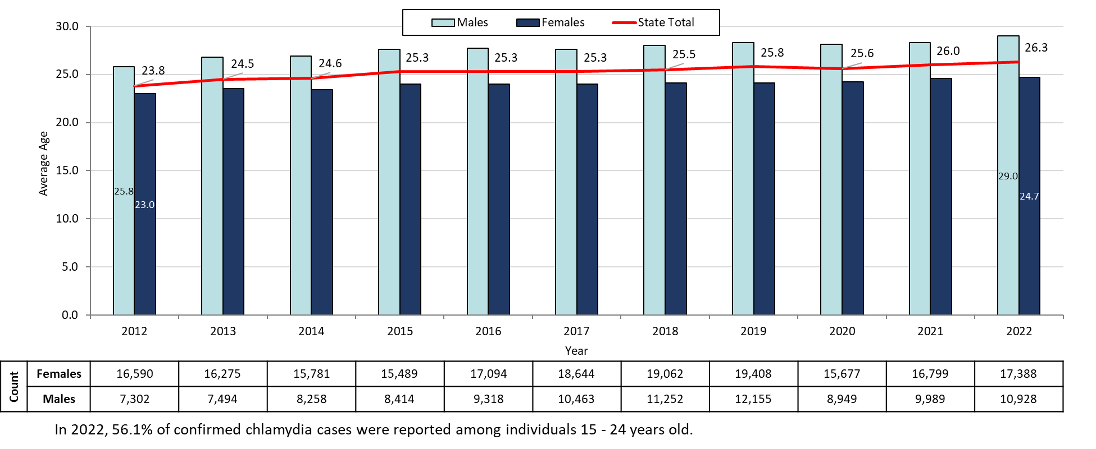
Average Age of Confirmed Chlamydia Cases by Gender¹, Massachusetts, 2012 to 2022²
Data are current as of 07/18/2023 and are subject to change.
Data Source: Massachusetts Department of Public Health/Bureau of Infectious Disease and Laboratory Sciences/ Division of STD Prevention and STD-HIV Surveillance.
1. Individuals of transgender experience that did not have complete gender data as of 10/24/2022 may not be included within this slide.
2. Please consider the impact of the COVID-19 pandemic on infectious disease screening, treatment and surveillance in the interpretation of 2020-2022 data.
Notes:
Average Age of Confirmed Chlamydia Cases by Gender, Massachusetts, 2012 to 2022
Graph depicts the average age of confirmed chlamydia cases by year between 2012 and 2022. The lowest average age is 23.8 years old for the year 2012 and then rises to a high average age of 26.3 years old in 2022.

Slide 9
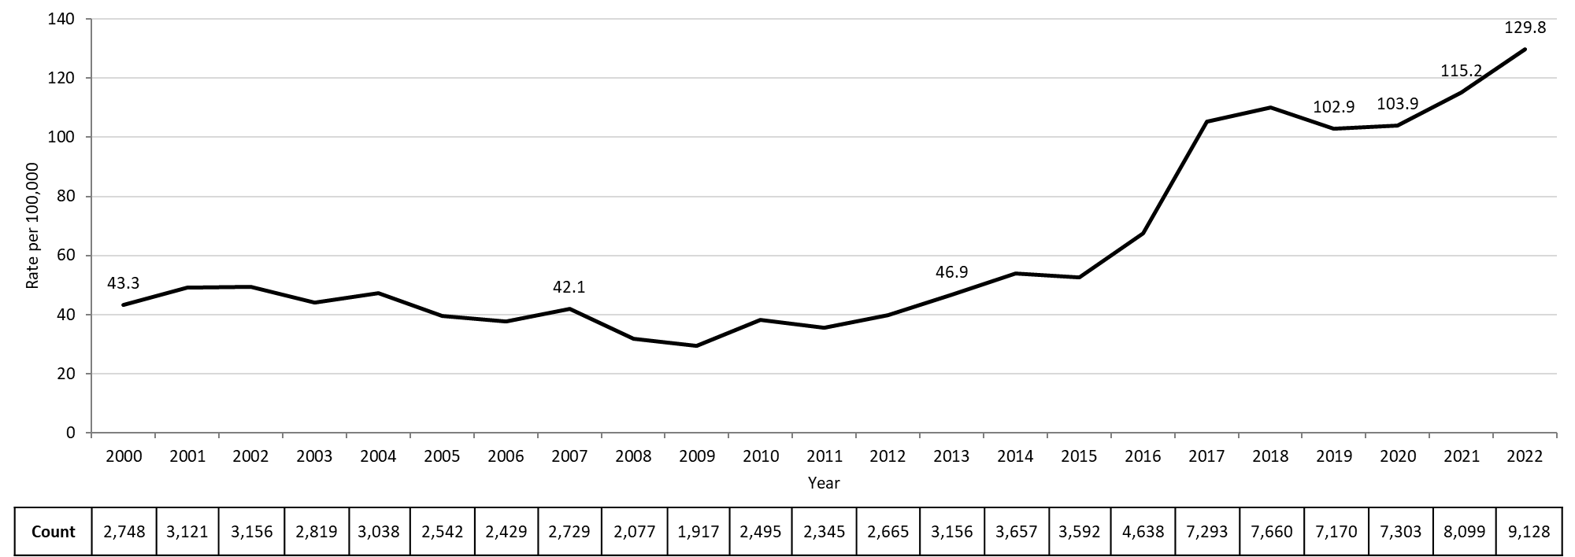
Rate of Confirmed Gonorrhea Cases, Massachusetts, 2000 to 2022¹
Data are current as of 07/18/2023 and are subject to change.
Data Source: Massachusetts Department of Public Health/Bureau of Infectious Disease and Laboratory Sciences/ Division of STD Prevention and STD-HIV Surveillance.
Population denominators estimated by the University of Massachusetts Donahue Institute using a modified Hamilton-Perry model (Strate S, et al. Small Area Population Estimates for 2011 through 2020 report, Oct 2016).
1. Please consider the impact of the COVID-19 pandemic on infectious disease screening, treatment and surveillance in the interpretation of 2020-2022 data.
Notes:
Rate of Confirmed Gonorrhea Cases, Massachusetts, 2000 to 2022
Graph depicts the rate per 100,000 population of confirmed cases of gonorrhea in Massachusetts between 2000 and 2022. It begins at 43.3 in 2000, drops to a low of 29.4 in 2009 and climbs to a high of 129.8 in 2022.

Slide 10
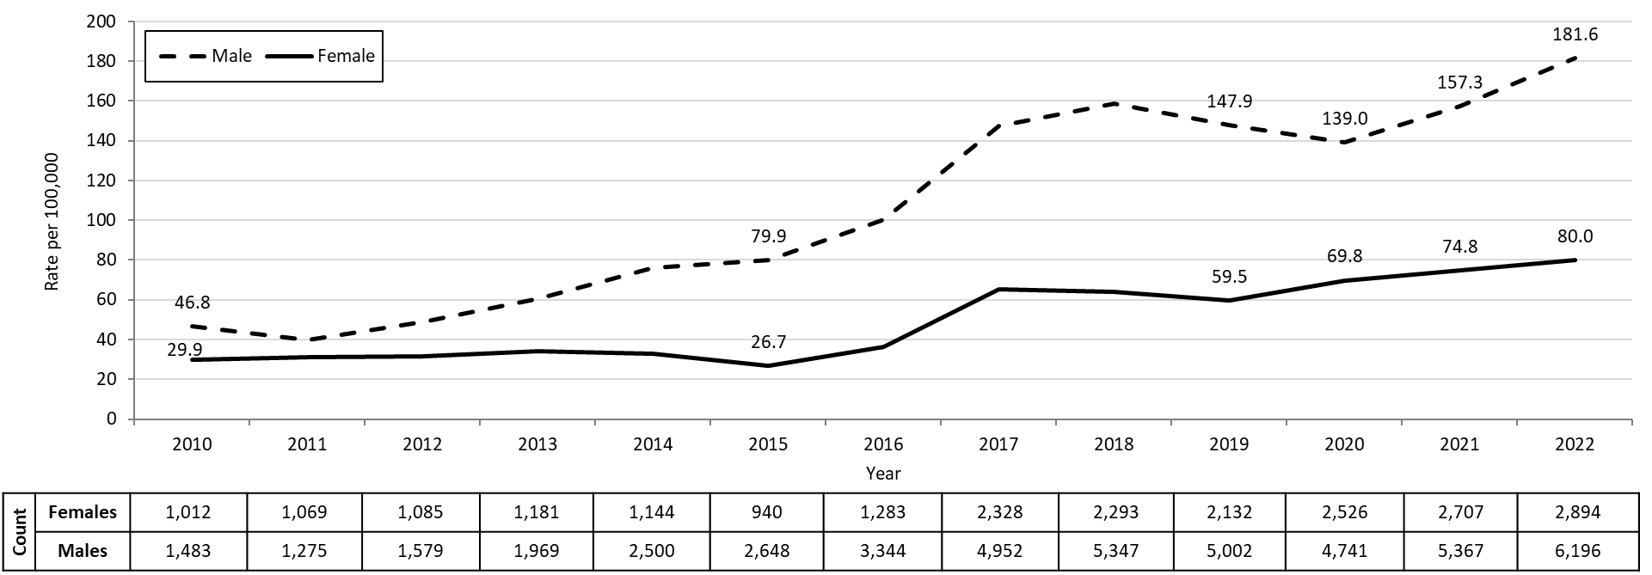
Confirmed Gonorrhea Rates by Gender¹, Massachusetts, 2010 to 2022²
Data are current as of 07/18/2023 and are subject to change.
Data Source: Massachusetts Department of Public Health/Bureau of Infectious Disease and Laboratory Sciences/ Division of STD Prevention and STD-HIV Surveillance.
Population denominators estimated by the University of Massachusetts Donahue Institute using a modified Hamilton-Perry model (Strate S, et al. Small Area Population Estimates for 2011 through 2020 report, Oct 2016).
1. In 2022, there were 34 individuals of transgender experience reported in our data system who do not have current gender documented. These cases were excluded since population estimates for individuals of transgender experience are not available at this time. There were 4 individuals with unknown gender which are not included in this slide.
2. Please consider the impact of the COVID-19 pandemic on infectious disease screening, treatment and surveillance in the interpretation of 2020-2022 data.
Notes:
Confirmed Gonorrhea Rates by Gender Identity, Massachusetts, 2010 to 2022
Graph depicts the rates per 100,000 population of confirmed cases of gonorrhea in Massachusetts by gender identity between 2010 and 2022. There are two lines, one for females that begins at 29.9 in 2010 and climbs to 80.0 in 2022 and another for males that begins at 46.8 in 2010 and climbs to 181.6 in 2022.
Note: There were cases reported among transgender individuals in 2014 through 2022. In 2022, there were 34 cases of gonorrhea among transgender identified individuals not included on this slide.

Slide 11
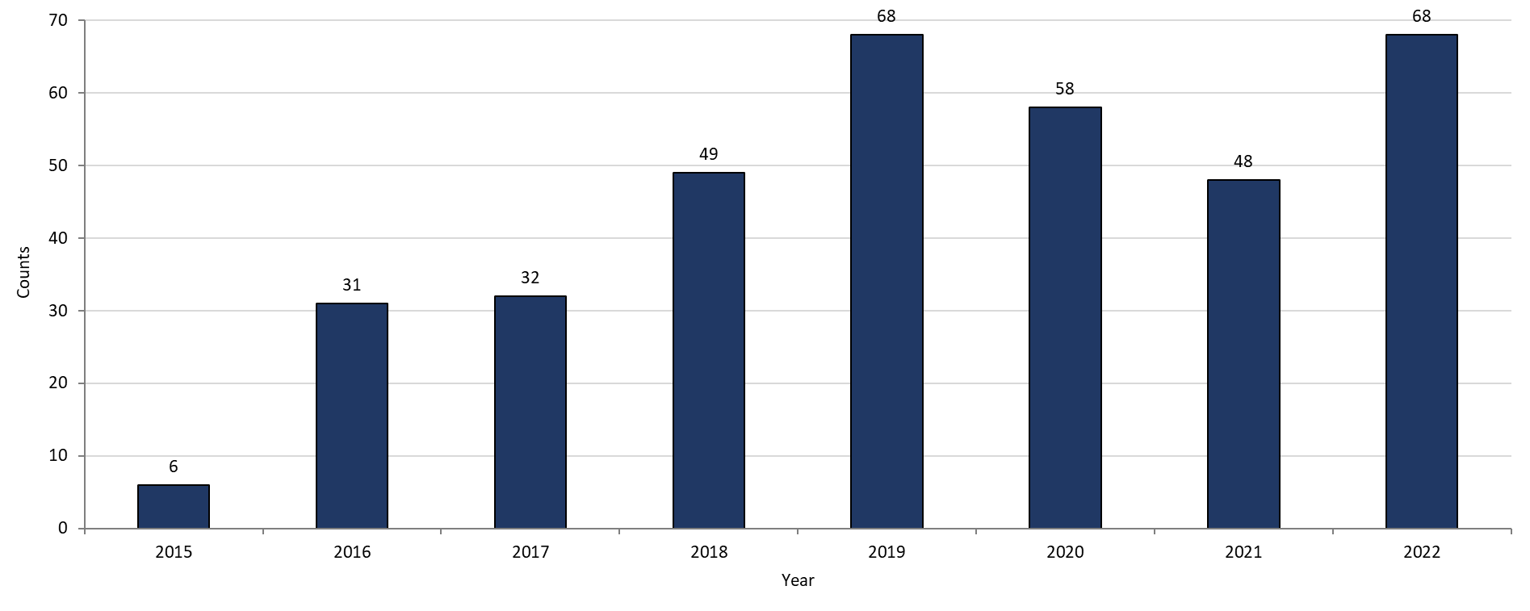
Gonorrhea Among Individuals of Transgender Experience¹, Massachusetts, 2015 to 2022²
Data are current as of 07/18/2023 and are subject to change.
Data Source: Massachusetts Department of Public Health/Bureau of Infectious Disease and Laboratory Sciences/ Division of STD Prevention and STD-HIV Surveillance.
All individuals of transgender experience are included in this graph regardless of current gender.
Please consider the impact of the COVID-19 pandemic on infectious disease screening, treatment and surveillance in the interpretation of 2020-2022 data.
Notes:
Gonorrhea among Transgender Identified Individuals, Massachusetts, 2015 to 2022
Graph shows the number of confirmed gonorrhea cases among transgender individuals in Massachusetts between 2015 and 2022. The case counts are 6, 31, 32, 49, 68, 58, 48, and 68 for 2015, 2016, 2017, 2018, 2019, 2020, 2021, and 2022, respectively.

Slide 12
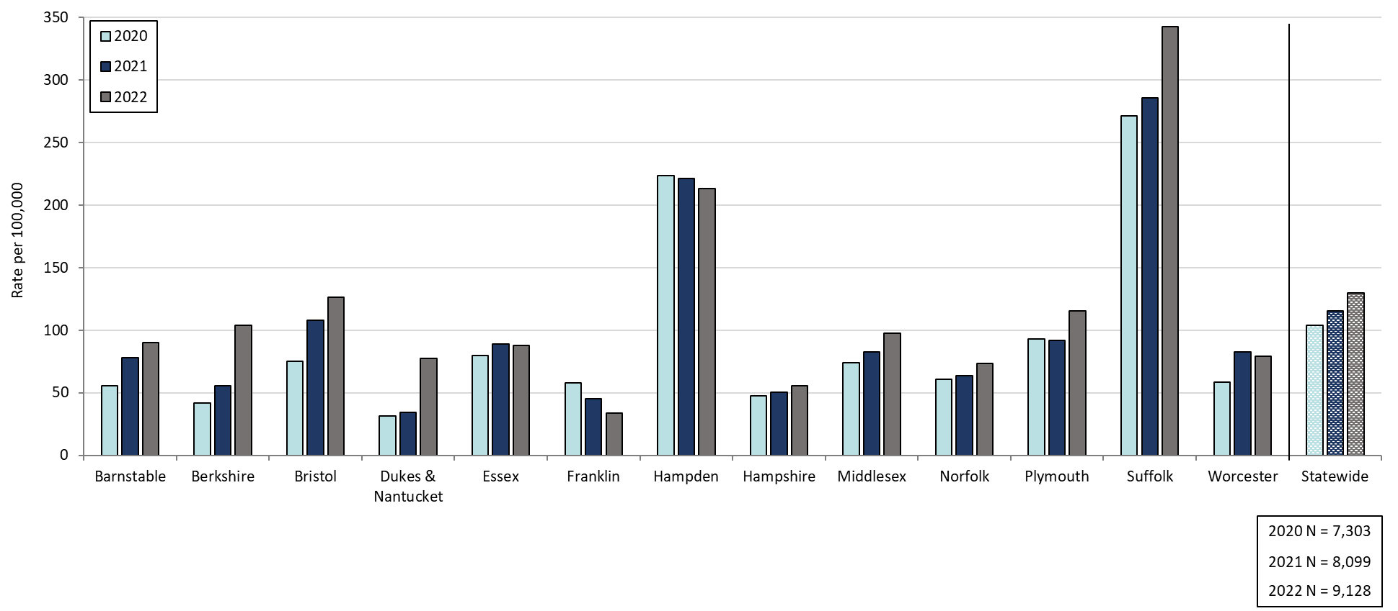
Confirmed Gonorrhea Rates by County and Statewide, Massachusetts, 2020-2022¹
Data are current as of 07/18/2023 and are subject to change.
Data Source: Massachusetts Department of Public Health/Bureau of Infectious Disease and Laboratory Sciences/ Division of STD Prevention and STD-HIV Surveillance.
Population denominators estimated by the University of Massachusetts Donahue Institute using a modified Hamilton-Perry model (Strate S, et al. Small Area Population Estimates for 2011 through 2020 report, Oct 2016).
1. Please consider the impact of the COVID-19 pandemic on infectious disease screening, treatment and surveillance in the interpretation of 2020-2022 data.
Notes:
Confirmed Gonorrhea Rates by County, Massachusetts, 2020-2022
Graph depicts rate per 100,000 population of gonorrhea cases reported in Massachusetts by county comparing 2020 through 2022. The rate is highest in Suffolk county with a rate of 343.0 in 2022 followed by Hampden county with a rate of 213.4 in 2022. The lowest rates were in Hampshire and Franklin counties.

Slide 13
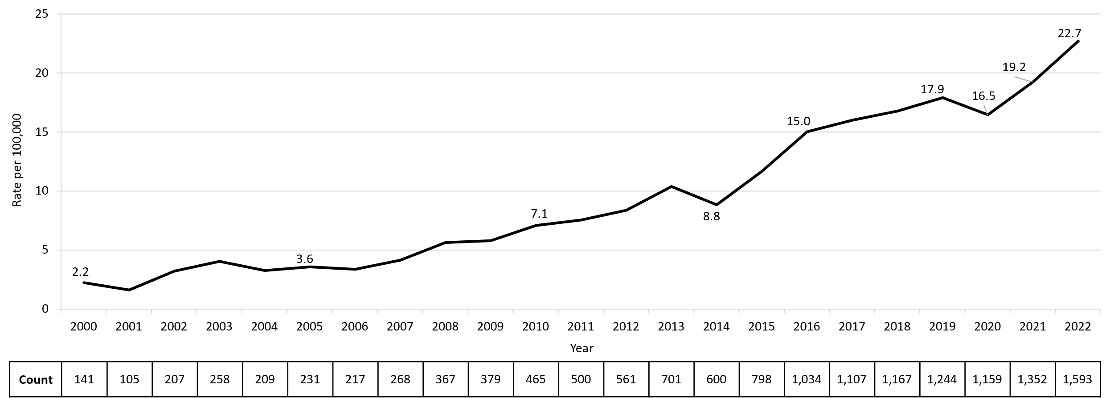
Confirmed and Probable Infectious Syphilis¹ Rates, Massachusetts, 2000 to 2022²
Data are current as of 07/18/2023 and are subject to change.
Data Source: Massachusetts Department of Public Health/Bureau of Infectious Disease and Laboratory Sciences/ Division of STD Prevention and STD-HIV Surveillance.
Population denominators estimated by the University of Massachusetts Donahue Institute using a modified Hamilton-Perry model (Strate S, et al. Small Area Population Estimates for 2011 through 2020 report, Oct 2016).
1. Infectious syphilis is defined as primary, secondary and early latent stages of syphilis within one year of infection.
2. Please consider the impact of the COVID-19 pandemic on infectious disease screening, treatment and surveillance in the interpretation of 2020-2022 data.
Notes:
Confirmed and Probable Infectious Syphilis Cases, Massachusetts, 2000 to 2022
Graph depicts the rate per 100,000 population of confirmed and probable cases of infectious syphilis in Massachusetts between 2000 and 2022. It begins at 2.2 in 2000, drops to a low of 1.6 in 2001, and climbs to a high of 22.7 in 2022.

Slide 14
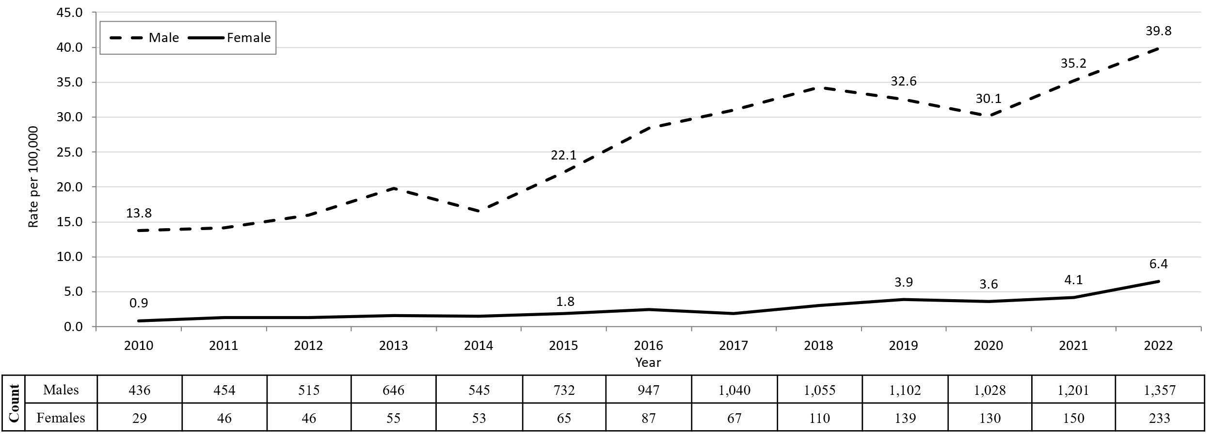
Confirmed and Probable Infectious Syphilis¹ Rates by Gender,² Massachusetts, 2010 to 2022³
Data are current as of 07/18/2023 and are subject to change.
Data Source: Massachusetts Department of Public Health/Bureau of Infectious Disease and Laboratory Sciences/ Division of STD Prevention and STD-HIV Surveillance.
Population denominators estimated by the University of Massachusetts Donahue Institute using a modified Hamilton-Perry model (Strate S, et al. Small Area Population Estimates for 2011 through 2020 report, Oct 2016).
1. Infectious syphilis is defined as primary, secondary and early latent stages of syphilis within one year of infection.
2. In 2022, there were 3 individuals of transgender experience reported in our data system who do not have current gender documented. These cases were excluded since population estimates for individuals of transgender experience are not available at this time.
3. Please consider the impact of the COVID-19 pandemic on infectious disease screening, treatment and surveillance in the interpretation of 2020-2022 data.
Notes:
Confirmed and Probable Infectious Syphilis rates by Gender Identity, Massachusetts, 2010 to 2022
Graph depicts the rates per 100,000 population of confirmed and probable cases of syphilis in Massachusetts by gender identity between 2010 and 2022. There are two lines, one for females that begins at 0.9 in 2010 and remains relatively stable with a high of 6.4 in 2022. Another line is for males that begins at 13.8 in 2010 and climbs to a high of 39.8 in 2022.
Note: Infectious syphilis is defined as primary, secondary and early latent stages of syphilis within one year of infection.
There were cases reported among transgender individuals in 2014 through 2022. They are classified on this slide based on their current gender. In 2022, there were 3 cases of infectious syphilis among transgender identified individuals not included on this slide as MA DSTDP does not have current gender information for those individuals.

Slide 15
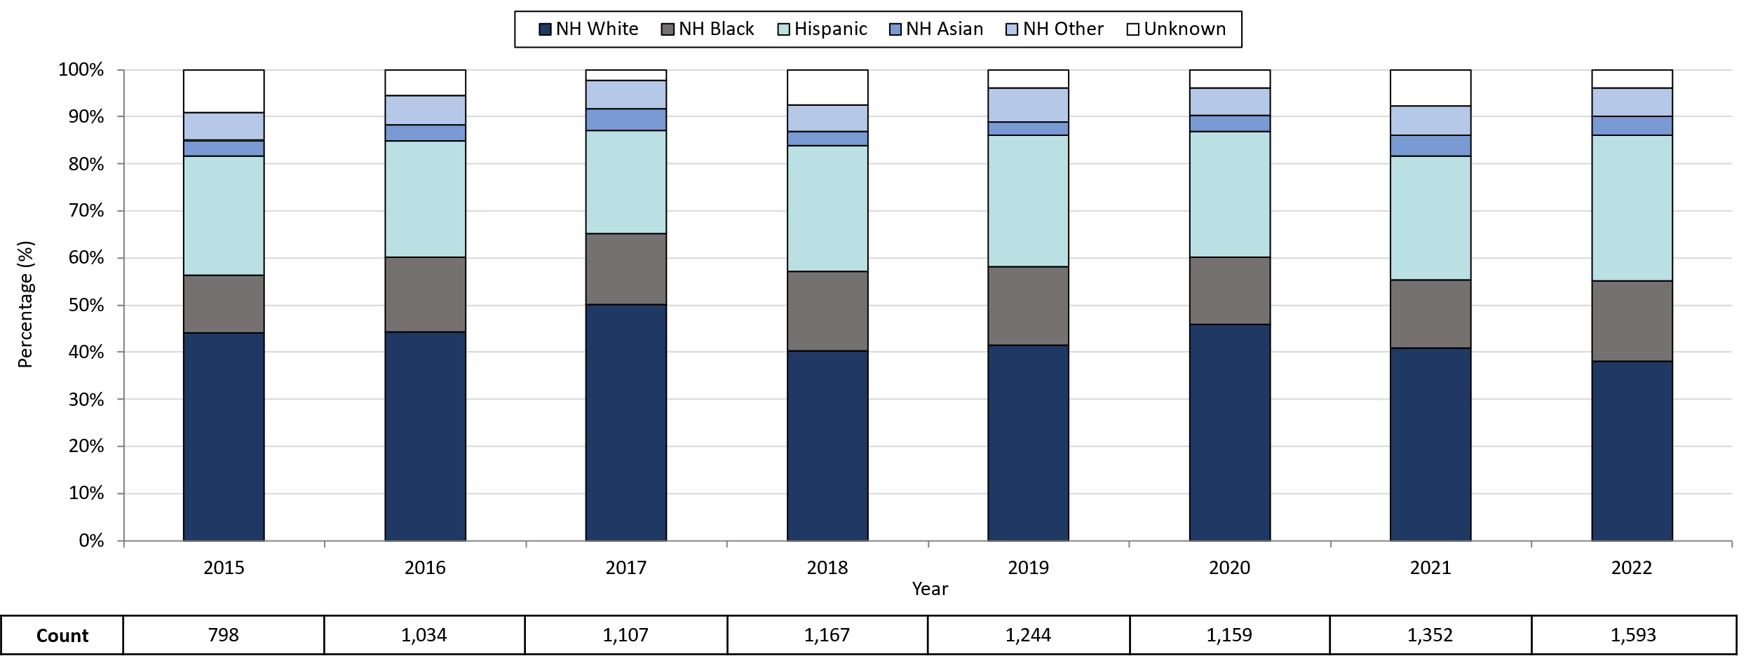
Infectious Syphilis¹ Reported Cases by Race/Ethnicity², Massachusetts, 2015-2022³
Data are current as of 07/18/2023 and are subject to change.
Data Source: Massachusetts Department of Public Health/Bureau of Infectious Disease and Laboratory Sciences/ Division of STD Prevention and STD-HIV Surveillance.
Note: National Notifiable Diseases Surveillance System (NNDSS) Congenital Syphilis case definition was updated in 2014.
1. Infectious syphilis is defined as primary, secondary and early latent stages of syphilis within one year of infection.
2. Other Race/Ethnicity includes individuals who identify as American Indian/ Pacific Islander/ Alaskan Native.
3. Please consider the impact of the COVID-19 pandemic on infectious disease screening, treatment and surveillance in the interpretation of 2020-2022 data.
Notes:
Infectious Syphilis Reported Cases by Race/Ethnicity, Massachusetts, 2015-2022
Graph depicts the proportion of Massachusetts reported confirmed and probable infectious syphilis cases broken down by race/ethnicity for the years 2015 through 2022. The highest percentage of cases for each year identified as Non-Hispanic White making up a high of 50.1% of cases in 2017 and a resulting 38.1% of cases in 2022. In total, over the seven year period, the proportion of cases by race/ethnicity were from highest to lowest: Non-Hispanic White, Hispanic, Non-Hispanic Black, Non-Hispanic Other, and Unknown.
Note: Infectious syphilis is defined as primary, secondary and early latent (non-primary/non-secondary) stages of syphilis within one year of infection.

Slide 16
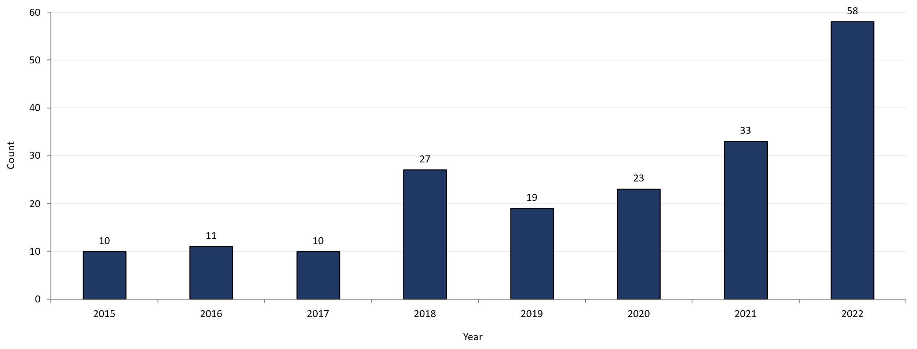
Confirmed and Probable Infectious Syphilis¹ Among Individuals of Transgender Experience², Massachusetts, 2015 to 2022^{3, 4}
Data are current as of 07/18/2023 and are subject to change.
Data Source: Massachusetts Department of Public Health/Bureau of Infectious Disease and Laboratory Sciences/ Division of STD Prevention and STD-HIV Surveillance.
1. Infectious syphilis is defined as primary, secondary and early latent stages of syphilis within one year of infection.
2. All individuals of transgender experience are included in this graph regardless of current gender.
3. Please consider the impact of the COVID-19 pandemic on infectious disease screening, treatment and surveillance in the interpretation of 2020-2022 data.
4. In 2022, a retrospective verification project was conducted to improve data quality in capturing current gender information.
Notes:
Confirmed and Probable Infectious Syphilis among Transgender Identified Individuals, Massachusetts, 2015 to 2022
Graph shows the number of confirmed and probable infectious syphilis cases among transgender individuals in Massachusetts between 2015 and 2022. The case counts are 10, 11, 10, 27, 19, 23, 33, and 58 for 2015, 2016, 2017, 2018, 2019, 2020, 2021, and 2022 respectively.
*Infectious syphilis is defined as primary, secondary and early latent stages of syphilis within one year of infection.

Slide 17
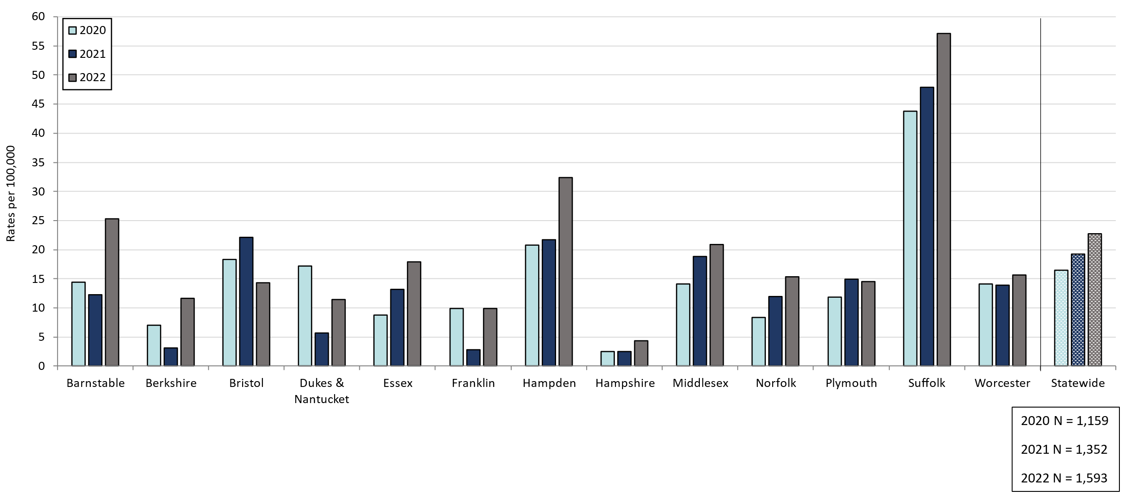
Confirmed and Probable Infectious Syphilis¹ Rates by County and Statewide, Massachusetts, 2020-2022²
Data are current as of 07/18/2023 and are subject to change.
Data Source: Massachusetts Department of Public Health/Bureau of Infectious Disease and Laboratory Sciences/ Division of STD Prevention and STD-HIV Surveillance.
Population denominators estimated by the University of Massachusetts Donahue Institute using a modified Hamilton-Perry model (Strate S, et al. Small Area Population Estimates for 2011 through 2020 report, Oct 2016).
1. Infectious syphilis is defined as primary, secondary and early latent stages of syphilis within one year of infection.
2. Please consider the impact of the COVID-19 pandemic on infectious disease screening, treatment and surveillance in the interpretation of 2020-2022 data.
Notes:
Confirmed and Probable Infectious Syphilis Rates by County, Massachusetts, 2020-2022
Graph depicts rate per 100,000 population of infectious syphilis cases reported in Massachusetts by county comparing 2020 through 2022. The rate is highest in Suffolk county with a rate of 57.1 in 2022 followed by Hampden county with a rate of 32.4 in 2022. The lowest rates were in Hampshire and Franklin county.

Slide 18
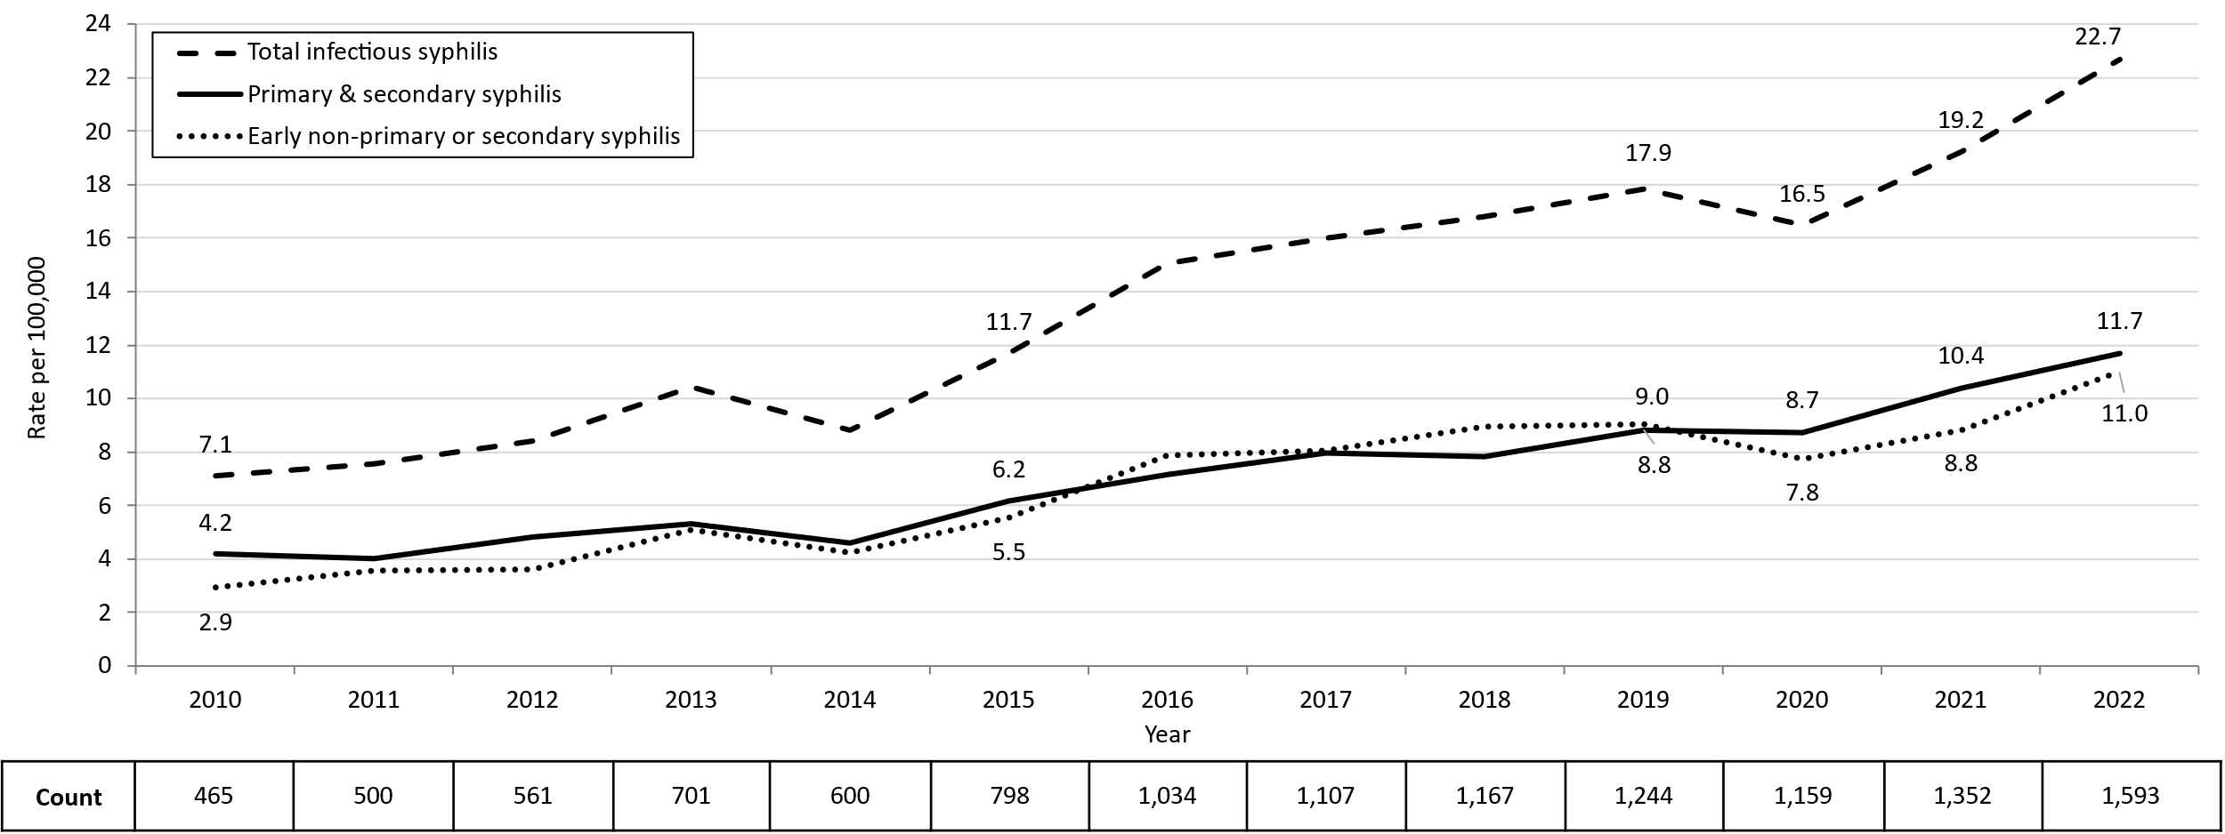
Confirmed and Probable Infectious Syphilis¹ Rates by Stage of Infection, Massachusetts, 2010–2022²
Data are current as of 07/18/2023 and are subject to change.
Data Source: Massachusetts Department of Public Health/Bureau of Infectious Disease and Laboratory Sciences/ Division of STD Prevention and STD-HIV Surveillance.
Population denominators estimated by the University of Massachusetts Donahue Institute using a modified Hamilton-Perry model (Strate S, et al. Small Area Population Estimates for 2011 through 2020 report, Oct 2016).
1. Infectious syphilis is defined as primary, secondary and early latent stages of syphilis within one year of infection.
2. Please consider the impact of the COVID-19 pandemic on infectious disease screening, treatment and surveillance in the interpretation of 2020-2022 data.
Notes:
Confirmed and Probable Infectious Syphilis Rates by Stage of Infection, Massachusetts, 2010–2022
Graph depicts the differences between the rate of infectious syphilis diagnosed in the primary and secondary stage compared to those cases diagnosed in the early non-primary and non-secondary stages reported in Massachusetts from 2010 to 2022. There are three lines on the graph. One line for primary and secondary cases starting with a rate of 4.2 per 100,000 in 2010 and peaking with a rate of 11.7 in 2022. Another line for non-primary non-secondary cases starting wit a rate of 2.9 in 2010, peaking with a rate of 11.0 in 2012. The final line shows the total infectious syphilis starting with a rate of 7.1 in 2010 and peaking at a rate of 22.7 in 2022.
Note: Infectious syphilis is defined as primary, secondary and early latent (non-primary/non-secondary) stages of syphilis within one year of infection.

Slide 19
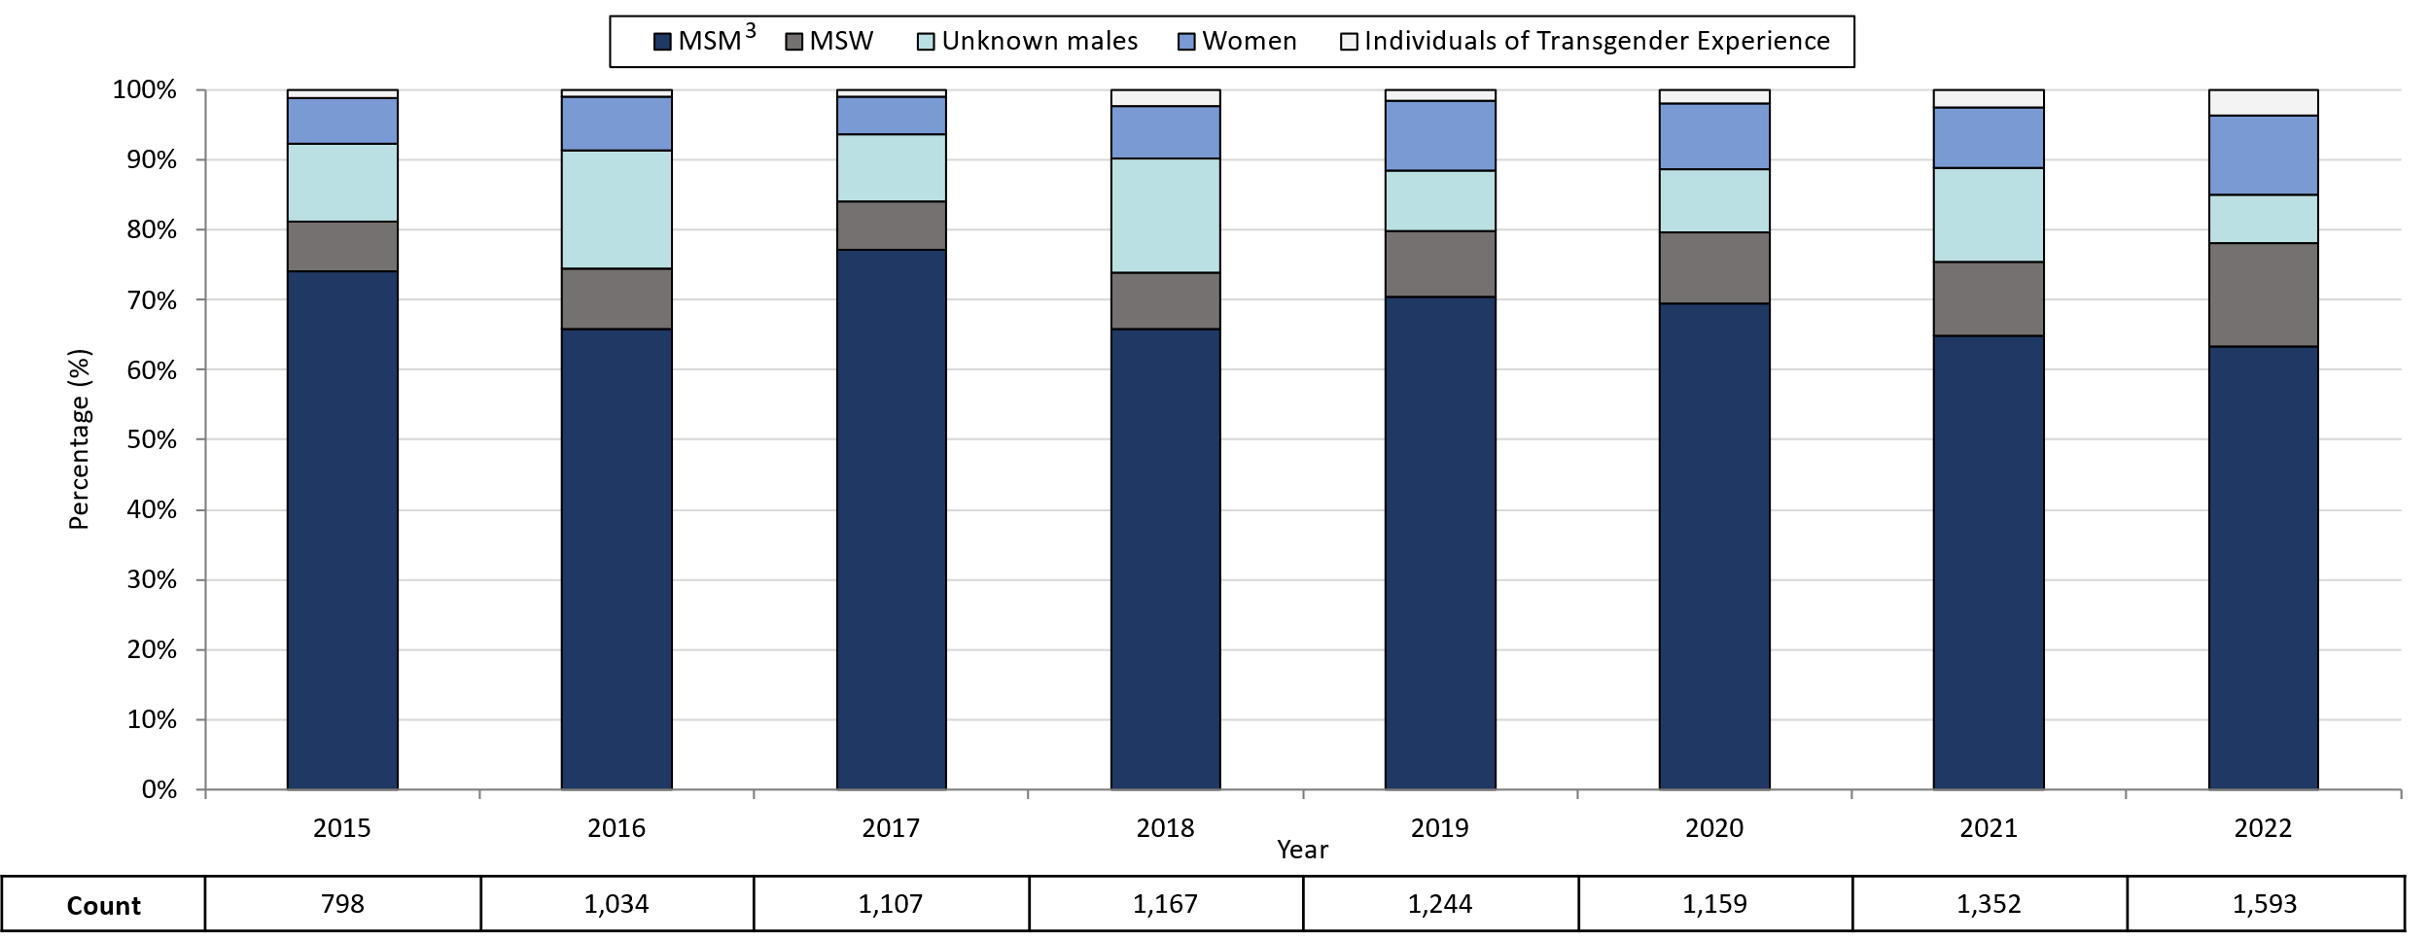
Infectious Syphilis¹ Reported Cases by Gender of Sex Partners, Massachusetts, 2015-2022²
Data are current as of 07/18/2023 and are subject to change.
Data Source: Massachusetts Department of Public Health/Bureau of Infectious Disease and Laboratory Sciences/ Division of STD Prevention and STD-HIV Surveillance.
Note: National Notifiable Diseases Surveillance System (NNDSS) Congenital Syphilis case definition was updated in 2014.
1. Infectious syphilis is defined as primary, secondary and early latent stages of syphilis within one year of infection.
2. Please consider the impact of the COVID-19 pandemic on infectious disease screening, treatment and surveillance in the interpretation of 2020-2022 data.
3. The MSM (men who have sex with men) category includes MSMT, MSMW, MSMWT, and MST with “W” referring to women and “T” referring to individuals of transgender experience.
Notes:
Infectious Syphilis Reported Cases by Gender of Sex Partners, Massachusetts, 2015-2022
Graph depicts the proportion of Massachusetts reported confirmed and probable infectious syphilis cases broken down by gender of sex partners for the years 2015 through 2022. The highest percentage of cases for each year reported male sex partners and are classified as MSM (men who have sex with men) making up a high of 77% of cases in 2017 and a resulting 63% of cases in 2022. In total, over the seven year period, the proportion of cases by gender of sex partners were from highest to lowest: MSM, MSW (men who have sex with women), unknown males, women, and transgender individuals. For 2022, the order in frequency from highest to lowest is: MSM, MSW, women, unknown males, and individuals of transgender experience.
Note: Infectious syphilis is defined as primary, secondary and early latent (non-primary/non-secondary) stages of syphilis within one year of infection.

Slide 20
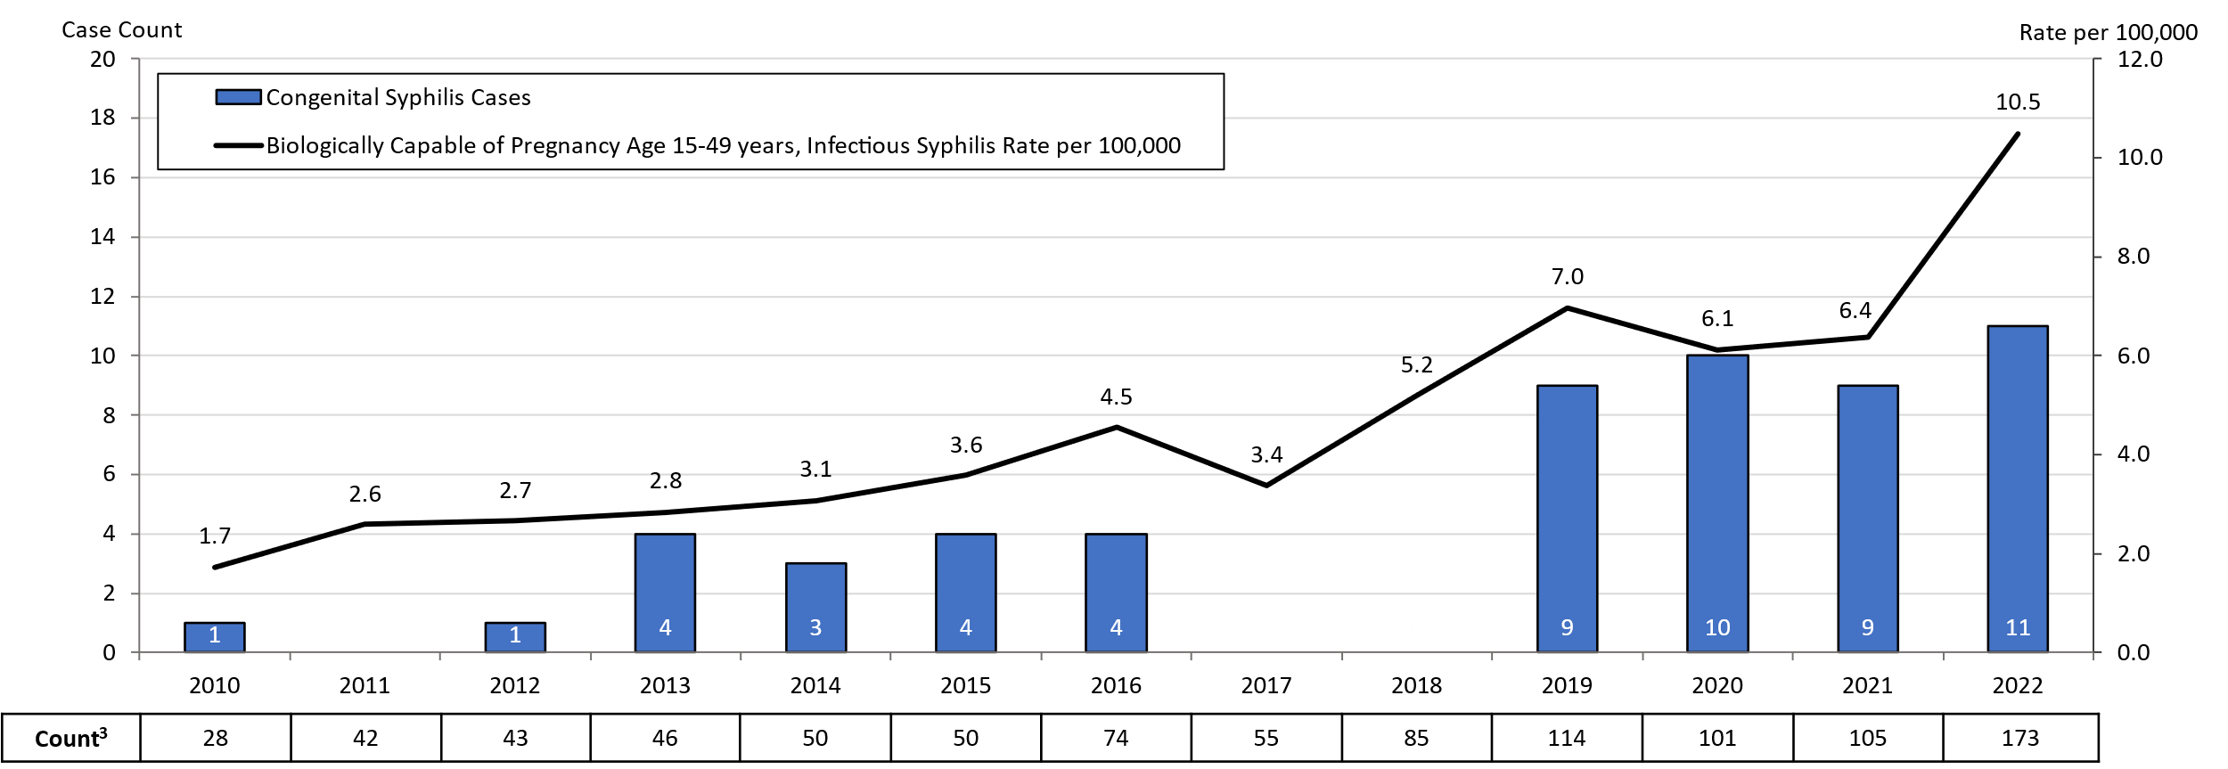
Congenital Syphilis Cases and Rate of Confirmed and Probable Infectious Syphilis¹ Among Individuals Thought to be Capable of Pregnancy Ages 15 to 49 Years, Massachusetts, 2010-2022²
Data are current as of 07/18/2023 and are subject to change.
Data Source: Massachusetts Department of Public Health/Bureau of Infectious Disease and Laboratory Sciences/ Division of STD Prevention.
Population denominators estimated by the University of Massachusetts Donahue Institute using a modified Hamilton-Perry model (Strate S, et al. Small Area Population Estimates for 2011 through 2020 report, Oct 2016).
Note: National Notifiable Diseases Surveillance System (NNDSS) Congenital Syphilis case definition was updated in 2014.
1. Infectious syphilis is defined as primary, secondary and early latent stages of syphilis within one year of infection.
2. Please consider the impact of the COVID-19 pandemic on infectious disease screening, treatment and surveillance in the interpretation of 2020-2022 data.
3. Count refers to individuals thought to be capable of pregnancy ages 15 to 49 years, the denominator for the yearly calculated congenital syphilis rate.
Notes:
Congenital Syphilis Cases and Rate of Confirmed and Probable Infectious Syphilis Among Individuals Though to be Capable of Pregnancy Ages 15 to 49 Years, Massachusetts, 2010-2022
Graph depicts the case count for confirmed and probable congenital syphilis cases reported in Massachusetts between 2010 and 2022. The case counts are 1, 0, 1, 4, 3, 4, 4, 0, 0, 9, 10, 9, 11 for 2010, 2022, 2012, 2013, 2014, 2015, 2016, 2017, 2018, 2019, 2020, 2021, and 2022, respectively. Additionally, the graph shows a line depicting the rate per 100,000 population of confirmed and probable infectious syphilis among individuals thought to be capable of pregnancy ages 15 to 49 years which starts with a rate of 1.7 in 2010, peaks in 2022 with a rate of 10.5.
Note: Infectious syphilis is defined as primary, secondary and early latent (non-primary/non-secondary) stages of syphilis within one year of infection.

Slide 21
Massachusetts SVI Trends
Chlamydia, Gonorrhea, and Infectious Syphilis:
Years 2018 to 2022
Notes:
Picture description: logo for the Massachusetts Department of Public Health

Slide 22
Social Vulnerability Index
Patient addresses were manually cleaned and geocoded utilizing SAS 9.4
Social Vulnerability Index (SVI) was based on the patient’s home address.
It characterizes community resilience/ability to withstand external hazards.
SVI incorporates 15 demographic and socioeconomic variables from the US census.
Patients’ census tracts are given a percentile rank and grouped as low, moderately low, moderately high, and high.
Higher percentile scores represent greater community vulnerability.
The CDC/ATSDR SVI database from 2018 was matched to cases from 2018-2019.
The CDC/ATSDR SVI database from 2020 was matched to cases from 2020-2022.

Slide 23
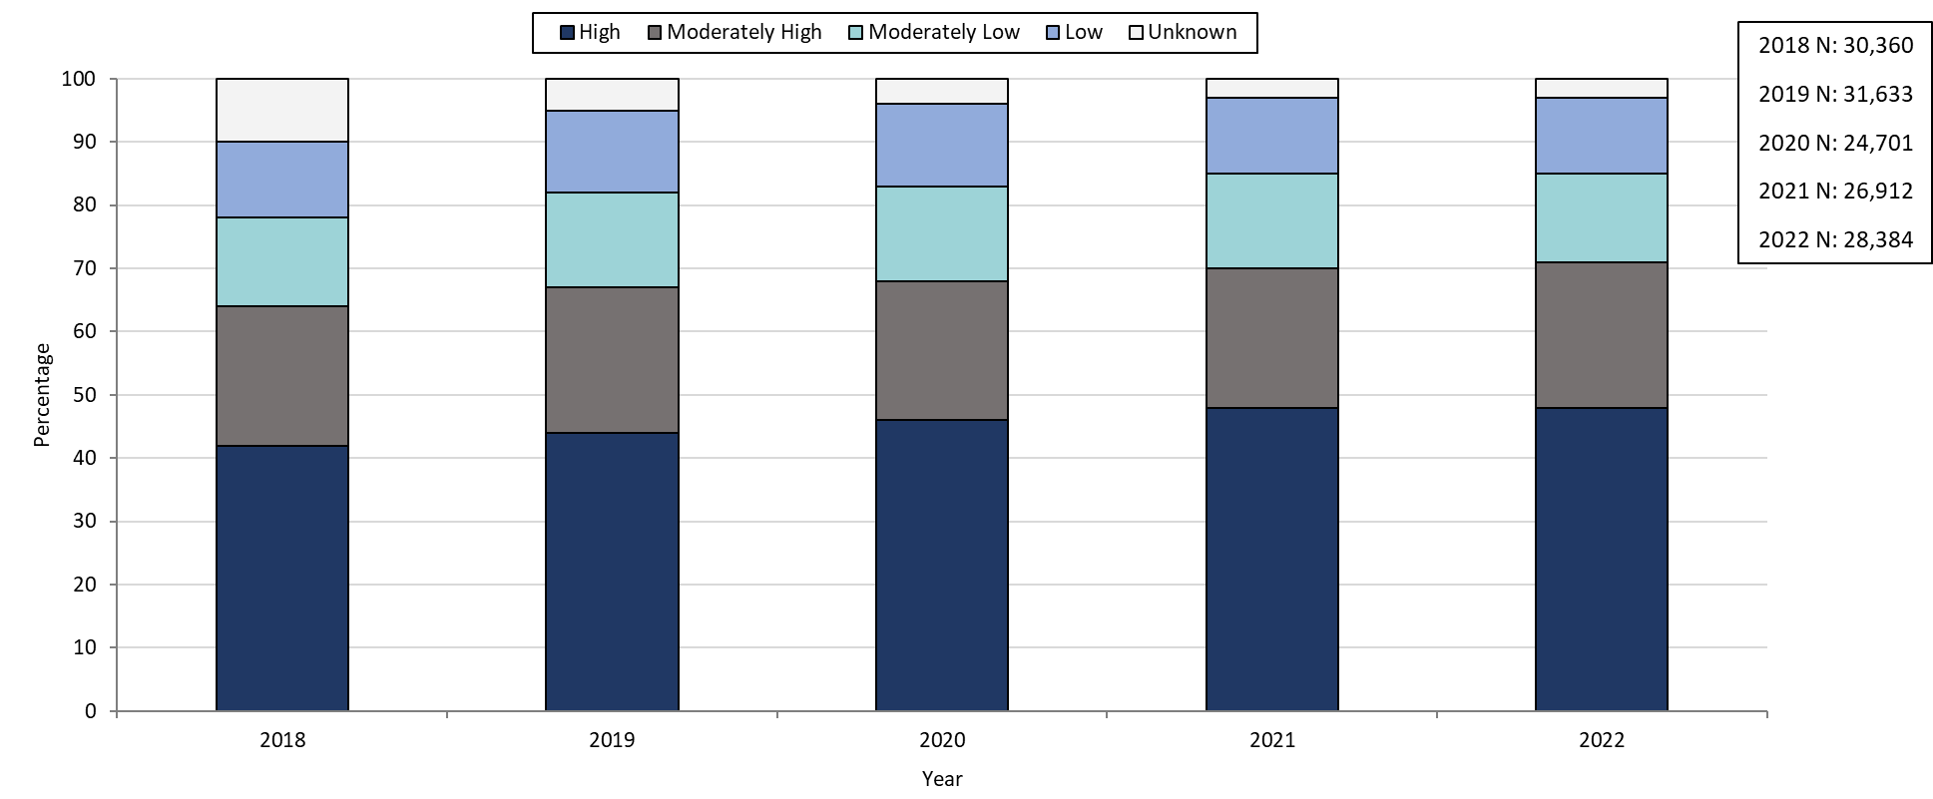
Confirmed Chlamydia Case Percentages by Social Vulnerability Index, Massachusetts, 2018-2022¹
Data are current as of 07/18/2023 and are subject to change.
Data Source: Massachusetts Department of Public Health/Bureau of Infectious Disease and Laboratory Sciences/ Division of STD Prevention and STD-HIV Surveillance.
1. Please consider the impact of the COVID-19 pandemic on infectious disease screening, treatment and surveillance in the interpretation of 2020, 2021, and 2022 data.
Notes:
Confirmed Chlamydia Case Percentages by Social Vulnerability Index, Massachusetts, 2018-2022
Graph depicts the proportion of Massachusetts reported confirmed chlamydia cases broken down by SVI quartile for the years 2018 through 2022. The High SVI group is largest for each year, making up 41 to 48% of cases each year. Each year, the order in frequency from highest to lowest is: High, Moderately High, Moderately Low, Low, and Unknown SVI.

Slide 24
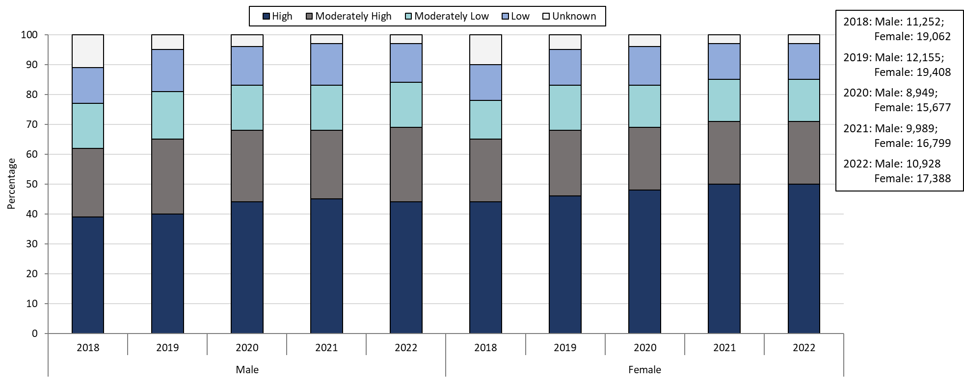
Confirmed Chlamydia Case Percentages by Social Vulnerability Index and Gender, Massachusetts, 2018- 2022^{1,2}
Data are current as of 07/18/2023 and are subject to change.
Data Source: Massachusetts Department of Public Health/Bureau of Infectious Disease and Laboratory Sciences/ Division of STD Prevention and STD-HIV Surveillance.
Please consider the impact of the COVID-19 pandemic on infectious disease screening, treatment and surveillance in the interpretation of 2020, 2021, and 2022 data.
Individuals of transgender experience that do not have complete gender data may not be included within this slide.
Notes:
Confirmed Chlamydia Case Percentages by Social Vulnerability Index and Gender, Massachusetts, 2018- 2022
Graph depicts the proportion of Massachusetts reported confirmed chlamydia cases broken down by SVI quartile and gender for the years 2018 through 2022. In 2022, 50% of female cases are High SVI, compared to 44% in males. 21% of female cases in 2022 are Moderately High SVI, 14% are Moderately Low SVI, 12% are Low SVI, and 3% are Unknown SVI. 25% of male cases in 2022 are Moderately High SVI, 15% are Moderately Low SVI, 13% are Low SVI, and 3% are Unknown SVI.

Slide 25
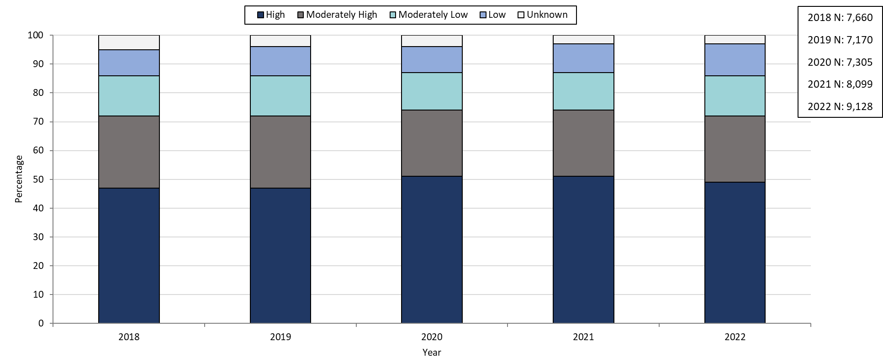
Confirmed Gonorrhea Case Percentages by Social Vulnerability Index, Massachusetts, 2018-2022¹
Data are current as of 07/18/2023 and are subject to change.
Data Source: Massachusetts Department of Public Health/Bureau of Infectious Disease and Laboratory Sciences/ Division of STD Prevention and STD-HIV Surveillance.
1. Please consider the impact of the COVID-19 pandemic on infectious disease screening, treatment and surveillance in the interpretation of 2020, 2021, and 2022 data.
Notes:
Confirmed Gonorrhea Case Percentages by Social Vulnerability Index, Massachusetts, 2018-2022
Graph depicts the proportion of Massachusetts reported confirmed gonorrhea cases broken down by SVI quartile for the years 2018 through 2022. The High SVI group is largest for each year, making up 47 to 51% of cases each year. Each year, the order in frequency from highest to lowest is: High, Moderately High, Moderately Low, Low, and Unknown SVI.

Slide 26
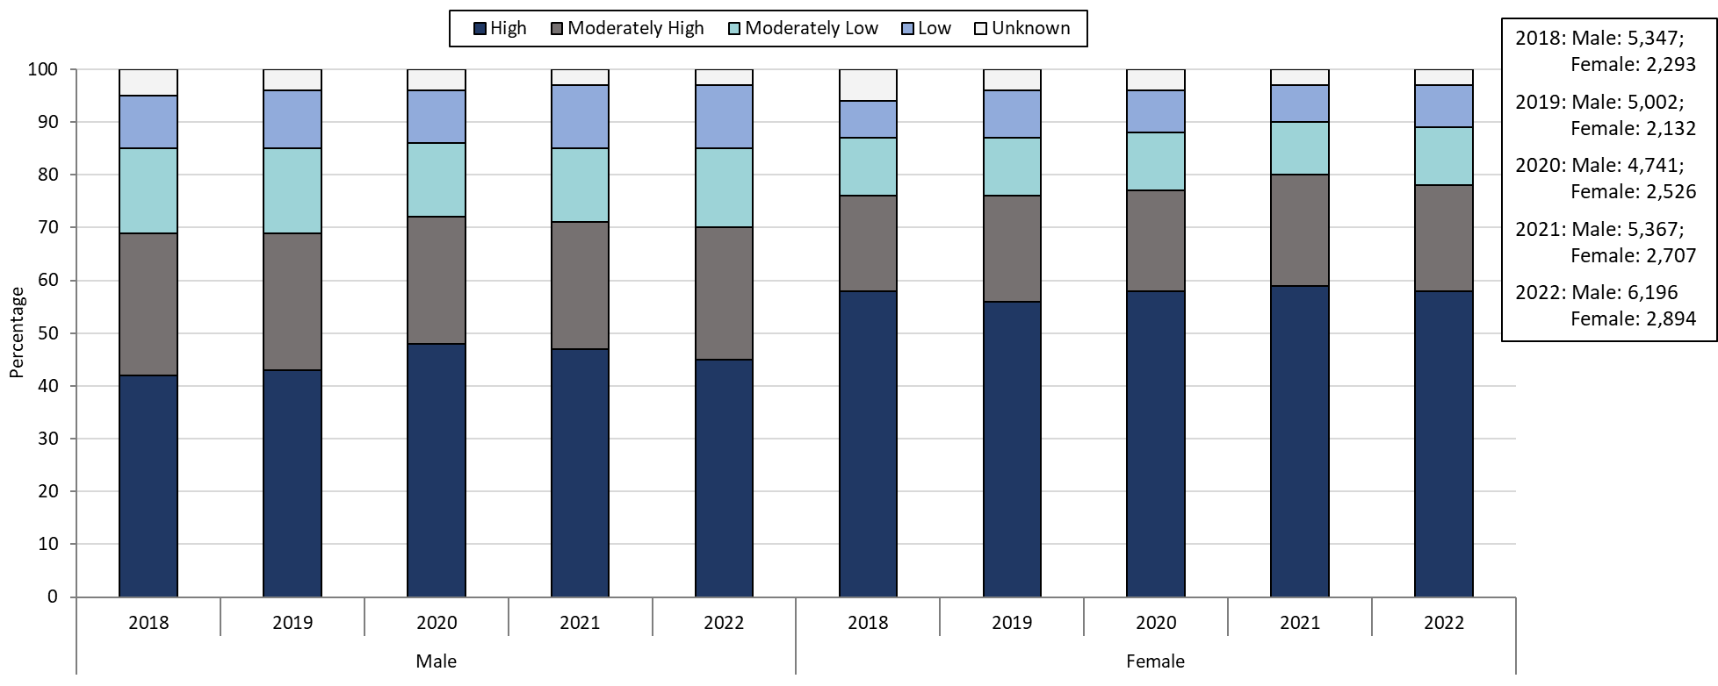
Confirmed Gonorrhea Case Percentages by Social Vulnerability Index and Gender, Massachusetts, 2018-2022^{1,2}
Data are current as of 07/18/2023 and are subject to change.
Data Source: Massachusetts Department of Public Health/Bureau of Infectious Disease and Laboratory Sciences/ Division of STD Prevention and STD-HIV Surveillance.
Please consider the impact of the COVID-19 pandemic on infectious disease screening, treatment and surveillance in the interpretation of 2020, 2021, and 2022 data.
Individuals of transgender experience that do not have complete gender data may not be included within this slide.
Notes:
Confirmed Gonorrhea Case Percentages by Social Vulnerability Index and Gender, Massachusetts, 2018-2022
Graph depicts the proportion of Massachusetts reported confirmed gonorrhea cases broken down by SVI quartile and gender for the years 2018 through 2022. In 2022, 58% of female cases are High SVI, compared to 45% in males. 20% of female cases in 2022 are Moderately High SVI, 11% are Moderately Low SVI, 8% are Low SVI, and 3% are Unknown SVI. 25% of male cases in 2022 are Moderately High SVI, 15% are Moderately Low SVI, 12% are Low SVI, and 3% are Unknown SVI.

Slide 27
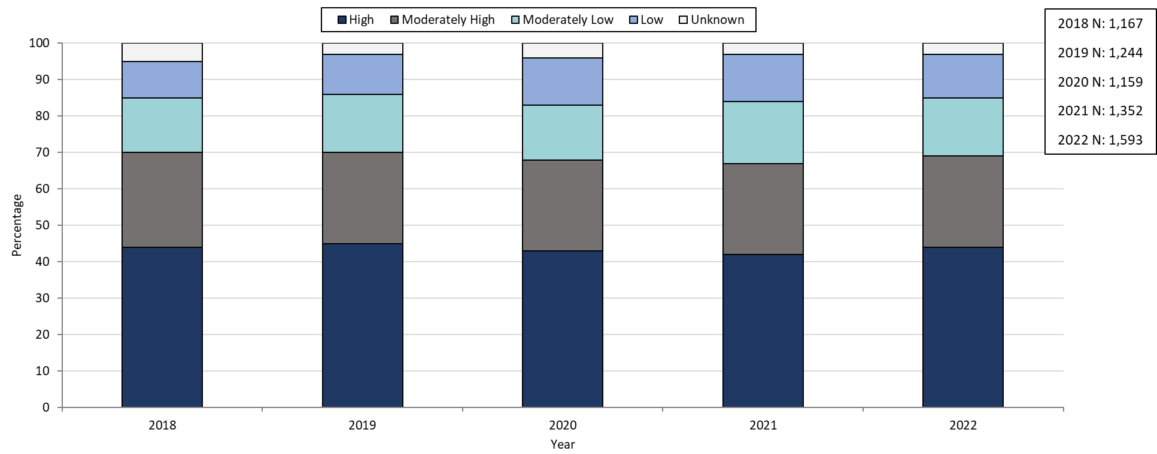
Confirmed and Probably Infectious Syphilis¹ Case Percentages by Social Vulnerability Index, Massachusetts, 2018- 2022²
Data are current as of 07/18/2023 and are subject to change.
Data Source: Massachusetts Department of Public Health/Bureau of Infectious Disease and Laboratory Sciences/ Division of STD Prevention and STD-HIV Surveillance.
1. Infectious syphilis is defined as primary, secondary and early latent stages of syphilis within one year of infection.
2. Please consider the impact of the COVID-19 pandemic on infectious disease screening, treatment and surveillance in the interpretation of 2020, 2021, and 2022 data.
Notes:
Confirmed and Probable Infectious Syphilis Case Percentages by Social Vulnerability Index, Massachusetts, 2018- 2022
Graph depicts the proportion of Massachusetts reported confirmed and probable infectious syphilis cases broken down by SVI quartile for the years 2018 through 2022. The High SVI group is largest for each year, making up 42 to 45% of cases each year. Each year, the order in frequency from highest to lowest is: High, Moderately High, Moderately Low, Low, and Unknown SVI.

Slide 28
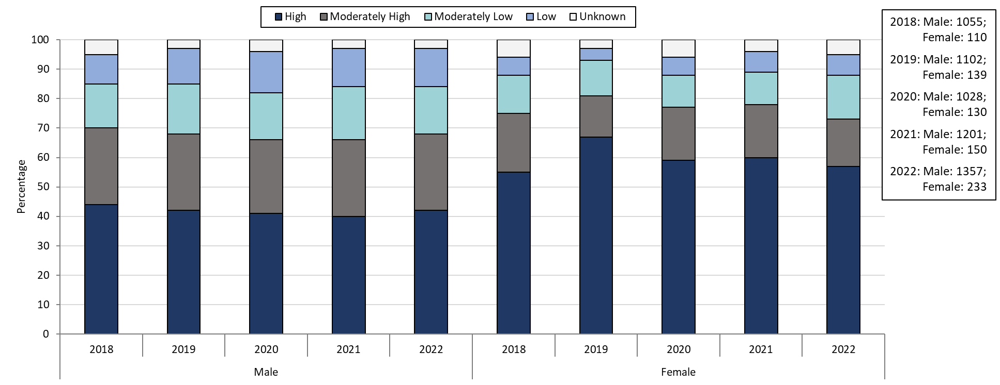
Confirmed and Probable Infectious Syphilis¹ Case Percentages by Social Vulnerability Index and Gender², Massachusetts, 2018-2022³
Data are current as of 07/18/2023 and are subject to change.
Data Source: Massachusetts Department of Public Health/Bureau of Infectious Disease and Laboratory Sciences/ Division of STD Prevention and STD-HIV Surveillance.
1. Infectious syphilis is defined as primary, secondary and early latent stages of syphilis within one year of infection.
2. Individuals of transgender experience that do not have complete gender data may not be included within this slide.
3. Please consider the impact of the COVID-19 pandemic on infectious disease screening, treatment and surveillance in the interpretation of 2020, 2021, and 2022 data.
Notes:
Confirmed and Probable Infectious Syphilis Case Percentages by Social Vulnerability Index and Gender², Massachusetts, 2018-2022
Graph depicts the proportion of Massachusetts reported confirmed and probable infectious syphilis cases broken down by SVI quartile and gender for the years 2018 through 2022. In 2022, 57% of female cases are High SVI, compared to 42% in males. 16% of female cases in 2022 are Moderately High SVI, 15% are Moderately Low SVI, 7% are Low SVI, and 5% are Unknown SVI. 26% of male cases in 2022 are Moderately High SVI, 16% are Moderately Low SVI, 13% are Low SVI, and 3% are Unknown SVI.

Slide 29
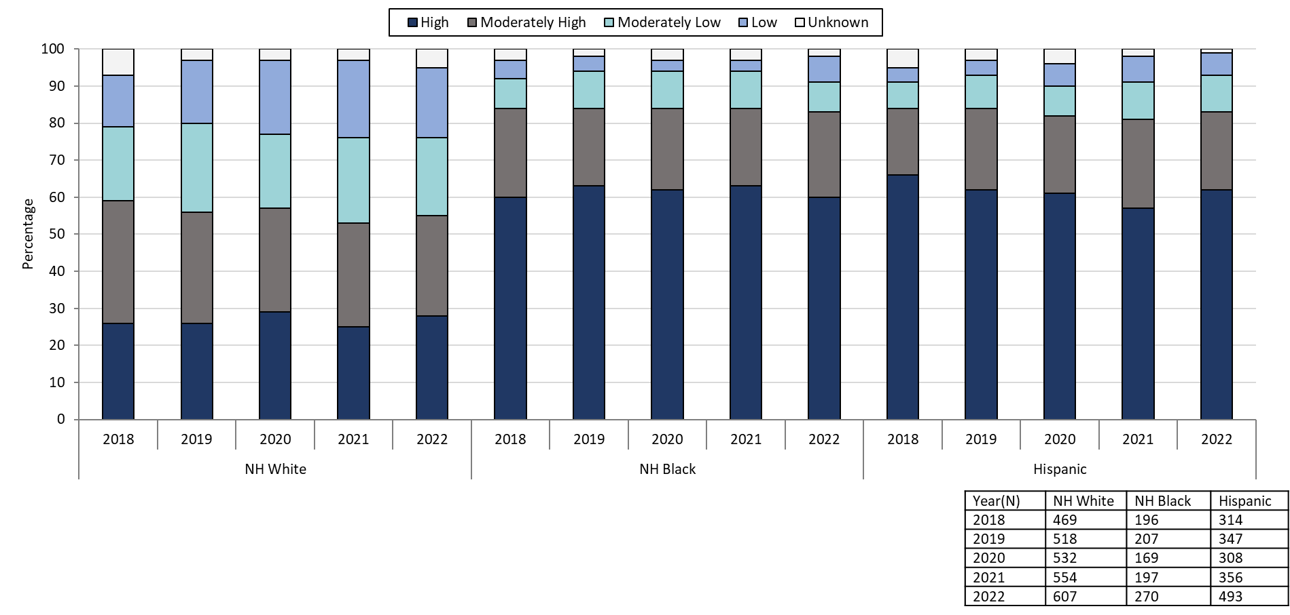
Confirmed and Probable Infectious Syphilis¹ Case Percentages by Social Vulnerability Index and Race, Massachusetts, 2018- 2022²
Data are current as of 07/18/2023 and are subject to change.
Data Source: Massachusetts Department of Public Health/Bureau of Infectious Disease and Laboratory Sciences/ Division of STD Prevention and STD-HIV Surveillance.
1. Infectious syphilis is defined as primary, secondary and early latent stages of syphilis within one year of infection.
2. Please consider the impact of the COVID-19 pandemic on infectious disease screening, treatment and surveillance in the interpretation of 2020, 2021, and 2022 data.
Notes:
Confirmed and Probable Infectious Syphilis Case Percentages by Social Vulnerability Index and Race, Massachusetts, 2018- 2022
Graph depicts the proportion of Massachusetts reported confirmed and probable infectious syphilis cases broken down by SVI quartile and race for the years 2018 through 2022. Each year, NH White cases have a lower proportion of High SVI cases compared to NH Black and Hispanic cases. In 2022, 28% of NH White cases are High SVI, compared to 60% of NH Black cases and 62% of Hispanic cases.

Slide 30
Description of 2022 STI Cases
Geographic Distribution
Age, Gender, Sexual Risk Categories, and Race-Ethnicity
Notes:
Picture description: logo for the Massachusetts Department of Public Health

Slide 31
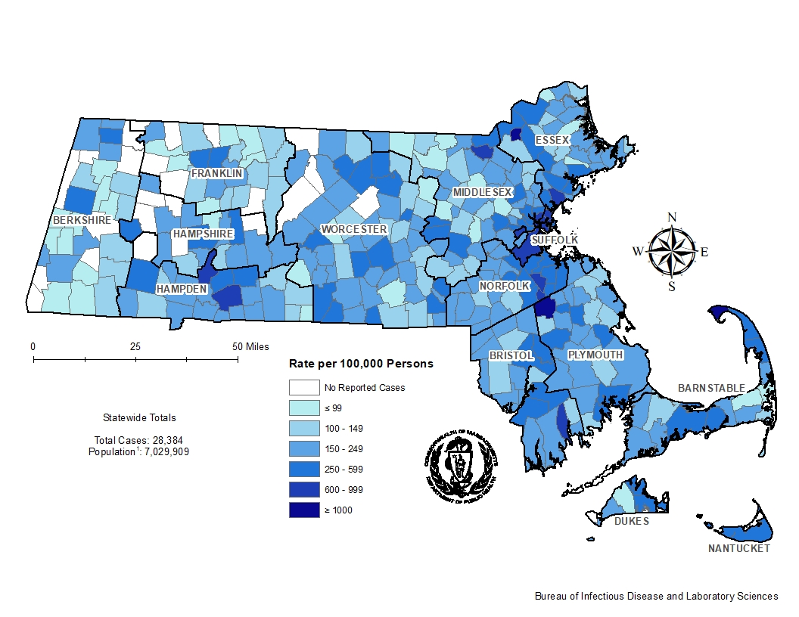
Incident Rate of Confirmed Chlamydia Cases, per 100,000 Persons¹ by City/Town², Massachusetts, 2022³
Data are current as of 07/18/2023 and are subject to change.
Data Source: Massachusetts Department of Public Health/Bureau of Infectious Disease and Laboratory Sciences/ Division of STD Prevention and STD-HIV Surveillance.
1. Population denominators estimated by the University of Massachusetts Donahue Institute using a modified Hamilton-Perry model (Strate S, et al. Small Area Population Estimates for 2011 through 2020 report, Oct 2016).
2. There are no city/towns with <10 cases of chlamydia that fall within the top two rate categories (≥600 cases per 100,000).
3. Please consider the impact of the COVID-19 pandemic on infectious disease screening, treatment and surveillance in the interpretation of 2022 data.
Notes:
Incident Rate of Confirmed Chlamydia Cases, per 100,000 Persons by City/Town, Massachusetts, 2022
Map of Massachusetts cities and towns color-coded to indicate the areas of the state with the highest chlamydia case rates in 2022. The cities that have the highest rates (greater than 600 per 100,000 persons) are Provincetown, Brockton, Lawrence, Springfield, Boston, Chelsea, Lynn, Everett, Holyoke, Randolph, Revere, New Bedford, Avon, and Lowell.

Slide 32
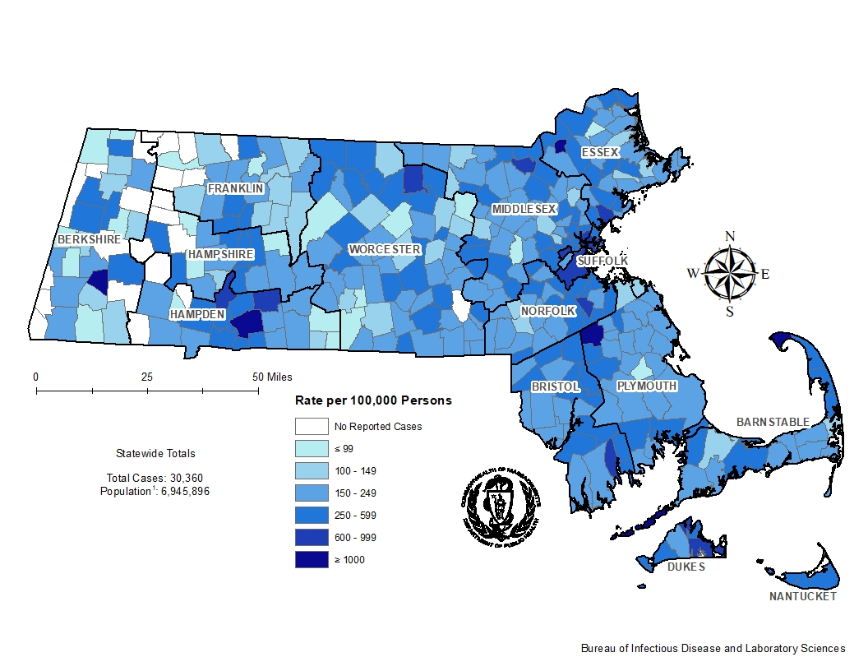
Incident Rate of Confirmed Chlamydia Cases, per 100,000 Persons¹ by City/Town², Massachusetts, 2018
Data are current as of 07/18/2023 and are subject to change.
Data Source: Massachusetts Department of Public Health/Bureau of Infectious Disease and Laboratory Sciences/ Division of STD Prevention and STD-HIV Surveillance.
1. Population denominators estimated by the University of Massachusetts Donahue Institute using a modified Hamilton-Perry model (Strate S, et al. Small Area Population Estimates for 2011 through 2020 report, Oct 2016).
2. There are no city/towns with <10 cases of chlamydia that fall within the top two rate categories (≥600 cases per 100,000).
Notes:
Incident Rate of Confirmed Chlamydia Cases, per 100,000 Persons by City/Town, Massachusetts, 2018
Map of Massachusetts cities and towns color-coded to indicate the areas of the state with the highest chlamydia case rates in 2018. The cities that have the highest rates (greater than 600 per 100,000 persons) are Tyringham, Provincetown, Gosnold, Brockton, Lawrence, Springfield, Boston, Chelsea, Everett, Holyoke, Edgartown, Lynn, Randolph, Tisbury, Lowell, Fitchburg, New Bedford, and Ludlow.

Slide 33
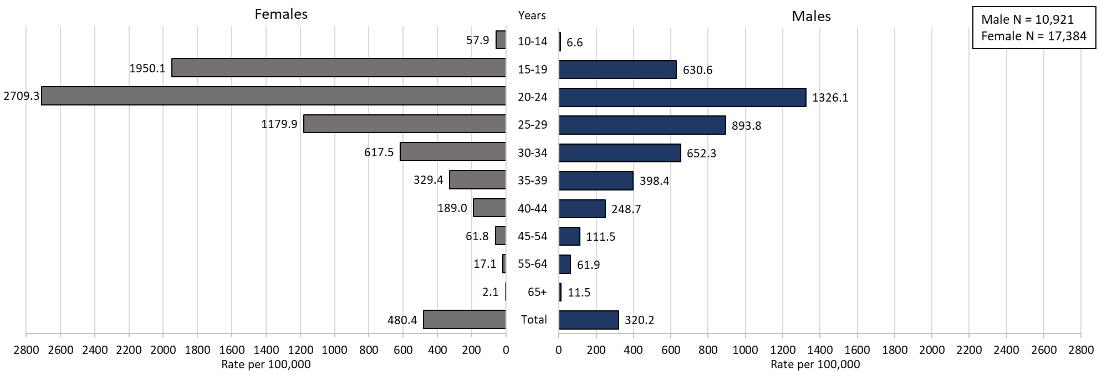
Confirmed Chlamydia Case Rates per 100,000 Population by Gender¹ and Age, Massachusetts, 2022²
Data are current as of 07/18/2023 and are subject to change.
Data Source: Massachusetts Department of Public Health/Bureau of Infectious Disease and Laboratory Sciences/ Division of STD Prevention and STD-HIV Surveillance.
Population denominators estimated by the University of Massachusetts Donahue Institute using a modified Hamilton-Perry model (Strate S, et al. Small Area Population Estimates for 2011 through 2020 report, Oct 2016).
1. In 2022, there were 38 individuals of transgender experience documented in our data system and MA DSTDP does not have current gender information for those individuals and 3 individuals had unknown age. These cases were excluded since rate for this population cannot be calculated at this time.
2. Please consider the impact of the COVID-19 pandemic on infectious disease screening, treatment and surveillance in the interpretation of 2022 data.
Notes:
Confirmed Chlamydia Case Rates per 100,000 Population by Gender and Age, Massachusetts, 2022
Graph depicts chlamydia case rates per 100,000 population by age categories for the overall state, males, and females. For the overall state, the highest rate is among those 20-24 years. When looking at the gender specific rates, the age categories with the highest rates are 20-24 years for both males and females.

Slide 34
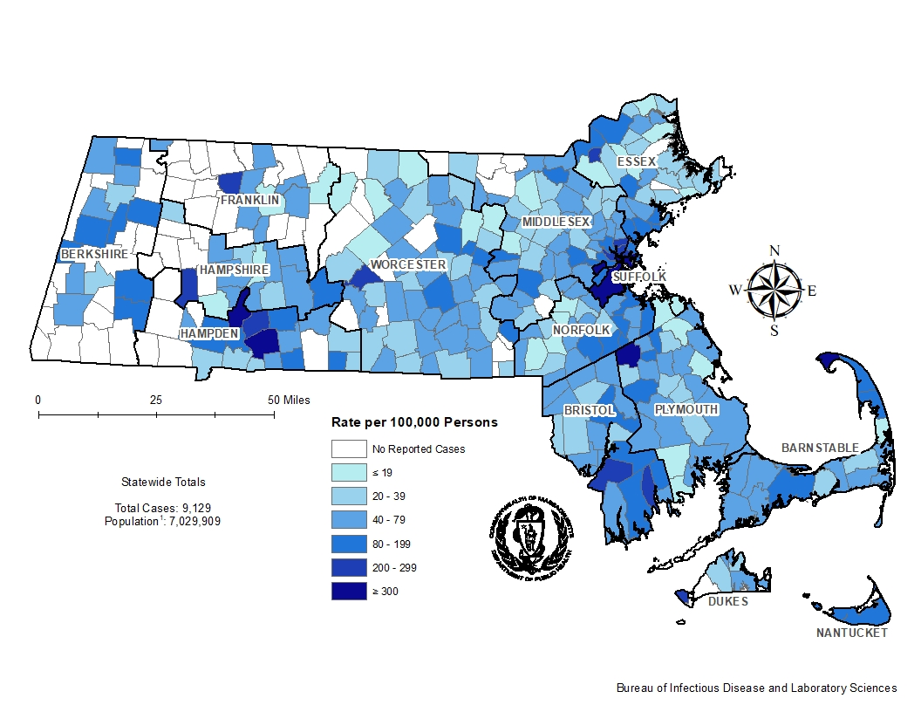
Incident Rate of Confirmed Gonorrhea Cases, per 100,000 Persons¹ by City/Town², Massachusetts, 2022³
Data are current as of 07/18/2023 and are subject to change.
Data Source: Massachusetts Department of Public Health/Bureau of Infectious Disease and Laboratory Sciences/ Division of STD Prevention and STD-HIV Surveillance.
1. Population denominators estimated by the University of Massachusetts Donahue Institute using a modified Hamilton-Perry model (Strate S, et al. Small Area Population Estimates for 2011 through 2020 report, Oct 2016).
2. There are four city/towns with <10 cases of gonorrhea that fall within the top two rate categories (≥200 cases per 100,000): Shelburne, Huntington, Aquinnah, and New Braintree.
3. Please consider the impact of the COVID-19 pandemic on infectious disease screening, treatment and surveillance in the interpretation of 2022 data.
Notes:
Incident Rate of Confirmed Gonorrhea Cases, per 100,000 Persons by City/Town, Massachusetts, 2022
Map of Massachusetts cities and towns color-coded to indicate the areas of the state with the highest gonorrhea case rates in 2022. The city with the highest rate (>500 per 100,000 persons) is Provincetown. Other cities that have the high rates (>300 per 100,000 persons) are Springfield, Brockton, Boston, and Holyoke.

Slide 35
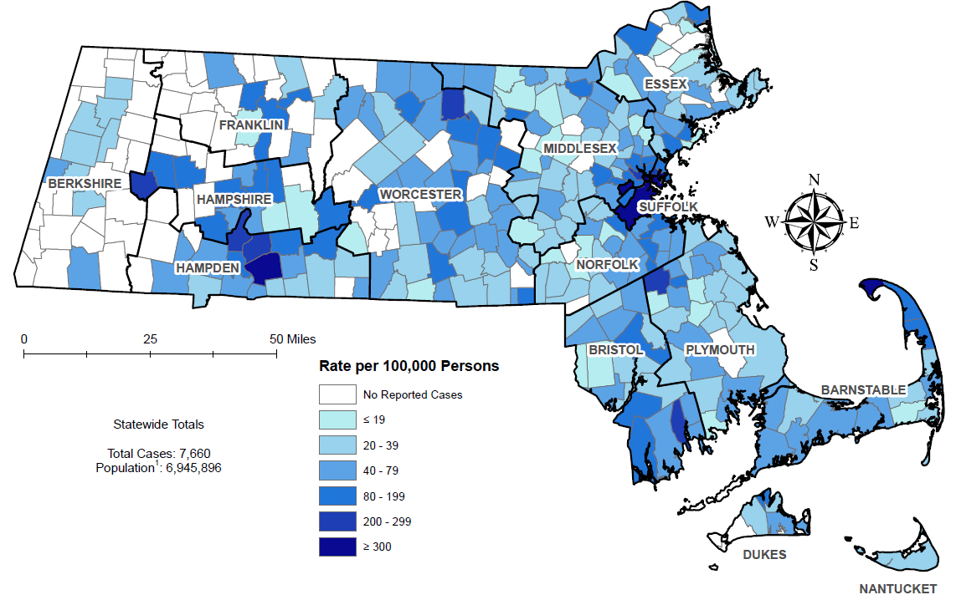
Incident Rate of Confirmed Gonorrhea Cases, per 100,000 Persons¹ by City/Town², Massachusetts, 2018
Data are current as of 07/18/2023 and are subject to change.
Data Source: Massachusetts Department of Public Health/Bureau of Infectious Disease and Laboratory Sciences/ Division of STD Prevention and STD-HIV Surveillance.
1. Population denominators estimated by the University of Massachusetts Donahue Institute using a modified Hamilton-Perry model (Strate S, et al. Small Area Population Estimates for 2011 through 2020 report, Oct 2016).
2. There is one city/town with <10 cases of gonorrhea that fall within the top two rate categories (≥200 cases per 100,000): Middlefield.
Notes:
Incident Rate of Confirmed Gonorrhea Cases, per 100,000 Persons by City/Town, Massachusetts, 2018
Map of Massachusetts cities and towns color-coded to indicate the areas of the state with the highest gonorrhea case rates in 2018. The city with the highest rate (>500 per 100,000 persons) is Provincetown. Other cities that have the high rates (>300 per 100,000 persons) are Springfield and Brockton.

Slide 36
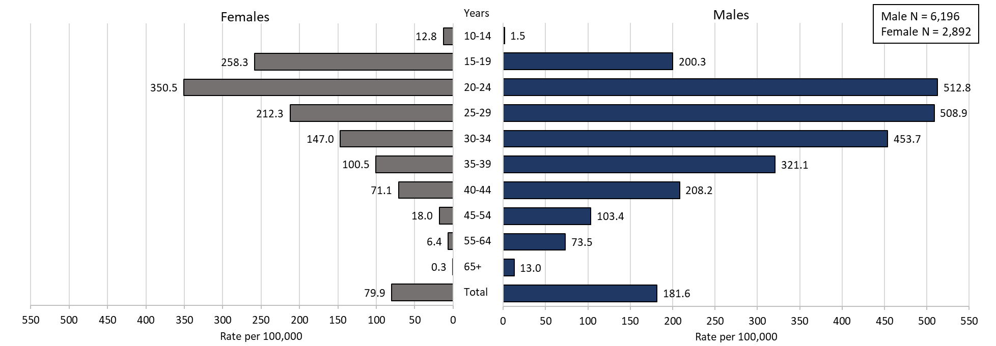
Confirmed Gonorrhea Case Rates per 100,000 Population by Gender¹ and Age, Massachusetts, 2022²
Data are current as of 07/18/2023 and are subject to change.
Data Source: Massachusetts Department of Public Health/Bureau of Infectious Disease and Laboratory Sciences/ Division of STD Prevention and STD-HIV Surveillance.
Population denominators estimated by the University of Massachusetts Donahue Institute using a modified Hamilton-Perry model (Strate S, et al. Small Area Population Estimates for 2011 through 2020 report, Oct 2016).
1. In 2022, there were 34 individuals of transgender experience documented in our data system and MA DSTDP does not have current gender information for those individuals and 4 other individuals had unknown gender. 2 individuals had unknown age. These cases were excluded since rate for this population cannot be calculated at this time.
2. Please consider the impact of the COVID-19 pandemic on infectious disease screening, treatment and surveillance in the interpretation of 2022 data.
Notes:
Confirmed Gonorrhea Case Rates per 100,000 Population by Gender and Age, Massachusetts, 2022
Graph depicts gonorrhea case rates per 100,000 population by age categories for the overall state, males, and females. For the overall state, the highest rate is among those 20-24 years. When looking at the gender specific rates, the age categories with the highest rates are 20 to 24 years for both males and females.

Slide 37
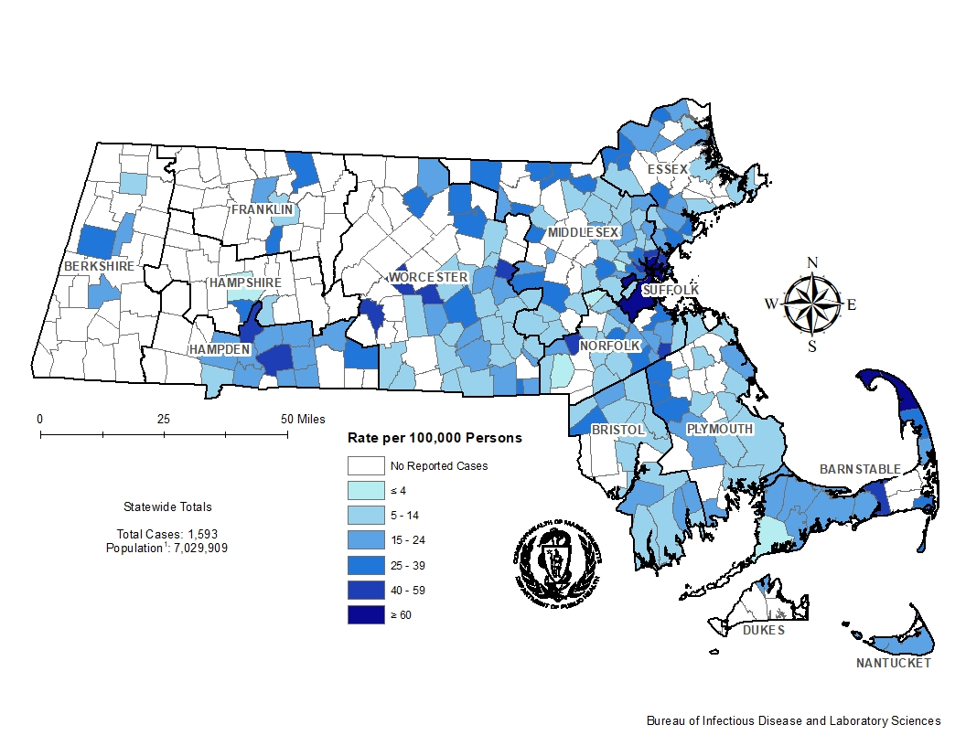
Incident Rate of Infectious Syphilis¹ Cases, per 100,000 Persons² by City/Town, Massachusetts, 2022³
Data are current as of 07/18/2023 and are subject to change.
Data Source: Massachusetts Department of Public Health/Bureau of Infectious Disease and Laboratory Sciences/ Division of STD Prevention and STD-HIV Surveillance.
1. Infectious syphilis is defined as primary, secondary and early latent stages of syphilis within one year of infection.
2. Population denominators estimated by the University of Massachusetts Donahue Institute using a modified Hamilton-Perry model (Strate S, et al. Small Area Population Estimates for 2011 through 2020 report, Oct 2016).
3. There are seven city/towns with <10 cases of syphilis that fall within the top two rate categories (≥40 cases per 100,000): Truro, Oakham, West Brookfield, Berlin, Millis, Holbrook, and Dennis.
4. Please consider the impact of the COVID-19 pandemic on infectious disease screening, treatment and surveillance in the interpretation of 2022 data.
Notes:
Incident Rate of Infectious Syphilis Cases, per 100,000 Persons by City/Town, Massachusetts, 2022
Map of Massachusetts counties color-coded to indicate the areas of the state with the highest infectious syphilis case rates in 2022. The cities that have the highest rates (greater than 40 per 100,000 persons) are Provincetown, Truro, Chelsea, Everett, Boston, Springfield, Oakham, West Brookfield, Revere, Berlin, Somerville, Millis, Holbrook, Malden, and Dennis.

Slide 38
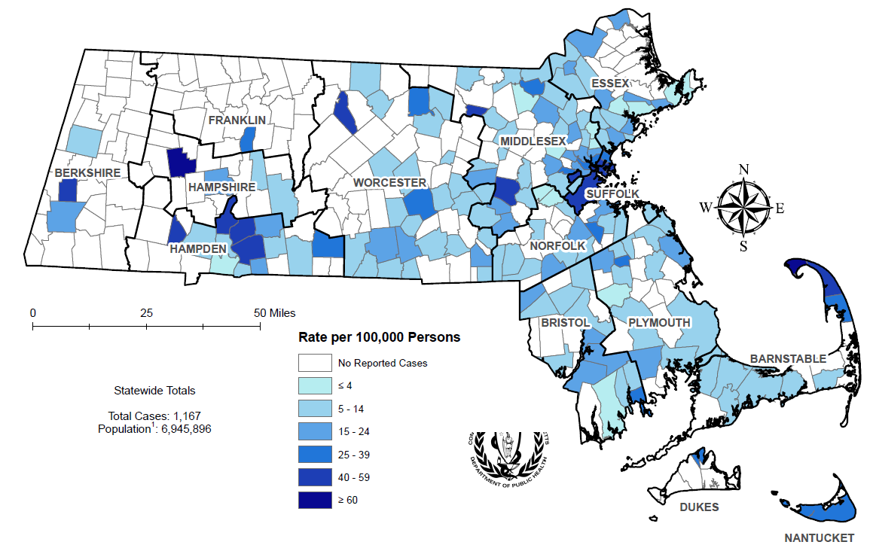
Incident Rate of Infectious Syphilis¹ Cases, per 100,000 Persons² by City/Town, Massachusetts, 2018
Data are current as of 07/18/2023 and are subject to change.
Data Source: Massachusetts Department of Public Health/Bureau of Infectious Disease and Laboratory Sciences/ Division of STD Prevention and STD-HIV Surveillance.
1. Infectious syphilis is defined as primary, secondary and early latent stages of syphilis within one year of infection.
2. Population denominators estimated by the University of Massachusetts Donahue Institute using a modified Hamilton-Perry model (Strate S, et al. Small Area Population Estimates for 2011 through 2020 report, Oct 2016).
3. There are eight city/towns with <10 cases of syphilis that fall within the top two rate categories (≥40 cases per 100,000): Chesterfield, Winthrop, Phillipston, Strockbridge, Russell, Truro, Springfield, and Ayer.
Notes:
Incident Rate of Infectious Syphilis Cases, per 100,000 Persons by City/Town, Massachusetts, 2018
Map of Massachusetts counties color-coded to indicate the areas of the state with the highest infectious syphilis case rates in 2018. The cities that have the highest rates (greater than 40 per 100,000 persons) are Provincetown, Chesterfield, Winthrop, Phillipston, Strockbridge, Russell, Truro, Springfield, Ayer, Holyoke, Framingham, Boston, Chicopee, and Chelsea.

Slide 39
Confirmed and Probable Infectious Syphilis¹ Cases per 100,000 Population by Gender² and Age, Massachusetts, 2022³
Data are current as of 07/18/2023 and are subject to change.
Data Source: Massachusetts Department of Public Health/Bureau of Infectious Disease and Laboratory Sciences/ Division of STD Prevention and STD-HIV Surveillance.
Population denominators estimated by the University of Massachusetts Donahue Institute using a modified Hamilton-Perry model (Strate S, et al. Small Area Population Estimates for 2011 through 2020 report, Oct 2016).
1. Infectious syphilis is defined as primary, secondary and early latent stages of syphilis within one year of infection.
2. In 2022, there were 3 individuals of transgender experience documented in our data system and MA DSTDP does not have current gender information for those individuals. These cases were excluded since rate for this population cannot be calculated at this time.
3. Please consider the impact of the COVID-19 pandemic on infectious disease screening, treatment and surveillance in the interpretation of 2022 data.
Notes:
Incident Rate of Confirmed and Probable Infectious Syphilis Cases per 100,000 Population by Gender and Age, Massachusetts, 2022
Graph depicts infectious syphilis rates per 100,000 population by age categories for the overall state, males, and females. For the overall state, the highest rate is among those 30-34 years. When looking at the gender specific rates, the age categories with the highest rates are 25 to 29 years for females and 30 to 34 years for males.

Slide 40
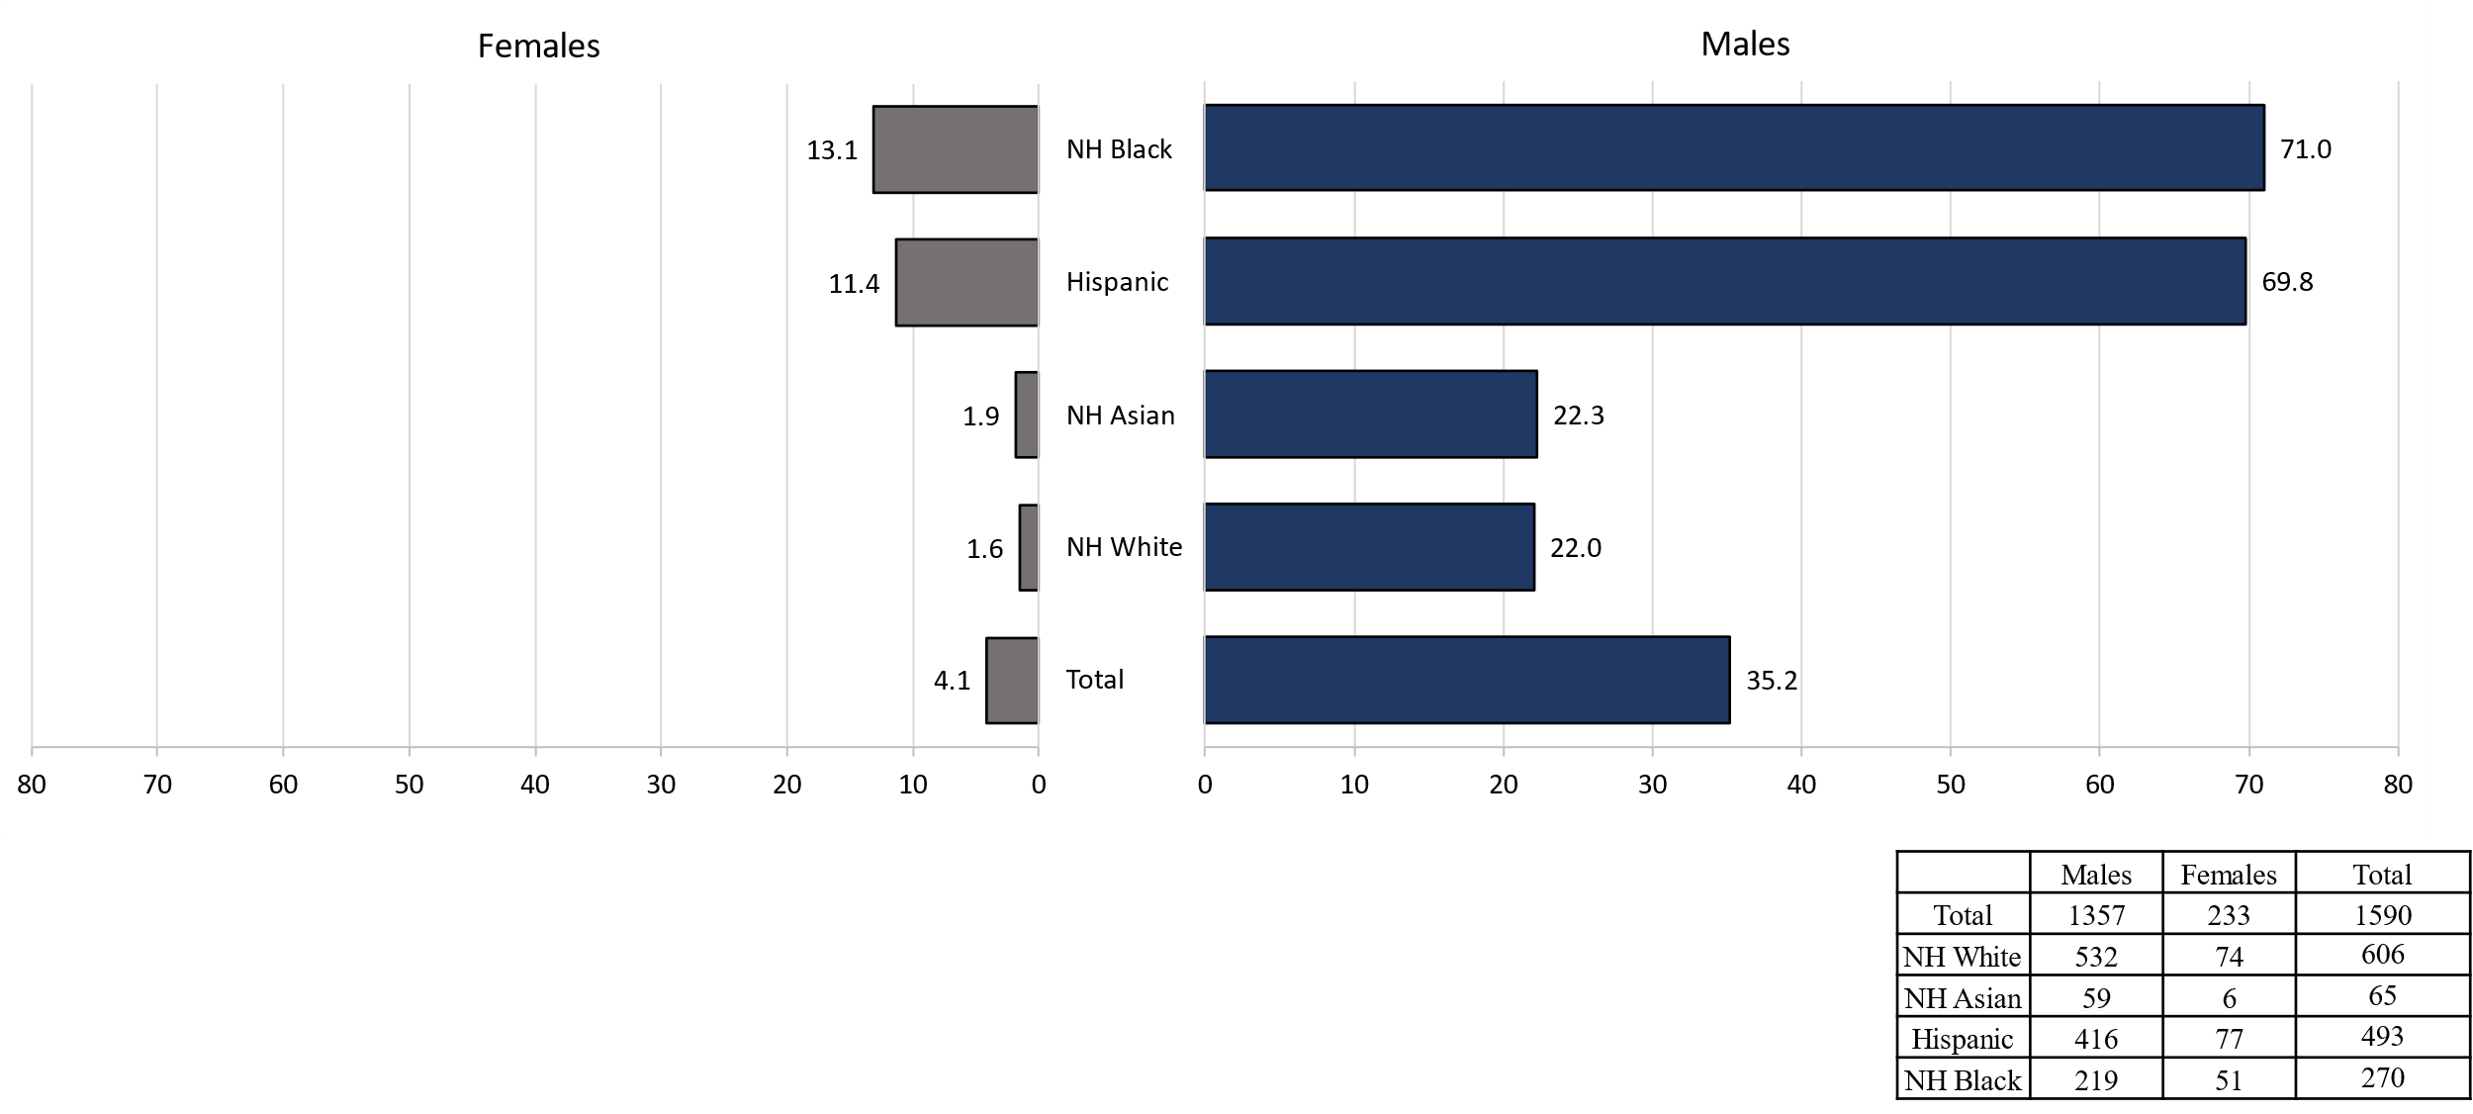
Comparison of the Rate of Confirmed and Probable Infectious Syphilis¹ Cases by Gender² and Race and Ethnicity³, Massachusetts, 2022⁴
Data are current as of 07/18/2023 and are subject to change.
Data Source: Massachusetts Department of Public Health/Bureau of Infectious Disease and Laboratory Sciences/ Division of STD Prevention and STD-HIV Surveillance.
Population denominators estimated by the University of Massachusetts Donahue Institute using a modified Hamilton-Perry model (Strate S, et al. Small Area Population Estimates for 2011 through 2020 report, Oct 2016).
Infectious syphilis is defined as primary, secondary and early latent stages of syphilis within one year of infection.
In 2022, there were 3 individuals of transgender experience documented in our data system and MA DSTDP does not have current gender information for those individuals. These cases were excluded since rate for this population cannot be calculated at this time.
Those cases reported among non-Hispanic/Latinx individuals with other race categories were excluded based on small counts (6.4% of cases). Cases with unknown race and ethnicity were excluded because rates could not be calculated (3.8% of cases).
Please consider the impact of the COVID-19 pandemic on infectious disease screening, treatment and surveillance in the interpretation of 2022 data.
Notes:
Comparison of the Rate of Confirmed and Probable Infectious Syphilis Cases by Gender and Race and Ethnicity, Massachusetts, 2022
Graph depicts infectious syphilis rates per 100,000 population by age and race/ethnicity categories for the overall state, males, and females. For all infectious syphilis cases, the highest rate is among Non-Hispanic/Latinx Black and Hispanic/Latinx for both male and females.

Slide 41
HIV Co-infection
Notes:
Picture description: logo for the Massachusetts Department of Public Health

Slide 42
2022¹ HIV² Co-Infection with Chlamydia and Gonorrhea
Chlamydia with HIV Co-Infection
2.2% of chlamydia cases were HIV co-infection (N = 28,384)
As age increases the proportion of HIV co-infection increases
<1% of cases in their 20s are HIV co-infected
20% of cases 50+ are HIV co-infected
Gonorrhea with HIV Co-Infection
7.7% of gonorrhea cases were HIV co-infection (N = 9,128)
As age increases the proportion of HIV co-infection increases
3% of cases in their 20s are HIV co-infected
23% of cases 50+ are HIV co-infected
Data are current as of 07/18/2023 and are subject to change. Data Source: Massachusetts Department of Public Health/Bureau of Infectious Disease and Laboratory Sciences/ Division of STD Prevention and STD-HIV Surveillance.
1. Please consider the impact of the COVID-19 pandemic on infectious disease screening, treatment and surveillance in the interpretation of 2022 data.
2. HIV status is based on a full year match with HIV Surveillance data.

Slide 43
2022¹ HIV² Co-Infection with Infectious Syphilis³
25% of infectious syphilis cases were co-infected with HIV (N = 1,593)
As age increases the proportion of HIV co-infection increases
12.8% of cases in their 20s are HIV co-infected
53.9% of cases 50+ are HIV co-infected
Of individuals co-infected with HIV and infectious syphilis, 81.9% were MSM⁴ (N = 397), compared with 56.4% for those with no known HIV diagnosis (N = 1196).
Of known MSM individuals infected with infectious syphilis (N = 1000), 32.5% were co-infected with HIV.
8.1% of co-infected individuals were newly diagnosed with HIV within 30 days of infectious syphilis event date; 91.7% had a prior HIV diagnosis.
Data are current as of 07/18/2023 and are subject to change. Data Source: Massachusetts Department of Public Health/Bureau of Infectious Disease and Laboratory Sciences/ Division of STD Prevention and STD-HIV Surveillance.
1. Please consider the impact of the COVID-19 pandemic on infectious disease screening, treatment and surveillance in the interpretation of 2022 data.
2. HIV status is based on a full year match with HIV Surveillance data.
3. Infectious syphilis is defined as primary, secondary and early latent stages of syphilis within one year of infection.
4. The MSM (men who have sex with men) category includes MSMT, MSMW, and MSMWT with “W” referring to women and “T” referring to individuals of transgender experience.

Slide 44
2022¹ HIV² Co-Infection
Infectious Syphilis³ with HIV Co-Infection
25% of infectious syphilis cases were HIV co-infection (N = 1,593)
As age increases the proportion of HIV co-infection increases
12.8% of cases in their 20s are HIV co-infected
53.9% of cases 50+ are HIV co-infected
Add bullet on MSM risk = % of co-infected MSM for 2022…
Add bullet on % previously infected or newly infected
Data are current as of 07/18/2023 and are subject to change. Data Source: Massachusetts Department of Public Health/Bureau of Infectious Disease and Laboratory Sciences/ Division of STD Prevention and STD-HIV Surveillance.
1. Please consider the impact of the COVID-19 pandemic on infectious disease screening, treatment and surveillance in the interpretation of 2022 data.
2. HIV status is based on a full year match with HIV Surveillance data.
3. Infectious syphilis is defined as primary, secondary and early latent stages of syphilis within one year of infection.

Slide 45
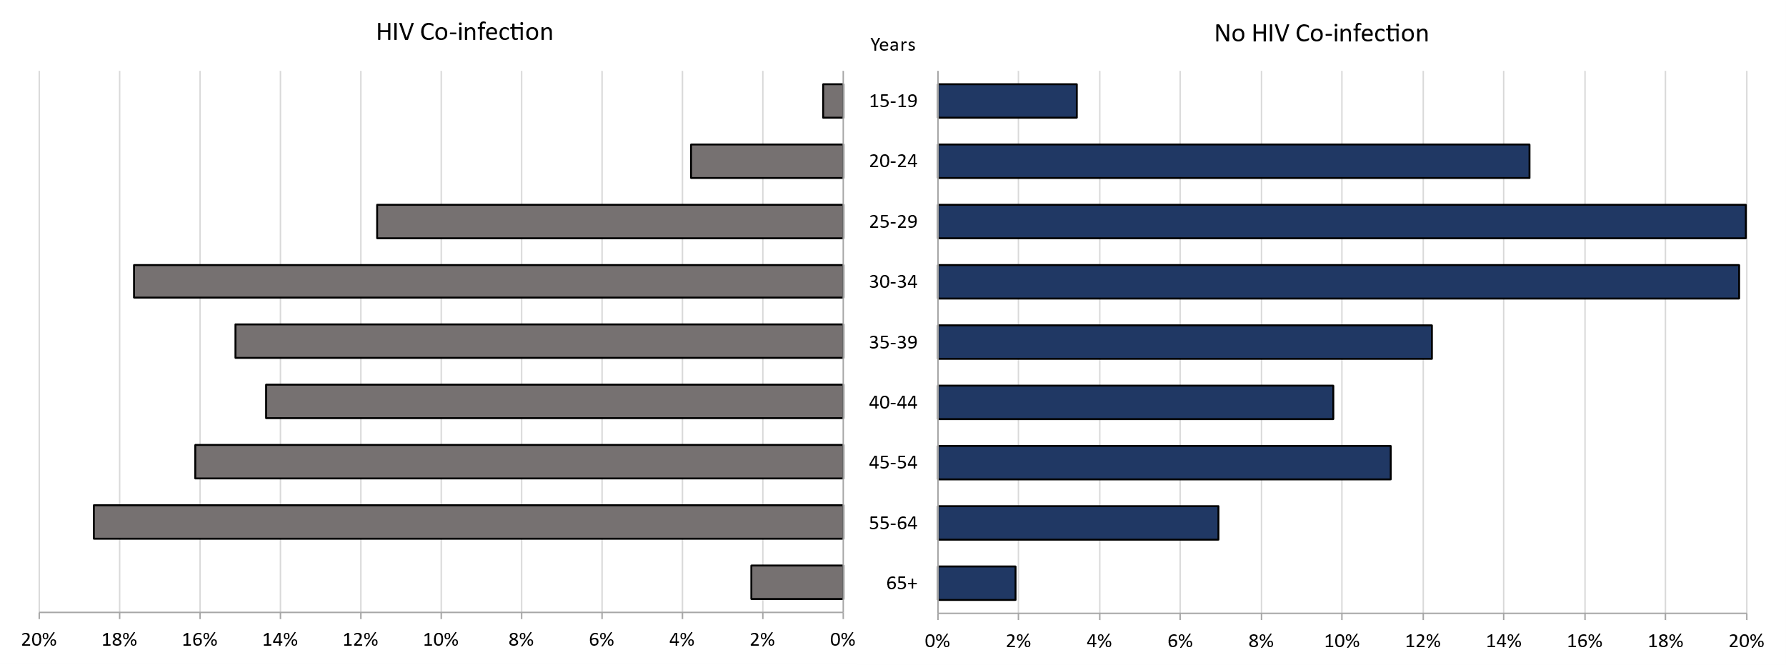
Comparison of Infectious Syphilis¹ Cases by HIV² Co-Infection and Age³, Massachusetts, 2022⁴
Data are current as of 07/18/2023 and are subject to change.
Data Source: Massachusetts Department of Public Health/Bureau of Infectious Disease and Laboratory Sciences/ Division of STD Prevention and STD-HIV Surveillance.
1. Infectious syphilis is defined as primary, secondary and early latent stages of syphilis within one year of infection.
2. HIV status is based on a full year match with HIV Surveillance data.
3. Individuals younger than 15 years are not included within this slide due to low case counts.
4. Please consider the impact of the COVID-19 pandemic on infectious disease screening, treatment and surveillance in the interpretation of 2022 data.
Notes:
Comparison of Infectious Syphilis Cases by HIV Co-Infection and Age, Massachusetts, 2022
Graph depicts infectious syphilis case percentages for age categories by HIV co-infection status. The proportion of infectious syphilis cases with HIV co-infection were highest among those age 55 to 64 as well as those age 30 to 34. The proportion of cases with HIV co-infection were lowest among those 15 to 19 years followed by those over the age of 65 years.

Slide 46
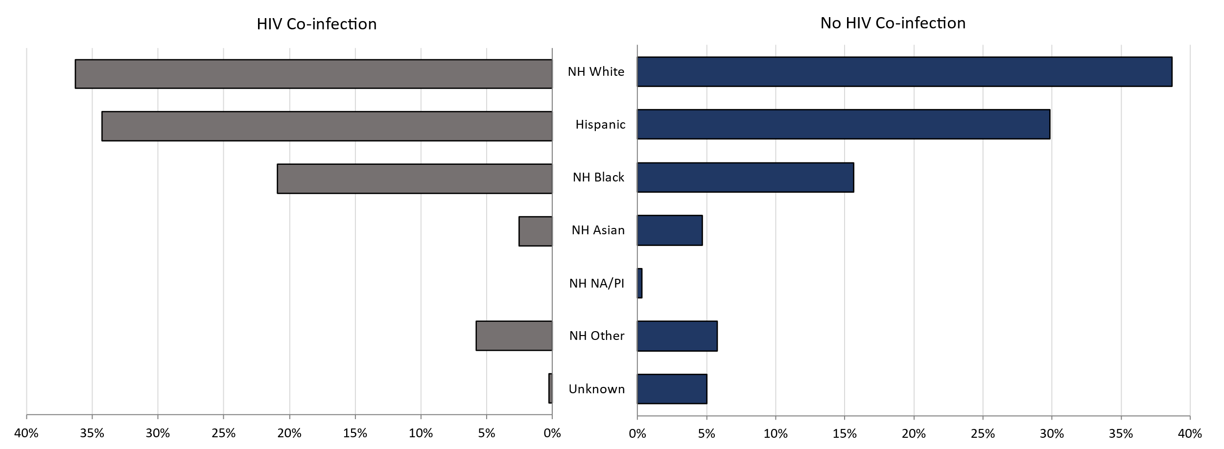
Comparison of Infectious Syphilis¹ Cases by HIV² Co-Infection and Race/Ethnicity, Massachusetts, 2022³
Data are current as of 07/18/2023 and are subject to change.
Data Source: Massachusetts Department of Public Health/Bureau of Infectious Disease and Laboratory Sciences/ Division of STD Prevention.
1. Infectious syphilis is defined as primary, secondary and early latent stages of syphilis within one year of infection.
2. HIV status is based on a full year match with HIV Surveillance data.
3. Please consider the impact of the COVID-19 pandemic on infectious disease screening, treatment and surveillance in the interpretation of 2022 data.
Notes:
Comparison of Infectious Syphilis Cases by HIV Co-Infection and Race/Ethnicity, Massachusetts, 2022
Graph depicts infectious syphilis case percentages for race/ethnicity categories by HIV co-infection status. The proportion of infectious syphilis cases with HIV co-infection is highest among Non-Hispanic Whites followed by Hispanic and then Non-Hispanic Black individuals.

Slide 47
2022 Summary Slide
Chlamydia: The 2022 Massachusetts state rate was 403.8 per 100,000
The highest rate of chlamydia cases was among females 20 to 24 years with a rate of 2,709.3 cases per 100,000 population*
Gonorrhea: The 2022 Massachusetts state rate was 129.8 per 100,000
The highest rate of gonorrhea cases was among males 20 to 24 years with a rate of 512.8 cases per 100,000 population
Infectious Syphilis: The 2022 Massachusetts state rate was 22.7 per 100,000
The highest rate of infectious syphilis cases was among males 30 to 34 years with a rate of 107.9 cases per 100,000 population
Congenital syphilis cases maintained the increased number of reportable cases seen from 2019 to 2022
The overall increases in infectious syphilis rates in individuals believed to be biologically capable of pregnancy and the increase in reportable congenital syphilis cases led to a recommendation for universal third trimester screening in 2020, on top of routine screening for syphilis upon entry into prenatal care in Massachusetts.
Data Source: Massachusetts Department of Public Health/Bureau of Infectious Disease and Laboratory Sciences/ Division of STD Prevention.
Data are current as of 07/18/2023 and are subject to change
* Population based on 2019 University of Massachusetts Donahue Institute Estimates

Slide 48
Technical Data Notes
STI and HIV specific laboratory and case management information are reported directly to the Department of Public Health and maintained in the Massachusetts integrated disease surveillance and case management system, MAVEN
The majority (>90%) of laboratory test results are reported via electronic laboratory reporting
Case management information is reported via electronic medical record feeds, case reporting forms and collected by epidemiologists
Data are routinely reviewed, cleaned, and analyzed by surveillance epidemiologists
Routine reports are shared with internal and external stakeholders
All data are collected and maintained according to strict confidentiality and security requirements

Slide 49
Technical Data Notes (Continued)
Case classifications (confirmed, probable or suspect) are based on CSTE/CDC case definitions for nationally notifiable infectious diseases.
For full STI case classifications, see: https://www.cdc.gov/std/statistics/2019/case-definitions.htm
All data in this report are accurate as of their analysis date and are subject to change. Common reasons for data changes include amendments to reporting and routine data cleaning.
Transgender individuals are included in current gender identity categories, except where noted due to incomplete information on current gender identity. Nonbinary gender identity is captured but suppressed according to Massachusetts privacy and confidentiality rules. Collection of transgender data categories began in mid-2014.
Gender of sex partners categories for this report include: MSM = men who have sex with men, MSW = men who have sex with women, WSM = women who have sex with men, Other = include transgender sexual risk categories and females who have sex with females or both male and female partners, and Unknown are cases reported without sexual risk. These categories are based on patient and provider report and do not necessarily reflect an individual’s sexual identity in relation to gender (i.e. gay, bisexual, heterosexual, etc).

Slide 50
Coronavirus 2019 (COVID-19): Impact of Other Reportable Infections
When reviewing 2020-2022 data for Massachusetts, please note the impact of the coronavirus 2019 (COVID-19) pandemic on infectious disease screening, treatment, and surveillance. Nationally, CDC observed a sharp decline in reported STD cases from March-April 2020, compared to March-April 2019.
Three factors were cited as likely contributing to the initial decrease in reported cases:
Reduced screening – many health care clinics limited in-person visits to symptomatic cases or closed
Limited resources – many state and local health department STD staff were redirected from routine STD responsibilities to COVID-19 activities, which affected STD tracking capacity and reporting
Stay-at-home orders (March 24 through April 7th, 2020) – which were intended to reduce COVID-19 spread may have influenced sexual behaviors and reduced STD transmission¹
As the impact of the COVID-19 pandemic continues, it’s full effect on case reporting and efforts to control the spread of infectious disease in the Commonwealth has yet to be determined. As such, please interpret 2020 infectious disease data with caution.
CDC Press Release, July 16, 2021: Trends in STD case reports during the U.S. COVID-19 pandemic, January-December 2020 available at: https://www.cdc.gov/nchhstp/newsroom/2021/2020-std-trend-report.html”

Slide 51
Thank You!
If you have questions or to request more information: call the Massachusetts Department of Public Health, Division of STD Prevention, at 617-983-6940

