Slide 1
Agenda
1. Housekeeping
Call to Order, Establish Quorum, Vote to Accept Minutes
2. Unfinished Business - Discussion of Objective 1
Unmet Needs of Patients, families
Time-of-Diagnosis Statistics
Risk factors
3. New Business - Discussion of Objective 2
Programs in the Commonwealth
Prevention
Screening
Education
Support
4. Open Discussion
5. Adjournment

Slide 2
1. Housekeeping
Call to order
Establish quorum
Vote to accept minutes

Slide 3
2. Unfinished Business - Discussion of Objective 1
Unmet needs of patients and families (data from 3/26 meeting)
Patient | Family
Clinical trial options ( ↑ awareness) | Awareness of high rick screening programs
Improved communication | Genetic testing
Information in many languages | Psychosocial support
Managing complications | Symptom control
Drug/treatment costs | Financial hardship

Slide 4
2. Unfinished Business - Discussion of Objective 1
Time-of-Diagnosis Statistics

Slide 5
Pancreatic Cancer Burden in Massachusetts, 2011-2015
Massachusetts Department of Public Health
Bureau of Community Health and Prevention
Division of Clinical Preventive Services
Massachusetts Comprehensive Cancer Prevention and Control Network
April 2019

Slide 6
Pancreatic Cancer Burden in Massachusetts, 2011-2015
Outline
Overall cancer burden in Massachusetts
Pancreatic cancer incidence by race, gender year, county and stage
Pancreatic cancer mortality by race, gender, year
Pancreatic cancer survival
Massachusetts Cancer Registry Data

Slide 7
Overall Cancer Burden in Massachusetts, 2011 - 2015
Cancer is the leading cause of death in Massachusetts
Lung, prostate, colorectal, and pancreatic cancers account for 50% of all cancer deaths in males
Lung, breast, colorectal and pancreatic cancers account for 55% of all cancer deaths in females
Overall cancer incidence and mortality for both males and females decreased between 2011 and 2015
Source: Massachusetts Vital Statistics

Slide 8
Top Ten New Cancers in MA Males and Females, 2011-2015
Male
Rate/100,000
Female
Rate/100,000

Slide 9
Top Ten Causes of Cancer Deaths in MA Males and Females, 2011-2015

Slide 10
Pancreatic Cancer Incidence in Massachusetts, 2011 - 2015
Pancreatic cancer was the 9th most commonly diagnosed cancer among Massachusetts females (2,636) and the 10th among males (2,556)
It accounted for 2.9% of all cancers in males and 2.8% in females with incidence rates of:
14.5 per 100,000
11.4 per 100,000
Incidence rates increased between 2011 and 2015 but the increase was only significant in females
14.3 cases to 15.3 per 100,000 in males 10.9 cases to 12.0 per 100,000 in females
Source: Massachusetts Cancer Registry

Slide 11
Pancreatic Cancer Incidence in Massachusetts, 2011 – 2015 (cont’d)
Pancreatic cancer incidence rates were higher among White non-Hispanic (14.8/100,000) and Black non-Hispanic (16.3/100,000) males than other racial/ethnic groups
Among females, White non-Hispanics (11.6/100,000) and Black non-Hispanics (12.9/100,000) had higher pancreatic cancer incidence than other racial/ethnic groups
The median age at diagnosis was 69 years for males and 74 years for females
There were no significant differences in pancreatic cancer incidence by county
Source: Massachusetts Cancer Registry

Slide 12
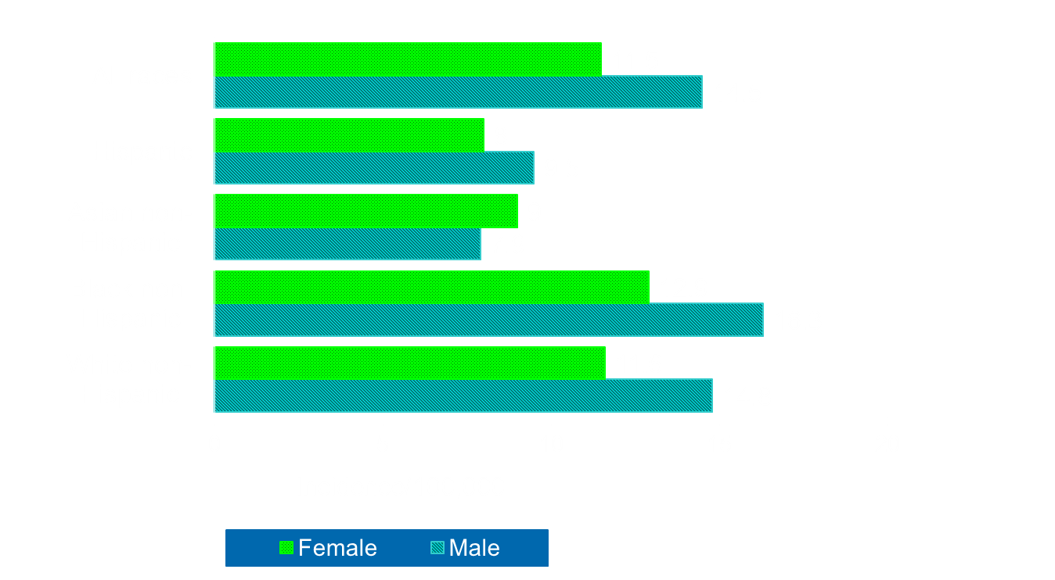
Age-Adjusted Pancreatic Cancer Incidence Rates in Massachusetts by Race and Gender, 2011 - 2015
Source: Massachusetts Cancer Registry

Slide 13
Annual Age-Adjusted Pancreatic Cancer Incidence Rates in Massachusetts by Gender, 2011- 2015
Male
Female
Source: Massachusetts Cancer Registry

Slide 14
Annual Age-Adjusted Pancreatic Cancer Incidence Rates in Massachusetts by Gender and County, 2011-2015
Source: Massachusetts Cancer Registry

Slide 15
Pancreatic Cancer Mortality in Massachusetts, 2011 - 2015
Pancreatic cancer was the 4th leading cause of cancer deaths (4,527 Deaths) among both males and females between 2011 and 2015
It accounted for 6.7% of all cancer deaths in males (2,181) and 7.4% in females (2,346)
Age-adjusted mortality rate:
12.3 per 100,000 9.8 per 100,000
Pancreatic cancer mortality rates for males remained unchanged but increased by 3% in females between 2011 and 2015
Source: Massachusetts Vital Statistics

Slide 16
Pancreatic Cancer Mortality in Massachusetts, 2011 – 2015 (cont’d)
The median age at death was 72 years
There were significant racial disparities in pancreatic cancer deaths
Mortality was higher among White non-Hispanic and Black non-Hispanic males both (12.7 per 100,000) compared to other racial/ethnic groups
Asian males had the lowest pancreatic cancer mortality (5.7 per /100,000)
Source: Massachusetts Vital Statistics

Slide 17
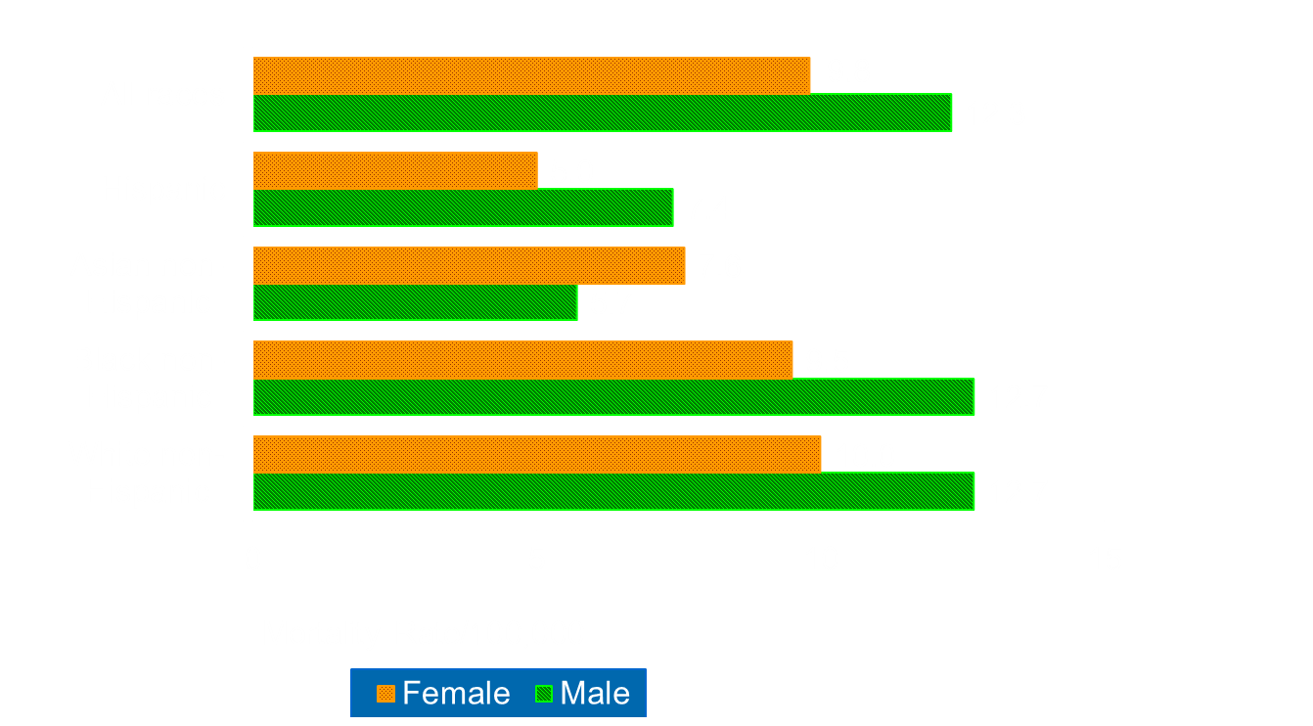
Age-Adjusted Pancreatic Cancer Mortality Rates in Massachusetts by Race and Gender, 2011 - 2015
Source: Massachusetts Vital Statistics

Slide 18
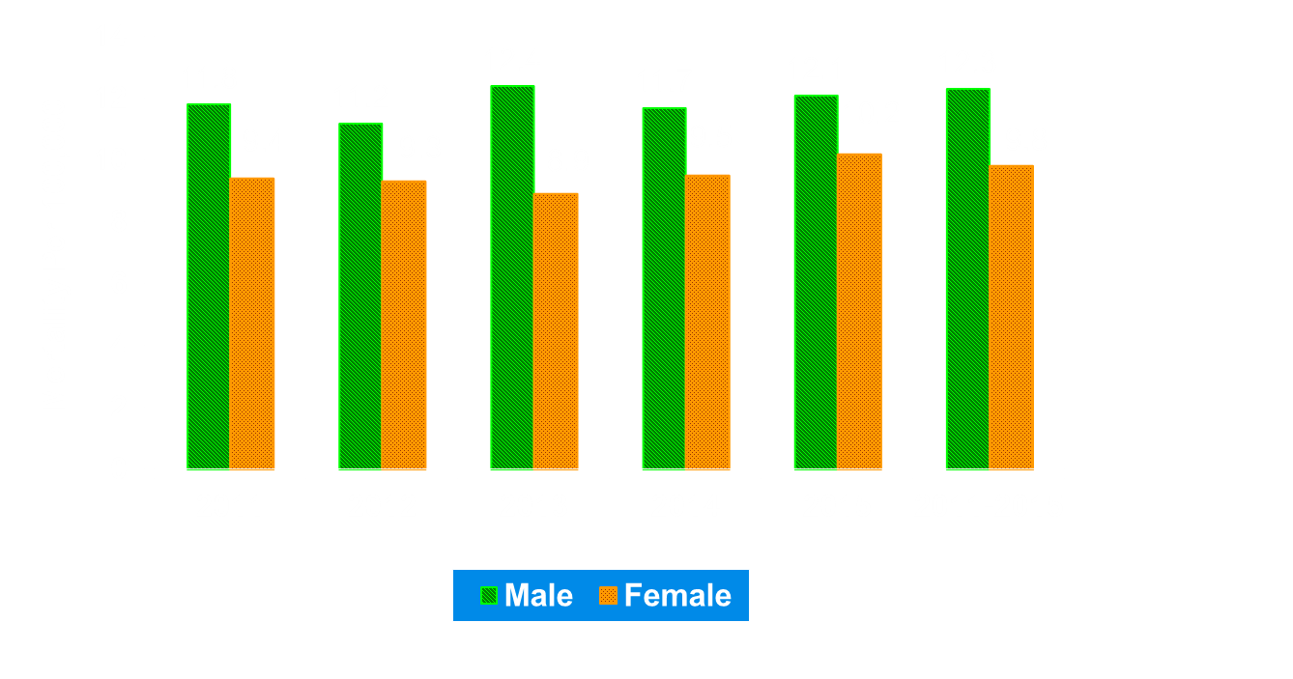
Annual Age-Adjusted Pancreatic Cancer Mortality Rates in Massachusetts by Gender and Year, 2011-2015
Source: Massachusetts Vital Statistics

Slide 19
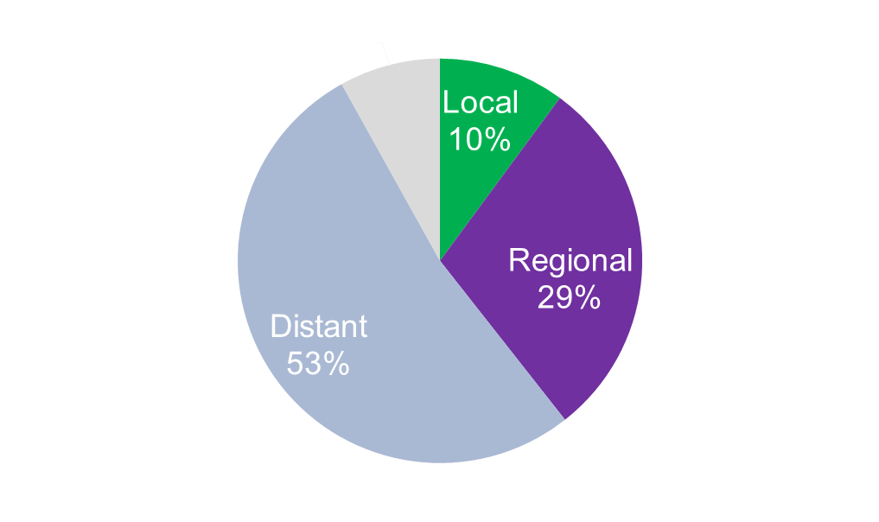
US Percent of Pancreatic Cancer Cases by Stage at Diagnosis, 2013 - 2015
Local: Cancer is still confined to primary site
Regional: Cancer has spread to regional (nearby) lymph nodes
Distance: Cancer has metastasized (spread further away from primary site)
Source: SEER Cancer Stat Facts: Pancreatic Cancer. National Cancer Institute

Slide 20
Pancreatic Cancer Stage at Diagnosis in MA

Slide 21
Survival and Staging Rates for Pancreatic Cancer in US
Approximately 1.6 percent of Americans born today will be diagnosed with pancreatic cancer at some point during their lifetime
The overall 5-year relative survival pancreatic cancer between 2008 – 2014 was 8.5%
Survival By Stage:
Local 34.3%
Regional 11.5%
Distant 2.7%
Unknown 5.5%
Source: Surveillance Epidemiology and End Results (SEER) Fact Sheets-Pancreatic Cancer

Slide 22
Massachusetts Cancer Registry Data
The Massachusetts Cancer Registry is part of the CDC’s National Program of Cancer Registries (NPCR)
Collects cancer incidence and other data including:
Age, date of birth, sex, race/ethnicity
Date of Diagnosis
State, county, census tract, poverty, occupation, insurance type
Histologic Type ICD-O-3
Treatment, stage at diagnosis
The full list of required Cancer Registry data is available on Chapter VIII at: http://datadictionary.naaccr.org/
Source: North American Association of Central Cancer Registries (NAACCR)

Slide 23
2. Unfinished Business - Discussion of Objective 1
Familial pancreatic cancer - a family with at least one pair of first-degree relatives (parent-child or sibling pair) with pancreatic cancer without an identifiable gene mutation
# First Degree Relatives with Pancreatic Cancer | Risk for Developing Pancreatic Cancer
0 | 1-2%
1 | 4-6%
2 | 4-7%
3+ | 17-32%
*NCGC Familial Pancreatic Cancer Fact Sheet

Slide 24
2. Unfinished Business - Discussion of Objective 1
Hereditary pancreatic cancer - an identifiable gene mutation associated with an increased risk for pancreatic cancer
Syndrome | Relative Risk | Gene(s)
Familial atypical multiple mole melanoma (FAMMM) | 13 to 39-fold | CDKN2A
Familial breast and ovarian | 2-fold and 3 to 9-fold | BRCA1 and 2
Fanconi anemia, breast CA | Unknown | PALB2
Familial adenomatous polyposis (FAP) | 5-fold | APC
Lynch syndrome | 9 to 11-fold | MLH1, MSH6, MSH2, PMS2, EPCAM
Peutz-Jeghers syndrome | 132 –fold | STK11/LKB1
Hereditary pancreatitis | 53 -fold | PRSS1
Li-Fraumeni syndrome | 7 -fold | p53
Ataxia-telangiectasia | ~3 –fold | ATM
Solomon, S., et al. Inherited Pancreatic Cancer Syndromes. Cancer journal (Sudbury, Mass.) 18, 485-491 (2012).

Slide 25
2. Unfinished Business - Discussion of Objective 1
Modifiable Risk Factors
Risk Factors | Increased PDAC Risk
Current cigarette/pipe/cigar use | 1.5-2.2
> 3 alcoholic drinks/day | 1.2-1.4
Chronic pancreatitis | 13.3
BMI> 40kg/m² | 1.5-2.8
Diabetes mellitus, T1 and T2 | 1.8-2.0
Cholecystectomy | 1.2
Gastrectomy | 1.5
Helicobacter pylori infection | 1.4
https://doi.org/10.3748%2Fwjg.v20.i32.11182; Becker et al

Slide 26
3. New Business - Discussion of Objective 2
Programs in the Commonwealth
Do any currently exist?
Mandatory genetic testing for anyone diagnosed with pancreatic cancer
Linked to improved survival d/t targeted therapies perioperatively
https://ascopubs.org/doi/10.1200/PO.18.00271
Prevention/ High-risk screening
Hospitals in MA with high-risk screening programs
Education
PCP awareness and education – ? Mandatory CME for pancreatic cancer
Signs and symptoms, genetic testing/counselor
Support

Slide 27
Upcoming Meetings
Tuesday, May 28, 3-5pm, at 1 Ashburton Place, 21st Floor, Conference Room 1

