Slide 1
Agenda
1. Establish Quorum/Introductions
2. Vote to Accept Minutes of the Previous Meeting
3. Review draft recommendations
4. Adjournment

Slide 2
1. Housekeeping
Call to order
Establish quorum
Vote to accept minutes

Slide 3
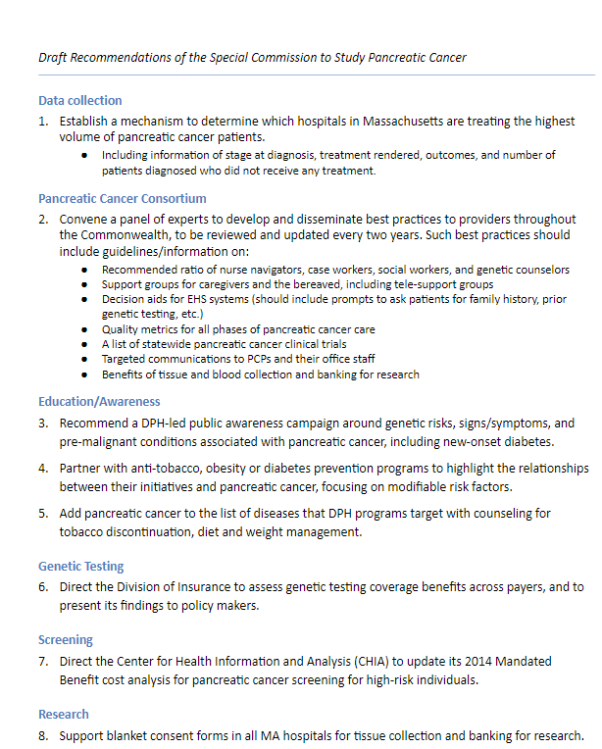
Purpose: The special commission shall make an investigation and study to:
Establish a mechanism in order to ascertain the prevalence of pancreatic cancer in the commonwealth and the unmet needs of persons with pancreatic cancer and those of their families and collect time-of-diagnosis statistics and likely risks for pancreatic cancer;
study pancreatic cancer prevention, screening, education and support programs for in the commonwealth; and
provide recommendations for additional legislation, support programs and resources necessary to meet the unmet needs of persons with pancreatic cancer and their families and how to effectuate an early diagnosis and treatment for pancreatic cancer patients.

Slide 4
Draft Recommendations of the Special Commission to Study Pancreatic Cancer
Data collection
Establish a mechanism to determine which hospitals in Massachusetts are treating the highest volume of pancreatic cancer patients.
Including information of stage at diagnosis, treatment rendered, outcomes, and number of patients diagnosed who did not receive any treatment.

Slide 5
Draft Recommendations of the Special Commission to Study Pancreatic Cancer
Pancreatic Cancer Consortium
Convene a panel of experts to develop and disseminate best practices to providers throughout the Commonwealth, to be reviewed and updated every two years. Such best practices should include guidelines/information on:
Recommended ratio of nurse navigators, case workers, social workers, and genetic counselors
Support groups for caregivers and the bereaved, including tele-support groups
Decision aids for EHS systems (should include prompts to ask patients for family history, prior genetic testing, etc.)
Quality metrics for all phases of pancreatic cancer care
A list of statewide pancreatic cancer clinical trials
Targeted communications to PCPs and their office staff
Benefits of tissue and blood collection and banking for research

Slide 6
Draft Recommendations of the Special Commission to Study Pancreatic Cancer
Education/Awareness
3. Recommend a DPH-led public awareness campaign around genetic risks, signs/symptoms, and pre-malignant conditions associated with pancreatic cancer, including new-onset diabetes.
4. Partner with anti-tobacco, obesity or diabetes prevention programs to highlight the relationships between their initiatives and pancreatic cancer, focusing on modifiable risk factors.
5. Add pancreatic cancer to the list of diseases that DPH programs target with counseling for tobacco discontinuation, diet and weight management.

Slide 7
Draft Recommendations of the Special Commission to Study Pancreatic Cancer
Genetic Testing
Direct the Division of Insurance to assess genetic testing coverage benefits across payers, and to present its findings to policy makers.

Slide 8
Draft Recommendations of the Special Commission to Study Pancreatic Cancer
Screening
Direct the Center for Health Information and Analysis (CHIA) to update its 2014 Mandated Benefit cost analysis for pancreatic cancer screening for high-risk individuals.

Slide 9
Draft Recommendations of the Special Commission to Study Pancreatic Cancer
Research
Support blanket consent forms in all MA hospitals for tissue collection and banking for research.

Slide 10
Next Steps/Upcoming Meetings?
None scheduled

Slide 11
Adjournment

