Slide 1
Special Commission to Study Pancreatic Cancer
March 26, 2019
Brock Cordeiro, Chair
Cindy Callahan, Vice Chair

Slide 2
Agenda
Introductions
Discussion of Objective 1
Engaging outside group to support Commission work
Open Discussion
Close

Slide 3
Pancreatic cancer is the 2nd leading cause of cancer death in Massachusetts
19 “cancer hospitals” in Commonwealth; only 3 with NPF designation
MGH
Dana Farber/B&W’s
BIDMC

Slide 4
National Pancreas Foundation
Designated Core Personnel
Special Expertise and Services
The Program Director should be a board certified/board eligible physician with a focus in pancreatic cancer
Notes:
• Program Director (as described below)
• Medical Oncologist § At least two with primary practice in gastrointestinal cancers including expertise in pancreatic/hepatobiliary malignancies
• Pathologist with expertise in gastrointestinal malignancies
• Radiation oncologist
• Diagnostic radiologist with an expertise in pancreatic diseases
• Interventional radiologist
• Pancreatic/hepatobiliary surgeons. The surgery center must have at least two surgeons. The center must have experience/expertise in complex pancreatic operations (must perform a minimum of 20 pancreas resections a year for 3 consecutive years)
• Gastroenterologist § One experienced in therapeutic endoscopy, including EUS and ERCP (must have min. 5 years’ of experience)
_______________________
Clinical trials § Have clinical trials available for pancreatic cancer and have access to an IRB (Institutional Review Board) for research. Institutions should be aware of the complete clinical trial landscape and what might be available at other institutions.
Psychosocial support/social work. The patient will have access to a patient support network which may including support groups, social worker access, and/or a psychiatrist.
• Palliative care program. Palliative care program to include symptom management, pain management, hospice services and other supportive services (palliative care measures must be defined in the audit application). Program should follow the NCCN Guidelines.
• Dietitian/nutrition support § Registered Dietitian Nutritionist with credentials of RD or RDN available
• Electronic Medical Records. EMRs to include imaging, labs, and prescriptions
___________________________________
Program Director Qualifications and Responsibilities
The Program Director should be a board certified/board eligible physician with a focus in pancreatic cancer.
Responsibilities
Provides quality assurance and oversight for operations of the NPF Center Program.
Assures the institution is providing adequate facilities and ancillary support to the NPF Centers Program.
Assures that all NPF Centers Program team personnel (physician and nonphysician) are of the highest quality and continually strive to improve their expertise in the area of pancreatic disease.
Assures that all aspects of the agreement with the NPF Center are met.
Assures that the personnel time allotted to the care of patients with pancreatic disease is appropriate for the patient population.
Coordinates plans with other Program Directors or appropriate personnel when it is necessary

Slide 5
Low Survival Rate

Slide 6
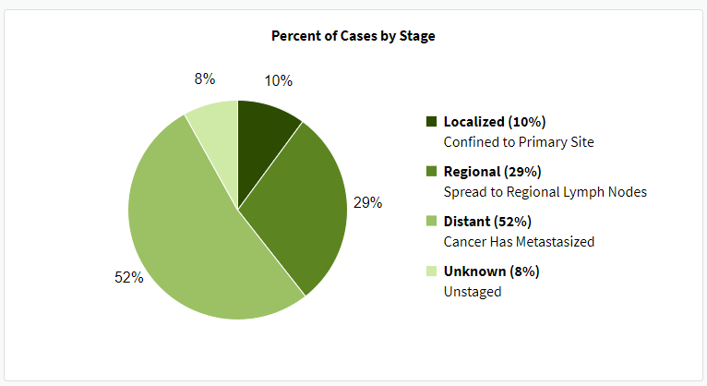
Diagnosis by Stage

Slide 7
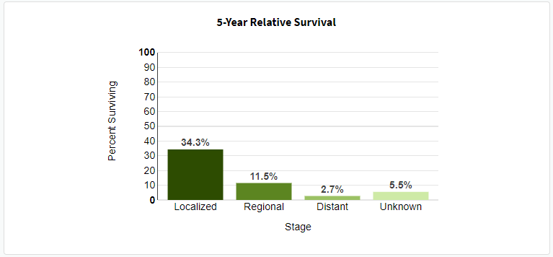
Survival Rates by Stage at Diagnosis

Slide 8
Objective 1
Establish a mechanism in order to ascertain the prevalence of pancreatic cancer in the commonwealth and the unmet needs of persons with pancreatic cancer and those of their families and collect time-of-diagnosis statistics and likely risks for pancreatic cancer.

Slide 9
Decisions to be made
Focus on the most common (pancreatic ductal adenocarcinoma or PDAC) or be all encompassing (neuroendocrine and PDAC)?

Slide 10
Pancreatic Cancers
 | Pancreatic Adenocarcinoma | Pancreatic Neuroendocrine Tumors
Abbreviation | PDAC | PNETS
Origin | Exocrine cells (supports digestion) | Endocrine cells (regulates blood sugar)
Incidence | More common (93%) | Less common (7%)
Recovery | Poorer chance | Better chance
5-year survival rates | 8.5% | 42%

Slide 11
Unmet Needs of Patients
Group discussion

Slide 12
Unmet needs of Families
Group discussion

Slide 13
Time of Diagnosis Data – Registry Information
What is currently being collected vs what should we be collecting?
Genetic testing
Familial history
Environmental factors (including alcohol use, smoking)

Slide 14
Report Preparation
Ovarian Cancer Commission engaged a consultant through DPH
JSI Research & Training Institute, Inc. is a public health research and consulting firm dedicated to improving the health of individuals and communities throughout the world.
Meetings were structured to guide, inform and complete the report
Final report drafted by JSI, reviewed and approved by the Commission

Slide 15
Other topics
Mandated Benefit Review of S.B. 471; An Act Relative to Pancreatic Cancer Screening
Sponsored by Sen. Moore of Uxbridge
Bill proposes insurance companies provide insurance coverage for early screening and detection for pancreatic cancer.

Slide 16
Upcoming Meetings
Tuesday, April 23, 3-5pm, at 1 Ashburton Place, 10th Floor, Charles River Conference Room
Tuesday, May 28, 3-5pm, at 1 Ashburton Place, 21st Floor, Conference Room 1

