Slide 1
PANDAS/PANS Advisory Council Launch Meeting September 29, 2021 10 am – 11:30 am Please stand by. The meeting will begin shortly.

Slide 2
Agenda
Welcome & Introductions
Open Meeting Law and Conflict of Interest Policy
Overview of the Council’s Charge and Deliverables
Council Expectations
Next Steps
Meeting Schedule
Adjournment

Slide 3
Meeting Rules
Open Meeting Law applies
Agenda pre-planned
Council Member attendance taken to establish quorum
Cameras on during the meetings
Mute your mic unless you are speaking
Chat function disabled
Meeting not recorded. Is anyone recording this meeting?
“Raise your Hand” option to speak

Slide 4
Brief Introductions
Your name
Your organization (limit to 2)
Your specialty or affiliation to PANDAS/PANS

Slide 5
Welcome PANDAS/PANS Advisory Council Members
Council Member | Affiliation | Council Seat
Elaine Gabovitch, MPA | DPH Division for Children & Youth with Special Health Needs | Commissioner’s Designee Chair
Sheilah Gauch, LICSW, MEd | Dearborn Academy Massachusetts Coalition for PANDAS/PANS Legislation | Special Educator Administrator Council Co-Facilitator
Jennifer M. Vitelli, MBA | JBC PANS & PANDAS Foundation Massachusetts Coalition for PANDAS/PANS Legislation | Parent of a child with PANDAS/PANS Council Co-Facilitator
Margaret Chapman, APRN, MSN, PNMHCNS | Bridge Consultants | Child psychiatric practitioner
Karen Colwell | Massachusetts Coalition for PANDAS/PANS Legislation | Appointed council member
Sylvia Fogel MD | Mass General Hospital Lurie Center for Autism Harvard Medical School | Appointed council member
John Gaitanis, MD | Tufts Medical Center Floating Hospital for Children | Health care provider/medical specialist
Melissa Glynn-Hyman, LICSW | Private Practice New England PANS/PANDAS Association | Licensed social worker

Slide 6
Welcome PANDAS/PANS Advisory Council Members
Council Member | Affiliation | Council Seat
Lisa Grisolia | New England PANS/PANDAS Association | Representative of a Massachusetts non-profit PANDAS/PANS Advocacy Organization.
Kathleen Maher, MS-PHCNS, RN | Perkins School for the Blind | Representative of a professional organization in this State for school nurses.
Melissa McCormack, MD, PhD | Wholistic Pediatricians Bridge Consultants | Pediatrician
Mark Pasternack, MD | Massachusetts General Hospital for Children | Physician specializing in infectious diseases
Michelle Pinto, RN | Worcester State University Massachusetts Coalition for PANDAS/PANS Legislation | Parent of a child with PANDAS/PANS
Blake Poggi, MA, CCC-SLP | Mending Minds Foundation for the Diagnosis and Treatment of Post-infectious Neuroimmune Disorders | Appointed council member
Kyle Williams, MD, PhD | Massachusetts General Hospital MGH Lurie Center for Autism | Medical researcher
Yujuan (Julia) Zhang, MD | Tufts Children’s Hospital | Health care provider/medical specialist

Slide 7
Open Meeting Law and Conflict of Interest Policy
Open Meeting Law
and
Conflict of Interest Policy

Slide 8
Open Meeting Law (OML)
The purpose of OML is transparency in government.
All meetings of a public body must be open to the public.
A public body includes any multi-member board, commission, committee, or subcommittee if established to serve a public purpose.

Slide 9
Deliberation
A meeting is “a deliberation by a public body with respect to any matter within the body’s jurisdiction.”
Deliberation is defined as “an oral or written communication through any medium, including electronic mail, between or among a quorum of a public body on any public business within its jurisdiction.”
Deliberation does not include scheduling or procedural information.
If a quorum of a public body wants to discuss public business within that body’s jurisdiction, they must do so during a properly posted meeting.
NOTE: If a public body member sends an email to a quorum of the public body expressing an opinion on any matter that could come before that body, the communication violates the OML, even if no recipient responds.

Slide 10
Posting Notice of Meetings
A public body must post notice of its meetings on its website at least 48 hours before the meeting, excluding Saturdays, Sundays, and legal holidays.
The notice must include the following:
Date;
Time and place; and
List of topics the chair reasonably anticipates will be discussed at the meeting.
The list of topics should provide sufficient information to inform the public of the issues to be discussed at the meeting.
Notes:
10

Slide 11
What is a Quorum?
A Quorum is defined as:
A simple majority of the members of a public body, unless otherwise provided in a general or special law, executive order, or other authorizing provision. G.L. c. 30A, § 18.
As applied to the PANDAS/PANS Advisory Council quorum equals 15 members (½ of 15 members + 1) (8 members = quorum).
Notes:
11

Slide 12
Avoiding OML Violation-Best Practice Recommendations
Public body members must not engage in “serial deliberations”—a series of separate, independent conversations outside of a meeting among a quorum of the members regarding a topic within its jurisdiction.
In order to avoid even the appearance of a potential OML violation, the AGO advises public body members to refrain from communications over email except for distributing meeting agenda, scheduling meetings and distributing documents created by nonmembers.

Slide 13
Remote Participation
Chapter 20 of the Acts of 2021, An Act Extending Certain COVID-19 Measures Adopted During the State of Emergency (June 16, 2021), authorized remote participation of public bodies:
Public bodies are permitted to have live “adequate, alternative means” of public access, including video conference;
Remote participation is allowed by all members of the public body; and
All votes taken during a meeting in which a member participates remotely must be by roll call vote.

Slide 14
Public Meetings – Miscellaneous
A member of the public may not address the public body without permission of the chair.
A member of the public may not disrupt the meeting.
The public body must create and maintain minutes of all meetings.
Records reviewed by the public body during the meeting are public records.
The Attorney General’s Office enforces OML.
A member of the public may file a complaint alleging an OML violation, first with the public body, and subsequently with the Attorney General’s Office if necessary.

Slide 15
Conflict of Interest Law
The Conflict of Interest (COI) law, M.G.L. c. 268A, is meant to prevent conflicts (and appearances of conflict) between a state employee’s private interests and his or her public duties.
As statutory public body members, you are considered to be “special state employees” subject to the COI law.
The COI law is complex; State Ethics Commission attorneys are available, through the “Attorney of the Day” program, to provide confidential advice/guidance on how the COI law applies to you in a particular situation.
Contact Attorney of the Day @ (617) 371-9500

Slide 16
Conflict of Interest Law: More Details
Asking for and taking bribes is prohibited.
Asking for or accepting a gift because of your official position is prohibited.
Using your official position to get something you are not entitled to, or to get someone else something they are not entitled to, is prohibited.
Participating as a state employee in a matter in which you, your immediate family, your business organization, or your future employer has a financial interest is prohibited.
Acting in a manner that would make a reasonable person think you can be improperly influenced is prohibited.

Slide 17
Conflict of Interest Law: Training Requirements
All state employees subject to the COI law are required to:
Certify they received and reviewed the annual Summary of Conflict-of-Interest Law, and
Complete the biannual online training program

Slide 18
Training Requirements
Required Conflict of Interest Law PACE Online Trainings Conflict of Interest Law Online Training Program
Conflict of Interest Law Summary
Summary of COI law:
https://www.mass.gov/service-details/summary-of-the-conflict-of-interest-law-for-state-employees
COI training:
https://www.mass.gov/how-to/complete-the-online-training-program-for-state-and-county-employees

Slide 19
Conflict of Interest Trainings
State Ethics Commission
For information regarding the Education & Training requirements, refer to the State Ethics Commission website: http://www.mass.gov/ethics/revised-implementation-procedures.html
Phone: (617) 371-9500
You must complete the training within 30 days.

Slide 20
Additional References
Conflict of Interest Law:
https://www.mass.gov/laws-regulations-rulings-opinions-and-advisories
https://www.mass.gov/learn-more-about-conflicts-of-interest
Office of Attorney General, Open Meeting Law Website and Guide:
https://www.mass.gov/files/documents/2017/09/25/2017%20Guide%20only.pdf
http://www.mass.gov/ago/government-resources/open-meeting-law/

Slide 21
Overview: The Council’s Charge & Deliverables
Overview
The Council’s Charge & Deliverables

Slide 22
Statutory Authority
Section 26 of Chapter 260 of the Acts of 2020, or the Health Care Omnibus bill establishes a special advisory council, chaired by the Commissioner of the Department of Public Health, or her designee, to advise the commissioner on research, diagnosis, treatment and education relating to pediatric autoimmune neuropsychiatric disorder associated with streptococcal infections and pediatric acute neuropsychiatric syndrome (PANDAS/PANS).

Slide 23
Statutory Requirements
The council is required to create an annual report to the DPH Commissioner with recommendations for:
practice guidelines for the diagnosis and treatment of the disorder and syndrome;
development of screening protocols;
mechanisms to increase clinical awareness and education regarding the disorder and syndrome among physicians, including pediatricians, school-based health centers and providers of mental health services;
outreach to educators and parents to increase awareness of the disorder and syndrome; and
development of a network of volunteer experts on the diagnosis and treatment of the disorder and syndrome.

Slide 24
Statutory Requirements: Allowable Actions
The advisory council may request from all state agencies such information and assistance as the council may require.
The advisory council may accept and solicit funds, including any gifts, donations, grants or bequests or any federal funds, for any of the purposes of this section.
Such funds shall be deposited in a separate account with the state treasurer, be received by the treasurer on behalf of the commonwealth and be expended by the advisory council in accordance with the law.

Slide 25
Council Member Expectations
Council Member Expectations

Slide 26
Advisory Council Member Requirements
Each member of the council will serve for a term of 3 years without receiving compensation.
There is no maximum term.
Any member of the advisory council appointed by the commissioner may be a member of the general court.
The advisory council shall meet upon the call of the chair or upon the request of a majority of council members.

Slide 27
Voting and Meeting Notes
Depending on the agenda, votes may be needed:
The Chair will make a motion for a vote.
One member should approve, and another should second it.
The DPH Administrator will record all votes.
Voting results, main actions taken, and decisions made will be recorded in the meeting notes.
Meeting notes will be posted on the Council landing page on mass.gov.

Slide 28
A Working Council
The council will work during meetings to create an annual report with recommendations.
The contents of the report should reflect the experience and expertise of Council members
Between meetings, all Council members will produce agreed-upon deliverables to advance the goals and objectives for each annual report by year
In Year One, the report should include a full environmental scan to document what’s known and what’s needed for:
practice guidelines for diagnosis and treatment;
development of screening protocols;
clinical awareness and education needed among physicians, including pediatricians, school-based health centers and providers of mental health services;
educators’ and parents' awareness of the disorder and syndrome

Slide 29
The Work Ahead: Getting to Know the Council
For our next meeting, please prepare to share your background with fellow Advisory Council members
Please address:
What is your connection to PANDAS/PANS? What brought you here?
What skills & experience will you contribute to the Council?
What do you hope to achieve?
We will spend up to two hours establishing our identity as an Advisory Council before moving on to the work.
Due to limited time, please plan for no more than 5 minutes.

Slide 30
The Work Ahead: Logic Model

Slide 31
The Work Ahead: Aim Statement

Slide 32
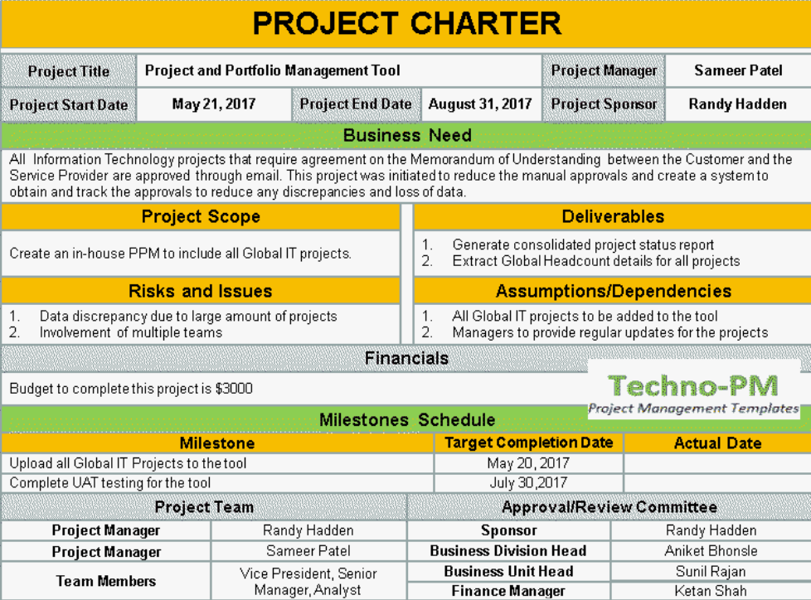
The Work Ahead: Charter

Slide 33
Next Steps
Two 2-hour monthly meetings in October and November
Members will receive two Doodle polls with available meeting times for each month
October: Council members will exchange experience & expertise
Members should prepare a 5-minute statement
November: Set up Charter and Aim Statement with goals, objectives, timeline
If there is no quorum to meet in October, we’ll shift to Nov/Dec meetings.
Bi-monthly meetings start in January 2022 to begin the work
Members will receive a Doodle poll with regular meeting day/week
The Council will meet until it determines its work is complete.

Slide 34
October & November Proposed Meeting Dates
October
10/22 11-1 F
10/25 9-1 M (least preferred)
10/28 9-11 Th
November
11/22 9-1 M
11/29 9-1 M
11/30 3-5 T

Slide 35
Vote to Adjourn
Thank You!

