Slide 1
PFAS Tracking and Reporting: TRI and TURA
1
 | Report to TRI | TURA tracking starting | Report to DEP | How Reportable | Threshold
TURA Certain PFAS NOL | --------- | January 1, 2022 | July 1, 2023 | As a category | 25,000 lbs. manufactured/ processed;10,000 lbs. otherwise used
172 TRI/TURA PFAS – 2020 | July 1, 2021 | January 1, 2021 | July 1, 2022 | Individually | 100 lbs. (de minimis exemption no longer applies)
Four TRI PFAS – 2021 | July 1, 2022 | January 1, 2023 | July 1, 2024 | Individually | 100 lbs. (de minimis exemption no longer applies)
Four TRI PFAS – 2022 | July 1, 2023 | January 1, 2023 | July 1, 2024 | Individually | 100 lbs. (de minimis exemption no longer applies)
Nine TRI PFAS – 2023 | July 1, 2024 | January 1, 2024 | July 1, 2025 | Individually | 100 lbs. (de minimis exemption no longer applies)
Seven TRI PFAS - 2024 | July 1, 2025 | January 1, 2025 | July 1, 2026 | Individually | 100 lbs. (de minimis exemption no longer applies)
Nine TRI PFAS-2025 | July 1, 2026 | January 1, 2026 | July 1, 2027 | Individually | 100 lbs. (de minimis exemption no longer applies)
Notes:
Because EPA is regularly adding more PFAS, the NOL (not otherwise listed) category changes, as those chemicals become individually reportable at lower thresholds.
There is a lag between when EPA lists them and when TURA lists them, so we are trying to help you navigate that, in this table.

Slide 2
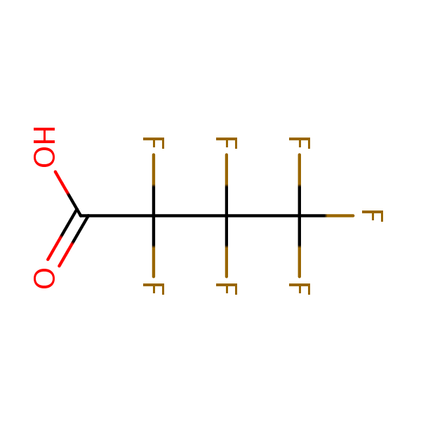
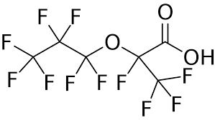
Reminder: TURA Certain PFAS NOL Category-reportable since 2022
For the 2022 Reporting Year, the Certain PFAS NOL category was added under TURA. The Certain PFAS NOL category is defined as those PFAS that contain:
a perfluoroalkyl moiety with three or more carbons
(e.g., –C_{n}F_{2n}– , n ≥ 3; or CF₃–C_{n}F_{2n}– , n ≥ 2)
a perfluoroalkylether moiety with two or more carbons
(e.g., –C_{n}F_{2n}OC_{m}F_{2m}− or –C_{n}F_{2n}OC_{m}F_{m}–, n and m ≥ 1)
wherein for the example structures shown, the dash (–) is not a bond to a hydrogen and may represent a straight or branched structure, and that are not otherwise listed.
Notes:
This is a reminder that TURA has a category of Certain PFAS NOL that has been reportable since RY2022.
The category is in addition to the individually listed PFAS coming from TRI.
Refer to the PFAS guidance in the TURA Reporting Instructions Appendices for more information.
Check to see if you are using any PFAS that meet this definition over TURA reporting thresholds.

Slide 3
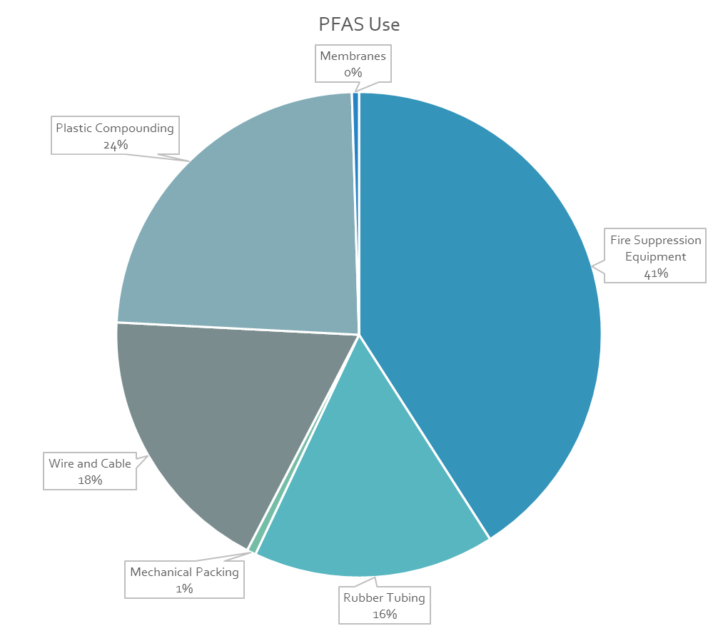
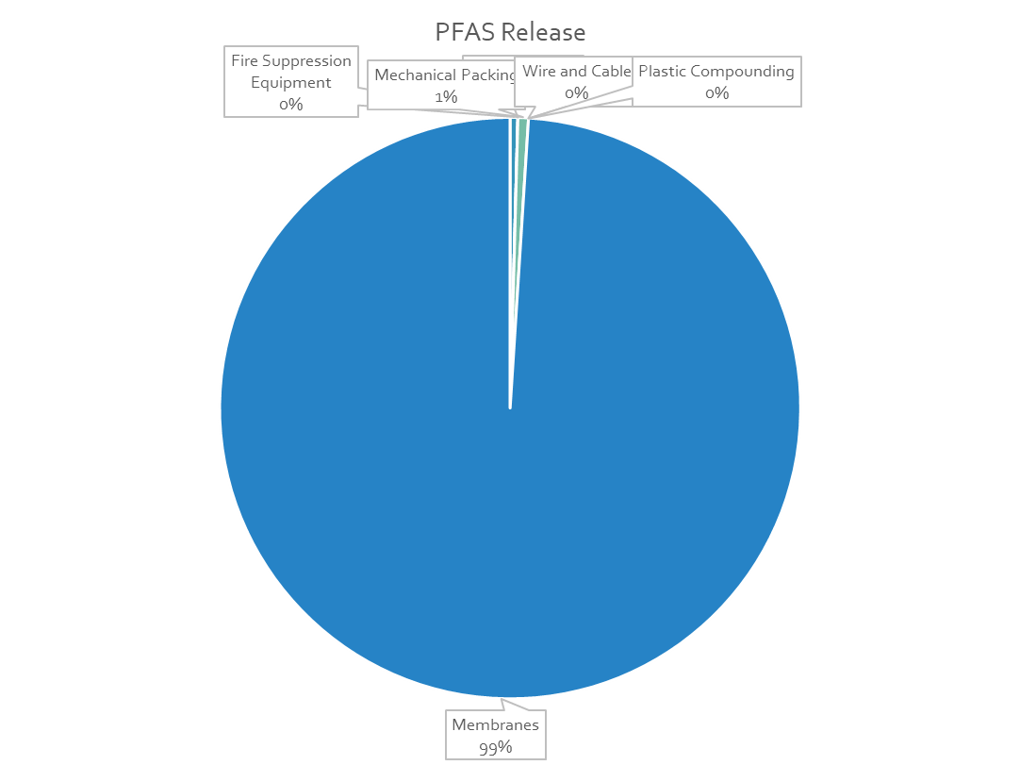
Use and Release of PFAS by TURA Filers
Current Use: 4,273, 726 lbs
Current Releases: 5,648 lbs
Notes:
These charts display RY2024 use and release of PFAS reported by TURA filers.
There was over 4 million pounds used, and over 5,000 pounds released.
If you are in any of these industry sectors, consider whether there are PFAS at your facility.
Particularly, plastic compounding and wire and cable.
Note the hydrofluoroethers (HFEs) in the transDCE/HFE solvent cleaning blends ARE PFAS under the TURA category definition.
[transDCE = 1,2-dichloroethylene]
[John Raschko can answer questions]

Slide 4
Alternative Planning for PFAS
Alternative planning for PFAS – TURA Resource Conservation planning provisions
Facility-wide characterization of PFAS use
Select specific PFAS uses to investigate
Evaluate safer alternatives and other TUR options
Notes:
Remember, you can choose Resource Conservation planning for PFAS if you are using PFAS under the reporting threshold, or if you are using a PFAS that doesn’t meet the TURA category definition.

Slide 5
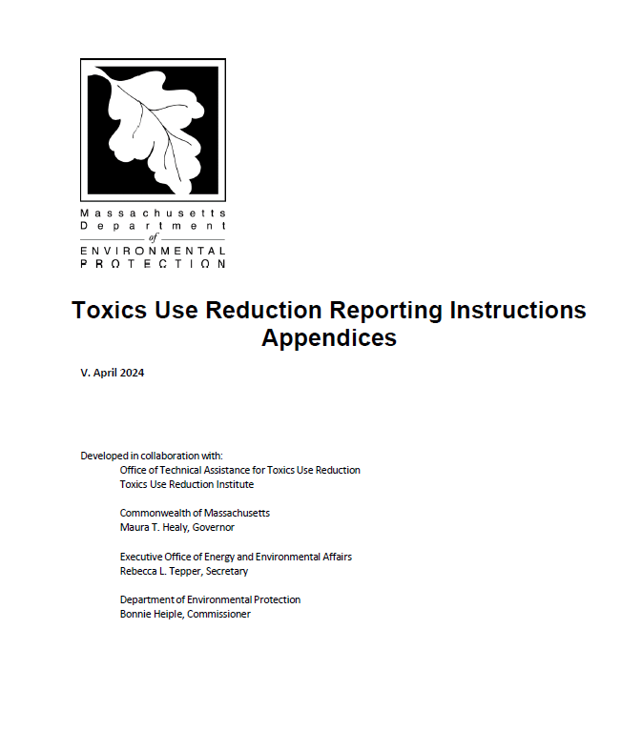
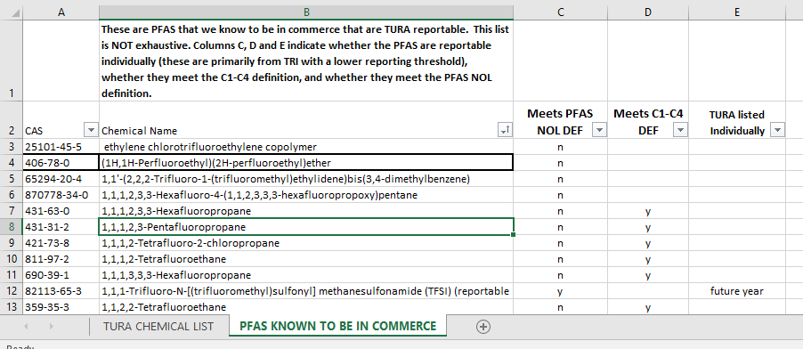
PFAS Reporting Resources
TURA Reporting Instructions
  Appendices have PFAS reporting guidance
TURA Chemical list
  PFAS Excel sheet
Notes:
Resources –
In addition to the Reporting Instruction Appendices, the TURA chemical list in Excel has an additional sheet called "PFAS Known to be in Commerce" with helpful info:
For a non-exhaustive list of chemicals that meet the TURA Certain PFAS NOL definition, chemicals that meet the TURA C1-C4 NOL definition, and TRI PFAS that are individually listed.
Now, Pam Eliason will present a Planning Refresher.

