Slide 1

700.012(C)(7).
Pharmacy Stakeholder Webinar
Informational Update
July 25, 2018
Commonwealth of Massachusetts
Department of Public Health

Slide 2
Important Reminders
Customer ID at pickup only
Customer ID required to be submitted with Gabapentin record submissions beginning on August 1st.
Social Security Numbers continue to be entered in the Customer ID field despite warnings that this is not a valid entry

Slide 3
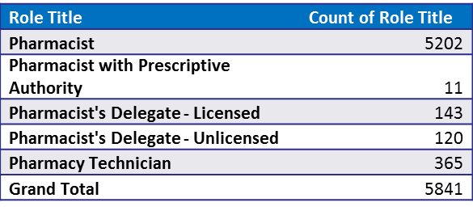
Pharmacists
Registered in MassPAT
Pharmacist Community registered in MassPAT

Slide 4
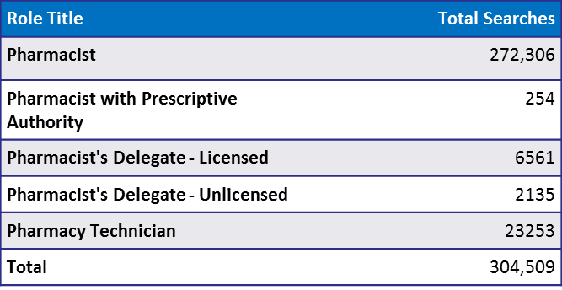
MassPAT Searches by Pharmacists
Pharmacist searches by Role title in CY2018,Q1

Slide 5

Awareness Campaign
Goal of the “Part of the Solution Campaign” is to encourage Massachusetts prescribers and dispensers to play an active, ongoing role in addressing the opioid crisis by utilizing one of the important tools made available to them, the Massachusetts Prescription Awareness Tool (MassPAT).
Roll-out plan September 2018.
DPH email
An email template to distribute quarterly emails through the DPH database.
Organization Partnerships
Identify ten key organizations to partner with this campaign as distribution channels
Campaign Website
Assets and content to be housed on the .gov platform for users to reference or gather more information on MassPAT.

Slide 6
Integration Update
The ability for pharmacies to integrate a patient’s MassPAT prescription history directly in their pharmacy software system is now available.
  Once integrated, the pharmacist is no longer forced to login to a separate web application and to enter the patient’s name and DOB.
  Instead, the EHR/PMS would initiate a query to MassPAT with the pharmacist’s credentials (License Number or DEA Number), patient information (Name, DOB, Zip Code), and location information (name, address, NPI Number)
Two API versions available to pharmacies: ASAP and V5.1.
  ASAP requires pharmacy software systems to use a style sheet to stylize the data
  V5.1 returns a link to a pre-formatted HTML report.
Walmart pharmacies went live in MA this week and Boston Medical Center pharmacies are in the testing phase.
  Both have also purchased NarxCare from Appriss Health which returns an enhanced report that includes a patient risk score for three categories of schedule drugs.

Slide 7
Pharmacy Software Systems
Company | Products | API | Status
ComputerRX | WinRx | V5.1 | In development
McKesson | PharmacyRx, EnterpriseRx, Pharmaserve | V5.1 | No Progress
PioneerRx | PioneerRx | V5 – V5.1 | V5 Live, V5.1 In development
QS/1 | NRx, Primecare, SharpRx | ASAP | Live
Transaction Data Systems (TDS) | Rx30 | V5 – V5.1 | V5 Live, V5.1 Coded in Beta

Slide 8

Company | Products | API | Status
Lagniappe Pharmacy Services (LPS) | Rx1/Synercom | V5 | Live
Mobile Medsoft | Helix | V5 | Live
PDX | PDX Classic (Legacy); May require additional software. Release 4805 or higher. | V5 – Set up to use 2 Way SSL | Live
PHI Medical Office Solutions | TBD | V5.1 | No Progress

Slide 9
Integrations Status
CVS has gone live in RI with V5.
Walgreens currently in negotiations with Appriss Health.

Slide 10
Integration Update
Integration requests can be made on the EHR Integration section of our website and should only be made by authorized decision makers.
  Questions can be addressed to PMP.EHR@state.ma.us
Pharmacies will be required to complete:
  Integration Request Form
  Terms and Conditions
  PMP Gateway Questionnaire
Pharmacists will need to have an active MassPAT account, with a valid DEA or Professional License Number, to perform integration searches.
  Only “Pharmacist” and “Pharmacist with prescriptive authority” roles are allowed via integration
  Pharmacy Technicians and Pharmacy Delegates - both licensed and unlicensed - will not be allowed and should continue to use the MassPAT web portal.

Slide 11
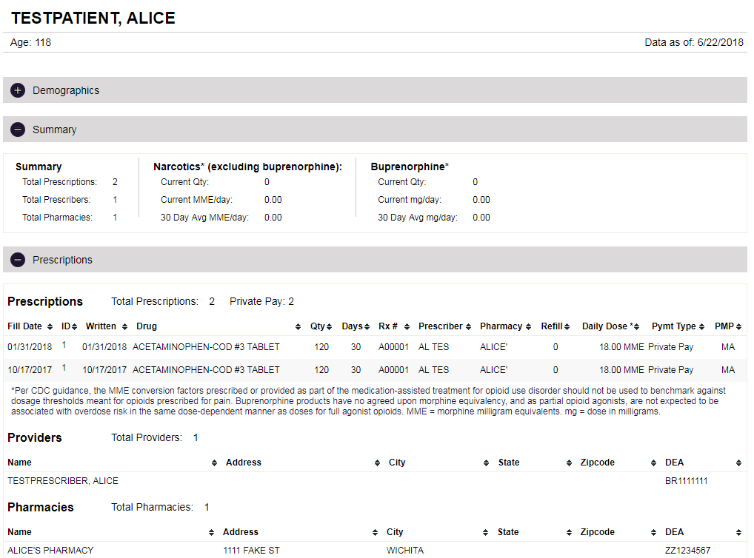
Integration Update
Sample V5.1 Report

Slide 12
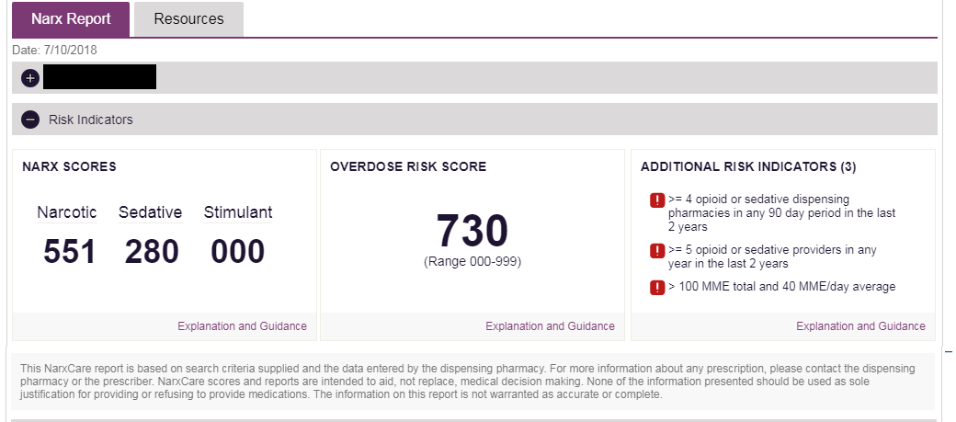
V5.1

Slide 13
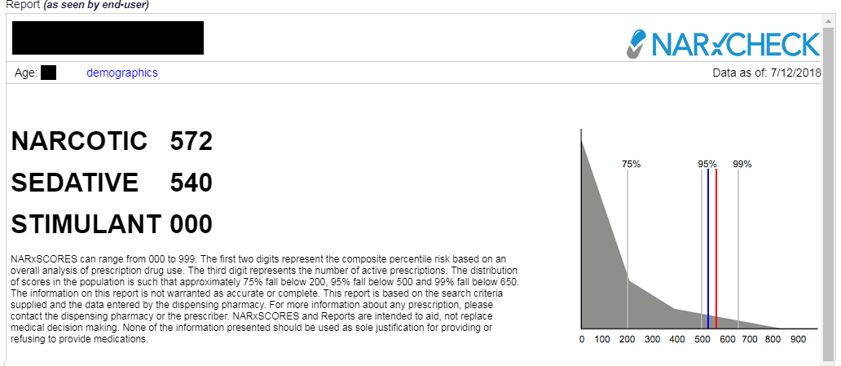

Slide 14
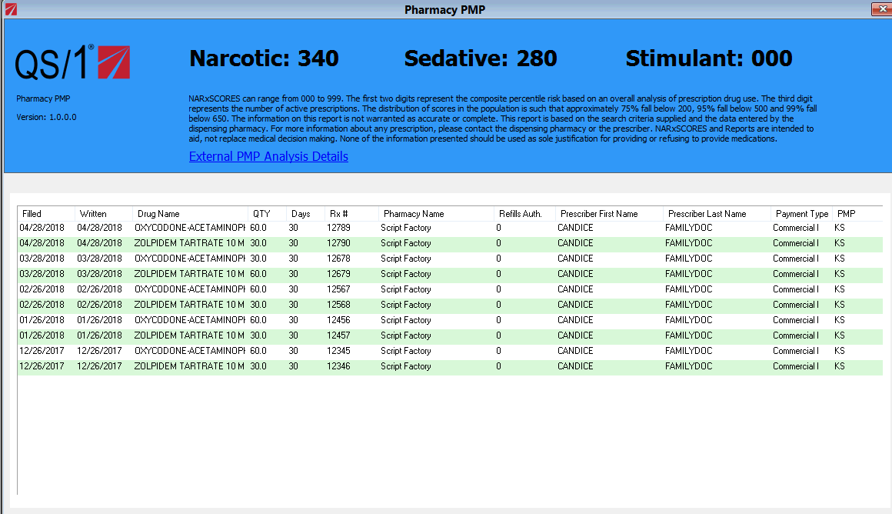
Integration Update
Sample ASAP report with NarxCare as displayed by QS/1

Slide 15
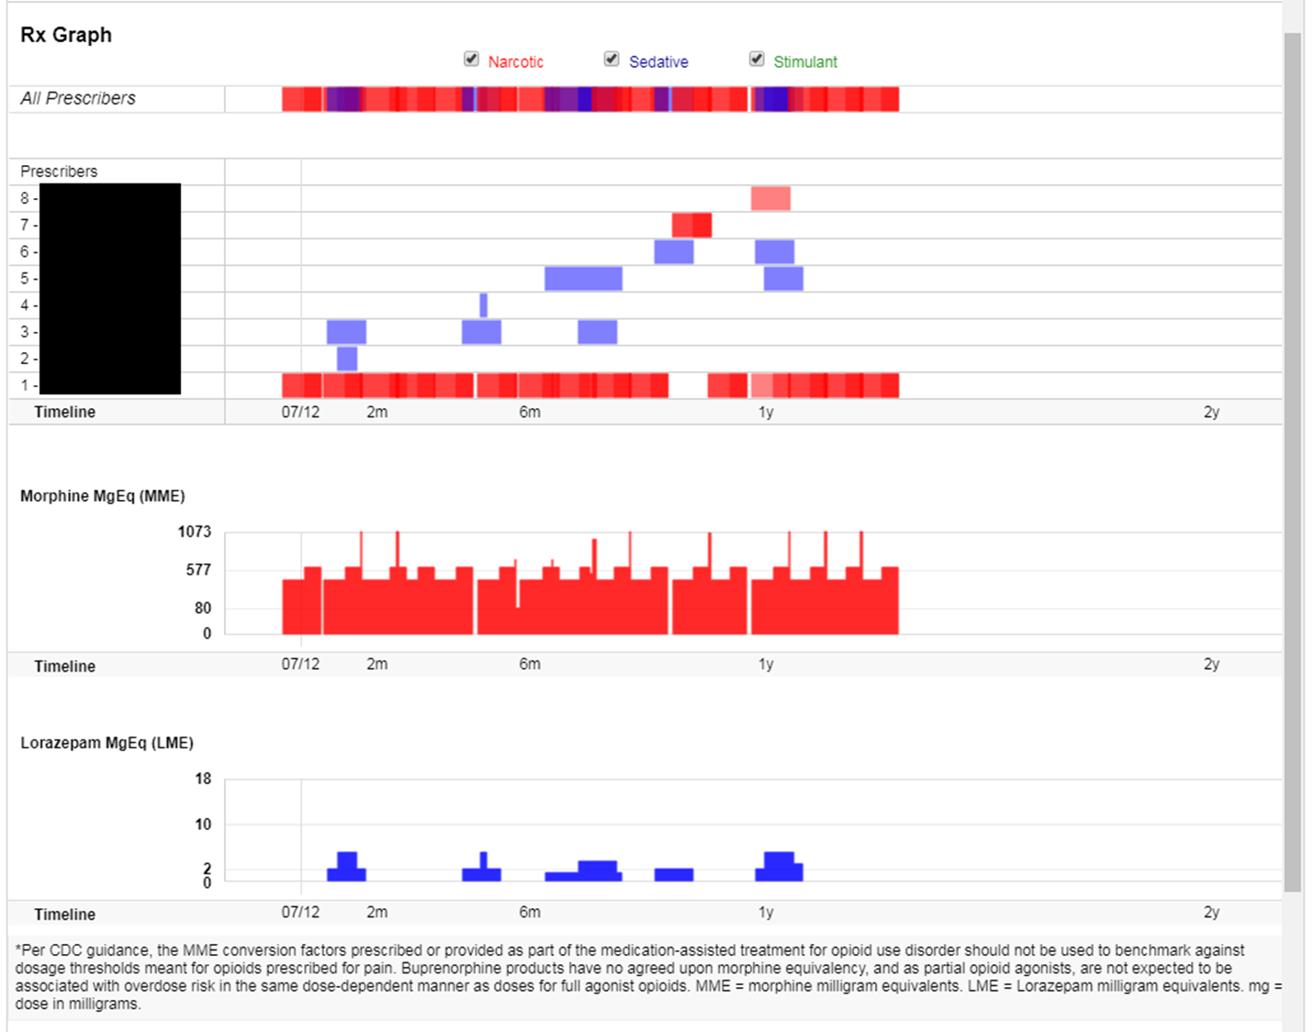

Slide 16
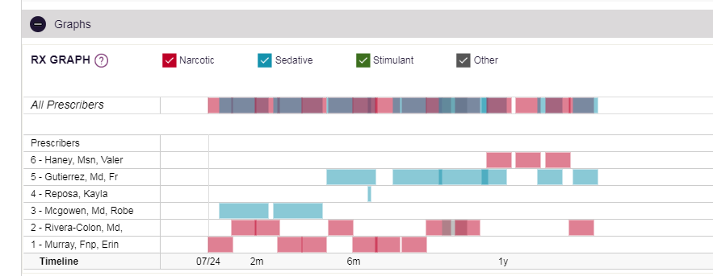

Slide 17
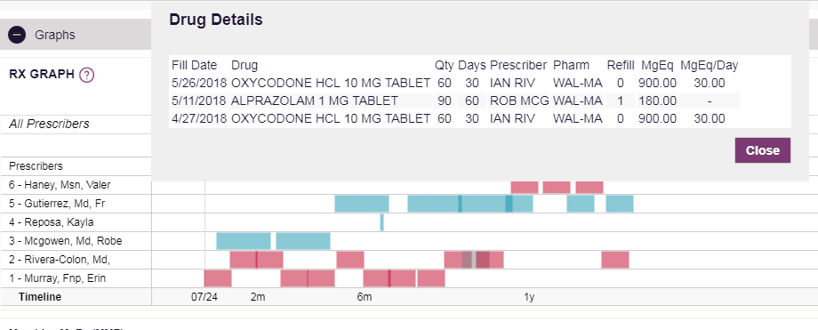

Slide 18
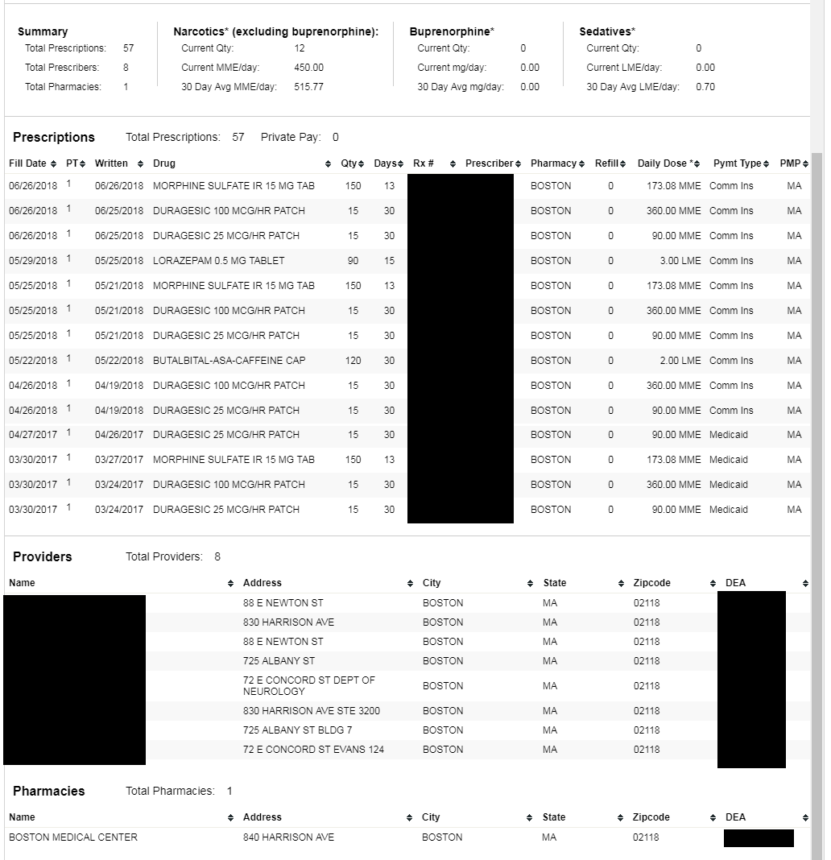

Slide 19
Data Quality
Top issues affecting the quality of data a prescriber or pharmacist might see in a patient’s prescription history:
Delinquent Reporting- Trending downward but there is still room for improvement. Waiver requests for submission for the 2018 fiscal year are due July 1st.

Slide 20
Data Quality (cont.)
Submission Errors – Records are rejected by the PMP Clearinghouse usually due to missing information that is required. Prescription records with uncorrected errors will not be found by the clinician or pharmacist during a patient search, so it is imperative that the errors be corrected as soon as possible. The most common errors are:
Missing or invalid prescriber first and last names, and DEA numbers
Missing dispensation surrogate information
Missing patient demographic information- name, address, birthdate, gender.

Slide 21
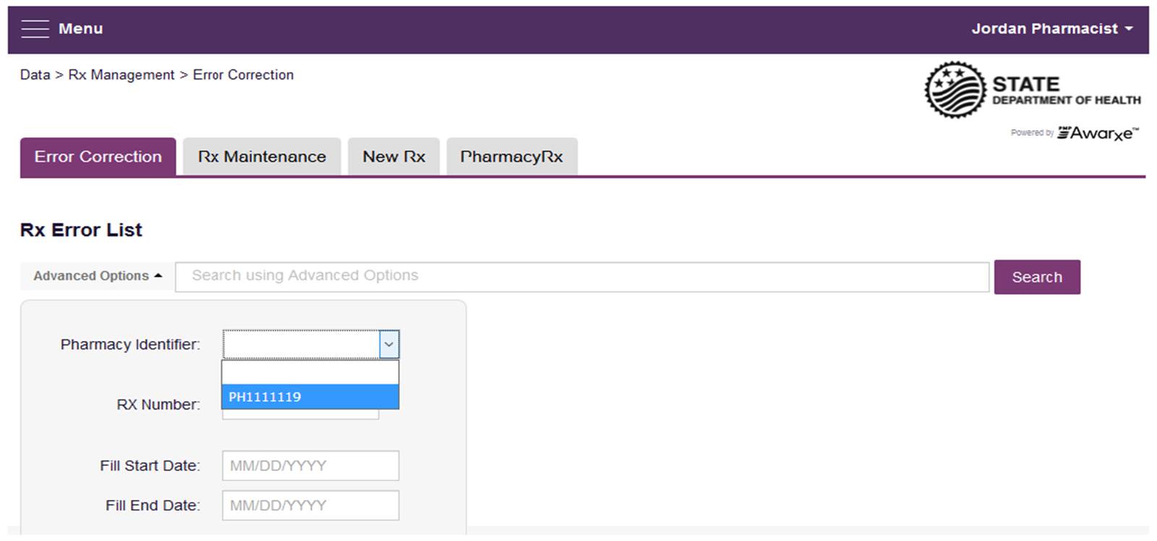
Error Correction on MassPAT
Pharmacies may not be ware of outstanding prescription submission errors. To remedy this issue, we are introducing a new feature on MassPAT called Error Correction:
Pharmacy staff who have been selected by the pharmacy and given privileges by the PMP will be able to view and correct errors for prescriptions submitted via sFTP, file upload, or Realtime to PMP AWARXE that did not pass validation.

Slide 22
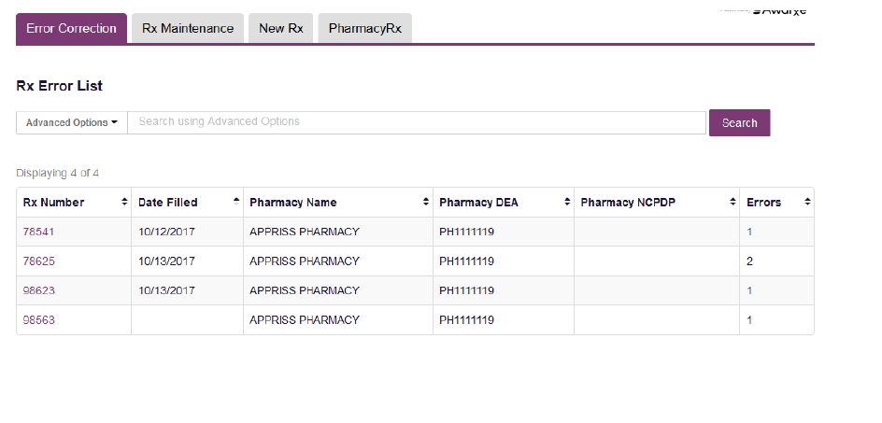

Slide 23
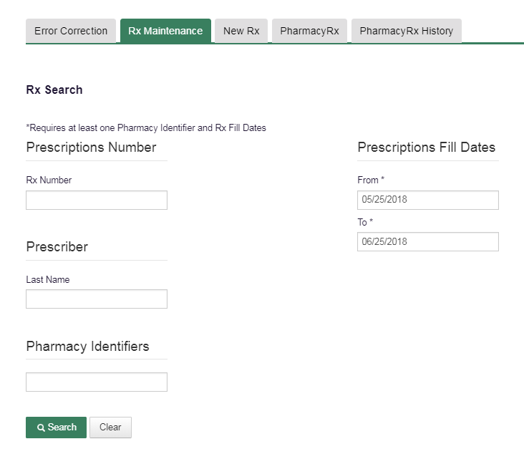
Rx Maintenance
For accepted files in need of correction, we are currently testing the Rx Maintenance feature on MassPAT

Slide 24
DEA Issues
Filling Under Expired DEA:
Over 5,000 prescriptions have been filled under expired DEA numbers so far in 2018.
Filling Under the Wrong DEA:
We have gotten calls from many prescribers reporting that prescriptions, prescribed by other clinicians, have been filled erroneously under their DEA numbers.

Slide 25
DEA Issues (cont.)
These practices impact calculations such as multiple provider episodes, affecting alerts we send to prescribers and trends we report to the public. If one pharmacy uses a valid DEA and one uses an expired DEA it looks like two different prescribers instead of one.

Slide 26
Questions
Questions?
mapmp.dph@state.ma.us
Phone: (617) 753-7310

