Slide 1
Public health council
April 28, 2021
Please standby – the meeting will begin shortly
Today’s presentation is available on the mass.gov/dph website under “Upcoming Events” by clicking on the April 28 Public Health Council listing

Slide 2
Public health council
April 28, 2021
Today’s presentation is available on the mass.gov/dph website under “Upcoming Events” by clicking on the April 28 Public Health Council listing

Slide 3
New PSA in our public information campaign

Slide 4
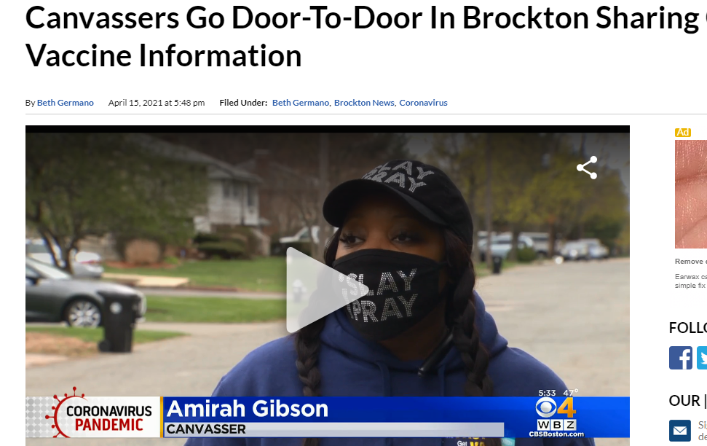
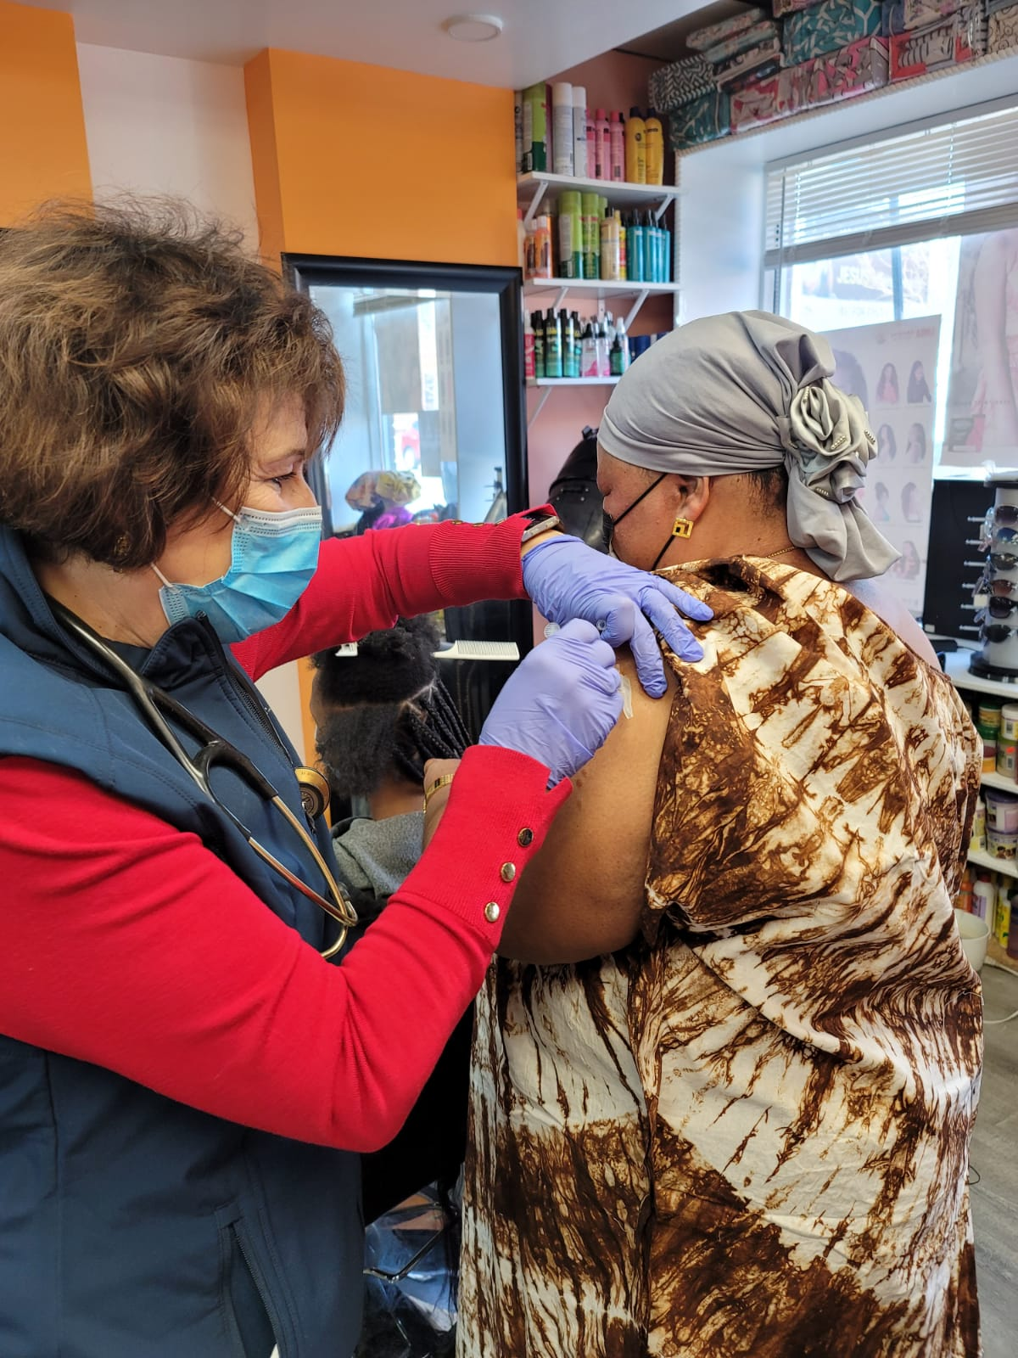
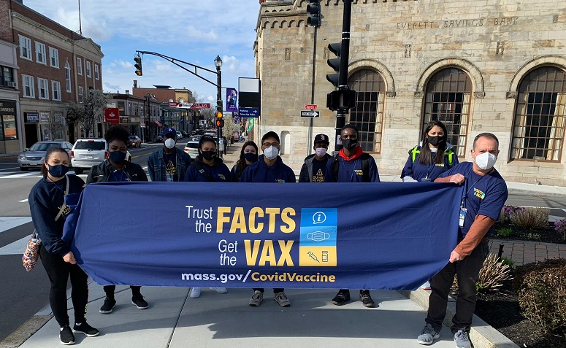
Vaccine Equity Initiative
WBZ-TV coverage of door-knocking in Brockton
Delivering vaccine information in downtown Everett
“meeting people where they are” in stores and hair salons in Worcester’s Main South neighborhood

Slide 5
ASTHO Equity Summit

Slide 6
Red Sox Week at the Hynes April 19-25
DPH provided added signage in Spanish and bilingual staff

Slide 7
Determination of Need:
Request by Campion Health & Wellness, Inc. for Substantial Change in Service

Slide 8
Final Promulgation of Revisions to 105 CMR 140.000 Licensure of Clinics
Public Health Council Department of Public Health
April 28, 2021

Slide 9
Summary of Regulation
105 CMR 140.000, Licensure of Clinics:
Sets forth standards for the licensure, maintenance and operation of clinics; and
Provides a legal structure that promotes industry standardization, promotes higher quality of care, and stronger consumer protection for individuals receiving care at clinics.

Slide 10
1st PHC Presentation: Overview of Previous Revisions to Regulation
As a reminder, the Department presented to the Public Health Council proposed initial revisions to 105 CMR 140.000, Licensure of Clinics. Specific initial revisions included:
Improvements in readability by updating language;
Updating definitions where necessary;
Aligning reporting of serious complaints and incidents with other state and federal requirements; and
Incorporating birth center provisions from the proposed rescission of birth center regulations (105 CMR 142.000).

Slide 11
Public Comment Period
Following the first presentation to the PHC with the proposed initial revisions, the Department held a public comment period, including a public hearing.
In addition to the public comment period, DPH collaborated with MassHealth, the Department of Mental Health and the Bureau of Substance Addiction Services to update and refine the clinic licensure regulation to encourage better integration of mental health and substance use disorder treatment in clinic settings and provide consistency across regulations, whenever possible.

Slide 12
2nd PHC Presentation: Overview of Previous Revisions to Regulation
In January 2020, the Department presented to the Public Health Council further revisions to 105 CMR 140.000 to encourage better integration of mental health and substance use disorder treatment in the clinic setting, including:
Reducing the administrative burden associated with licensure when a provider wants to provide substance use treatment and mental health treatment within the same setting;
Emphasizing the potential for co-occurring mental health and substance use disorder by requiring substance use disorder screenings for all patients treated in a mental health clinic;
Allowing for longitudinal patient assessments and treatment planning so that treatment can begin prior to completion of a full evaluation; and
Providing flexibility with regard to mental health clinic staffing.

Slide 13
Additional Public Comment Period
Following the second presentation to the PHC with the proposed further revisions, the Department held another public comment period, including a public hearing in March 2020, and made additional revisions to the regulation.
This presentation will outline the revisions made in response to comments received from the March 2020 public comment period.

Slide 14
Highlights of Post-Comment Review
As a result of the comments received during the March 2020 public comment period, DPH recommends the following additional revisions to 105 CMR 140.000:
Provide consistency with the Bureau of Substance Addiction Services regulations by aligning the timeframe submission of the licensure renewal application and designation of clinic leadership; and
Clarify the responsibilities of the mental health clinic lead.

Slide 15
Post-Comment Revisions: Licensure Renewal
CURRENT REGULATION:
Requires clinic license renewal applications to be submitted 90 days prior to the expiration of the license.
REVISION AFTER COMMENT PERIOD:
In response to comments requesting consistency between the license renewal submission timeframes for clinic licenses and licenses from the Bureau of Substance Addiction Services (BSAS), the Department has revised the time frame for clinic license renewal applications to require submission 60 days prior to the expiration of the license.

Slide 16
Post-Comment Revisions: Clinic Leadership
CURRENT REGULATION:
Requires each clinic to designate a clinic administrator and professional services director, who is responsible for the clinical services provided at the clinic.
PROPOSED REVISION:
Requires both the clinic administrator and professional services director to be physically present at the clinic as is necessary to oversee the services provided by the clinic.
FURTHER REVISION AFTER COMMENT PERIOD:
In response to comments received, consistent with BSAS regulations, the Department clarified that clinic leadership may designate a person with appropriate skills and training when leadership is unable to be present at the clinic.

Slide 17
Post-Comment Revisions: Mental Health Clinic Lead
CURRENT REGULATION:
In addition to the requirement that a physician be responsible for all policies and supervision for medical services, a psychiatrist or other physician must complete physical evaluations, patient referrals, provide case consultation and quality assurance oversight.
PROPOSED REVISION:
Allowed a licensed mental health professional to be responsible for the policies and procedures for the services provided at the mental health clinic.
FURTHER REVISION AFTER COMMENT PERIOD:
In response to concerns regarding the role of the mental health clinic lead, the Department has clarified that the mental health clinic lead is responsible for establishing all administrative policies and procedures for mental health services rather than policies for all medical services. Any standards informing medical policies and protocols must be approved by the psychiatrist.

Slide 18
Next Steps
The Department requests the Public Health Council approve the proposed regulations for promulgation.
Following Public Health Council approval, the Department will file the amended regulation with the Secretary of the Commonwealth for final enactment.

Slide 19
Thank you for the opportunity to present this information today.
For more information regarding clinic licensure, please find the relevant statutory language and the full current regulation here:
https://www.mass.gov/doc/105-cmr-140-licensure-of-clinics/download
https://malegislature.gov/Laws/GeneralLaws/PartI/TitleXVI/Chapter111

Slide 20
COVID-19
Community Impact Survey(CCIS)
Preliminary Analysis Results as of
April 28, 2021 Presented by W.W. Sanouri Ursprung PhD
Massachusetts Department of Public Health
4.28.21 release

Slide 21
CCIS TEAM MEMBERS
CCIS Project Leads
W.W. Sanouri Ursprung (presenter), Laruen Cardoso, Beth Beatriz, Glory Song, Caroline Stack, Kathleen Fitzsimmons, Emily Sparer-Fine, Ben Wood, Lisa Bandoian, Heather Nelson, Amy Flynn, Lisa Arsenault, Abby Atkins
CCIS Analytic Team
Beth Beatriz, Glory Song, Caroline Stack, Kathleen Fitzsimmons, Emily Sparer-Fine, Ziming Xuan, Matthew Tumpney, Rebecca Han, Lauren Larochelle, Arielle Coq, Anne Marie Matteucci, Lauren Fogharty, Vera Mouradian, Melody Kingsley, Ta Wei Lin, Anna Agan, Justine Egan, Allison Guarino, Elizabeth Showalter, Beatriz Pazos Vautin, Priyokti Rana, Mayowa Sanusi, Emily Lawson, Alana LeBrón Lauren Cardoso, W.W. Sanouri Ursprung
CCIS Data to Action Workgroup
Jessica del Rosario, Kim Etingoff, Lisa Bandoian, Andrea Mooney, Ben Kingston, Lauren Cardoso; Dawn Fukuda, Lamar Polk, Hermik Babakhanlou-Chase, Glennon Beresin, Mahsa Yazdy, Emily White, Timothy St. Laurent, Fareesa Hasan, Nicole Roos
CCIS Steering Committee
Lauren Cardoso, W.W. Sanouri Ursprung, Beth Beatriz, Abbie Averbach, Ruth Blodgett, Ben Wood, Sabrina Selk, Nicole Daley, Lisa Bandoian
CCIS Data Dissemination Workgroup
Beth Beatriz, Glory Song, Emily Sparer-Fine, Ta Wei Lin, Vera Mouradian, Rebecca Han
4.28.21 release

Slide 22
CCIS COMMUNITY PARTNERS
Many groups that were critical in the success of this effort and gave important input on the development and deployment of the survey:
Academic Public Health Volunteer Corps and their work with local boards of health and on social media
Mass in Motion programs, including Springfield, Malden, and Chelsea
Cambodian Mutual Assistance
The Mashpee Wampanoag Tribe
The Immigrants’ Assistance Center, Inc
Families for Justice as Healing
City of Lawrence Mayor’s Health Task Force
The 84 Coalitions, including the Lawrence/Methuen Coalition
Boys and Girls Clubs, including those in Fitchburg and Leominster and the Metro South area
Chinatown Neighborhood Association
Father Bill’s
UTEC
MassCOSH
Stavros Center for Independent Living
Greater Springfield Senior Services
Center for Living and Working
DEAF, Inc.
Massachusetts Commission for the Deaf and Hard of Hearing
Viability, Inc.
4.28.21 release

Slide 23
OVERVIEW
Purpose and Approach of the Covid-19 Community Impact Survey (CCIS)
Preliminary Findings
Ability to mitigate individual risk of infection
Access to Testing
Access to Healthcare
Impact on Social Determinants of Health
Mental Health
Converting these Data to Action with our partners
Appendix
4.28.21 release
3.10.21 release

Slide 24
PURPOSE AND APPROACH
4.28.21 release
3.10.21 release

Slide 25
Why did we conduct the CCIS?
Goals:
1) Identify the most pressing immediate and long-term health needs created by the pandemic, including its social and economic consequences
2) Determine which populations have been most disproportionately impacted
.... in order to inform and prioritize resource deployment and policy actions

Slide 26
OVERVIEW OF CCIS APPROACH
Conducted a self-administered online survey between Sept. and Nov. 2020
Covered a wide range of topics
Perceptions & experiences of COVID-19, Basic needs, Access to healthcare, Pandemic-related changes in employment, Mental health, Substance use, and Safety
Available in 11 languages; additional focus groups also conducted in ASL
Open ended questions captured previously unknown needs and barriers
Weighted results to the state average
Recruitment via network of community-based organizations (CBOs)
Employed a snowballing sampling strategy to ensure we reach key populations
eg. People of color, LGBTQ+ individuals, People with disabilities, Essential workers, People experiencing housing instability, Older adults, and Individuals living in areas hardest hit by COVID-19

Slide 27
RESULTS TOPICS TO DATE
MITIGATING INDIVIDUAL RISK OF INFECTION
ACCESS TO HEALTHCARE​
SOCIAL DETERMINANTS OF HEALTH
ACCESS TO TESTING​
MENTAL HEALTH
NEW: SUBSTANCE USE
NEW: PARENTS &
FAMILIES
COMING NEXT: SAFETY
COMING NEXT: POPULATION SPOTLIGHTS
NEW: EMPLOYMENT
4.28.21 release

Slide 28
EMPLOYMENT Kathleen Fitzsimmons, PhD, MPH Emily Sparer-Fine, ScD Amy Flynn, MS
4.28.21 release
Notes:
Objective: To better understand the impact of the pandemic on Massachusetts workers and to identify groups or populations that have been disproportionately impacted in order to guide prevention efforts and address potential inequities.
Note: The CCIS captures experiences through November 2020.
Context:
Over the course of the COVID-19 pandemic in Massachusetts (since March 2020):
Some workplaces/businesses transitioned to remote work, some have closed either permanently or temporarily, and others deemed essential remained open and continued operations.
This has resulted in workers experiencing job loss, reduction in hours, having to take leave, or other disruptions/changes in the nature of work.
It also has resulted in workers in certain jobs remaining in or returning to the workplace, putting them at increased risk of exposure to the virus, while others have been working from home.

Slide 29
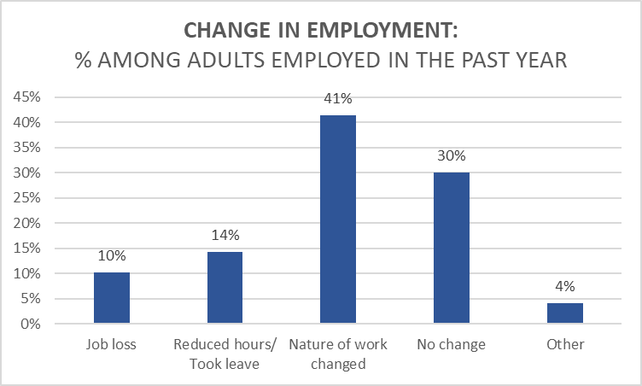
RISK MITIGATION
CHANGES IN EMPLOYMENT STATUS DUE TO THE PANDEMIC
The pandemic has had a severe impact on Massachusetts workers.
Overall, 7 in 10 adults employed in the past year reported changes to their employment status due to the pandemic:
- 10% reported job loss
- 14% reduced hours or took leave
- 41% nature of work changed.
1 in 4 adults employed in the past year reported job loss, reduced hours or taking leave.
Note: Percentages are weighted to the statewide age and educational distribution of those 25 years old or older in Massachusetts
4.28.21 release
Notes:
Read slide.
We looked more closely at those experiencing job loss, reduced hours or taking leave (animation to highlight those two).

Slide 30
The following groups were more likely to report:
JOB LOSS:
American Indian/Alaska Native
Non-binary gender
Of transgender experience
Bi/Pansexual, Queer, or Asexual
Lower educational attainment
Lower annual household income
Deaf/Hard of hearing
Cognitive, Mobility, or Self-care/Independent-living disabilities
4.28.21 release
Notes:
When we looked by select demographics, certain groups were more likely to experience job loss compared to their respective reference groups.
NOTE: Right now there is animation in this slide to highlight each group – may want to take out the animation.

Slide 31
The following groups were more likely to report:
JOB LOSS:
REDUCED HOURS/LEAVE:
American Indian/Alaska Native, Hispanic/Latinx, or Multi-racial
Non-binary gender or Female
Of transgender experience
Bi/Pansexual, Questioning of sexual orientation
Speak a language other than English
Aged 25-34 years
Lower educational attainment
Lower annual household income
Deaf/Hard of hearing
Cognitive, Mobility, or Self-care/Independent-living disability
American Indian/Alaska Native
Non-binary gender
Of transgender experience
Bi/Pansexual, Queer, or Asexual
Lower educational attainment
Lower annual household income
Deaf/Hard of hearing
Cognitive, Mobility, or Self-care/Independent-living disability
American Indian/Alaska Native, Hispanic/Latinx, or Multi-racial
Non-binary gender or Female
Of transgender experience
Bi/Pansexual, Questioning of sexual orientation
Speak a language other than English
Aged 25-34 years
Lower educational attainment
Lower annual household income
Deaf/Hard of hearing
Cognitive, Mobility, or Self-care/Independent-living disability
4.28.21 release
Notes:
Some of the same groups more likely to experience job loss were also more likely to report having reduced hours or taking leave due to the pandemic (bolded animation).
More complete and detailed findings are available in the web deck.

Slide 32
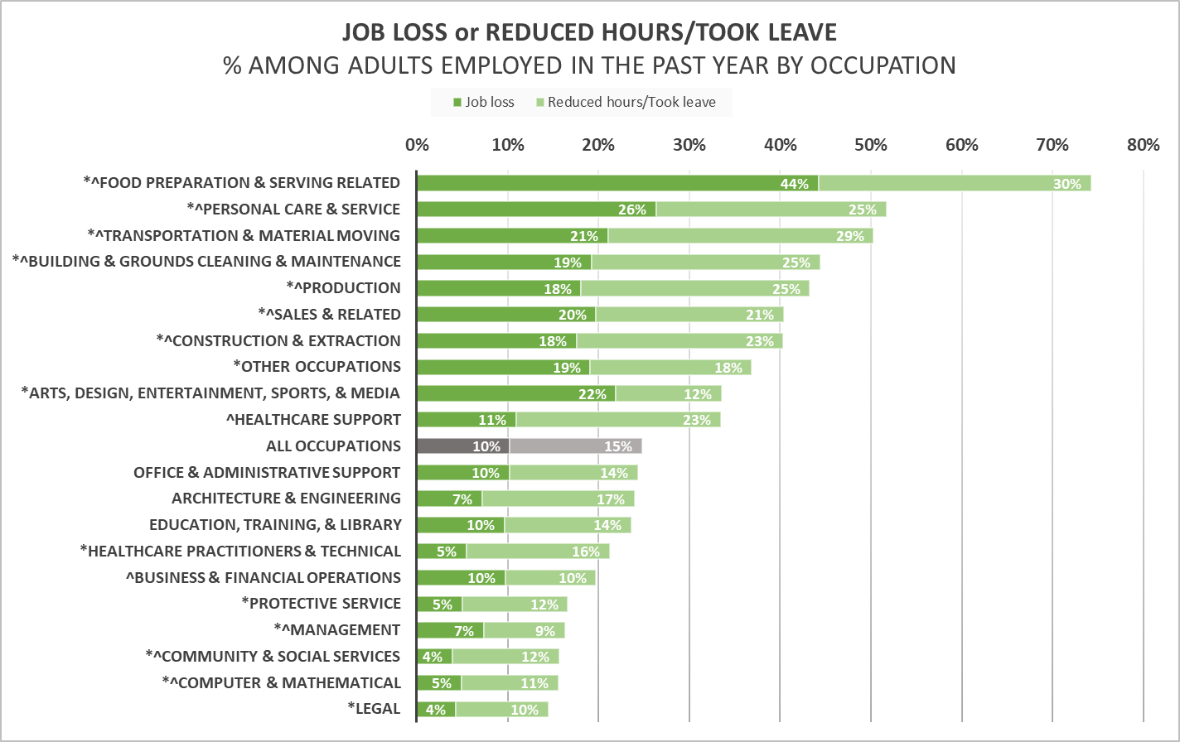
CHANGE IN EMPLOYMENT STATUS DUE TO THE PANDEMIC.
BY OCCUPATION GROUP
Workers in the following occupations were more likely to report job loss, reduced hours or taking leave:
Food Preparation & Serving Related – 3 in 4
Personal Care & Service – 1 in 2
Transportation & Material Moving – 1 in 2
Building & Grounds Cleaning & Maintenance – over 2 in 5
Notes: 1)Occupation groups are based on Bureau of Census Occupation Codes (COC); 2)"Other Occupations" = Farming, Fishing & Forestry; "Installation, Maintenance, & Repair"; and Military occupations.; 3)* ^ denotes a statistically significant difference (ie. p<0.05) in job loss (*) and/or in reduced hours/took leave (^) compared to the average for all occupations; 4) Percentages are weighted to the statewide age and educational distribution of those 25 years old or older in Massachusetts
4.28.21 release
Notes:
When we looked by occupation group, workers in Food Preparation & Serving related were most likely to experience job loss and most likely to report reduced hours or having to take leave.
Followed by Personal Care & Service , Transportation & Material Moving, and Building & Grounds Cleaning & Maintenance
Example occupations in the four groups:
Food Preparation & Serving Related: chef/cook, baker, waiter/waitress, bar tender, dishwasher, host/hostess
Personal Care & Service: hairdresser, cosmetologist, manicurist, personal care attendant (PCA) funeral service worker, child daycare worker, recreation/fitness worker
Transportation & Material Moving: airline pilot, flight attendant, taxi driver, bus driver, truck driver, subway worker, packer and packager, refuse/recyclable collector
Building & Grounds Cleaning & Maintenance: janitor, housekeeper, landscaper, pest control worker, pesticide applicator, tree trimmer

Slide 33
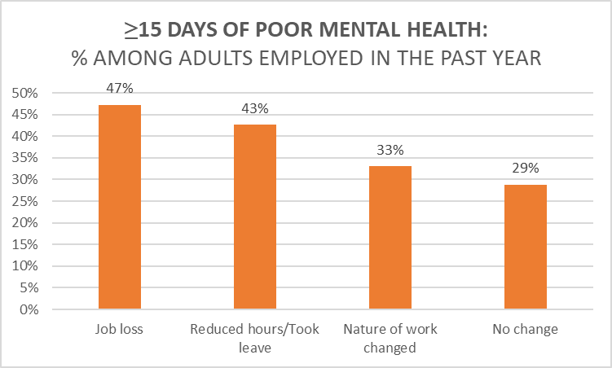
IMPACT OF CHANGES IN EMPLOYMENT STATUS
Compared to those with no change in employment, those who lost jobs, reduced hours or took leave were:
.
1.5 - 2.5X more likely to worry about paying expenses or bills in upcoming weeks
Housing, utilities, debt, vehicle, insurance, school/daycare
1.5X more likely to report ≥ 15 days of poor mental health in the past 30 days
Nearly half of those who lost their jobs
All three groups experiencing a change in employment were more likely than those with no change to report ≥ 15 days of poor mental health
*
*
*
Notes: 1) * denotes a statistically significant difference (ie. p<0.05) compared to the reference category of ‘no change’ in employment status or nature of work’; 2)Percentages are weighted to the statewide age and educational distribution of those 25 years old or older in Massachusetts
4.28.21 release
Notes:
We began to explore the impact of these changes in employment status due to the pandemic.
And we found that compared to those with no change in employment, those who lost jobs, reduced hours or took leave were:
1.5 - 2.5X more likely to worry about paying expenses or bills in upcoming weeks. This was across a range of expenses including: Housing, utilities, debt, vehicle, insurance, school/daycare
As the graph shows, they were also 1.5X more likely to report ≥ 15 days of poor mental health in the past 30 days
Nearly half of those who lost their jobs.
All three groups experiencing disruptions to their work were more likely than those with no change to report poor mental health.

Slide 34
RISK MITIGATION
SUMMARY OF FINDINGS:
WORKING OUTSIDE THE HOME
1 in 2 employed respondents worked a job outside the home,
facing increased risk of exposure.
Among respondents who had ever been tested for COVID-19, those working outside the home were nearly 2X more likely to report testing positive than those working from home.
4 in 5 respondents working outside the home listed work-related reasons for not being able to socially distance (ie. maintain 6 ft. of distance from others).
Respondents who were Hispanic/Latinx, spoke a language other than English, had lower educational attainment or lower annual household income, and those with cognitive disability were more likely to work outside the home. These same groups were less likely to have employer-provided COVID-19 protections at work or paid sick leave.
The following occupation groups were more likely to work outside the home, most likely to be "very worried" about getting COVID-19, and less likely to have protections at work or paid sick leave:
- Transportation & Material Moving
- Food Preparation & Serving Related
- Building & Grounds Cleaning and Maintenance
4.28.21 release
Notes:
NOTE for Sanouri: This is a summary slide for oral PHC presentation - summary of a couple other slides that will be presented in the web deck. We are hoping that you have time to also present slides 16-18. However, If limited on time and cannot present slides 16-18 on occupations then the last bullet on this slide summarizes the findings on the next three slides. If you do have time to present slides 16-18, then the final bullet on this slide just sets those up. So you can either modify the bullet and/or use it to introduce the next three slides (ie. don’t necessarily have to read it as is if showing next three slides).
Notes:
Working outside the home is a risk factor for SARS-CoV-2 exposure.
Work-related reasons = “In order to do my work, I need to be physically close to others.”; “My workplace is crowded.”; “I have to take public transportation to get to work.”
COVID-19 protections at work = Personal protective equipment (PPE), social distancing implemented, additional health and safety training
NOTE for Sanouri: This is a summary slide for oral PHC presentation - summary of a couple other slides that will be presented in the web deck. The last bullet on occupations can be deleted if you hve time in the oral PHC presentation for the following three occupations slides (WHO, worried, protections). If no time for three occupation slides, the findings are summarized in the bullet on this slide.

Slide 35
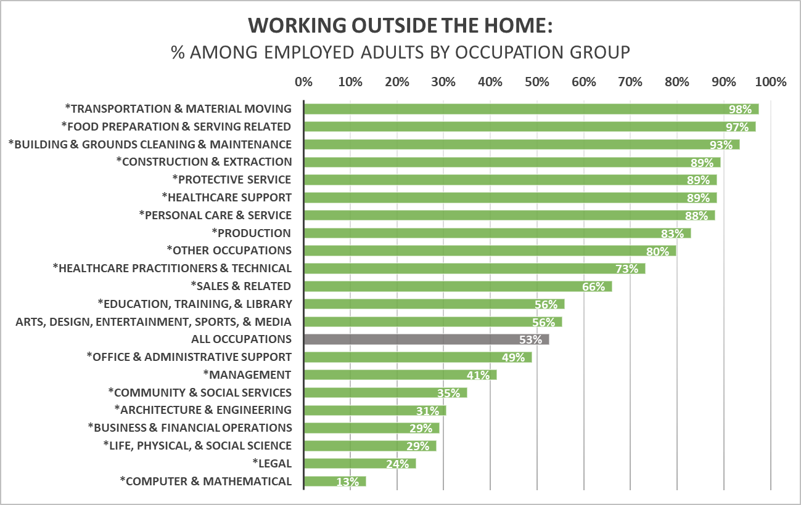
RISK MITIGATION
WORKING OUTSIDE THE HOME
BY OCCUPATION GROUP
The percentage varied across occupation groups ranging from 98% in Transportation and Material Moving to 13% in Computer and Mathematical occupations.
Working outside the home was most common among respondents working in:
Transportation & Material Moving, followed by Food Prep & Serving Related; and Building & Grounds Cleaning & Maintenance occupations
Notes: 1)Occupation groups are based on Bureau of Census Occupation Codes (COC); 2)"Other Occupations" = Farming, Fishing & Forestry; "Installation, Maintenance, & Repair"; and Military occupations.; 3)*denotes percentage is statistically significantly different (p<0.05) compared to the average percentage for all occupations; 4) Percentages are weighted to the statewide age and educational distribution of those 25 years old or older in Massachusetts
4.28.21 release
Notes:
NOTE: Include this slide if using SLIDE 16 (VERSION 2) of summary slide and presenting slides 17-19 as well. Delete this slide if using SLIDE 15.
Talking point: Working outside the home was most common among the threeoccupations highlighted here – which makes sense since these occupations are less conducive to teleworking.

Slide 36
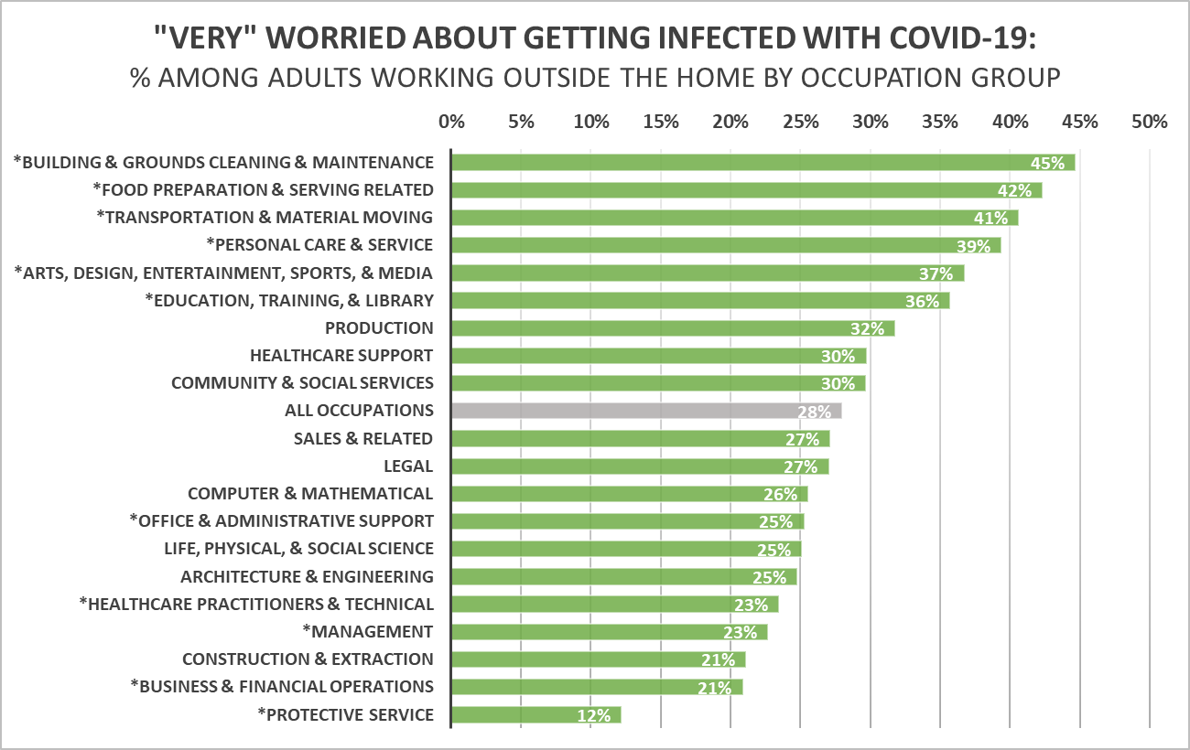
“VERY" WORRIED ABOUT GETTING INFECTED WITH COVID-19
BY OCCUPATION GROUP
Over a quarter (28%) of adults working outside the home were “very" worried about getting infected with COVID-19.
Being "very" worried was most common among respondents working in:
Building & Grounds Cleaning and Maintenance, followed by Food Preparation & Serving Related, and
Transportation & Material Moving occupations.
Notes: 1)Occupation groups are based on Bureau of Census Occupation Codes (COC); 2)"Other Occupations" = Farming, Fishing & Forestry; "Installation, Maintenance, & Repair"; and Military occupations.; 3) Percentage for “Other Occupations” suppressed due to insufficient data; 4)*denotes percentage is statistically significantly different (p<0.05) compared to the average percentage for all occupations; 5) Percentages are weighted to the statewide age and educational distribution of those 25 years old or older in Massachusetts
4.28.21 release
Notes:
The three occupation groups most likely to work outside the home were also most likely to report being "very" worried about getting infected with COVID-19.
Being "very" worried was most common among workers in:
Building & Grounds Cleaning and Maintenance,
Food Preparation & Serving Related,
Transportation & Material Moving occupations
These groups were also less likely to report employer-provided COVID-19 protective measures in the workplace, as well as paid sick leave. (NEXT SLIDE)
NOTE: Example occupations in the three groups:
Building & Grounds Cleaning & Maintenance: janitor, housekeeper, landscaper, pest control worker, pesticide applicator, tree trimmer
Food Preparation & Serving Related: chef/cook, baker, waiter/waitress, bar tender, dishwasher, host/hostess
Transportation & Material Moving: airline pilot, flight attendant, taxi driver, bus driver, truck driver, subway worker, packer and packager, refuse/recyclable collector

Slide 37
EMPLOYER-PROVIDED PROTECTIVE MEASURES
The three occupation groups below were most likely to be “very” worried about getting infected by COVID-19.
They were less likely to have key employer-provided COVID-19 precautions at work .
Building and Grounds Cleaning & Maintenance | Food Preparation & Serving Related | Transportation & Material Moving
58% | 59% | 71%^
34% | 55% | 51%
24% | 35% | 29%
49% | 52% | 65%
Overall, among those working outside the home:
77% (3 in 4) of respondents worked in places that
provided personal protective equipment (PPE).
67% (2 in 3) of respondents worked in places that
implemented social distancing.
44% (2 in 5) respondents worked in places that provided additional health & safety training.
80% (4 in 5) reported having paid sick leave.
Notes: Full occupation breakdowns are provided in the appendix; ^ denotes estimate is not statistically significantly different from the average for all occupations.
4.28.21 release
Notes:
NOTE: Include this slide if using SLIDE 16 (VERSION 2) of summary slide and presenting slides 17-19 as well. Delete this slide if using SLIDE 15.
As you saw on the previous slide, the three occupation groups below were most likely to be “very” worried about getting infected by COVID-19.
They were also less likely to have key employer-provided COVID-19 precautions at work. Across the board, for each protective measure, percentages were lower than average for each of the groups.
The full occupation breakdown (as well as demographic and industry breakdowns) are available in the Appendix.
Context Notes: 1. These three occupation groups had higher age-adjusted COVID mortality rates early on in the pandemic (March through July 2020) compared to the average for all MA workers (Hawkins et al., Am J Ind Med, Jan 2021). In fact, they had the 2nd-4th highest rates behind only Healthcare Support workers (1st). 2. While vaccination is a crucial preventive measure, findings suggest that there is still work to be done around improving access to other key employer-provided COVID-19 precautions, especially for workers in high-risk occupations that cannot be done remotely (ie. Public facing, work in close proximity to others, work indoors).

Slide 38
YOUTH & FAMILIES Elizabeth Beatriz, PhD Justine Egan, MPH Allison Guarino, MPH Beatriz Pazos Vautin, MPH
4.28.21 release

Slide 39
PARENTS & FAMILIES
Compared to respondents who were not parents, parents or guardians
of children were:
35% more likely to be worried about any expenses
35% more likely to lose their jobs or reduce hours/take leave.
Nearly 1 in 3 who lost their jobs cited needing to take care of children as a reason.
50% more likely to be worried about housing
More likely to report delaying healthcare
Preliminary data - 1.7.21 - Not for external distribution
4.28.21 release
Notes:
Week of 2/8:
Highlighted themes and findings emerging the week of __________:
1 in 3 of MA adults* reported poor mental health (15+ days of poor mental health). All demographic groups in MA are experiencing increases in poor mental health.
Respondents experiencing poor mental health are delaying care, including both routine and urgent mental health care.
Top reasons for delayed care: appointment was cancelled/delayed, worried about getting COVID-19, affordability or insurance coverage, no private place, no safe transportation
Respondents with 15+ days of poor mental health are seeking health resources, are worried about expenses/bills, are worried about basic needs at higher rates compared to those who experienced “0” days or “1-14” days of poor mental health.
Priority questions we will be focusing on next:
What are possible reasons why people are experiencing poor mental health? (See “Next research steps” slide for more detail)

Slide 40
PARENTS & FAMILIES
Parents have unique needs:
Nearly 1 in 5 parents reported being worried about accessing available and affordable childcare.
Parents were more likely to report 15+ days of poor mental health in the last month, but less likely to request certain mental health resources.
Parents worried about expenses, housing, and childcare were more likely to report 15+ days of poor mental health.
Parents of children with special healthcare needs were more likely to report being concerned about meeting basic needs compared to all parents, particularly for food and healthcare.
Preliminary data - 1.7.21 - Not for external distribution
4.28.21 release
Notes:
Week of 2/8:
Highlighted themes and findings emerging the week of __________:
1 in 3 of MA adults* reported poor mental health (15+ days of poor mental health). All demographic groups in MA are experiencing increases in poor mental health.
Respondents experiencing poor mental health are delaying care, including both routine and urgent mental health care.
Top reasons for delayed care: appointment was cancelled/delayed, worried about getting COVID-19, affordability or insurance coverage, no private place, no safe transportation
Respondents with 15+ days of poor mental health are seeking health resources, are worried about expenses/bills, are worried about basic needs at higher rates compared to those who experienced “0” days or “1-14” days of poor mental health.
Priority questions we will be focusing on next:
What are possible reasons why people are experiencing poor mental health? (See “Next research steps” slide for more detail)

Slide 41
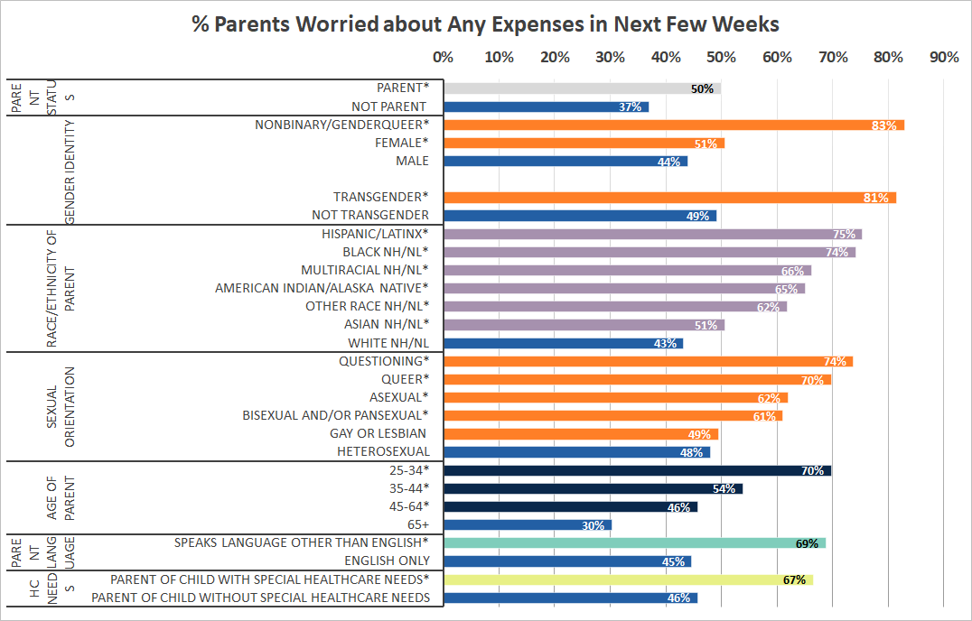
EXPENSES AMONG PARENTS
1 in 2 parents reported being worried about expenses, including housing, utilities, vehicle, and debt expenses. Parents are 35% more likely to be worried about expenses than non-parents.
Prior to the pandemic, MA had the 4th highest level of income inequality and 1 in 9 children were living below the FPL.¹ The pandemic has further exacerbated financial strains on families.
As many as 3 in 4 parents in certain groups were worried about expenses:
Nonbinary/genderqueer parents
Transgender parents
Hispanic/Latinx parents
Black nH/nL parents
Queer and Questioning parents
Parents aged 25-34
¹Source: American Community Survey 2019; Analysis by talkpoverty.org
Data notes: 1)”Non-binary” includes respondents identifying as non-binary, genderqueer, not exclusively male or female. Those “questioning/unsure of their gender identity” was suppressed due to small numbers; 2)“nH/nL”=non-Hispanic/non-Latinx; 3)“American Indian/Alaskan Native” includes Hispanic/Latinx; 4)* denotes rate is significantly different (p<0.05) compared to the reference group; 5) All percentages are weighted to the statewide age and educational distribution of those ≥25 years.
4.28.21 release
* denotes rate is significantly different compared to the reference group

Slide 42
HOUSING NEEDS AMONG PARENTS
1 in 3 parents reported being worried about housing expenses.
Prior to the pandemic, Massachusetts had the second highest number of homeless families with children in the US and the number of homeless families with children in MA nearly doubled from 2007-2018.¹
While parents and non-parents were equally worried about having to move in the next few months, parents were almost twice as likely to say that this was due to not being able to pay the rent or mortgage.
Unstable housing impacts the whole family, including the mental health and education of children.
Source: (1) US Department of Housing and Urban Development. (2018). The 2018 Annual Homeless Assessment Report to Congress. Retrieved from: https://files.hudexchange.info/resources/documents/2018-AHAR-Part-1.pdf Data notes: 1)”Non-binary” includes respondents identifying as non-binary, genderqueer, not exclusively male or female. Those “questioning/unsure of their gender identity” was suppressed due to small numbers; 2)“nH/nL”=non-Hispanic/non-Latinx; 3)“American Indian/Alaskan Native” includes Hispanic/Latinx; 4)* denotes rate is significantly different (p<0.05) compared to the reference group; 5) All percentages are weighted to the statewide age and educational distribution of those ≥25 years.
4.28.21 release

Slide 43
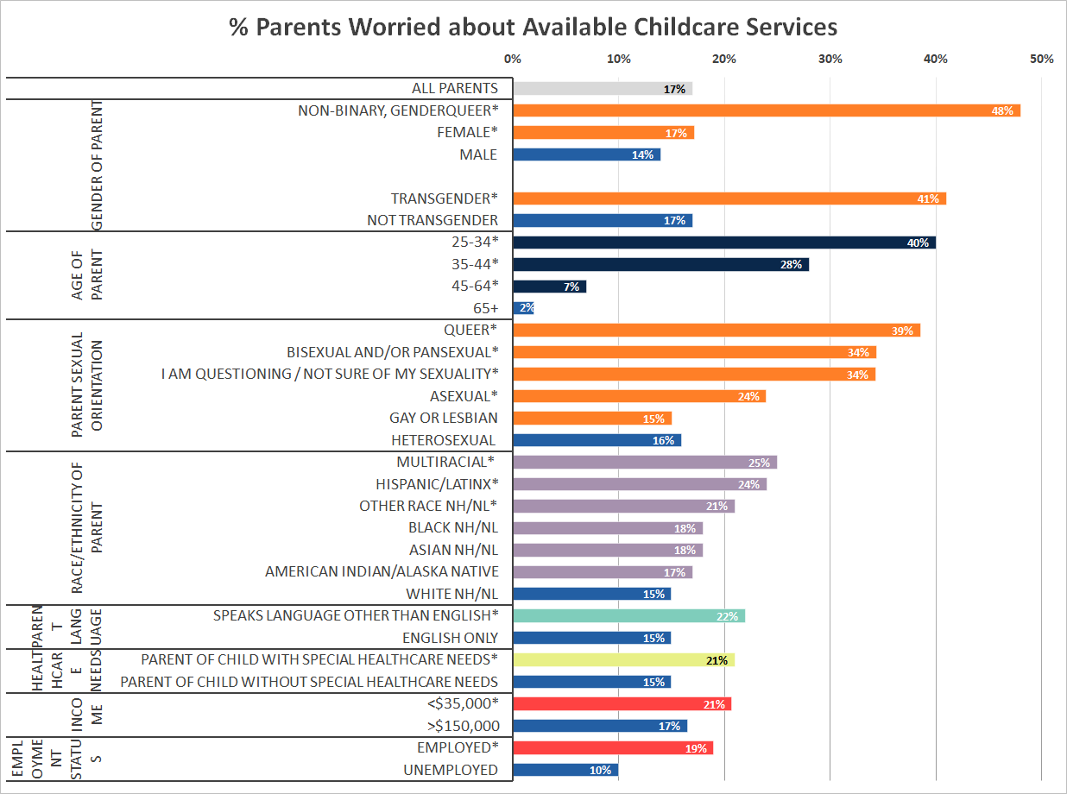
AVAILABLE & AFFORDABLE CHILDCARE
Nearly 1 in 5 parents reported being worried about accessing available and affordable childcare.
Lack of childcare may affect employment, parent and child mental health, and access to healthcare.
Several groups of parents reported rates that were 2 times higher than parents overall:
Non-binary/genderqueer parents
Transgender parents
Parents under 35 years old
Queer, Bi-sexual and/or Pansexual, and parents questioning their sexuality
Data notes: 1)”Non-binary” includes respondents identifying as non-binary, genderqueer, not exclusively male or female. Those “questioning/unsure of their gender identity” was suppressed due to small numbers; 2)“nH/nL”=non-Hispanic/non-Latinx; 3)“American Indian/Alaskan Native” includes Hispanic/Latinx; 4)* denotes rate is significantly different (p<0.05) compared to the reference group; 5) All percentages are weighted to the statewide age and educational distribution of those ≥25 years.
4.28.21 release

Slide 44
EMPLOYMENT & CHILDCARE
1 in 4 employed parents lost their jobs or reduced hours/took leave.
Parents were 35% more likely to report reducing hours/taking leave than non-parents.
43% of parents who reduced hours/took leave and 32% of parents who lost jobs listed
needing to take care of children as a reason.
Populations who have experienced inequities in other areas face additional challenges in balancing parental stressors.
The following parental groups were more likely to report a change in status or nature of employment in order to take care of children:
Questioning of sexual orientation, Bisexual and/or Pansexual, and Queer parents
Non-binary, and female parents
Younger parents
Hispanic/Latinx and Multiracial parents
Parents with lower income or lower education
Parents of children with special healthcare needs
4.28.21 release

Slide 45
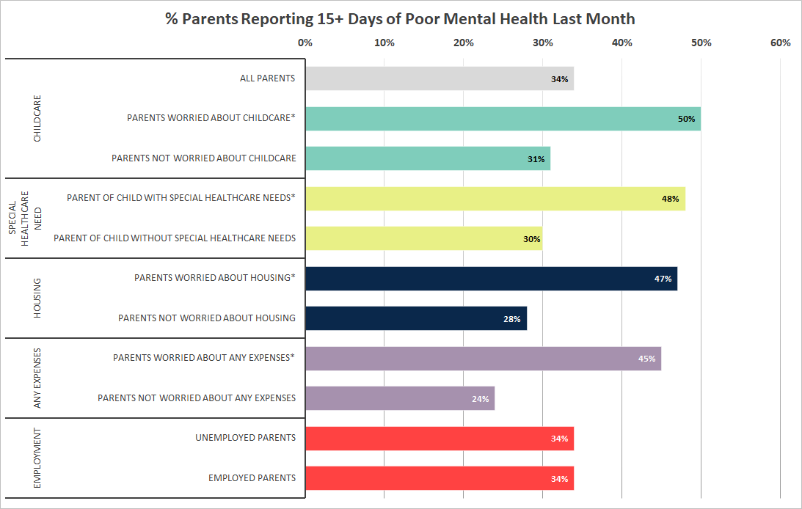
MENTAL HEALTH OF PARENTS
Parents worried about basic needs and parents of children with special healthcare needs are more likely to report poor mental health for 15+ days in the past month
Parents worried about childcare, housing, or any expenses are between 61% - 88% more likely to report poor mental health. Poor parental mental health affects not only parents, but also their children.
Parents of children with special healthcare needs are 60% more likely to report poor mental health. Parents of children with special healthcare needs who do not have access to respite care or programs outside of the home to support their children may have little time to work, perform household tasks, or rest.
Data notes: 1)* denotes rate is significantly different (p<0.05) compared to the reference group; 2) All percentages are weighted to the statewide age and educational distribution of those ≥25 years.
4.28.21 release

Slide 46
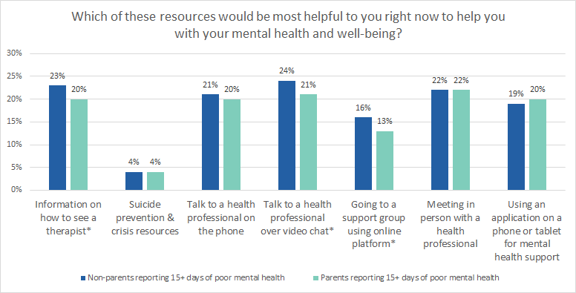
RISK MITIGATION
MENTAL HEALTH RESOURCES: PARENTS
While parents were more likely to report 15+ days of poor mental health than non-parents, they were less likely to indicate that mental health resources would be helpful.
Instead they expressed needs for a variety of childcare and basic needs resources:
"When would I have the time for this with my child home all day every day?"
"The most helpful thing has been getting a nanny (at tremendous cost) so I could get adequate sleep while ensuring my professional and parental responsibilities are met."
"Time and childcare. None of the above options matter if I don't have the time and capacity to engage with them."
"Childcare, income assistance. These will help my mental health the most."
Data notes: 1)* denotes rate is significantly different (p<0.05) between parents and non-parents; 2) All percentages are weighted to the statewide age and educational distribution of those ≥25 years.
4.28.21 release

Slide 47
SUBSTANCE USE
Lauren Larochelle, MS Anna Agan, MPH Hermik Babakhanlou-Chase Anne Marie Matteucci, PhD, MHA
David Hu,MD, MPH
Arielle Coq,MPH
Lisa Bandoian, MPH
4.28.21 release

Slide 48
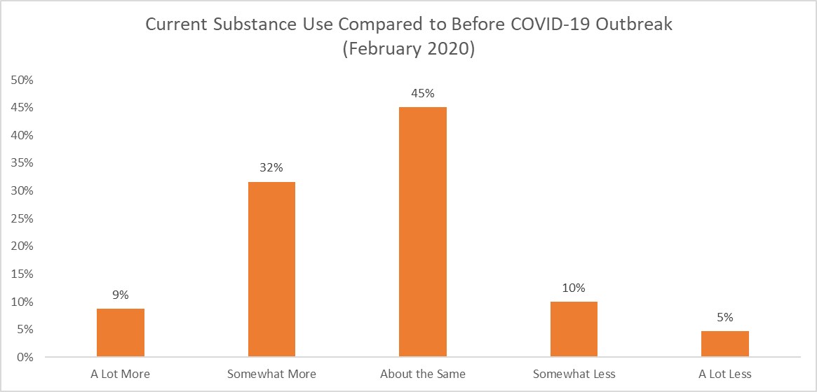
CHANGE IN SUBSTANCE USE
2 out of 5 MA adults using substances reported increasing their substance use compared to prior to February 2020.
Among respondents who reported substance use in the last 30 days:
45% reported that their current substance use has remained about the same
This aligns with trends seen in statewide substance use treatment data.
Preliminary data - 1.7.21 - Not for external distribution
4.28.21 release
Notes:
Talking points:
Since question only asked about use, prescription drugs (including Other Opioids) and OTC may have been being taken as prescribed or intended.
From NSDUH for ages 26+ – Alcohol Use Past 30 days (64.9%), Marijuana Use Past 30 days (12.7%), Tobacco Use in Past 30 days (18.7%), Cocaine Use in Past Year (1.63%), Heroin Use in Past Year (0.41%) Source: SAMHSA, Center for Behavioral Health Statistics and Quality, National Survey on Drug Use and Health, 2018 and 2019.

Slide 49
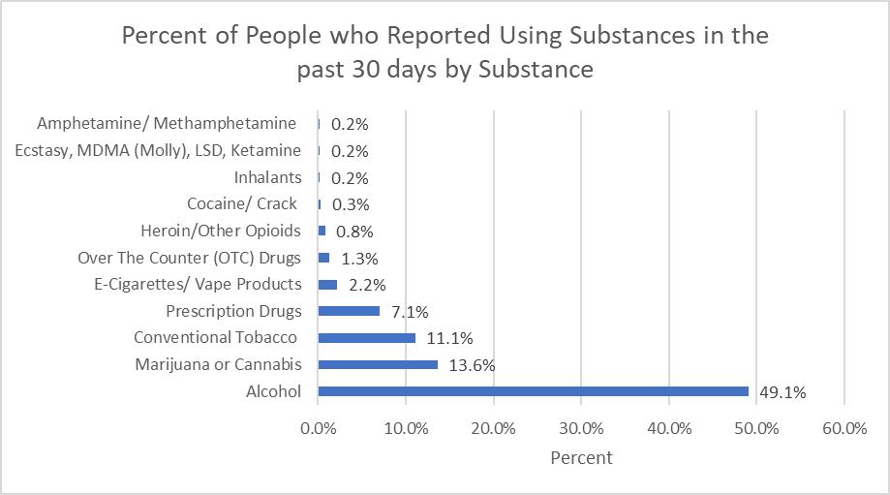
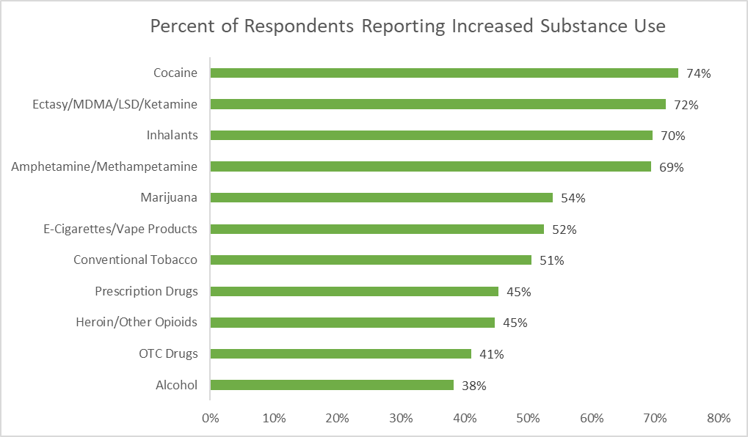
SUBSTANCE USE
3 out of 5 MA adults reported using one or more substance/product in the past 30 days.
.
Among survey respondents, the most commonly used substances were:
Alcohol
Marijuana/Cannabis
Conventional Tobacco
However, the substances mostly likely to have seen an increase in use were:
cocaine
ecstasy/MDMA/LSD/ketamine
amphetamine/methamphetamine or inhalants
The most commonly used substances were not those that saw the biggest increases in use during the pandemic.
.
NOTE: Some reported prescription drugs, other opioids and OTC drugs may have been taken as prescribed/intended.
Preliminary data - 1.7.21 - Not for external distribution
4.28.21 release
Notes:
Talking points:
Since question only asked about use, prescription drugs (including Other Opioids) and OTC may have been being taken as prescribed or intended.
From NSDUH for ages 26+ – Alcohol Use Past 30 days (64.9%), Marijuana Use Past 30 days (12.7%), Tobacco Use in Past 30 days (18.7%), Cocaine Use in Past Year (1.63%), Heroin Use in Past Year (0.41%) Source: SAMHSA, Center for Behavioral Health Statistics and Quality, National Survey on Drug Use and Health, 2018 and 2019.

Slide 50
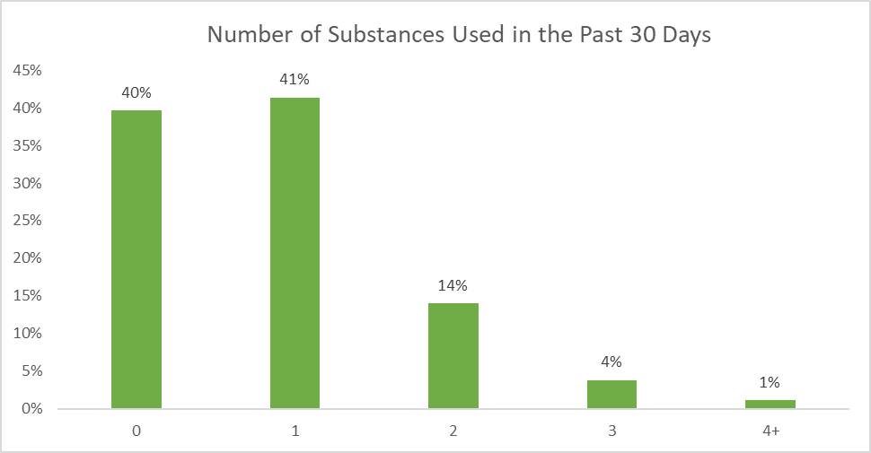
SUBSTANCE USE
3 out of 5 MA adults reported using one or more substance/product in the past 30 days.
.
1 out of 5 MA adults reported using 2 or more substances/products in the past 30 days.
Preliminary data - 1.7.21 - Not for external distribution
4.28.21 release
Notes:
Talking points:
Since question only asked about use, prescription drugs (including Other Opioids) and OTC may have been being taken as prescribed or intended.
Amphetamine/methamphetamine (0.18%), ecstacy/MDMA/LSD/ketamine (0.21%) & inhalants (0.23%) were not shown since percentages were so low, they weren’t visible on chart
From NSDUH for ages 26+ – Alcohol Use Past 30 days (64.9%), Marijuana Use Past 30 days (12.7%), Tobacco Use in Past 30 days (18.7%), Cocaine Use in Past Year (1.63%), Heroin Use in Past Year (0.41%) Source: SAMHSA, Center for Behavioral Health Statistics and Quality, National Survey on Drug Use and Health, 2018 and 2019.

Slide 51
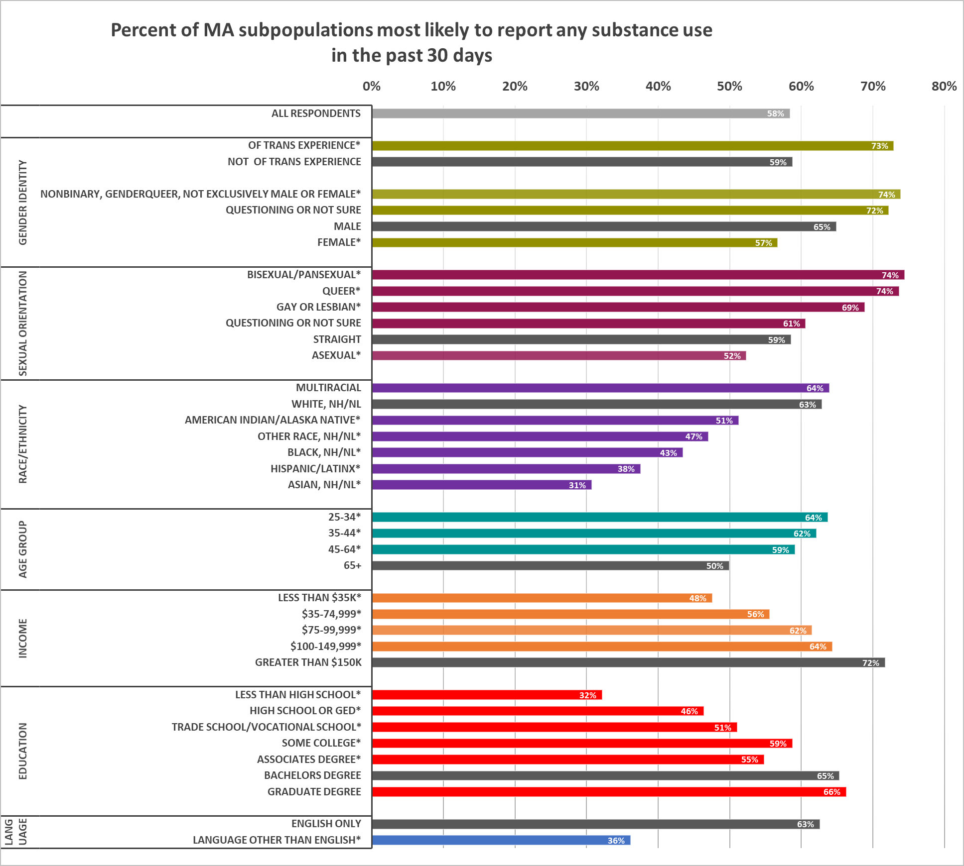
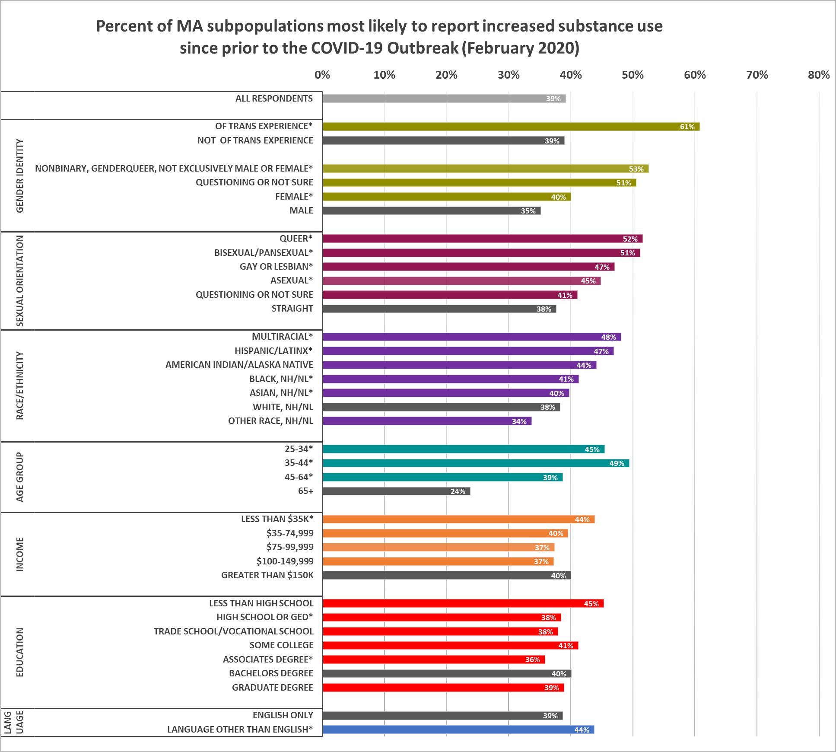
SUBSTANCE USE
Populations who were most likely to use substances were not always the same populations who saw the biggest increase in use.
* significant at the p<0.05 level as compared to the grey referent group in each cluster
Preliminary data - 1.7.21 - Not for external distribution
Notes:
Talking points:
Notes:

Slide 52
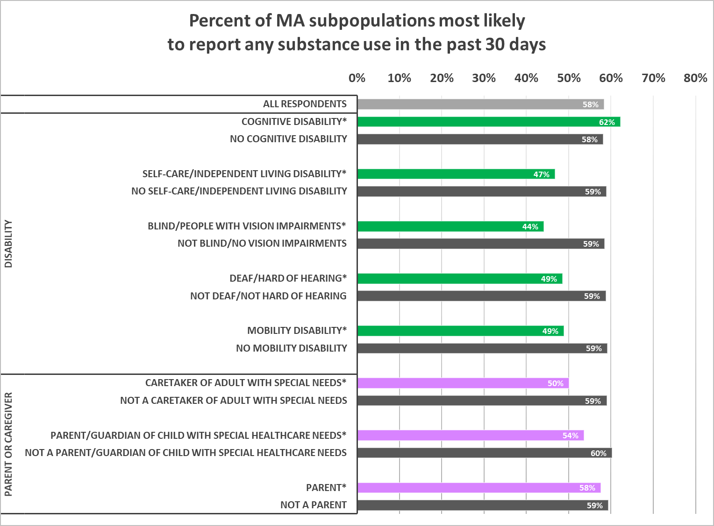
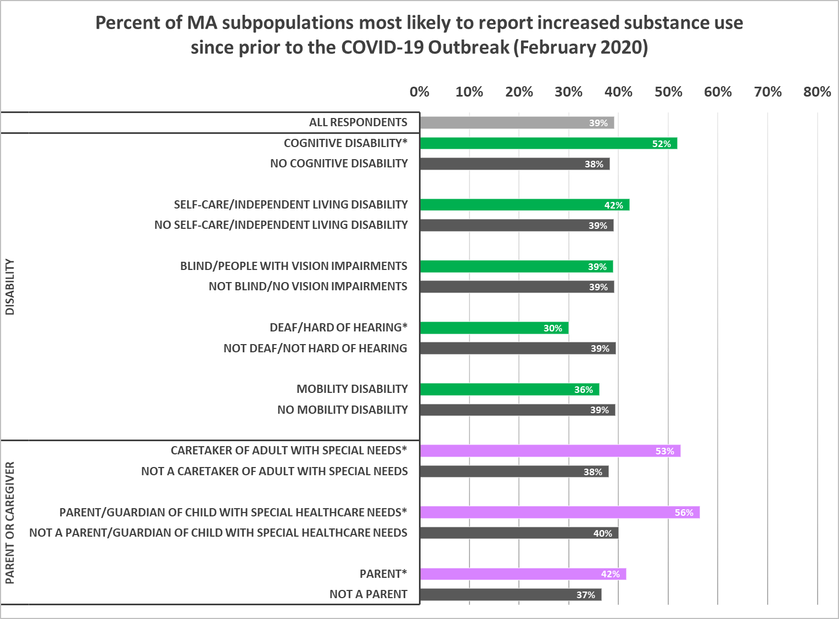
SUBSTANCE USE, CONT.
Populations who were most likely to use substances were not always the same populations who saw the biggest increase in use.
* significant at the p<0.05 level as compared to the grey referent group in each cluster
Preliminary data - 1.7.21 - Not for external distribution
4.28.21 release
Notes:
Talking points:

Slide 53
SUBSTANCE USE & SDOH
Those who reported substance use in the last 30 days were more likely to be burdened with a range of social determinant related needs.
1.3X more likely to WORRY ABOUT HAVING TO MOVE IN THE NEXT FEW MONTHS
1.3X more likely to BE “VERY WORRIED” ABOUT GETTING COVID-19 (often at work or in their neighborhood)
1.4X more likely to WORRY ABOUT access to MENTAL OR EMOTIONAL SUPPORT
3.6X more likely to have had an overnight or longer stay at a CORRECTIONS INSTITUTION
Preliminary data - 1.7.21 - Not for external distribution
4.28.21 release
Notes:
Talking Point:
Notes: 3/24: waiting on delayed care data

Slide 54
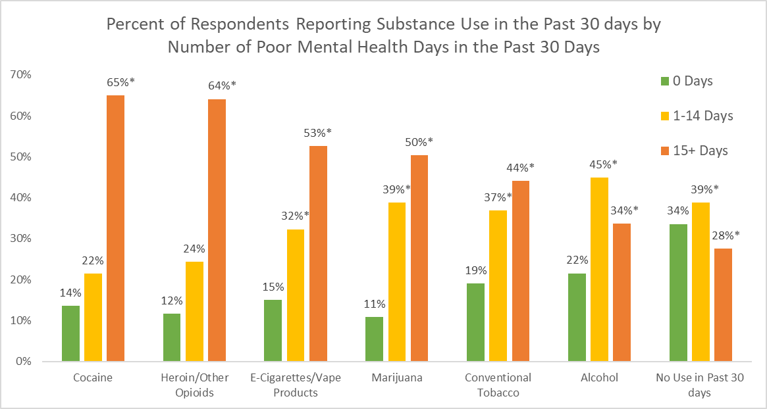
SUBSTANCE USE & MENTAL HEALTH
People reporting substance use were more likely to report poor mental health days in the past 30 days.
At least half of the people reporting use of cocaine, heroin/other opioids,
e-cigarettes/vape products or marijuana reported 15+ days of poor mental health.
* significant at the p<0.05 level as compared to the green referent group (0 days of poor MH)
4.28.21 release
Notes:
Talking points:

Slide 55
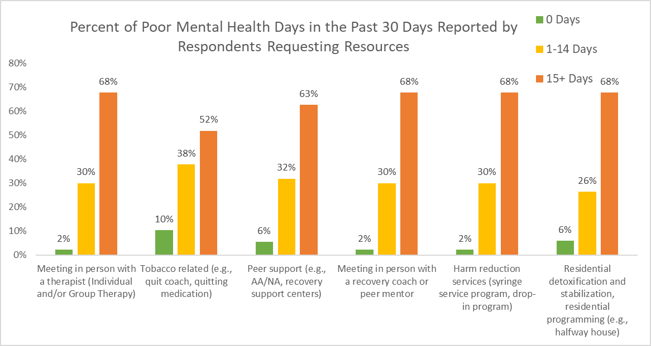
SUBSTANCE USE & MENTAL HEALTH
People experiencing persistent poor mental health were more likely to request a wide range of substance use resources.
The majority of people requesting resources for substance use report 15 or more days of poor mental health in the past 30 days.
* significant at the p<0.05 level as compared to the green referent group (0 days of poor MH)
4.28.21 release
Notes:
Talking points:

Slide 56
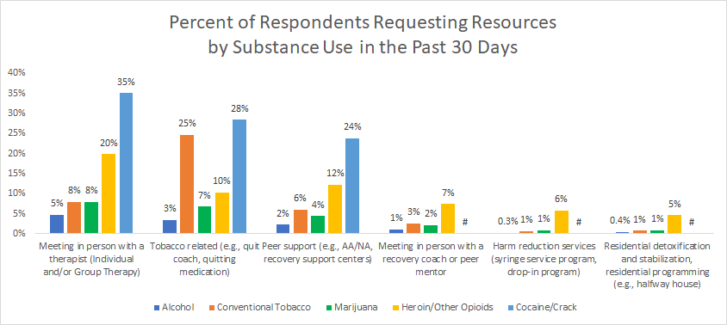
SUBSTANCE USE RESOURCES
Respondents reporting substance use were more likely to request resources, especially users of cocaine, heroin, and tobacco.
TOP 3 RESOURCES REQUESTED among respondents reporting substance use
1. Meeting in person with a therapist (individual and/or group therapy)
2. Tobacco related resources (e.g., quit coach, quitting medication)
3. Peer support (e.g., AA/NA, recovery support centers)
# percentage suppressed due to small counts
Note: Nicotine replacement therapy (NRT) was the most requested tobacco-related resource across substance use groups.
Preliminary data - 1.7.21 - Not for external distribution
4.28.21 release
Notes:
Talking points:

Slide 57
SUBSTANCE USE & DELAYED CARE
Respondents reporting substance use were 1.2X more likely to delay care than respondents reporting no substance use.
​
People reporting any substance use were 2.1X more likely to HAVE DELAYS IN ROUTINE MENTAL HEALTH CARE than those reporting no substance use.
People reporting cocaine/crack and heroin/other opioid use were 2- 2.2X more likely to DELAY CARE
People reporting marijuana were 3.3X more likely, while those reporting conventional tobacco were 3.1X
​People using heroin/other opioids were 3.7X more likely to report DELAYED ROUTINE AND URGENT CARE.
​People using heroin/other opioids and conventional tobacco were 1.3 - 1.4X more likely to report DELAYED URGENT CARE.
Preliminary data - 1.7.21 - Not for external distribution
4.28.21 release
Notes:
Talking points:
- this is echoed in the national overdose data which shows increases in overdose deaths due to individuals using alone, delaying care, delaying tx, not seeking support/help, and isolating (no Naloxone)
-Access to telehealth

Slide 58
DATA TO ACTION
Jessica del Rosario Kim Etingoff
4.28.21 release

Slide 59
RESOURCE INFORMATION
How can we help people access needed supports, services, and resources?
COMMUNICATION / PSAs
How can we utilize alternative channels to reach key populations (not currently being reach)? What modes to use?
HEALTH LITERACY & TRUST
How can we craft understandable messaging that also addresses concerns and fears not just recommended actions?
Key Themes of Actions Needed Emerging from Findings
SDOH OVERLAP
How do we address the multiple layers of barriers and burden?
HEALTHCARE CAPACITY
How can we increase appointments, telehealth infrastructure, culturally competent providers, CHWs?
EMPLOYMENT
How can we promote more equitable worker protections (physical conditions, testing, and benefits/leave)?
ACCESSIBILITY
How can we improve accessibility of information and services (e.g., language, technology, cultural competence of providers)?
TELEHEALTH & TECHNOLOGY
How can we reduce technology-related barriers to accessing services?
4.28.21 release

Slide 60
DATA TO ACTION
We are getting input from both internal and external stakeholders
in order to convert these data to action.
INTERNAL GROUPS
Established a Data to Action (DTA) Workgroup to convene Bureaus, Offices, work groups etc. in integrating findings into DPH actions.
Eg. integrate population specific lessons learned into the launch of the Vaccine Equity Initiative among the top 20 impacted towns/cities
COLLABORATORS
We are eliciting input from our advisory groups (eg. PHC, HEAG, Tribal Partners) to help us interpret and identify possible actions resulting from the data.
Eg. improve accessible options on the vaccine website after hearing from external partners that existing measures still posed accessibility barriers
LOCAL PARTNERS
We are also providing the data presented here by granular geographies, and populations. to equip our local partners in tailoring their own pandemic response.
Eg. Providing data by race, ethnicity groups, sexual orientation, gender identity, transgender status, types of disability, income, education, language spoken, geography, rural cluster, age, etc.
4.28.21 release

Slide 61
DATA TO ACTION – EXAMPLE
Key Finding: Substance Use – Respondents are burdened with a range of social determinant related needs, and are more likely to delay care
Heard: Need to increase integration of mental health and substance use disorder services, address recent changes in substances used, and provide for basic needs and wrap-around support
Action Taken: BSAS’ comprehensive portfolio of programs/initiatives, including:
Funding triage-urgent care centers to address co-occurring MH/SUD, allowing for immediate access at the initial point of care
Reinforcing the use of Screening, Brief Intervention and Referral to Treatment (SBIRT) to address increased alcohol consumption during COVID
Addressing stimulant use by allowing admissions into MAT Enhanced settings
Leverage use of telehealth for induction/intake for Medications for Opioid Use Disorder (MOUD), including telehealth induction on buprenorphine and naltrexone and promoting the use of telehealth by reimbursing providers for patient cell phones/data plans
Providing recovery-based/culturally-responsive services for Black and Latino men at risk of fatal overdoses following release from incarceration
Increasing investments in new and existing housing-related initiatives, including expanding low threshold/housing first and recovery housing programs
4.28.21 release

Slide 62
DATA TO ACTION – EXAMPLE
Key Finding: Parents and Families – Parents and guardians have additional stressors during the pandemic, including balancing childcare and making ends meet. Parents worried about paying for expenses were 88% more likely to report poor mental health.
Heard: Parents, particularly younger parents and parents of children with special healthcare needs, need flexible services to meet their needs
Actions Taken:
Expanded the Massachusetts Pregnant and Parenting Teens Initiative (MPPTI) in collaboration with DTA
Collaborate with Young Parent Statewide Convening to share results, gather feedback, and discuss implications
Shared with programs aimed at providing flexible, multigenerational support to families, including Project LAUNCH and the Division of Children and Youth with Special Healthcare Needs
Applied to use CDC COVID Disparities funding to provide flexible support to parents of children with special healthcare needs, including supports for basic needs and respite for caregivers
4.28.21 release

Slide 63
DATA TO ACTION – EXAMPLE
Key Finding: The effect of COVID-19 on workers in Massachusetts has been severe, and has disproportionately impacted specific groups of workers
Heard: As we move continue to make efforts to increase vaccination efforts state-wide, as well as ensure that other COVID-19 prevention strategies are in place, we need to recognize that work is an important contributor to COVID-19 risk.
Action Taken:
Community Liaisons to the 20 VEI communities are being briefed on the CCIS employment findings. We are also adding contextual information about the employment make-up of the 20 communities prioritized in the Vaccine Equity Initiative to help increase vaccinations of high-risk worker populations in those communities.
Advocating for employee centric considerations in vaccination uptake efforts such as appointments available outside of regular working hours, increased mobile units, educating employers about tax credits, etc.
We have met with the HEAG as well as our OHSP Advisory Board to strategize about ways to engage with workers and employers and are working to implement these ideas.
4.28.21 release

Slide 64
DATA TO ACTION – EXAMPLE
Key Finding: Determinants of Health - Food insecurity is directly associated with mortality from obesity, hypertension, diabetes, and heart disease, which are all also risk factors for more severe COVID-19 illness and mortality. More than 1 in 4 (28%) respondents worried about getting food or groceries in the coming weeks.
Heard: Multiple state agencies work to increase/improve food access, need to connect with them to share findings and identify actions
Action Taken: Engaged with COVID-19 Command Center's Food Security Task Force Inter-Agency Work Group and full Task Force to share Determinants of Health findings and discuss implications
4.28.21 release

Slide 65
DATA TO ACTION – EXAMPLE
Key Finding: Mental Health - Requests for suicide prevention and crisis management resources were as high as 11% among certain subpopulations and was the highest among Transgender respondents, non-binary respondents, and respondents questioning their gender identity.
Heard: Need to expand and adapt services
Action Taken: DPH's Suicide Prevention Program with intra- & inter-agency partners:
Supporting expanded/adapted services including offering virtual support groups, new in-language groups, tele-check calls, peer programs (for youth and attempt survivors)
Increased support to crisis centers who provide emotional support for those experiencing suicidal crisis or emotional pain, contracted with Riverside Trauma Center to provide services to schools/communities after the death of a youth by suicide
New/modified online training modules on Behavioral Health among Older Adults, providing suicide prevention training to MA Corrections, first offering for state employees, Zero Suicide monthly learning series provided to health care, behavioral health care and community organizations in southeast MA, trainings for the public, Annual Suicide Prevention Conference to be held virtually 5/19 & 5/20
4.28.21 release

Slide 66
THANK YOU!
For more details please visit https://www.mass.gov/covidsurvey
4.28.21 release

Slide 67
Next Meeting:
May 12, 2021

