Slide 1
Public health council
April 6, 2022
Please standby – the meeting will begin shortly
Today’s presentation is available on the mass.gov/dph website under “Upcoming Events” by clicking on the April 6th Public Health Council listing

Slide 2
PUBLIC HEALTH COUNCIL meeting
April 6, 2022
Margret R. Cooke, Commissioner

Slide 3
National Public Health Week

Slide 4
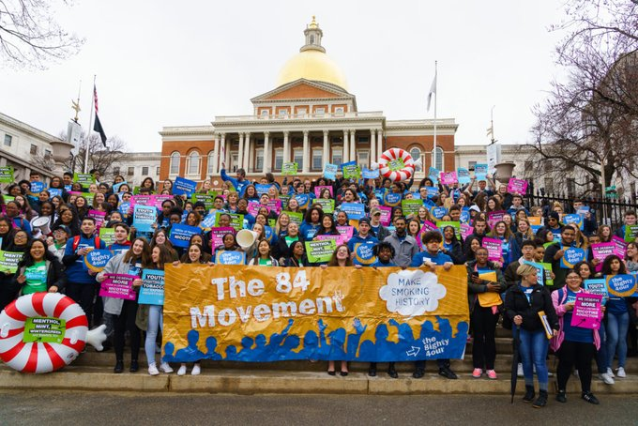
MA “Kick Butts” Day of Action – March 31
Kick Butts Day 2019

Slide 5
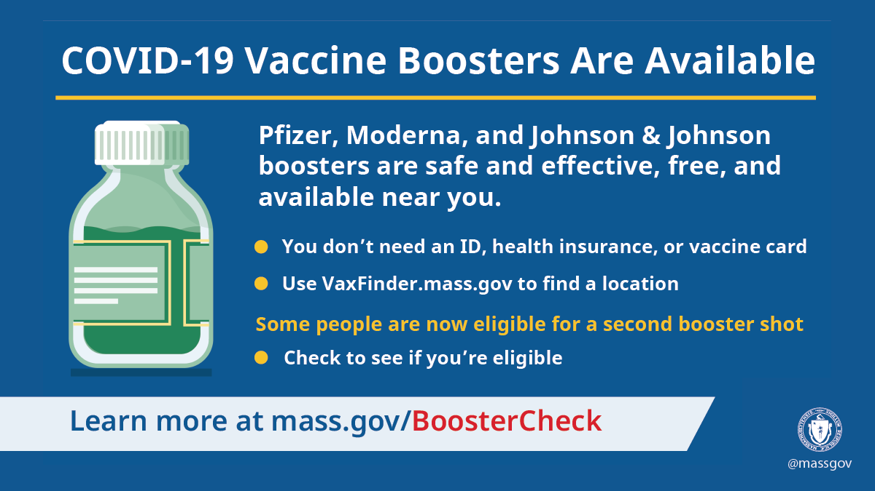
COVID-19
Update
Metrics
Boosters

Slide 6
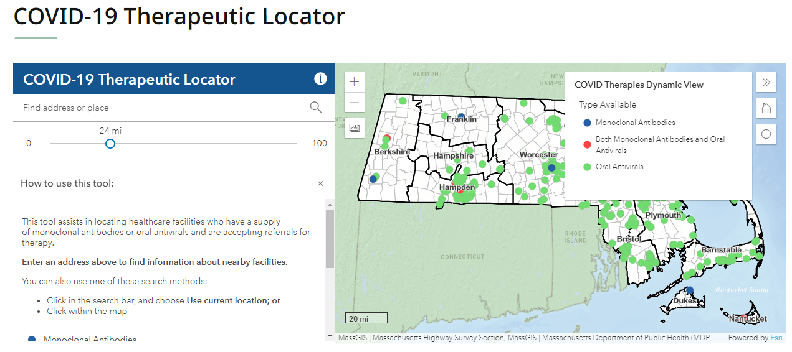
COVID Treatments
mass.gov/CovidTreatments

Slide 7
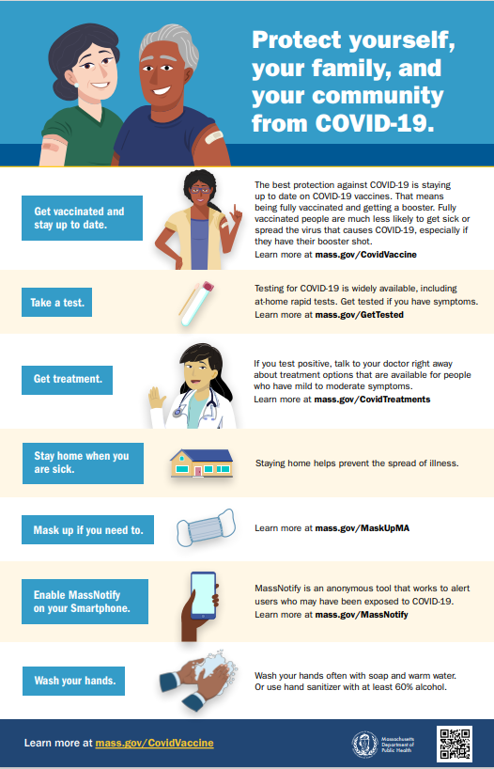
Steps to Stay Safe and Healthy
Get vaccinated and stay up to date.
Take a test.
Get treatment.
Stay home when you are sick.
Mask up if you need to.
Enable MassNotify on your smartphone.
Wash your hands.

Slide 8
PUBLIC HEALTH COUNCIL meeting
April 6, 2022
Margret R. Cooke, Commissioner

Slide 9
Proposed Revisions to 105 CMR 130.000:
Hospital Licensure (Pre-Comment)

Slide 10
Summary of Regulation
105 CMR 130.000, Hospital Licensure:
Sets forth standards for the maintenance and operation of hospitals, pursuant to M.G.L. c. 111, §§ 51 and 51G.
Ensures a high quality of care, industry standardization, and strong consumer protection for individuals receiving care in hospitals.

Slide 11
Safe Patient Access to Emergency Departments
In August 2021, in response to legislation, the Department convened the Safe Patient Access to Emergency Departments Workgroup.
The statutory charge of the Workgroup was to report on and make recommendations to inform Department regulations on patient access to hospital emergency departments.
The Workgroup was charged with providing recommendations relative to signage, lighting, wayfinding, and security specific to accessing hospital emergency departments.

Slide 12
Safe Patient Access to Emergency Departments
The Workgroup met four times between August and December 2021 and reviewed the Facility Guideline Institute (FGI) recommendations on hospital wayfinding and signage, and received presentations on current hospital practices related to wayfinding, security and lighting.
The Workgroup recommendations were submitted to the Legislature on December 15, 2021.

Slide 13
Overview of Proposed Revisions to Regulation
Based upon the recommendations and framework of the Workgroup, the Department proposes adding the following amendments to 105 CMR 130 by requiring hospitals to:
Implement signage, lighting, wayfinding and security requirements to ensure safe patient access to hospital emergency departments; and
Conduct a thorough annual review of signage, lighting, wayfinding and security policies and protocols.

Slide 14
Regulation Change: Wayfinding, Signage, Security, Lighting Requirements
SUMMARY OF PROPOSED REVISIONS TO 105 CMR 130
Requires hospitals with emergency departments to adhere to wayfinding, signage and security requirements, including:
Having clearly marked external signs that are visible from public streets and requiring all emergency departments to have signs identifying the entrance with “EMERGENCY” in all capital letters. Exterior emergency department signs must be sufficiently lit to allow drivers and pedestrians to see signage after dark and during inclement weather.
Maintaining lighted communications technology, such as two-way live intercom systems, with duress alarms around hospital grounds.
Ensuring all main entrance doors and any doors that the public may use to enter the hospital are well-lit and include directions to the emergency department.
Maintaining written policies and procedures for video/audio monitoring of exterior access points and emergency department patient drop off.
Placing directional signs leading to the emergency department in such a manner as to ensure visual continuity.

Slide 15
Regulation Change: Annual Review
SUMMARY OF PROPOSED REVISIONS TO 105 CMR 130
Requires hospitals with emergency departments to conduct an annual review of wayfinding, signage and lighting, including a review of:
Plans for maintaining lighting, footpaths and signs clear of debris, vegetations and snow;
Surveillance monitoring;
Patrols of hospital grounds; and
Policies and procedures related to wayfinding, signage and lighting.
Hospital personnel from multiple departments, such as security, facilities maintenance, and risk management, must participate in the annual review.

Slide 16
Next Steps
Following this presentation to the Public Health Council, staff will hold a public hearing and will provide a public comment period during which the public may provide written comments on the proposed revisions.
After the close of the public comment period, staff will review public comments, revise as necessary to reflect comments received, and then request approval of the final version of the revised regulation at a subsequent meeting of the Public Health Council.

Slide 17
Thank you for the opportunity to present this information today.
For more information regarding hospital licensure, please find the relevant statutory language and the full current regulation here:
https://malegislature.gov/Laws/GeneralLaws/PartI/TitleXVI/Chapter111
https://www.mass.gov/doc/105-cmr-130-hospital-licensure/download

Slide 18
Repeal of 105 CMR 216.000:
Wellness Tax Credit Incentive (Post-Comment)

Slide 19
105 CMR 216.000 Wellness Tax Credit Incentive
Chapter 224 of the Acts of 2012, §41and §56 established a tax incentive for small businesses that implement workplace wellness programs.
The statute charged DPH with determining the criteria by which businesses would be eligible for the credit, and with certifying small business wellness plans.
105 CMR 216.000 codified the criteria for small businesses to be eligible for this tax credit, and the mechanism for DPH certification of wellness programs.

Slide 20
105 CMR 216.000 Wellness Tax Credit Incentive
DPH certification was required in order to be eligible for a tax credit of 25% of the costs associated with implementing a certified wellness program (up to a maximum of $10,000 per business per fiscal year).
Under Chapter 224, these wellness tax credit incentives sunset on December 31, 2017 (Chapter 224 of the Acts of 2012, §41A, §56A, §298).

Slide 21
Public Comment Period
The Department held a public comment period from November 11, 2021, to December 28, 2021.
In addition, the Department held a public hearing on December 28, 2021.
The Department did not receive public comment regarding 105 CMR 216.

Slide 22
Next Step
Upon PHC approval, the Department will file the rescission of 105 CMR 216.000 with the Secretary of the Commonwealth.

Slide 23
Thank you for the opportunity to present this information today.
For more information regarding Wellness Tax Credit Incentive , please find the relevant statutory language and the full current regulation here:
https://malegislature.gov/laws/sessionlaws/acts/2012/chapter224
https://www.mass.gov/regulations/105-CMR-21600-massachusetts-wellness-tax-credit-incentive
Please direct any questions to:
Ben Kingston, Bureau of Community Health and Prevention
Benjamin.Kingston@mass.gov

Slide 24
Supporting and Enhancing the Commonwealth's Local and Regional Public Health System

Slide 25
Presentation Outline
Background
Local Public Health System
Special Commission on Local and Regional Public Health
Blueprint for Public Health Excellence
Blueprint Implementation
Funding
State Budget
ARPA Funding

Slide 26
Data Analysis and Reporting
Health Education and Outreach
Environmental Health (food, septic, pools, etc.)
Local Public Health
Policy Development
Infectious Disease Control
Community Health & Prevention (healthy eating, active living)
Behavioral Health (substance use, tobacco, mental health)
Immunizations
Emergency Preparedness

Slide 28
Background
351 municipalities = 351 local public health authorities (boards of health/health departments)
No dedicated state funding until recently
Extensive inequities in resources received and services provided
Municipalities often do not meet statutory and regulatory requirements

Slide 29
Special Commission on Local and Regional Public Health
“…assess the effectiveness and efficiency of municipal and regional public health systems and … make recommendations regarding how to strengthen the delivery of public health services and preventive measures.”
- Chapter 3 of the Resolves of 2016

Slide 30
Blueprint for Public Health Excellence
The report documents the Commission’s findings and makes recommendations for strengthening local public health services and protections across the Commonwealth

Slide 31
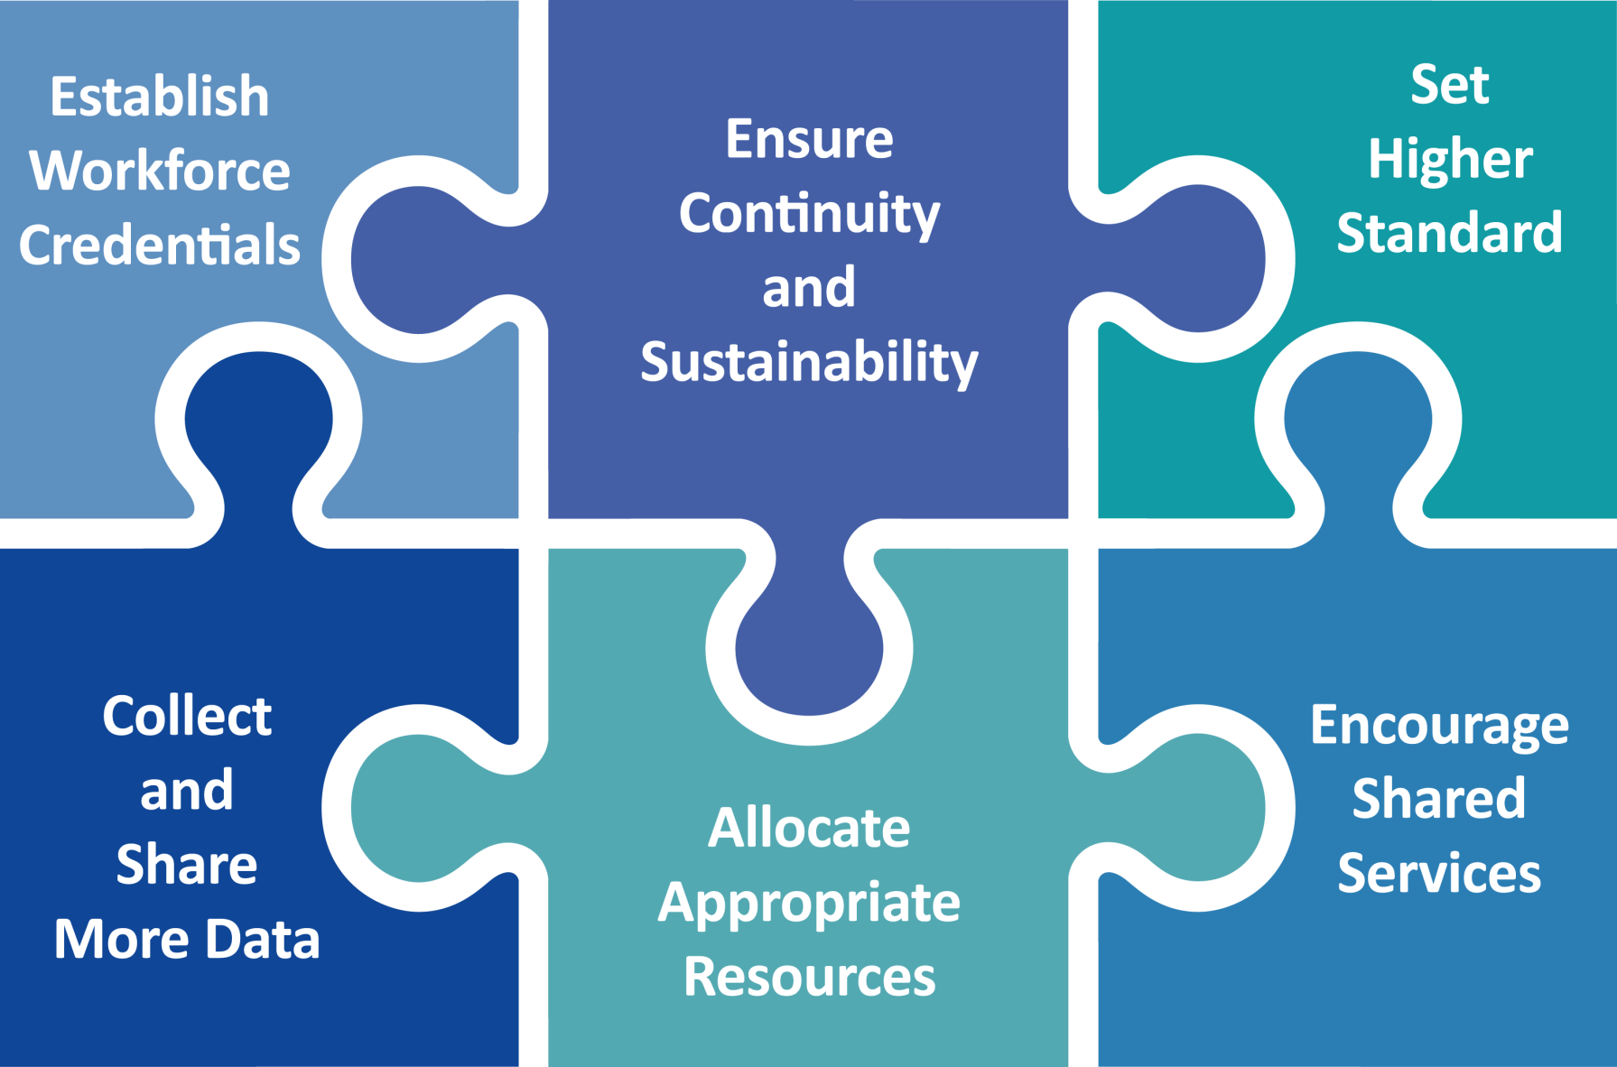
Six Recommendations

Slide 32
Blueprint Implementation: Set Higher Standards
Establish Performance Standards
Phase 1 Performance Standards for Local & Regional Public Health - 2022
Future Phases
Assess Capacity and Performance
Baseline Capacity Assessment - 2022
Improvement Planning
Foundational Public Health Services
Future Periodic Assessments

Slide 33
Blueprint Implementation: Encourage Shared Services
Establish Public Health Excellence for Shared Services Program (PHE)
43 regional collaboratives (277 municipalities)
4th round procurement - 2022
Provide Technical Assistance (TA)
Legal TA - 2021
Established in 2021
TA on capacity assessment, communications & relations - 2022
Support Health & Racial Equity
Health & Racial Equity Training - 2022
Health & Racial Equity TA
Health Disparity Data to Action TA
FY22 annualized funding: ~$12M

Slide 34
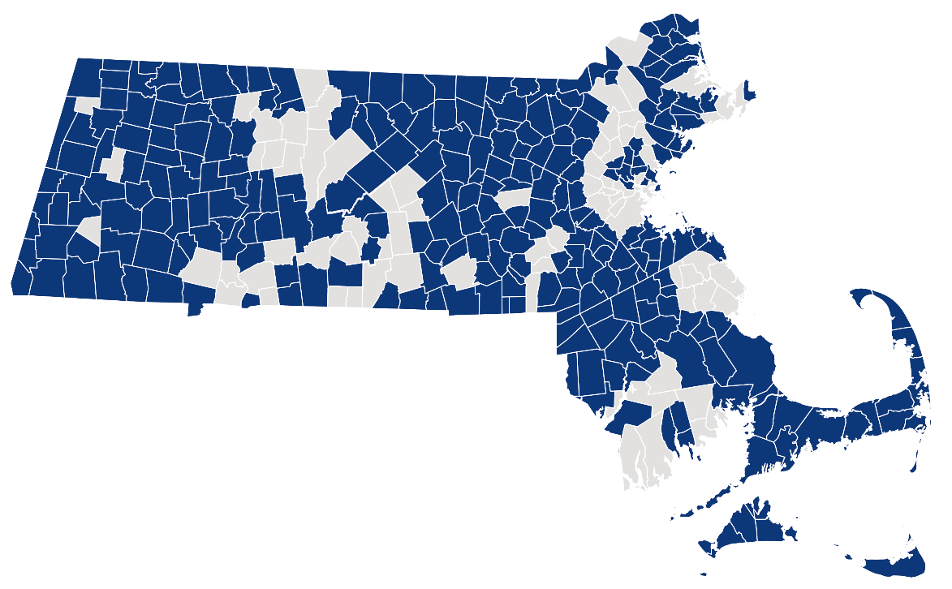
Public Health Excellence for Shared Services Program (PHE)
As of 3/21/2022

Slide 35
Blueprint Implementation: Collect and Share More Data
Establish Standardized and Unified Data Systems
Standardized and Unified Data Systems
Electronic Inspection System
Online Permitting
Performance Tracking
Workforce Credential Tracking
Hardware and Software Distribution
Training and Technical Assistance
Data Systems
Data to Action
Data Analysis

Slide 36
Blueprint Implementation: Support Workforce Development
Promote Workforce Pipeline, Recruitment, and Retention
13 higher education public health schools and programs
Establish Field Training Infrastructure
Field training for public health inspectors:
Established the Academic Public Health Corps in 2021
Expand Access to Professional Development
Create new training courses specified in the Blueprint
Hundreds corps members deployed to local & regional health departments
Food Protection, Septic Systems, Healthy Homes and Housing Code, Public Swimming Pools, Recreational Camps for Children, etc.
Planned for 2022 - 2023
Procure new Learning Management System
Support local public health workforce to meet Blueprint’s Workforce Credential Standards
Support Workforce Credentials
Establish “Careers of Public Health” website to promote recruitment and retention
Transition Registered Sanitarians (RS) and Certified Health Officers (CHO) credentials from Division of Occupational Licensure to DPH
Connect e-licensing software for credentials with new Unified Data Systems for Local and Regional Public Health

Slide 37
Blueprint Implementation: Ensure Continuity of Stakeholder Engagement
Established the Local and Regional Public Health Advisory Committee
Currently suspended due to COVID-19 pandemic
Continue to engage stakeholders
Coalition of Local Public Health
Massachusetts Large Cities Program
PHE Grantees
Ensure Continuity of Stakeholder Engagement

Slide 38
Blueprint Implementation: Allocate Appropriate Resources
Commit Appropriate Resources to Support Local and Regional Public Health
State Funding
$15M FY22 State Budget
Federal COVID-19 Response Funding
$200M ARPA Funding (available until FY27)

Slide 39
Overview – ARPA Funding ($200M)
Prioritize expansion and enhancement of shared services. Earmarked areas:
Capacity Building of Local and Regional Public Health ($71.15M)
Goal 1: Establish infrastructure for cross-jurisdictional sharing of public health services to create the foundation for meeting current and future statutory and regulatory obligations
Goal 2: Support local health in addressing health disparities and improving population health
Workforce Development ($30M)
Goal 1: Promote workforce development
Goal 2: Establish adequate training and educational opportunities for regional public health
Data Systems & Performance Tracking ($98.85M)
Goal 1: Establish standardized and unified data systems
Goal 2: Establish performance standards
Goal 3: Conduct capacity and performance assessment

Slide 40
Blueprint Recommendations and ARPA Earmarked Areas Crosswalk
Blueprint Areas of Focus and Recommendations
ARPA Earmarked Areas and DPH Actions
Public Health Standards
Elevate the standards and improve the performance of local public health departments
Cross-Jurisdictional Sharing
Increase the number and scope of comprehensive public health districts, formal shared services agreements, and other arrangements for sharing public health services.
Data Reporting and Analysis
Create a standardized, integrated, and unified public health reporting system
Strengthen DPH and local public health capacity to collect, analyze, and share data
Workforce Credentials
Set education and training standards for local public health workforce and expand access to professional development by implementing local public health workforce credentialing standards.
Resources to meet System Needs
Commit appropriate resources to the local public health system changes recommended by the Commission.
Continuity and Sustainability
Continue to engage a wide range of stakeholders to provide ongoing support for the recommendations for systems improvement.
Give DPH the infrastructure and authority to support the recommendations.
Capacity Building of Local and Regional Public Health
Establish and implement Public Health Excellence for Shared Services (PHE) grant program
Support PHE grantees to meet performance standards including communicable disease surveillance and response
Provide technical assistance and support to strengthen cross-jurisdictional service sharing infrastructure
Provide training and technical assistance to PHE grantees to support health equity, incorporating health equity into operations, and population health initiatives.
Workforce Development
Partner with academic institutions to establish the Academic Public Health Corps to foster the development of robust workforce pipelines and deployment to LBOHs including COVID-19 related responses
Assume the management of select credentials
Establish the “Careers of Public Health” website to support efforts to recruit, retain, and sustain local public health workforce
Develop and update training programs and establish hands-on skill-based field training infrastructure on priority topic areas, including environmental health and public health nursing
Data Systems & Performance Tracking
Establish standardized and unified data systems to collect/analyze/share data from and with LBOHs and evaluate system performance.
Maintain new data systems and provide ongoing system enhancements
Establish performance standards and assess capacity of local and regional public health departments to meet established performance standards

Slide 41
Thank you!

Slide 42
COVID-19 Community Impact Survey(CCIS): Reflecting on Impact & Looking Ahead
April 2022 Presented by Lauren Cardoso, PhD
Massachusetts Department of Public Health

Slide 43
CCIS TEAM MEMBERS
CCIS Project Leads
W.W. Sanouri Ursprung, Lauren Cardoso, Beth Beatriz, Glory Song, Caroline Stack, Kathleen Fitzsimmons, Emily Sparer-Fine, Ta-wei Lin, Lisa Potratz, Heather Nelson, Amy Flynn, Lisa Arsenault, Abby Atkins
CCIS Steering Committee
Lauren Cardoso, W.W. Sanouri Ursprung, Beth Beatriz, Abbie Averbach, Ruth Blodgett, Ben Wood, Sabrina Selk,
Jessica del Rosario Nicole Daley, Lisa Potratz
CCIS Analytic Team, Data to Action Team, Data Dissemination Team, Communications Team
Allison Guarino, Andrea Mooney, Angela Laramie, Ann Marie Matteucci, Anna Agan, Arielle Coq, Barry Callis,
Beatriz Pazos Vautin, Ben Wood, Brittany Brown, Chelsea Orefice, Dana Bernson, David Hu, Dawn Fukuda,
Ekta Saksena, Elise Pechter, Emily White, Fareesa Hasan, Frank Gyan, Glennon Beresin, Hanna Shephard,
Hannah Walters, Hermik Babkhanlou-Chase, James Laing, Jena Pennock, Jennica Allen, Jennifer Halstrom,
Justine Egan, Kathleen Grattan, Kim Etingoff, Kirby Lecy, Lamar Polk, Lauren Fogarty, Lauren Larochelle,
Mahsa Yazdy, Marianne Mabida, Matthew Tumpney, Megan Hatch, Megan Young, Melody Kingsley, Michelle Reid, Miriam Scrivener, Nassira Nicola, Nicole Daniels, Nicole Roos, Rebecca Berger, Rebecca Han, Robert Leibowitz, Susan Manning, Thomas Brigham, Timothy St. Laurent, Vera Mouradian, Victoria Nielsen, Ziming Xuan,
Elizabeth Showalter, Priyokti Rana, Mayowa Sanusi, Emily Lawson, Alana LeBrón

Slide 44
CCIS COMMUNITY PARTNERS
Many groups that were critical in the success of this effort and gave important input on the development and deployment of the survey:
Academic Public Health Volunteer Corps and their work with local boards of health and on social media
Mass in Motion programs, including Springfield, Malden, and Chelsea
Cambodian Mutual Assistance
The Mashpee Wampanoag Tribe
The Immigrants’ Assistance Center, Inc
Families for Justice as Healing
City of Lawrence Mayor’s Health Task Force
The 84 Coalitions, including the Lawrence/Methuen Coalition
Boys and Girls Clubs, including those in Fitchburg and Leominster and the Metro South area
Chinatown Neighborhood Association
Father Bill’s
UTEC
MassCOSH
Stavros Center for Independent Living
Greater Springfield Senior Services
Center for Living and Working
DEAF, Inc.
Massachusetts Commission for the Deaf and Hard of Hearing
Viability, Inc.

Slide 45
Why did we conduct the COVID-19 Community Impact Survey (CCIS)?

Slide 46
BACKGROUND
Context
The pandemic is exacerbating pre-existing public health concerns and creating new health crises to address. Even people who have not become sick with COVID-19 are managing stress, uncertainty, and isolation during this challenging time. DPH and its partners need real time data to prioritize resources and inform policy actions.
Goal
DPH conducted a survey to understand the specific needs of populations that have been disproportionately impacted by the pandemic, including its social and economic impacts.
Actions
DPH will use and share these data to prioritize our pandemic response and to create new, collaborative solutions with community partners.
3.10.21 release

Slide 47
How did the CCIS fill these data gaps?

Slide 48
The Need
PRECISION PUBLIC HEALTH DATA NEEDS
Timely & nimble enough to capture emerging health needs
Detailed enough to illuminate not just disparate outcomes but also actionable root causes of these inequities
Granular enough to tell us where to tailor efforts to certain geographies and populations
Cross cutting enough to inform how related content areas across the department intersect and should be coordinated

Slide 49
CCIS APPROACH
Conducted a self-administered online survey (fall 2020) with over 33,000 adults and 3,000 youth in the final sample
Paired with population specific focus groups
Covered a wide range of topics specific to adults and youth respectively
Perceptions & experiences of COVID-19, Basic needs, Access to healthcare, Pandemic-related changes in employment, Mental health, Substance use, and Safety
Available in 11 languages; additional focus groups also conducted in ASL
Open ended questions captured previously unknown needs and barriers
Weighted results to the state average, with different weights applied to youth and adult samples
Recruitment via network of community-based organizations (CBOs)
Employed a snowballing sampling strategy to ensure we reach key populations
eg. People of color, LGBTQ+ individuals, People with disabilities, Essential workers, People experiencing housing instability, Older adults, and Individuals living in areas hardest hit by COVID-19

Slide 50
The Need
DATA INNOVATIONS
Community engagement at every point ensures better questions, answers, and interpretation (eg. question development, pilot testing, recruitment, focus groups, dissemination)
Developed a novel weighting/sampling approach scalable across DPH to generate granular results
Population focused not condition focused- high representation by race, ethnicity, sexual orientation, gender identity, transgender status, types of disability, education, language spoken, industry/occupation, geography, employment status, age, etc.
Mixed methods – focus groups and open responses allowed us to hear more nuanced stories and unknown health needs.

Slide 51
ACTION INNOVATIONS
Built in Action workstreams (eg. data to action workgroup; public data access workgroup; community data technical assistance; contextualized webinars; and web reports.
Build racial and social justice framing and call to action to aid external audiences in acting on findings
?
Built in community engagement infrastructure to rapidly get direct community input and get data back to community
Sheds light on light on both “who” and “why” MA residents have been impacted, not just the “what” – (captures intersection of multiple root causes like occupation; SDOH: childcare; ability to socially distance)

Slide 52
Did it work?

Slide 53
OUR EFFORTS WERE SUCCESSFUL
Unprecedented sample sizes allow results by number of groups including:
race, ethnicity, substance use history, incarceration history, sexual orientation, gender identity, transgender status, types of disability, income, education, language spoken, industry/occupation, geography, employment status, age, etc.
Compared to past surveillance surveys, CCIS priority population samples reached:
10x as many Alaska Native/Native Americans
10x as many LGBTQ respondents
5x as many residents who speak languages other than English
5x as many Hispanic residents
5x as many Asian residents
Over twice as many respondents in other populations including the deaf/hard of hearing and Black community
*example comparison rates were calculated in comparison to the 2019 Behavioral Risk Factor Surveillance Survey (BRFSS) sample sizes

Slide 54
SOME KEY POPULATION-FOCUSED FINDINGS
Black and American Indian / Alaska Native youth were 2x as likely to lose someone close to them due to COVID-19, compared to all youth
1 in 3 Parents faced housing insecurity (50% more than respondents not parents)
1 in 5 Cambodian respondents lost their job (2nd highest among all CCIS ethnic groups)
70% of non-binary adults reported experiencing poor mental health 15+ days in the past month and 84% of non-binary and queer youth reported feeling sad or hopeless for 2+ weeks in past year
Respondents with a cognitive disability were 2x as likely to worry about getting food or groceries, compared to respondents without a cognitive disability
American Indians / Alaska Natives were 2.3x as likely to worry about getting access to broadband than White NH respondents
Hispanic/Latinx adults were 2x as likely as White Non-Hispanic adults to change the status or nature of their employment to take care of children.​
1 in 4 Asian, Multiracial, and Black respondents experienced racial discrimination during the pandemic

Slide 55
These innovations enabled us to share contextualized, granular data internally and to the public in an unprecedented way.

Slide 56
CCIS IN NUMBERS
26 reports released
1 Interactive dashboard
25 webinars recorded
5 live webinar events
12 PHC presentations
30+ data presentations(to DPH staff, interagency workgroups, community groups, committees, advisory groups, national organizations, etc.)
29K+ views on the CCIS website
25+ data to action discussions across DPH
7 DPH bureaus involved
60+ DPH staff volunteering to support
11 focus groups conducted
19 town/county level metrics released in tables
37 free text questions hand coded
39,206 free text responses hand coded
50+ CCIS Tweets from DPH Twitter
118 key findings released in our Q&A document

Slide 57
AVAILABLE CHAPTERS & RECORDED WEBINARS
Population Spotlights
Young parents
Persons with disability
Sexual orientation and gender identity (SOGI)
Asian American and Pacific Islander (AAPI)
Black
American Indian and Alaskan Native (AI/AN)
Hispanic/Latinx
Discrimination/Framing Matters
Housing
Rural Communities
Caregivers: adults with special needs and parents of children & youth with special healthcare needs
Essential workers
Coming soon: Older Adults
Adult Survey
General Methods/Descriptive Stats
Personal Risk Mitigation
Access to Testing
Access to Healthcare
Social Determinants of Health
Vaccine Implications
Mental Health
Employment
Substance Use
Intimate Partner Violence
Parents & Families
Youth Survey
Part 1 - Mental health, changing responsibilities, and COVID experiences and perception
Part 2 - Education and employment
Part 3 - Youth safety and healthcare access

Slide 58
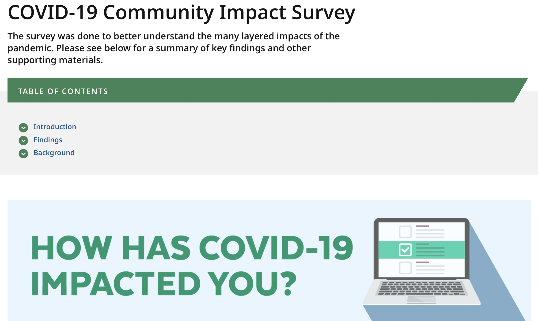
ACCESSING CCIS DATA / ANALYSIS
CCIS Data is posted on its own webpage:
https://www.mass.gov/covidsurvey
On the website you will find:
Complete slide deck of all the CCIS data that has been released to date.
Recorded webinars for each of the chapters released to date
Data tables with CCIS data by MA county, municipality, and demographic groups.
Q&A document with more information about the survey and high-level talking points from each chapter and spotlight.
Interactive dashboard

Slide 59
These innovations also enabled us to create critical change across the Commonwealth

Slide 60
Population-focused
IMPACT
“We have been data poor, relying on limited data sources with small sample sizes. The kids and families we serve have great needs and have been historically unseen & unheard. The CCIS has provided a rich resource for us to make smart, strategic, evidence-based decisions that can make a difference in their lives.”
Prioritized inclusion of previously invisible populations
- CCIS Partner
48% of Parents of Youth and Children with Special Health needs reported persistent poor mental health (vs. 30% of other parents)
Share needs of populations at state-level to inform policy making, in this case elevating need for respite care to be covered by Mass Health

Slide 61
Population-focused
IMPACT
Mass Health is adopting the use of our rural definitions
BMC’s Pediatric ED is utilizing CCIS SDOH questions
MAVEN now uses SOGI data standards
Normalize the inclusion and naming of systemic drivers of inequities (structural racism, heterosexism, ableism) as health priorities among health systems and municipalities conducting needs assessments and improvement planning across the state
Utilized data standards that are granular, inclusive, and reflective of populations’ experiences
Codify equity in other data collection systems

Slide 62
Community Engagement
IMPACT
“Native Americas were once again visible in the data…The fact that CCIS connected the bureau with tribal members to pilot and then took their feedback and brought the data back was so important.”
Prioritized community engagement with historically marginalized communities
- CCIS Partner
Strengthened trust in DPH in communities where there is a history of distrust

Slide 63
Action workgroups
IMPACT
“With CCIS data in mind, VEI prioritized improving vaccine access to people with disabilities. In the disability setting, people got vaccinated who wouldn’t have because of CCIS data.”
Were nimble and shared breaking needs data for prioritization
- CCIS Partner
CCIS illustrated the many unique barriers persons with disabilities face in accessing information and services related to COVID risk mitigation
Initiatives could quickly pivot to meet the needs of priority populations.

Slide 64
Racial & Social Justice Frameworks
IMPACT
Health systems, municipalities and other entities conducting health needs assessments and improvement plans across the state, stated that the CCIS reports provided them with the evidence and framing needed to prioritize these systemic drivers in their health assessments and associated funding allocations.
Normalize the inclusion and naming of systemic drivers of inequities (structural racism, heterosexism, ableism) as health priorities among health systems and municipalities conducting needs assessments and improvement planning across the state
Utilized social justice framing when releasing results that drew linkages between inequities and systemic drivers
Normalize the inclusion and naming of systemic drivers of inequities (structural racism, heterosexism, ableism) as health priorities

Slide 65
We didn’t do everything right and learned some lessons about where we can improve

Slide 66
LESSONS LEARNED
Challenges
Solutions
Time & human resource constraints​
Building a team
In roads with some priority populations
Built relationships, will continue to do so
CBOs stretched thin
Provide financial support where possible
Distilling results into digestible formats
Building communications strategy
Being fully accountable to partners
Consider full spectrum of work & engagement

Slide 67
We are now building on these lessons learned to create a sustainable data system that continues to engage communities, move our work upstream, and center health and racial equity.

Slide 68
VISION FOR CCIS 2.0
Replicate Successes and Incorporate Lessons Learned from CCIS 1.0
Build a sustainable data system centered on racial and health equity to identify and support policy and practice ACTION
Reduce inequities in health outcomes, including outcomes experienced during the pandemic
Strengthen Relationships with Key Partners Using Core Community Engagement Principles

Slide 69
Next Meeting:
May 4, 2022

