Slide 1
Public health council
August 11, 2021
Please standby – the meeting will begin shortly
Today’s presentation is available on the mass.gov/dph website under “Upcoming Events” by clicking on the August 11 Public Health Council listing

Slide 2
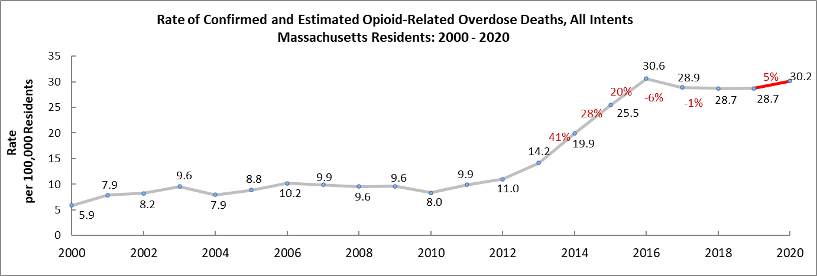

The rate of opioid-related overdose deaths increased 5% in 2020 compared with 2019.
This is 1% lower than the 2016 peak.
Opioid overdose death rates, 2000 – 2020

Slide 3
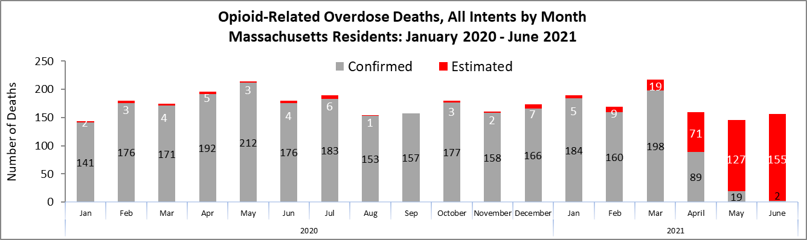
Preliminary data show 1,038 confirmed and estimated opioid-related overdose deaths in the first six months of 2021, an estimated 5% decrease compared with the same period in 2020
Number of deaths, 2020 to Q2 2021
Estimated 1,089 deaths
Estimated 1,038 deaths

Slide 4
Fentanyl remains a key factor in opioid-related overdose deaths (92% present in toxicology screen through Q1 2021).
Toxicology results 2014 through Q1 2021

Slide 5
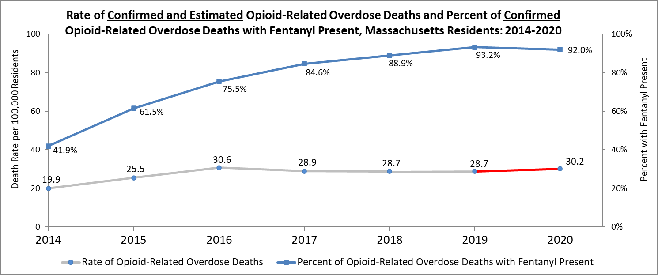
Although the presence of fentanyl in opioid-related overdose deaths continues to rise, the opioid-related overdose death rate has remained relatively stable since 2016
2014-2020 death rate and presence of fentanyl

Slide 6
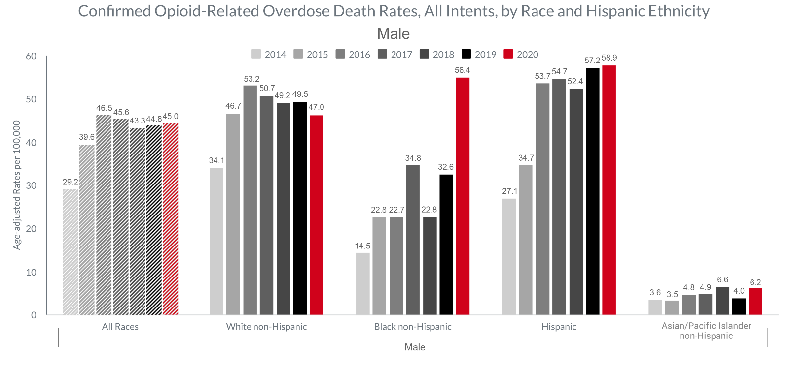
Between 2019 & 2020, the confirmed opioid-related overdose death rates for Black non-Hispanic males increased significantly, while the death rates for White non-Hispanic males decreased.
Male death rates by race, 2014-2020

Slide 7
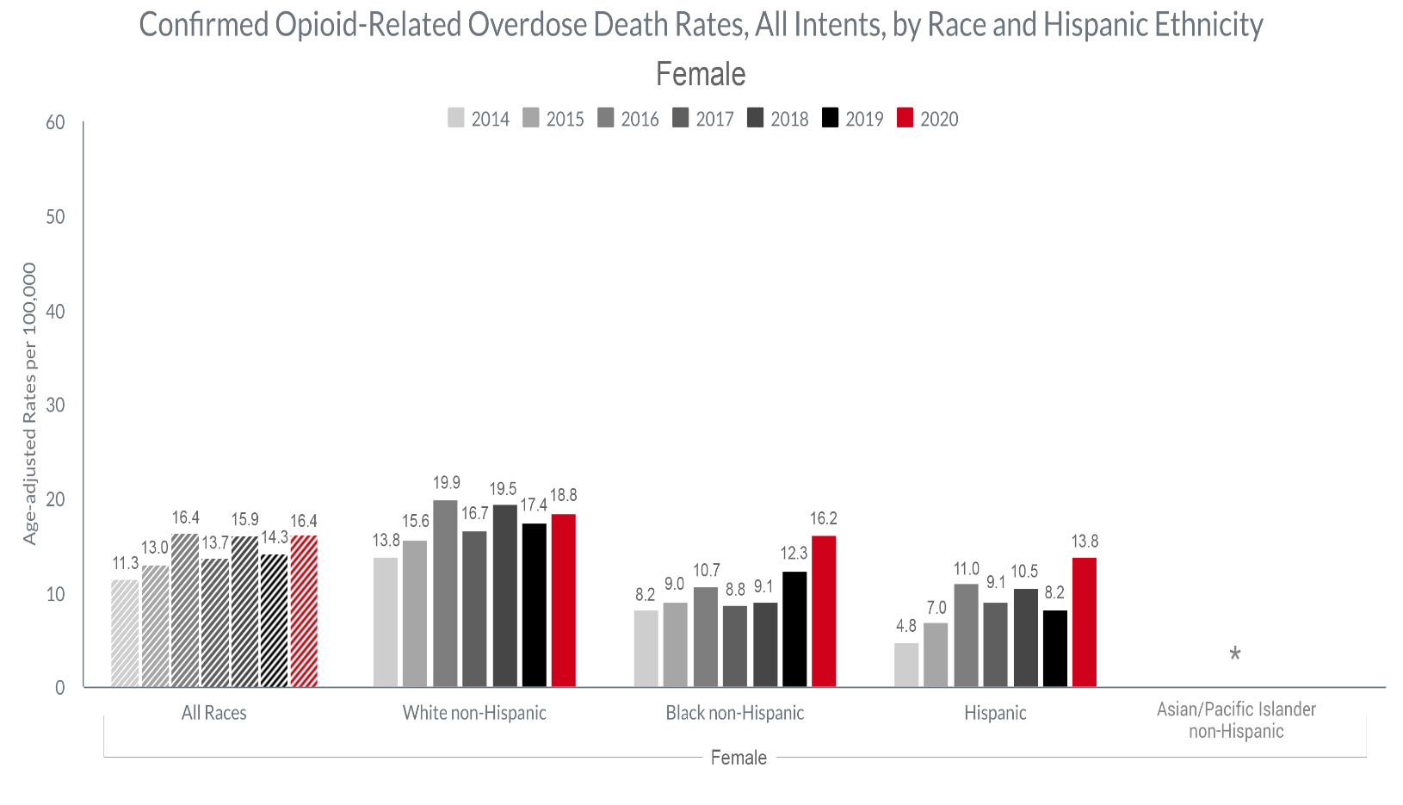
The confirmed opioid-related overdose death rate for females increased in 2020 compared with 2019. Death rate for Black non-Hispanic and Hispanic females increased more than the death rate for White non-Hispanic females.
Female death rates by race, 2014-2020

Slide 8
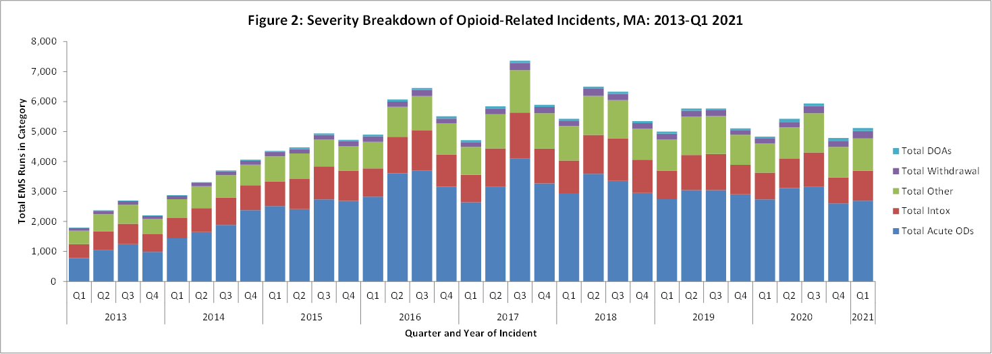
In the first quarter of 2021, 53% of all opioid-related EMS incidents were Acute Opioid Overdoses
Opioid-related EMS incidents 2013- Q1 2021
Naloxone was administered in 96% of these incidents

Slide 9
Proposed Emergency Amendments to 105 CMR 150.000
Standards for Long-Term Care Facilities
Public Health Council
August 11, 2021
Sherman Lohnes, JD, Director
Division of Health Care Facility Licensure and Certification
Bureau of Healthcare Safety and Quality

Slide 10
Summary of Regulation
105 CMR 150.000, Standards for Long-Term Care Facilities:
  Sets forth standards governing long-term care facilities, including nursing homes and rest homes, and
  Provides a legal structure that promotes industry standardization, promotes higher quality of care, and stronger consumer protection for residents in long-term care facilities

Slide 11
Summary of Amendments
On August 4, 2021, the Commissioner of Public Health issued a Public Health Order to require nursing home personnel to be fully vaccinated against COVID-19 by October 10, 2021.
The proposed emergency amendment to this regulation was drafted to adopt the requirements of the Public Health Order in an effort to strengthen infection control in nursing homes and protect vulnerable nursing home residents.

Slide 12
Regulation Changes: COVID-19 Vaccination Requirement
The Department is proposing an emergency amendment to the regulations to require all nursing home personnel be fully vaccinated against COVID-19.
Personnel includes all individuals employed directly or by contract by the nursing home.
Exemptions from vaccination are provided for those personnel with medical restrictions or sincerely held religious beliefs that prevent them from receiving vaccination.
COVID-19 vaccination is the most effective method for preventing infection and serious illness from the virus, and personnel at nursing homes serving vulnerable individuals are critical in efforts to protect nursing home residents.

Slide 13
Regulation Changes: Infuenza Vaccination
For consistency, the Department is also proposing updates to the existing influenza vaccination requirement to align language with the new COVID-19 vaccination requirement.
The proposed amendment amends the language regarding exemptions for personnel with medical restrictions or sincerely held religious beliefs that prevent the personnel from receiving vaccination.

Slide 14
Next Steps
The Department respectfully requests that the Public Health Council vote to approve the proposed regulation, 105 CMR 150.000, on an emergency basis.
This will allow the regulation to take effect upon filing with the Secretary of State’s office while the Department conducts a public comment period.
Final approval of the proposed amendments, along with a review of public comments, will be requested at a subsequent meeting of the Public Health Council.

Slide 15
Thank you for the opportunity to present this information today.
For more information regarding standards for long-term care facilities, please find the relevant statutory language and the full current regulation here:
https://malegislature.gov/Laws/GeneralLaws/PartI/TitleXVI/Chapter111
https://www.mass.gov/doc/105-cmr-150-standards-for-long-term-care-facilities/download

Slide 16
Commonwealth of Massachusetts
Department of Public Health
CONFIDENTIAL/FOR POLICY DELIBERATION
WNV and EEE 2021 UPDATE
August 11, 2021

Slide 17
Human Disease
WNV
  Incubation period 3 to 14 days
  Age-related severity
  80% Mild and sub-clinical infection
  20% Headache, sore throat, fatigue, muscle and joint aches, fever (moderate to high),
  <1% Aseptic meningitis, encephalitis, meningoencephalitis
EEE
  Rare but severe mosquito-borne infection
  Incubation period 3-10 days
  Abrupt onset: fever, chills, headache, muscle aches, nausea and vomiting, seizures, coma
  ~30-50% mortality rate
  ~80% of those who recover have permanent neurological damage
  Children: 10/38 cases (40%) mortality rate; Adults 28/38 cases (60%)
Notes:
17

Slide 18
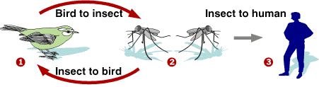
WNV and EEE Transmission Cycles
Enzootic Cycle:
Virus Amplification by Ornithophilic (bird-biting) Mosquitoes
Epizootic Cycle:
Incidental Transmission by Zoophilic (mammal-biting) Mosquitoes
EEEV mosquitoes involved: Culiseta melanura and Coquillettidia perturbans
WNV mosquito involved: Culex pipiens and Culex restuans

Slide 19


Habitats for EEE versus WNV
Eastern equine encephalitis (EEE)
  Red maple/white cedar swamps are source habitat (for birds and mosquitoes)
  Type of habitat most common in SE MA
West Nile virus
  Urban habitats that accumulate small collections of stagnant water are source habitat

Slide 20
Human and Mosquito EEE, 1970-2020

Slide 21
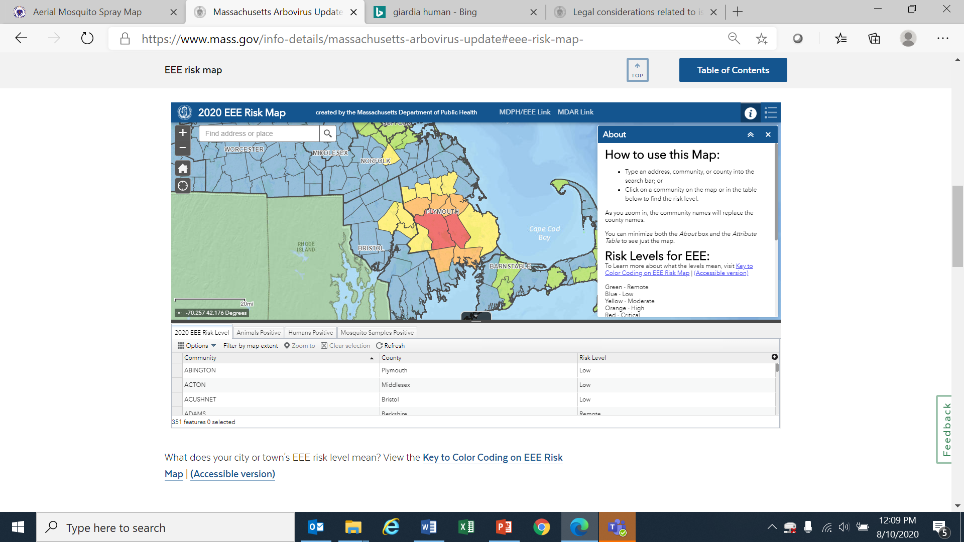
2020 Data
 | Season Total | Total Positive
Number of Mosquito Samples Tested | 7155 | WNV – 97 EEE – 66
Number of Animals Tested | 12 | WNV – 0 EEE – 0
Number of People Tested | 229 | WNV – 8 EEE – 5

Slide 22
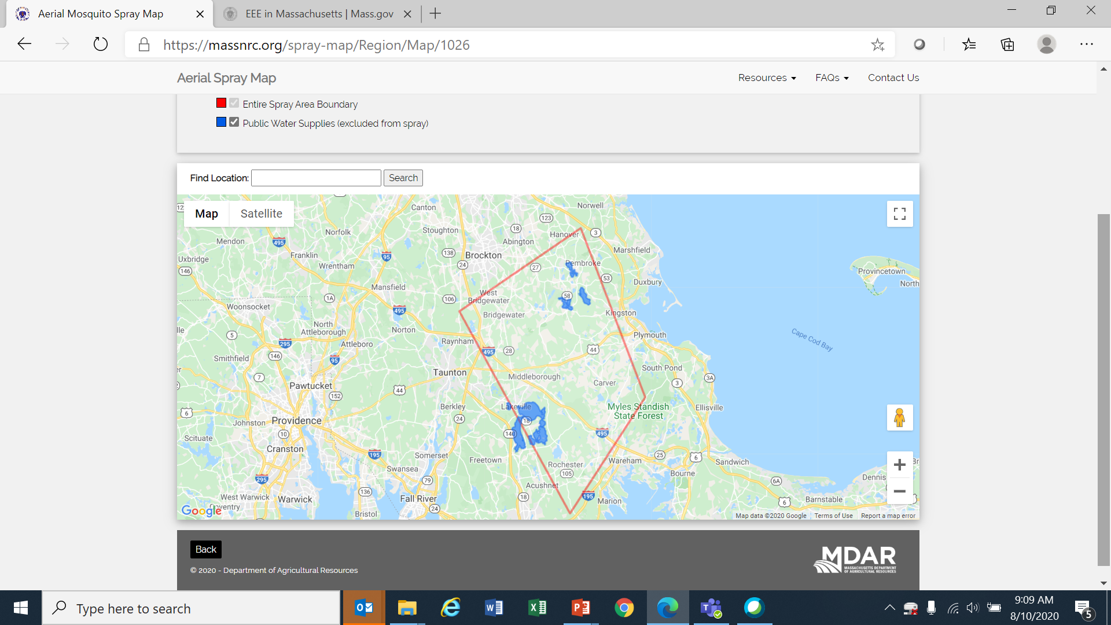
2020 Spray Map
 | % Total Control | % PER Control | % MEL Control
Efficacy | 70.1 | 82.2 | 52.8

Slide 23
Testing To Date

Slide 24
So Far This Year
WNV
  Wet summer weather has increased the Culex mosquito populations
  BUT it is also flushing them out of the catch basins where they breed
  Cool weather slows down mosquito reproductive cycles
EEE
  Was likely to be the third year of EEE outbreak cycle
  Very dry fall and spring may have suppressed mosquito populations
  Cool weather slows down mosquito reproductive cycles

Slide 25
Prevention Tools
Aerial spraying to kill infected adult mosquitoes
Ground spraying to kill infected adult mosquitoes
Limited data from larviciding in EEE environments suggest that it can be an effective tool as part of an Integrated Pest Management control strategy.
Increasing Risk
Frequency of use
-Awareness
-Repellents
-Clothing
-Avoiding peak mosquito activity time

Slide 26

2021 Public Awareness Campaign
  Website: www.mass.gov/mosquitoesandticks
  Press release on summer safety: mosquito/tick safety awareness
  Video assets, TV, paid social media and digital media
  DOT billboards, electronic signs, infographics, printed materials
  Stakeholder-specific calls and factsheets
  Messaging focuses on ticks in June and transitions to mosquitos in late June/July
  Established guidelines for press releases

Slide 27
Arbovirus Press Release Triggers
  First identifications of WNV and EEE in a mosquito
  Any laboratory confirmation of WNV or EEE in a veterinary specimen
  Any laboratory confirmation of a human WNV or EEE case
  Risk assessment level changes (high or critical)
  Aerial spraying operations (per SOP Action Plan)

Slide 28
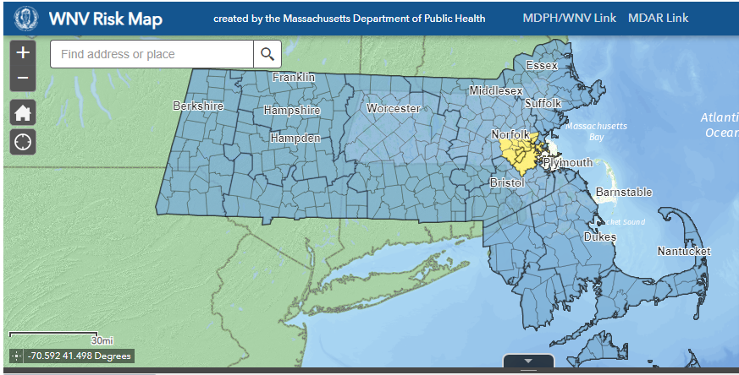
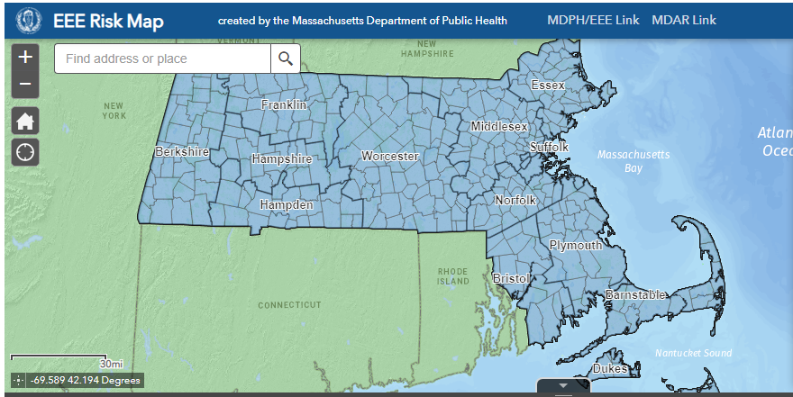
Current Risk Levels
https://www.mass.gov/info-details/massachusetts-arbovirus-update

Slide 29


Questions and Discussion

Slide 30
COVID-19
Community Impact Survey(CCIS)
Preliminary Analysis Results as of
August 11, 2021
Presented by Lauren Cardoso PhD
Massachusetts Department of Public Health
8.11.21 release

Slide 31
CCIS TEAM MEMBERS
CCIS Project Leads
W.W. Sanouri Ursprung, Lauren Cardoso, Beth Beatriz, Glory Song, Caroline Stack, Kathleen Fitzsimmons, Emily Sparer-Fine, Ben Wood, Lisa Bandoian, Heather Nelson, Amy Flynn, Lisa Arsenault, Abby Atkins
CCIS Analytic Team
Beth Beatriz, Glory Song, Caroline Stack, Kathleen Fitzsimmons, Emily Sparer-Fine, Ziming Xuan, Matthew Tumpney, Rebecca Han, Lauren Larochelle, Arielle Coq, Anne Marie Matteucci, Lauren Fogharty, Vera Mouradian, Melody Kingsley, Ta Wei Lin, Anna Agan, Justine Egan, Allison Guarino, Elizabeth Showalter, Beatriz Pazos Vautin, Priyokti Rana, Mayowa Sanusi, Emily Lawson, Alana LeBrón Lauren Cardoso, W.W. Sanouri Ursprung
CCIS Data to Action Workgroup
Jessica del Rosario, Kim Etingoff, Lisa Bandoian, Andrea Mooney, Ben Kingston, Lauren Cardoso; Dawn Fukuda, Lamar Polk, Hermik Babakhanlou-Chase, Glennon Beresin, Mahsa Yazdy, Emily White, Timothy St. Laurent, Fareesa Hasan, Nicole Roos
CCIS Steering Committee
Lauren Cardoso, W.W. Sanouri Ursprung, Beth Beatriz, Abbie Averbach, Ruth Blodgett, Ben Wood, Sabrina Selk, Nicole Daley, Lisa Bandoian
CCIS Data Dissemination Workgroup
Beth Beatriz, Glory Song, Emily Sparer-Fine, Ta Wei Lin, Vera Mouradian, Rebecca Han
8.11.21 release

Slide 32
CCIS COMMUNITY PARTNERS
Many groups that were critical in the success of this effort and gave important input on the development and deployment of the survey:
Academic Public Health Volunteer Corps and their work with local boards of health and on social media
Mass in Motion programs, including Springfield, Malden, and Chelsea
Cambodian Mutual Assistance
The Mashpee Wampanoag Tribe
The Immigrants’ Assistance Center, Inc
Families for Justice as Healing
City of Lawrence Mayor’s Health Task Force
The 84 Coalitions, including the Lawrence/Methuen Coalition
Boys and Girls Clubs, including those in Fitchburg and Leominster and the Metro South area
Chinatown Neighborhood Association
Father Bill’s
UTEC
MassCOSH
Stavros Center for Independent Living
Greater Springfield Senior Services
Center for Living and Working
DEAF, Inc.
Massachusetts Commission for the Deaf and Hard of Hearing
Viability, Inc.
8.11.21 release

Slide 33
OVERVIEW
Purpose and Approach of the Covid-19 Community Impact Survey (CCIS)
Preliminary Findings
  Intimate Partner Violence (IPV)
Appendix
8.11.21 release

Slide 34
PURPOSE AND APPROACH
3.10.21 release

Slide 35











RESULTS TOPICS TO DATE
MITIGATING INDIVIDUAL RISK OF INFECTION
ACCESS TO
TESTING​
ACCESS TO HEALTHCARE​
SOCIAL DETERMINANTS OF HEALTH
MENTAL HEALTH
EMPLOYMENT
SUBSTANCE USE
DISCRIMINATION: & RACE SPOTLIGHTS
SOGI POPULATION SPOTLIGHTS
INTIMATE PARTNER VIOLENCE
PARENTS & FAMILIES
YOUTH SPOTLIGHT
8.11.21 release

Slide 36

SAFETY : INTIMATE
PARTNER VIOLENCE
Vera E. Mouradian, PhD
Caroline Stack, MPH
Lauren Cardoso, PhD
Amy Flynn, MS

Slide 37
DEFINING INTIMATE PARTNER VIOLENCE
Intimate Partner Violence (IPV) refers to a pattern of behaviors that one person in an intimate partner relationship uses against the other person in the relationship to try to establish and maintain power and control.
IPV involves behaviors including, but not limited to:
Physical assaults
Sexual assaults
Controlling behaviors
Verbal and implied threats of non-physical harm
Verbal and implied threats to assault or kill
Stalking behaviors
Other types of psychological and emotional abuse
Financial abuse and exploitation
IPV involves current or former:
Spouses
Romantic partners who live/lived together
Fiances/Fiancees
Dating Partners
8.11.21 release

Slide 38
OPPRESSIVE SYSTEMS CREATE A SOCIAL ENVIRONMENT THAT ENABLES INTIMATE PARTNER VIOLENCE
Layers of oppression make some people more vulnerable to intimate partner violence.
Intimate Partner Violence
Racism
Hetero-sexism
Capitalism
Patriarchy & Sexism
Survivors of color may experience racism when seeking IPV services, preventing them from accessing IPV resources
Beliefs about gender roles influence the behavior of IPV perpetrators (e.g., women should be subservient to men)
IPV services may exclude or not provide appropriate services for LGBTQIA individuals
Partners of LGBTQIA individuals may use heterosexist abuse tactics (e.g., threatening to ‘out’ their partner)
Witnessing IPV as a child may reinforce patriarchal beliefs about the acceptability of male dominance over women/feminine people
The objectification and dehumanization of women/feminine people in media/advertising makes it easier for people to commit violence against women and non-binary people.
Figure 1. Examples of intersections of oppressions with intimate partner violence. Adapted from Virginia Sexual and Domestic Violence Action Alliance, by Virginia Sexual & Domestic Violence Action Alliance, 2019, retrieved from https://www.communitysolutionsva.org/files/How_Oppressive_Systems_Connect-final.pdf.

Slide 39
FRAMING MATTERS
Despite the common belief that survivors of intimate partner violence (IPV) can exercise control over their circumstances, access to social and economic resources affects survivors' ability to attain safety.
There is also a tendency to focus on physical injury as the only impact of IPV, however, IPV also affects mental health and multiple other life domains.
Some groups are at higher risk, but IPV affects people of all backgrounds (genders, races, ethnicities, ages, sexual orientations, disability statuses, educational backgrounds, incomes, etc.).
8.11.21 release

Slide 40
INTIMATE PARTNER VIOLENCE REPORTING PATTERNS
Overall, 2.3%† of adult respondents reported experiencing IPV during the first 6-8 months of the pandemic
“Throughout the past year, our advocates have indicated they are seeing higher levels of dangerousness and potential lethality in the experiences of survivors…noticing more strangulations, brutal assaults, uses of weapons, etc. Clients also appear to have more difficulty accessing services in the early stages of escalation, due to increases in isolation and less time apart from abusive partners.”
- MA IPV Service Provider
Of those adults who reported IPV during Covid-19,
more than 60% reported that it was new or had gotten worse.
This finding is consistent with anecdotal reports
from service providers
† Frequency of respondents reporting IPV during COVID = 572. Effective sample size = 26769.
8.11.21 release

Slide 41
INTIMATE PARTNER VIOLENCE & DEMOGRAPHICS
Some groups may be particularly in need of IPV screening and follow-up support services.
Percent of MA Subpopulations Reporting Experiences of IPV During Covid-19 Pandemic
Experiences of IPV during Covid-19 were reported over 2 to 4x more frequently by respondents identifying as:
LGBQA
Of transgender experience and non-binary gender
Multi-racial nH/nL, American Indian/Alaska Native, Black nH/nL, Asian nH/nL, and Hispanic/Latinx
Having a disability
nH/nL = non-Hispanic/non-Latinx;
American Indian/Alaska Native includes respondents who identify as Hispanic/Latinx. Non-binary gender identity includes respondents identifying as non-binary, genderqueer, and not exclusively male or female. See Appendix for sub-population frequencies.
*Difference is statistically significant at p. < .05
8.11.21 release

Slide 42
INTIMATE PARTNER VIOLENCE & DEMOGRAPHICS (cont.)
Some groups may be particularly in need of IPV screening and follow-up support services.
Percent of MA Subpopulations Reporting Experiences of IPV During Covid-19 Pandemic (cont.)
Experiences of IPV during Covid-19 were reported over 1.5 to 3x more frequently by respondents identifying as:
Residing in Western MA or Suffolk county
Younger
Of lower income
Of lower educational attainment
Speaking a language other than English
*Difference is statistically significant at p. < .05. Response categories for which differences were not statistically significant are not represented in graph. See Appendix sub-population frequencies.
8.11.21 release

Slide 43
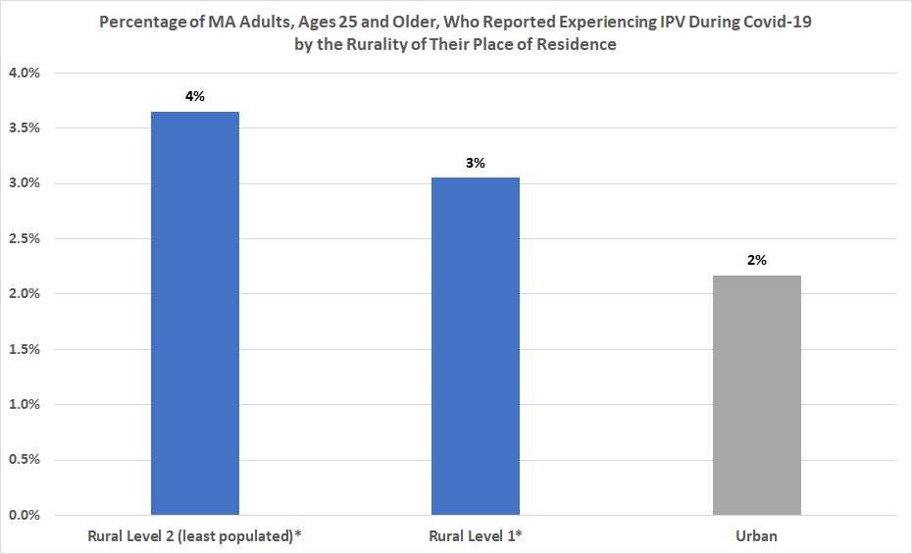
INTIMATE PARTNER VIOLENCE & RURALITY
Residents in rural areas† were more likely than residents in urban areas to report having experienced IPV in the first 6-8 months of the pandemic suggesting that tailored solutions are needed to address
structural barriers, based on where people live.
Adult residents in rural areas of Massachusetts† were more likely than adult residents in urban areas to report having experienced IPV in the first 6-8 months of the COVID-19 pandemic. suggesting that tailored solutions are needed to address structural barriers, based on where people live.
†City-town groupings were based on the MA State Office of Rural Health's MA rural designations.
Rural definitions are available at: https://www.mass.gov/doc/rural-definition-detail-0/download. Towns in level two are less densely populated and more remote and isolated from urban core areas than are towns in level one, but both are considered rural.
*Difference is statistically significant at p. < .05. See Appendix for sub-population frequencies.
8.11.21 release

Slide 44
Survivors had needs over and above other adults in multiple domains and these needs shape their vulnerability to violence.
IPV AND BASIC NEEDS ARE INTERCONNECTED
Intimate Partner Violence
Basic Needs
Mental Health
Employment
Housing
Healthcare Access
Violence Support Services
Figure 2. Interconnection of Intimate Partner Violence and Basic Needs: Adapted from MN Department of Health, by Child and Family Health Division, Minnesota Department of Health, 2019, Retrieved from https://www.health.state.mn.us/docs/communities/titlev/cultsafety.pdf.

Slide 45
ONLINE SAFETY SUPPORTS REQUESTED BY IPV SURVIVORS
People who reported experiencing IPV during Covid-19 wanted not just IPV survivor services, but also support for other types of abuse.
Reaching Survivors with Resources
Almost 1 in 4 (22%) survivors who experienced IPV during Covid-19‡ identified social media as a top source for obtaining Covid-19 information –1.5x the percentage of people who did not report experiencing IPV during Covid-19.
... reinforcing the need for tailored outreach to IPV survivors around health information and safety support resources.
‡ Percentage denominator reflects question respondents reporting IPV during COVID-19 (n = 119).
*Difference is statistically significant at p. < .05.
† Percentages are out of question respondents reporting IPV during COVID-19 (n = 572 ) and reporting no IPV During COVID-19 (n = 26197 ).
8.11.21 release

Slide 46
CHANGES IN EMPLOYMENT & IPV
MA adults who reported experiencing IPV during Covid-19 were more likely than those who did not to report changes in employment during the same time period that adversely affected their personal and household income.
More than 1 in 10 MA survivors of IPV during Covid-19 reported losing a job
Nearly 1 in 4 MA survivors of IPV had a reduction in
work hours or had to take a leave of absence
The lack of stable, independent financial resources is a known barrier to leaving an abusive relationship.
AND more than 1 in 3 MA adult survivors of IPV during Covid-19 who were parents and who experienced a change in employment status or nature of work† had to make this change due to childcare needs
… reminding us that IPV and income insecurity also affect children
†MA adult survivors of IPV during COVID-19 who were parents and experienced a change in employment status or nature of work: n = 236.
8.11.21 release

Slide 47

HOUSING STABILITY & IPV
People who reported experiencing IPV during Covid-19 were more likely than those who did not to also report worries about housing expenses* and needing to move soon*.
“Facing homelessness is one of our primary calls. Many of the people we provide services to have experienced job loss or they have been furloughed, exacerbating their financial insecurity. Many of those we provide services to have to sneak out of their homes or hide in a closet to call for assistance because the abuser is living with them.... It is much more dangerous [now] for many of those we serve.”
Survivors were 3x as likely to report being worried about needing to move in the next few weeks
Not having a safe place to go is a known barrier to leaving an abusive relationship.
…And 7X as likely to report being worried about needing to move because of conflict with roommates/family or because of experiencing abuse at home.
*Difference is statistically significant at p. < .05. Comparisons are to those who did not report experiencing IPV during Covid-19.
8.11.21 release

Slide 48
BASIC NEEDS & WORRIES ABOUT EXPENSES
MA adults who reported experiencing IPV during COVID-19 were more likely than those who hadn’t to report worry about paying multiple expenses, attaining a range of basic needs, and information on their rights.
Survivors of IPV during COVID-19 were more likely than those who hadn’t experienced IPV during COVID-19 to report worry about:
Housing*, utilities*, debt*, vehicles*, insurance*, and school tuition/daycare* expenses
Household*, medical/healthcare*, technology*, and childcare* needs
Survivors of IPV during COVID-19 were 2-11x as likely as those who hadn’t experienced IPV during COVID-19 to request information regarding:
Benefits/help applying for them (40%*)
Employee rights (37%*)
Renter/tenant rights (23%)
Emergency childcare services (18%*)
Goods/services for people with disabilities (14%*)
Immigrant rights (6%*)
Indigenous person rights (5%*)
Translation services to obtain goods and services (4%*)
*Difference is statistically significant at p. < .05
† Percentages are out of question respondents reporting IPV During COVID (n = 572).
8.11.21 release

Slide 49
BASIC NEEDS & WORRIES ABOUT EXPENSES: DISPARATE IMPACTS
Some survivors were more likely to report worry about expenses and basic needs than others.
Out of respondents reporting IPV during Covid-19, respondents identifying as:
Women*, Non-binary gender*
Parents*
Having a cognitive*, mobility*, and/or self-care/individual-living disability*
Younger*
Of lower income*
...were more likely to report worry about at least one expense.†
*Difference is statistically significant at p. < .05
† As compared to 1) men; 2) non-parents; 3) no cognitive, no mobility, no self-care/ind. Living disability; 4) age 65+; 5) income of $150k+.
8.11.21 release

Slide 50
MENTAL HEALTH & IPV
IPV survivors 2x as likely to report experiencing poor mental health as adults who did not report experiencing IPV
      Survivors of IPV during Covid-19 were more likely to report:
      15+ Days of Poor Mental Health* (61% vs. 32%)
      3+ Symptoms consistent with PTSD†* (49% vs. 25%)
†Attributed to experiences with Covid-19. *Difference is statistically significant at p < .05.
Note: Percentages are out of question respondents reporting IPV During COVID (n = 572) and reporting no IPV During COVID (n = 26197).
8.11.21 release

Slide 51
MENTAL HEALTH & IPV
Adults who reported experiencing IPV during the pandemic were 5x as likely to report needing suicide prevention and crisis resources as adults who did not report experiencing IPV during this time period.*
*7.8% vs. 1.4%: This difference is statistically significant at p < .05.
Note: Percentages are out of question respondents reporting IPV During COVID (n = 572) and reporting no IPV During COVID (n = 26197).
8.11.21 release

Slide 52
MENTAL HEALTH & IPV
IPV survivors were more likely to report needing certain mental health services, including
support accessed via digital means.
The top 6 mental health resources survivors of IPV during Covid-19 identified as of potential help:
Meeting in-person with a mental health professional for individual or group mental health therapy* (30%)
Talking to a mental health professional via video chat* (29%)
Using an app on a cell phone or tablet to obtain mental health support* (25%)
Talking to a mental health professional over the telephone* (24%)
Information on seeing a therapist* (24%)
Attending a support group via an on-line platform* (19%)
*Difference from those not reporting IPV during Covid-19 is statistically significant at p < .05.
Note: Percentages are out of question respondents reporting IPV During COVID (n =572).
8.11.21 release

Slide 53
DELAYS IN HEALTHCARE & IPV
MA adults who reported experiencing IPV during Covid-19 were more likely than those who did not to also report experiencing delays in medical and/or mental health care.*
The reasons for these delays were more likely to be structural among IPV survivors
The top reasons for delays in healthcare among Survivors of IPV During Covid-19 were:
1) Appointment cancellations, delays, and long wait times | 55%
2) Worry about catching Covid-19 by seeing a doctor in person | 22%
3) No private place for a phone call or video chat* | 11%*
4) No safe transportation to get to appointment* | 11%*
5) No phone, tablet, or computer, or poor phone and/or internet connection* | 10%*
6) Worried about cost of care or insurance coverage for care* | 6%*
7) No accommodations for people who have trouble seeing or are hard of hearing* | 4%*
3.7x
2.7x
Higher than those who did not report experiencing IPV during Covid-19
3.3x
1.8x
6.0x
*Differences were statistically significant at p < 0.05 level. Note: Percentages are out of question respondents reporting IPV During COVID and delays in healthcare (n = 141) and question respondents reporting no IPV during COVID and delays in healthcare (n = 3546).
8.11.21 release

Slide 54
KEY TAKEAWAYS
IPV survivors were more likely to experience:
  Job loss, reduction in work hours, and the need to take leave
  Concerns about housing stability, paying expenses, and meeting basic needs
  Poor mental health AND face structural barriers to accessing needed healthcare
Lack of social and economic resources and access to care both exacerbate the impacts of IPV and make survivors more vulnerable to further abuse
Continuing digital outreach and service provision approaches may expand access to resources for survivors in the context of a pandemic and after; access to technology and broadband is critical
8.11.21 release

Slide 55
NEED IPV OR SEXUAL VIOLENCE RESOURCES?
Call SafeLink, the MA statewide toll-free domestic violence hotline: (877) 785-2020
Deaf and hard-of-hearing callers can reach SafeLink via video relay service using the main number (877) 785-2020, or by TTY at (877) 521-2601.
Or, visit https://www.mass.gov/sexual-and-domestic-violence-prevention-and-services for the contact information of agencies who serve:
Sexual assault and rape survivors (Rape Crisis Centers)
Domestic violence/IPV survivors and their children (through a variety of service models)
People who abuse their intimate partners (MA-certified Intimate Partner Abuse Education Programs)
8.11.21 release

Slide 56
APPENDIX
8.11.21 release

Slide 57






CCIS DOMAINS
PERCEPTIONS & EXPERIENCES OF COVID-19
Concern, access to testing, ability to social distance
DEMOGRAPHICS
Age, geography, gender, race, ethnicity, sexual orientation, disability status, education, income
BASIC NEEDS
Access to goods, services, information, social safety nets
ACCESS TO HEALTHCARE
Healthcare needs, types of care, barriers to care
SAFETY
Intimate partner violence, discrimination
SUBSTANCE USE
Change in use, resource needs
MENTAL HEALTH
Trauma, other mental health challenges, resource needs
EMPLOYMENT
Changes in employment, barriers to employment, ability to work from home, access to protections
8.11.21 release

Slide 58
Survey Questions
Demographics
What city or town do you live in?
How many people - adults and children - currently live with you, including yourself?
How many people who are over 60 years old currently live with you, including yourself?
Are you a caretaker of an adult(s) with special needs in your household?
Are you a parent/guardian of a child or youth with special health care needs?
Please select all that apply to you: I am deaf or hard of hearing. I am blind or I have trouble seeing even when I am wearing glasses. I have trouble concentrating, remembering, or making decisions because of a physical, mental, or emotional condition. I have trouble walking or climbing stairs. I have trouble getting dressed or taking a bath or shower. I have difficulty doing errands alone such as visiting a doctor's office or shopping. None of the above apply to me.
Were you pregnant during the COVID-19 outbreak or did you give birth since February 2020?
When did you give birth?
After the start of the COVID-19 outbreak, did your birth plans change?
What is the highest grade or year of school you have finished?
In 2019, what was your total annual household income before taxes?
Have you ever been sentenced to stay overnight or longer in any type of corrections institution? Examples include a jail or prison.
What is your sexual orientation?
What is your current gender identity?
Are you transgender or of transgender experience?
Are you Hispanic or Latino?
8.11.21 release

Slide 59
Survey Questions
Demographics
Perceptions & Experiences of COVID-19
What is your race? Select all that apply.
What is your ethnicity? Select all that apply.
(For English Survey) Do you speak language(s) other than English at home?
Which language(s) do you speak at home?
(For Non-English Surveys) How well do you speak English?
Do you agree or disagree with the following statements? My community is receiving adequate support to: Prevent the spread of COVID-19 Protect workers from COVID-19 Ensure medical facilities have the capacity to treat everyone who is sick or injured? Help people who have lost income Help businesses recover
Have you had fever and/or cough or shortness of breath and/or muscle aches or loss of sense of taste or smell in the last 30 days?
Did you ever get tested for COVID-19?
Why didn't you get tested? Select all that apply.
Have you or anyone you know tested positive for COVID-19? Select all that apply.
Has someone close to you died from COVID-19?
Perceptions & Experiences of COVID-19
How worried are you about getting infected with COVID-19 in Massachusetts?
Please select the two sources that you go to for the most reliable and up-to-date information about COVID-19.
When you are outside of the home are you able to keep 6 feet between yourself and others?
Why not? Check all that apply
8.11.21 release

Slide 60
Survey Questions
Healthcare Access
Basic Needs
Do you currently have any of the following health conditions? Select all that apply.
Since July 1, 2020, what has been your experience with trying to see a doctor, counselor or another medical professional? Select all that apply.
For the care you did not get, why did you want to see a doctor or counselor at that time? Select all that apply.
What type(s) of regular care or check-up did you need at that time? Select all that apply.
What condition(s) did you need emergency or urgent care for at the time? Select all that apply
Why were you not able to get care at the time? Select all that apply.
What type(s) of health insurance do you currently have? Select all that apply.
Has your health insurance changed since the COVID-19 outbreak?
Which of the following basic needs are you worried about getting for you and your family? This could be now or in the next couple of weeks. Select all that apply. Household Items Healthcare and medication Technology Childcare supplies Other
Which of these would be helpful to you right now? Select all that apply. (Food, help getting benefits, knowledge about rights, accessible services – translation, disability, childcare, other)
Which types of expenses or bills are you most worried about paying in the next few weeks?
Are you worried about any of these that will require you to move out of where you live in the next few months? Select all that apply
Have you applied to any of these financial supports since the beginning of the COVID-19 outbreak? What is the status of your application?
8.11.21 release

Slide 61
Survey Questions
Mental Health
Substance Use
Now thinking about your mental health, which includes stress, depression, and problems with emotions, on how many days during the past 30 days was your mental health not good?
In the past month, have you had three or more of the following reactions to things you’ve seen, heard, or experienced related to the COVID-19 outbreak: Had nightmares or thought about it when you did not want to? Tried not to think about it or went out of your way to avoid situations that reminded you of it? Been constantly on guard, watchful, or easily startled? Felt numb or detached from people, activities, or your surroundings? Felt guilty or unable to stop blaming yourself or others for it or any problems it may have caused?
Which of these resources would be most helpful to you right now to help you with your mental health and well-being? Select all that apply.
During the past 30 days, have you used any of the following products Select all that apply.
Compared to before the COVID-19 outbreak (February 2020), how often are you using these products now?
Which of the following resources would be most helpful to you right now? Select all that apply.
Employment/Income
Which of the following best describes your current work situation? (Employed, Retired, unemployed, furloughed, etc.)
What kind of work do/did you do? For example, registered nurse, janitor, cashier, auto mechanic. If you have more than one job, please answer for your primary job.
What kind of business do you work in? For example, hospital, elementary school, manufacturing, restaurant. If you have more than one job, please answer for your primary job.
8.11.21 release

Slide 62
Survey Questions
Employment/Income
Safety
Has your employer given you any of the following to protect you against COVID-19? Select all that apply.
If you are currently working, do you have paid sick leave you can use through your employer?
Was your employment status or the nature of your work changed in any of the following ways due to COVID-19? Select all that apply.
Why did your employment status or the nature of your work change? Select all that apply
Since COVID-19 began (March 10, 2020), has someone you were dating or married to physically hurt you? (i.e. being shoved, slapped, hit, kicked, punched, strangled, forced into sexual activity, or anything that could have caused an injury)
Since COVID-19 began (March 10, 2020), has someone you were dating or married to done any of the following: monitored your cell phone, called or texted you a lot to ask where you were, stopped you from doing things with friends, been angry if you were talking to someone else, or prevented you from going to school or work (including remotely)?
For which of the following topics would online support be most helpful to you or someone you know right now? Please select all that apply:
Discrimination can refer to harmful words and behaviors aimed at you because of your race or ethnicity. Since the COVID-19 outbreak began (March 10, 2020), have you experienced any form of discrimination because of your race or ethnicity?
In what way(s) did you experience discrimination?
8.11.21 release

Slide 63
Recruitment among priority populations was unprecedented
Priority Populations | 2018 MA BRFSS | 2020 CCIS Final Sample | Magnitude of Difference
Overall sample | 6,669 | 33,948 | 5X
Race/Ethnicity
Hispanic | 522 | 2,506 | 5X
Black NH | 365 | 1,162 | 3X
Asian NH | 248 | 1,188 | 5X
Amer. Ind/Alaska Nat | 35 | 351 | 10X
Disability Status
Deaf/Hard of hearing | 427 | 922 | 2X
Blind/Hard to see | 258 | 236 | On par
Lesbian, Gay, Bisexual + | 359 | 3,931 | 10X
Non-English Speakers | 158 (in 2 languages) | 829 (in 8 languages) | 5X
This number of responses will enable us to conduct the critical subanalysis needed to understand the specific needs and experiences of these groups and to prioritize our deployment of resources to address them.
8.11.21 release

Slide 64
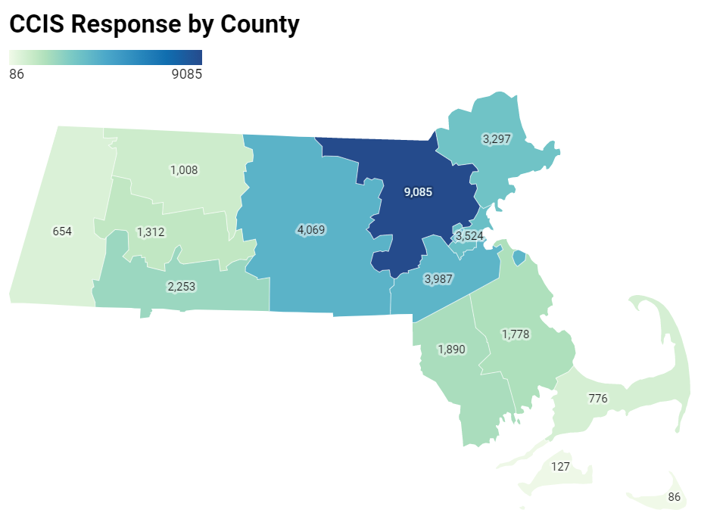
Recruitment efforts were overwhelmingly successful
For example, more people responded from western and central MA alone, than in the entire 2019 BRFSS statewide sample.
8.11.21 release

Slide 65
Demographics of the sample
 | Demographics | Freq. | Percent
Sexual Orientation | Asexual | 646 | 1.92
 | Bisexual | 1,252 | 3.73
 | Gay/Lesbian | 1,352 | 4.03
 | Heterosexual | 29,231 | 84.08
 | Queer | 464 | 1.38
 | Questioning | 217 | 0.65
 | Other/DK/refuse | 1,414 | 4.21
Disability Status | Deaf/Hard to hear | 920 | 2.72
 | Blind/With vision impairement | 233 | 0.69
 | Cognitive disability | 1,588 | 4.70
 | Mobility disability | 1,622 | 4.80
 | Self-care/Independent living disability | 912 | 2.70
Income | <$35K | 3,961 | 12.54
 | $35-74,999K | 7,163 | 22.67
 | $75-99,999K | 4,532 | 14.34
 | $100-149,999K | 6,851 | 21.68
 | $150K+ | 9,089 | 28.77
Education | Less than HS | 446 | 1.32
 | High school or GED | 2,279 | 6.73
 | Trade /Vocational | 905 | 2.67
 | Some college | 2,798 | 8.26
 | Associates degree | 2,484 | 7.33
 | Bachelor's degree | 10,635 | 31.39
 | Graduate degree | 14,338 | 42.31
 | Demographics | Freq. | Percent
Age | <25* | 148 | 0.44
 | 25-35 | 6,726 | 19.81
 | 36-49 | 11,785 | 34.71
 | 50-64 | 10,012 | 29.49
 | 65+ | 5,277 | 15.54
Race/Ethnicity | Am Indian/Alaska Native | 351 | 1.03
 | Hispanic/Latinx | 2,506 | 7.38
 | Multiracial, nH/nL | 475 | 1.40
 | Asian/Pacific Islander, nH/nL | 1,188 | 3.50
 | Black, nH/nL | 1,162 | 3.42
 | White, nH/nL | 27,605 | 81.32
 | Unknown/Other | 661 | 1.95
Gender | Male | 6,520 | 19.21
 | Female | 26,518 | 78.11
 | Non-Binary | 392 | 1.15
 | Prefer not to answer | 518 | 1.53
Transgender Identity | Of transgender experience | 245 | 0.73
 | Not of transgender experience | 32,500 | 96.29
 | Not sure/Dont know/refused | 1,007 | 2.98
Survey Lang. | English | 33,119 | 97.56
 | Other | 829 | 2.44
Notes: numbers in this table are unweighted. Subsequent analyses were weighted to the state average
nH/nL = non-Hispanic/non-Latinx; ​
American Indian/Alaska Native includes respondents who identify as Hispanic/Latinx​
Questioning/undecided/non-binary gender identity includes respondents identifying as non-binary, genderqueer, not exclusively male or female, and questioning/unsure of their gender identity
8.11.21 release

Slide 66
Demographics of the CCIS Black sample
 | Demographics | Freq. | Percent
Speak Language other than English | English | 808 | 70%
 | Languages other than English | 342 | 30%
Disability Status | Deaf/Hard of hearing​ | 8 | 1%
 | Blind/ People with vision impairment​ | 11 | 1%
 | Cognitive disability​ | 65 | 6%
 | Mobility disability​ | 74 | 6%
 | Self-care/ Independent-living disability​ | 35 | 3%
Income | <$35K | 248 | 23%
 | $35-74,999K | 430 | 39%
 | $75-99,999K | 156 | 14%
 | $100-149,999K | 148 | 14%
 | $150K+ | 110 | 10%
Education | Less than HS | 21 | 2%
 | High school or GED | 118 | 10%
 | Trade /Vocational | 53 | 5%
 | Some college | 160 | 14%
 | Associates degree | 114 | 10%
 | Bachelor's degree | 343 | 30%
 | Graduate degree | 342 | 30%
 | Demographics | Freq. | Percent
Counties | Barnstable | 9 | 1%
 | Berkshire | 11 | 1%
 | Bristol | 47 | 4%
 | Dukes | * | *
 | Essex | 56 | 5%
 | Franklin | * | *
 | Hampden | 115 | 10%
 | Hampshire | 14 | 1%
Survey Lang. | Middlesex | 179 | 16%
 | Nantucket | * | *
 | Norfolk | 151 | 13%
 | Plymouth | 99 | 9%
 | Suffolk | 403 | 35%
 | Worcester | 57 | 5%
 | Demographics | Freq. | Percent
Age | 25-34 | 261 | 23%
 | 35-44 | 314 | 27%
 | 45-64 | 477 | 41%
 | 65+ | 101 | 9%
Gender | Male | 199 | 17%
 | Female | 931 | 81%
 | Non-Binary | * | *
 | Prefer not to answer | * | *
Transgender Identity | Transgender | 6 | 1%
 | Not Transgender | 1108 | 97%
 | Not sure/DK/refuse | 33 | 3%
Sexual Orientation | Asexual | 36 | 3%
 | Bisexual | 45 | 4%
 | Gay/Lesbian | 30 | 3%
 | Heterosexual | 925 | 82%
 | Queer | 14 | 1%
 | Questioning | 8 | 1%
 | Other/DK/refuse | 72 | 6%
8.11.21 release

Slide 67
Demographics of the CCIS Hispanic/Latinx sample (n=2432)
 | Demographics | Freq. | Percent
Speak Language other than English | English | 552 | 18%
 | Languages other than English | 1875 | 82%
Disability Status | Deaf/Hard of hearing​ | 34 | 2%
 | Blind/ People with vision impairment​ | 24 | 1%
 | Cognitive disability​ | 171 | 8%
 | Mobility disability​ | 105 | 6%
 | Self-care/ Independent-living disability​ | 81 | 4%
Income | <$35K | 755 | 46%
 | $35-74,999K | 755 | 33%
 | $75-99,999K | 226 | 7%
 | $100-149,999K | 269 | 8%
 | $150K+ | 278 | 6%
Education | Less than HS | 172 | 11%
 | High school or GED | 384 | 24%
 | Trade /Vocational | 107 | 7%
 | Some college | 359 | 22%
 | Associates degree | 245 | 15%
 | Bachelor's degree | 593 | 14%
 | Graduate degree | 560 | 8%
 | Demographics | Freq. | Percent
Age | 25-34 | 695 | 37%
 | 35-44 | 791 | 24%
 | 45-64 | 853 | 33%
 | 65+ | 93 | 7%
Gender | Male | 373 | 16%
 | Female | 2001 | 82%
 | Non-Binary | 21 | 1%
 | Q/Not Sure/Oth/DU | 10 | <1%
 | Prefer not to answer | 27 | <1%
Transgender Identity | Transgender | 18 | 1%
 | Not Transgender | 2290 | 95%
 | Not sure/DK/PNTA | 98 | 5%
Sexual Orientation | Asexual | 73 | 3%
 | Bisexual | 80 | 3%
 | Gay/Lesbian | 74 | 3%
 | Heterosexual | 1919 | 78%
 | Queer | 25 | 1%
 | Questioning/NS | 16 | 1%
 | Other/DU/PNTA | 124 | 11%
 | Demographics | Freq. | Percent
Counties | Barnstable | 20 | 1%
 | Berkshire | 42 | 2%
 | Bristol | 63 | 3%
 | Dukes | * | *
 | Essex | 461 | 20%
 | Franklin | 18 | 1%
 | Hampden | 430 | 21%
 | Hampshire | 29 | 1%
Survey Lang. | Middlesex | 465 | 16%
 | Nantucket | * | *
 | Norfolk | 184 | 6%
 | Plymouth | 62 | 2%
 | Suffolk | 451 | 19%
 | Worcester | 221 | 7%
8.11.21 release

Slide 68
Demographics of the CCIS Hispanic/Latinx sample (n=2432), continued
 | Demographics | Freq. | Percent
Industry | Construction | 17 | 2%
 | Manufacturing | 59 | 5%
 | Retail | 47 | 4%
 | Transportation & Warehousing | 18 | 2%
 | Information | 10 | <1%
 | Finance & Insurance | 49 | 3%
 | Real Estate & Rental & Leasing | 16 | 1%
 | Professional, Scientific & Technical Services | 53 | 3%
Survey Lang. | Admin & Support & Waste Management & Remediation Services | 29 | 3%
 | Education Services | 211 | 12%
 | Healthcare | 372 | 26%
 | Social Assistance | 228 | 17%
 | Arts, Entertainment, & Recreation | 11 | 1%
 | Accommodation & Food Services | 51 | 5%
 | Other Services | 142 | 10%
 | Public Administration | 105 | 6%
 | Other Industries | 12 | 1%
8.11.21 release

Slide 69
Demographics of the CCIS AAPI sample
 | Demographics | Freq. | Percent
Speak Language other than English | English | 398 | 34%
 | Languages other than English | 785 | 66%
Disability Status | Deaf/Hard of hearing​ | 20 | 2%
 | Blind/ People with vision impairment​ | * | *
 | Cognitive disability​ | 37 | 3%
 | Mobility disability​ | 21 | 2%
 | Self-care/ Independent-living disability​ | 26 | 2%
Income | <$35K | 149 | 14%
 | $35-74,999K | 228 | 21%
 | $75-99,999K | 127 | 12%
 | $100-149,999K | 215 | 20%
 | $150K+ | 354 | 33%
Education | Less than HS | 30 | 3%
 | High school or GED | 62 | 5%
 | Trade /Vocational | 14 | 1%
 | Some college | 32 | 3%
 | Associates degree | 39 | 3%
 | Bachelor's degree | 376 | 32%
 | Graduate degree | 629 | 53%
 | Demographics | Freq. | Percent
Counties | Barnstable | * | *
 | Berkshire | 6 | <1%
 | Bristol | 12 | 1%
 | Essex | 45 | 4%
 | Franklin | 7 | <1%
 | Hampden | 29 | 2%
 | Hampshire | 12 | 1%
Survey Lang. | Middlesex | 467 | 40%
 | Norfolk | 171 | 14%
 | Plymouth | 16 | 1%
 | Suffolk | 191 | 16%
 | Worcester | 221 | 19%
 | Demographics | Freq. | Percent
Age | 25-34 | 347 | 29%
 | 35-44 | 395 | 33%
 | 45-64 | 375 | 32%
 | 65+ | 66 | 6%
Gender | Male | 317 | 27%
 | Female | 840 | 71%
 | Non-Binary | 12 | 1%
 | Prefer not to answer | 11 | 1%
Transgender Identity | Transgender | 7 | 1%
 | Not Transgender | 1103 | 94%
 | Not sure/DK/refuse | 68 | 6%
Sexual Orientation | Asexual | 29 | 2%
 | Bisexual | 42 | 4%
 | Gay/Lesbian | 25 | 2%
 | Heterosexual | 924 | 79%
 | Queer | 14 | 1%
 | Questioning | 13 | 1%
 | Other/DK/refuse | 124 | 11%
8.11.21 release

Slide 70
YOUTH SAMPLE
 | Population | Sample Size
 | Total | 3052
Race/ Ethnicity | American Indian/Alaska Native | 63
 | Asian, nH/nL | 278
 | Black, nH/nL | 221
 | Hispanic/Latinx | 675
 | Multiracial, nH/nL | 104
 | Other, nH/nL | 44
 | White, nH/nL | 1608
Age | <18 | 1400
 | 18+ | 1652
Geography | Rural | 203
 | Urban | 2785
 | Population | Sample Size
Sexual Orientation | Asexual | 71
Race/Ethnicity | Bisexual and/or Pansexual | 445
 | Gay or Lesbian | 175
 | Straight (Heterosexual) | 2023
 | Queer | 81
 | Questioning | 137
 | Other; Don’t understand; prefer not answer | 101
Transgender | Of transgender experience | 103
 | Not of transgender exp. | 2816
 | Population | Sample Size
Disability | Deaf/hard of hearing | 24
Race/Ethnicity | Blind/ vision impairment | 44
 | Cognitive disability | 414
 | Mobility disability | 40
 | Self-care/independent living disability | 133
Working/ employed youth | Yes | 1190
 | No | 1318
Young parents | Yes | 148
 | No | 2904
Gender Identity | Male only | 789
 | Female only | 2059
 | Non-binary | 128
 | Questioning | 31
 | Other | 36
Note: May not sum to total due to missing data for some questions.
Includes respondents under the age of 25 (both from youth survey and young parents who took the adult survey)
Language | English only | 2056
 | Speaks lang other than Eng. | 991
8.11.21 release

Slide 71
Demographics of the CCIS AAPI sample
 | Demographics | Freq. | Percent
Speak Language other than English | English | 398 | 34%
 | Languages other than English | 785 | 66%
Disability Status | Deaf/Hard of hearing​ | 20 | 2%
 | Blind/ People with vision impairment​ | * | *
 | Cognitive disability​ | 37 | 3%
 | Mobility disability​ | 21 | 2%
 | Self-care/ Independent-living disability​ | 26 | 2%
Income | <$35K | 149 | 14%
 | $35-74,999K | 228 | 21%
 | $75-99,999K | 127 | 12%
 | $100-149,999K | 215 | 20%
 | $150K+ | 354 | 33%
Education | Less than HS | 30 | 3%
 | High school or GED | 62 | 5%
 | Trade /Vocational | 14 | 1%
 | Some college | 32 | 3%
 | Associates degree | 39 | 3%
 | Bachelor's degree | 376 | 32%
 | Graduate degree | 629 | 53%
 | Demographics | Freq. | Percent
Counties | Barnstable | * | *
 | Berkshire | 6 | <1%
 | Bristol | 12 | 1%
 | Essex | 45 | 4%
 | Franklin | 7 | <1%
 | Hampden | 29 | 2%
 | Hampshire | 12 | 1%
Survey Lang. | Middlesex | 467 | 40%
 | Norfolk | 171 | 14%
 | Plymouth | 16 | 1%
 | Suffolk | 191 | 16%
 | Worcester | 221 | 19%
 | Demographics | Freq. | Percent
Age | 25-34 | 347 | 29%
 | 35-44 | 395 | 33%
 | 45-64 | 375 | 32%
 | 65+ | 66 | 6%
Gender | Male | 317 | 27%
 | Female | 840 | 71%
 | Non-Binary | 12 | 1%
 | Prefer not to answer | 11 | 1%
Transgender Identity | Transgender | 7 | 1%
 | Not Transgender | 1103 | 94%
 | Not sure/DK/refuse | 68 | 6%
Sexual Orientation | Asexual | 29 | 2%
 | Bisexual | 42 | 4%
 | Gay/Lesbian | 25 | 2%
 | Heterosexual | 924 | 79%
 | Queer | 14 | 1%
 | Questioning | 13 | 1%
 | Other/DK/refuse | 124 | 11%
8.11.21 release

Slide 72
% Reported Experiencing IPV During Covid-19
 | Demographics | Frequency | Weighted %
 | Overall | 572 | 2%
Race/ Ethnicity | American Indian/Alaska Native | 15 | 5%
 | Hispanic/Latinx | 52 | 3%
 | Multiracial, nH/nL | 16 | 6%
 | Asian, nH/nL | 30 | 4%
 | Black, nH/nL | 28 | 4%
 | White, nH/nL | 415 | 2%
 | Other Race, nH/nL | 8 | 5%
 | Unknown Race | 8 | 6%
Age | 25-34 | 146 | 4%
 | 35-44 | 201 | 4%
 | 45-64 | 193 | 2%
 | 65+ | 32 | 1%
Gender Identity | Male | 147 | 3%
 | Female | 394 | 2%
 | Non-binary, Genderqueer, Not Exclusively M/F | 18 | 7%
Sexual Orientation | Asexual | 19 | 5%
 | Bi/Pansexual | 37 | 4%
 | Gay or Lesbian | 21 | 3%
 | Heterosexual | 431 | 2%
 | Queer | 20 | 5%
 | I am questioning / not sure of my sexuality | 8 | 9%
 | Demographics | Frequency | Weighted %
Transgender Experience | Of Trans Experience | 13 | 7%
 | Not of Trans Experience | 531 | 2%
Income | <$35K | 100 | 3%
 | $35-74,999K | 146 | 3%
 | $75-99,999K | 83 | 3%
 | $100-149,999K | 107 | 2%
 | $150K+ | 116 | 1%
Educational Attainment | Less than high school | 9 | 3%
 | High school or GED | 29 | 2%
 | Trade/ vocational school | 23 | 3%
 | Some college | 76 | 3%
 | Associates Degree | 47 | 2%
 | Bachelors Degree | 193 | 2%
 | Graduate Degree | 193 | 2%
Disability | Deaf/Hard of hearing | 22 | 4%
 | Blind/Vision Impairment | 14 | 5%
 | Cognitive Disability | 76 | 6%
 | Mobility Disability | 42 | 3%
 | Self-Care/ Independent Living Disability | 34 | 5%
English language | Speaks language other than English | 105 | 3%
 | Demographics | Frequency | Weighted %
Ethnicity (selected from presentation) | Cambodian | 5 | 9%
 | Cape Verdean | 7 | 8%​
 | Asian Indian | 18 | 8%
 | Caribbean Islander | 11 | 6​%
 | African | 6 | 5%
 | Native American | 18 | 5%
 | African American | 27 | 5%​
 | Dominican | 13 | 4%​
Rural Designation | Rural Level 2 | 37 | 4%
 | Rural Level 1 | 65 | 3%
 | Urban | 467 | 2%
 | Demographics | Frequency | Unweighted %
County | Barnstable | 13 | 2%
 | Berkshire | 20 | 4%​
 | Bristol | 22 | 2%
 | Dukes | # | #​
 | Essex | 44 | 2%
 | Franklin | 31 | 4%
 | Hampden | 48 | 3%​
 | Hampshire | 37 | 3%​
 | Middlesex | 122 | 2%
 | Nantucket | # | #​
 | Norfolk | 56 | 2%
 | Plymouth | 39 | 3%
 | Suffolk | 68 | 3%
 | Worcester | 70 | 2%
Note: All percentages presented here (except County) are weighted to the statewide age and educational distribution of those 25 years old or older in Massachusetts
Data presented at sub-state geographies (county, rural cluster, municipality) were NOT weighted to the statewide age and educational distribution of those 25 years or older in MA since the age and educational distributions within those geographies may be different than the statewide distribution. Unweighted percentages should NOT be compared to weighted percentages.
nH/nL = non-Hispanic/non-Latinx; American Indian/Alaska Native includes respondents who identify as Hispanic/Latinx
Questioning/undecided/non-binary gender identity includes respondents identifying as non-binary, genderqueer, not exclusively male or female, and questioning/unsure of their gender identity. ‘Any IPV’ includes report from respondent of physical, sexual, and/or controlling forms of IPV experienced during the first six to eight months of the Covid-19 pandemic.
8.11.21 release

