Slide 1
Public health council
December 8, 2021
Please standby – the meeting will begin shortly
Today’s presentation is available on the mass.gov/dph website under “Upcoming Events” by clicking on the December 8th Public Health Council listing

Slide 2
PUBLIC HEALTH COUNCIL meeting
DECEMBER 8, 2021
Margret R. Cooke, Acting Commissioner

Slide 3
Monoclonal Antibody Treatment Sites Expanded

Slide 4
Omicron

Slide 5
PUBLIC HEALTH COUNCIL meeting
DECEMBER 8, 2021
Margret R. Cooke, Acting Commissioner

Slide 6
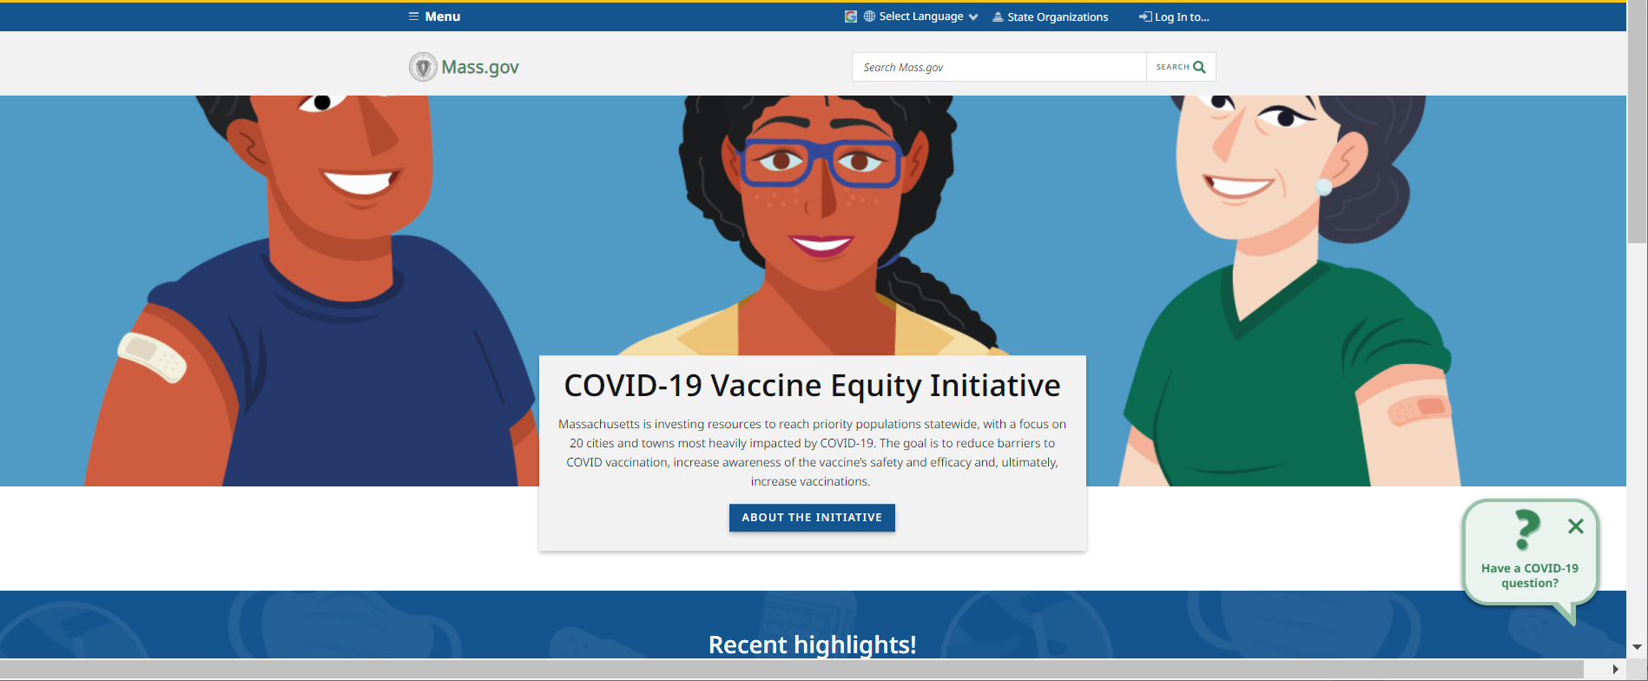
Vaccine Equity Initiative
www.mass.gov/covidvaccineequity

Slide 7
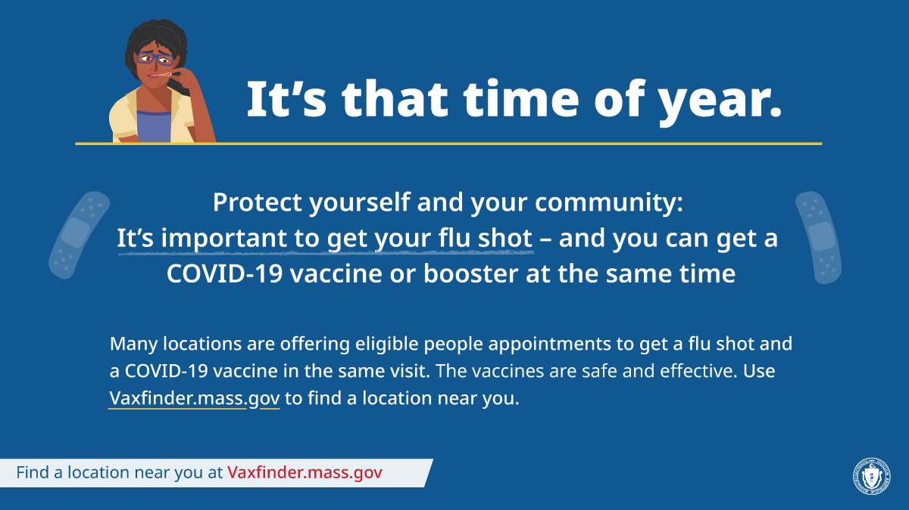
Get a Flu Shot

Slide 8
PUBLIC HEALTH COUNCIL meeting
DECEMBER 8, 2021
Margret R. Cooke, Acting Commissioner

Slide 9
Update on overdose prevention and OTHER
harm reduction efforts
Public Health Council Meeting
December 8, 2021
Deirdre Calvert, LICSW
Director, Bureau of Substance Addiction Services

Slide 10
What is Harm Reduction?
Harm reduction refers to policies, programs, and practices that aim to minimize negative health and social impacts associated with drug use. Harm reduction:
Focuses on individuals making positive changes to actions/habits
Encompasses a range of health and social services
Utilizes a strong body of evidence to implement interventions that are practical, feasible, safe, and cost-effective
Includes participation from the entire multi-disciplinary team involved in addiction treatment and recovery support

Slide 11
Overview of Overdose Prevention and Harm Reduction Efforts
Syringe Service Programs (SSP)
Overdose Education and Naloxone Distribution (OEND)
Post Overdose Support Teams (POST)
Low Threshold Housing
Mobile Addiction Services
Massachusetts Drug Supply Data Stream (MADDS) and Rapid Access to Community Knowledge (RACK)
Mass/Cass Update
Other new and upcoming efforts
Emergency Department-Based Efforts

Slide 12
Existing Service Syringe Programs
DPH currently funds 38 syringe services programs (SSP) across the Commonwealth, including 10 mobile units.

Slide 13
Overview of Overdose Prevention and Harm Reduction Efforts
Syringe Service Programs (SSP)
Overdose Education and Naloxone Distribution (OEND)
Post Overdose Support Teams (POST)
Low Threshold Housing
Mobile Addiction Services
Massachusetts Drug Supply Data Stream (MADDS) and Rapid Access to Community Knowledge (RACK)
Mass/Cass Update
Other new and upcoming efforts
Emergency Department-Based Efforts

Slide 14
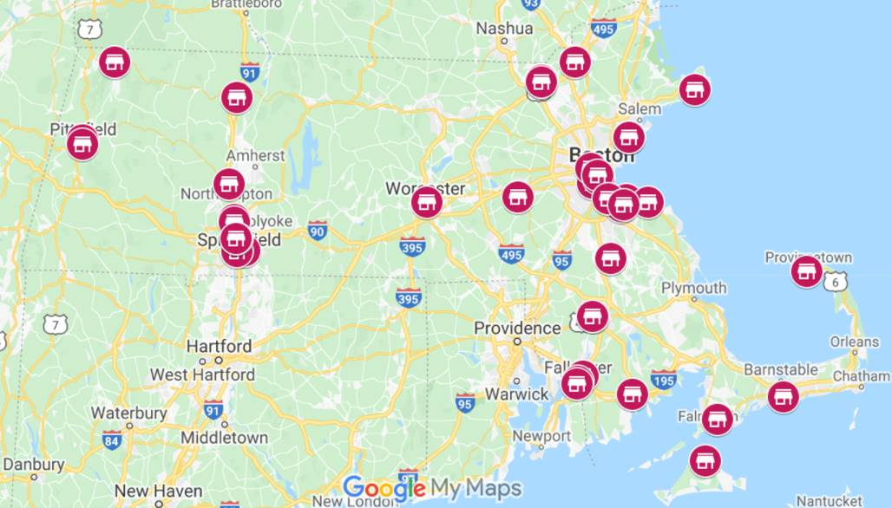
Overdose Prevention and Naloxone Distribution (OEND)
DPH funds 33 OEND sites across the Commonwealth.

Slide 15
Overview of Overdose Prevention and Harm Reduction Efforts
Syringe Service Programs (SSP)
Overdose Education and Naloxone Distribution (OEND)
Post Overdose Support Teams (POST)
Low Threshold Housing
Mobile Addiction Services
Massachusetts Drug Supply Data Stream (MADDS) and Rapid Access to Community Knowledge (RACK)
Mass/Cass Update
Other new and upcoming efforts
Emergency Department-Based Efforts

Slide 16
Post Overdose Support Teams (POST)
Currently funds 11 agencies across 46 communities to provide in-person support to overdose survivors, their families and social networks

Slide 17
Overview of Overdose Prevention and Harm Reduction Efforts
Syringe Service Programs (SSP)
Overdose Education and Naloxone Distribution (OEND)
Post Overdose Support Teams (POST)
Low Threshold Housing
Mobile Addiction Services
Massachusetts Drug Supply Data Stream (MADDS) and Rapid Access to Community Knowledge (RACK)
Mass/Cass Update
Other new and upcoming efforts
Emergency Department-Based Efforts

Slide 18
Low Threshold Housing
Vendor | Location | Capacity
Northeast Region
Southern Middlesex Opportunity Council | Lowell | 14
Commonwealth Land Trust | Lawrence | 12
Central Region
Southern Middlesex Opportunity Council | Worcester | 14
Western Region
Southern Middlesex Opportunity Council | Springfield | 14
River Valley Counseling Center | Holyoke | 20
Center for Human Development | Springfield/Holyoke | 40
Clinical Support Options | Springfield | 70
Amherst Community Connections | Amherst | 10
Metro West / Southeast
Father Bill’s & Mainspring | Quincy/Brockton and other South Shore locations | 20
Suffolk County
Commonwealth Land Trust | Boston | 30
Victory Programs | Boston | 30
Justice Resource Inc. | Boston | 24
BSAS currently funds 9 vendors with 12 locations throughout the Commonwealth to offer low-threshold housing, based on the Housing First model

Slide 19
Overview of Overdose Prevention and Harm Reduction Efforts
Syringe Service Programs (SSP)
Overdose Education and Naloxone Distribution (OEND)
Post Overdose Support Teams (POST)
Low Threshold Housing
Mobile Addiction Services
Massachusetts Drug Supply Data Stream (MADDS) and Rapid Access to Community Knowledge (RACK)
Mass/Cass Update
Other new and upcoming efforts
Emergency Department-Based Efforts

Slide 20
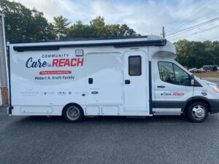
Mobile Addiction Services
Boston Healthcare for the Homeless
SSTAR
Tapestry
UMass Memorial Medical Center
Brockton Neighborhood Health Center
AIDS Support Group of Cape Cod (ASGCC)
Healthy Streets
One Stop Gloucester
Greater Lawrence Family Health Center

Slide 21
Overview of Overdose Prevention and Harm Reduction Efforts
Syringe Service Programs (SSP)
Overdose Education and Naloxone Distribution (OEND)
Post Overdose Support Teams (POST)
Low Threshold Housing
Mobile Addiction Services
Massachusetts Drug Supply Data Stream (MADDS) and Rapid Access to Community Knowledge (RACK)
Mass/Cass Update
Other new and upcoming efforts
Emergency Department-Based Efforts

Slide 22
Drug Checking and Other Surveillance – MADDS and RACK
State-funded collaborations between Brandeis University and DPH include:
The Massachusetts Drug Supply Data Stream (MADDS), which seeks to learn more about the local illicit drug supply through drug checking
The Rapid Assessment of Consumer Knowledge (RACK) study is a brief, mixed methods research approach to gain insight into local challenges and responses to the opioid crisis

Slide 23
Overview of Overdose Prevention and Harm Reduction Efforts
Syringe Service Programs (SSP)
Overdose Education and Naloxone Distribution (OEND)
Post Overdose Support Teams (POST)
Low Threshold Housing
Mobile Addiction Services
Massachusetts Drug Supply Data Stream (MADDS) and Rapid Access to Community Knowledge (RACK)
Mass/Cass Update
Other new and upcoming efforts
Emergency Department-Based Efforts

Slide 24
Mass/Cass Update
In collaboration with EOHHS, BSAS is implementing several initiatives to address the situation at Mass/Cass, including:
Implementing low-threshold housing in Boston and across the Commonwealth and transitional housing at hotels
Standing up temporary low-threshold housing (“cottage community”) on the Southeast portion of the Shattuck campus to serve up to 30 people
25 Acute Treatment Services (ATS) beds have been set aside for rapid referrals from the area, with an additional 20-25 female ATS/CSS beds being deployed in the next 2-3 weeks
Increasing methadone access for patients utilizing Opioid Treatment Programs (OTPs) in the area
Initiating Sunday closures for the OTPs in Mass/Cass (Habit OpCo and HCRC) in October in order to cut down on congestion in the area

Slide 25
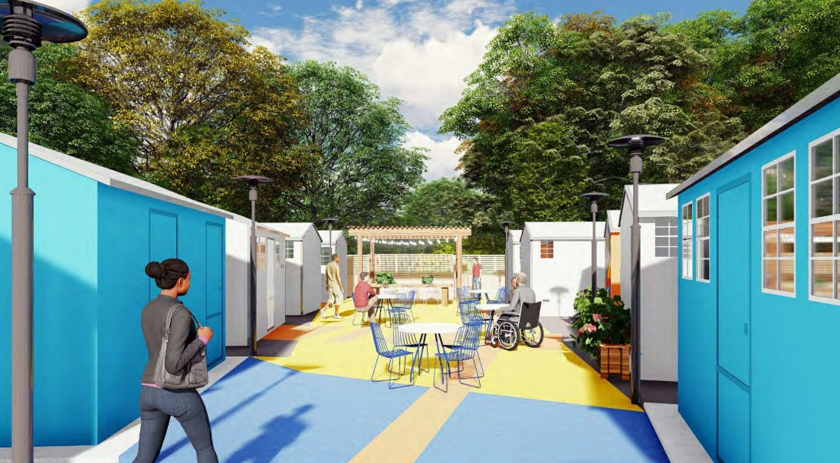
Shattuck Temporary Cottage Community
The path to stability out of homelessness begins with a safe place to sleep and a supportive environment.
The Cottage Community will provide temporary low-threshold transitional housing and wraparound services for up to 30 individuals.
Behavioral (including recovery services), medical, and housing search services will be offered to residents through a contracted provider.
Most importantly, it will serve as a safe place for those in transition from homelessness.

Slide 26
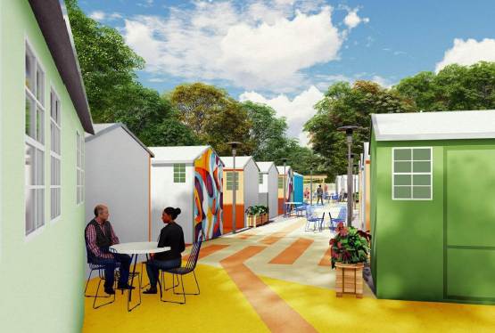
Temporary Cottage Community – Service Overview
Commonwealth Care Alliance, in partnership with Eliot Human Services, will oversee this program and provide the following services:
24/7 staffing/supervision that will include:
Behavioral health services
Onsite medical services and access to primary care
Recovery services
Intensive housing-search and transition support to long-term housing placements
Pharmacy services and medication assisted treatment (MAT)
Onsite Security

Slide 27
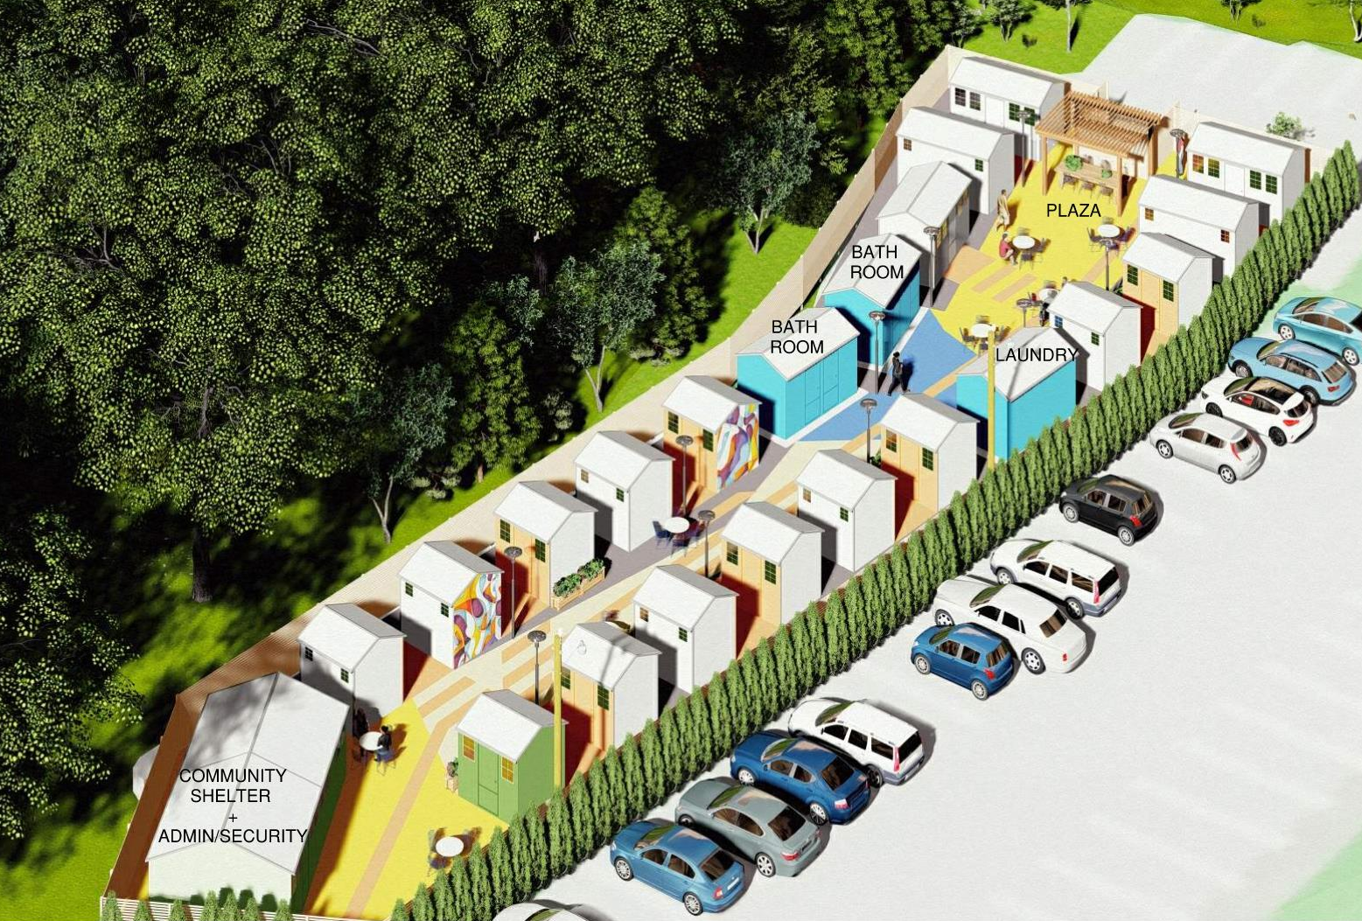
Temporary Cottage Community Site Plan
The Shelter Community will comprise of:
18 sleeping shelters
13 one-bed shelters (65 sf)
10 two-bed shelters (100 sf including 2-wheelchair accessible units)
3 hygiene shelters (accessible restrooms, showers, and laundry)
One 400SF Community room
One Security Cabin
Shared outdoor gathering space
24-hr security, and wraparound social and support services during the day

Slide 28
Overview of Overdose Prevention and Harm Reduction Efforts
Syringe Service Programs (SSP)
Overdose Education and Naloxone Distribution (OEND)
Post Overdose Support Teams (POST)
Low Threshold Housing
Mobile Addiction Services
Massachusetts Drug Supply Data Stream (MADDS) and Rapid Access to Community Knowledge (RACK)
Mass/Cass Update
Other new and upcoming efforts
Emergency Department-Based Efforts

Slide 29
Other New and Upcoming Efforts
Utilizing opioid settlement monies that have been incorporated into the Massachusetts Opioid Recovery and Remediation Trust Fund, DPH/BSAS are proposing to expend $10 million in annual funding on:
Increasing access to harm reduction services, including $3.4 million to expand harm reduction programming at Syringe Service Programs
Increasing access to methadone, including $3.1 million to expand low-threshold MOUD access
Expanding supportive housing programs, with $2 million to expand low-barrier recovery housing options and other basic needs support
Funding $1.5 million for the development of Multi-Disciplinary Community Outreach (MDCO) teams

Slide 30
Overview of Overdose Prevention and Harm Reduction Efforts
Syringe Service Programs (SSP)
Overdose Education and Naloxone Distribution (OEND)
Post Overdose Support Teams (POST)
Low Threshold Housing
Mobile Addiction Services
Massachusetts Drug Supply Data Stream (MADDS) and Rapid Access to Community Knowledge (RACK)
Mass/Cass Update
Other new and upcoming efforts
Emergency Department-Based Efforts

Slide 31
Emergency Department-Based Efforts
DPH/BSAS have several emergency department-based substance use initiatives underway, including:
Partnering with MassHealth to review ED claims data for MOUD prescriptions
Surveying all Massachusetts EDs to document current practices with SUD

Slide 32
Thank You for the
Opportunity to Present Today

Slide 33
COVID-19
Community Impact Survey(CCIS)
Preliminary Analysis Results as of
December 8, 2021 Presented by Nassira Nicola
Massachusetts Department of Public Health

Slide 34
CCIS TEAM MEMBERS
CCIS Project Leads
W.W. Sanouri Ursprung, Lauren Cardoso, Beth Beatriz, Glory Song, Caroline Stack, Kathleen Fitzsimmons, Emily Sparer-Fine, Ta-wei Lin, Lisa Potratz, Heather Nelson, Amy Flynn, Lisa Arsenault, Abby Atkins
CCIS Steering Committee
Lauren Cardoso, W.W. Sanouri Ursprung, Beth Beatriz, Abbie Averbach, Ruth Blodgett, Ben Wood, Sabrina Selk,
Jessica del Rosario Nicole Daley, Lisa Potratz
CCIS Analytic Team, Data to Action Team, Data Dissemination Team, Communications Team
Allison Guarino, Andrea Mooney, Angela Laramie, Ann Marie Matteucci, Anna Agan, Arielle Coq, Barry Callis,
Beatriz Pazos Vautin, Ben Wood, Brittany Brown, Chelsea Orefice, Dana Bernson, David Hu, Dawn Fukuda,
Ekta Saksena, Elise Pechter, Emily White, Fareesa Hasan, Frank Gyan, Glennon Beresin, Hanna Shephard,
Hannah Walters, Hermik Babkhanlou-Chase, James Laing, Jena Pennock, Jennica Allen, Jennifer Halstrom,
Justine Egan, Kathleen Grattan, Kim Etingoff, Kirby Lecy, Lamar Polk, Lauren Fogarty, Lauren Larochelle,
Mahsa Yazdy, Marianne Mabida, Matthew Tumpney, Megan Hatch, Megan Young, Melody Kingsley, Michelle Reid, Miriam Scrivener, Nassira Nicola, Nicole Daniels, Nicole Roos, Rebecca Berger, Rebecca Han, Robert Leibowitz, Susan Manning, Thomas Brigham, Timothy St. Laurent, Vera Mouradian, Victoria Nielsen, Ziming Xuan,
Elizabeth Showalter, Priyokti Rana, Mayowa Sanusi, Emily Lawson, Alana LeBrón

Slide 35
CCIS COMMUNITY PARTNERS
Many groups that were critical in the success of this effort and gave important input on the development and deployment of the survey:
Academic Public Health Volunteer Corps and their work with local boards of health and on social media
Mass in Motion programs, including Springfield, Malden, and Chelsea
Cambodian Mutual Assistance
The Mashpee Wampanoag Tribe
The Immigrants’ Assistance Center, Inc
Families for Justice as Healing
City of Lawrence Mayor’s Health Task Force
The 84 Coalitions, including the Lawrence/Methuen Coalition
Boys and Girls Clubs, including those in Fitchburg and Leominster and the Metro South area
Chinatown Neighborhood Association
Father Bill’s
UTEC
MassCOSH
Stavros Center for Independent Living
Greater Springfield Senior Services
Center for Living and Working
DEAF, Inc.
Massachusetts Commission for the Deaf and Hard of Hearing
Viability, Inc.

Slide 36
OVERVIEW
Purpose and Approach of the Covid-19 Community Impact Survey (CCIS)
Preliminary Findings
Persons with Disability Spotlight
Appendix

Slide 37
PURPOSE AND APPROACH
3.10.21 release

Slide 38
Why did we conduct the CCIS?
Goals:
1) Identify the most pressing immediate and long-term health needs created by the pandemic, including its social and economic consequences
2) Determine which populations have been most disproportionately impacted
.... in order to inform and prioritize resource deployment and policy actions

Slide 39
OVERVIEW OF CCIS APPROACH
Conducted a self-administered online survey (Sept. and Nov. 2020) with over 33,000 adults and 3,000 youth respondents in the final sample
Covered a wide range of topics specific to adults and youth respectively
Perceptions & experiences of COVID-19, Basic needs, Access to healthcare, Pandemic-related changes in employment, Mental health, Substance use, and Safety
Available in 11 languages; additional focus groups also conducted in ASL
Open ended questions captured previously unknown needs and barriers
Weighted results to the state average, with different weights applied to youth and adult samples
Recruitment via network of community-based organizations (CBOs)
Employed a snowballing sampling strategy to ensure we reach key populations
eg. People of color, LGBTQ+ individuals, People with disabilities, Essential workers, People experiencing housing instability, Older adults, and Individuals living in areas hardest hit by COVID-19

Slide 40
RESULTS TOPICS TO DATE
SOCIAL DETERMINANTS OF HEALTH
MITIGATING INDIVIDUAL RISK OF INFECTION
ACCESS TO
TESTING​
ACCESS TO HEALTHCARE​
MENTAL HEALTH
EMPLOYMENT
SUBSTANCE USE
DISCRIMINATION: & RACE SPOTLIGHTS
PARENTS & FAMILIES
YOUTH SPOTLIGHT
SOGI POPULATION SPOTLIGHTS
INTIMATE PARTNER VIOLENCE
HOUSING STABILITY
RURAL COMMUNITIES SPOTLIGHT
DISCRIMINATION: & RACE SPOTLIGHTS
NEW: PERSONS WITH DISABILITIES SPOTLIGHT

Slide 41
POPULATION SPOTLIGHT: PERSONS WITH DISABILITIES

Slide 42
“The COVID-19 pandemic has… starkly exposed the heightened vulnerability and risks to persons with disabilities that is underpinned by entrenched discrimination and inequality. […] While many persons with disabilities have health conditions that make them more susceptible to COVID-19, pre-existing discrimination and inequality means that persons with disabilities are one of the most excluded groups in terms of health prevention and response actions and economic and social support measures, and among the hardest hit in terms of transmission risk and actual fatalities.” – United Nations Office of the High Commissioner for Human Rights

Slide 43
FRAMING MATTERS
Out-dated dominant frames about disability frame it as a problem with individual bodies/minds. According to this frame (also called the “medical model”¹ ):
Disability is an outcome of failed health care and public-health policies.
People with disabilities are, by definition, unhealthy and have low quality of life.
Differences in health outcomes are seen as a natural and expected result of biological differences.
Interventions are focused on curing and preventing disabilities and “restoring” people to a state of non-disabled health.
1. WHO’s World Report on Disability, 2011 (https://www.who.int/publications/i/item/9789241564182) ; The Institute of Medicine’s consensus report The Future of Disability in America, 2007 (https://www.nap.edu/catalog/11898/the-future-of-disability-in-america); The Surgeon General's Call to Action to Improve the Health and Wellness of Persons with Disabilities, 2005 (https://www.ncbi.nlm.nih.gov/books/NBK44667/).

Slide 44
FRAMING MATTERS
More current equity-focused frames about disability see it as a combination of atypical bodies/minds with an environment that is designed by and for non-disabled people. According to this frame (one version of what is known as the “social model”¹ ):
People with disabilities are a demographic group whose bodies/minds reflect normal diversity and variation. They can be happy and healthy.
Differences in health outcomes are more likely to be the result of societal ableism than natural biological differences.
Interventions focus on reducing barriers to health and community participation.
1. WHO’s World Report on Disability, 2011 (https://www.who.int/publications/i/item/9789241564182) ; The Institute of Medicine’s consensus report The Future of Disability in America, 2007 (https://www.nap.edu/catalog/11898/the-future-of-disability-in-america); The Surgeon General's Call to Action to Improve the Health and Wellness of Persons with Disabilities, 2005 (https://www.ncbi.nlm.nih.gov/books/NBK44667/).

Slide 45
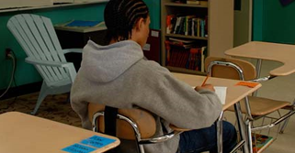
Ableism, like other oppressions, acts at multiple levels:
INTERNALIZED
INTERPERSONAL
• Suppressing own needs to avoid feeling like a burden
• Avoiding other people with disabilities to avoid being seen as similar to them
• Pity, condescension
• Scrutiny of who’s “disabled enough”
• Withholding access to exert control
INSTITUTIONAL
STRUCTURAL
• Mandatory on-site work policies
• Patients with disabilities pressured to sign Do Not Resuscitate orders
• Laptop bans in classrooms
• Financial penalties for marriage, work
• “Undue burden” clauses in civil-rights law
• Public charge restrictions in immigration policies

Slide 46
Ableism doesn’t act alone.
MA Subpopulations Reporting Experiences of Discrimination based on Race/Ethnicity During COVID-19 Pandemic
Black, Asian, and Multiracial groups experienced more discrimination than other subpopulations.
Other subpopulations experiencing greater discrimination include Questioning/Not Sure gender identity, Speaks language other than English, Less than high school education, and those with disabilities
For each aspect of our identities (gender, age, race etc.), the systems we live in can cause cumulative and compounding inequities, leaving some groups being even more impacted (e.g. persons of color who also have a disability). This is called intersectionality.

Slide 47
ABLEISM, DISABILITY & COVID-19
Limited systematic data on COVID-19 outcomes by disability status
COVID-19 swept through congregate settings (e.g., nursing homes); restrictions on movement from congregate settings limit independence and safety of residents
Media messaging that “only people with pre-existing conditions” were at risk perceived as devaluing disabled lives
Barriers to following best practices for preventing virus exposure (e.g., handwashing, keeping 6 ft. distance, wearing masks)
Prioritization of health care resources (e.g., ventilators) based on assumptions regarding quality of life
Challenging to get COVID-19 accommodations for people with disabilities, whereas employers moved swiftly to make telecommuting possible
Increases in telehealth removes some barriers to health care & creates barriers to communication & assessing conditions or treatment plans
Fast changing COVID-19 information may not be adapted or accessible
Disruption of support systems

Slide 48
REACHING THE DISABILITY POPULATION IN MA CCIS
Over 4,100 CCIS participants had 1+ disability.
While we did not directly sample residents <25 years of age and may not have reached many residents living in congregate settings, CCIS allows us to examine the experiences of multiple disability subgroups.
Focus groups conducted with deaf and hard of hearing residents (10 participants) to better understand experiences with COVID-19 mitigation, testing, and communication.
MA CCIS begins to fill an important gap in COVID-19 data by disability status.
CCIS DISABILITY PROFILE

Slide 49
SOCIOECONOMIC INEQUITIES AND DISABILITY
While the Americans with Disabilities Act mandates equal educational and occupational opportunities and prohibits discrimination due to disability, people with disabilities are more likely to have incomes below poverty and have lower levels of education than people without disabilities.
There are socioeconomic differences across disability subgroups.
In the CCIS, one-quarter to half of respondents with a disability have incomes <$35K.
About half of respondents with a self-care or independent living disability, mobility disability, or cognitive disability have less than a college education.

Slide 50
SPOTLIGHT DEAF OR HARD OF HEARING

Slide 51
COMMUNICATION BARRIERS AMONG DEAF OR HARD OF HEARING POPULATION
Deaf or hard of hearing focus group participants highlighted how practices to prevent virus transmission served as barriers to communication
“I almost never use my voice, but now with masks, sometimes I have to speak out loud to get people's attention, and they all look at me like I'm an alien and I have to try and tell them I’m deaf.”
“All of the grocery store workers know that I am deaf and sometimes they will pull down their masks for a second so that I can see what they’re saying. Everyone seems more serious though when you can’t see their faces. “
“There have been some challenges with repair people for our home and having to communicate with pen and paper – hard to keep that distance in our home.”

Slide 52
JOB LOSS AND ECONOMIC STRAIN AMONG DEAF AND HARD OF HEARING RESPONDENTS
Employed deaf or hard of hearing respondents are 1.5X* more likely to experience job loss and 1.4X* more likely to experience reduced hours or leave due to the pandemic.
4 in 10 (39%) deaf or hard of hearing respondents worry about paying for 1+ expenses or bills in the coming few weeks.
Nearly 2 in 10 (18%) deaf or hard of hearing respondents have not gotten medical care needed since July 2020.
*Indicates compared to hearing respondents
p<0.05

Slide 53
DEAF OR HARD OF HEARING & COVID-19​
Face masks muffle sound and prevent lip reading, and may be hard to wear for people with behind-the-ear devices
Deaf people are less likely than hearing people to be hired for jobs, and more likely to lose those jobs in difficult times
People who need interpreters or other supports may be incorrectly affected by rules limiting visitors in medical settings
Urgent COVID-19 information may be disseminated in inaccessible formats first, and only made accessible to deaf or hard of hearing people later
Telehealth visits are not always fully accessible (e.g., arranging for interpreter services)
Testing/vaccine providers may not know how to communicate with deaf people, or may be uncomfortable touching shared objects like pens and paper

Slide 54
SPOTLIGHT BLIND OR VISION IMPAIRMENT

Slide 55
INEQUITIES IN COVID-19 PREVENTION PRACTICES AND BASIC NEEDS AMONG RESPONDENTS WHO ARE BLIND OR WHO HAVE A VISION IMPAIRMENT
Respondents who are blind or who have a vision impairment are:
1.2X* more likely to be “very” worried about getting infected with COVID-19.
1.9X* more likely to not be able to keep 6 ft. distance when outside the home, compared to respondents who are not blind or have a vision impairment.
1.9X* more likely to worry about getting food or groceries.
2.1X* more likely to worry about getting broadband (internet).
1.8X* more likely to worry about paying for housing.
1.5X* more likely to report 15+ poor mental health days in past 30 days.
*Indicates compared to seeing respondents
p<0.05

Slide 56
BLIND OR VISION IMPAIRMENT & COVID-19
Touch & tactile senses are important for routine activities
Best practices for virus prevention often visually conveyed
May need to be guided by holding someone’s elbow; elbows used for sneezing & coughing
Getting groceries is more difficult: staff occupied with pick-up & delivery orders, items hard to find due to demand, cannot search multiple stores
Difficult to locate hand sanitizer stations
Higher prevalence of comorbidities than general population, which increases risk of severe COVID-19
Public transportation schedules reduced, may be crowded
Difficult to arrange ride share services, need to sit in close proximity to driver
Elective surgeries were postponed, which may include eye surgeries
Telehealth visits not fully accessible
Drive-up testing is difficult if use transportation services

Slide 57
SPOTLIGHT SELF-CARE OR INDEPENDENT LIVING DISABILITY

Slide 58
INEQUITIES IN MEETING BASIC NEEDS FOR RESPONDENTS WITH A SELF-CARE OR INDEPENDENT LIVING DISABILITY
Respondents who have a self-care or independent living disability are:
1.8X* more likely to be “very” worried about getting infected with COVID-19.
2X* more likely to have not gotten medical care needed since July 2020.
2X* more likely to worry about getting food or groceries.
2.6X* more likely to worry about getting medications.
2X* more likely to worry about getting broadband (internet).
1.6X* more likely to worry about paying for housing.
1.8X* more likely to report 15+ poor mental health days in past 30 days.
*Indicates compared to respondents who do not have a self-care or independent living disability
p<0.001

Slide 59
SELF-CARE OR INDEPENDENT LIVING DISABILITY & COVID-19
Rapid change to routine may strain day-to-day activities & support, stressful to adopt new behaviors
Limitations on leaving home to prevent virus exposure
Congregate settings (e.g., nursing homes) had outbreaks linked with close quarters, shared living spaces, frequent staff changes
Support of family members or caregivers outside of household could increase risk of virus exposure (e.g., cannot fully distance)
Finding reliable & safe in-home care may be more difficult (e.g., rotation of caregivers, staffing constraints due to illness or isolation)
Reduced in-person visits with social & health care providers who may support disability management or other healthcare needs
Community-based supports (e.g., schools, day programs) interrupted
Drive-up testing inaccessible for users of public transit or paratransit services
Barriers to following best practices for preventing virus exposure (e.g., handwashing, keeping 6 ft. distance, wearing masks)
Higher prevalence of comorbidities than general population, which increases risk of severe COVID-19

Slide 60
SPOTLIGHT COGNITIVE DISABILITY

Slide 61
MENTAL TOLL OF COVID-19 AMONG RESPONDENTS WITH A COGNITIVE DISABILITY
Respondents who have a cognitive disability are:
1.6X* more likely to be “very” worried about getting infected with COVID-19.
2.1X* more likely to not be able to keep 6 ft. distance when outside the home.
2X* more likely to worry about getting food or groceries.
1.9X* more likely to worry about paying for housing.
2.4X* more likely to report 15+ poor mental health days in past 30 days.
2.3X* more likely to report 3+ PTSD-like reactions in the past month.
*Indicates compared to respondents who do not have a cognitive disability
p<0.001

Slide 62
COGNITIVE DISABILITY & COVID-19
Rapid change to routine may strain day-to-day activities & support, stressful to adopt new behaviors
Limitations on leaving home to prevent virus exposure
Congregate settings (e.g., nursing homes) had outbreaks linked with close quarters, shared living spaces, frequent staff changes
Support of family members or caregivers outside of household could increase risk of virus exposure (e.g., cannot fully distance)
Finding reliable & safe in-home care may be more difficult (e.g., rotation of caregivers, staffing constraints due to illness or isolation)
Reduced in-person visits with social & health care providers who may support disability management
Community-based supports (e.g., schools, day programs) interrupted
Drive-up testing is difficult if use transportation services
Barriers to following best practices for preventing virus exposure (e.g., handwashing, keeping 6 ft. distance, wearing masks)
Some genetic factors linked with cognitive disability may increase risk of severe COVID-19

Slide 63
COGNITIVE DISABILITY & COVID-19
Physical proximity to caregivers may be important for making routines manageable & predictable
Cognitive impairments may limit processing of information communicated
Deluge of information about COVID-19 may heighten anxiety, contribute to paranoid thinking and/or catalyze externalizing behaviors
COVID-19 restrictions & limits on usual routine, connections, supports may be stressful, contribute to externalizing behaviors
Disproportionately isolated before COVID-19, isolation increased after COVID-19
May rely on others to process COVID-19 information & how to act upon information
Abuse may be more difficult to detect by providers using remote communication or physical distancing

Slide 64
SPOTLIGHT MOBILITY DISABILITY

Slide 65
INEQUITIES IN BASIC NEEDS AMONG RESPONDENTS WITH A MOBILITY DISABILITY
Respondents who have a mobility disability are:
1.5X* more likely to be “very” worried about getting infected with COVID-19.
1.4X more likely to have not gotten medical care needed since July 2020.
1.7* more likely to worry about getting food or groceries.
2.2X* more likely to worry about getting medications.
1.8X* more likely to worry about getting broadband (internet).
1.3X* more likely to worry about paying for housing.
*Indicates compared to respondents who do not have a mobility disability
p<0.001

Slide 66
MOBILITY DISABILITY & COVID-19
Support of family members or caregivers outside of household could increase risk of virus exposure (e.g., cannot fully distance)
Reduced in-person visits with social & health care providers who may support disability management
Finding reliable & safe in-home care may be more difficult (e.g., rotation of caregivers, staffing constraints due to illness or isolation)
Drive-up testing is difficult if use transportation services
Barriers to following best practices for preventing virus exposure (e.g., handwashing, keeping 6 ft. distance, wearing masks)
Higher prevalence of comorbidities than general population, which increases risk of severe COVID-19

Slide 67
"Disabled people know what it means to be vulnerable and interdependent. We are modern-day oracles. It’s time people listened to us." - Alice Wong

Slide 68
Next Meeting:
January 12, 2022

