Slide 1
Public Health Council Meeting
February 11, 2026
Robert Goldstein, Commissioner
Today’s presentation is available on mass.gov/dph under “Upcoming Events” by clicking on the February Public Health Council listing.​

Slide 2
Updates
Commissioner Robbie Goldstein

Slide 3

Black History Month
“A Book of Medical
Discourses in Two Parts,”
by Dr. Rebecca Lee Crumpler
Image courtesy of the U.S. National Library of Medicine

Slide 4

Rural Health Transformation Program award

Slide 5
State budget proposal
Highlights for public health
$5.7
million
increase in funding to Office of Local and Regional Health
$4.3
million
to further implement Maternal Health Law

Slide 6
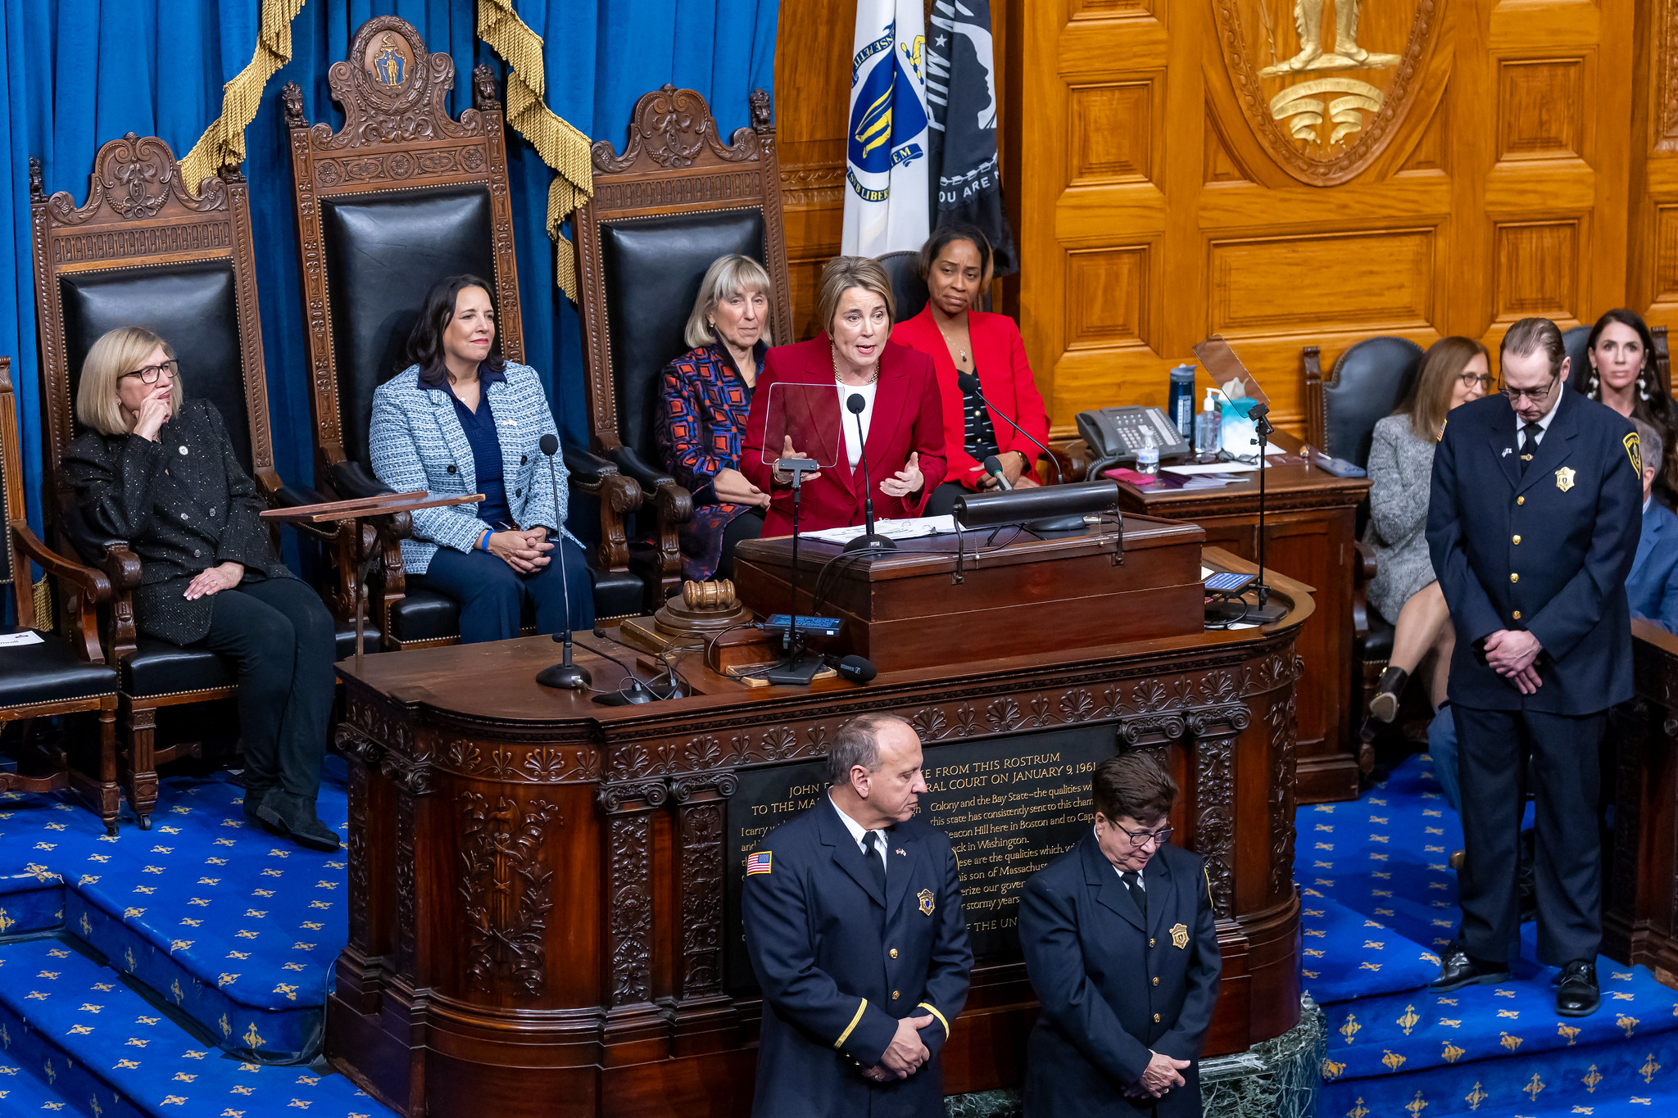
State of the Commonwealth

Slide 7
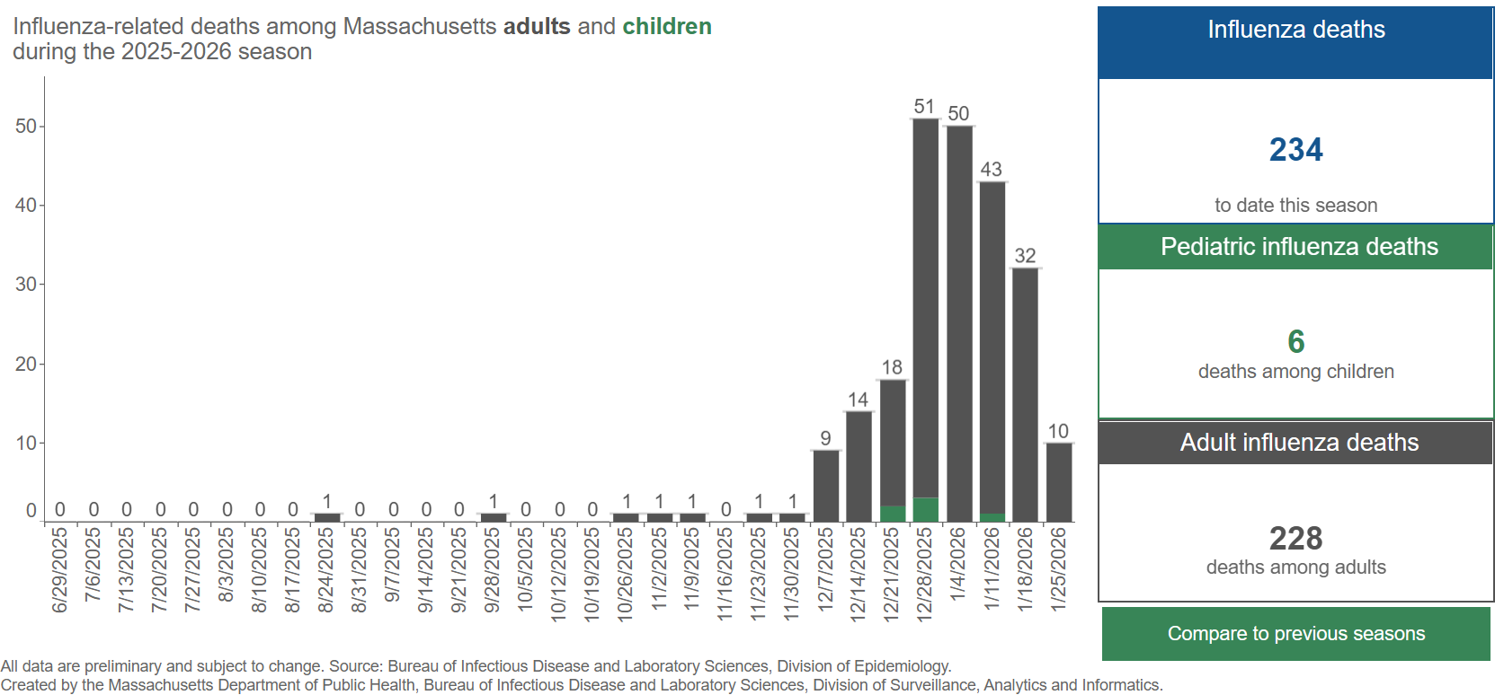
Respiratory illness: flu deaths
Screenshot of Weekly Influenza Update dashboard, updated February 5, with data through January 31

Slide 8
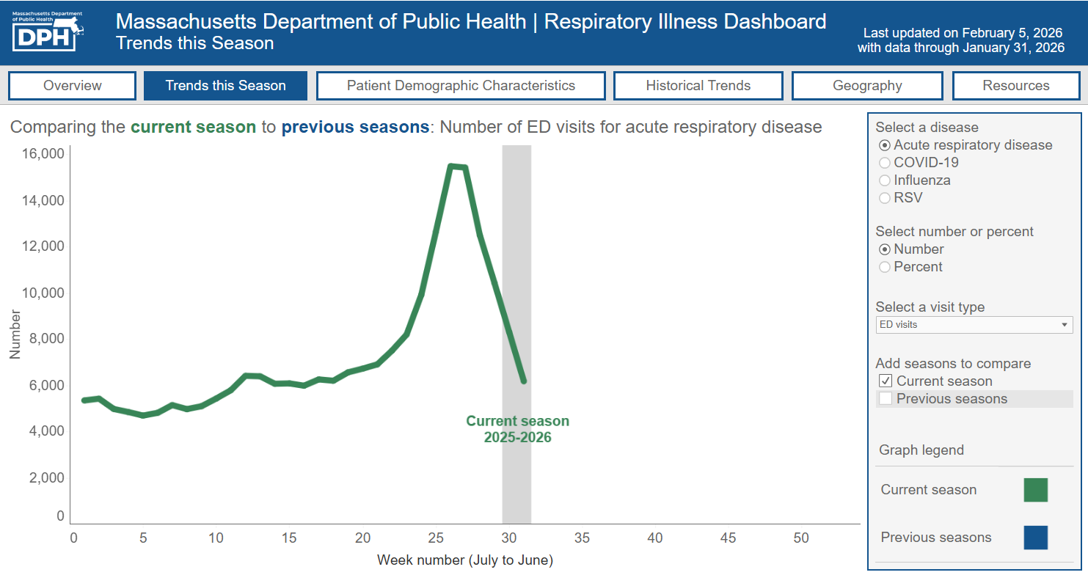
Hospital capacity and respiratory illness
Screenshot of Respiratory Illness Dashboard, updated February 5, with data through January 31

Slide 9

Federal updates: SAMHSA funding

Slide 10
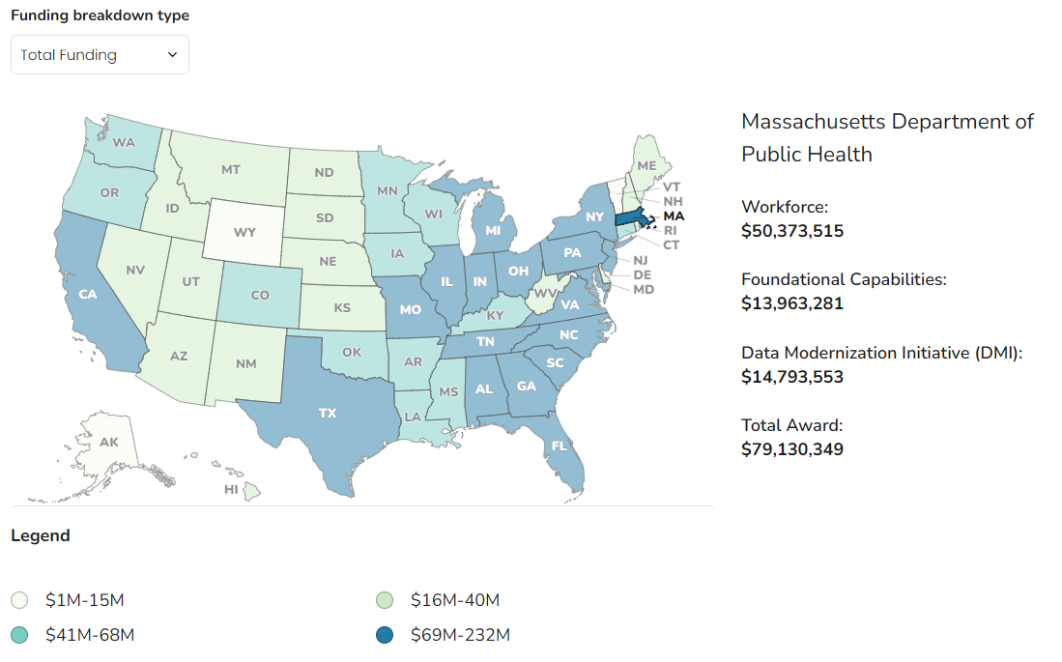
Federal updates: CDC Public Health Infrastructure Grant
Source: CDC PHIG State & Territory Funding Profiles

Slide 11
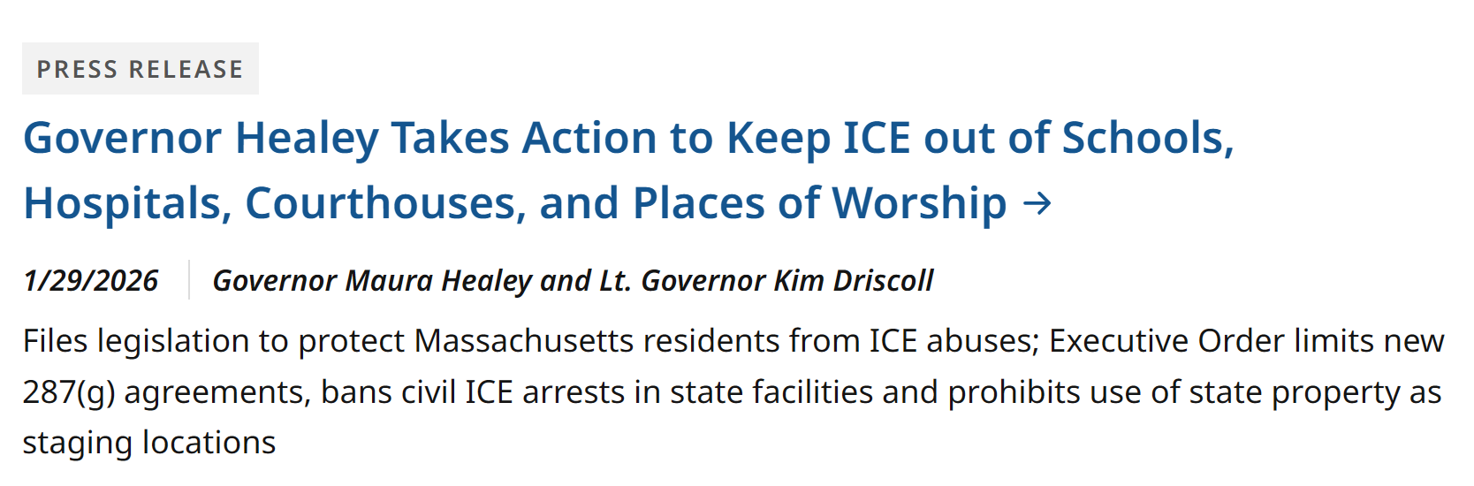
ICE actions in Minnesota and Massachusetts response

Slide 12
Determination of Need:
Mass General Brigham Ambulatory Surgery - Cambridge, LLC
Ambulatory Surgery
Teryl Smith​​
Director, Bureau of Health Care Safety and Quality​

Slide 13
Background Information
Mass General Brigham Ambulatory Surgery – Cambridge, LLC
Mass General Brigham, Inc
Regent Surgical Health, LLC
13

Slide 14
Proposed Project Description
To establish a freestanding single-specialty ambulatory surgery center in Cambridge focusing on endoscopy encompassing of 3 procedure rooms and ten pre/post-operative bays
A system-wide initiative to address the backlog of endoscopy patients
14

Slide 15
Proposed Project Description, continued
As a new entity, the proposed facility has no existing Patient Panel
The Proposed Project is intended to shift outpatient endoscopy volume from MGH and BWH to the new facility
The Patient Panel analysis references patients served by MGB-affiliated facilities, consistent with DoN regulation
The total value for the Proposed Project is $7,349,450.00
The Community Health Initiative (CHI) contribution is $367,472.50
15

Slide 16
Six Factors of a Determination of Need (DoN) Application
Factor 1 | Patient Need, Public Health Value and Operational Objectives
Factor 2 | Health Priorities
Factor 3 | Compliance
Factor 4 | Financial Feasibility and Reasonableness of Expenditures and Costs
Factor 5 | Relative Merit
Factor 6 | Community Health Initiatives
16

Slide 17
Factor 1: Patient Need, Public Health Value and
Operational Objectives - Requirements
In Factor 1,the Applicant must demonstrate the project will positively impact three areas:
Patient Panel Need
Public Health Value
Operational Objectives
17

Slide 18
Factor 1: Patient Panel Need Analysis
The Applicant attributes need for the Proposed Project to the following:
The need to address a growing backlog of MGB’s outpatient endoscopy cases; and
The need to alleviate capacity constraints at the MGB AMCs, including:
    Historical utilization
    Anticipated population growth
    Projected utilization
18

Slide 19
Factor 1: Patient Panel Need Analysis, continued (2)
Growing backlog of MGB outpatient endoscopy cases necessitates additional capacity:
In FY24, AMCs performed 29, 723 outpatient endoscopies; 20,117 were ASC-eligible
Boston currently has only one dedicated endoscopy ASC
As of July 2025, 26,586 MGB patients were awaiting scheduling for endoscopy at an AMC
19

Slide 20
Factor 1: Patient Panel Need Analysis, continued (3)
There are capacity constraints at all MGB locations, which prevents the AMCs from shifting volume to alternate locations within the MGB system:
Newton Wellesley Hospital
  Endoscopy volume increased steadily over time
  Operating capacity has risen from ~67% to >90%
MG Waltham (HOPD)
  Expanded endoscopy capacity to shift eligible cases from MGH
  Utilization remains high (~80%)
20

Slide 21
Factor 1: Patient Panel Need Analysis, continued (4)
Endoscopy-related case shifting from MGH to MG Waltham reflects the following:
Eligible cases were shifted from the MGH Main campus to MG Waltham, including endoscopy
Case shifting has reached a plateau due to limited available capacity at MG Waltham
Endoscopy utilization at MG Waltham increased following the expansion
21

Slide 22
Factor 1: Patient Panel Need Analysis, continued (5)
Contributing factors associated with the growing backlog of endoscopy patients include the following:
Majority of outpatient endoscopy services provided by the MGB AMCs consist of colonoscopy screens
Screening rates declined during the COVID-19 pandemic, contributing to growing backlogs at MGH and BWH
Expanded screening eligibility and rising colorectal cancer rates among younger adults have increased
By July 2025, more than 25,000 adults were waiting to be scheduled for routine endoscopy procedures at MGH and BWH.
22

Slide 23
Factor 1: Patient Panel Need Analysis, continued (6)
Overall growth in endoscopy wait times at MGB AMCs reflects ongoing capacity constraints:
Backlog has increased, and wait times for endoscopy procedures at both AMCs increased ~20% from FY2022 to FY2025.
MGB's initiative to shift patients from AMCs to other facilities are helping to reduce wait times
No additional capacity exists to shift more patients, so overall wait times remain elevated

Slide 24
Factor 1: Patient Panel Need Analysis, continued (7)
There was a 19% increase in inpatient procedures performed at the AMCs from FY2022-FY2025 alone.
As inpatient volume increased, endoscopy room utilization rate rose at both MGH and BWH.
Inpatient endoscopy wait times at the AMCs range from1 to 2 days.

Slide 25
Factor 1: Patient Panel Need Analysis, continued (8)
Projected Population Growth and Endoscopy Demand:
PSA towns expected to add ~8,000 residents aged 45–75 by 2040.
Significant growth in key towns by 2035:
  Cambridge: +20% residents aged 50–59
  Revere: +33% residents aged 45–54
  Somerville: +23% residents aged 45–54
High utilization of MGB AMC endoscopy rooms (75–89%)

Slide 26
Factor 1: Patient Panel Need Analysis, continued (9)
Proposed Utilization of the New ASC
 | FY2027 | FY2028 | FY2029 | FY2030 | FY2031
Volume | 4,752 | 7,350 | 7,460 | 7,572 | 7,686
Operating Capacity | 53% | 82% | 83% | 84% | 85%

Slide 27
Factor 1: Public Health Value
Improved Outcomes and Quality of Life
A) The benefits of endoscopy as a screening
B) Its impact on colorectal cancer rates and
C) The advantages of endoscopy in the ASC setting

Slide 28
Factor 1: Public Health Value, continued
The Applicant states that Proposed Project will work to reduce health inequity through:
Targeted improvements in colorectal cancer screenings
Reducing barriers to screening

Slide 29
Factor 1: Operational Objectives
Efficiency, Continuity, Coordination of Care Analysis
Electronic Medical Record (EMR):
The ASC will use Epic for its EMR, a system shared across MGB facilities
Enable data exchange between providers and reporting capabilities.
Support the flow of clinical documentation flows directly into the broader health system
Emergency Procedures:
Written emergency and referral protocols
Agreements for inter-facility transport in non-emergency situations to support continuity of care

Slide 30
Factor 1: Competition on Price, Total Medical Expenses (TME), Costs
The Applicant asserts the following factors will impact price and TME:
Cost benefit of ASCs
Timely detection
Improved patient throughput in hospital settings
Cost savings to payers

Slide 31
Factor 2: Health Priorities - Requirements
The expectation is that, using objective data, Applicants will address how the Proposed Project supports Commonwealth Cost containment goals and improved public health outcomes.

Slide 32
Factor 2: Analysis- Cost Containment
Expanding access to endoscopy in a lower cost setting
ASCs maximize operational efficiencies
Only 18 of the Commonwealth’s ASCs are offering endoscopy services (12 single-specialty and 6 multi-specialty)

Slide 33
Factor 2: Analysis – Improved Public Health Outcomes
The Proposed Project will improve access to endoscopy services, supporting health outcomes for patients.
Early cancer detection
Improved patient experience
Shorter wait times and fewer scheduling delays

Slide 34
Factor 2: Analysis – Delivery System Transformation
The Applicant will meet the Delivery Transformation System by:
Screening for Social determinants of health (SDoH) needs
Screening all Medicaid ACO patients annually
Connecting patients to community resources

Slide 35
Factor 3: Compliance - Key Requirements and Analysis
The Determination of Need Program has determined that the Applicant has provided evidence of compliance and good standing with federal, state, and local laws and regulations.

Slide 36
Factor 4: Financial Feasibility and Reasonableness of Expenditures and Costs - Requirements
CPA Review
To assess Financial Feasibility in compliance with this Factor, the Applicant must provide evidence that it has sufficient funds available for capital and ongoing operating costs necessary to support the Proposed Project without negative impacts or consequences to the Applicant’s existing Patient Panel. The report is certified by an Independent CPA.

Slide 37
Factor 4: Analysis
As a result of the CPA’s analysis, they concluded the following:
“Based upon my review of the relevant documents and analysis of the projected financial statements, I determined the project and continued operating surplus are reasonable and are based upon feasible financial assumptions. Accordingly, I determined that the Projections are feasible and sustainable and not likely to have a negative impact on the Patient Panel or result in a liquidation of assets of Mass General Brigham Ambulatory Surgery - Cambridge, LLC.”

Slide 38
Factor 5: Relative Merit - Requirements
When conducting an evaluation and articulating the relative merit determination, Applicants shall take into account, at a minimum, the quality, efficiency, and capital and operating costs of the Proposed Project relative to potential alternatives or substitutes, including alternative evidence-based strategies and public health interventions.

Slide 39
Factor 5: Analysis-Alternatives Considered to the Proposed Project
Alternative #1: Use the existing procedure rooms in the HOPDs at BWH and MGH to continue to provide endoscopy procedures:
Would not increase capacity and expand access for the people in the PSA
Continues to rely on the AMC procedure rooms which further strains an already inefficient system
No capital expenses
The HOPDs at BWH and MGH have higher operating expenses than the Proposed Project due to the overhead costs required of a hospital

Slide 40
Factor 5: Analysis-Alternatives Considered to the Proposed Project- cont.
Alternative #2: Construct and license additional endoscopy procedure rooms at BWH and MGH.
Would not increase capacity and expand access for the patients previously identified as part of proposed Patient Panel area
It would not support access to endoscopy services within the Proposed Project’s geographic area
Construction will impact patient care
Capital would be significant
Higher operating costs

Slide 41
Factor 6: Community Health Initiatives - Requirements
Community-based Health Initiatives (CHI)
Factor 6, or the CHI, serves to connect hospital expenditures to public health goals by making investments in Health Priority Areas—referred to interchangeably as the social determinants of health (SDoH).
CHI projects are a mechanism for Applicants to engage local partners in community health investments, addressing SDoH and advancing racial and health equity.
Factor 6 requirements and conditions depend on the Applicant and Application Type, and size of CHI contribution.
Built Environment
Violence &
Trauma
Education
CHI Health
Priority
Areas
Social Environment
Employment
Housing

Slide 42
Factor 6: Key Requirements
1. The City of Cambridge 2025 CHNA
2. A Self-Assessment
3. Partner Assessments
4. CHI Narrative

Slide 43
Factor 6: Key Requirements, continued
The total required CHI contribution is $367,472.50
  $35,277.36 will be directed to the CHI Statewide Initiative.
  $317,495.24 will be dedicated to local approaches to the DoN Health Priorities.
  $14,698.90 will be designated as the administrative fee.

Slide 44
Other Conditions
The Holder must certify annually that all physicians and health professionals who practice at the facility are enrolled as participating providers of MassHealth
The new facility to maintain or increase the percentage of MassHealth patients within its Payer Mix as compared with the Applicant's AMCs
The Holder will report on Endoscopy Volume by procedure for MGB Cambridge ASC, MGH Main Campus, and BWH

Slide 45
Outcome Measures
The Applicant will report on the following outcome measures annually and for a period of 5 years to assess the impact of the proposed project:
Wait time from scheduling to procedure
Colonoscopy screening withdrawal time
Adenoma detection rate
Patient Satisfaction

Slide 46
Informational presentation thank-you
Thank you for the opportunity to present this information today.
Please direct any questions to:
Teryl Smith, RN, MPH
Director
Bureau of Health Care Safety and Quality
Teryl.A.Smith@mass.gov

Slide 47
Proposed revisions to regulation:
105 CMR 270.000: Blood Screening of Newborns for Treatable Disease and Disorders
H. Dawn Fukuda
Assistant Commissioner
Director, Bureau of Infectious Disease and Laboratory Sciences

Slide 48
Summary of 105 CMR 270.000
This regulation implements the provisions of G.L. c. 111, s.110A which requires every infant born in Massachusetts to be tested for treatable genetic or biochemical disorders or treatable infectious diseases which may be determined by testing as specified by the commissioner, with exceptions only for religious reasons.
Mandated newborn screening tests are specified in this regulation, as well as optional newborn screening, or pilot studies, for those diseases and disorders that do not currently meet the criteria for mandated newborn screening.
The regulation describes the Newborn Screening Advisory Committee (NBSAC), who advise the Commissioner on mandated screening tests.
Specimen handling, retention, hospital fees, and confidentiality are also addressed in this regulation.
This regulation was last amended in 2016.

Slide 49
Newborn Screening in MA
The University of Massachusetts Chan Medical School (UMMS) is designated as the agent of the Department to implement the Massachusetts Newborn Screening Program.
UMMS operates the New England Newborn Screening Program, which provides newborn screening for Maine, New Hampshire, Rhode Island and Vermont, in addition to Massachusetts.

Slide 50
Regulatory criteria for adding diseases/disorders to the mandated newborn screening panel
The NBSAC makes recommendations to the Commissioner of the Department of Public Health for any additions to the mandated newborn screening panel for diseases and disorders for which:
  There is a significant, life-challenging risk of morbidity or mortality to those who have the disease or disorder if they are not treated in the newborn/infant period;
  A standard of care screening test is universally available;
  A standard of care diagnostic evaluation is universally available for all newborns/infants whose newborn screening results warrant such;
  A standard of care treatment for the screened newborn/infant affected with the condition or disorder is universally available;
  A standard of care treatment in the newborn/infant period or early childhood is beneficial to the screened newborn with a confirmed diagnosis;
  Resources for and access to treatment and counseling are available; and
  The positive health benefits outweigh the risks and burdens of screening and treatment.

Slide 51
Proposed revisions to 105 CMR 270.000
The proposed amendments to 105 CMR 270.000 will implement amendments to G.L. c. 111, §110A, made by Chapter 186 of the Acts of 2025 – the “Maternal Health Bill,” to add an additional disorder - Duchenne Muscular Dystrophy (DMD) - to the mandatory newborn screening list and to define the number of yearly meetings of the NBSAC.
The proposed amendments also add seven additional disorders to the mandated newborn screening list that were voted on by the NBSAC and approved by the Commissioner.
The proposed amendments also provide updates, clarify language, and incorporate policy provisions previously specified in sub-regulatory guidance.

Slide 52
Proposed revisions: Purpose & Definitions
270.001: Purpose
Clarify the conditions under which disorders are added to the mandated screening panel.
270.004: Definitions
Add new definitions that were previously in sub-regulatory guidance
Add new definitions not previously included in the regulation.
Add a new definition based on the clinical nature of proposed additional mandatory disorders.
Revise existing definitions for clarity.

Slide 53
Proposed revisions: Newborn Screening Advisory Committee (NBSAC)
270.005: Newborn Blood Screening Advisory Committee
Clarify the authority of the Commissioner.
Clarify the role of the NBSAC.
Addition of language calling for the Committee to meet not less than twice per year based on amendments to G.L. c. 111, §110A (currently the NBSAC meets at least quarterly).

Slide 54
Proposed revisions: Diseases and Disorders included in Newborn Blood Screening
270.006: Diseases and Disorders Included in Newborn Blood Screening
Add an additional disorder to the mandated screening list required by amendments to G.L. c. 111, §110A - Duchenne Muscular Dystrophy (DMD).
Add seven additional disorders to the mandated screening list based on recommendations from the NBSAC and approval by the Commissioner
  Mucopolysaccharidosis type I, (MPS-I);
  Glycogen Storage Disorder-II (GSD-II aka Pompe Disease);
  X-linked adrenoleukodystrophy (X-ALD);
  Spinal Muscular Atrophy (SMA);
  Krabbe Disease (globoid cell leukodystrophy) (KD);
  Metachromatic Leukodystrophy (MLD) and
  Guanidinoacetate Methyltransferase (GAMT).
Update language and categorization of disorders.
Clarify text concerning by-product conditions.

Slide 55
Proposed revisions: Collection and Submission of Specimens and Screening Fees
270.007: Collection and Submission of Newborn Blood Specimens
Clarify the responsibilities of health care providers attending to a newborn.
270.008: Newborn Blood Screening Fees
Explanation of fees charged to hospitals to include all components of the MA Newborn Blood Screening Program.

Slide 56
Proposed revisions: Follow-up and Confidentiality
270.010: Follow-up of Newborn Blood Screening
Describe the timeframe for the health care provider to report on long-term outcomes and any additional relevant information once requested by the MA Newborn Screening Program.
270.011: Confidentiality of Newborn Screening Test Results and Information
Clarify the confidentiality protections of newborn blood screening results or follow-up information.
Identify the legal circumstances under which this information may be released.

Slide 57
Proposed revisions: Residual Specimens and Severability
270.012: Storage and Use of Residual Specimens
Clarify the storage, authorized uses and timeframe for destruction of residual specimens.
Require written authorization by a parent or guardian for use or sharing.
Describe the uses authorized by law.
State the notifications necessary should the MA Newborn Blood Screening Program receive a court order.
270.013: Severability
Propose new section, as the current regulation does not contain a severability clause.

Slide 58
Next steps: Public comment
Following this presentation to the Public Health Council, staff will hold a public hearing and as required, provide a public comment period.
After the close of the public comment period, staff will review public comments, revise as necessary to reflect comments received, and then request approval of the final revised regulation at a subsequent meeting of the Public Health Council.

Slide 59
Regulation presentation thank-you
Thank you for the opportunity to present this information today.
For more information regarding newborn blood screening in Massachusetts, please find the relevant statutory language and the full current regulation online.
Massachusetts law:
G.L. c. 111, s.110A
Current regulation:
105 CMR 270.00: Blood screening of newborns for treatable diseases and disorders
Proposed amendment:
mass.gov/dph/proposed-regulations
Please direct any questions to:
dawn.fukuda@mass.gov

Slide 60
DPH Strategy Map:
Introduction and Progress Update
Karen Clawson Cosmas
Senior Director of Strategy, Office of the Commissioner

Slide 61
Strategy Map:
Advancing the Department’s Strategic Priorities

Slide 62
How Our Strategy Works
Strategic Priorities | What outcomes matter most
Objectives + KPIs | What success looks like and how we track it
Key Initiatives | The major cross-cutting work we’re investing in now

Slide 63
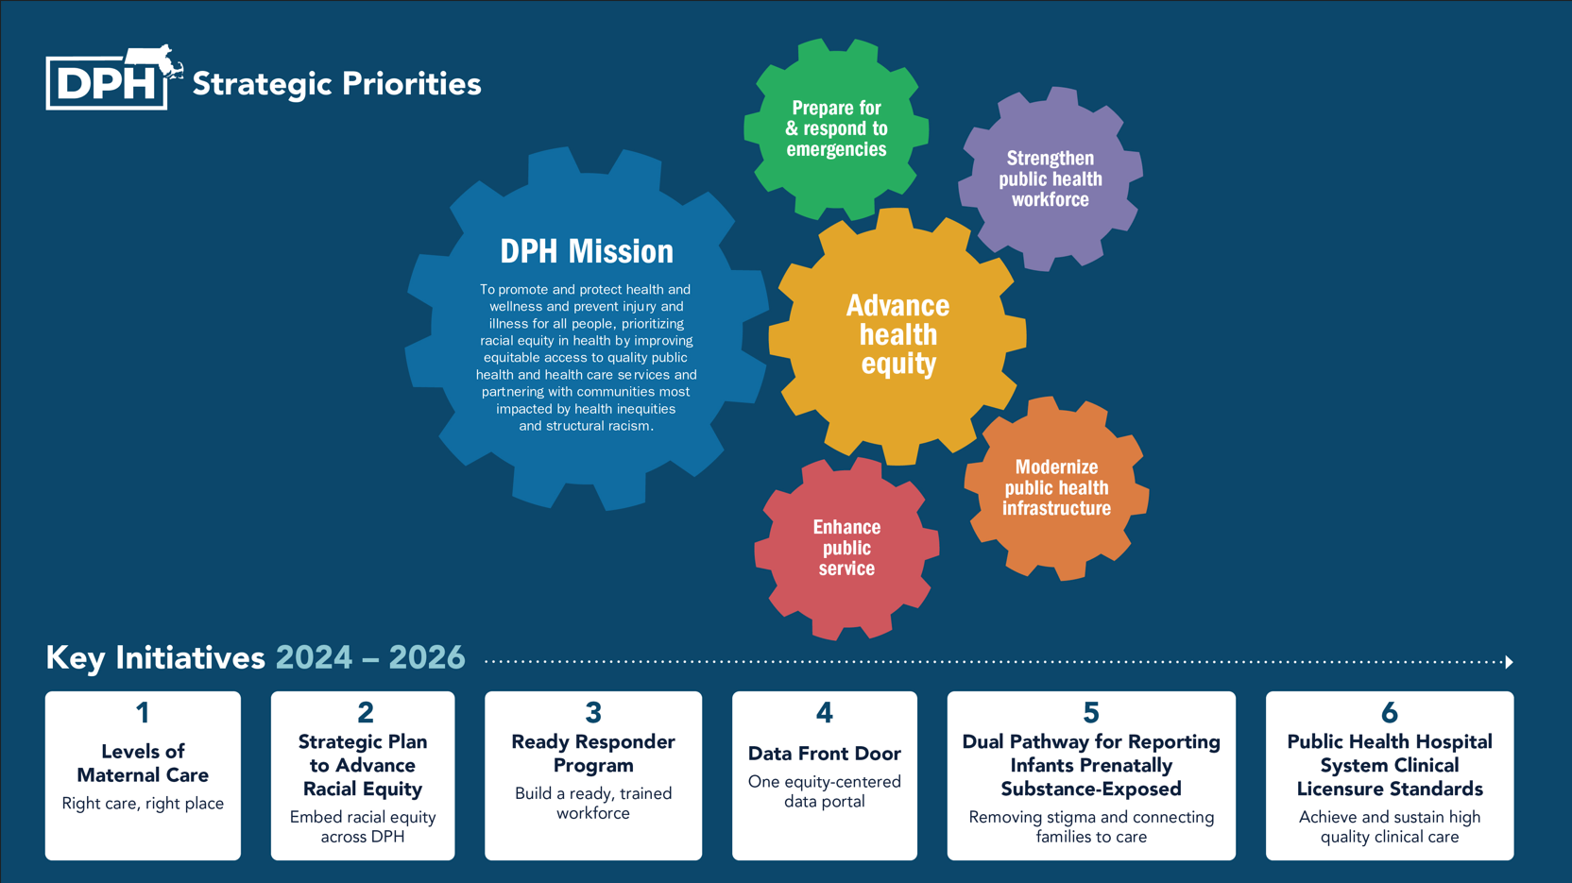
DPH Strategic Priorities and Key Initiatives

Slide 64
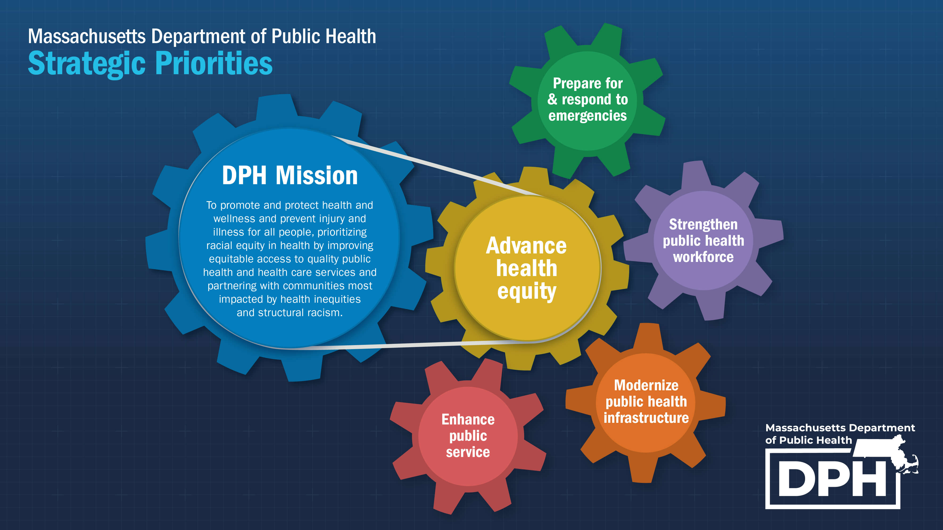
DPH Strategic Priorities

Slide 65
Implement a regulatory framework for Levels of Maternal Care
What challenge this addresses
Maternal morbidity and mortality continue to increase nationally, with persistent disparities for women of color. Patients and providers currently navigate maternity care without consistent information about the level of care available across facilities.
How this advances our priorities
Advances health equity and improved health outcomes while strengthening system transparency and public health infrastructure through a statewide regulatory framework.
What progress looks like
Statewide framework nearing implementation following multi-year collaboration across DPH and external partners, moving toward clearer guidance so patients and providers can access the right care, in the right place, at the right time.

Slide 66
Implement the Strategic Plan to Advance Racial Equity
What challenge this addresses
Racial equity efforts historically developed unevenly across programs, without consistent structure, shared accountability, or coordinated implementation across the Department.
How this advances our priorities
Provides a department-wide framework that strengthens equity, community engagement, and decision-making across all strategic priorities and initiatives.
What progress looks like
Strategic plan launched in 2024 with defined objectives and activities; early progress includes expanded staff engagement, shared assessment tools, leadership development pathways, and improved data to guide ongoing systems change.

Slide 67
Develop the DPH Ready Responder Program
What challenge this addresses
Public health emergencies increasingly require rapid, coordinated response across multiple programs, but preparedness skills and response capacity have not been consistently distributed across the Department
How this advances our priorities
Strengthens emergency preparedness and response while building a shared culture of readiness and supporting equitable response for communities most impacted by emergencies.
What progress looks like
Pilot training launched across the Department, with broad staff participation and new preparedness training complete by hundreds of staff; program development informed by recent emergency activations and moving toward full training completion and cadre launch.

Slide 68
Create a “Data Front Door” for the Department’s data
What challenge this addresses
Public health data has historically been distributed across disconnected systems and webpages, making it difficult for residents, partners, and policymakers to find and use reliable information.
How this advances our priorities
Modernizes public health infrastructure, strengthens clear and trusted communication, and improves access to actionable data for communities, policymakers, and internal decision-making across priorities.
What progress looks like
Initial launch of a unified entry point to public health data has established the foundation for a more coordinated, user-centered data ecosystem, with next phases focused on improving data quality, consistency, and timely access across programs.

Slide 69
Establish a pathway for supporting infants with pre-natal substance exposure
What challenge this addresses
Historically, prenatal substance exposure often resulted in automatic system involvement regardless of family circumstances, creating barriers for birthing people seeking treatment and limiting opportunities to support otherwise healthy families through a public health approach.
How this advances our priorities
Advances equity and early intervention by aligning health care, public health, and child welfare partners around a coordinated family-centered approach to care and support.
What progress looks like
Cross-agency collaboration has established shared guidance, workflows, and training to support consistent statewide implementation, with next phases focused on adoption, improved data feedback, and strengthening family-centered care pathways.

Slide 70
The Public Health Hospitals will be compliant with applicable clinical licensure standards
What challenge this addresses
Our Public Health Hospitals historically operated outside certain clinical licensure requirements applied to other hospitals, creating inconsistency in standards and limiting opportunities to strengthen care, infrastructure, and system alignment.
How this advances our priorities
Improves quality and equity of care for patients while strengthening infrastructure, workforce practice, and alignment between the Public Health Hospital System and the broader health system.
What progress looks like
Hospitals have addressed identified licensure gaps across clinical standards, with remaining work focused on modernizing core systems and advancing infrastructure improvements to support high-quality, dignified care.

Slide 71
Objectives + KPIs: How we track progress
Constituent Objectives | What do residents need from us
Internal Process Objectives | What we need to deliver consistently
Learning and Growth Objectives | Building our capacity to innovate
Healthy, long lives
Quality public health and healthcare services
Clear, trusted communication with DPH
Actionable, reliable public health data
Community resilience to respond to and recover from adverse situations
Facilitate improved communication channels with external partners
Strengthen collaboration across agencies, LPH, and community partners
Invest in improving facilities and IT infrastructure
Build a modernized data and analytics system for best-in-class data collection and dissemination
Operational and programmatic excellence, particularly for mission essential functions
Improve talent attraction and retention processes & systems
Promote & incentivize training (esp. equity, customer service, emergency prep, & external comms)
Center equity principals at all levels of organization
Promote equitable culture and processes of collaboration & innovation
Develop culture of definite emergency preparedness in the broadest sense

Slide 72
Tracking Progress: Constituent Objectives
Why this matters
Trusted communication and public engagement
What we’re seeing
Flu uptake stable year over year, COVID uptake significantly lower
How this supports strategy
Helps assess how effectively we are reaching and engaging residents across priorities

Slide 73
Tracking Progress: Internal Operations and Processes
KPI: Percentage of Professional Licensure Board meetings making quorum
Why this matters
Boards support licensing, oversight, and public protection
What we’re seeing
Performance varies, reveals ongoing structural challenges
How this supports strategy
Highlights where operational changes are needed to strengthen reliability and continuity
 | Boards meeting quorum | Meetings canceled for lack of quorum | Notes
FY25 Q3 | 100% | 0
FY25Q4 | 100% | 0
FY26 Q1 | 93.6% | 3 | Allied Mental Health, Community Health Workers (x2)
FY26Q2 | 92.3% | 4 | Allied Mental Health, Community Health Workers, Nursing, Respiratory Care

Slide 74
Tracking Progress: Learning and Growth
Why this matters
Building shared skills and equity-centered practice
What we’re seeing
Manager completion nearing goal, non-manager completion has plateaued
How this supports strategy
Strengthens organizational capacity to advance priorities equitably and consistently

Slide 75
Looking ahead
Continue advancing priority work
  Continuing implementation of cross-cutting initiatives aligned to departmental priorities
Monitoring progress and outcomes
  Ongoing monitoring of KPIs to assess progress toward objectives and inform adjustments
Refinement and engagement
  Continuing to refine initiatives and align work across bureaus based on emerging needs and feedback

Slide 76
Informational presentation thank-you: Karen Cosmas
Thank you for the opportunity to present this information today
Please direct any questions to:
Karen Clawson Cosmas
Senior Director of Strategy
Office of the Commissioner
karen.cosmas@mass.gov

Slide 77
Next meeting:
March 11, 2026

